Slide 1
Ethical Student Hackers
Hack the Box

Slide 2
The Legal Bit
The skills taught in these sessions allow identification and exploitation of security vulnerabilities in systems. We strive to give you a place to practice legally, and can point you to other places to practice. These skills should not be used on systems where you do not have explicit permission from the owner of the system. It is VERY easy to end up in breach of relevant laws, and we can accept no responsibility for anything you do with the skills learnt here.
If we have reason to believe that you are utilising these skills against systems where you are not authorised you will be banned from our events, and if necessary the relevant authorities will be alerted.
Remember, if you have any doubts as to if something is legal or authorised, just don't do it until you are able to confirm you are allowed to.

Slide 3
Code of Conduct
Before proceeding past this point you must read and agree to our Code of Conduct - this is a requirement from the University for us to operate as a society.
If you have any doubts or need anything clarified, please ask a member of the committee.
Breaching the Code of Conduct = immediate ejection and further consequences.
Code of Conduct can be found at https://shefesh.com/downloads/SESH%20Code%20of%20Conduct.pdf

Slide 4
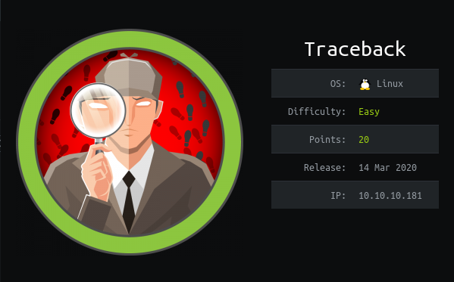
Traceback

Slide 5
Connecting to Hack the Box
You’ll need an account - unfortunately, they’re a bit hard to come by! If you haven’t already got one, don’t worry - you can just follow along
Traceback is a retired box, so you’ll also need a VIP account. Again, don’t worry if you haven’t got one - but it’s a worthwhile investment if you can afford it and want to practice regularly!
To connect to Hack the Box:
Download your connection pack from https://www.hackthebox.eu/home/htb/access (e.g. shefesh.ovpn)
Run openvpn /path/to/shefesh.ovpn
Ping the box (ping 10.10.10.181) to check your connection!

Slide 6

That’s it for now!
We’ll be going over the box live, so if you’re recapping the slides… they won’t be much use
For those of you hacking along, good luck!
We’ll be taking suggestions as we go, so please shout out ideas at any point
Pssst - if you’re reading the slides after the session and want a walkthrough, check out Ippsec’s video here: https://www.youtube.com/watch?v=OI7PbBT589E We’ll also be uploading a writeup after the session! No cheating if you’re watching this live!

Slide 7
Upcoming Sessions
14th December - Holiday Hackery!
… and that’s it for the semester :(
What’s up next?
www.shefesh.com/sessions

Slide 8

Any Questions?
www.shefesh.com
Thanks for coming!

