Slide 1
Ethical Student Hackers
Understanding and Exploring Networks

Slide 2
The Legal Bit
The skills taught in these sessions allow identification and exploitation of security vulnerabilities in systems. We strive to give you a place to practice legally, and can point you to other places to practice. These skills should not be used on systems where you do not have explicit permission from the owner of the system. It is VERY easy to end up in breach of relevant laws, and we can accept no responsibility for anything you do with the skills learnt here.
If we have reason to believe that you are utilising these skills against systems where you are not authorised you will be banned from our events, and if necessary the relevant authorities will be alerted.
Remember, if you have any doubts as to if something is legal or authorised, just don't do it until you are able to confirm you are allowed to.

Slide 3
Code of Conduct
Before proceeding past this point you must read and agree to our Code of Conduct - this is a requirement from the University for us to operate as a society.
If you have any doubts or need anything clarified, please ask a member of the committee.
Breaching the Code of Conduct = immediate ejection and further consequences.
Code of Conduct can be found at https://shefesh.com/downloads/SESH%20Code%20of%20Conduct.pdf

Slide 4
Why Learn Networking?
Computer networks are ubiquitous; every day, more devices come online
While this opens up countless possibilities, it also means that networked devices need to defend against remote threats – not just local ones
At their core, security holes are design oversights. To find what others haven’t thought of, you’ll need to understand everything they have
By learning networking, you’ll learn where there are holes and how to patch / exploit them

Slide 5
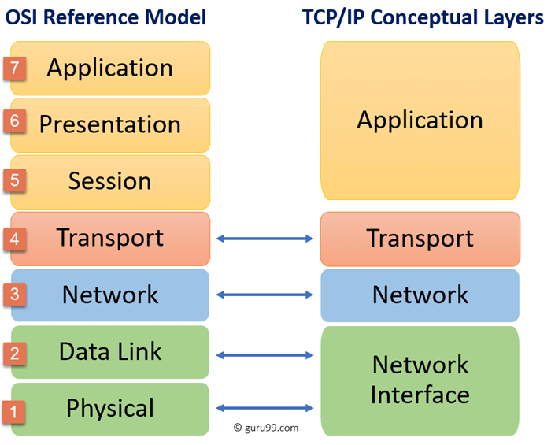
The (Simplified) OSI Model
Physical (wires, radio, optical)
Data Link (Ethernet, 802.11, ARP, etc)
Network (IPv4/IPv6, ICMP, WireGuard, etc)
Transport (TCP, UDP)
Application (HTTP, SSH, DHCP, SMB, etc)

Slide 6
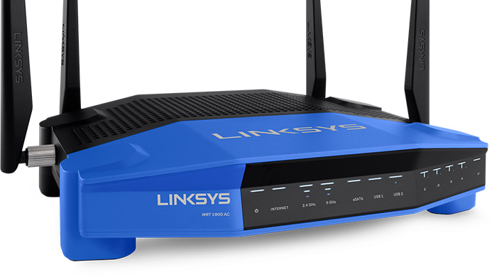
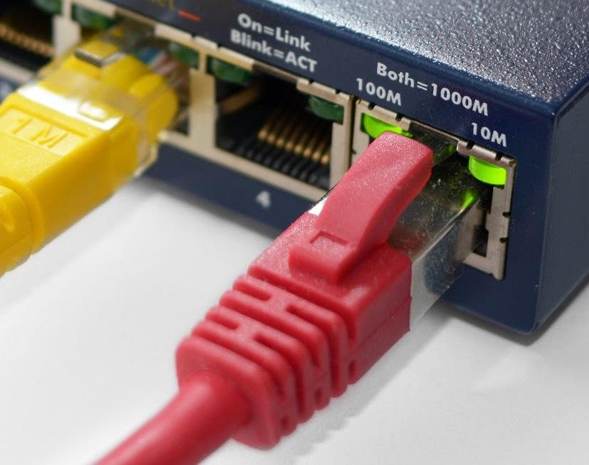
The Physical Layer
This is the simplest layer of a network and is only concerned with the transmission of raw information
Cables often have “link lights” that indicate if they are functional
Wireless access points often have something similar
As most network attacks are carried out remotely, this layer isn’t the most interesting to us
With that being said, some connections (particularly wireless ones) can be physically jammed

Slide 7
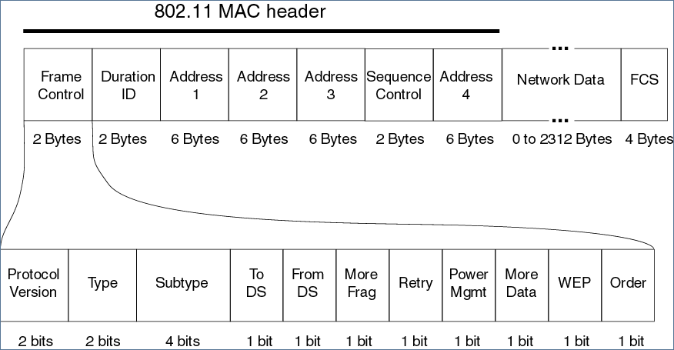
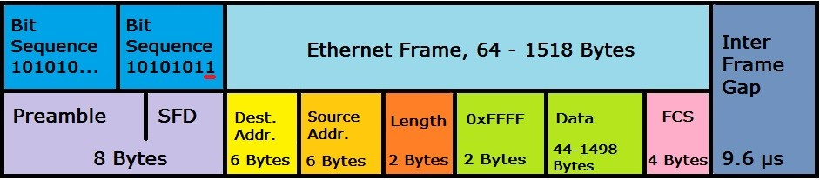
The Data Link Layer
The dominant protocols at this layer are Ethernet and WiFi (802.11)
At this level, MAC addresses are used to identify different machines on the same network
Ethernet is generally unsecured, so access to Ethernet ports needs to be tightly controlled
Access can be obscured via MAC filtering
VLANs can be used to isolate parts of the network
There are many ways to secure WiFi: WEP, WPS, WPA2-PSK, WPA2-Enterprise, etc.

Slide 8
WiFi Deauth Attacks
The 802.11 standard for WiFi allows for cleartext “management” frames. One of these frames is designed to “deauthenticate” a station and kick them off of the network
This can be used to soft-jam a WiFi network, capture a WPA handshake, or generate ARP requests
This can be performed using any wireless NIC capable of monitor mode and packet injection
airmon-ng start wlan0
aireplay-ng -0 1 -a 00:14:6C:7E:40:80 -c 00:0F:B5:34:30:30 wlan0
-0 is the flag for deauthentication (1 is the number of deauths)
-a 00:14:6C:7E:40:80 is the MAC address of the AP we are impersonating
-c 00:0F:B5:34:30:30 is the MAC of the client to deauth (can be left blank for broadcast)
wlan0 is the name of the network interface to use

Slide 9
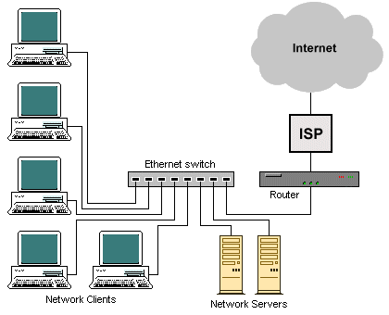
The Network Layer
While MAC addresses are fine to messaging within a LAN, the limited addresses and broadcast nature of Ethernet means a different protocol is needed to connect to the internet
There are two versions of IP: IPv4 and IPv6
IPv4 is still the most commonly used, but is being steadily replaced by IPv6
IP is designed to perform a best-effort routing of packets from A to B, but does not guarantee delivery, order, or duplicate avoidance

Slide 10
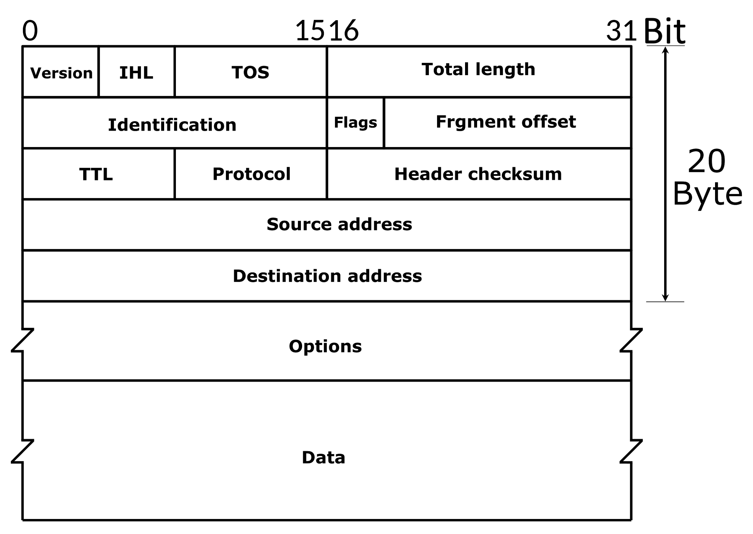
IPv4 Packet Structure
Version – Always 4 for IPv4
IHL – The length of the header (the “options” field is optional)
TOS – Type of service; used in VoIP to prioritise packets
Total Length – Combined size of the header and data
Identification – Identify each fragment of a packet
Flags – Are fragments allowed? More to come?
Fragment Offset – Where does this fragment start?
TTL – How many hops before this packet is tossed out?
Protocol – ICMP (1), TCP (6), UDP (17)
Header Checksum – For checking the validity of the header
Src / Dest Addresses – Where from and where to?
Options – Optional extra information
Data – The actual information to transmit

Slide 11
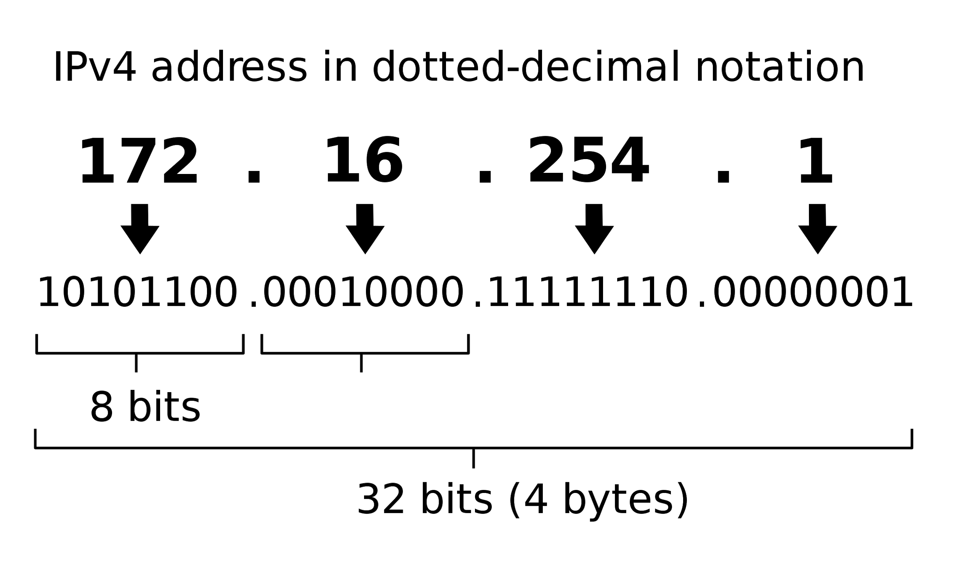
IPv4 Addresses
Every computer on the Internet has a unique IPv4 address* that it can use to send and receive data
These are broken into subnets of different sizes. Computers can communicate directly within them, but a router is needed to bridge between them
CIDR notation is used to communicate the size of a subnet: 192.168.0.0/16
Subnet address
Subnet size (in bits)
All addresses in a subnet contain the subnet address with the remaining bits free to change
There are some common, reserved subnets:
0.0.0.0/8 – the current network (source only)
127.0.0.0/8 – the loopback / localhost address
10.0.0.0/8 – large private networks
192.168.0.0/16 – smaller private networks
* Except when they don’t

Slide 12
Routing & ARP
How does IP help us route data from one computer to the next?
Every computer maintains its own routing table that maps subnets to interfaces and, when the address isn’t local, a forwarding gateway
Routes are tried in order from most specific to least specific
When the address is NOT on the LAN:
The packet is forwarded to the default gateway which has an interface for forwarding to the public internet
When the address is on the LAN:
The routing table indicates which interface the subnet is present on
From there, ARP (IPv4) or ND (IPv6) maps IP addresses to MAC addresses
Ethernet or 802.11 frames can then be used to transmit the packet to its correct destination
ARP Poisoning (or similar route spoofing) allow for Man in the Middle (MitM) attacks, where traffic is routed through an attacker’s computer

Slide 13
Poking Around
ip addr – Get a list of all available interfaces and their address information
ip neigh – Get the currently cached ARP table (find the MAC addresses of local IPs)
ip route – Get the current routing table, showing where each subnet is connected
nmap -sn 192.168.42.0/24 – Scan all addresses of a given subnet, but skip the port scan (ping scan)
ping 10.0.0.6 – Check if 10.0.0.6 is reachable* and how long a round-trip takes
traceroute 192.168.4.1 – Path taken to get from the local machine to the destination address
* Usually, in the absence of any tomfoolery

Slide 14


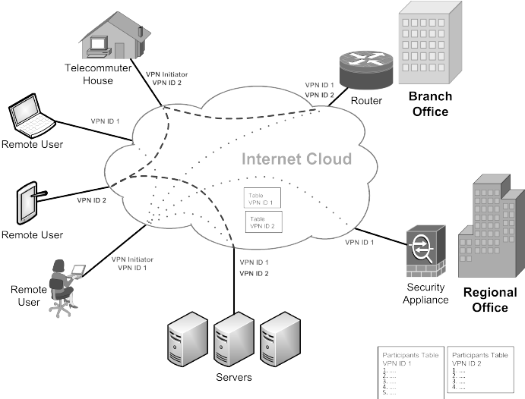
VPNs Are Remote LANs
VPNs work at the network level to build fake LANs between remote networks
They allow access to private services within the network that can’t be accessed from the Internet directly
Additionally, most VPNs encrypt all of the traffic sent through them. This can improve privacy and security, but only if the endpoint is to be trusted
While all LAN-traffic used to be publicly visible, nowadays nearly all important data (e.g. banking details) are already encrypted via HTTPS without needing to use a VPN

Slide 15
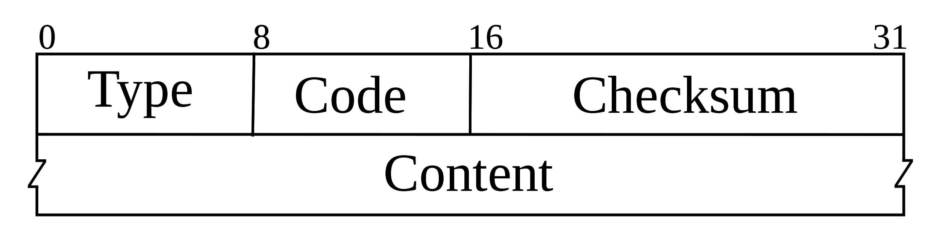
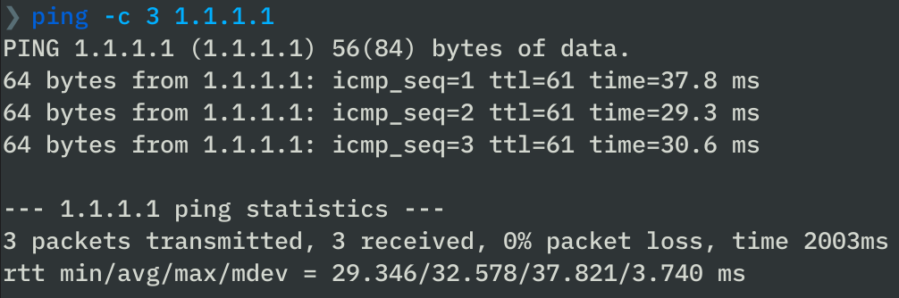
Internet Control Message Protocol
ICMP is used to relay important control and status messages over IP
Type 8 code 0 (8:0) signals a ping request, to which clients can respond with 0:0 (a ping response)
When a packet’s TTL expires, an ICMP 11:0 message is used to inform the sender – this is how traceroute works
ICMP can be used to probe a network or even launch a DoS attack. As a result, some admins take the blunt approach of disabling ICMP, but this is only security through obscurity
https://blog.securityevaluators.com/icmp-the-good-the-bad-and-the-ugly-130413e56030

Slide 16
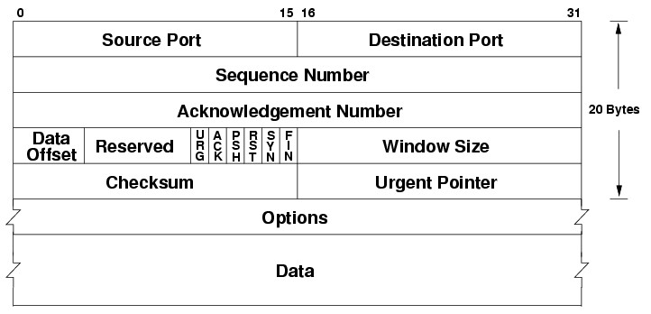
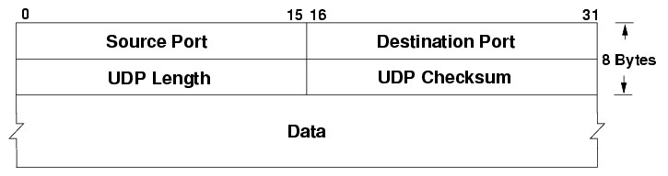
The Transport Layer
While IP is great for routing packets, it’s still missing some features:
How do you know which application a packet is intended for?
How do you ensure reliable transmission?
TCP provides reliable transmission by establishing a connection, requiring acknowledgement, and ordering packets
UDP still allows for multiplexing and targeting via port numbers, but is used for quick, unreliable transport
Services like HTTP use TCP while UDP is used for VPNs and things like VoIP

Slide 17
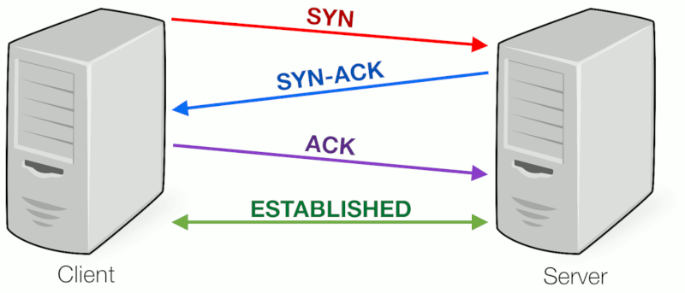
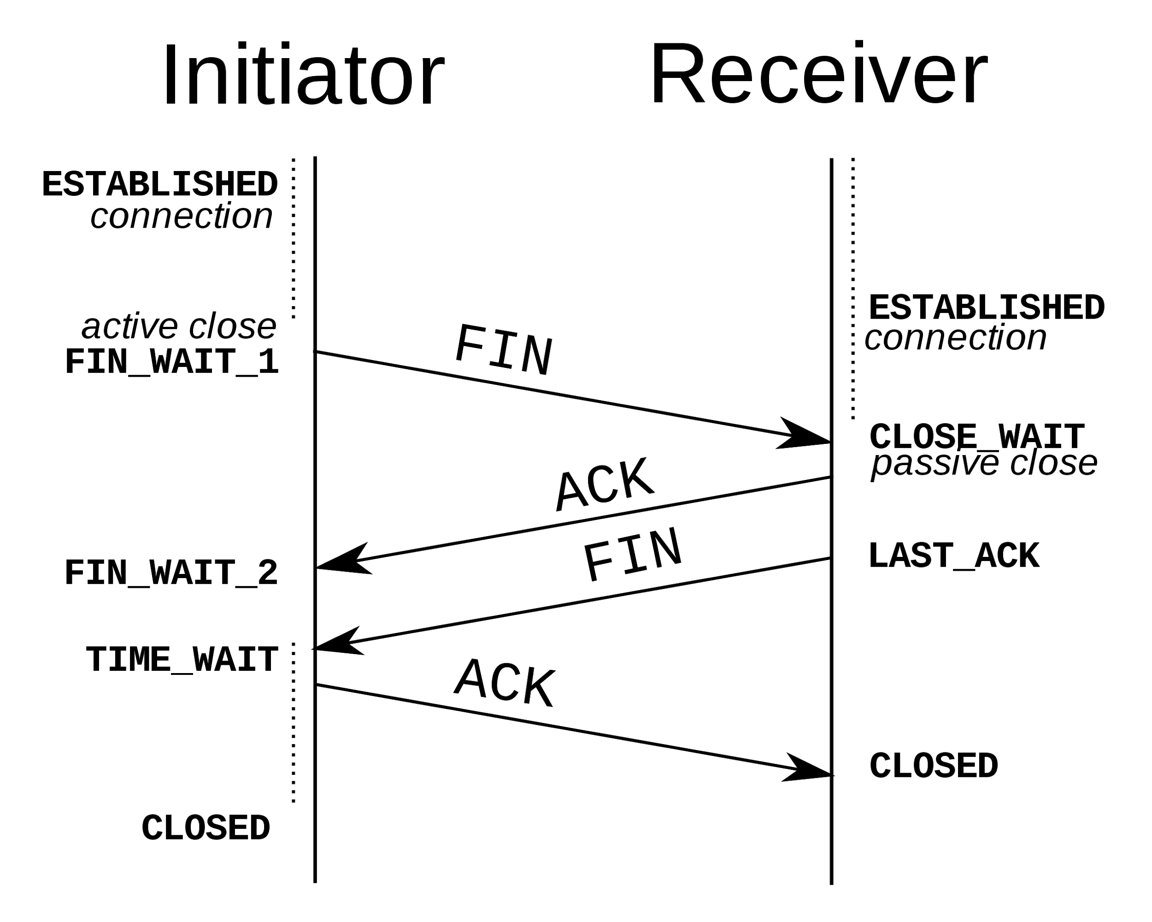
Transport Control Protocol (TCP)
TCP builds stateful connections and requires a handshake to both set up and tear down
When packets are lost, they can be re-requested
A SYN-flood is a form of DoS attack that creates thousands of hanging connections by sending SYN requests with spoofed source addresses

Slide 18
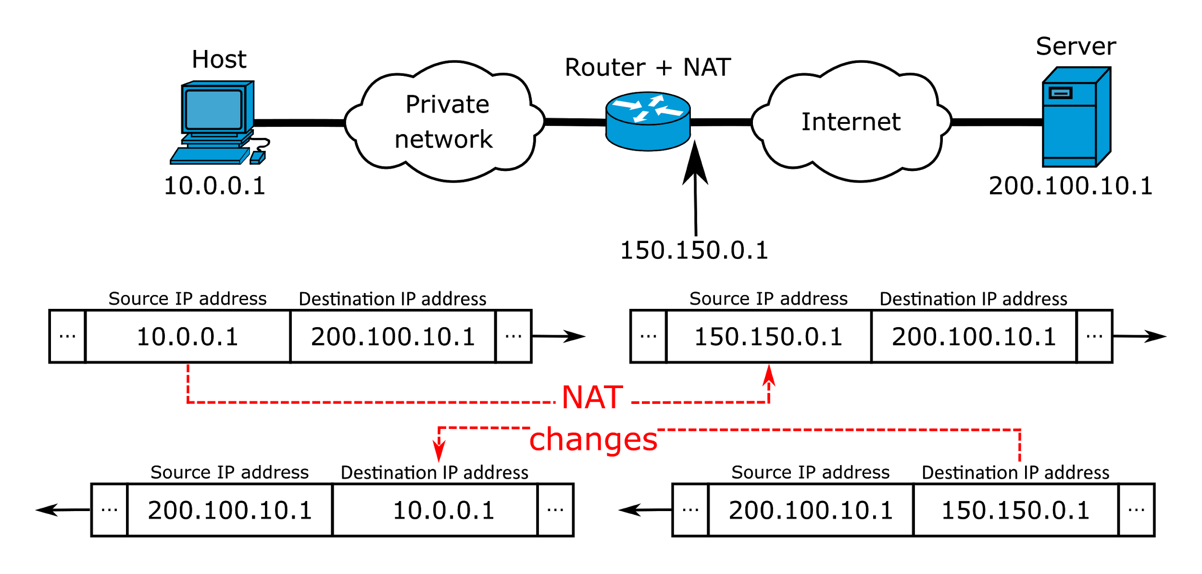
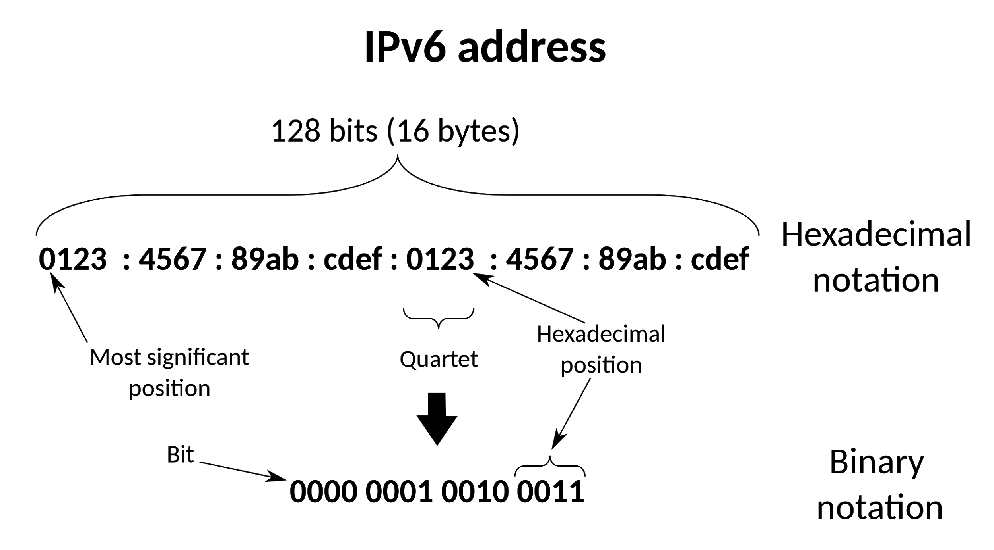
Network Address Translation (NAT)
There are ~4 billion IPv4 addresses; that’s a lot, but not enough for every device on the internet
IPv6 solves this with longer, 128 bit addresses (allowing for 3.4×10³⁸ unique IPs), but still hasn’t been widely adopted
NAT allows for local addresses to be non-unique (within the private subnets) but to be “routed” through a single, shared address
A table of TCP / UDP ports is used to associate incoming connections with local devices
NAT acts like a weak firewall, denying unrequested incoming packets by default, but is usually only an inconvenience for the attacker as there are many ways to “punch-through” it

Slide 19
Higher Level Protocols

Slide 20
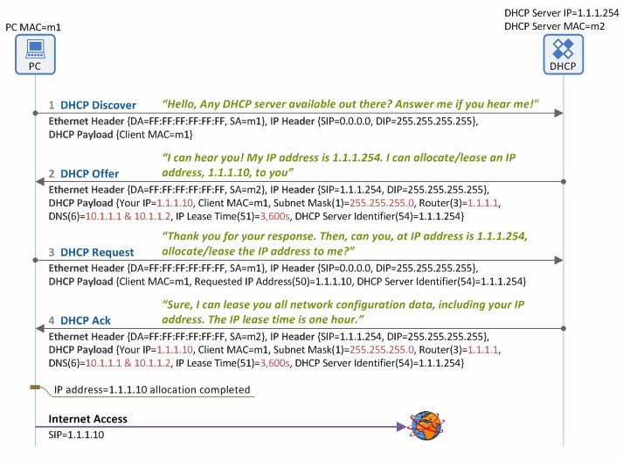
Using DHCP to Let Local IPs
While it’s possible to manually set IP addresses for every client in a local network, this requires planning and is prone to collisions
DHCP is a high-level protocol that runs atop UDP is is used to allocate IP addresses to devices on the network
Rogue DHCP servers on a network can trick clients into using a malicious DNS service or create intentional address clashes

Slide 21
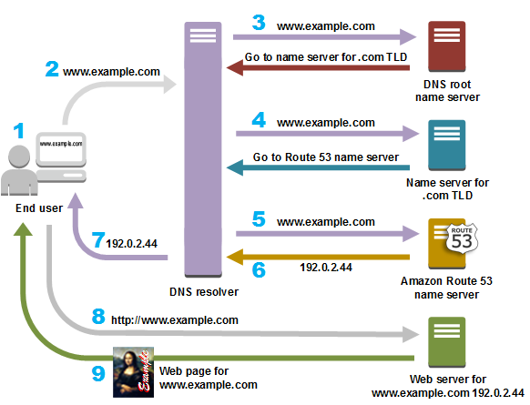
Resolving Names with DNS
All of the protocols we’ve seen so far rely on having the IP address of the computer we are communicating with, so how does typing google.co.uk in your address bar get you anywhere?
The DNS mapping is cached on both local devices and your DNS resolver, so only rarely will you need to go through the whole resolution process
Like with ARP, these caches can be poisoned (by impersonating a name server) and victims could be unknowingly redirected to a malicious IP

Slide 22
Having Another Nosy
ss -tup – List all TCP and UDP connections, as well as their process
ss -tupl – List all TCP and UDP connections and processes listening for new connections
ss -s – Get a summary of the system’s current connections
dig shefesh.com – Perform a DNS lookup of shefesh.com, returning its IP address
dig -x 8.8.8.8 – Perform a reverse DNS lookup of 8.8.8.8, returning its domain names

Slide 23
Sniffing Some Packets
What is “packet sniffing”?
Packet sniffing is the interception and analysis of network traffic
Because of the broadcast nature of the link-level protocols (Ethernet and 802.11), it’s possible to see not just your own traffic, but all traffic on the local network
What is Wireshark?
Wireshark is a popular, cross-platform application for packet sniffing
What can it do?
Wireshark can provide information about every bit of data traversing the network, letting you inspect Ethernet frames, IP packets, TCP segments, and more
For connection-based protocols, conversations can be reassembled and the transmitted files extracted

Slide 24
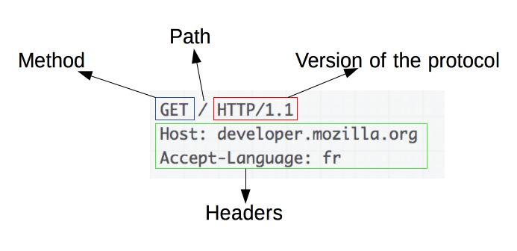
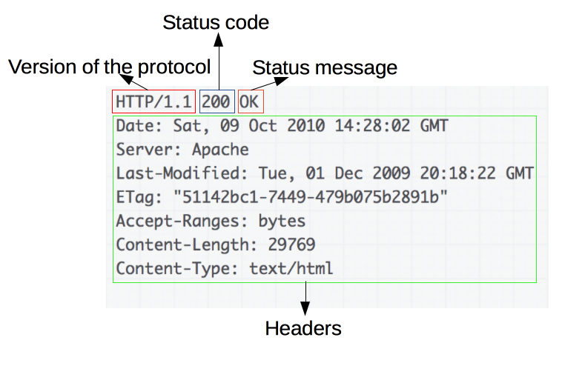
Understanding HTTP
HTTP is a stateless protocol that allows for the communication between a client and server via a request-response model
The request method is most commonly GET or POST, but many others like HEAD and PUT, also exist
There are many response status codes, but here are a few of the more common ones:
200 – OK (request successful)
301 – Moved Permanently
404 – Not Found (path didn’t exist)
500 – Internal Server Error
After the HTTP headers, there is an optional body in which the content is actually stored

Slide 25
Common HTTP Headers
General Headers:
Date – The date and time at which the message originated
Connection – Often set to Keep-Alive when the connection is to be reused
Content-Length – Size of the body in bytes
Content-Type – Specifies how the body should be interpreted
Request Headers:
User-Agent – Describes the client making the request
Accept – Specify the content types that will be accepted as a response
Cookie – Used to communicate session information back to the server
Response Headers:
Server – Information about the server that handled the request

Slide 26
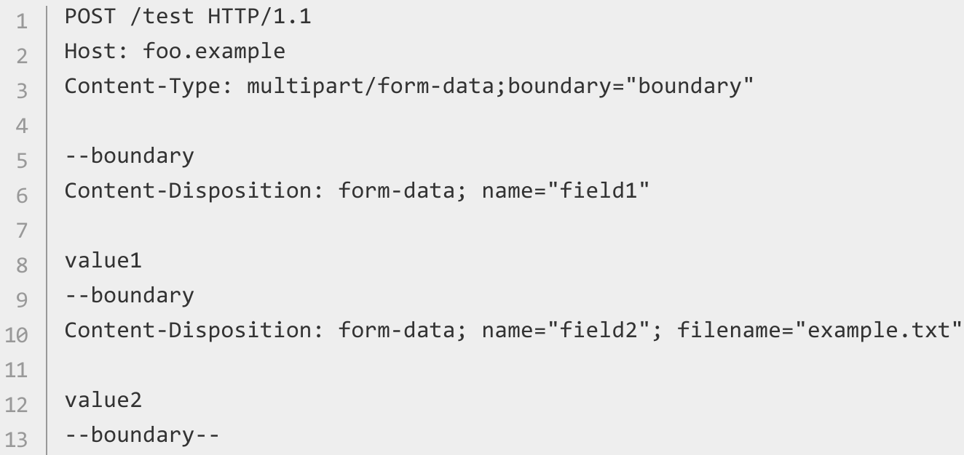
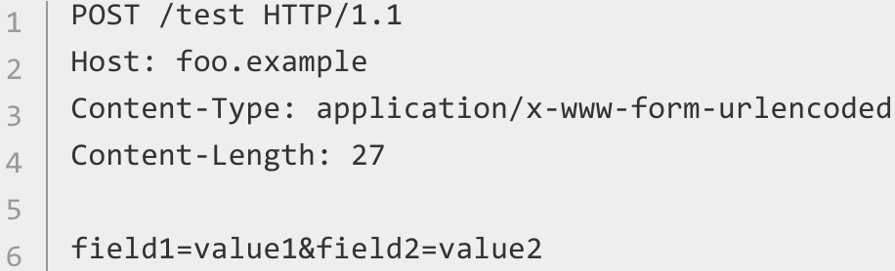
HTTP POST Requests
Sending URL Encoded Data
Sending Raw Multipart Data

Slide 27
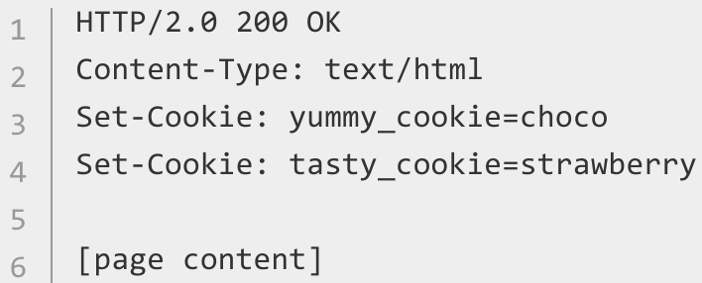
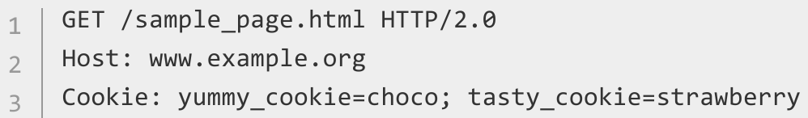
HTTP Cookies
Cookies are a way to emulate state over the stateless HTTP protocol and can be used to for authentication or storing other session information
Cookies are set by the server via an HTTP response header. The client then stores these cookies and sends them in future HTTP requests
Authentication cookies are particularly valuable tidbits as a valid authentication cookie is often all that’s needed to impersonate another user
Private cookies can be extracted using methods like XSS

Slide 28
Secure Networking
The ‘Security by Layers’ principle
Why have one barrier when you can have multiple?
Protect your network with firewalls and multiple levels of authentication, based on the sensitivity of what is in that part of the network
A ‘layered approach’ may also refer to employing multiple techniques on different services - firewalls, intrusion detection systems, email & web filtering, packet inspection, and encryption
Separate subnets
Partition your network into publicly visible, internet-accessible IP ranges; and IP ranges that are only accessible by other machines on your network
Create ‘jumpboxes’ or ‘Bastion servers’ that guard the way into the network
These ‘partitioned’ networks are a key component of Secure Cloud Infrastructure - for example, AWS’ Virtual Private Clouds (VPCs)

Slide 29
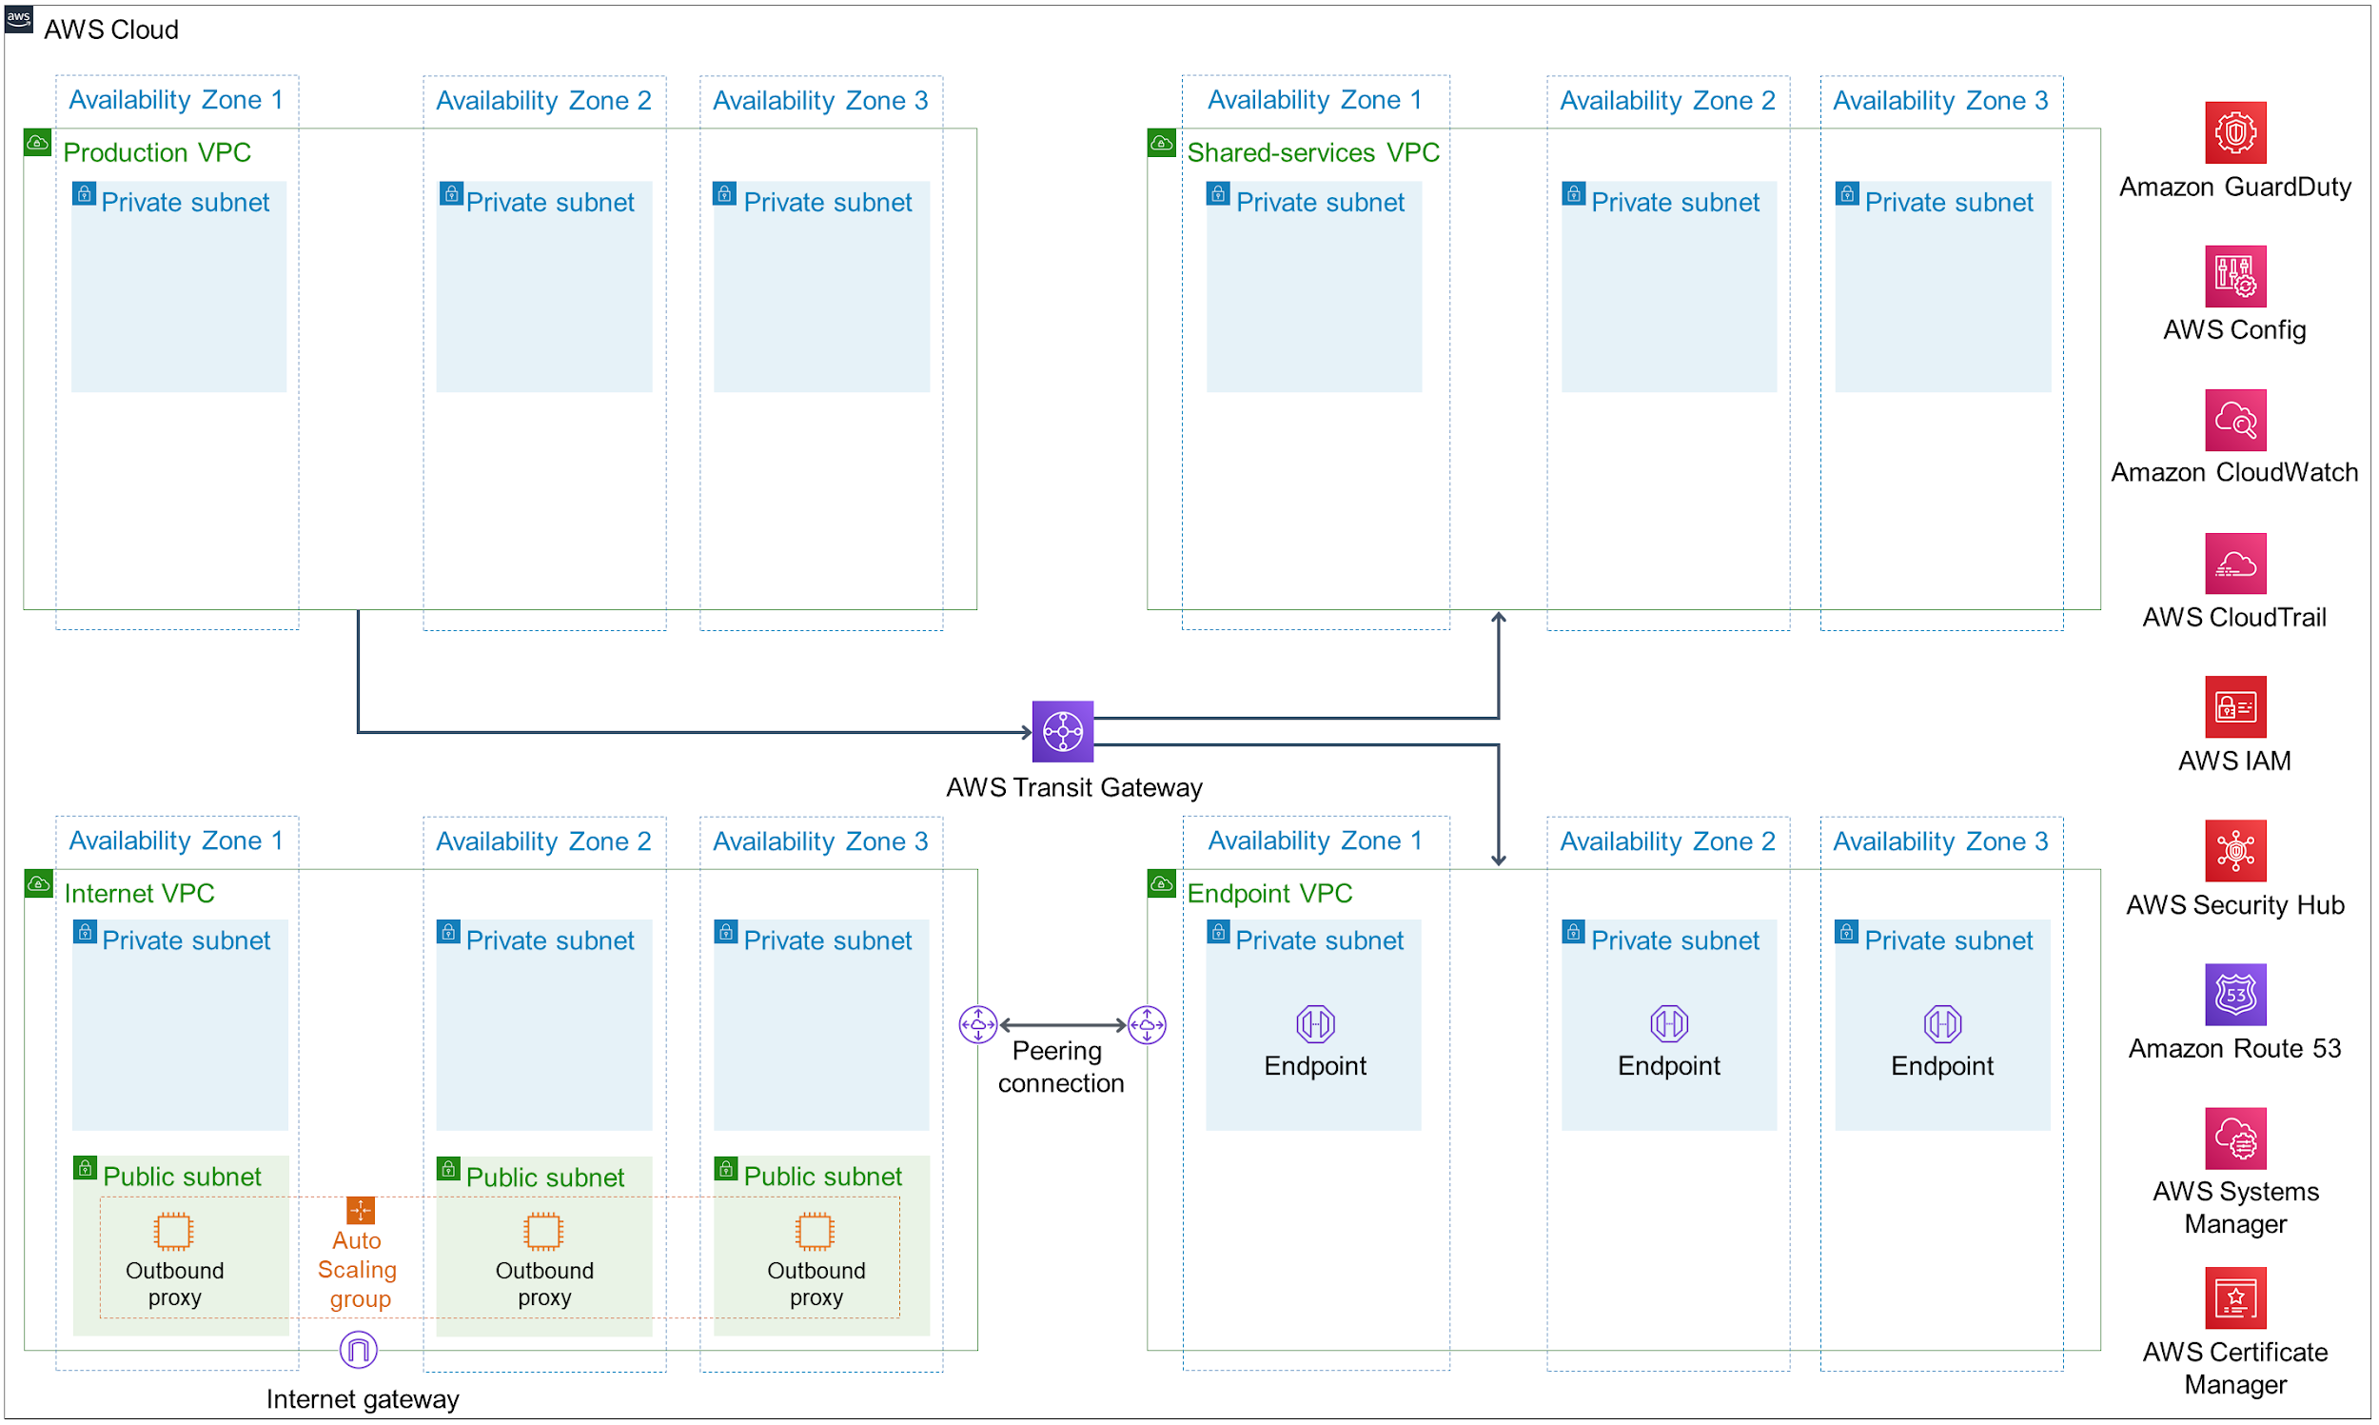
An example of a highly-rated network architecture https://aws.amazon.com/quickstart/architecture/compliance-uk-official/

Slide 30
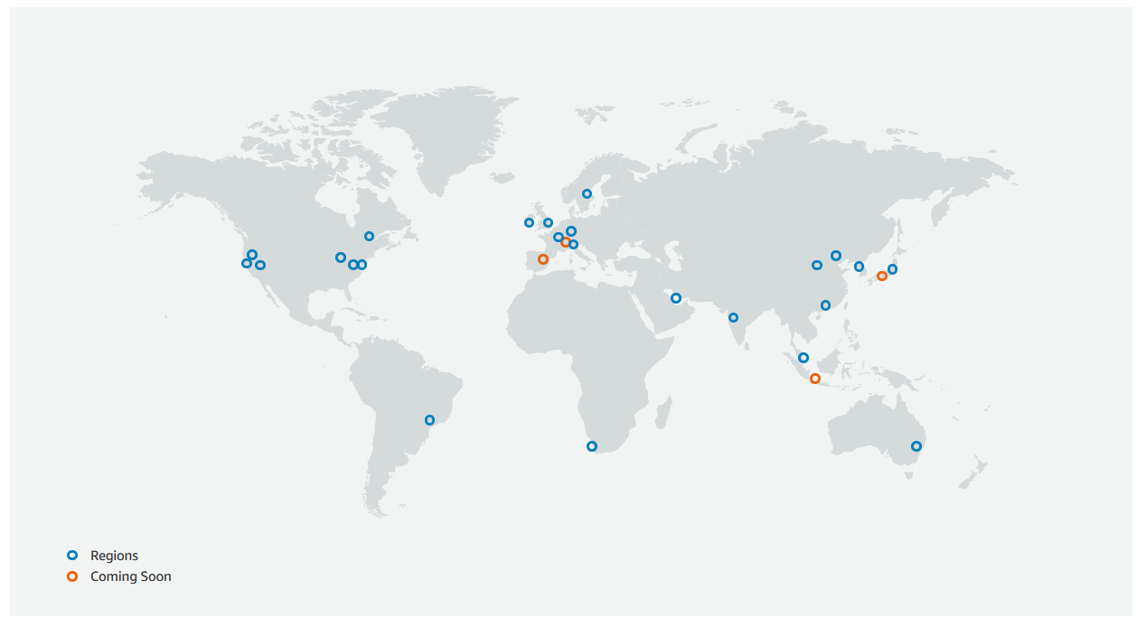
Security Bits & Bobs
Air gapping
A technique to physically separate a machine or subnet from the outside internet - wireless cards may be disabled or even removed
Data is required to be transferred physically, for example on a USB drive
Resilience
Regular backups
Standby servers
‘Availability Zones’ within Cloud Infrastructure
Privacy & Anonymity
Use a VPN!
Rotating proxy services are available from many providers, and can simulate ‘residential IPs’ for use in general browsing and for automated tasks like web scraping on a large scale
https://aws.amazon.com/about-aws/global-infrastructure/

Slide 31
Burp Suite
What is a proxy?
Essentially a ‘middle-man’ for network traffic - it’s an extra step between source & destination
What is Burp?
A powerful proxy that captures your HTTP/HTTPS traffic and allows you to modify it on the fly
It’s great for analysing how a website/server functions and crafting attack payloads
What can it do?
Show you all the HTTP traffic passing through, and info about data, headers, and more
Intercept a request before it is sent, and allow modification of details such as data and URLs
Send a request to the ‘Repeater’ to allow fine-grained control of its properties, and define an attack payload in the ‘Intruder’ for fuzzing and automation
Encode/decode with common web encodings such as Base 64

Slide 32
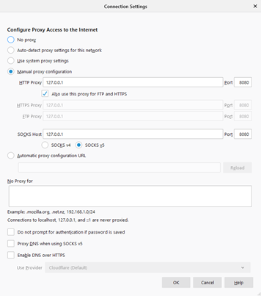
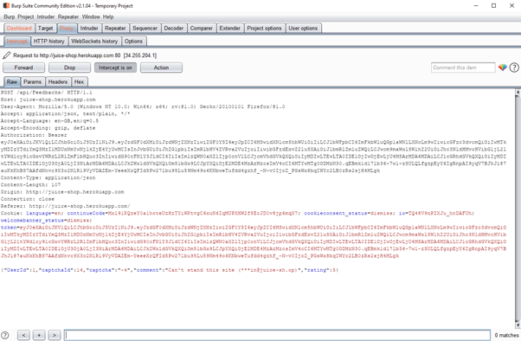
Setting up Burp
Install here: https://portswigger.net/burp/communitydownload
Configure your browser to proxy your HTTP traffic
Go to the ‘Proxy’ tab, turn on Intercept, and watch the traffic flow!
Note: You can visit localhost:8080 in your browser to import Burp’s certificate and prevent those annoying MITM warnings

Slide 33
Using Burp
Proxy
‘Intercept’ determines whether traffic is held up before being passed on
‘HTTP History’ shows all requests and responses captured by Burp
From here, you can send requests to the Repeater/Intruder for more options
You can also tell Burp not to intercept certain requests using the ‘Action’ Button
Repeater
Send a request here using Ctrl+R!
Once it’s in the Repeater, you can modify anything you like and resend
Intruder
You can configure ‘positions’ and ‘payloads’ here to set up an automated attack
See our worksheet from Session 3 for a detailed look at using the Intruder!

Slide 34
Upcoming Sessions
7th-8th November - HackSheffield 6! (see https://hacksheffield.com/)
9th November - All the Shells!
16th November - Enumeration
23rd November - Privilege Escalation
30th November - Open Source Intelligence
What’s up next?
www.shefesh.com/sessions

Slide 35

Any Questions?
www.shefesh.com
Thanks for coming!

