Slide 1

Gold Price Analysis
22 years of data · 2004–2026
EXPLORATORY DATA ANALYSIS

Slide 2

Dataset Overview
5,531
22
Daily Records
Years Covered
Open, High, Low, Close, Volume
2004 – 2026
6
Variables
Date, OHLC, Volume

Slide 3
Price Trends by Era
2004–2008
1
Stable growth, $380–$900
2
2009–2012
Surge past $1,800
2013–2018
3
Correction, $1,200–$1,400
4
2019–2021
Crossed $2,000 (pandemic)
2022–2026
5
Mixed volatility

Slide 4
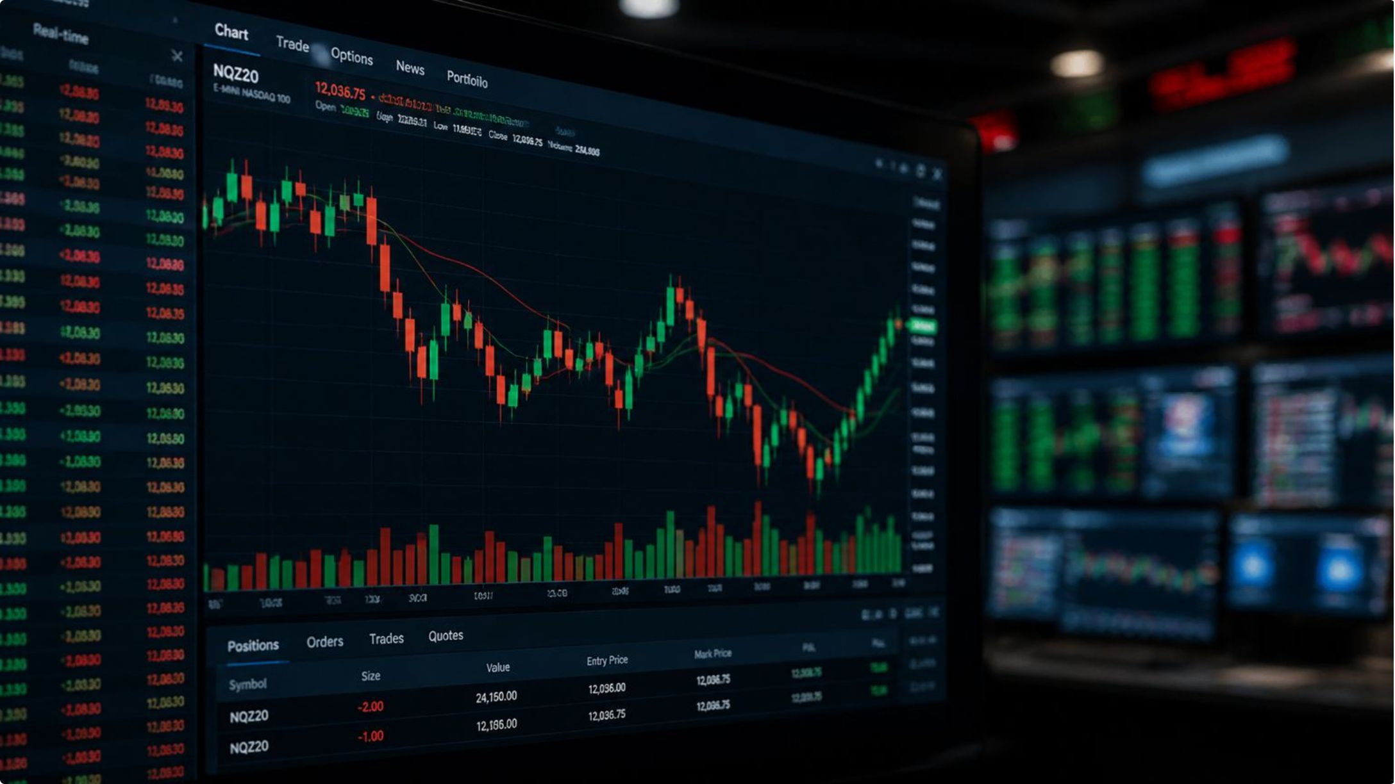

VOLATILITY
Crisis-Driven Swings
Turbulent Years
Avg daily swing: $20–$30
Stable Periods
Avg daily swing: $5–$10
High volatility during 2008 recession & 2020 pandemic

Slide 5
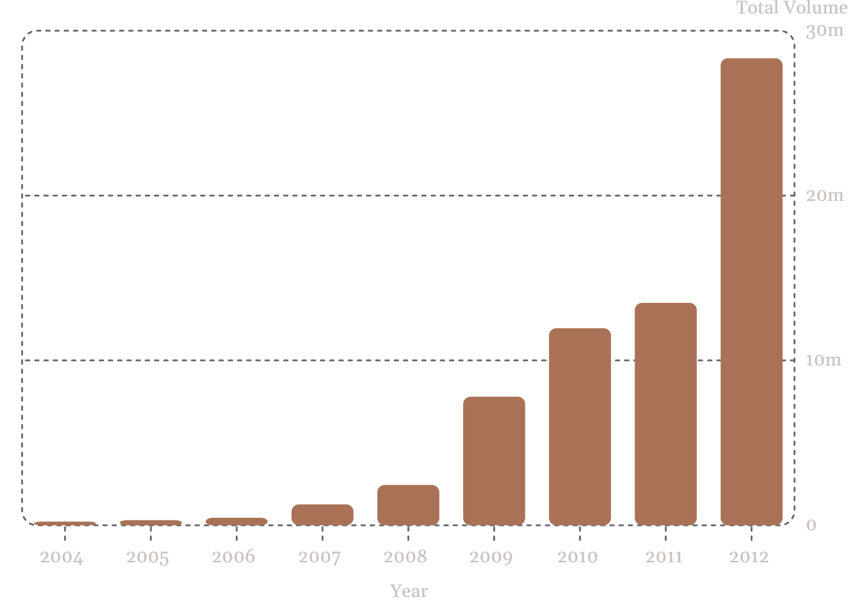

Volume Insights
What Volume Tells Us
Volume spikes correlate with price surges → speculative activity
Lower volumes during stable phases → reduced investor interest

Slide 6
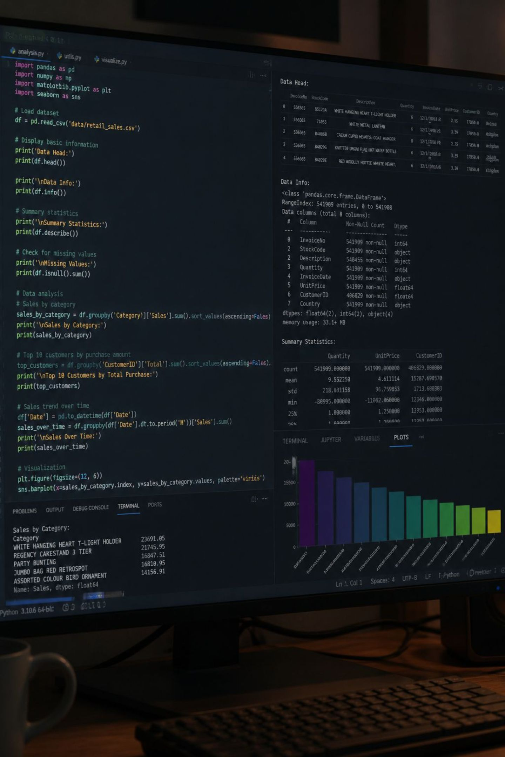
EDA with Python
Data Loading
Cleaning
Imported via pandas
Null checks, snake_case rename
PostgreSQL
Loaded DataFrame for SQL analysis

Slide 7

SQL Analysis Highlights
1
2
Missing Dates
Price Volatility
Gap detection across 22 years
Annual high/low ranges
3
4
Y-O-Y Growth
Avg Price & Volume
Peak: +30.75% in 2007
Monthly totals by year

Slide 8
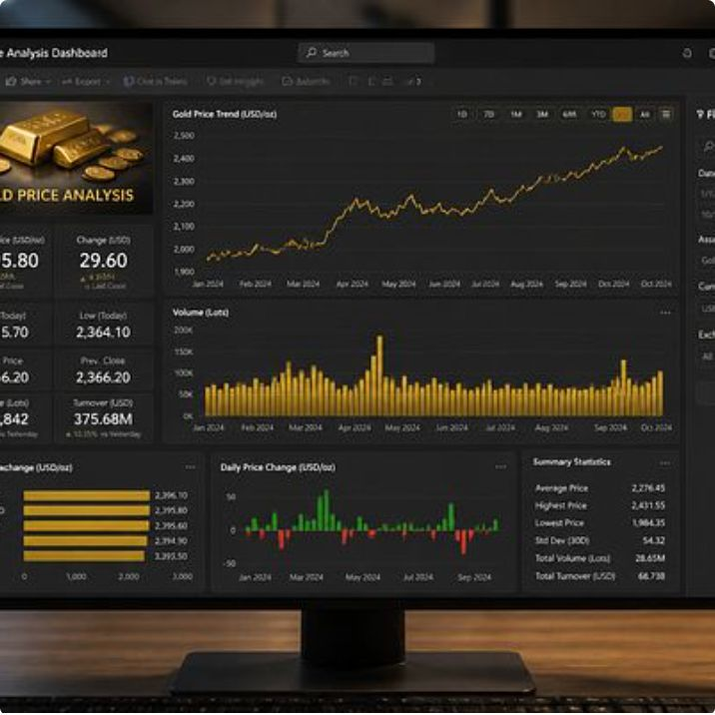
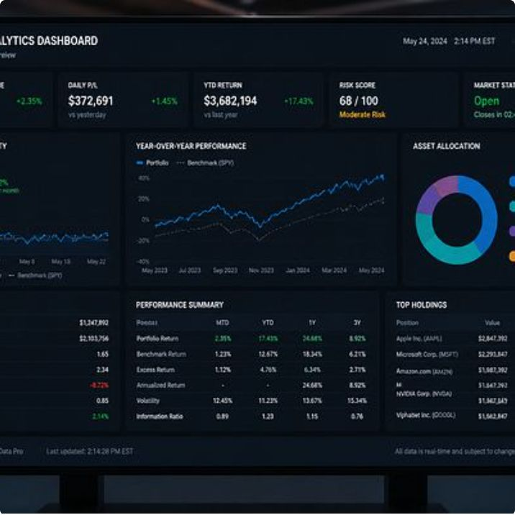
Power BI Dashboard
Interactive visualizations for key insights

Slide 9




Business Implications
Investment Strategy
Gold = safe-haven during downturns
Risk Management
Volatility patterns → hedging need
Market Outlook
Geopolitical risk sustains demand

Slide 10
Recommendations & Conclusion
For Investors
Key Takeaway
Diversify with gold in high-risk periods
Gold prices are cyclical, driven by macroeconomic events — valuable for investment, planning & risk management.
For Businesses
Monitor trends for material costs
For Analysts
Apply ARIMA / Prophet forecasting

