Slide 1


SPOTIFY SENTIMENT ANALYSIS
Presented By:
Shefali(500120337)
Shivansh(500124854)
Kartik(500120358)

Slide 2
INTRODUCTION TO SENTIMENT ANALYSIS
Problem statement
User Behaviour &mood
Datasets used
Correlation Insights
Tools & Techniques
Streamlit App demo
Results Summary
Conclusion & Future Scope
Vaider sentiment analysis
Textblob Analysis

Slide 3
PROBLEM STATEMENT
❓ Objective
To analyze and understand the emotional impact of music using sentiment analysis techniques.
Explore how user-generated content like lyrics, playlist names, and behavior reflects mood.
🧠 Why It Matters
Music directly affects emotions, productivity, and mental health.
Platforms like Spotify use personalization—our project aims to uncover patterns behind this personalization.

Slide 4
DATASETS USED:
📁 1. Lyrics Dataset
Source: Kaggle
Fields: Song, Artist, Lyrics
Used for emotional tone detection
📁 2. Playlist Dataset
Source: GIthub
Fields: Title, Description
Reflects how users tag and group songs by mood
📁 3. User Behavior Dataset
Source: Kaggle
Fields: Age, Mood, Genre, Time of Listening
Helps relate personal context to sentiment

Slide 5
TOOLS &TECHNIQUES
Programming & Libraries
Python, Pandas, NumPy, Seaborn, Matplotlib
NLP & ML Models
TextBlob & VADER (Lexicon-based sentiment analysis)
TF-IDF + Logistic Regression (ML model, ~83% accuracy)
Visualization
Bar charts, Pie charts, Box plots, Heatmaps
Built using Matplotlib & Seaborn
Deployment
Streamlit for web app demo

Slide 6
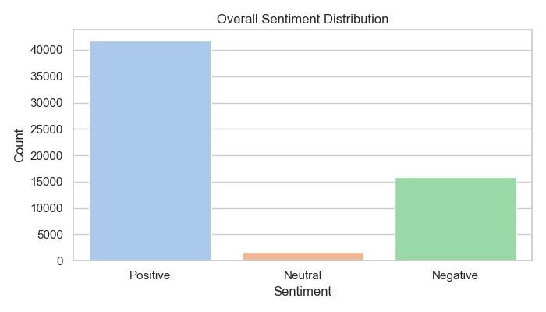
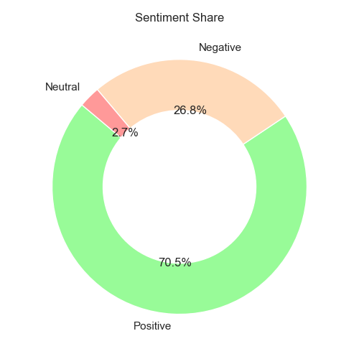
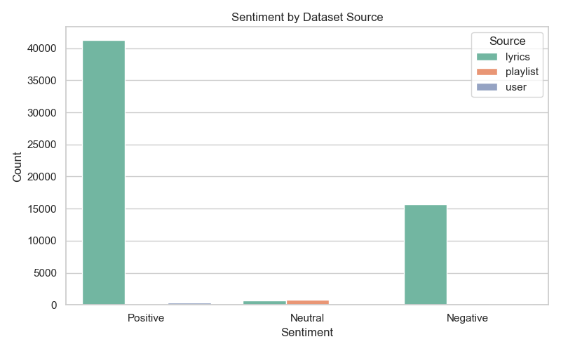
VADER SENTIMENT ANALYSIS
Key Insights
High occurrence of positive sentiment
Lyrics more emotionally expressive
Playlists slightly neutral/uplifting
Visuals Include:

Slide 7
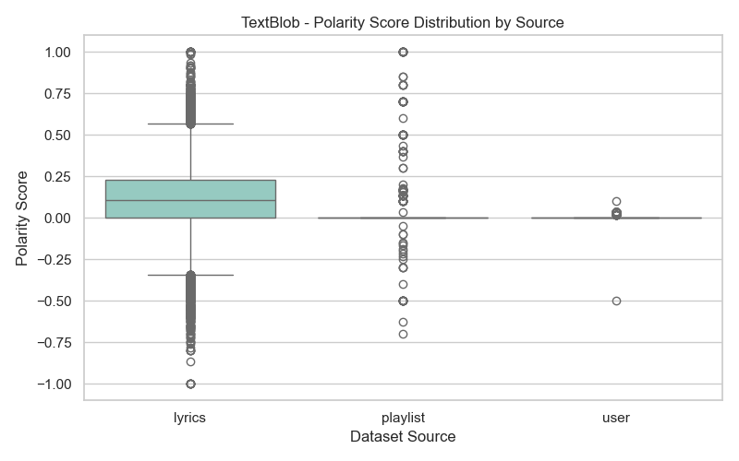
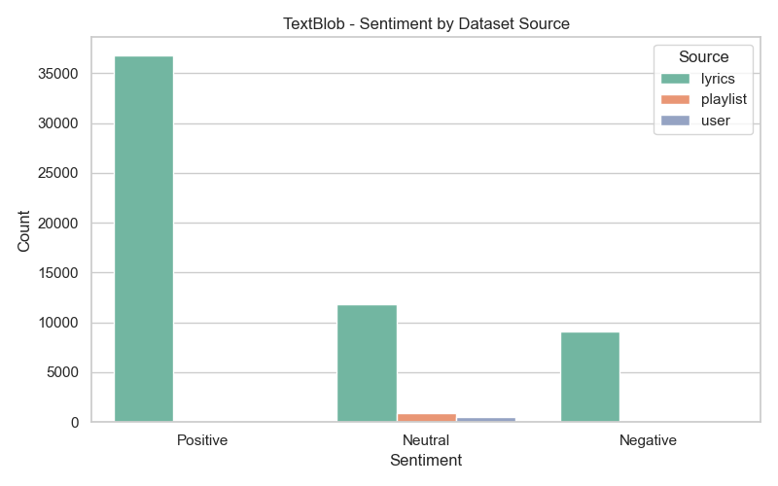
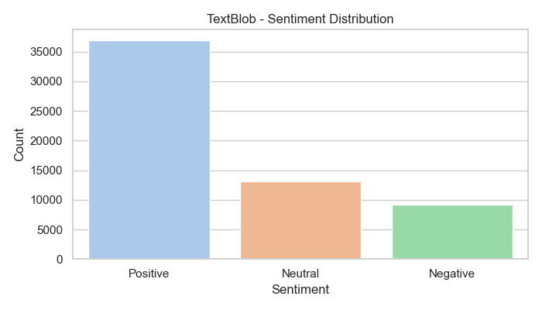
TEXTBLOB ANALYSIS
Key Features
Polarity Score: -1 to +1 (Emotion)
Subjectivity Score: 0 to 1 (Opinion-based)

Slide 8
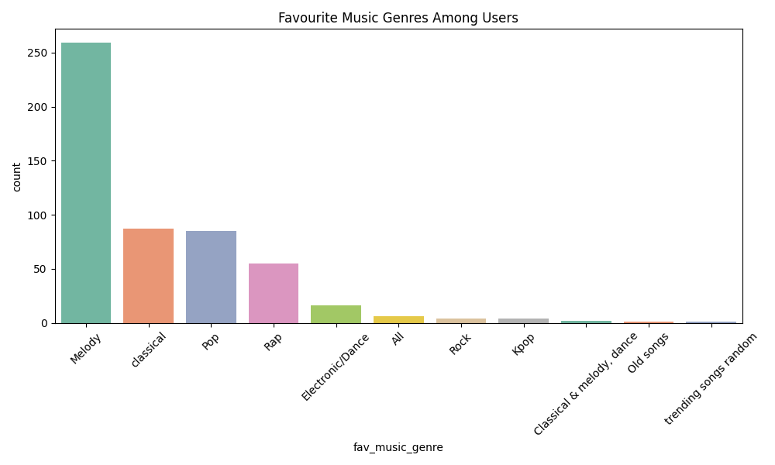
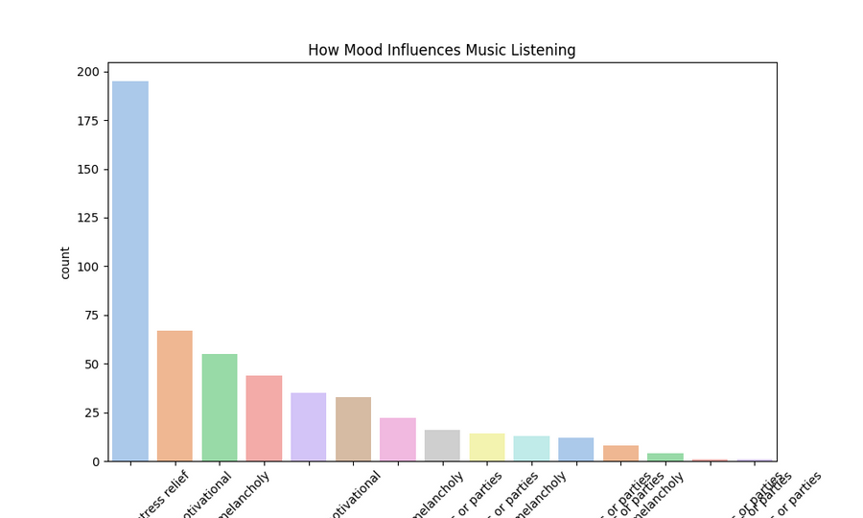
USER BEHAVIOR & MOOD
Findings from Survey
Pop, Lo-fi, Indie = top genres
Listeners prefer music during Morning & Night
Music influences both mood and concentration

Slide 9
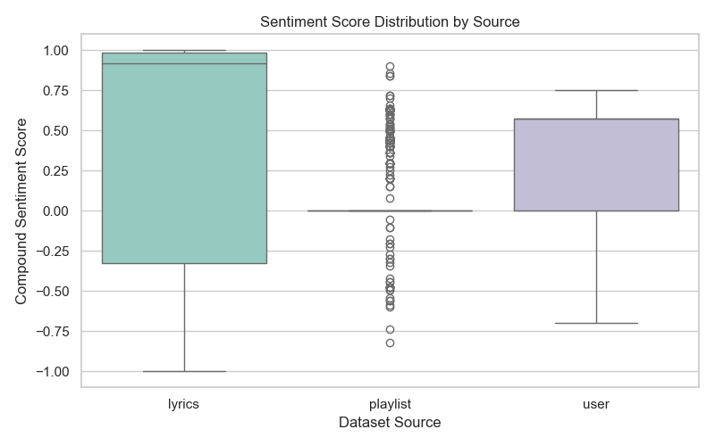
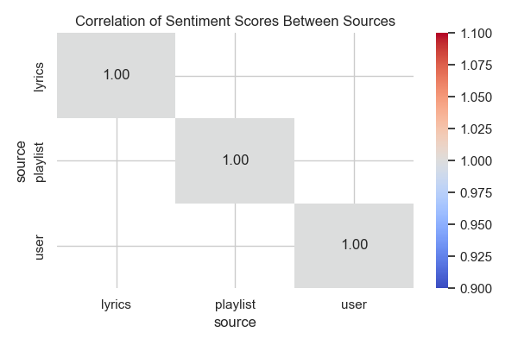
CORRELATION INSIGHTS
Sentiment Score vs. Data Source
Combined all three datasets for broader sentiment correlation
Insight
Lyrics and playlists contribute differently to overall mood prediction

Slide 10
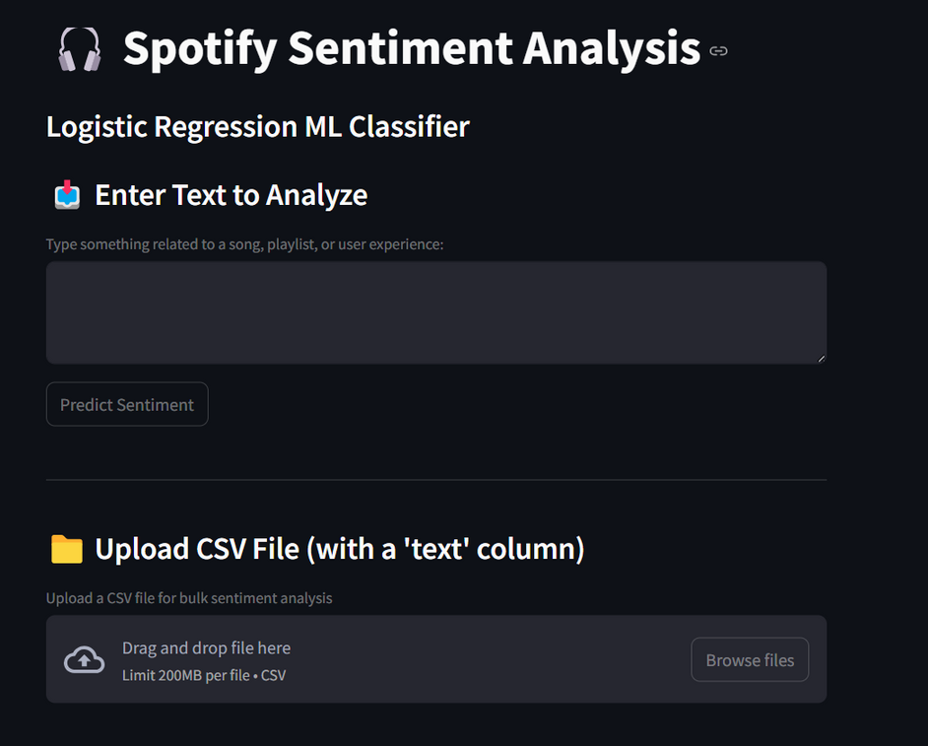
STREAMLIT APP DEMO
Analyze lyrics or playlist descriptions in real-time
Upload CSV for batch sentiment prediction
Choose sentiment model: VADER, TextBlob, or ML Classifier
View results with charts and sentiment labels
Download results (CSV)

Slide 11
RESULTS SUMMARY
Overall Accuracy: ~83% (ML Model)
Sentiment Trends: Music is mostly positive, especially in lyrics
User Insight: Genre and mood alignment is clear
Visuals Recapped
combined_sentiment.xlsx
lyrics_sentiment.xlsx
playlists_sentiment.xlsx

Slide 12
CONCLUSION & FUTURE SCOPE
Achievements
Processed over 59k+ records
Applied dual NLP models + ML classifier
Built a full working Streamlit app
Created 12+ visualization charts
Future Work
Add real-time Spotify API support
Support other languages
Add audio feature analysis (tempo, genre tags)
Integrate BERT or LSTM for deep sentiment learning

Slide 13
Thank You
For your attention

