Slide 1




Home Credit Default Risk
Group 23(Phase -2)
Tanay Kulkarni
tankulk@iu.edu
Shefali Luley
sluley@iu.edu
Sanket Bailmare
sbailmar@iu.edu
Raj Chavan
rchavan@iu.edu

Slide 2
Outline
Project Description
Summary Visual EDA
Summary of Phase 0 and Phase 1
Phase 2 plan
Feature Engineering
Hyperparameter tuning
Modeling pipeline
Accuracy in 2 models
Results and discussion of results
Conclusion and next steps

Slide 3
Project Description
Home credit utilizes several alternative data and methods to predict their client’s repayment abilities.
We will be using machine learning and statistical methods to determine these predictions.
We have finalized Logistic Regression and Random forest classifier for prediction.
Our goal in this phase is to perform Feature Engineering, do hyperparameter training and train model using best parameters and setting.
We aim at cleaning and preprocessing techniques on the data, perform feature Engineering, parameter tuning as we build pipeline after examining the accuracies of explored pipelines.

Slide 4
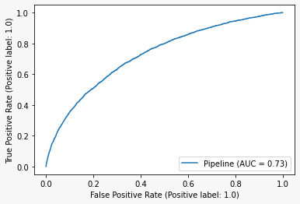
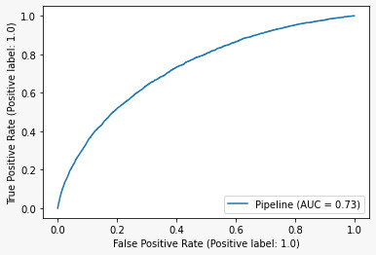
Summary Visual EDA

Slide 5
Summary of Phase 0 and Phase 1
We cleaned the data and picked only the features which were important to the target variable and prediction.
We featured the data performing OHE and applied imputing methods to fix the data before feeding it to the model.
We were able to create the baseline pipeline and could experimentally understand the accuracies of the models like logistic regression, naive bayes and Random forest. Based on the results of the models we saw that there might be underfitting in naive bayes and overfitting in Random Forest.
The best model that we could get for Phase 0 was Logistic Regression which gave a training accuracy of 91.9% and the Kaggle submission accuracy of 73.6%

Slide 6
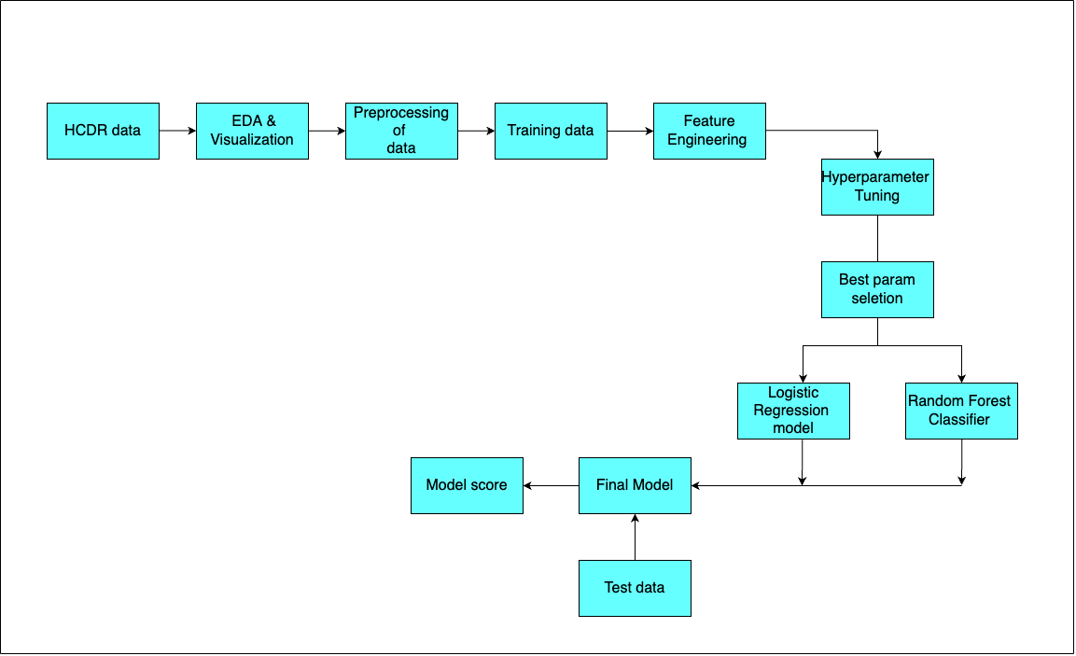
Phase 2 Plan

Slide 7
Feature Engineering
We merged all the subordinate data with the application_Train and application_Test data .
Example : credit_card_balance, POS_cash_balance,bureau_balance, previous_applications, installments data.
Adding the above features on the data contributed to the relevance of the data towards prediction, which was evident when we calculated the correlation of the added features from other files.
From above features , we tried to add new features by computing ratios on the columns which were more correlated to Target.
For Instance :
Feature 2 i.e AMT_TOTAL_RECIEVABLE/AMT_RECIVABLE
Feature 7 i.e (EXT_SOURCE_1+ EXT_SOURCE_2+ EXT_SOURCE_3)/AMT_TOTAL_RECIEVABLE
Feature 8 i.e (EXT_SOURCE_1+ EXT_SOURCE_2+ EXT_SOURCE_3)
Feature 9 i.e (EXT_SOURCE_1* EXT_SOURCE_2* EXT_SOURCE_3)
Feature 10 i.e (EXT_SOURCE_1* 2+EXT_SOURCE_2*3+ EXT_SOURCE_3*4)

Slide 8
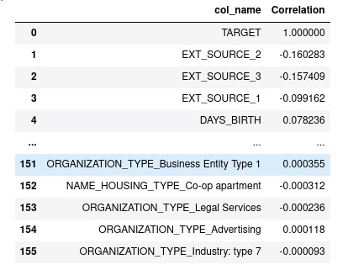
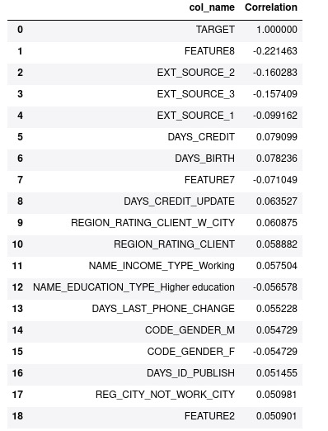
Correlation of all columns with Target
Features created from the highly correlated columns

Slide 9
Hyperparameter Tuning
After selecting the optimal features for our models, we use hyperparameter tuning to find the most optimal setting for running our model.
By just specifying the model, input parameters, and accuracy we want, we can easily obtain the best running conditions and features using GridSearchCV.
In our code, for logistic regression, we have created a function for GridSearchCV with 3 cross-validations for the hyperparameters and 1000 max iterations.
We did the same for our Random Forest Classifier model with 2 cross-validations for the hyperparameters and got the following accuracies.

Slide 10
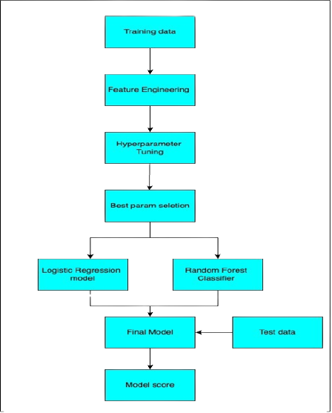
Modeling Pipeline
Pipeline include following steps:
Separation of Numerical and Categorical features.
Imputing the numerical and categorical features using pipeline
Feature Engineering
Hyper parameter tuning using GridSearchCV
Modeling

Slide 11
Results and discussion of results

Slide 12
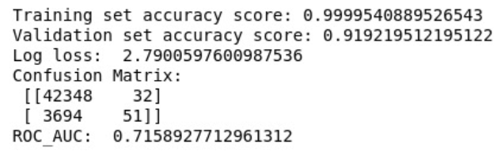
Modeling Pipelines And Comparison
Logistic Regression
Random Forest Classifier
TRAINING ACCURACY WITHOUT HYPERPARAMETER TUNING

Slide 13
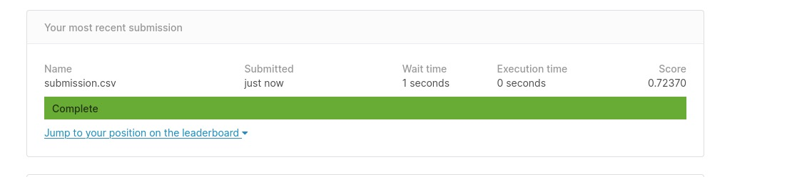
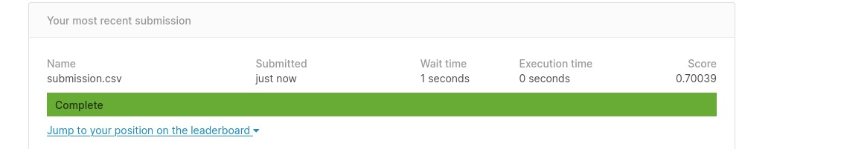
Types of Modeling Pipelines And Comparison
TESTING ACCURACY WITHOUT HYPERPARAMETER TUNING
Logistic Regression
Random Forest Classifier

Slide 14
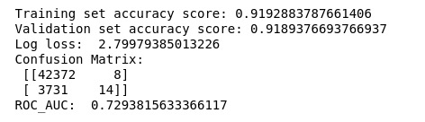
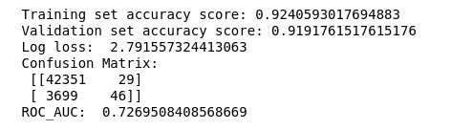
Types of Modeling Pipelines And Comparison
TRAINING ACCURACY WITH HYPERPARAMETER TUNING
Logistic Regression
Random Forest Classifier

Slide 15
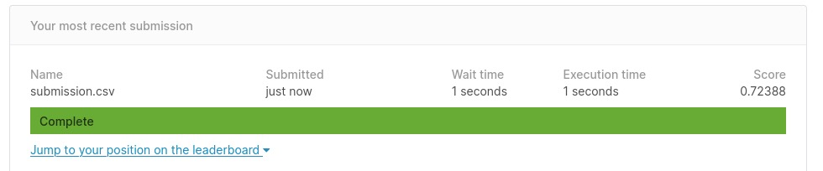
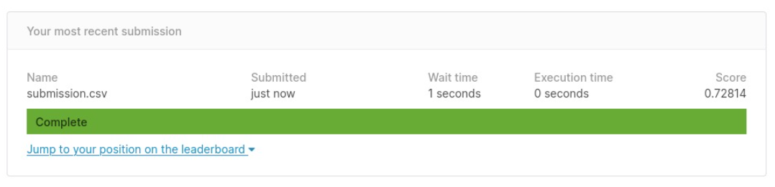
Types of Modeling Pipelines And Comparison
TESTING ACCURACY WITH HYPERPARAMETER TUNING
Logistic Regression
Random Forest Classifier

Slide 16
Conclusion and Next Steps
In this phase, we merged the whole dataset and extracted all possible features.
We cleaned the data and found the most relevant features to the Target variable and prediction.
We created our own features from the most correlated features which contributed towards the prediction.
We featured the data performing OHE and applied imputing methods to fix the data before feeding it to the model.
We performed hyperparameter tuning for our models alongside using K-Fold cross validation and GridSearchCV.
Therefore, mentioned steps contributed to improve the test accuracy as the model used best parameters for prediction.
Our next plan is to apply Deep Learning techniques like developing Artificial Neural Networks for better prediction results.

