Slide 1

Understanding High Availability and Multi-AZ Architectures in AWS
A comprehensive guide for cloud engineers on implementing resilient architectures across AWS Availability Zones to ensure maximum uptime and reliability for your critical applications.

Slide 2
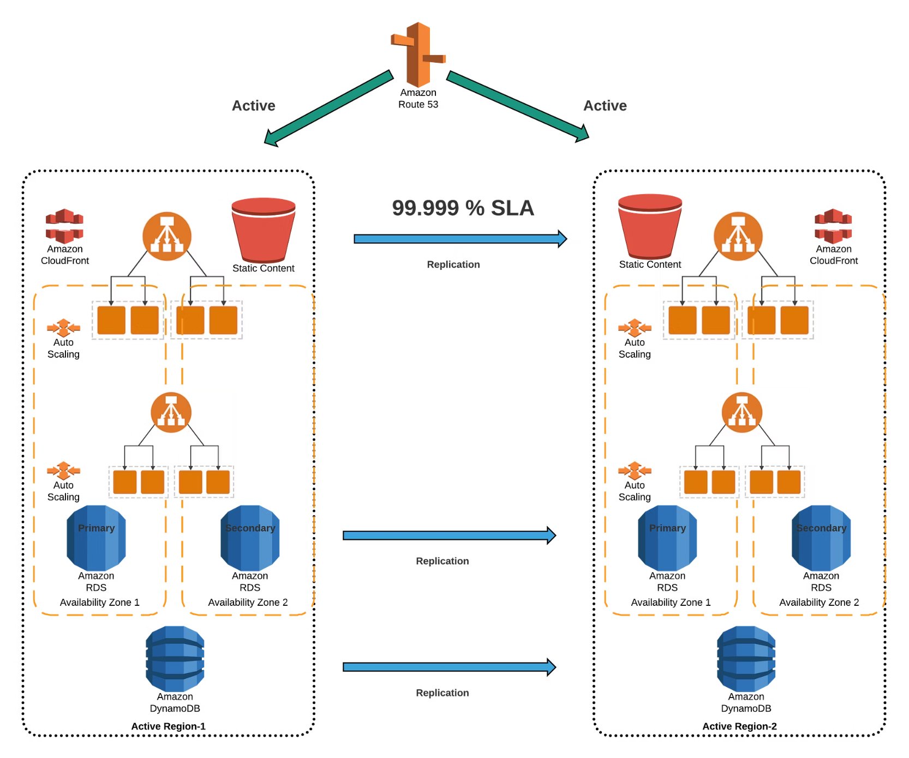
What is High Availability (HA)?
High Availability means ensuring that an application or service is continuously operational with minimal downtime, even in the event of hardware or infrastructure failure.
In AWS, HA is achieved by deploying resources in a redundant and distributed manner — often across multiple Availability Zones (AZs).
High availability systems are designed to automatically recover from failures with little or no human intervention, maintaining service continuity.

Slide 3
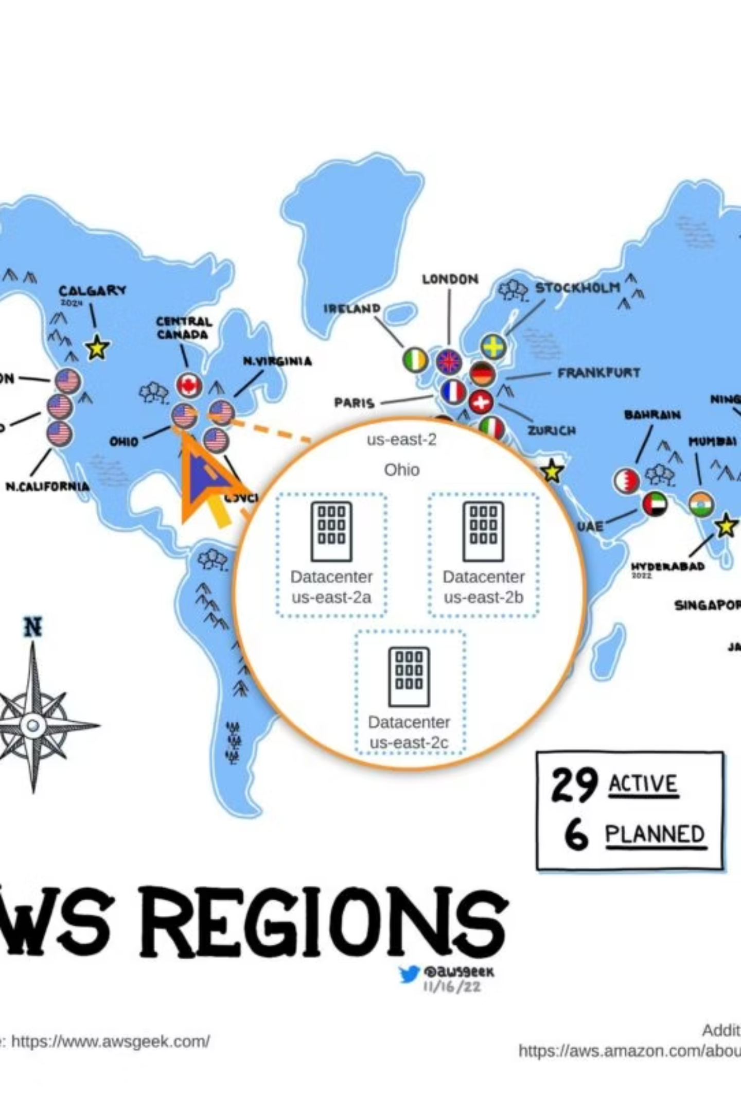
What are Availability Zones (AZs)?
1
2
Data Centers
Isolation
An Availability Zone consists of one or more data centers within a region, with dedicated power and networking.
Each AZ is physically isolated from failures in other AZs but connected via low-latency links.
3
Mumbai Example
In the AWS Mumbai Region, there are multiple AZs (e.g., ap-south-1a, ap-south-1b, ap-south-1c).

Slide 4
High Availability using Multi-AZ Architecture in AWS
Multi-AZ = Deploying components across two or more AZs within a region.
Fault Isolation
Minimal Downtime
Problems in one AZ won't affect resources in other AZs, protecting against data center-level failures.
Redundant deployment ensures continuous service even when an AZ experiences outages.
Disaster Resilience
Seamless Failover
Withstand natural disasters, power outages, or hardware failures affecting a single location.
Automatic redirection of traffic from impaired resources to healthy ones without user intervention.

Slide 5
How AWS Services Use Multi-AZ for High Availability
AWS Component
How it supports HA with Multi-AZ
EC2 Auto Scaling
Launch instances in multiple AZs in an Auto Scaling Group with an ELB to reroute traffic.
Elastic Load Balancer (ELB)
Distributes traffic across healthy targets in multiple AZs.
Amazon RDS
Multi-AZ deployment creates a standby replica in another AZ and automatically fails over.
Amazon S3
Designed for 11 9's durability with replication across multiple AZs automatically.
Amazon DynamoDB
Globally distributed with automatic multi-AZ replication.
Amazon ECS/EKS
Cluster tasks or pods across AZs for fault tolerance.

Slide 6



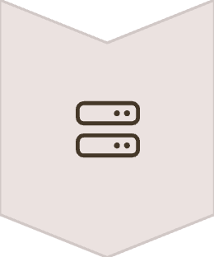

Example: High Availability Web App Architecture
Client
End users accessing the application from various locations
Amazon Route 53
DNS failover + geo latency routing for optimal user experience
Elastic Load Balancer
Distributes traffic across multiple AZs
EC2 Instances in Different AZs
EC2 Instance A, B, and C deployed across separate availability zones
Amazon RDS Multi-AZ
Primary DB with standby instance in a different AZ

Slide 7
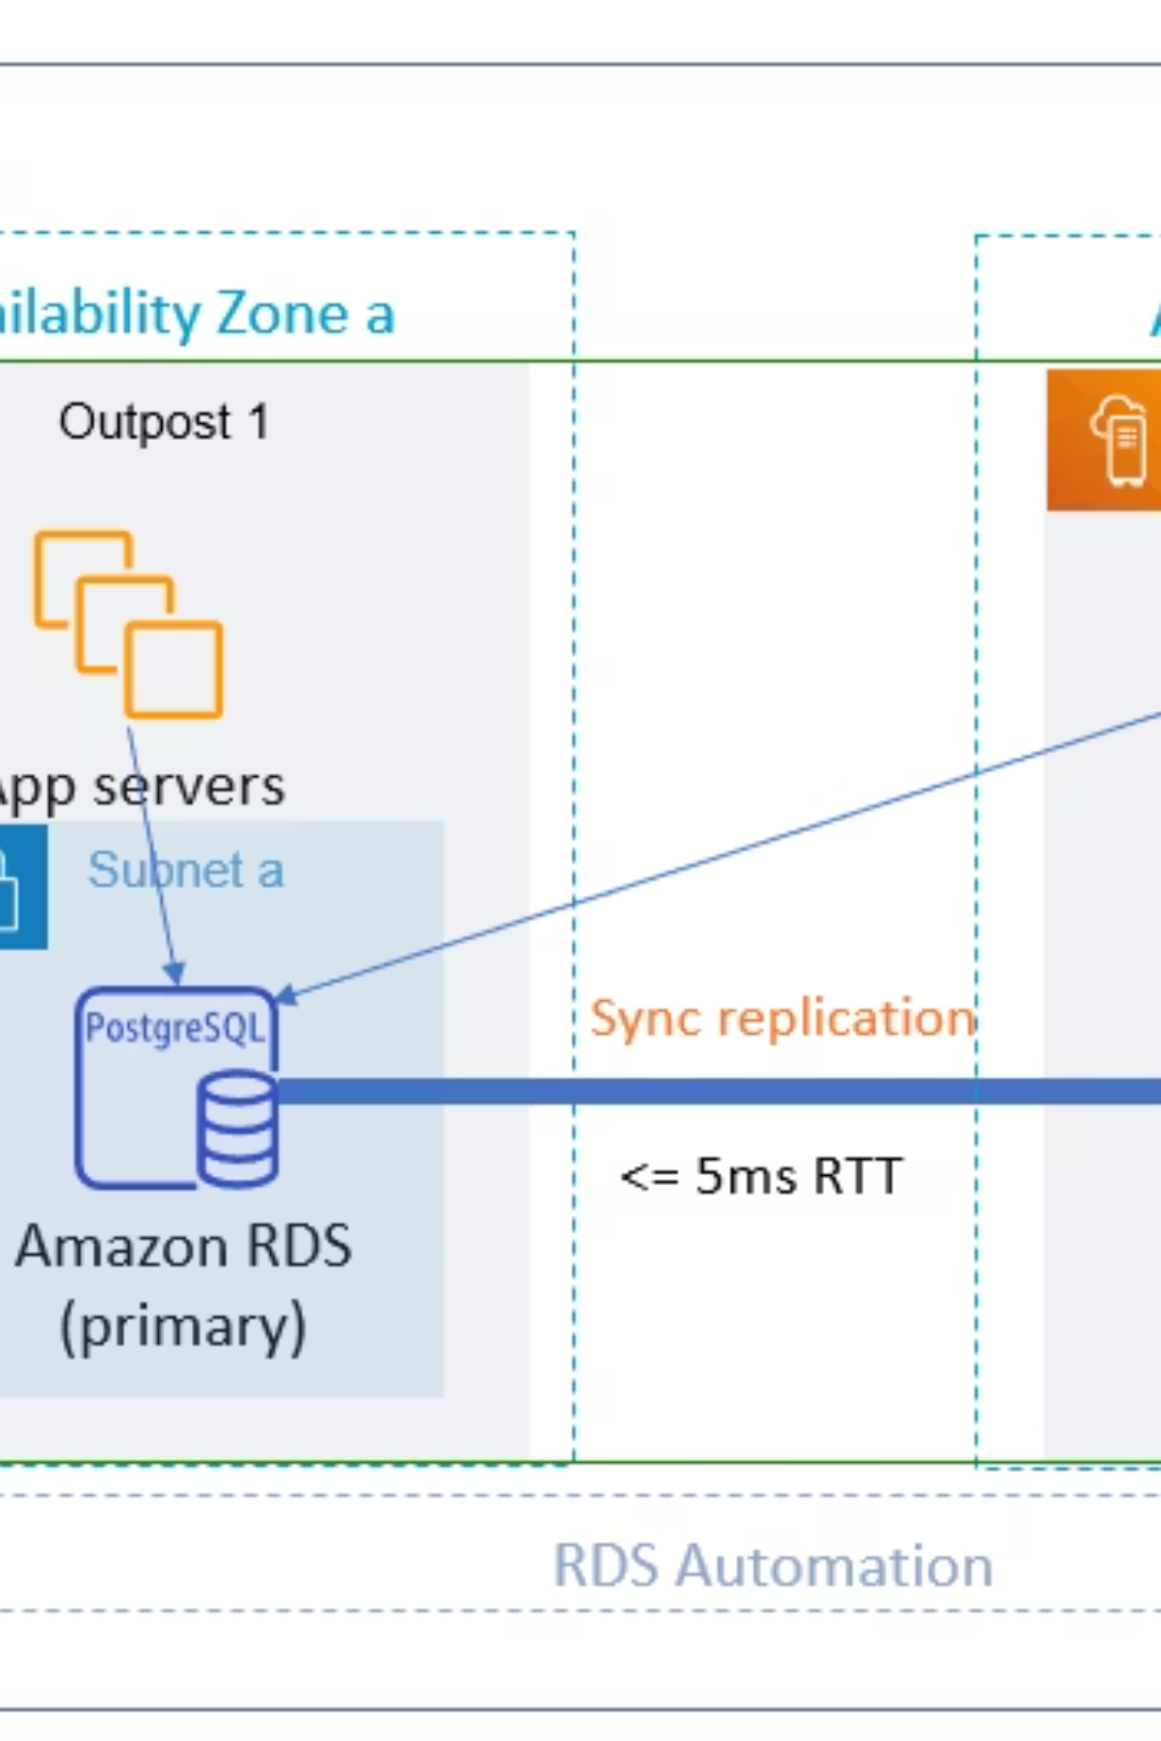
AWS Multi-AZ Architecture Visualization
This comprehensive architecture demonstrates how AWS services work together across multiple Availability Zones to create a resilient infrastructure that can withstand various failure scenarios.

Slide 8
Best Practices for AWS HA & Multi-AZ Design
Deploy compute in at least 2 AZs
Use managed services where possible
Implement Route 53 failover routing
Avoids single point of failure by ensuring application continues running even if an entire AZ fails.
Leverage built-in HA capabilities of services like RDS, DynamoDB, and Lambda to reduce operational overhead.
Automatically detects outages and reroutes DNS queries to healthy endpoints across regions.
Enable RDS Multi-AZ for production
Configure comprehensive monitoring
Ensures automatic failover and minimal downtime during maintenance or infrastructure failures.
Set CloudWatch alarms for availability, latency, and health metrics to proactively address issues.

Slide 9
Multi-AZ vs Multi-Region
Aspect
Multi-AZ
Multi-Region
Scope
Across AZs within a single region
Across multiple AWS regions
Primary Purpose
High Availability & Fault Tolerance
Disaster Recovery, Global Redundancy
Latency
Low (intra-region links are fast)
Higher latency across continents
Example
EC2 in ap-south-1a and ap-south-1b
EC2 in ap-south-1 and us-east-1
Data Sovereignty
Data stays within same geographic region
Data may cross country boundaries

Slide 10
Summary and Key Takeaways
1
High Availability Foundation
Next Steps:
AWS provides Multi-AZ architectures as a core design pattern for ensuring system uptime and reliability.
Review your current AWS architecture for HA gaps
Implement Multi-AZ for critical production workloads
Set up proper monitoring and testing for failover scenarios
2
Key Services for HA
Implement Auto Scaling, Load Balancing, and managed services to build fault-tolerant, highly available systems.
3
Advanced Implementation
Consider multi-region architectures for global applications requiring disaster recovery capabilities beyond what Multi-AZ provides.

