Slide 1
Azure Administration Case Study:
Automated Infrastructure Deployment
Done by:Shegin Ismail AP
Associate Software Engineer
ID:1108207

Slide 2
CONTENTS
1)Phase 1:Azure Essentials
1)Introduction:Problem Statement,Objectives,Solution
2)Implementation Flow
3)Architecture Diagram
4)Network Diagram
5)Best Practises and Pitfalls to Avoid
6)Tools and Technologies
7)Conclusion and Results
2)Phase 2:Automated Infrastructure Deployment
1)Introduction:Problem Statement,Business Objectives,Technical Solution
2)Detailed Implementation Flow
3)User flow diagram
5)Best Practises and Pitfalls to Avoid
6)Tools and Technologies
7)Conclusion and Results

Slide 3

Introduction: Phase 1-Azure Essentials
Problem Statement
Organizations face challenges in establishing a secure, scalable Azure infrastructure that ensures availability and connectivity while supporting advanced cloud scenarios. Configuring virtual machines, storage, networking, databases, and monitoring requires careful planning to achieve seamless integration and operational efficiency.
Objectives:
  Set up foundational Azure infrastructure
  Ensure security, availability, and connectivity
  Prepare base environment for advanced scenarios
Solutions:
Virtual Machines behind Load Balancer
Storage accounts with blob and file share
VNet with subnet, NSG, public/private IPs
Azure SQL Database deployment
Resource monitoring and backup configuration

Slide 4

Implementation Flow
1.Create Resource Group
2. Set up VNet (192.168.0.0/16) with Subnet (192.168.1.0/24)
3. Deploy 2 VMs (Windows), secure with NSG
4. Implement Load Balancer (Layer 4) for the VMs
5. Create Azure Storage (Blob, File Share, SAS key)
6. Map File Share on VMs
7. Provision Azure SQL Database (basic tier)
8. Set up Recovery Services Vault for VM backups
9. Configure CPU alert (80%) via Azure Monitor
10. Create Azure AD Group (e.g., ITAdmins), assign RBAC
01
.
0
4
0
2
0
3

Slide 5
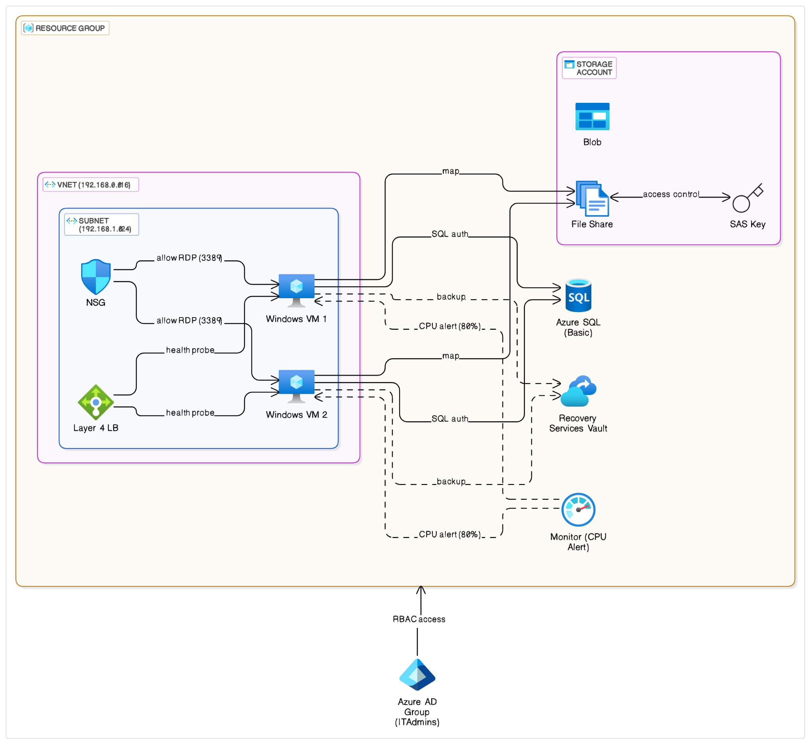
Architecture Diagram
Highlights
01

Slide 6
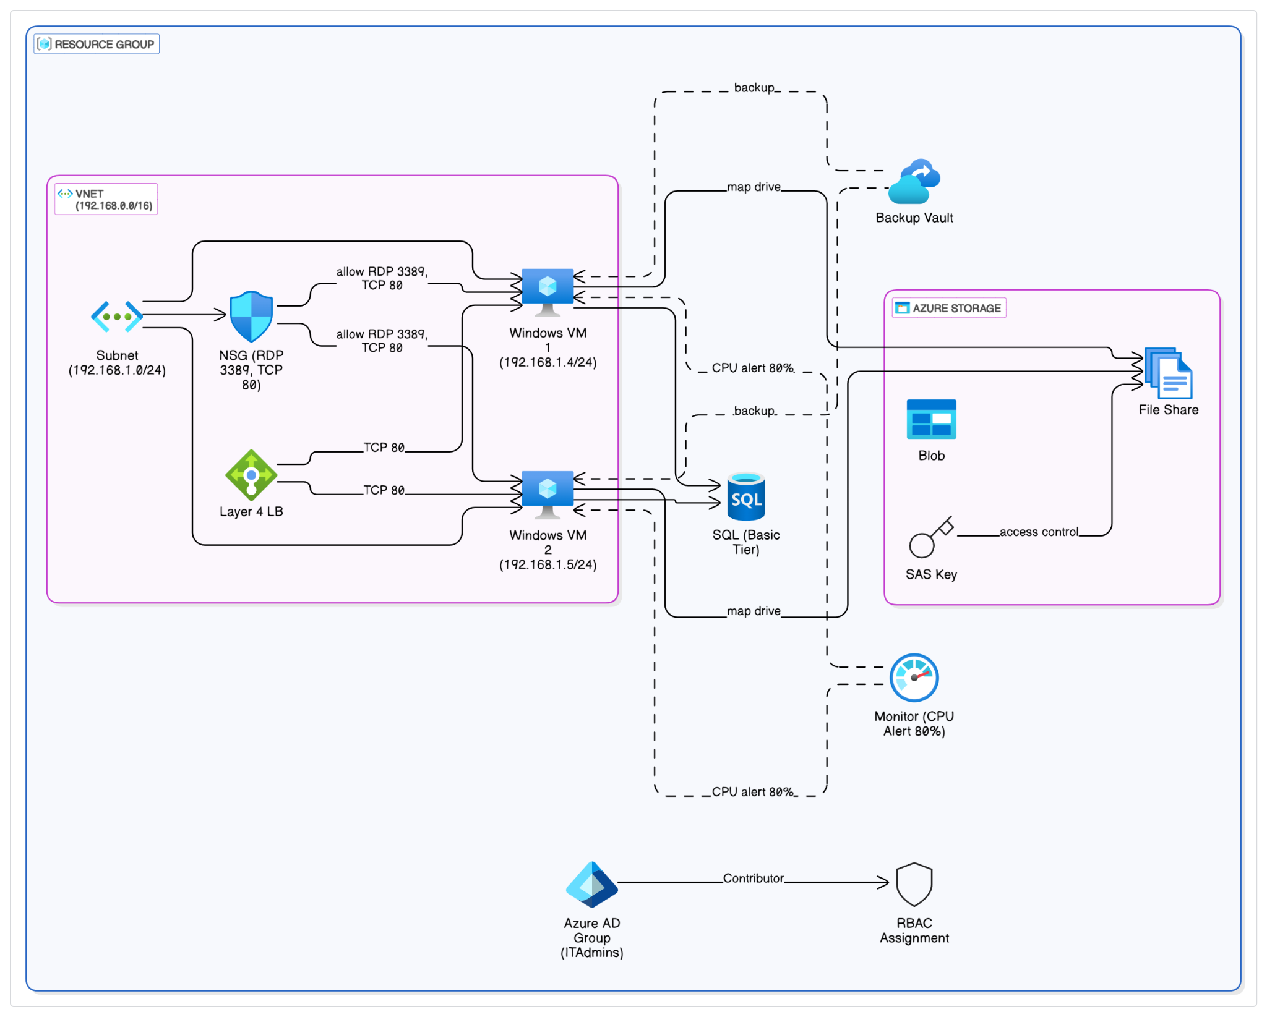
Network Diagram

Slide 7

Best Practices & Pitfalls to Avoid
Best Practices:
• Use tags and consistent naming
• Apply least privilege for access controls
• Backup policies and test restores regularly
Common Pitfalls to Avoid:
• Misconfigured NSGs blocking required ports
• Overlooking SAS key expiration
• Improper subnet IP planning

Slide 8

Tools & Technologies
Storage Account Stores cloud data.
VNet Enables secure networking.
Azure VM Provides scalable virtual machines.
Azure Monitor Tracks performance and logs.
SQL DB Manages relational databases.
Azure Portal Manages and deploys Azure resources
Recovery Services Vault Handles backups and disaster recovery.
NSG Controls network traffic.

Slide 9
Conclusion & Results
The Phase 1 of this case study successfully established a foundational Azure infrastructure, delivering a secure, available, and connected environment.
Key Outcomes:
Compute: Two Windows VMs behind an Azure Load Balancer for high availability.
Network: VNet with Subnet and NSGs for secure traffic control.
Storage: Azure Storage Accounts (Blob, File Share with SAS key) mapped to VMs.
Database: Azure SQL DB provisioned for applications.
Resilience: Recovery Services Vault enabled VM backups.
Monitoring: Azure Monitor CPU alerts configured for proactive issue detection.
Security: Azure AD Group with RBAC applied for least privilege access.
This comprehensive setup provides a robust and scalable base, ready for future advanced Azure deployments while adhering to best practices.

Slide 10

Introduction:
Phase 2 - Automated Infrastructure Deployment
Business Objective
Implement Infrastructure as Code (IaC) to streamline and standardize deployments, reduce manual efforts, and enhance operational efficiency for the DevOps team
​
Technical Solution
ARM/Bicep Templates – Define infrastructure​
Parameterization – Adapt to different environments​
Azure CLI Deployment – Streamline execution​
Validation – Verify with Azure Resource Manager logs​
GitHub Storage – Enable version control & reuse​
​

Slide 11
Detailed Implementation Flow
Phase 1 – Infrastructure Definition
Write ARM/Bicep templates to define resource configurations, such as virtual machines, storage, and networking.
Ensure modularity for ease of maintenance and follow naming conventions and tagging standards for clarity.
Add parameterization for environment variables to make templates dynamic for different environments.
Use secure variables for sensitive values to avoid hardcoded credentials.
Define default values where applicable to streamline deployment
Phase 2 – Deployment and Execution​
Deploy templates using Azure CLI commands to automate infrastructure provisioning.​
Validate deployments using dry-run previews before applying changes.​
Implement rollback logic for failure scenarios to maintain deployment integrity.​
Monitor deployment logs through Azure Resource Manager to identify errors and inconsistencies.​
Use Azure Monitor to analyze resource performance post-deployment and set up automated alerts for critical failures.​
Phase 3 – Version Control and Optimization
Store templates in GitHub to enable centralized version control and tracking.​
Implement branching strategies to manage environment-specific changes effectively.​
The link to the github for ARM deployment is given at Git-link↗

Slide 12
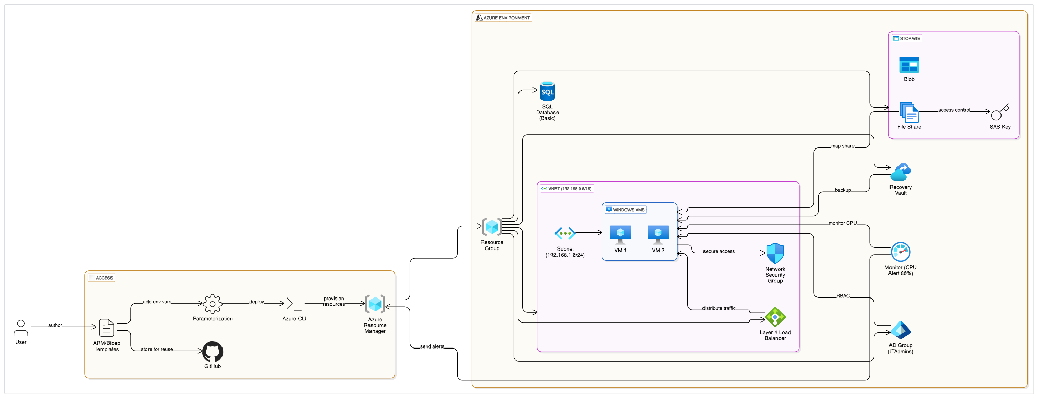
User Flow Diagram

Slide 13
Tools & Technologies
ARM Templates
Manage resources consistently with Infrastructure as Code principles.
Github
Enables standardized deployments, minimizing manual efforts, and ensuring efficient version control and collaboration for Infrastructure as Code templates.
Azure CLI
Interact with Azure resources directly through command-line interface.

Slide 14
Best Practices & Pitfalls to Avoid
Best Practices:
Modularize templates.
Follow naming and tagging standards.
Common Pitfalls to Avoid:
Hardcoding sensitive values.
No rollback or error handling logic.

Slide 15
Conclusion & Results
The phase 2 of this project successfully met the DevOps team's need to standardize deployments and minimize manual efforts using Infrastructure as Code (IaC).
Key Outcomes:
Automated & Repeatable Deployments: ARM/Bicep templates enable consistent, error-free infrastructure provisioning.
Reduced Manual Effort: Significant time savings and increased efficiency in deployments.
Enhanced Version Control: GitHub stores templates for clear change tracking and collaboration.
Reliable Deployments: Azure CLI deployments with parameterization ensure consistency.
Validated Infrastructure: ARM logs provide immediate deployment validation.
This initiative provides a robust, scalable foundation for future automation, perfectly aligning with modern DevOps practices.

Slide 16

Thank You

