Slide 1
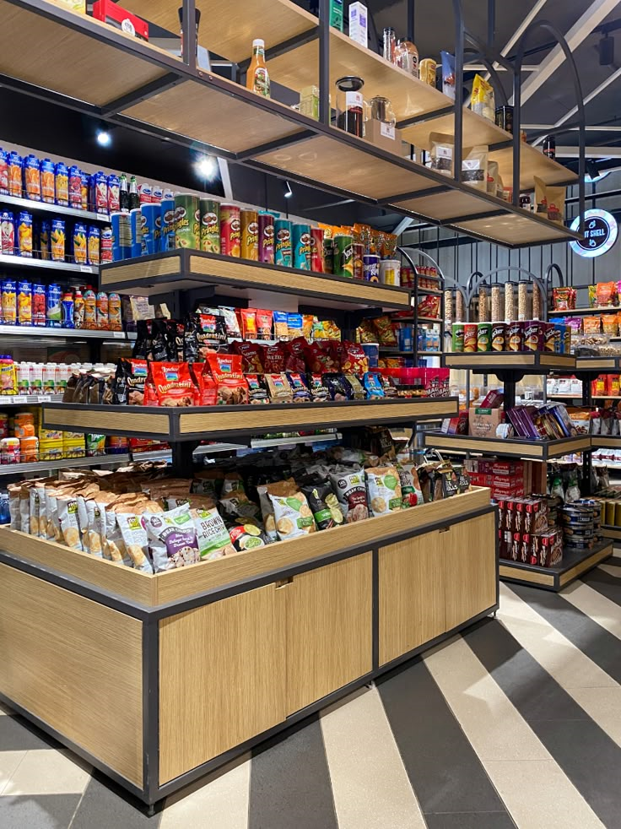
RETAIL SALES PRESENTATION

Slide 2
I am Awolola Segun Adewale, Today I will be doing a presentation on retail sales and customers demographics dataset.
This dataset includes some key details, such as Transaction ID, Date, Customer ID, Gender, Age, Product Category, Quantity, Price per Unit and Total Amount, And 9 other calculated columns.
I have created a dashboard to give more insight on the dataset given.
My dashboard contains 5 different pages.

Slide 3
So Let's dive in………………………………………..

Slide 4
let's look at,
How does customer age and gender influence their purchasing behavior?
The demographic in this dataset is the age and the gender.
From the dataset, I have categorized the age into 4 categories: teenagers, young adult, old adult and elders

Slide 5
Using this age category provided, The old adult has more purchasing power (240k) than others while the teenagers have the lease purchasing power 11k.
More insight, from the demographics page, the most purchased product categories by the old adult is the electronics product categories, mostly purchased by the female, Most revenue, came in around the 4th quarter of the year.
While for age category with the lease purchasing power (teenagers), the most purchase product category is the beauty product. Most revenue, came in around the 4th quarter of the year.

Slide 6
Are there discernible patterns in sales across different time periods?
From my sales analysis page, there is a significant fall in revenue from the end of year 2023 – 2024 (JAN).
Could be because of the season holiday or something else.

Slide 7
Which product categories hold the highest appeal among customers?
The clothing category has the highest count/volume or number than the rest caterogy, Because it’s the most requested product category in terms of quantity.

Slide 8
What are the relationships between age, spending, and product preferences?
From the dataset provided, the young adult and the old adult have more spending power than the elders and the teenegers

Slide 9
How do customers adapt their shopping habits during seasonal trends?
Quantity by quarter(date) and product category, it shows that in terms of quantity, we have more of clothing category during the first 2 quarters and electronics category in the last 2 quarters.
And in terms of revenue, we realized that electronic product category sold more in the 2nd and 4th quarter.

Slide 10
My recommendations: Stock and promote best-selling categories by demographic

Slide 11
What are the relationships between age, spending, and product preferences?
Age vs. Spending
Age vs. Product Preferences

