Slide 1

Impact of COVID-19 in Nigeria: A Data Analysis Report
Introduction
This report analyzes the progression and impacts of the COVID-19 pandemic in Nigeria, using data science techniques to provide insights that inform health, economic, and policy interventions.
COVID-19 has disrupted various aspects of life globally. In Nigeria, the pandemic led to public health challenges, economic decline, and reduced government budgets. This report examines these effects, focusing on the relationships between infection rates, community vulnerabilities, and economic outcomes.

Slide 2
Objectives
Explore the spread of COVID-19 across Nigerian states.
Investigate how community vulnerability affects the pandemic's severity.
Evaluate the economic impacts by analyzing changes in GDP and state budgets.
Outline
Data description and collection
Methods and techniques for data collection and analysis.
Exploratory analysis and visualizations.
Future Improvement
References

Slide 3
Dataset Description
The datasets used in this analysis include but not limited to:
COVID-19 Case Data: Collected from John Hopkins University Center for Systems Science and Engineering (JHU CSSE) detailing daily cases, deaths, and recoveries.
Community Vulnerability Index: Measures the potential impact of COVID-19 across Nigerian states based on socio-economic and health system factors.
Real GDP Data: Nigeria’s economic performance before and during the pandemic.

Slide 4
Data Collection
COVID-19 case data was obtained through web scraping using Python libraries such as BeautifulSoup.
Vulnerability index and economic data were imported from publicly available resources.
Data Cleaning and Wrangling
Handled missing values, standardized formats, and merged datasets for analysis.
Tools Used:
Python libraries including Pandas for data manipulation,
Seaborn and Matplotlib for visualizations, and
NumPy for numerical analysis.

Slide 5
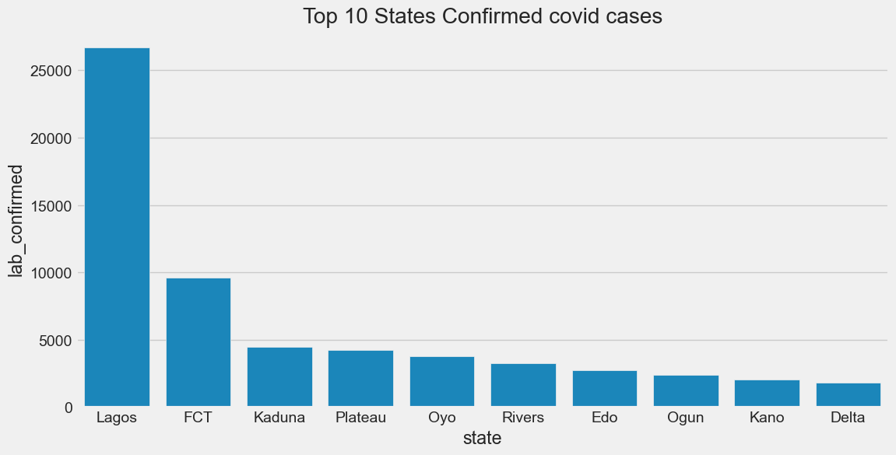
Data analysis and visualisation – Extracted data for Nigeria
Top 10 States Confirmed covid cases

Slide 6
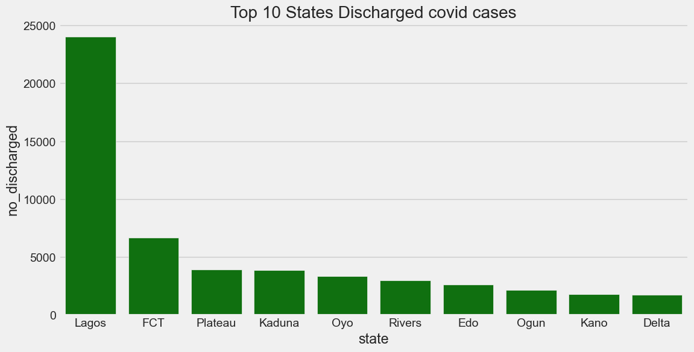
Top 10 States Discharged covid cases

Slide 7
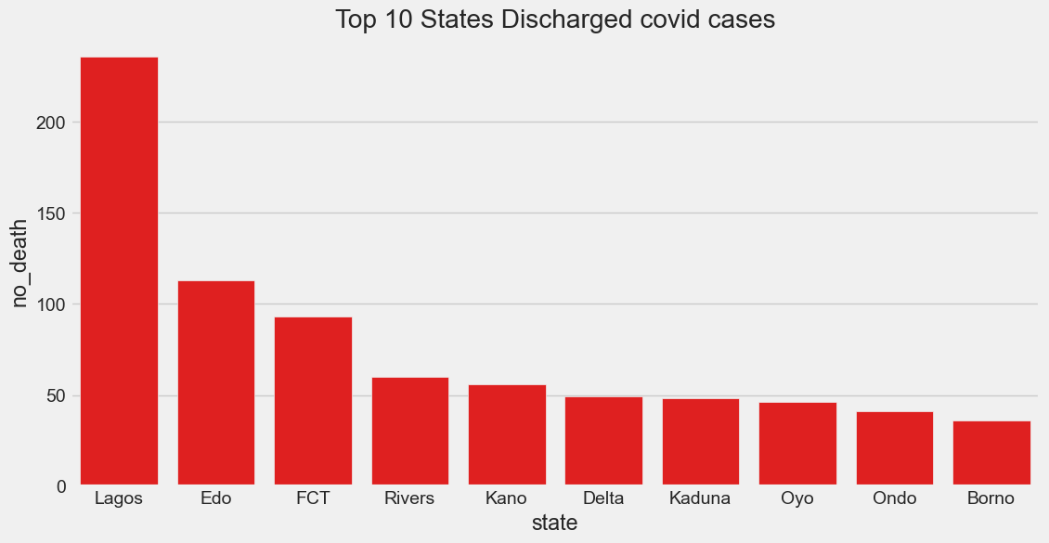
Top 10 States Discharged covid cases

Slide 8
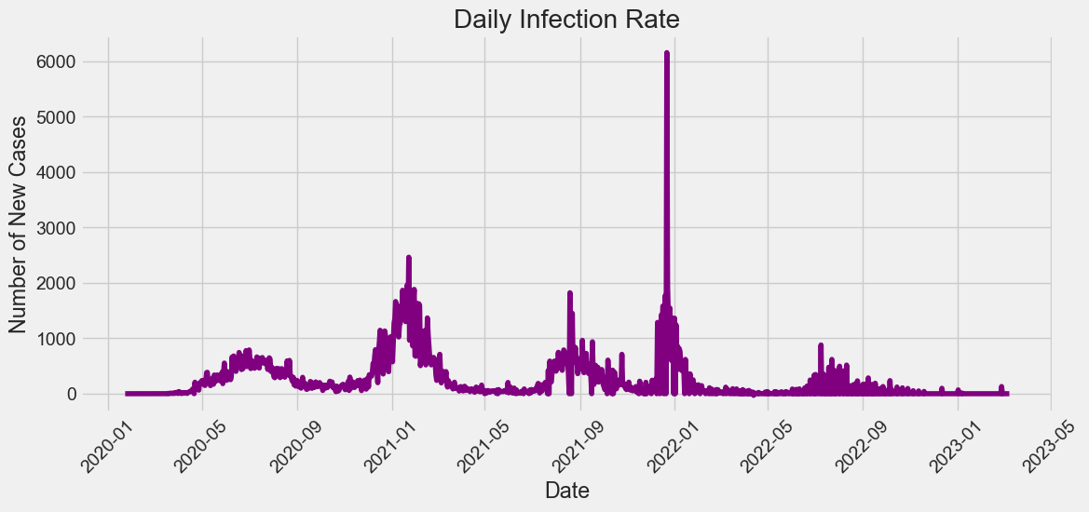
'Daily Infection Rate from Jan 2020 to May 2023

Slide 9
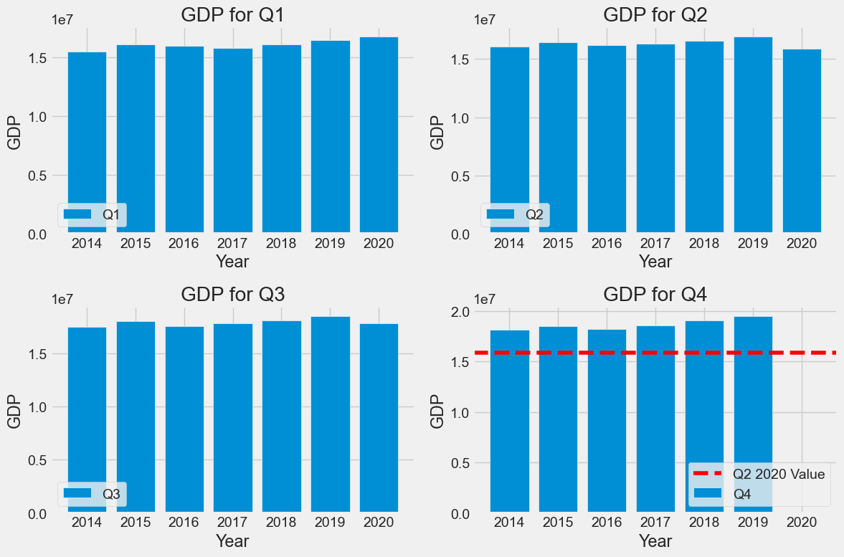
GDP Analysis for Pre and Post-Covid periods

Slide 10
Conclusion
As shown in the combined barchart, the gross domestic product (GDP) generally increases across the quarters from Q1 to Q4 each year, indicating seasonal economic growth patterns.
The horizontal line at Q2 2020 serves as a benchmark for comparison. It appears that most of the previous GDP values exceed this level, suggesting that Q2 2020 might have been an economically challenging period due to the COVID-19 pandemic.
In addition, the highest overall vulnerability index(0.3) within the shaded region. Values here indicate the state as Lagos having the highest confirmed covid-19 cases and experienced more severe outbreaks due to dense populations and limited health resources.

Slide 11
References
Johns Hopkins University Center for Systems Science and Engineering (JHU CSSE): https://systems.jhu.edu/
https://github.com/CSSEGISandData/COVID-19
Thank you…

