Slide 1


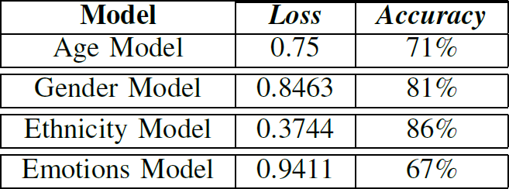
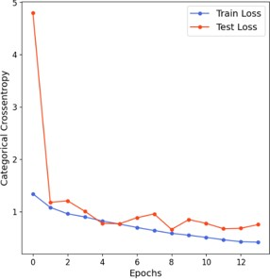
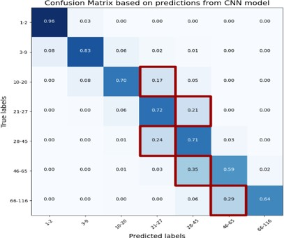
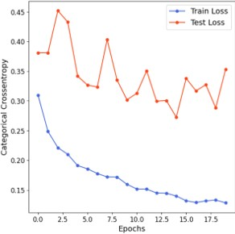
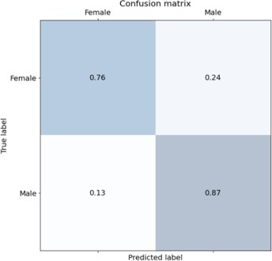
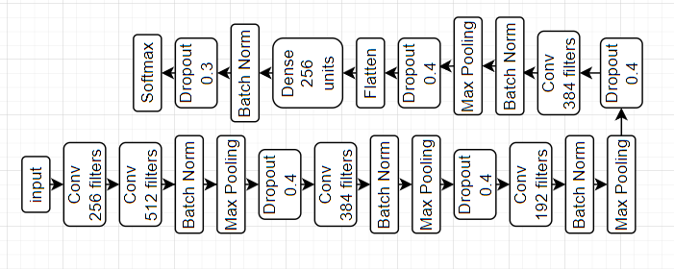
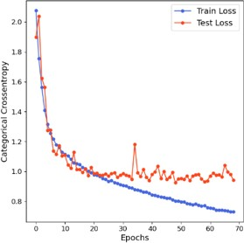
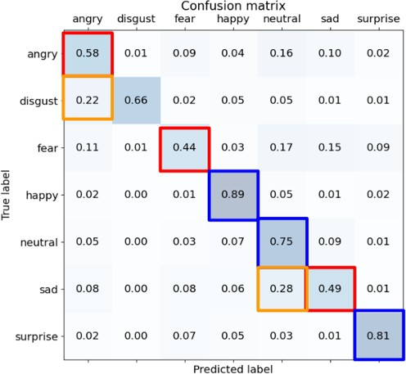
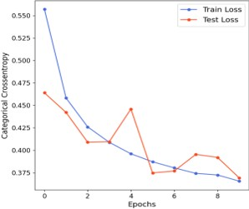
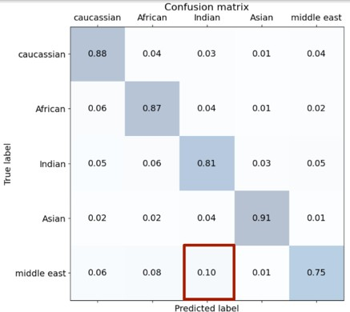
Human Face Detector and Analyzer
Abstract.
This Project aims to Develop an API application capable of detecting human face and predict Age, Gender, Ethnicity, and Emotions from it by utilizing the power of Convolutional Neural Networks.
Introduction
Results
In recent years, the need for systems capable of detecting and analyzing the human face is increasing rapidly with the wide possible application of it in our life. Those systems can be used in many areas like marketing by analyzing customer emotions from facial image to measure the degree of satisfaction or analyzing the ages of
most-visiting customers etc. it can also be integrated in surveillance systems to detect specific features. With the rabid development of machines and big datasets, applying deep learning techniques such as neural networks became possible. Starting with AlexNet, the CNN networks started to be deeper and have more parameters, with the right optimization techniques the performance of those networks can be vastly increased. In this project we built four CNN models and train and optimize them to develop models that achieve satisfactory results.
Datasets:
Age Model: Facial-Age/UTK-FACE
Gender Model: UTK-FACE/B3FD
Emotions Model: FER-2013
Ethnicity Model: Ethnicity-Aware/Arab-Celeb-Faces
Preprocessing:
Datasets Cleaned using Haar Cascade Algorithm to remove images with no human face in it
Data Augmentation
Image Normalization and Resizing
Mean Centering
Age and Gender Models CNN Archeticures:
The CNN architecture proposed by Juel in [1] was used in age and gender models. In the Age model, the last layer had softmax activation with 7 units. In the Gender model, the activation changed to sigmoid activation in the last layer.
:
Ethnicity Model CNN Archeticures
In ethnicity model a pre trained VGG-16 architecture with VGG-Face weights was used by fine tuning it. The architecture was fine-tuned by adding Global Average Pooling layer instead of the flatten layer, a dense layer with 1024 units and RelU activation, a dropout layer with probability 0.5 and a dense layer with 5 units and SoftMax activation.
Emotions Model CNN Archeticures:
The following architecture in figure 1 was used for emotions model. Input dimension
is 48x48x1, all convolution layers have kernel size of 3 and relu activation with “same” padding, Max pooling layers have pool size of 2, Dense layer have 256 units with relu activation and softmax layer have 7 units.
Emotions Model CNN Archeticures:
The following architecture in figure 1 was used for emotions model. Input dimension
is 48x48x1, all convolution layers have kernel size of 3 and relu activation with “same” padding, Max pooling layers have pool size of 2, Dense layer have 256 units with relu activation and softmax layer have 7 units.
Training:
Early Stopping Callback with 5 patience and 1 Verbose
Checkpoints Callback with 1 Verbose
Tensorboard Callback with 1 Verbose
32 Batch Size for Age and Gender Models
128 Batch Size for Ethnicity Model
All Models Fitted for 100 epochs
Class Weight Balancing
TensorFlow was Used
Cross Entropy Loss
Accuracy as Metric
Cross Validation
Adam Optimizer
0.001 Learning Rate
Face Detection:
References:
The Haar Cascade algorithm was Used for face Detection.
Nippon Datta Nippon , Juel Sikder Juel , “An Approach Based on Deep Learning for Recognizing Emotion, Gender and Age”, Rangamati Science and Technology University, 2022

