Slide 1
BRESTCANCER using a Naive Bayes (NB) classifier
BioStatistics
Presented to Dr. Ibrahim

Slide 2
Introduction
In this presentation, we will explore the Naive Bayes (NB) classifier in breast cancer analysis. Naive Bayes is a powerful algorithm for classification based on probability. We will discuss its simplicity, feature independence assumptions, and impressive results.
Breast cancer is a critical area of study with high prevalence and treatment challenges. Through Naive Bayes, we can make informed predictions and decisions about breast cancer presence. We will highlight its strengths, limitations, and future directions in this field.

Slide 3
Steps:
1
2
3
Select dataset
Cleaning the dataset
Removing the outliers

Slide 4
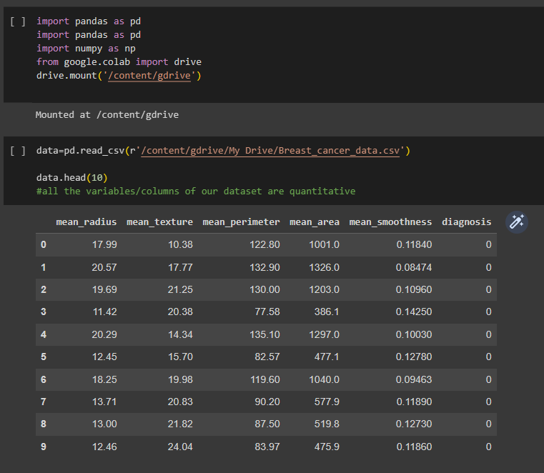
1.Select dataset
The first step of the research involves choosing the dataset on which we worked.
Our dataset is about the breast cancer has 5 futures (mean radius /mean texture / mean perimeter /mean area/ mean smoothness)

Slide 5
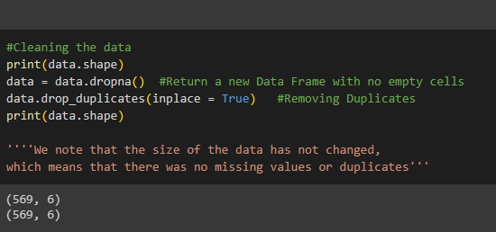
2.Cleaning the dataset
Cleaning the dataset which is an important step in preparing data for analysis including handling the missing data/duplicates, and
checking for outliers.
(We note that there was no missing values or duplicates)

Slide 6
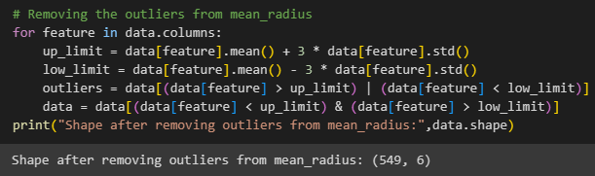
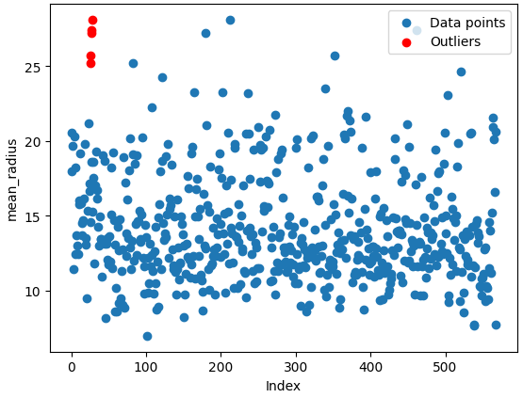
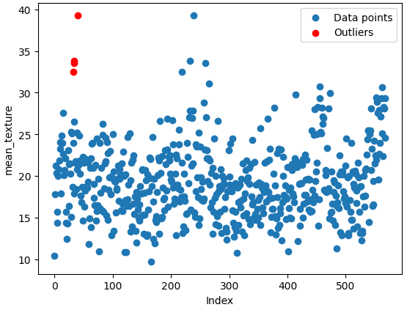
3. Removing the outliers
We used the z-score method removing the data points that are more than three standard deviations away from the mean.
(We note that there are 20 outliers the size shrink from (569 ,6) to (549 , 6)

Slide 7
Steps:
5. Standardizing features
4. Calculate a set of descriptive statistics

Slide 8
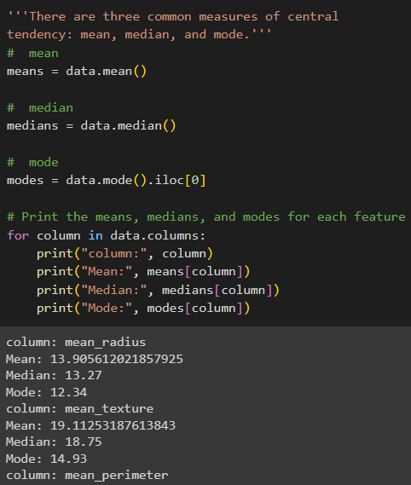
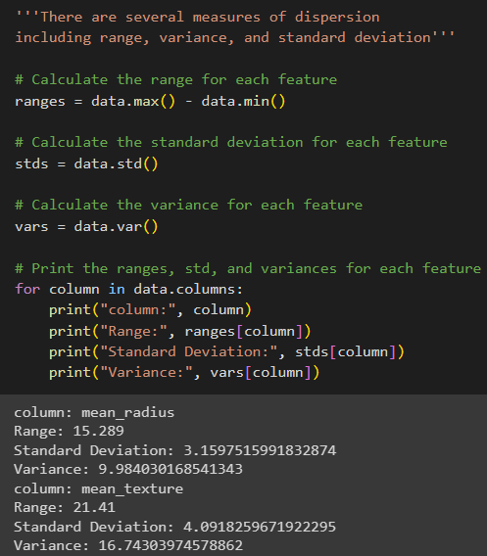
4. Calculate a set of descriptive statistics
1
Measures of Central Tendency
Measures of DISPERSION
2
Mean
Median
Mode
Range
Variance Standard deviation

Slide 9
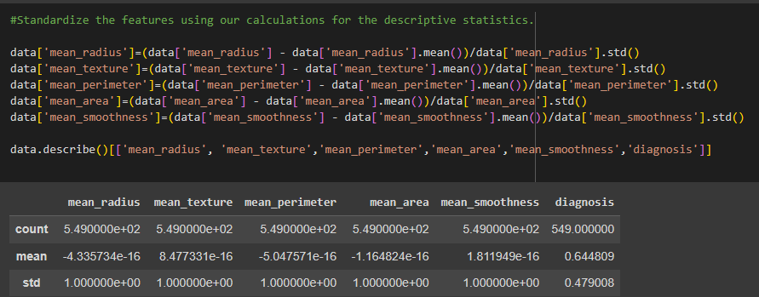
5. Standardizing features
Standardizing features which is an important data preprocessing step
This can help to ensure that all features are on the same scale and that the model is not biased towards features with larger values.

Slide 10
Steps:
6. Split the data
7. Plotted the histogram/
distribution

Slide 11
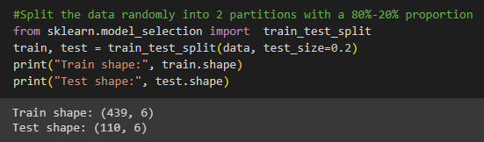
6. Split the data
We splatted the data randomly into 2 partitions with an 80%-20%
Proportion for training dataset and testing dataset in order.

Slide 12
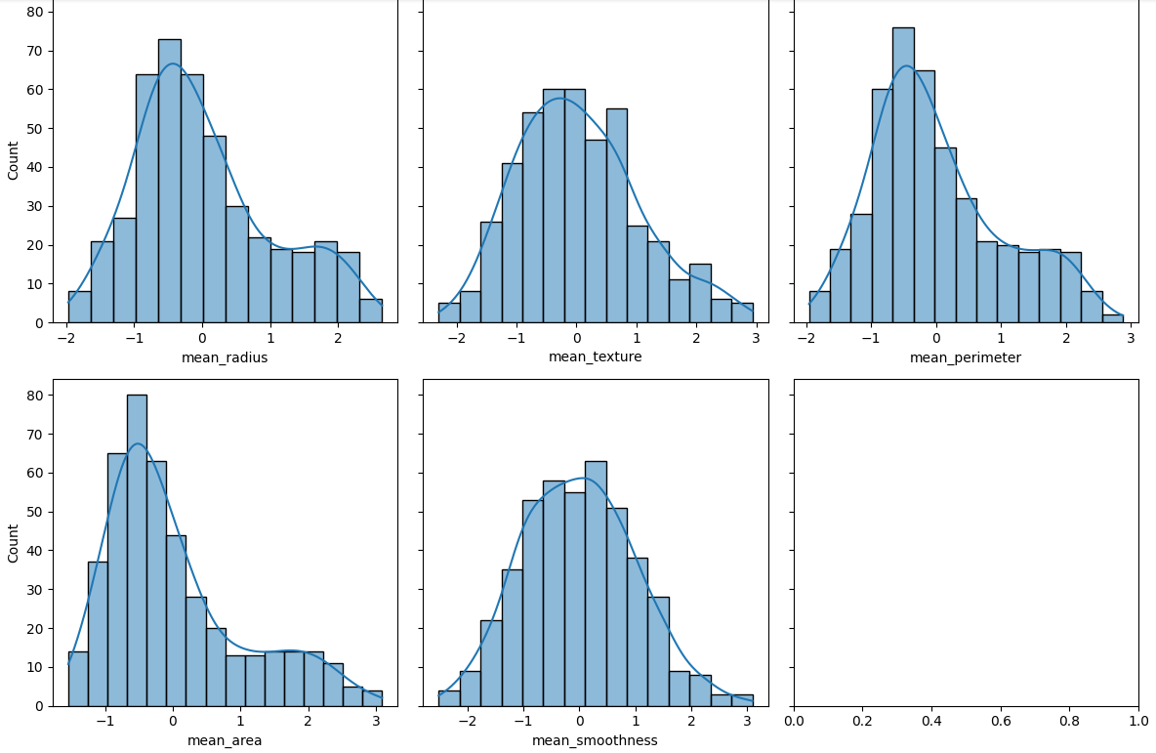
7. Plotted the histogram/distribution
We splatted the data randomly into 2 partitions with an 80%-20%
Proportion for training dataset and testing dataset in order.

Slide 13
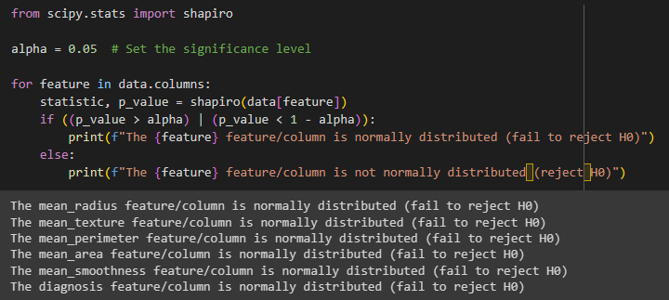
8.Hypothesis Test
We statistically test if a feature/column in the training data is normally
distributed by doing the following steps:
01
03
05
The feature
/column is not normally distributed
Compare the p-value to the significance level
Null hypothesis
(Ho)
Alpha
Set the significance level (alpha) for the test as 0.05.
Test statistic and p-value .
The feature /column is normally distributed.
Alternative hypothesis (H1)
02
04

Slide 14
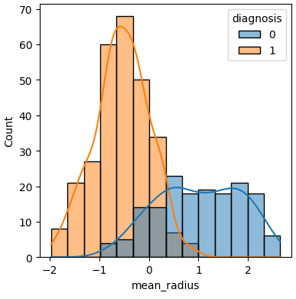
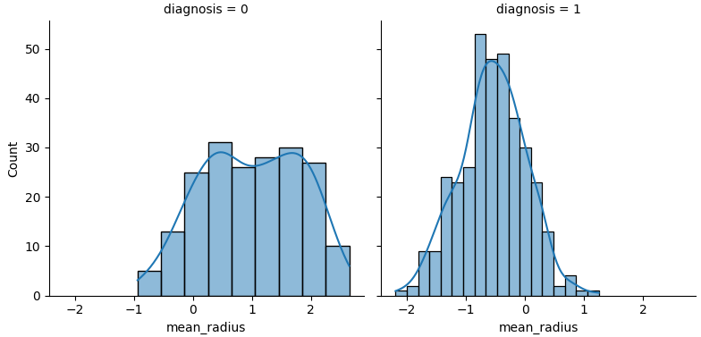
9.Conditional
Distributions
We plotted the conditional distributions of each feature in the training data on each target class, using the seaborn library in Python.

Slide 15
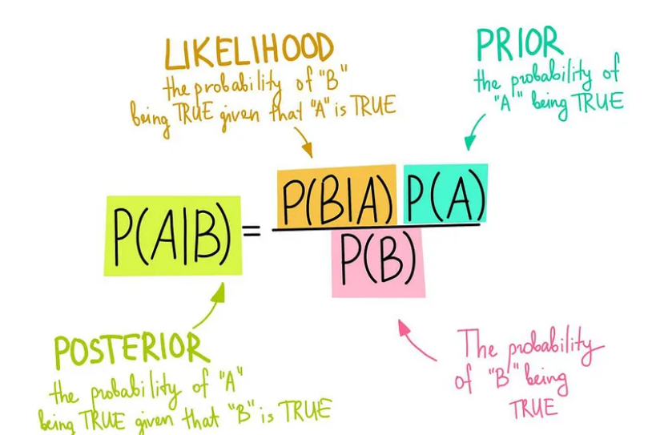
10.Naive Bayes classifier
Naive Bayes algorithm is a supervised classification algorithm based on Bayes theorem with strong(Naive) independence among features.
Bayes’ Theorem
In probability theory and statistics, Bayes’ theorem describes the probability of an event, based on prior knowledge of conditions that might be related to the event

Slide 16
10.Naive Bayes classifier
We started by calculating the prior probabilities for each class in the training data.
01
Calculate the conditional probabilities of each input feature given each class
02
Make predictions through calculating the probability of each class using Bayes' theorem and the conditional probabilities
03
Calculated its accuracy using the accuracy score from sklearn library in Python
Evaluated the model using F1 score the accuracy of our model (95.23%).
04
05

Slide 17
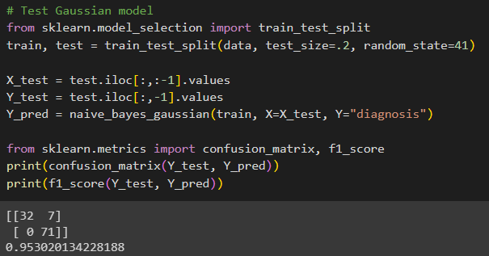
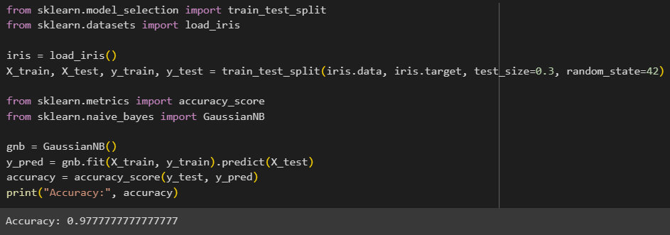
Result
  using the accuracy score from sklearn library in Python getting 97.77% accuracy percent deducing a difference of 2.47% difference between the 2 accuracies in favor of the last one

Slide 18
Conclusion
Based on the results obtained in this study, the following can be concluded the following:
    The Naive Bayes model proved to be an effective tool for predicting the target variable in this study.
    The model was able to accurately classify the testing data with an accuracy of 95.23% demonstrating its ability to generalize well to new data.
    The implementation of the model from scratch showed the importance of considering the prior probabilities and conditional probabilities of the features when making predictions. Comparison with the Gaussian NB implementation from the sklearn package showed similar performance, indicating the reliability and consistency of the Naive Bayes algorithm.

Slide 19
References:
https://link.springer.com/article/10.1023/A:1007413511361
https://colab.research.google.com/notebooks/intro.ipynb
https://www.itl.nist.gov/div898/handbook/eda/section3/eda35c.htm
The analysis was performed using:
Google Colab, a cloud-based platform that provides an interactive environment for data analysis and machine learning.
Python, a popular programming language for data analysis and machine learning, was available in Google Colab
Seaborn for advanced data visualization
Matplotlib for basic data visualization
Sklearn.model_selection package from scikit-learn was used for splitting the dataset into training and testing sets
Sklearn.metrics package from scikit-learn was used to evaluate the performance of the model.

Slide 20
THANK
YOU
Team 2
Sondos Mahmoud
Shehab Mohamed
Fatma Ehab
Mai Mohamed
Noura Osama

