Slide 1
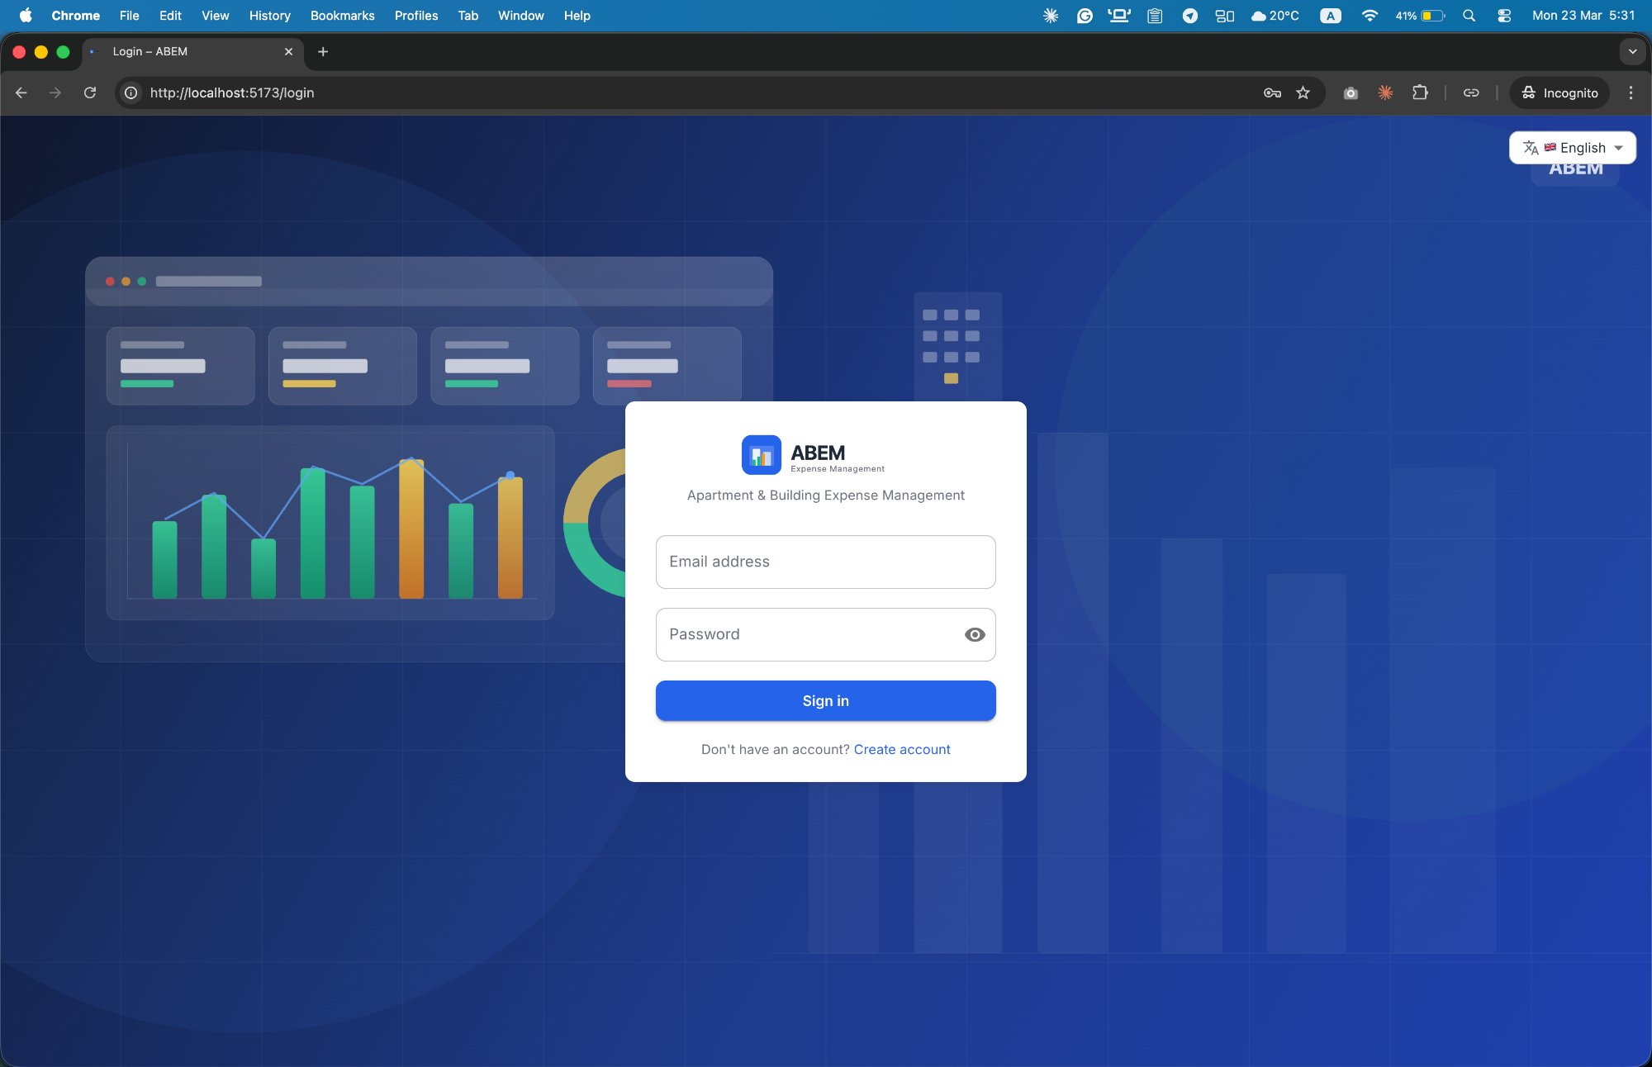
A
Platform at a Glance
Multi-Tenant SaaS
2 User Roles
Manage unlimited buildings
Admin & Owner with RBAC
ABEM
4 Split Types
Bilingual
Apartment & Building
Expense Management
Flexible expense distribution
English & Arabic (RTL)
Full Audit Trail
Web + API
Application Workflow Overview
Every action logged
React 18 + Django REST
Version 3.1 | March 2026

Slide 2
System Architecture
A
Technical Overview
How ABEM is Built
Request Flow
A layered, API-first architecture with stateless backend and horizontally scalable services.
Browser / Client
Web Client
Application API
React 18 + MUI v5
Django 4.2 + DRF
JWT Auth Middleware
RBAC Permission Check
Data Layer
Task Queue
PostgreSQL 16
Celery + Redis 7
DRF View / Serializer
File Storage
Auth & Security
PostgreSQL Query
Cloudinary
SimpleJWT + RBAC
Celery Async Task
JSON Response
🐳 Docker Compose — Full stack in one command

Slide 3
User Roles & Access Control
A
Security Layer
Two Roles. Clear Boundaries.
RBAC enforced at API layer via permission classes. JWT payload embeds role and user ID.
👑 ADMIN
🏠 OWNER
✓ Full building CRUD (multi-building)
✓ Manage all units & invite owners
✓ Create / edit / delete expenses
✓ Record payments & generate receipts
✓ View admin dashboard & analytics
✓ Manage all users (create, activate)
✓ Broadcast announcements
✓ View full audit log & export data
✓ Manage building assets & sales
✓ Configure expense categories
✓ View own building & unit (read-only)
✓ View shared expenses + own share
✓ View own payment history
✓ Download own PDF receipts
✓ View owner dashboard & charts
✓ Send direct messages
✓ View own in-app notifications
✓ Claim unit via registration code
✓ Update own profile & picture
✓ Change password
🔒 JWT HS256 • 15-min access token • 7-day refresh token • Blacklist on logout • Account lockout after 5 failed attempts (HTTP 423) • TLS 1.2+ enforced

Slide 4
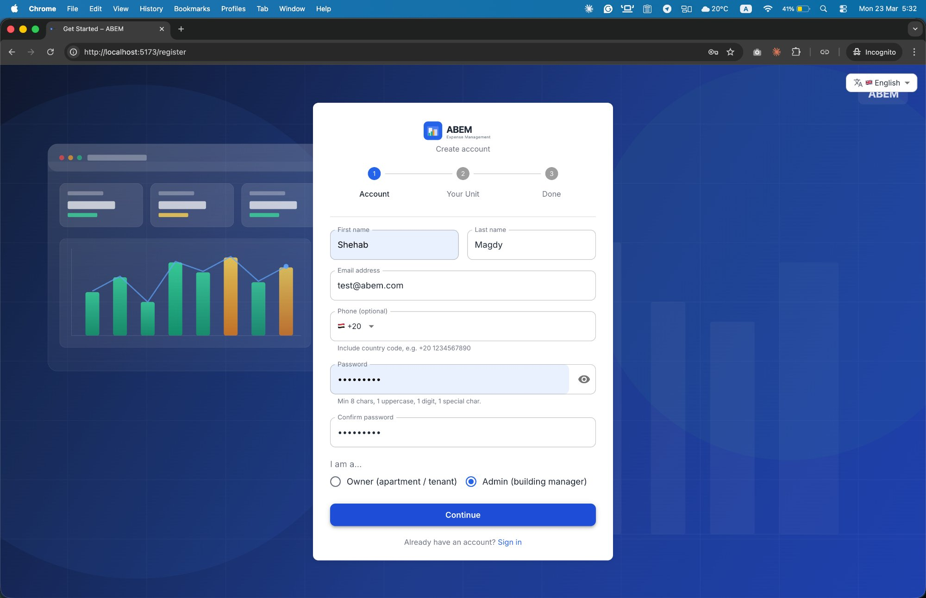
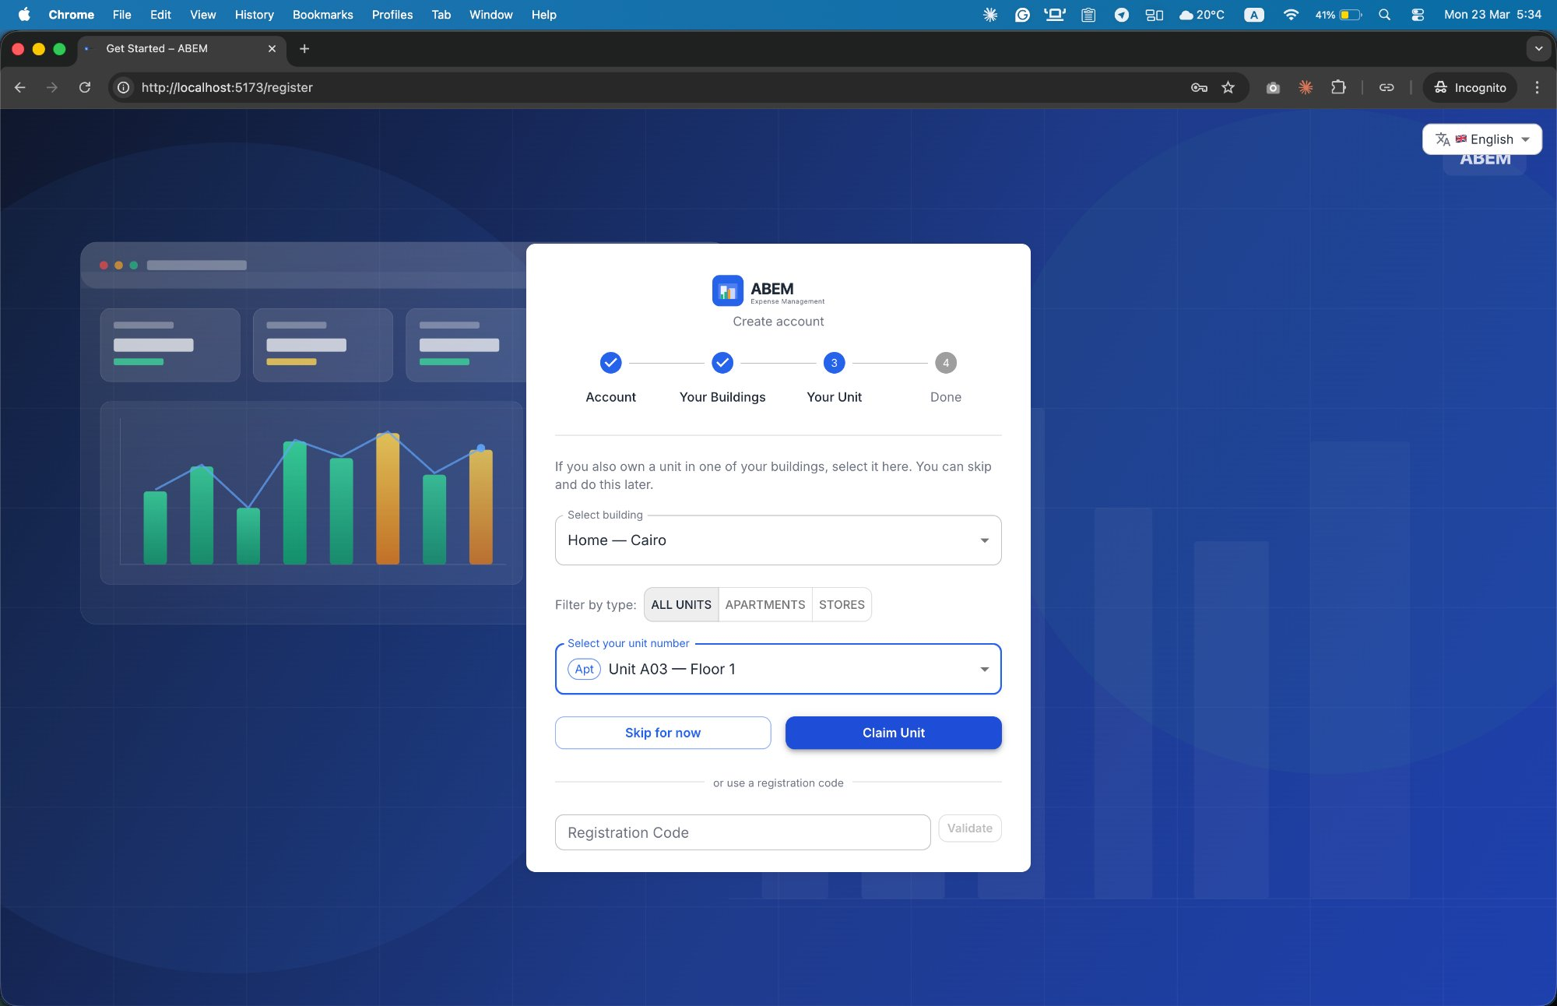
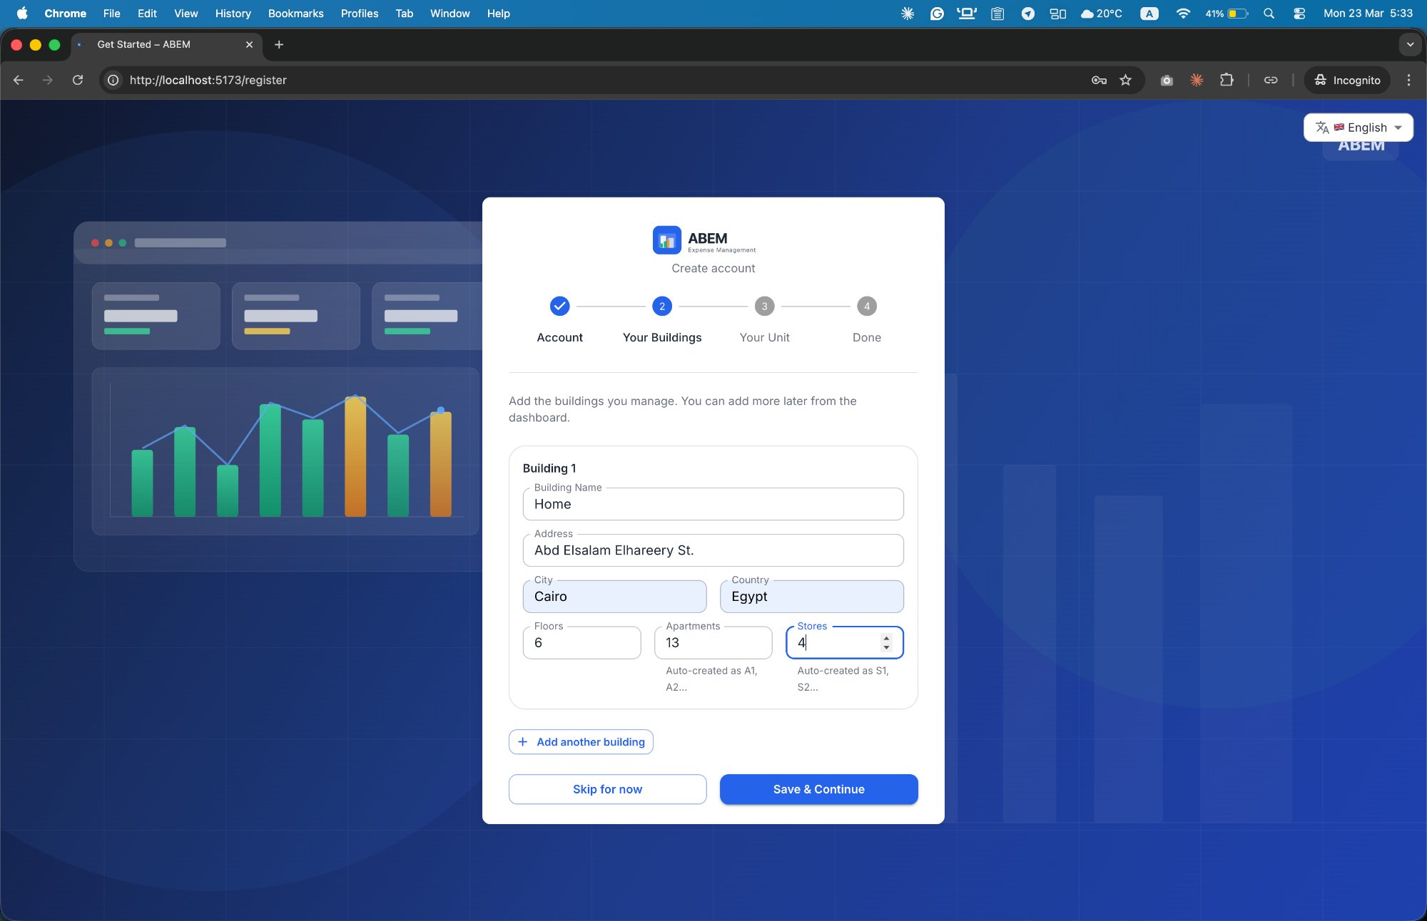
Workflow 1: User Registration & Onboarding
A
3 Self-Registration Paths
🔐 Invite-code path: one-time 8-char alphanumeric code • 30-day expiry • Single-use token • Multiple owners supported per unit via M2M
Owner Path
Admin Path
Invite-Code Path
1
Account Info
(name, email, password)
1
Account Info
+ Role Selection
1
Click Invite Link
(email pre-filled)
Select Building
+ Claim Unit
2
Define Buildings
(auto-creates units)
Complete
Account Info
2
2
Done → Dashboard
3
Optionally Claim
Own Unit
Auto-Claim
Invited Unit → Done
3
3
4
Done → Dashboard

Slide 5
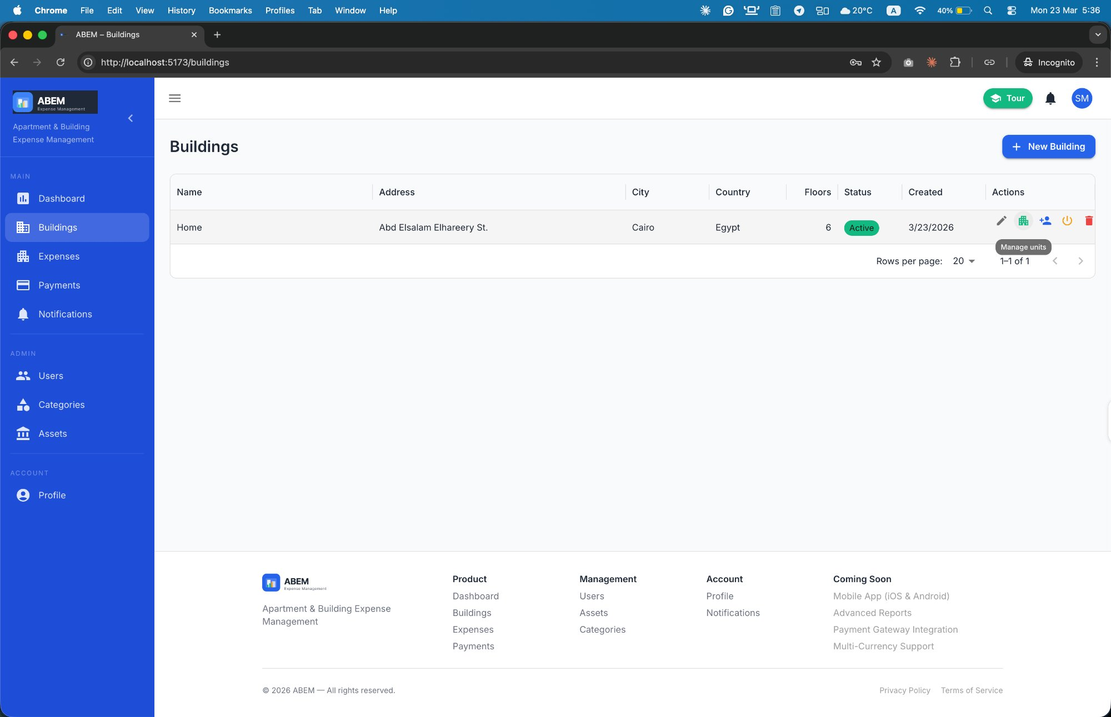
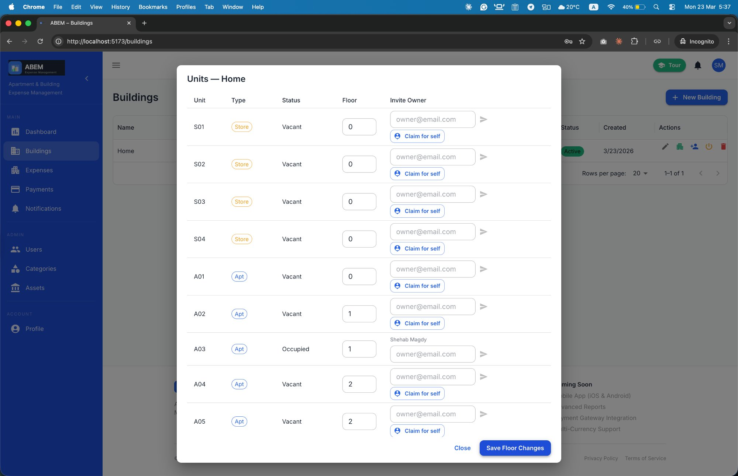
Workflow 2: Building & Unit Setup
A
Admin Configuration
Create Building
1
Name, address, floors, # apartments, # stores
Auto-Unit Generation
2
System creates A01, A02… & S01, S02… distributed across floors
Assign Co-Admins
3
Add additional admin users to share management duties
Buildings List — Manage buildings
Invite Owners
4
Enter email → system sends invite link + 8-char code
Owner Claims Unit
5
Via invite link or entering code in dashboard
Manage Units Dialog — Invite owners per unit

Slide 6
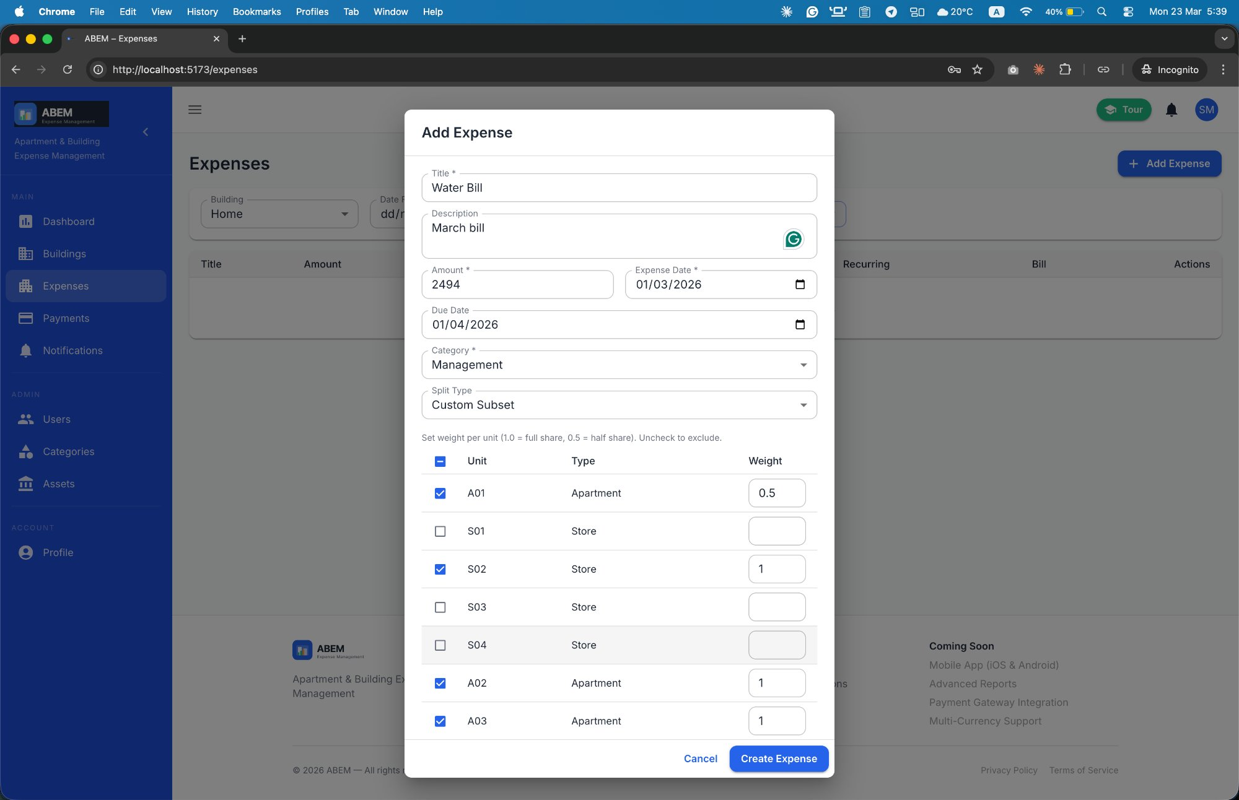
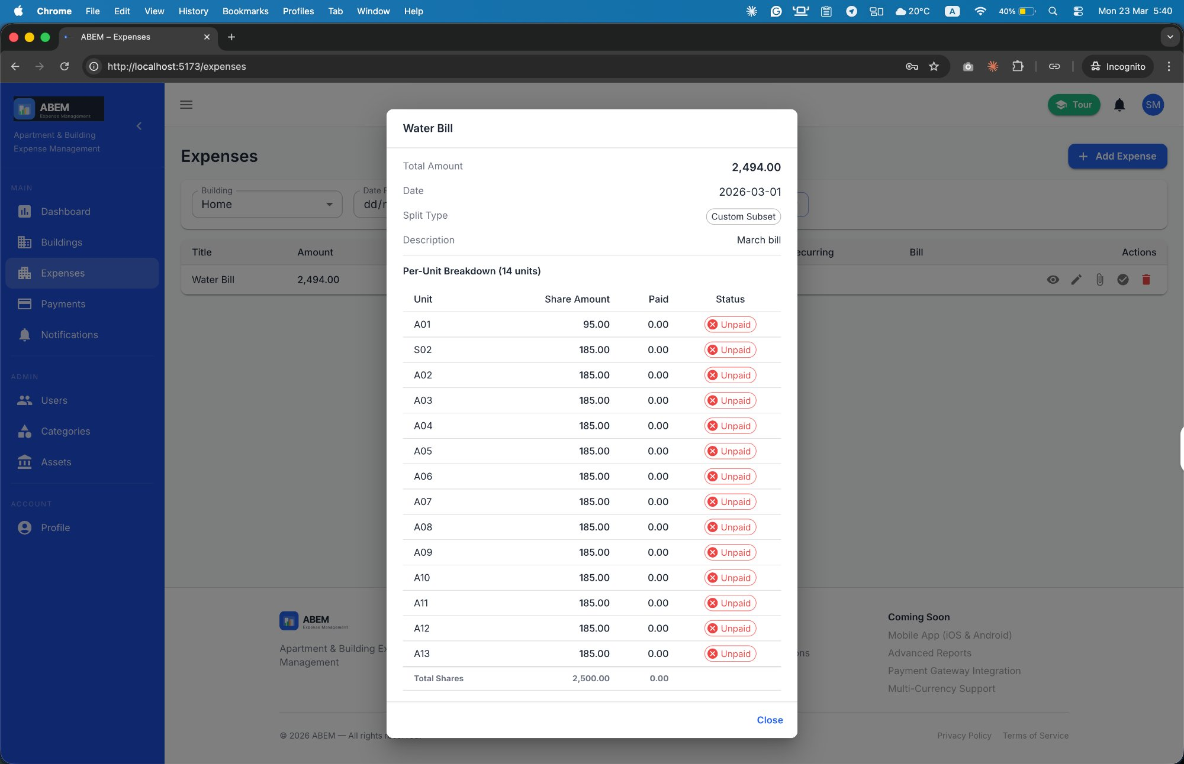
Workflow 3: Expense Management
A
Split Engine & Categories
4 Expense Split Types
Equal — All Units
Apartments Only
Stores Only
Custom Subset
Divided equally across all apartments & stores
Only apartment-type units pay this expense
Only store-type units receive a share
Select specific units & assign decimal weights (e.g. 0.5 = half share)
⚠ Rounding Rule: Every computed share is rounded UP to the nearest 5 EGP (e.g. 22.01 → 25.00 · 26.00 → 30.00) Total shares may exceed original expense amount.
Add Expense — Custom Subset split with weights
Expense Detail — Per-unit share breakdown

Slide 7
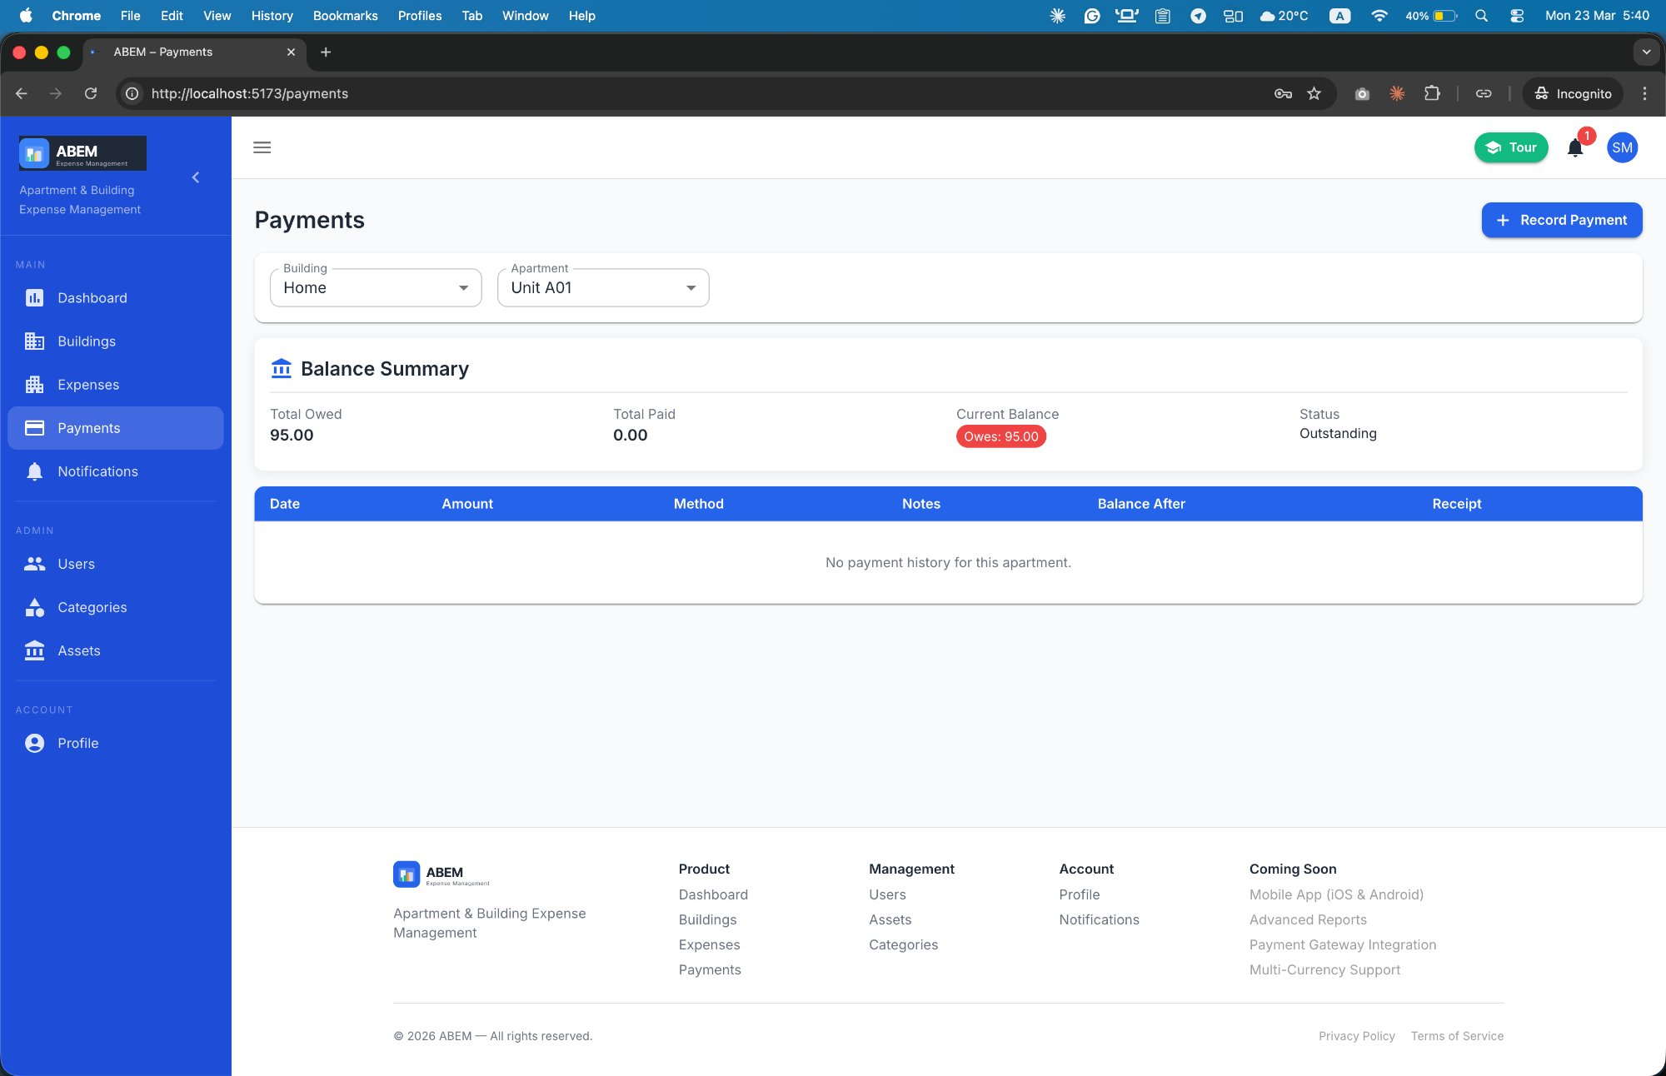
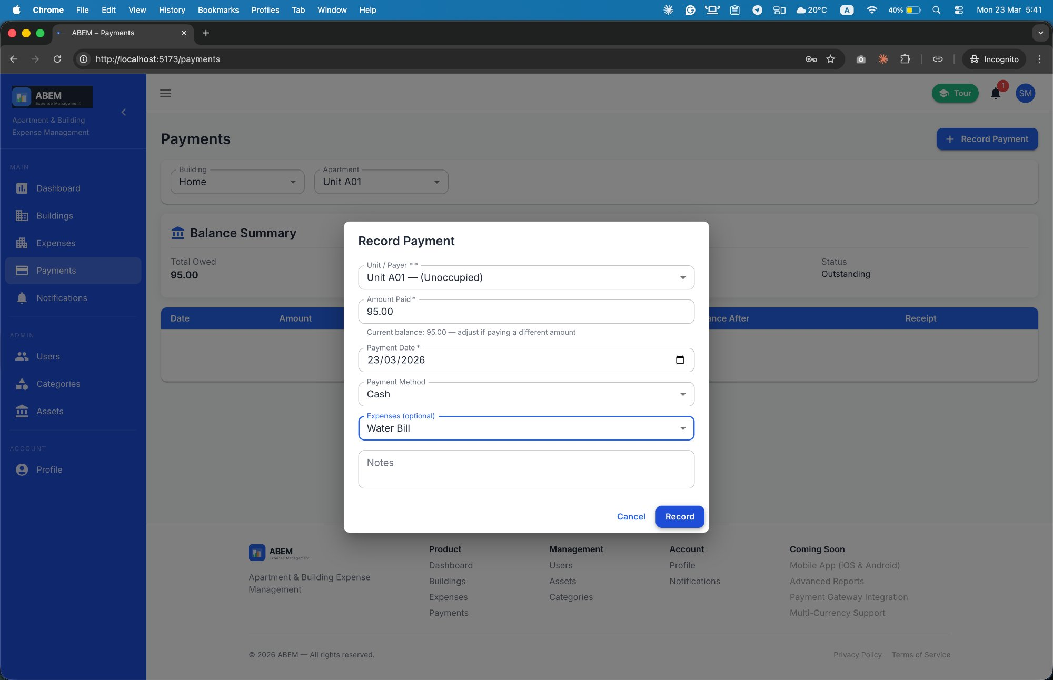
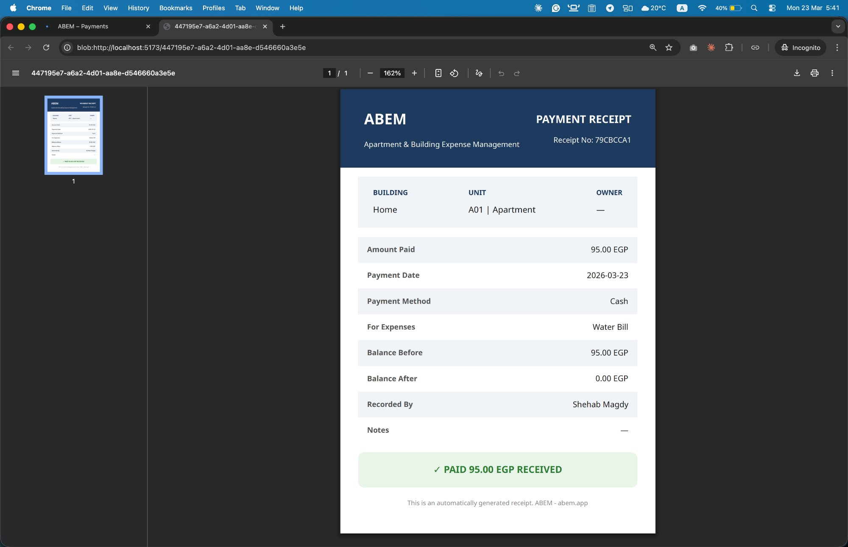
Workflow 4: Payment Recording & Receipts
A
Immutable Ledger
Payment Recording Flow
1
Admin selects unit + enters amount paid
2
Optionally links to specific expense(s)
3
Chooses payment method: Cash / Bank / Cheque / Wallet
Payments Page — Balance summary per unit
4
SELECT FOR UPDATE locks apartment row — atomic update
5
balance_before & balance_after snapshots stored
6
Apartment balance decremented — negative = credit/overpayment
Record Payment Dialog
7
PDF receipt generated via WeasyPrint (bilingual)
Balance States
Settled
Outstanding
Credit (Overpaid)
Auto-generated PDF Receipt

Slide 8
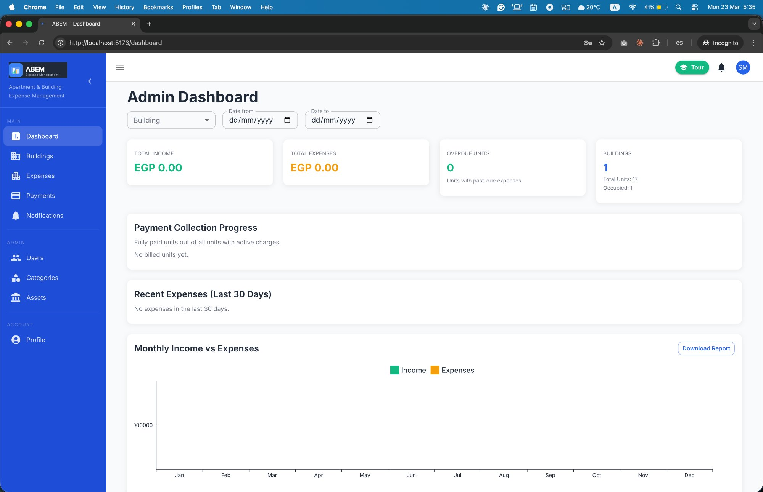
Workflow 5: Dashboards & Analytics
A
Real-Time Financial Insights
👑 Admin Dashboard
Total Income / Total Expenses cards
Overdue Accounts count (click → Buildings)
Building summary: units, occupied, vacant
Payment Coverage progress bar
Monthly Income vs Expenses bar chart (12 months)
Outstanding Balances sortable table
Filter by building & date range
🏠 Owner Dashboard
Personal balance summary card (Settled / Owed / Credit)
Recent expenses for own unit
Recent payments list
Expense breakdown pie chart by category
Claim unit section (enter registration code)
Filter by date range + Download Report
Admin Dashboard — Full financial overview

Slide 9
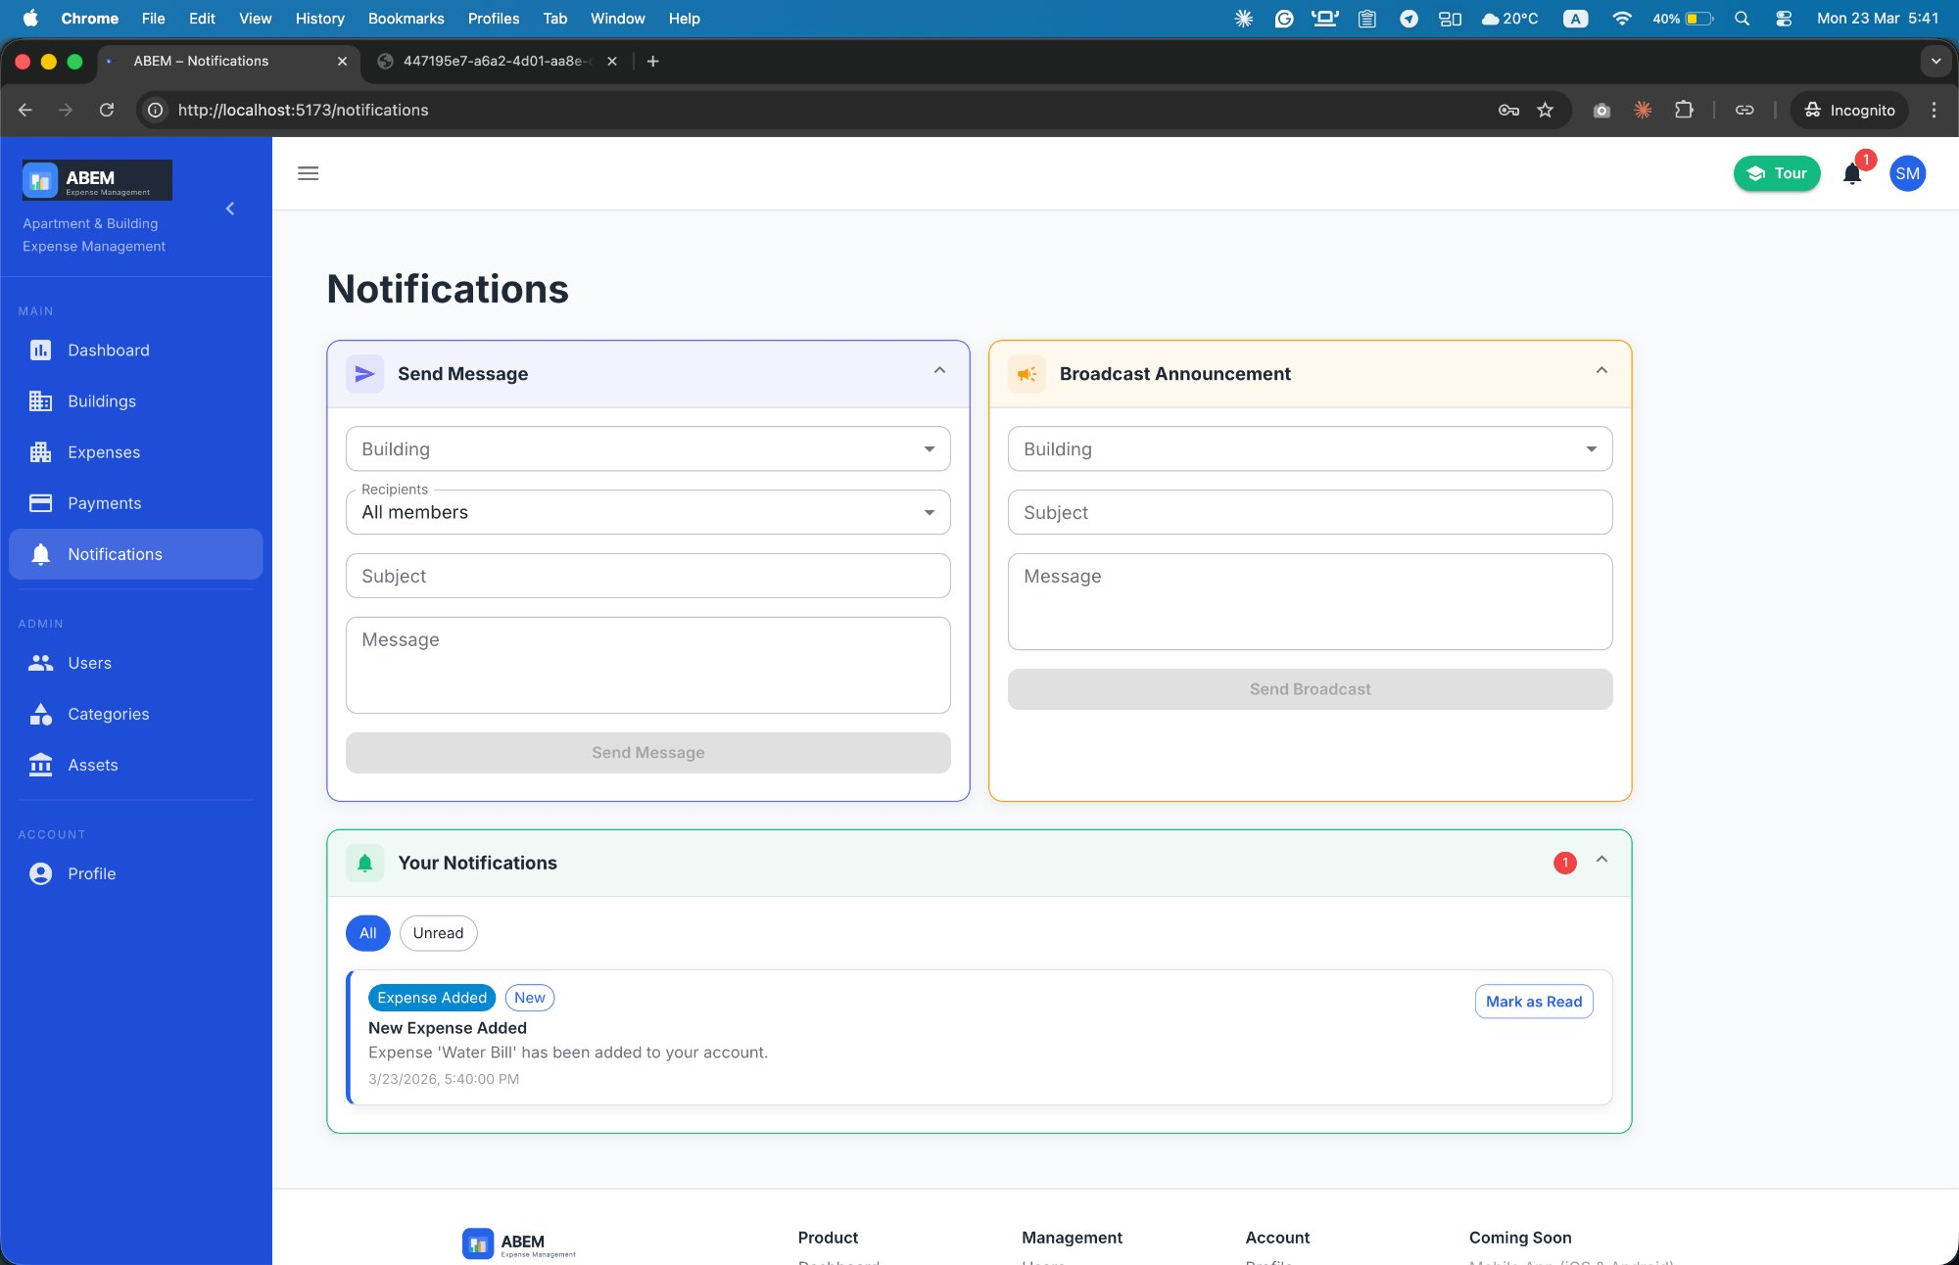
Workflow 6: Notifications & Messaging
A
In-App Communication
Notification Triggers
Expense Added
Payment Confirmed
Auto-notifies all affected unit owners
Notifies owner on payment recording
Payment Due
Payment Overdue
Scheduled 3 days before due date
Day after missed due date
Announcement
Direct Message
Admin broadcast to all building owners
All / Admins / Owners / Specific person
Messaging Restrictions (Admin-controlled)
messaging_blocked → user cannot send any messages
individual_messaging_blocked → direct messages blocked only
Notification Center Layout (Accordion Panels)
Send Message (indigo) • Broadcast Announcement (amber, admin only) • Your Notifications (green)
Notification Center — Send, Broadcast & Inbox

Slide 10
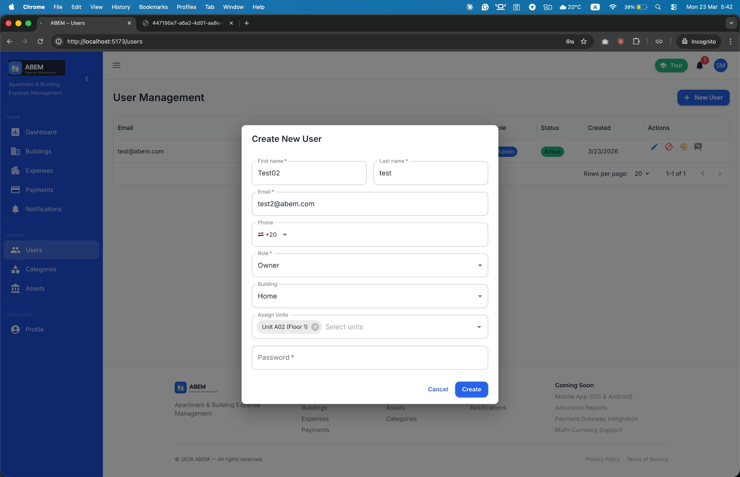
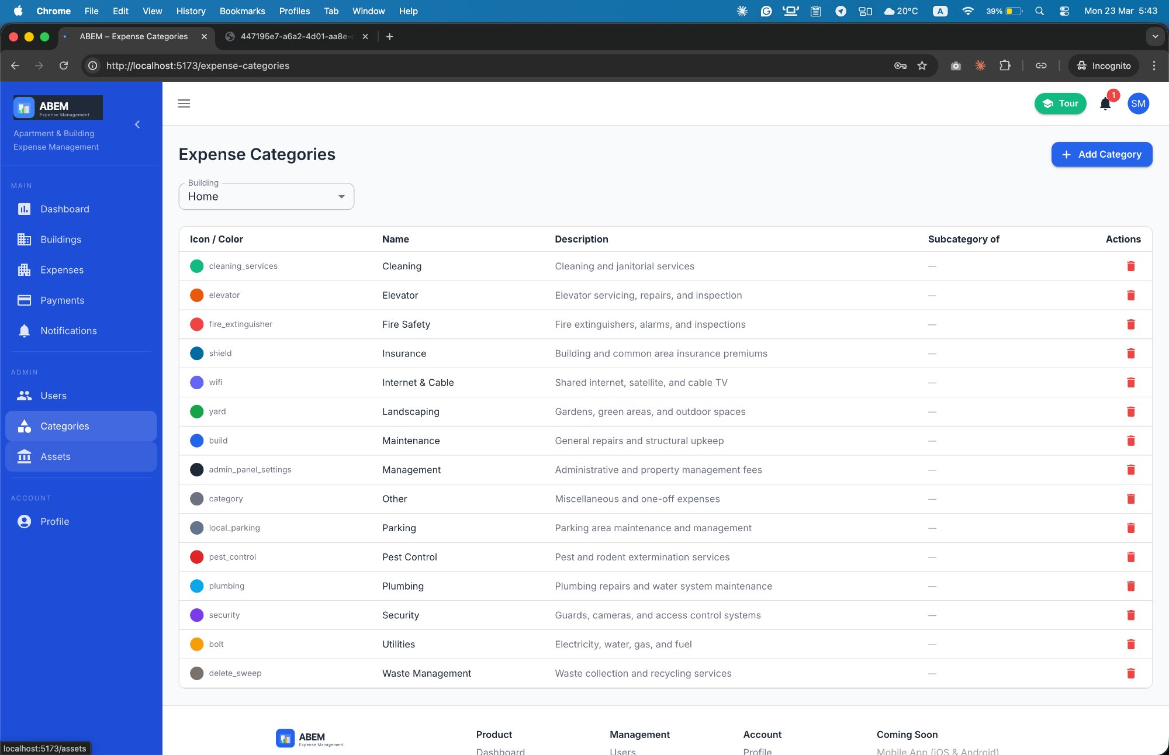
Workflow 7: User Management & Categories
A
Admin Configuration Tools
User Management
Expense Categories
Admin Creates User
User Lifecycle
15 Default Categories auto-created per building:
Maintenance · Utilities · Cleaning · Security · Elevator · Plumbing · Internet & Cable · Parking · Landscaping · Pest Control · Fire Safety · Waste Management · Insurance · Management · Other
Set role (Admin or Owner)
Assign to building
Assign to specific unit(s)
Set initial password
Activate / Deactivate accounts
Reset password (admin-initiated)
Forced password change on next login
Account lockout after 5 failures
Fully Configurable
Per-building (not global)
Custom icon (Material icon name)
Custom hex color
Parent/subcategory — one level deep
User Management — Create user with role & unit assignment
Expense Categories — 15 defaults with icon & color

Slide 11
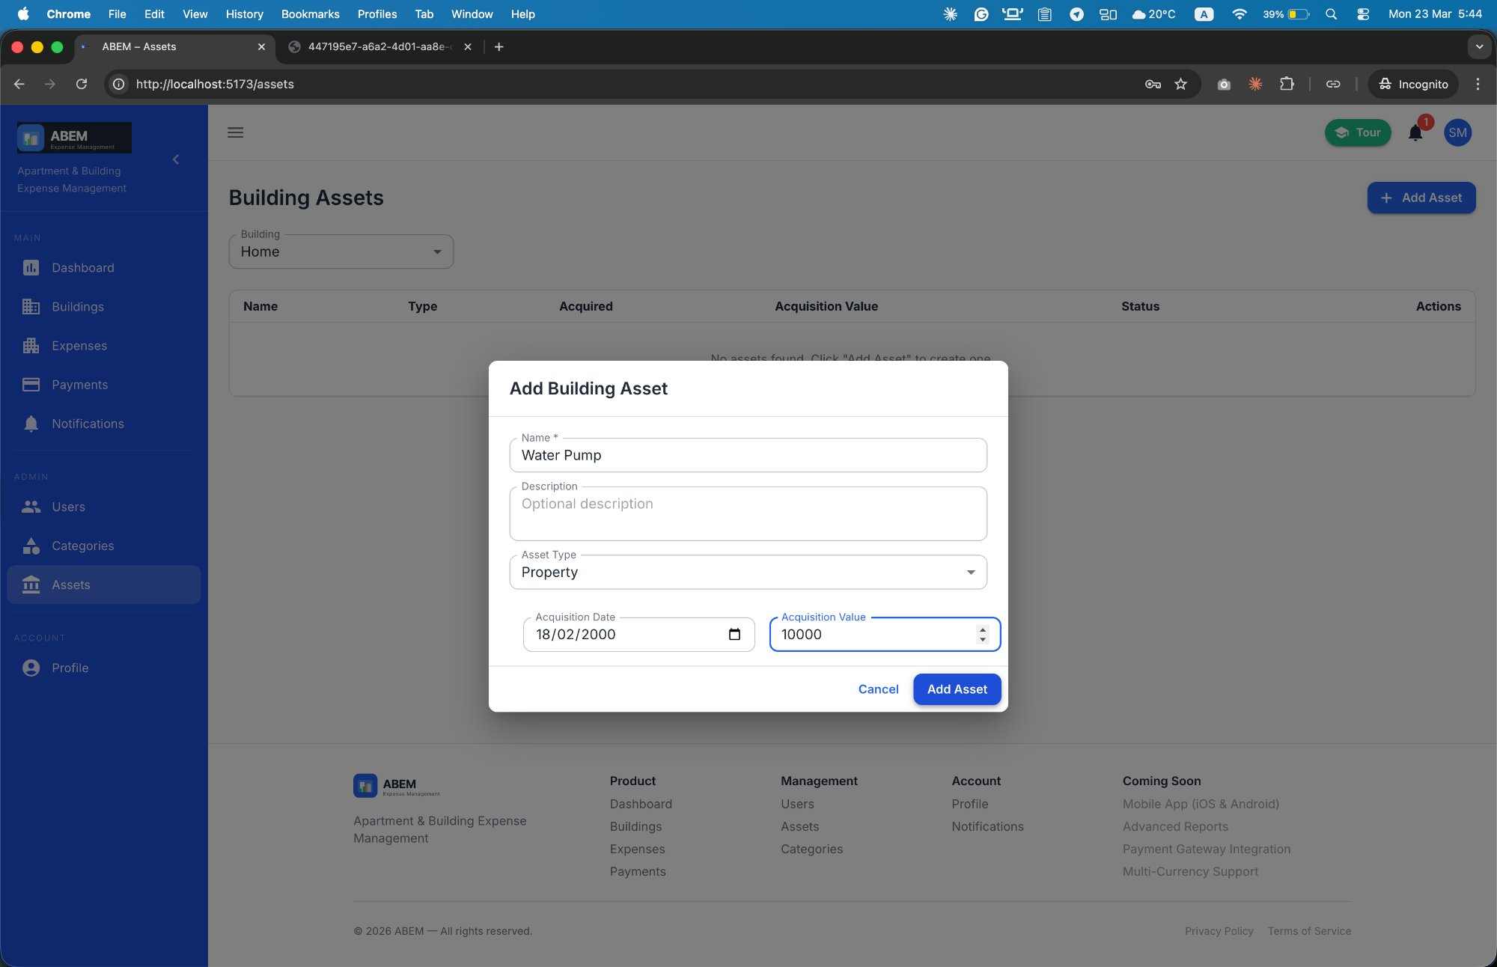
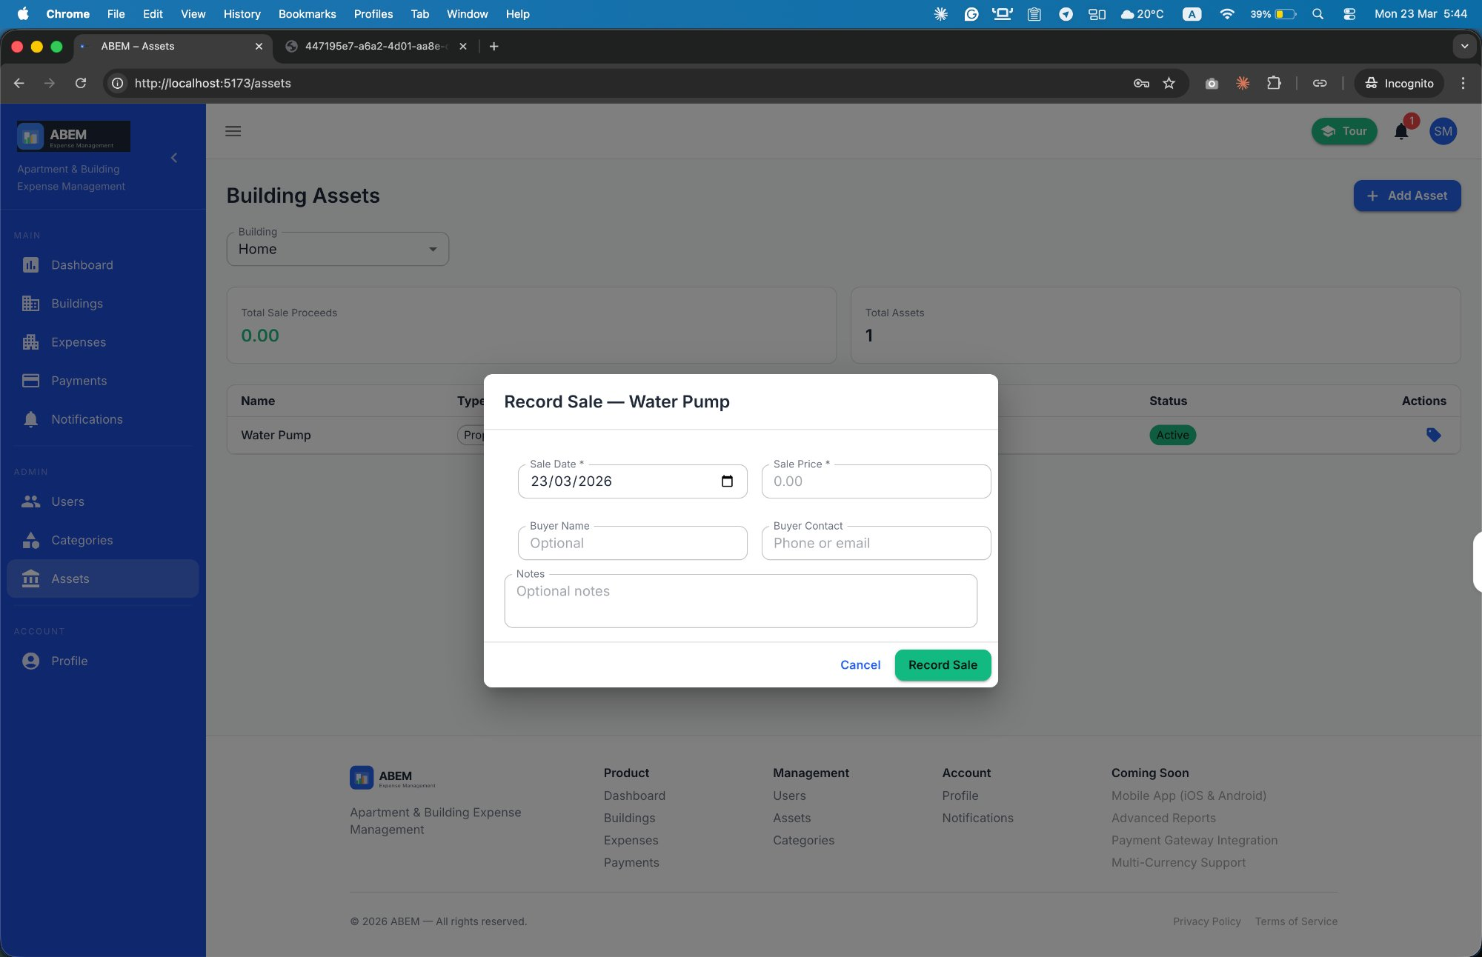
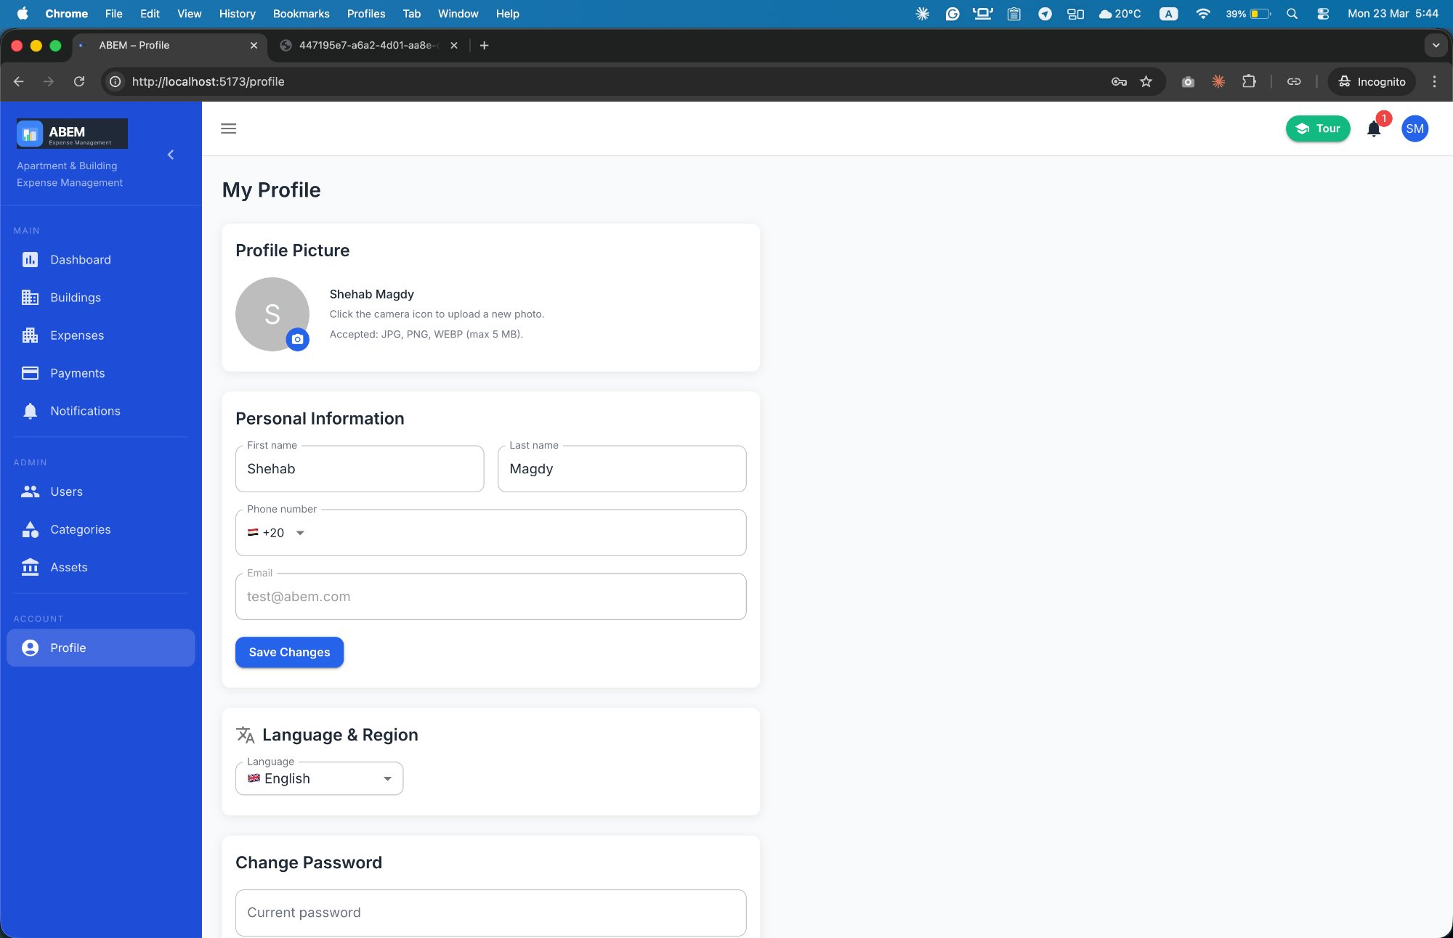
Workflow 8: Building Assets & User Profile
A
Asset Register & Account Settings
Building Asset Management
User Profile & Settings
Asset Register
Profile Management
Name, type (Vehicle, Equipment, Furniture, Electronics, Property, Other)
Acquisition date & value
Status: Active or Sold
Update name, phone number
Profile picture upload (JPG/PNG/WEBP, max 5 MB)
Stored in Cloudinary
Record Sale (Immutable)
Language & Security
Sale date, price, buyer name & contact
is_sold = True after recording — cannot be reversed
Summary: Total Sale Proceeds + Total Assets
Language preference: English / Arabic (persisted to DB)
Syncs across all devices via usePreferredLanguage hook
Change password (requires current password confirmation)
Session expiry warning 30s before token expiry
Add Asset Dialog
Record Sale Dialog
My Profile — Personal info, language & password

Slide 12
Security Architecture & Audit Trail
A
Enterprise-Grade Protection
Security Layers
🔑 JWT HS256
🛡️ RBAC
🔒 Account Lockout
🏢 Multi-Tenant
15-min access + 7-day refresh
Blacklist on logout
IsAdminRole / IsAuthenticated
Enforced at API layer
5 failed attempts → HTTP 423
Configurable cooldown
Isolation via UserBuilding
No cross-tenant data leaks
⚡ Atomic Payments
🔐 OWASP Top 10
🌐 HTTPS / TLS 1.2+
⏱️ Rate Limiting
SELECT FOR UPDATE
Race condition prevention
SQL injection via ORM
XSS via React escaping
File type whitelist
PBKDF2 password hashing
CORS configured origins
Secrets in env vars
django-ratelimit on auth
429 after threshold exceeded
📋 Audit Log — Every Write Operation Recorded
Fields captured: acting user · action label · entity type · entity UUID · before/after JSON diff · IP address · user agent · timestamp
create • update • delete • login • logout • lockout
activate • deactivate • reset_password • expense.marked_paid • payment.recorded • user.buildings_assigned

Slide 13
Technology Stack
A
Full-Stack Reference
Frontend
Backend
Database
Infrastructure
React 18 + Vite
Material-UI v5
Zustand (state)
React Router v6
Axios + AbortController
i18next (14 namespaces)
stylis-plugin-rtl
Django 4.2
Django REST Framework
SimpleJWT auth
drf-spectacular (OpenAPI)
Celery + Celery Beat
Redis 7 (broker)
WeasyPrint (PDF)
PostgreSQL 16
DECIMAL(10,2) for money
UUID primary keys
Soft-delete pattern
SELECT FOR UPDATE
Targeted DB indexes
Append-only audit logs
Docker + Docker Compose
Cloudinary (media)
GZip compression
WhiteNoise (static)
GitHub Actions CI/CD
ESLint v9 flat config
Playwright 300+ tests
🌍 Bilingual (EN / AR · RTL) • Eastern Arabic-Indic numerals for EGP values • Cairo font (AR) / Inter font (EN) • Backend validation errors in requested language

Slide 14
ABEM
Complete Workflow Summary
1
Registration
2
Building Setup
3
Expenses
4
Payments
3 paths: Owner · Admin · Invite
Create → Auto-units → Invite owners
4 split types + rounding + categories
Atomic ledger · PDF receipt · balance
5
Dashboards
6
Notifications
7
Audit & Exports
8
Security
Admin overview · Owner financials
Auto-triggers · Broadcast · DM
Full audit trail · CSV/XLSX export
JWT · RBAC · Lockout · Multi-tenant
© 2026 ABEM • Apartment & Building Expense Management • abem.app

