Slide 1
Reservations Analysis
Omar Tamer

Slide 2
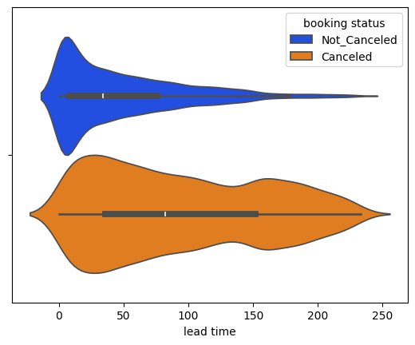
Reservations that has high lead time are more likely to be canceled.

Slide 3
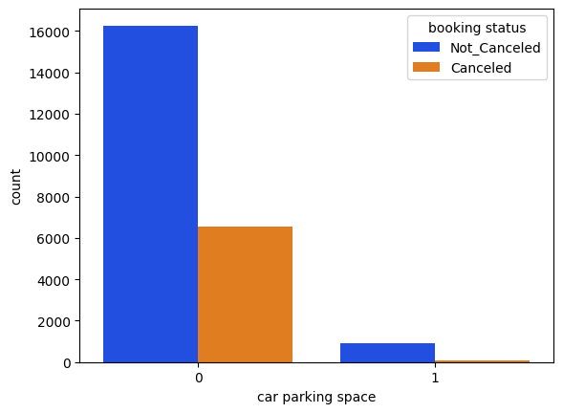
Reservations that has a car parking space are less likely to be canceled.

Slide 4
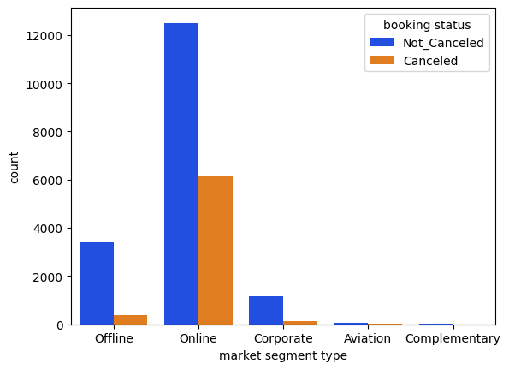
Reservations that are made online are more likely to be canceled than that made offline or by corporate.

Slide 5
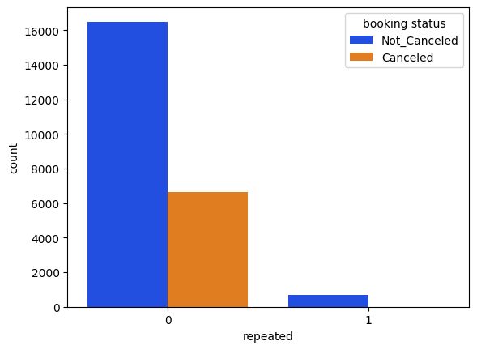
Repeated reservations are less likely to be canceled.

