Slide 1
CELLULA Task 1
PRESENTATION

Slide 2
Meet the team
Habiba El-sayed Mowafy
Omar Mamon Hamed
Mostafa Mohammed elsyed salama *
Ahmed Abdelgleel*

Slide 3
Agenda
Introduction
Data inspections
Data cleaning
Feature Engineering
Correlation matrix
Informative Graphics and Insights

Slide 4
The Power of
Data Preprocessing

Slide 5

Overcoming
Data Challenges

Slide 6
Why Data Preprocessing Matters?
Improves Data Quality – Handles missing values, removes noise, and ensures consistency.
Enhances Model Performance – Well-preprocessed data leads to better accuracy and efficiency.
Reduces Computational Complexity – Helps in faster training and inference.
Enables Better Feature Extraction – Identifies key patterns and relationships.

Slide 7
Data inspections
UNDERSTANDING & REFINING YOUR DATA

Slide 8
EFFECTIVE inspections
initial Data Review - Understand data types, structure, and identify potential issues.
Handling Missing Data - Techniques like imputation, deletion, or using predictive models.
We applied some steps as a start
Read csv file as data frame
Show first n entries to know more about data
Apply functions to explore data size, statistics, and quality, including missing values, duplicates, column types, and number of entries.
Search for unique types in our data

Slide 9
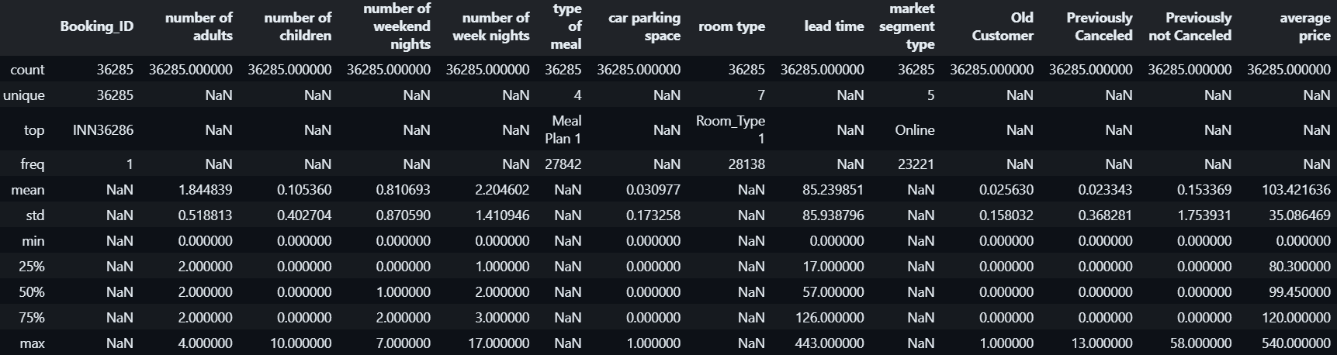
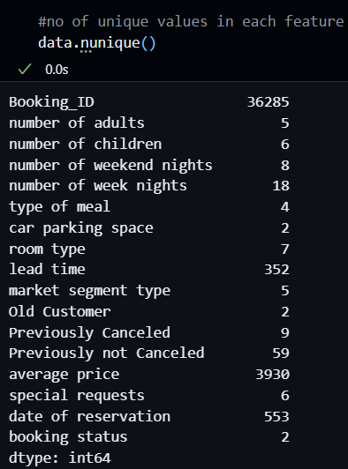
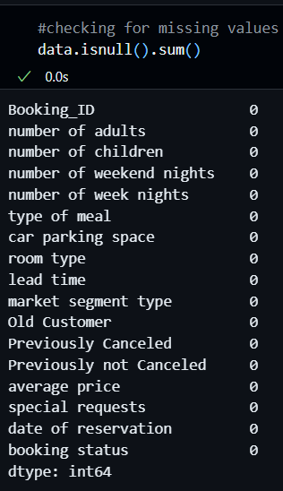
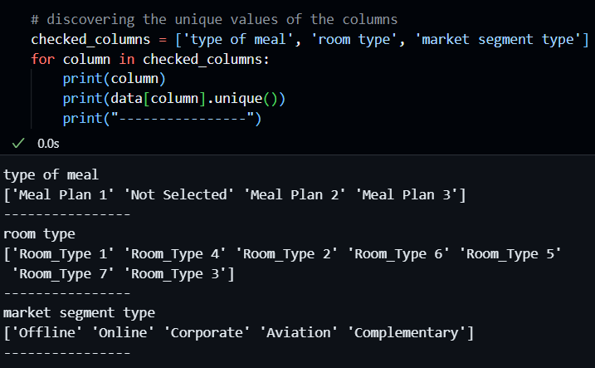
Show Case from our notebook

Slide 10
Data cleaning
CLEANING & OPTIMIZING YOUR DATA

Slide 11
EFFICIENT DATA CLEANING & PREPARATION
Handle Missing Data – Use imputation, deletion, or predictive modeling.
Remove Duplicates – Eliminate redundant entries to ensure data integrity.
Fix Data Inconsistencies – Standardize formats, correct errors, and unify categories.
Handle Outliers – Detect and treat extreme values that may skew analysis.
Normalize & Standardize – Scale numerical features for consistency.

Slide 12
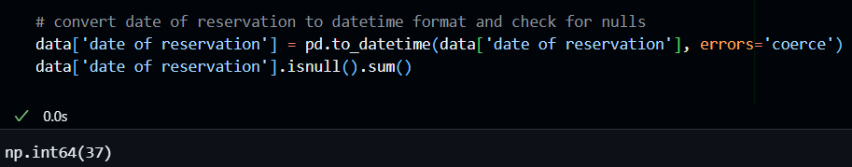
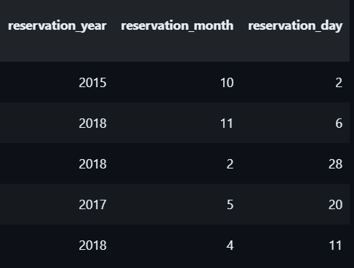

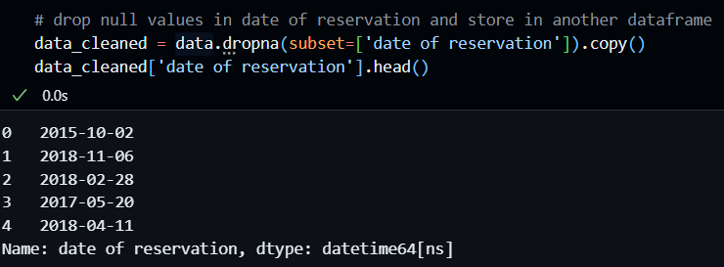
Show Case from our notebook

Slide 13
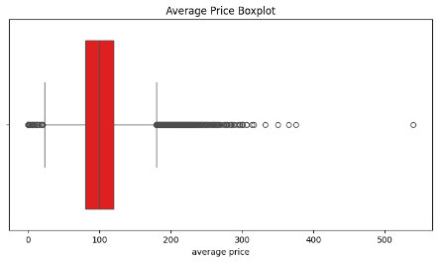
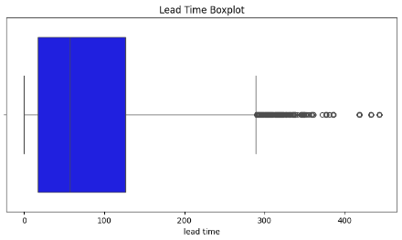
OUTLIERS
Impact on Data – Outliers distort analysis and affect model performance.
Detection – Identify using box plots, scatter plots, Z-score, or IQR.
Handling – Remove, transform, or use robust models to minimize impact.

Slide 14
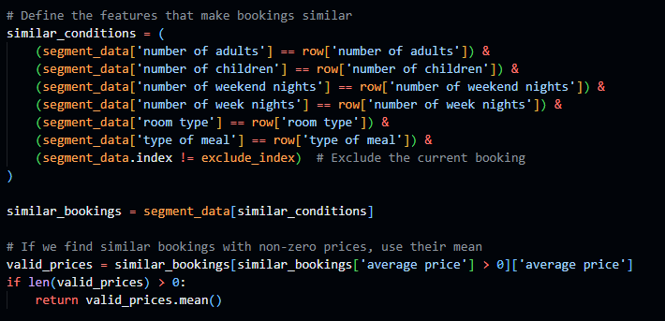
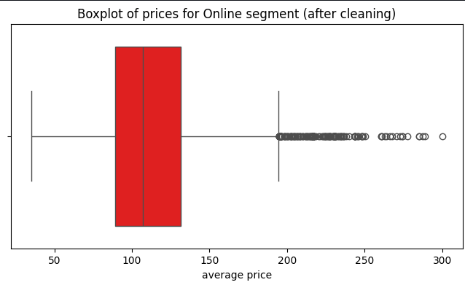
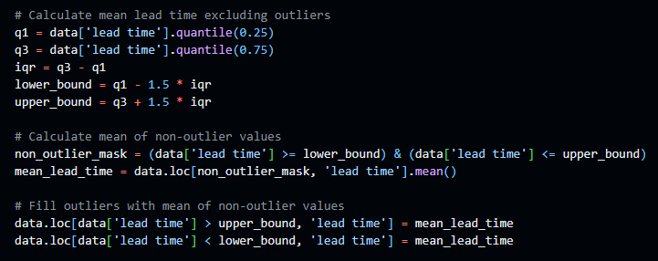
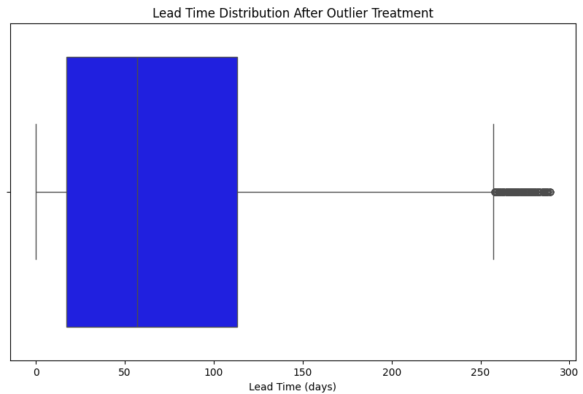
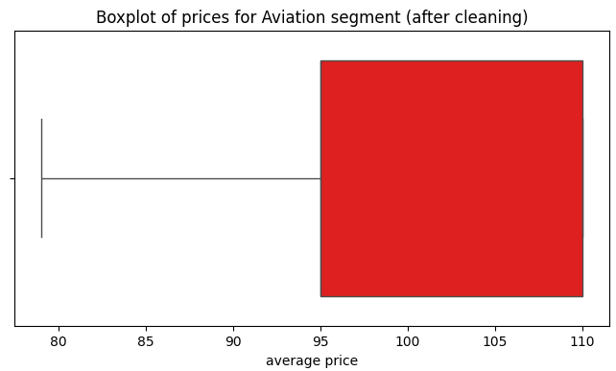
Outliers Handling
Action Taken – Outliers were replaced to reduce their impact.
Result – Data distribution improved, leading to better model performance and reliability.

Slide 15
Feature engineering
Creating and refining features to enhance model performance

Slide 16
Feature engineering & selection
Creating New Features – Derived new features to enhance model performance.
Encoding Categorical Data – Converted categorical variables into numerical representations.
Feature Selection – Identified key variables that contribute the most to model performance.

Slide 17
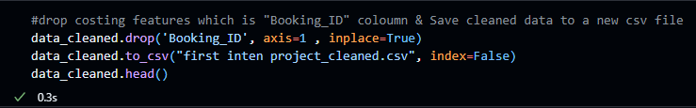




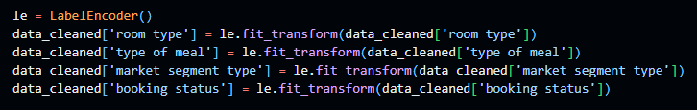

Show Case from our notebook

Slide 18
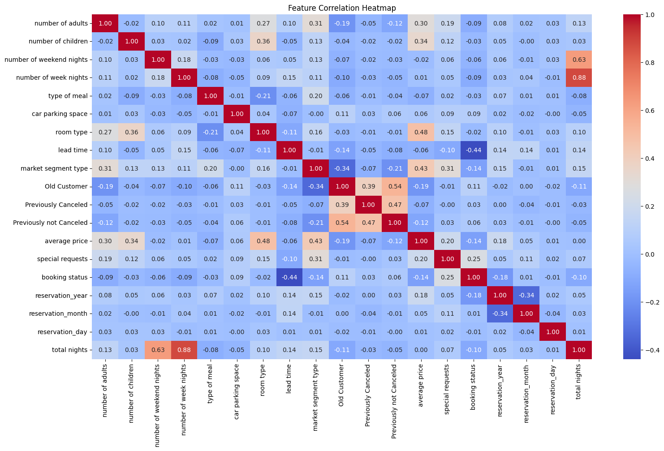
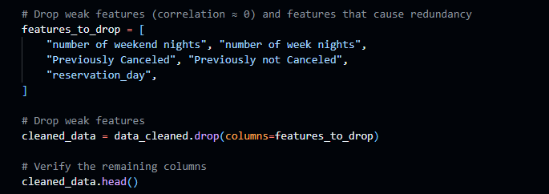
Correlation matrix
Understanding Relationships – Visualized correlations between features to detect dependencies.
Feature Reduction – Removed highly correlated features to prevent redundancy and overfitting.

Slide 19
Visualizations
Graphical representations of data to reveal patterns and insights.

Slide 20
Informative Graphics & Insights
Visualizing Data Trends – Used histograms, scatter plots, and box plots for deeper insights.
Pattern Recognition – Identified key trends and distributions in the data.
Decision Making – Derived actionable insights to improve the preprocessing pipeline.

Slide 21
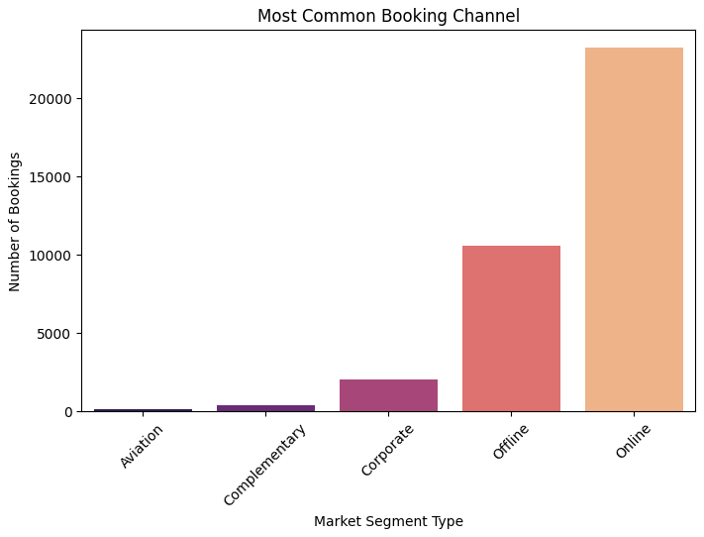
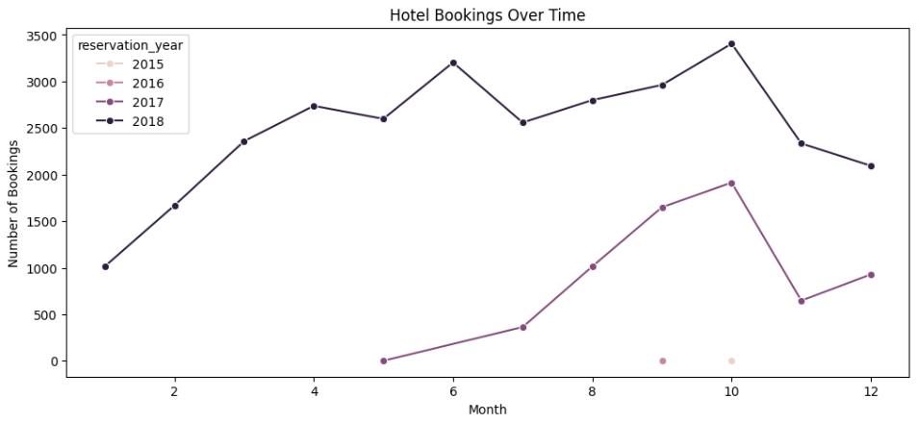
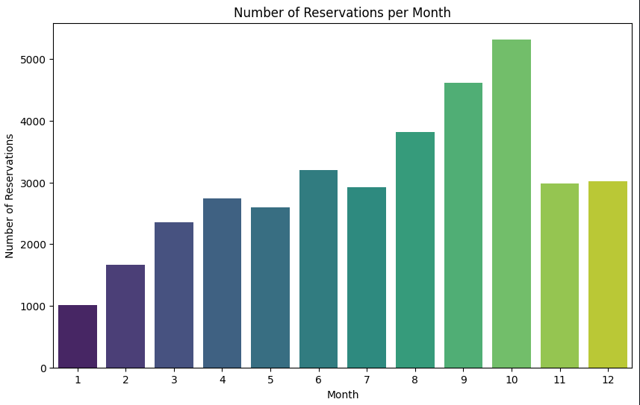
Show Case from our notebook

Slide 22
Show Case from our notebook

Slide 23
Show Case from our notebook

Slide 24
Show Case from our notebook

Slide 25
Show Case from our notebook

Slide 26
Show Case from our notebook

Slide 27
Show Case from our notebook

Slide 28
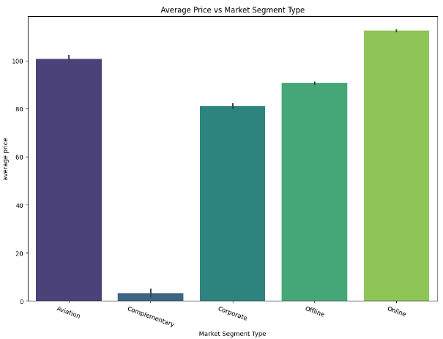
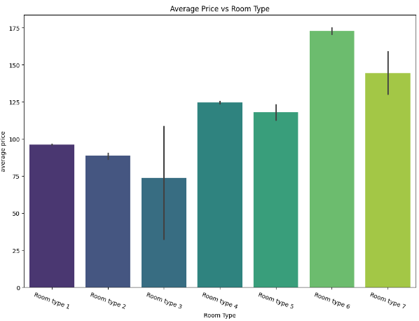
Show Case from our notebook

Slide 29
Show Case from our notebook

Slide 30
Show Case from our notebook

Slide 31
Show Case from our notebook

Slide 32
Show Case from our notebook

Slide 33
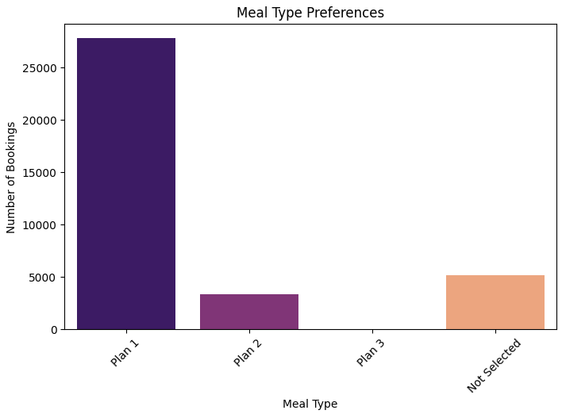
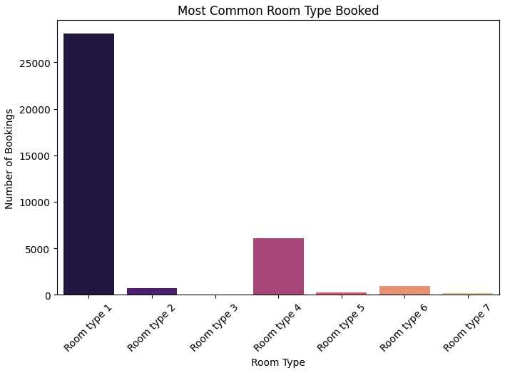
Show Case from our notebook

Slide 34
Conclusion
Effective preprocessing improves data quality, model accuracy, and interpretability.
Applying systematic steps ensures better feature extraction and predictive insights.
Final dataset is now clean, structured, and ready for modeling.

Slide 35
THANK YOU
​Data speaks, and so does our code! 💡🚀 Explore more on GitHub: 🔗 [Habiba Mowafy] | 🔗 [Omar Mamon]
Discover insights on Kaggle:
🔗[Habiba Mowafy] | 🔗 [Omar Mamon]

