Slide 1
Reservation Data Analysis
Machine Learning Training - Task 1

Slide 2
Introduction
The dataset contains reservations data for a hotel with the following characteristics: - Reservation period July-2017 to Dec-2018 - Total number of reservations: 36,285
11,889 of them were cancelled (32%)

Slide 3
Columns exploration

Slide 4
Columns types
ID: booking id
numerical: adults, children, weekend_nights, week_nights, lead_time, average_price, special_requests,P-C,P-not-C
date: reservation date
categorical: meal_type, room_type, market_segment
boolean: parking_space, repeated,, booking_stats

Slide 5
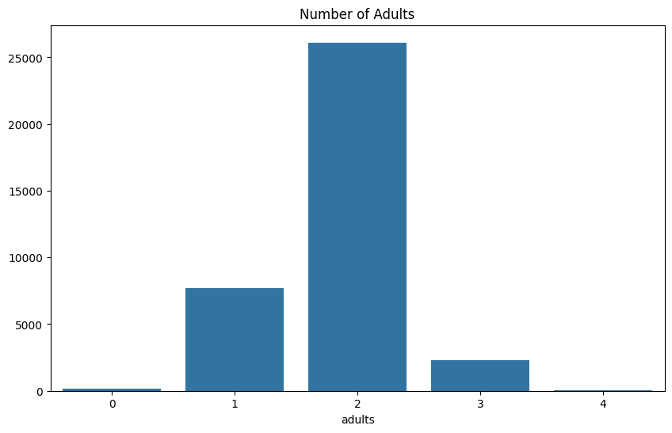
adults
adults count ranges from 0 - 4 adults, with 2 adults as the most frequent

Slide 6
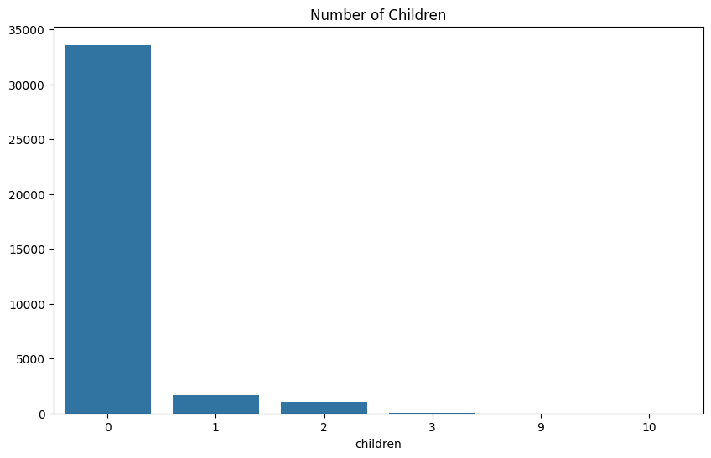
children
children possible values are 1,2,3,9,10,but most reservations has no children

Slide 7
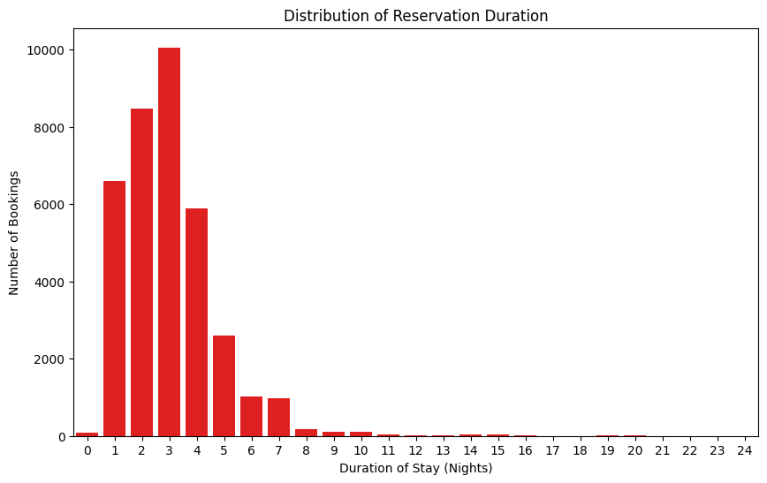
Reservation duration
The duration includes week days and
weekend nights, max duration is
24 days and the most frequent one
is 3 days

Slide 8
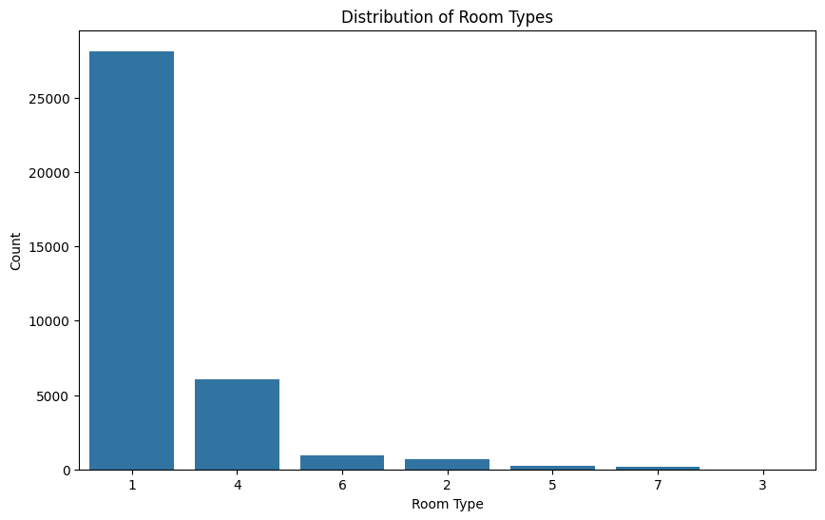
Room types
There are 7 room types,
Most people reserve room type 1

Slide 9
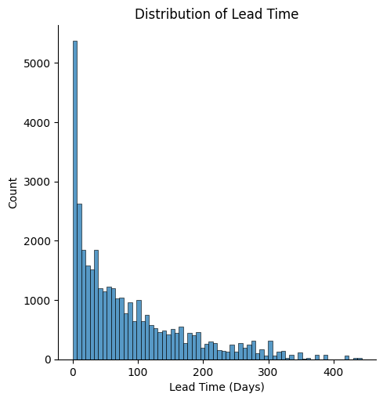
Lead time
Lead time may be the count of days before the reservation will take place, most reservations take place in the same day, with mean days count is 85 days

Slide 10
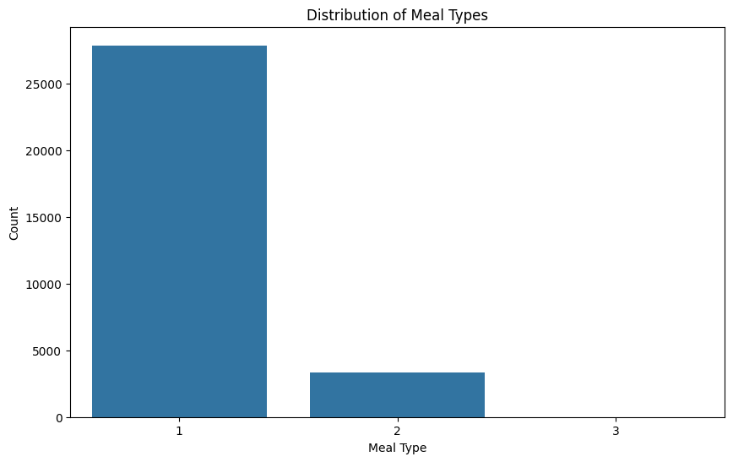
Meal types
There are 3 meals types,
Most people chose meal type 1

Slide 11
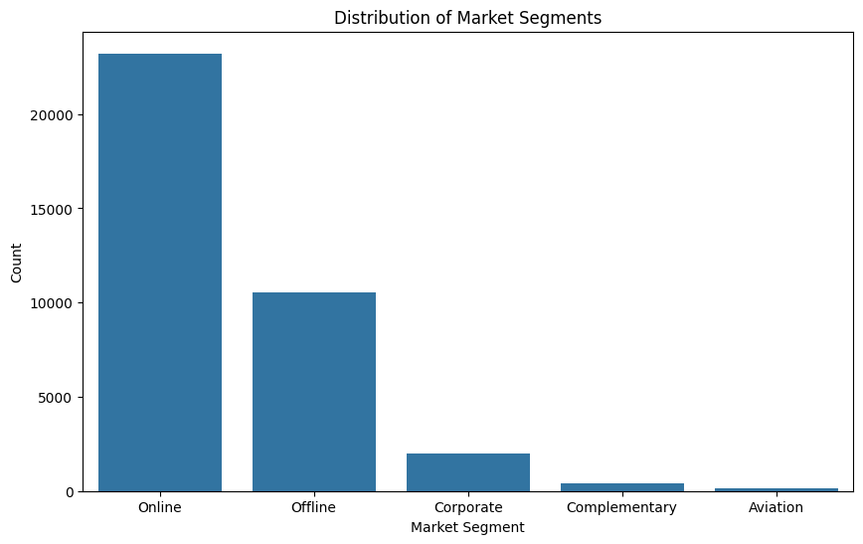
Market segment
There are 5 types of market segments [Online, Offline, Corporate, Complementary, Aviation]
The top segment is the online one

Slide 12
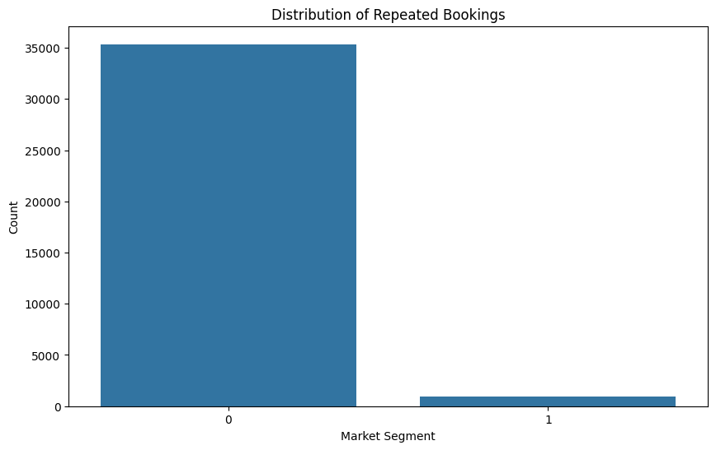
Repeated reservation
The are some reservations are repeated but most of them are not

Slide 13
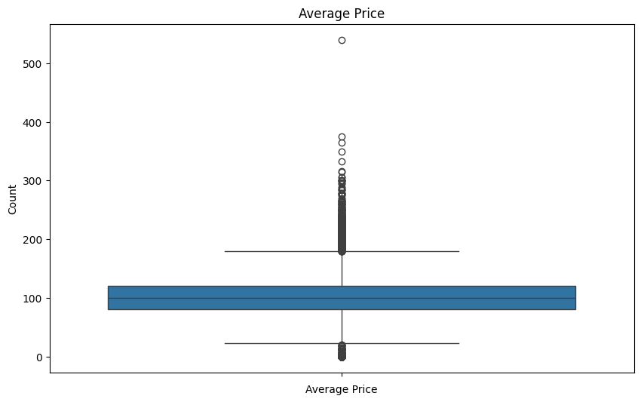
Average price
Average price has a mean of 103, with a lot of outliers

Slide 14
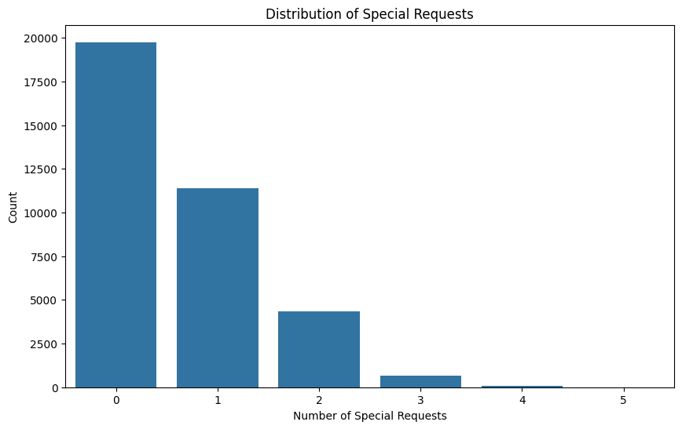
Special requests
Most reservations has no special requests

Slide 15
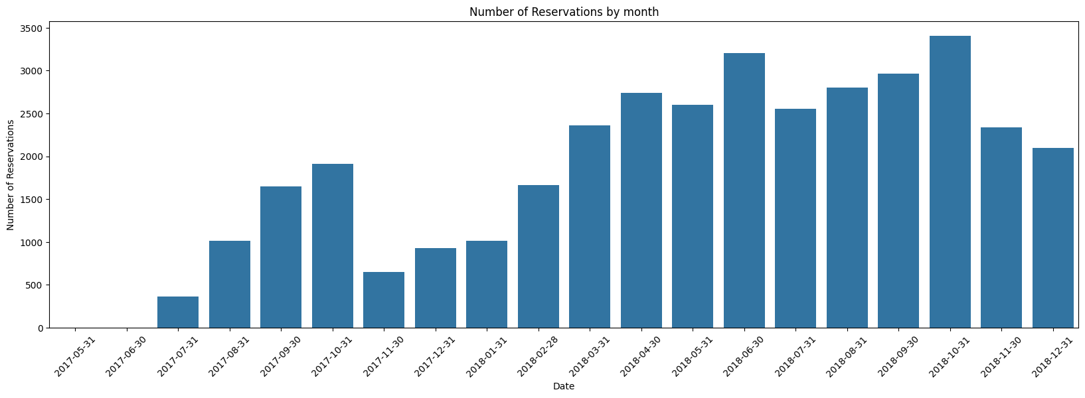
Reservations date

Slide 16
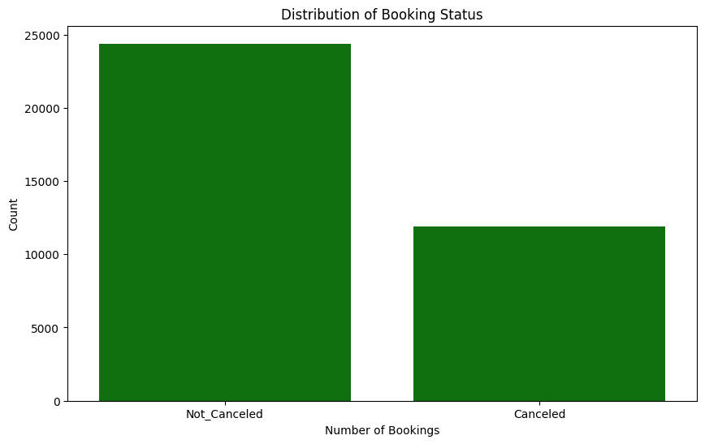
Booking Status

