Slide 1
Exploratory Data Analysis of Hotel Bookings
Mohammed Daif - Allah

Slide 2
CONTENTS
Introduction
Data Understanding
Data Cleaning
Data Analysis

Slide 3
INTRODUCTION
In this task, Our goal is to find relationships and trends between different information about 36285 reservations for a hotel from 2015 to 2018

Slide 4
INTRODUCTION
Key Questions.
Which months have the highest cancellations?
Is number of children correlated with special requests?
Can we predict if cancellation occurs based on week nights?
Do increased number of adults tend to take cheaper rooms ?

Slide 5
Data understanding
Dataset size : 36284 columns X 17 row
Key information:
Average price
Room type
Number of week nights
Number of adults
Number of children
Lead time

Slide 6
Data understanding
Mean of average prices is 103.4$
Maximum number of adults to reserve is 4
Maximum number of children are 10
Maximum number of week nights are 17
Mean of lead time is 85.23
Standard deviation of lead time is 85.93

Slide 7
Data understanding
The most ordered room is Room type 1 with 28138 reservation orders and the least order is Room type type 3 with 7 reservation orders.
People that used car space are 1124 against 35161 that didn’t
Most selected meal plan is 1 with 27842 orders versus least ordered which is meal plan 3 with 5 orders only
33584 people came in with no children

Slide 8
DATA CLEANING
No duplicates existed in the dataset
No null values existed
One error in reservation date handled

Slide 9
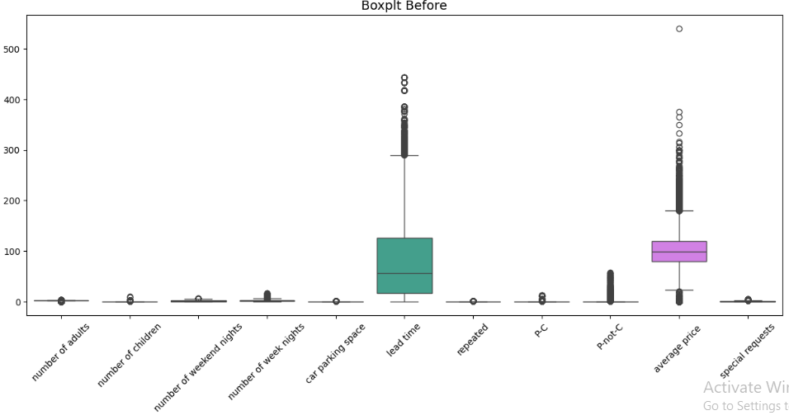
OUTLIER DETECTION
Many outliers existed through the dataset especially in the lead time column.

Slide 10
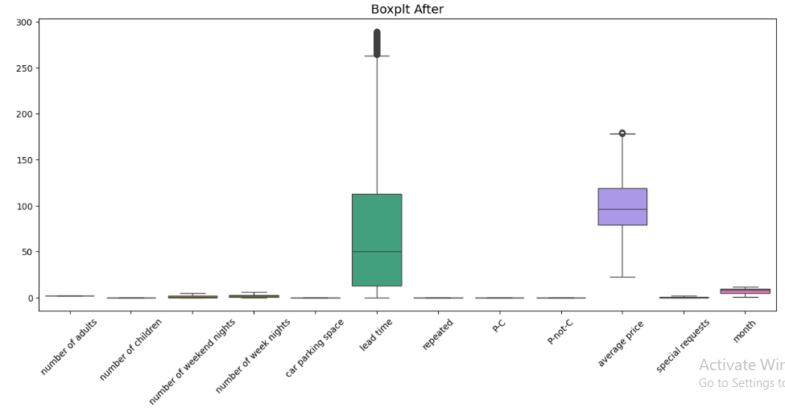
OUTLIER DETECTION
Outlier were handled and replaced.

Slide 11
DATA ANALYSIS
In exploratory data analysis, our aim is to determine trends, relationships, and test our hypotheses about the data.
Discover how data is distributed which gives us insight how to deal with it.

Slide 12
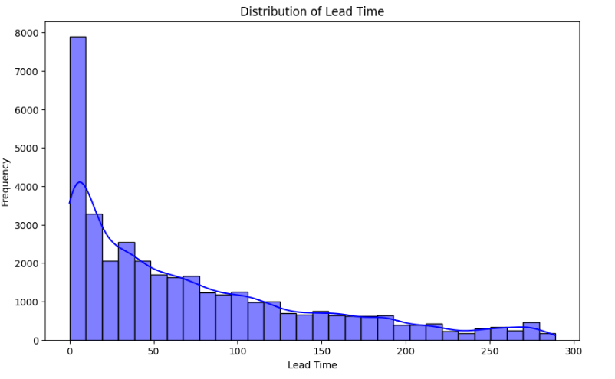
LEAD TIME DISTRIBUTION
Lead time distribution is skewed to the right in which we can conclude that customers come very close to check in after they put on a reservation order
We can see that the mode is 10 with frequency almost 8000 out of all bookings

Slide 13
MORE ADULTS, HIGHER PRICE?
We ask ourselves, what number of adults pay based on their number frequently ? And how many are those adults ?
Are more adults more likely to pay more ?

Slide 14
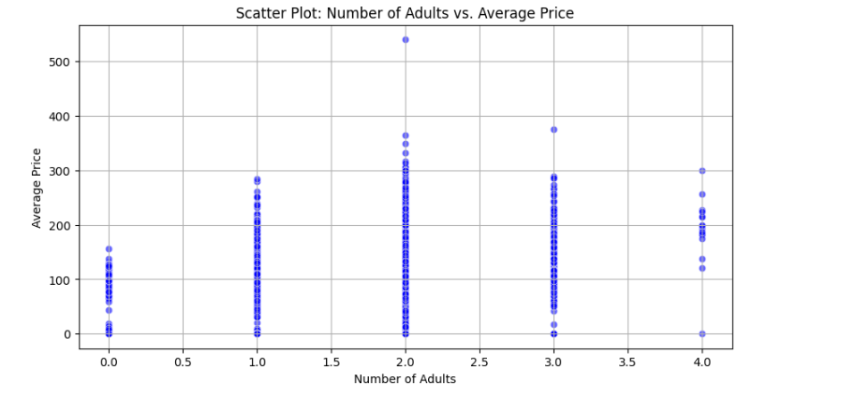
NUMBER OF ADULTS vs AVERAGE PRICE
The most number of adults that book a room is 2 adults, this can make guide us into expanding more room types that gets ordered frequently from 2 adults.
1 and 3 adults come to rent in the hotel
0 adults book more than 4 adult which indicates that the hotel accept children to book.

Slide 15
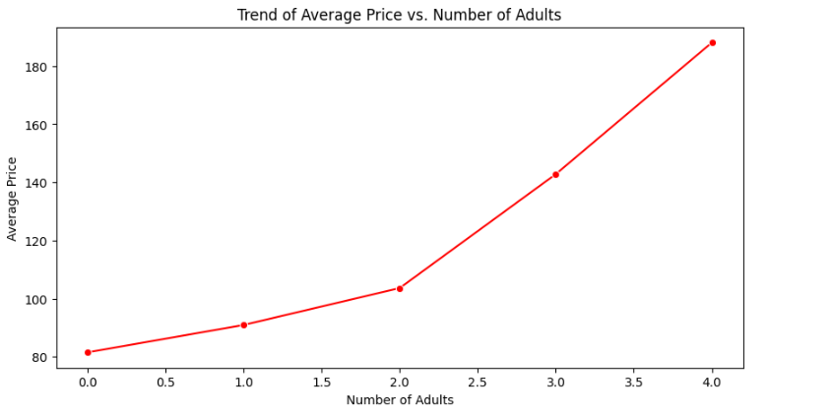
CHILDREN AND AD
Its clear to see based on the relation of number of adults and the MEAN of average prices per number of adults that the more adults to book, the more price they will pay

Slide 16
WHAT TYPE OF PEOPLE MOSTLY BOOK?
We try to guess what type of people that checks in in the hotel.

Slide 17
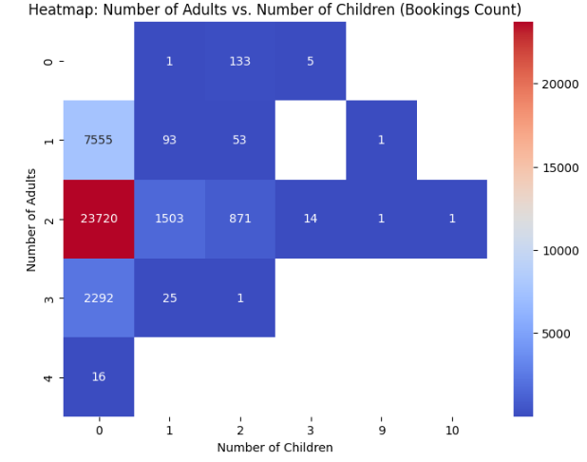
ADULTS vs CHILDREN
There are almost no bookings for 3+ adults or families with 3+ children.
This suggests that either the hotel has room limitations (e.g., not accommodating large families)
The hottest (dark red) cell represents 23,720 bookings for 2 adults and 0 children, making this the most common booking type.
This suggests that couples or pairs traveling without children make up the largest customer segment.

Slide 18
DO CHILDREN IMPACT ROOM TYPES ?
We try to guess what type of people that checks in in the hotel.

Slide 19
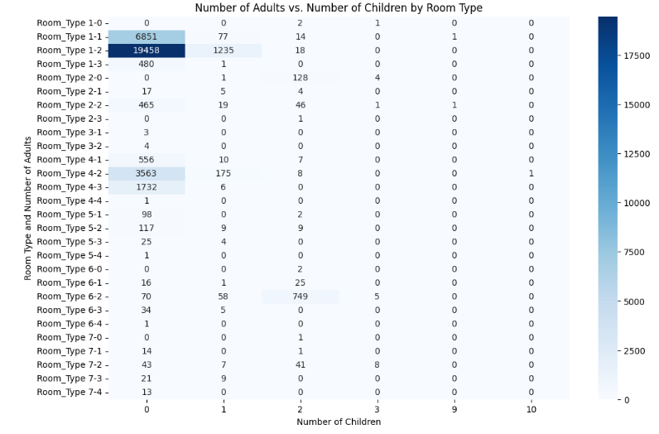
NUMBER OF ADULTS vs AVERAGE PRICE
The most significant counts are when the number of children is 0, suggesting that most bookings do not include children.
There are smaller, scattered values when children are present, but they are much lower than the adult-only numbers

Slide 20
NUMBER OF ADULTS vs AVERAGE PRICE
Most bookings involve only adults, with a significant drop in numbers when children are included.
The most commonly booked rooms are in Room_Type 1 and Room_Type 4.

Slide 21
WEEK NIGHTS vs CANCELATION COUNT
Lets observe number of week nights that a customer choose against how many times he cancelled the booking.

Slide 22
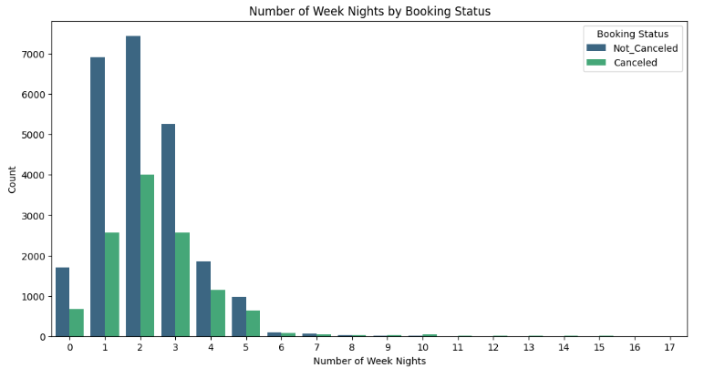
CANCELATION AGAINST WEEK NIGHTS
The most common booking durations are 1, 2, and 3 nights, with 2 nights having the highest count for both canceled and non-canceled bookings.
The number of bookings decreases significantly after 5 nights.

Slide 23
DO FAMILY OF CHILDREN MEAN MORE SPECIAL REQUESTS?
Lets observe if families with children require more special requests, such as cribs or high chairs.

Slide 24
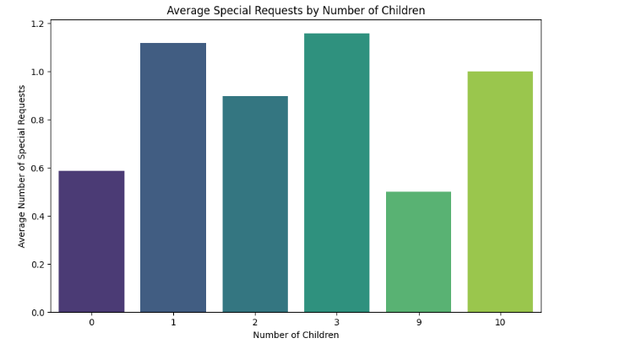
CANCELATION AGAINST WEEK NIGHTS
The average number of special requests is relatively low for 0 children
This suggests that bookings without children tend to have fewer special requests.
There may be a slight increase in the average number of special requests compared to bookings with 0 children.
This could indicate that families with 1-2 children have specific needs (e.g., cribs, high chairs).

Slide 25
CANCELATION AGAINST WEEK NIGHTS
The average number of special requests may increase significantly with 3 or more children.
This suggests that larger families (3+ children) have more complex needs, leading to more special requests.
If there are data points for 9-10 children, they might show unusually high or low averages.
These outliers could represent rare cases (e.g., group bookings) or data errors.

Slide 26
LUCKY MONTHS OR NOT ?
Not all people choose to stick to their bookings, lets view how many cancelation are there, what month is the unlucky month.

Slide 27
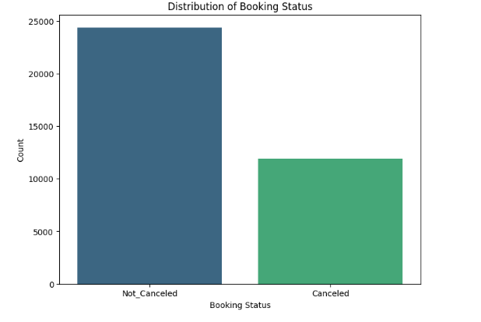
UNLUCKY MONTH
Almost 13000 bookings are canceled which is almost about 33% of total booking

Slide 28
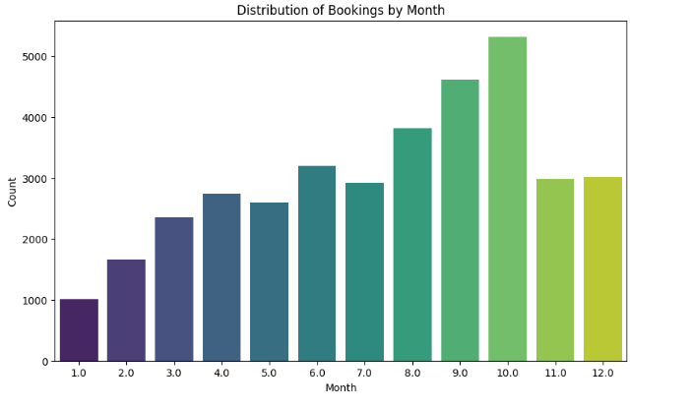
UNLUCKY MONTH
October is the highest month people call on reservation in general
January is the least month with reservation calls
But these are order of reservation in general they could be cancelled or not.

Slide 29
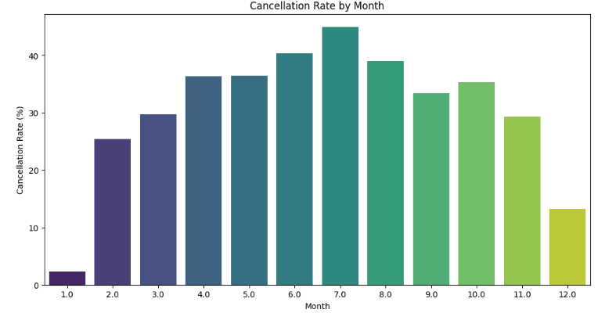
UNLUCKY MONTH
Even though October has the highest bookings, almost 38% of these bookings are cancelled.
January has the least cancellation rate despite having the least order of bookings.
But the unlucky month is July, not having the highest order of bookings and exceeding 40% cancellation rate

Slide 30
LEAD TIME AND AVG PRICE
Is there a secret correlation between these two that can benefit us ?

Slide 31
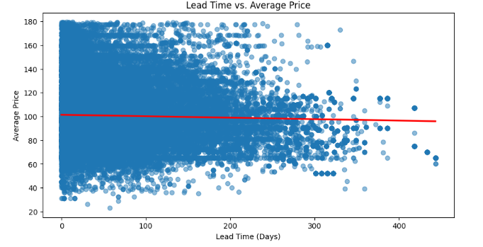
L.TIME VS AVG PRICE
A regression line with correlation coefficient less than zero and almost equals to zero shows little to no relationship between lead time and average price

