Slide 1


EDA Report for Café Insomnia

Slide 2
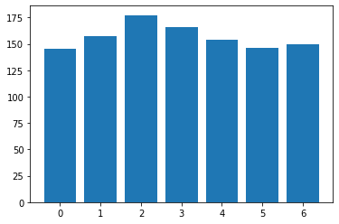
Seasonality – Daily effect

Slide 3
Seasonality – Hourly effect

Slide 4
Days Since opened TREND

Slide 5
Customer location – Distance effect

Slide 6
Modelling Hourly Sales
Since the data provided shows non-linear relationships a model cannot be built to predict hourly sales.

