Slide 1
Sales Prediction
Shehab hassanien

Slide 2


Agenda
The purpose of the study
Datasets and tools used
Data Preparation
Initial Observations
Machine Learning Models
Next Steps
Notes:
Background of the project

Slide 3
Purpose of the study
Given Big Mart Sales Prediction dataset from this source, the purpose of this project is to demonstrate the process of cleaning and preparing the dataset to be used in Machine Learning.
As 80% of the data scientist’s time is spent on data preparation, this presentation will highlight some of the efforts taken to clean and prepare the data.
We will also go over some initial visualized results that will demonstrate some of the factors that affect the sales prices.
Finally, we will look together at some evaluated supervised machine learning models that can be used to predict item sales.

Slide 4
Dataset and Tools
The dataset was downloaded from Big Mart Sales Practice Problem.
Python in Google Colab was used throughout the process to produce the results in the following slides.
Some of the Python libraries used in this effort includes pandas, sklearn, matplotlib, math, and numpy.

Slide 5
Data Preparation
After mounting and loading the dataset, I quickly observed missing values in 2 fields: Item Weight and Outlet Size. The missing data need to be imputed first before applying any machine models
Item Weight was handled by getting the values from different records with the same item identifiers and then the mean value of the weight of the items left.
Outlet size missing values was imputed with similar approaches as the size variations are small, medium and large.
Followed by checking and fixing spelling corrections found in the Item Fat Content Field.
Final step on the data cleaning, I replaced the 0 valued item visibility with the mean values of “Item Visibility”

Slide 6
Facts Shown In The Initial Analysis
A histogram was visualized on the effect of the Item Visualization and found a big variation at the 0 value. More explanation will be needed to understand the importance of this field in predicting the item sales.
The variation in the low fat items exceed and almost double the regular fat items in the outlets.
Canned, fruit and vegetables items are the majority of the item type representation in all the outlets.

Slide 7
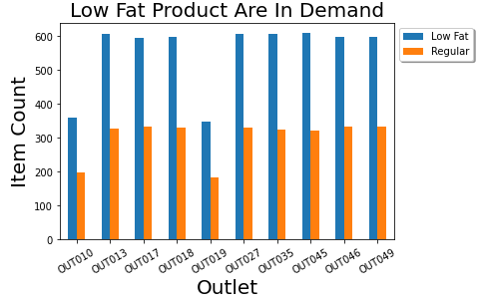
Popularity in Item Fat Content

Slide 8
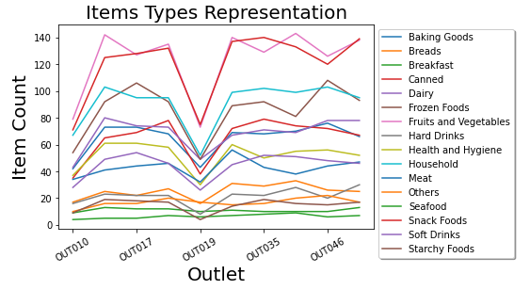
Item Types Visualized
Almost all the outlets have the same count representation in terms of the item types.
Observe the Canned and Fruits and Vegetables

Slide 9
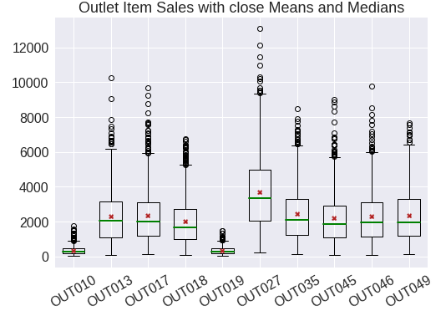
Close Means and Medians
In terms of Outlet sales; close means and medians in all the outlets was observed in the boxplot diagram.

Slide 10
Machine Learning Models
4 supervised machine learning models were applied in the same dataset after splitting the dataset into train and test datasets and comparing the results.
The used algorithm models are:
Linear Regression
Bagged Tree
Random Forest
K-Nearest Neighbors

Slide 11
Machine Learning Models Evaluations
I used the following regression evaluation metrics:
R²: the coefficient of determination
MAE: Mean Absolute Error
MSE: Mean Squared Error
RMSE: Root Mean Squared Error
Score: how much of the predictions matched or were close to the target.
Notes:
R^2: The proportion of the variation in y that is explained by x
MAE: The mean of the absolute value of errors
MSE: The mean of the sum of the squared errors (difference between your predicted value and the actual value)
RMSE: The square root of the MSE

Slide 12
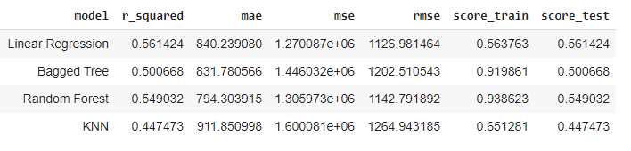
Results
By comparing the regression evaluation metrics in the used models, I concluded that Linear Regression is the better fit for Sales Prediction in this case.
I based my opinion on different factors:
Observed the high score on the test dataset, and how the training score was close and not over fit.
A close to 1 r_squared value
Low RMSE and average MAE compared to the other models.

Slide 13
Next Steps
Data science work done on any dataset requires understanding the meaning behind the data. For example, I worked on the item visibility by replacing the 0 values with the mean over the dataset. I could be wrong in this case; the point is, research and consultation is needed to understand the data to built prediction models.
A research need to done to determine if there’s an Artificial Intelligent library to evaluate different regression models. I manually built the models and tried to tune some of them. If not such a tool, maybe it is an opportunity to build one ☺
Thank you!

