Slide 1
Activity Recognition
Shehab hassanien

Slide 2
Agenda
The purpose of the study
Datasets and tools used
Observations
Machine Learning Model and Results
Code Demo and Technical Discussion
Notes:
Background of the project

Slide 3
Purpose of the study
The study is based on motion data performed to recognize scripted activities using a battery-less, wearable sensor on top of the clothing.
The purpose is to create a supervised machine learning model to predict the older aged activity based on the existing dataset activity recognition, from monitoring activity time, acceleration readings, signal strength, and frequency.
The data science team was tasked with this project and came up with the machine learning model requireed.

Slide 4
Dataset and Tools
The datasets are downloaded from UCI Machine Learning Repository with data collected from 14 healthy older aged between 66 and 86. And work was done to combine the datasets for this study. The dataset was downloaded from: https://archive.ics.uci.edu/ml/datasets/Activity+recognition+with+healthy+older+people+using+a+batteryless+wearable+sensor
The team used data science tools gained from the Coding Dojo’s data science class, knowledge and experiences, and online research on code blocks to perform the tasks presented in later slides.

Slide 5

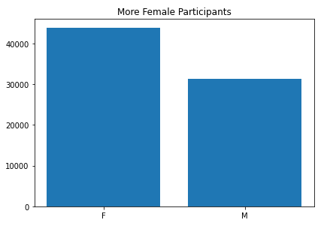
Gender observation
It looks like we have more female participants than male.

Slide 6
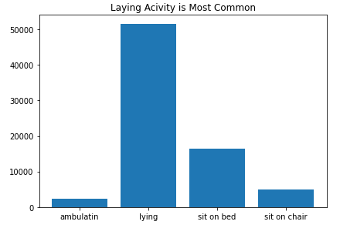
Activity Pattern
Laying activity seems to be the most common activity with the participants, followed by sitting on bed.

Slide 7
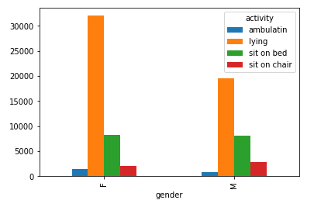
Sitting on bed is More common with Male Participants
When observing the activities per gender. And considering the difference between the Male and Female participates, as there are more females in the study, it appears that Male participants ‘sit on bed’ more commonly that female participants.

Slide 8
Supervised Machine Learning Models
In this study, we explored different multi-class classifiers supervised machine learning models. Models including Logistic Regression, Decision Tree, K Nearest Neighbor, Random Forest and Boosting algorithms were used to calculate the accuracy of the model.
Random Forest Model showed the best accuracy score. We believe this would be the best fitting model in using with the study. Random forest scored 100% accuracy in the training dataset and 99.1% in the testing dataset.

Slide 9
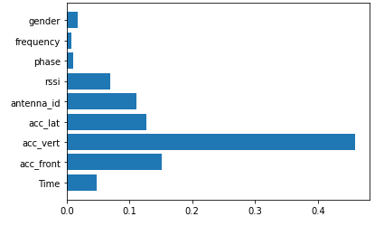
More Results
After deciding on Random Forest as the most fitting model for the dataset, we examined the feature importance in the activity recognition and found that the vertical axis acceleration reading has the most impact on classifying the activity. Followed by the front and lateral and frontal acceleration readings.

