Slide 1
Fibonacci Heap: Extract Min
min
7
24
23
17
3
30
26
46
18
52
41
35
39
44

Slide 2
Fibonacci Heap: Extract Min
min
7
24
23
17
18
52
41
39
44
30
26
46
35

Slide 3
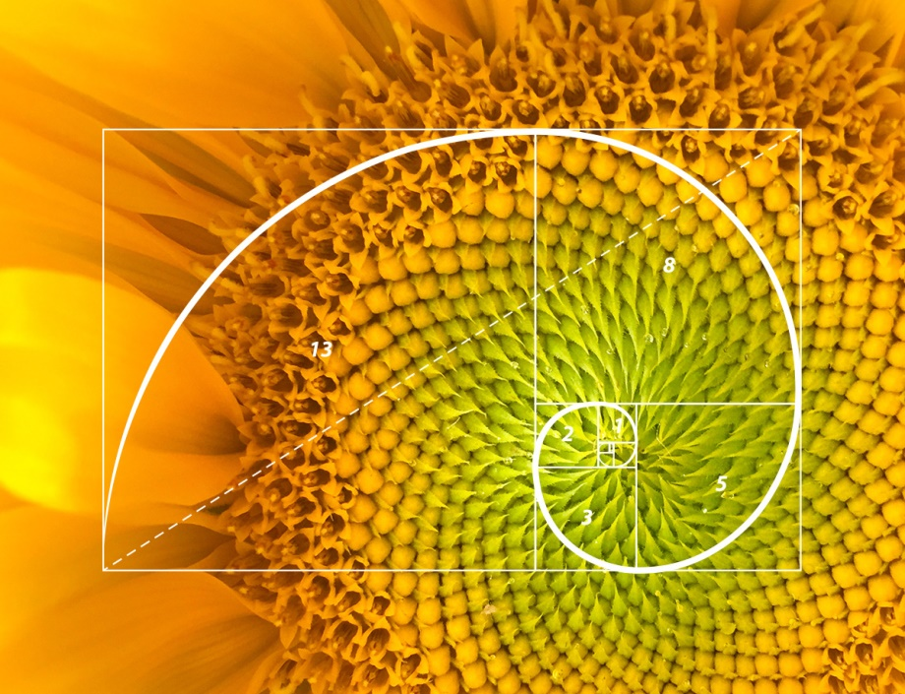
Fibonacci: text and image
Extract/delete Min
Delete min and add its children into the root list
Consolidate trees so that no two roots have same degree

