Slide 1

Basic Trigonometric Identities and Equations

Slide 2
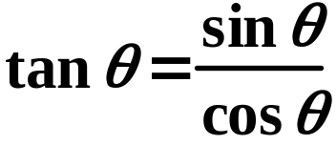
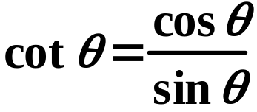
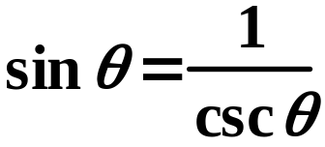
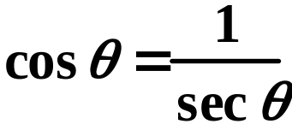
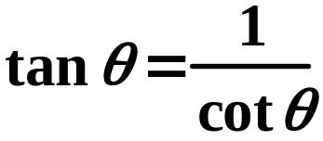
Trigonometric Identities
Quotient Identities
Reciprocal Identities
Pythagorean Identities
sin²θ + cos²θ = 1
tan²θ + 1 = sec²θ
cot²θ + 1 = csc²θ
sin²θ = 1 - cos²θ
tan²θ = sec²θ - 1
cot²θ = csc²θ - 1
cos²θ = 1 - sin²θ

Slide 3
Do you remember the Unit Circle?
Where did our pythagorean identities come from??
What is the equation for the unit circle?
x² + y² = 1
What does x = ? What does y = ?
(in terms of trig functions)
sin²θ + cos²θ = 1
Pythagorean Identity!

Slide 4
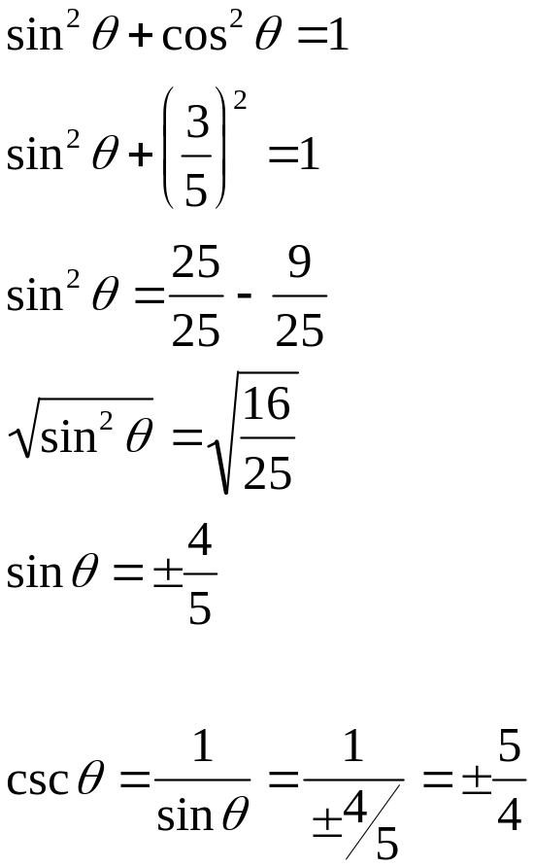
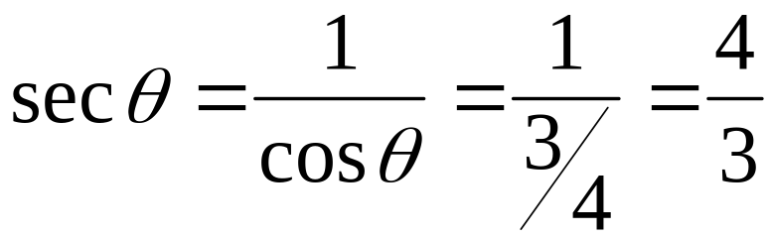
Using the identities you now know, find the trig value.
1.) If cosθ = 3/4, find secθ 2.) If cosθ = 3/5, find cscθ.

Slide 5

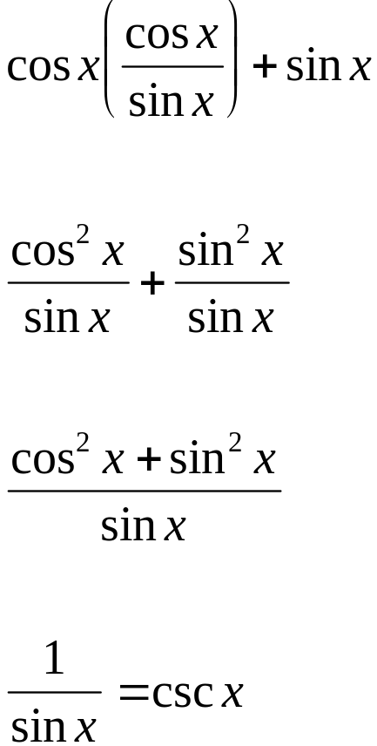
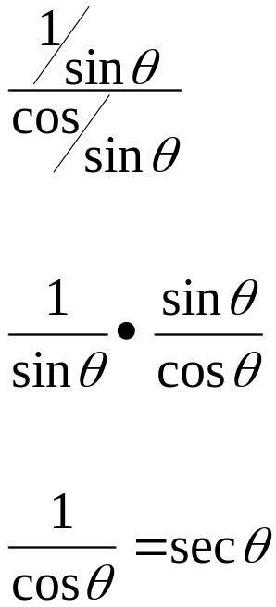
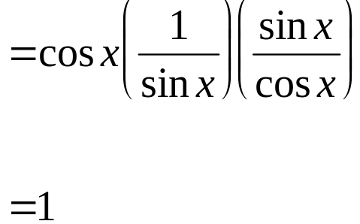
Simplify each expression.

Slide 6


Example
Simplify:
= cot x (csc² x - 1)
Factor out cot x
Use pythagorean identity
= cot x (cot² x)
Simplify
= cot³ x

Slide 7
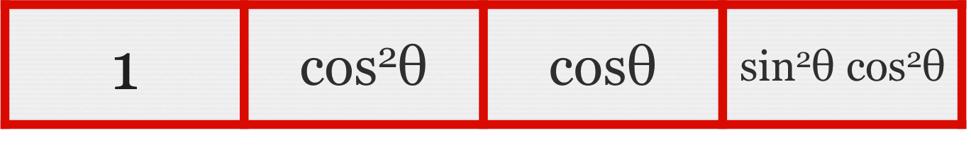
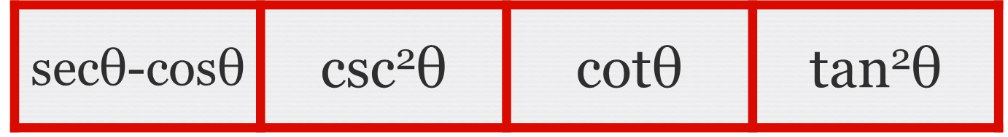



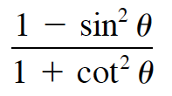





Practice

Slide 8
