Slide 1
CSE 305 Computer Architecture Instructions
Prepared by
Madhusudan Basak
Assistant Professor
CSE, BUET

Slide 2
Instructions
A computer is run by instructions
Instruction Set
All possible instructions for a CPU

Slide 3
Instruction Set Architecture
Instruction set architecture is the attributes of a computing system as seen by the assembly language programmer or compiler.
Instruction Set (what operations can be performed?)
Instruction Format (how are instructions specified?)
Data storage (where is data located?)
Addressing Modes (how is data accessed?)
Exceptional Conditions (what happens if something goes wrong?)

Slide 4
MIPS Architecture
Acronym of “Microprocessor without Interlocked Pipelined Stages”
Is a RISC (Reduced Instruction Set Computer) ISA (Instruction Set Architecture)
Developed by MIPS Technologies (then MIPS Computer Systems) in 1985

Slide 5
Design Principles
Design Principle 1: Simplicity favors regularity.
Design Principle 2: Smaller is faster.
Design Principle 3: Good design demands good compromises.

Slide 6
Simplicity favors regularity
The instructions of MIPS are fixed and rigid
Rigidity ensures Regularity
Simplicity favors regularity

Slide 7



Example Instruction
$Add$ and $subtract$ instructions always follow the following fixed format
$$a=b+c+d+e$$

Slide 8



Example Instruction
$Add$ and $subtract$ instructions always follow the following fixed format

Slide 9
MIPS Instruction Properties
Arithmetic operations only takes register values as operands
Size of a register : 32 bit
Number of registers: 32
Satisfies Design Principle 2: Smaller is faster.
Large number of registers -> longer time for electronic signal to travel -> Increased clock cycle
Large number of registers -> Increased number of control bits
A number is dedicated to a particular register.
5 bit are reserved to indicate each register when the count is 32
Compiler maps a program variable to a register
There is a number assigned against each register

Slide 10

MIPS Instruction Properties
Example

Slide 11
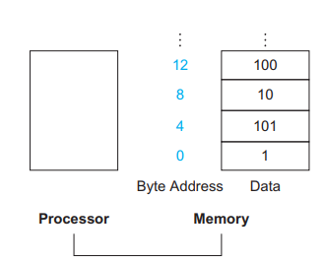
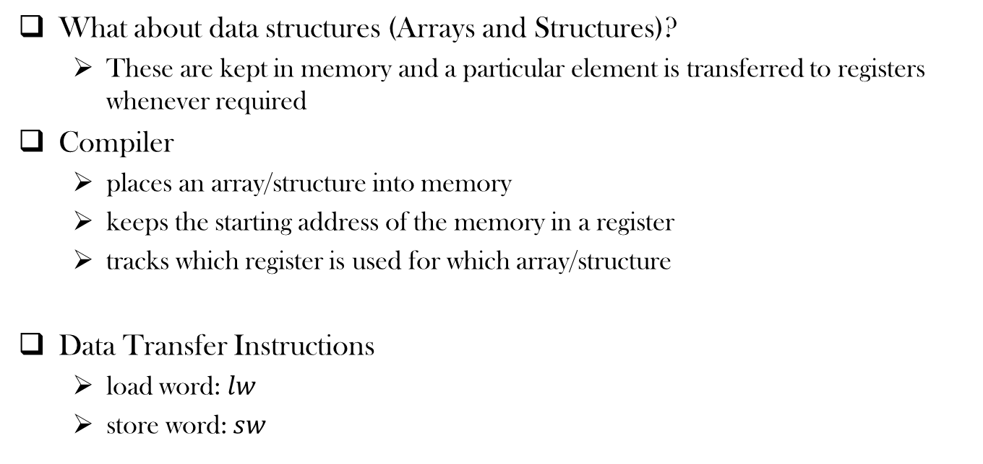
MIPS Instruction Properties
What about data structures (Arrays and Structures)?
These are kept in memory and a particular element is transferred to registers whenever required
Compiler
places an array/structure into memory
keeps the starting address of the memory in a register
tracks which register is used for which array/structure
Data Transfer Instructions
load word: $lw$
store word: $sw$

Slide 12


Data Transfer Instructions
Example
$A\left[12\right]=h+A[8]$

Slide 13
Spilling Registers
What if the number of variables and data structures is more than 32?
Keeps the most frequently used variables in registers and less frequents one in memory
Known as Spilling registers
Moves variables around registers and memory

Slide 14
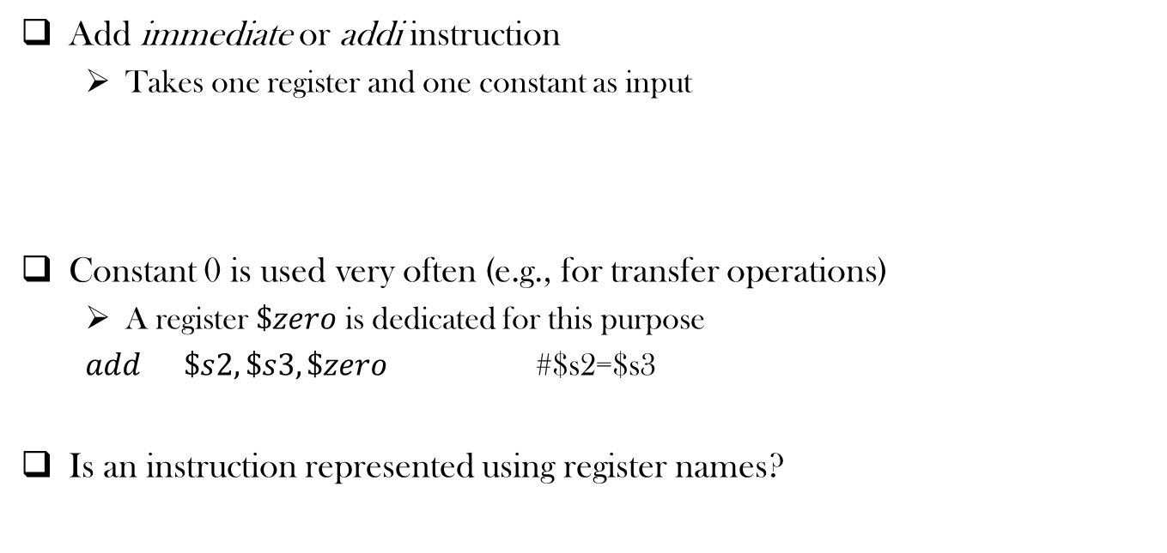
Operation with Constants
Add immediate or addi instruction
Takes one register and one constant as input
Constant 0 is used very often (e.g., for transfer operations)
A register $\$zero$ is dedicated for this purpose
$add \$s2, \$s3,\$zero$ #$s2=$s3
Is an instruction represented using register names?

Slide 15
Representing Instructions in the Computer
Key principles of Today’s computer instructions
Instructions are represented as numbers
Program are stored in memory to be read or written, just like data

Slide 16
Representing Instructions in the Computer
An instruction is a sequence of bits
Each register is mapped to a number
There is a convention to map register names into numbers (e.g., registers $s0 to $s7 map onto registers 16 to 23)
Each instruction is 32 bit long (size of a word)
Satisfies Design Principle 1: Simplicity favors regularity.
Instruction Format: format used by an instruction

Slide 17
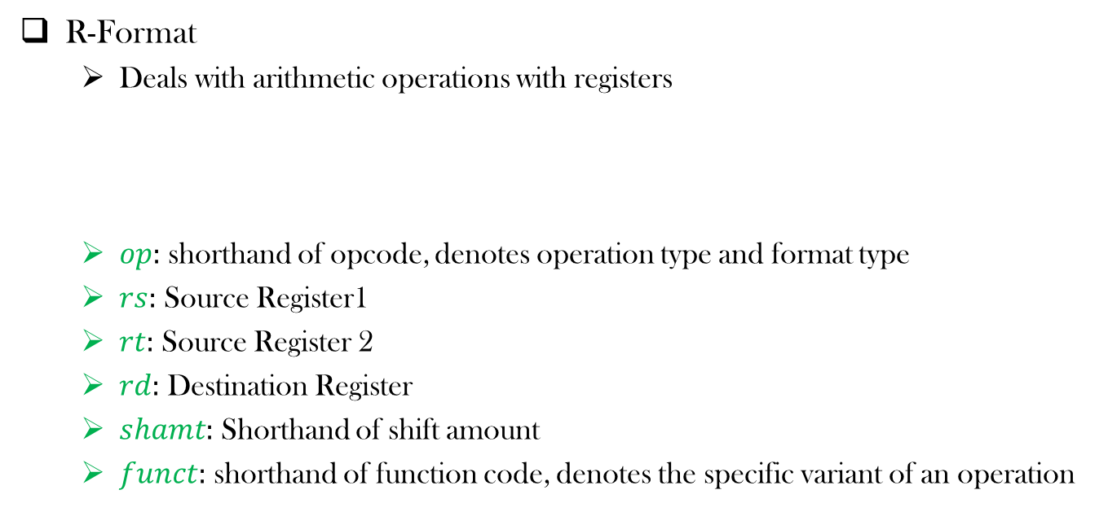
An MIPS Instruction Format
R-Format
Deals with arithmetic operations with registers
$op:$ shorthand of opcode, denotes operation type and format type
$rs:$ Source Register1
$rt:$ Source Register 2
$rd:$ Destination Register
$shamt:$ Shorthand of shift amount
$funct:$ shorthand of function code, denotes the specific variant of an operation

Slide 18
An MIPS Instruction Format
Would it be good to use just one format for all kind of operations?
No!
Design Principle 3: Good design demands good compromises.

Slide 19

Another MIPS Instruction Format
I-Format
Deals with immediate and data transfer operations
$rt:$ Here $rt$ represents the destination register

Slide 20
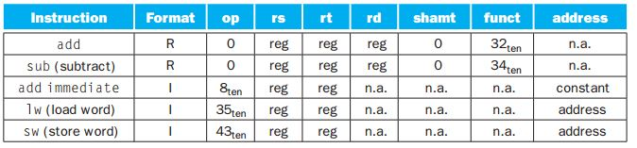

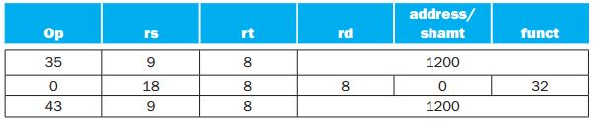

MIPS Instruction Encoding (Simplified)

Slide 21
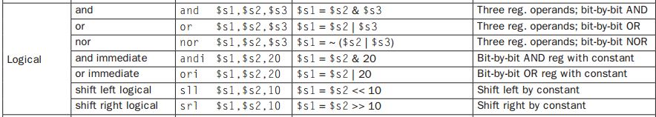
Logical Operations

Slide 22
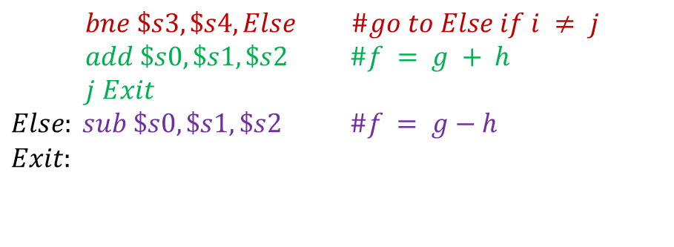
Branching Operations
if (i==j)
f = g + h;
else
f = g – h;
$$bne \$s3, \$s4, Else \#go to Else if i ≠ j$$
$$add \$s0, \$s1, \$s2 \#f = g + h$$
$$j Exit$$
$$Else: sub \$s0, \$s1, \$s2 \#f = g−h$$
$$\begin{aligned}Exit:\end{aligned}$$
Why not blt?

Slide 23
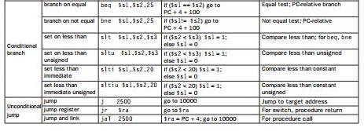
Branching Operations

Slide 24
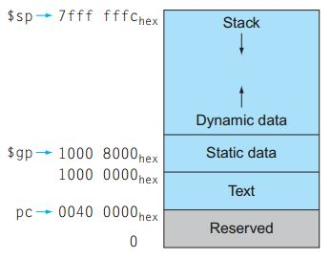
Memory Allocation for Program and Data
Reserved Memory
Text Segment: Program Code
Static Data Segment:
Contains static variables, constants, arrays
Dynamic Data Segment (Heap):
Contains linked lists, variable length data
Stack
Contains function local variables, parameters etc.

Slide 25
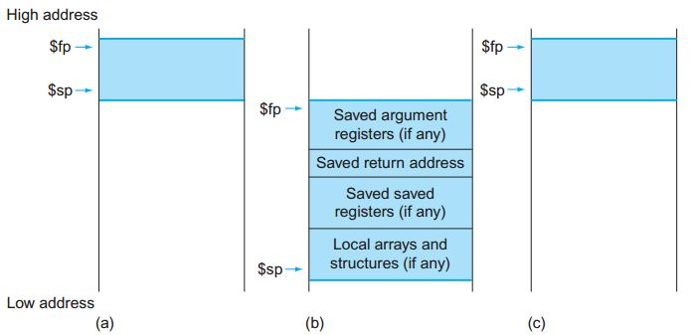
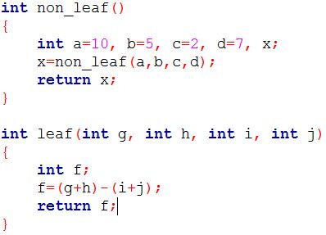
Stack During Procedure Call
Stores/saves the values of registers and Restores those later
Either $sp and $fp combination, or only $sp is used
The allocated stack area by a procedure is known as activation record or procedure frame

Slide 26
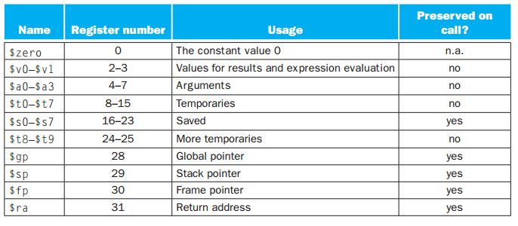
Stack During Procedure Call
Stores the values of registers

Slide 27
Procedures in MIPS
Six steps during a procedure call
Put parameters in a place where the procedure can access them.
Transfer control to the procedure.
Acquire the storage resources needed for the procedure.
Perform the desired task.
Put the result value in a place where the calling program can access it.
Return control to the point of origin, since a procedure can be called from several points in a program.

Slide 28
Procedures in MIPS
Six steps during a procedure call
Put parameters in a place where the procedure can access them.
Transfer control to the procedure.
Acquire the storage resources needed for the procedure.
Perform the desired task.
Put the result value in a place where the calling program can access it.
Return control to the point of origin, since a procedure can be called from several points in a program.
Place for parameters:
$a0–$a3: four argument registers in which to pass parameters
Memory (e.g., stack) can be used if more values to be returned

Slide 29
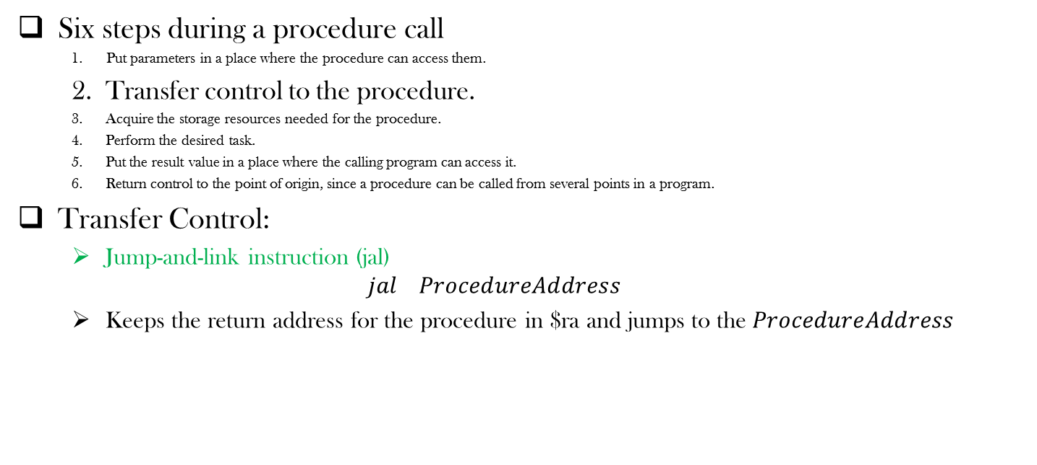
Procedures in MIPS
Six steps during a procedure call
Put parameters in a place where the procedure can access them.
Transfer control to the procedure.
Acquire the storage resources needed for the procedure.
Perform the desired task.
Put the result value in a place where the calling program can access it.
Return control to the point of origin, since a procedure can be called from several points in a program.
Transfer Control:
Jump-and-link instruction (jal)
$$jal ProcedureAddress$$
Keeps the return address for the procedure in $ra and jumps to the $ProcedureAddress$

Slide 30
Procedures in MIPS
Six steps during a procedure call
Put parameters in a place where the procedure can access them.
Transfer control to the procedure.
Acquire the storage resources needed for the procedure.
Perform the desired task.
Put the result value in a place where the calling program can access it.
Return control to the point of origin, since a procedure can be called from several points in a program.
Acquiring the storage resources
Different register values (manipulated by caller) are stored in the stack
Prepares the registers for operations
Can use the memory for data storage

Slide 31
Procedures in MIPS
Six steps during a procedure call
Put parameters in a place where the procedure can access them.
Transfer control to the procedure.
Acquire the storage resources needed for the procedure.
Perform the desired task.
Put the result value in a place where the calling program can access it.
Return control to the point of origin, since a procedure can be called from several points in a program.

Slide 32
Procedures in MIPS
Six steps during a procedure call
Put parameters in a place where the procedure can access them.
Transfer control to the procedure.
Acquire the storage resources needed for the procedure.
Perform the desired task.
Put the result value in a place where the calling program can access it.
Return control to the point of origin, since a procedure can be called from several points in a program.
Performing Tasks
Can perform all the operations allowed by the MIPS instruction set

Slide 33
Procedures in MIPS
Six steps during a procedure call
Put parameters in a place where the procedure can access them.
Transfer control to the procedure.
Acquire the storage resources needed for the procedure.
Perform the desired task.
Put the result value in a place where the calling program can access it.
Return control to the point of origin, since a procedure can be called from several points in a program.
Result storing by the callee
$v0–$v1: two value registers in which to return values
Memory (e.g., stack) can be used if more values to be returned

Slide 34
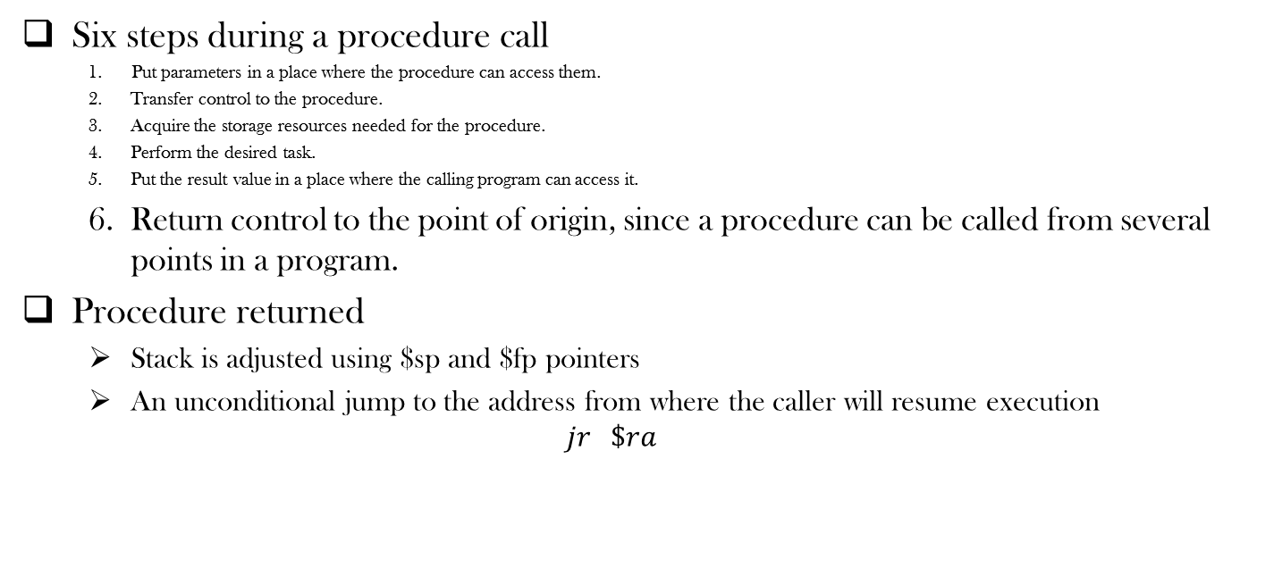
Procedures in MIPS
Six steps during a procedure call
Put parameters in a place where the procedure can access them.
Transfer control to the procedure.
Acquire the storage resources needed for the procedure.
Perform the desired task.
Put the result value in a place where the calling program can access it.
Return control to the point of origin, since a procedure can be called from several points in a program.
Procedure returned
Stack is adjusted using $sp and $fp pointers
An unconditional jump to the address from where the caller will resume execution
$$jr \$ra$$

Slide 35
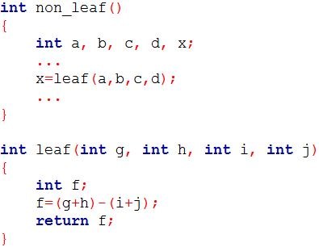
An Example
non_leaf:
...
add $a0, $s1, $zero
add $a1, $s2, $zero
add $a2, $s3, $zero
add $a3, $s4, $zero
jal leaf
add $s1, $zero, $v0
...
leaf: addi $sp, $sp, –12 # adjust stack to make room for 3 items
sw $t1, 8($sp) # save register $t1 for use afterwards
sw $t0, 4($sp) # save register $t0 for use afterwards
sw $s0, 0($sp) # save register $s0 for use afterwards
add $t0,$a0,$a1 # register $t0 contains g + h
add $t1,$a2,$a3 # register $t1 contains i + j
sub $s0,$t0,$t1 # f = $t0 – $t1, which is (g + h)–(i + j)
add $v0,$s0,$zero # Set return Value
lw $s0, 0($sp) # restore register $s0 for caller
lw $t0, 4($sp) # restore register $t0 for caller
lw $t1, 8($sp) # restore register $t1 for caller
addi $sp,$sp,12 # adjust stack to delete 3 items
jr $ra # jump back to calling routine
Put parameters in a place where the procedure can access them.
Transfer control to the procedure.
Acquire the storage resources needed for the procedure
Perform the desired task.
Put the result value in a place where the calling program can access it.
Return control to the point of origin, since a procedure can be called from several points in a program.

Slide 36
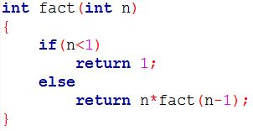
Nested Call
fact: addi $sp, $sp, –8 # adjust stack for 2 items
sw $ra, 4($sp) # save the return address
sw $a0, 0($sp) # save the argument n
slti $t0,$a0,1 # test for n < 1
beq $t0,$zero,L1 # if n >= 1, go to L1
addi $v0,$zero,1 # Set the return value
addi $sp,$sp,8 # pop 2 items off stack
jr $ra # return to caller
L1: addi $a0,$a0,–1 # n >= 1: argument gets (n – 1)
jal fact # call fact with (n –1)
lw $a0, 0($sp) # return from jal: restore argument n
lw $ra, 4($sp) # restore the return address
addi $sp, $sp, 8 # adjust stack pointer to pop 2 items
mul $v0,$a0,$v0 # return n * fact (n – 1)
jr $ra # return to the caller

Slide 37
J-Format
To support long jump to a remote procedure address
opcode
Jumping Address

Slide 38
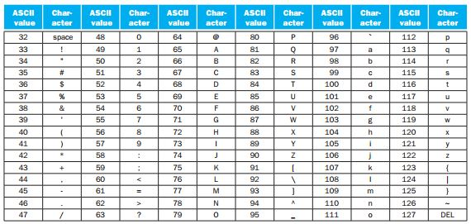
ASCII representation of characters
ASCII stands for American Standard Code for Information Interchange
Uses 1 byte to represent a character

Slide 39
1 Byte Memory Operation
ASCII demands 1-byte memory operation
MIPS supports
lb $t0,0($sp) #Reads 1 byte from memory and stores in the lowest (rightmost) byte of $t0
sb $t0,0($gp) #Reads 1 byte from the lowest (rightmost) byte of $t0 and stores in the memory
Unsigned Version:
Load Byte: lbu
Store Byte: Not available in MIPS

Slide 40
Dealing with Strings
Three commonly available strategies
the first position of the string is reserved to give the length of a string
an accompanying variable has the length of the string
the last position of a string is indicated by a character used to mark the end of a string

Slide 41
Dealing with String: Example
ASCII demands 1-byte memory operation
MIPS supports
lb $t0,0($sp) #Reads 1 byte from memory and stores in the lowest (rightmost) byte of $t0
sb $t0,0($gp) #Reads 1 byte from the lowest (rightmost) byte of $t0 and stores in the memory
Unsigned Version:
Load Byte: lbu
Store Byte: Not available in MIPS

Slide 42
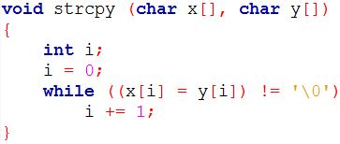
Dealing with String: An Example
strcpy: addi $sp,$sp,–4 # adjust stack for 1 more item
sw $s0, 0($sp) # save $s0
add $s0,$zero,$zero # i = 0 + 0
L1: add $t1,$s0,$a1 # address of y[i] in $t1
lbu $t2, 0($t1) # $t2 = y[i]
add $t3,$s0,$a0 # address of x[i] in $t3
sb $t2, 0($t3) # x[i] = y[i]
beq $t2,$zero,L2 # if y[i] == 0, go to L2
addi $s0, $s0,1 # i = i + 1
j L1 # go to L1. While loop continues
L2: lw $s0, 0($sp) # End of string. Restore old $s0
addi $sp,$sp,4 # pop 1 word off stack
jr $ra # return

Slide 43
Dealing with Multiple Languages
Unicode, a universal encoding, supports alphabets of most human languages
Java uses Unicode
Requires 16 bits to represent a character
Operations required to load and store 16bits (halfwords)
Load halfword: lh
Load halfword unsigned: lhu
Store halfword: sh

Slide 44
Constant Size: Is larger feasible?
The I-format is used by both immediate and memory data transfer operations
More than 16 bit long constant?
We have two options in hand
Supporting short constant in 1 instruction and deal long constant with additional instructions
Supporting long constant in 2 instructions
We opted for the first option (to exploit the benefit of common case fast)
Are we limited to use 16 bit constants (-32,768 to 32,767)?
No ☺ Use two instructions to populate a register with 32 bit constant

Slide 45
Manipulating Larger Constant
Populating a register with 32 bit constant
Load Upper Immediate (lui) : Loads upper 16 bits
Or Immediate (ori): : Loads lower 16 bits
Example: x=y+4000000
4000000 = 0000 0000 0011 1101 0000 1001 0000 0000
lui $s0, 61 // 61 = 0000 0000 0011 1101
ori $s0, 2304 // 2304= 0000 1001 0000 0000
add $s1, $t0, $s0
Think how to use 32 bit address to access data from memory
No sign extension for logical operations but it happens for arithmetic operations
$s0
0000 0000 0011 1101
0000 0000 0000 0000
0000 1001 0000 0000
0000 0000 0000 0000
0000 1001 0000 0000

Slide 46
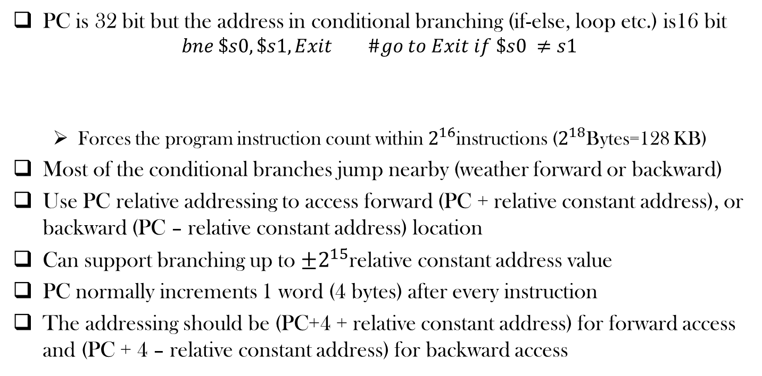
Addressing in Branches
PC is 32 bit but the address in conditional branching (if-else, loop etc.) is16 bit
$$bne \$s0, \$s1, Exit \#go to Exit if \$s0 ≠s1$$
Forces the program instruction count within $2^{16}$instructions ($2^{18}$Bytes=128 KB)
Most of the conditional branches jump nearby (weather forward or backward)
Use PC relative addressing to access forward (PC + relative constant address), or backward (PC – relative constant address) location
Can support branching up to $±2^{15}$relative constant address value
PC normally increments 1 word (4 bytes) after every instruction
The addressing should be (PC+4 + relative constant address) for forward access and (PC + 4 – relative constant address) for backward access

Slide 47
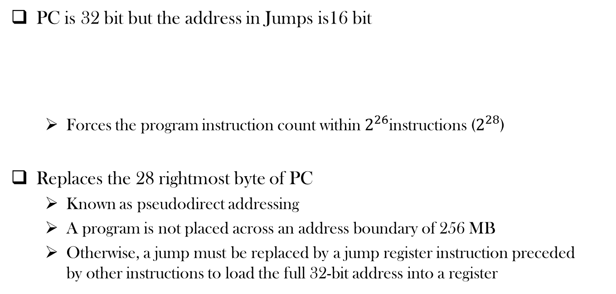
Addressing in Jumps
PC is 32 bit but the address in Jumps is16 bit
Forces the program instruction count within $2^{26}$instructions ($2^{28}$)
Replaces the 28 rightmost byte of PC
Known as pseudodirect addressing
A program is not placed across an address boundary of 256 MB
Otherwise, a jump must be replaced by a jump register instruction preceded by other instructions to load the full 32-bit address into a register
opcode
Jumping Address

Slide 48
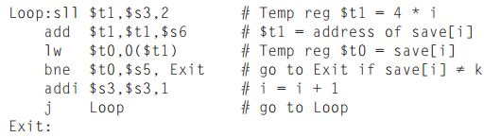
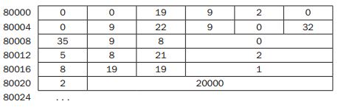
Example

Slide 49

Branching More than $2^{16}$ instructions
Assembler inverts the condition
Inserts an unconditional jump
beq $s0, $s1, L1
bne $s0, $s1, L2
j L1
L2:

Slide 50
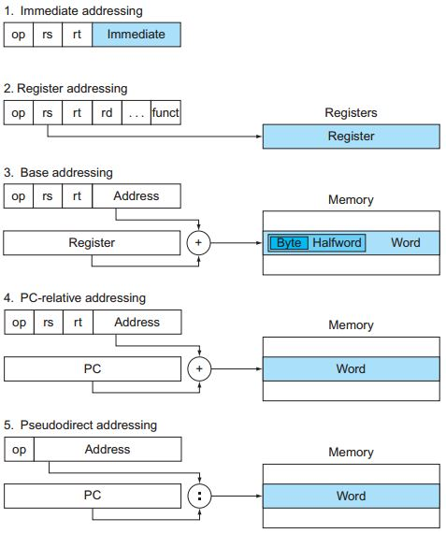
Addressing Modes

Slide 51
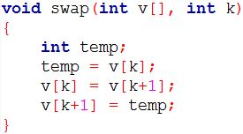
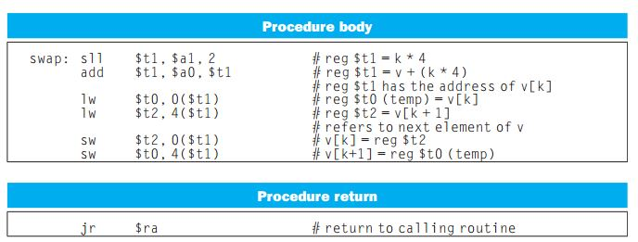
A C Sort Example

Slide 52
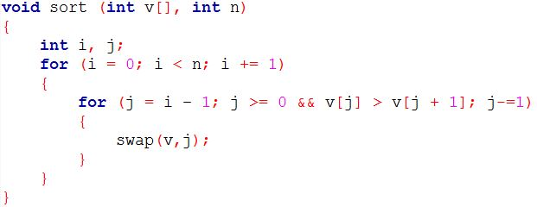
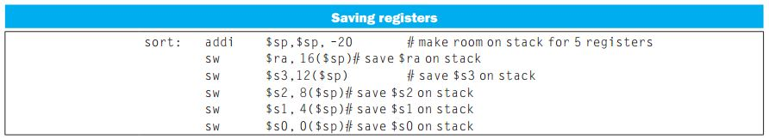
A C Sort Example

Slide 53
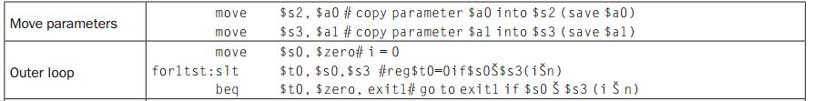
A C Sort Example

Slide 54
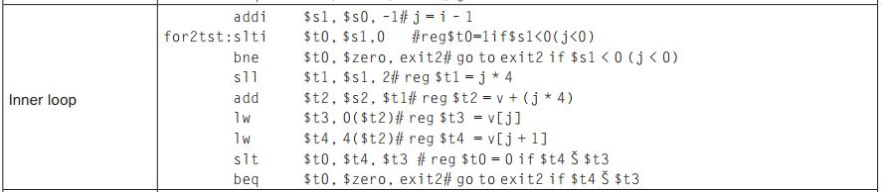
A C Sort Example

Slide 55
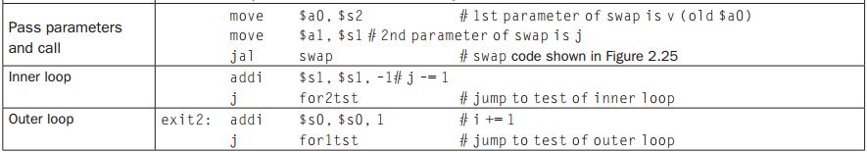
A C Sort Example

Slide 56
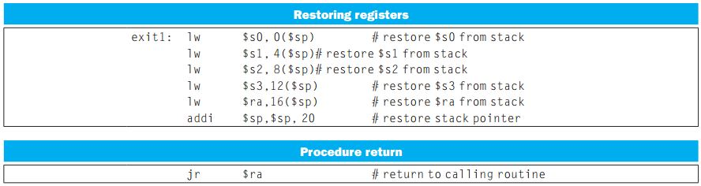
A C Sort Example

Slide 57
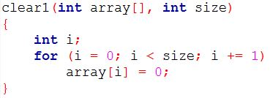
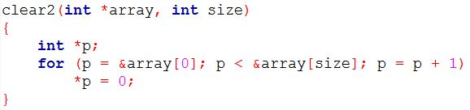
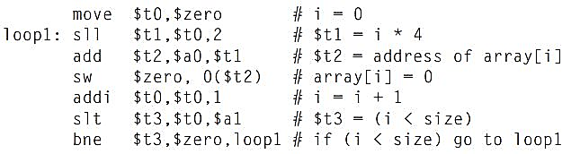
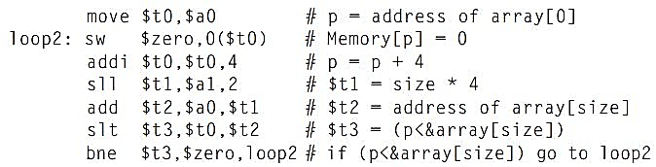
Arrays vs Pointers: Example

Slide 58
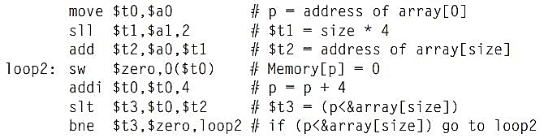
Arrays vs Pointers: Example
Pointer version has reduced the number of instructions per iteration
Many optimizing compilers generate this code, even for array-based C code

Slide 59
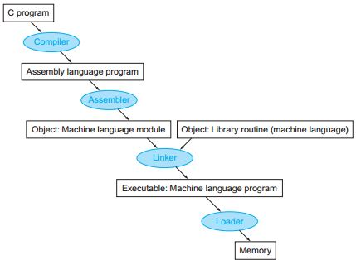
Translation Hierarchy

Slide 60
Compiler
Compiles the source program in to assembly language program
Assembly Language: A symbolic language translatable into binary machine language
Modern compilers generate optimized assembly code

Slide 61
Assembler
Converts assembly language instruction into machine instruction
Supports pseudoinstructions

Slide 62
Pseudoinstructions
Instructions supported by Assembler but not found in Hardware
Assembler takes the responsibility to convert it into a proper machine language
Example:
move $t0, $t1
Assembler converts it to
add $t0, $zero, $t1
More pseudoinstructions: blt, bgt, bge, ble
An example of Abstraction
Assembler requires a dedicated register $at for this purpose

Slide 63
Assembler
Keeps track of labels used in branches and data transfer instructions in a symbol table
Symbol table: a table that maps addresses against labels

Slide 64
Linker
Combine independently assembled machine language programs
Resolves undefined labels into an executable file

Slide 65
Loader
Loads (copies) an object program from disk to main memory in order to execute

Slide 66
Dynamically Linked Libraries (DLL)
Library routines that are linked to a program during execution
To incorporate the updated version of library routines
In lazy procedure linkage, each routine is linked only when it is called
Provides a level of indirection
Nonlocal routine calls a set of dummy entries at the end of the program, with one entry per nonlocal routine. These dummy entries each contain an indirect jump
The Dynamic Linker/Loader finds the desired routine, remaps it, and changes the address in the indirect jump location to point to that routine
From then, the call to the library routine jump indirectly to routine without the extra hops

Slide 67
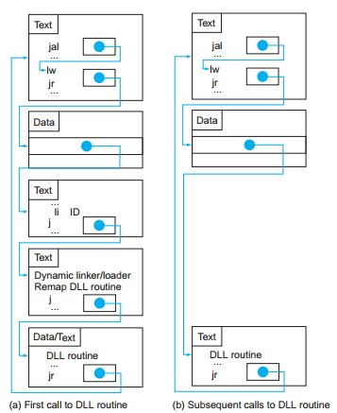
Dynamically Linked Libraries (DLL)

Slide 68
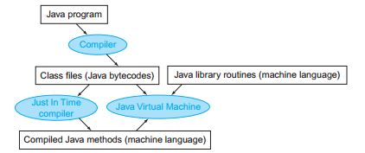
Starting a Java Program
Java programs ensure portability sacrificing some performance
Compiled first in to an easy-to-interpret instruction set: Java bytecode
A software interpreter, called Java Virtual Machine (JVM) can execute Java byte code
This process is slow
Just In Time Compiler (JIT) makes it faster
Statistically identify the commonly used (hot) methods
Compiles these methods into native instruction set

Slide 69
MIPS (RISC) Design Principles In Summary
Simplicity favors regularity
fixed size instructions
small number of instruction formats
opcode always the first 6 bits
Smaller is faster
limited instruction set
limited number of registers
limited number of addressing modes
Good design demands good compromises
Three instruction formats
Make the common case fast
arithmetic operands using the registers
Saving the commonly used registers into stack
PC-relative addressing
allow instructions to contain immediate operands

Slide 70
Alternative Architectures
Design alternative
provide more powerful operations
goal is to reduce number of instructions executed
danger is a slower cycle time and/or a higher CPI

Slide 71
x86 Instructions: Evolution
8080 (1974): 8-bit microprocessor
Accumulator, plus 3 index-register pairs
8086 (1978): 16-bit extension to 8080
Complex instruction set (CISC)
8087 (1980): floating-point coprocessor
Adds FP instructions and register stack
80286 (1982): 24-bit addresses, MMU
Segmented memory mapping and protection
80386 (1985): 32-bit extension (now IA-32)
Additional addressing modes and operations
Paged memory mapping as well as segments
Like the 80286, the 80386 has a compatibility mode to execute 8086 program without change

Slide 72
x86 Instructions: Evolution
80486 (1989): pipelined, on-chip caches and FPU
Compatible competitors: AMD, Cyrix, …
Pentium (1993): superscalar, 64-bit datapath
Later versions added MMX (Multi-Media eXtension) instructions
The infamous FDIV bug
Pentium Pro (1995), Pentium II (1997)
New microarchitecture (see Colwell, The Pentium Chronicles)
Pentium III (1999)
Added SSE (Streaming SIMD Extensions) and associated registers
Pentium 4 (2001)
New microarchitecture
Added SSE2 instructions

Slide 73
x86 Instructions: Evolution
AMD64 (2003): extended architecture to 64 bits
Long mode: execution of all x86 instructions
EM64T (2004), Extended Memory 64 Technology
AMD64 adopted by Intel (with refinements)
Added SSE3 instructions
Intel Core (2006)
Added SSE4 instructions, virtual machine support
AMD64 (2007): announced SSE5 instructions
Intel (2011): Advanced Vector Extension
Longer SSE registers (128 to 256 bits), more instructions

Slide 74
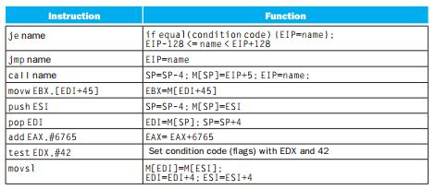
x86 32 bit (80386) Architecture
Four major types of integer instructions
Data movement including move, push, pop
Arithmetic and logical (destination register or memory)
Control flow (use of condition codes / flags )
String instructions, including string move and string compare

Slide 75
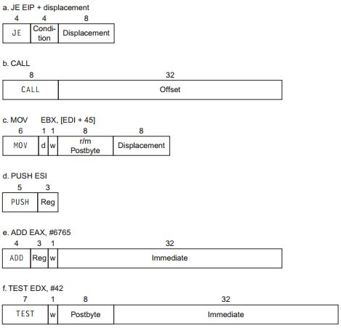
x86 32 bit (80386) Architecture
Typical Instruction Formats
Different instructions are different in length

Slide 76
x86 32 bit (80386) Architecture
Complexity
Instructions from 1 to 15 bytes long
one operand must act as both a source and destination
one operand can come from memory
complex addressing modes
e.g., “base or scaled index with 8 or 32 bit displacement”

Slide 77
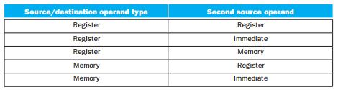
x86 32 bit (80386) Architecture
Registers and Data Addressing Modes
Supports different combination of registers, constants and memory operands in a single instruction

Slide 78
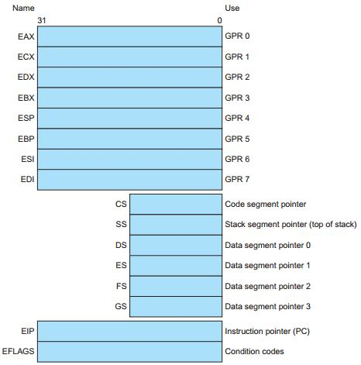
x86 32 bit (80386) Architecture
Registers and Data Addressing Modes
Contains only eight general purpose registers

Slide 79
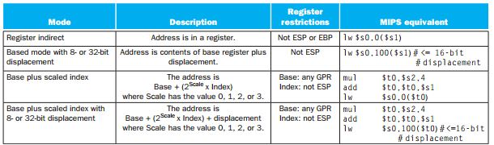
x86 32 bit (80386) Architecture
Registers and Data Addressing Modes
Contains only eight general purpose registers
Even restrictions on these general purpose registers!

Slide 80
x86 32 bit (80386) Architecture
Saving Grace
the most frequently used instructions are not too difficult to build
compilers avoid the portions of the architecture that are slow

Slide 81
Fallacies and Pitfalls
Fallacy: More powerful instructions mean higher performance.
Fallacy: Write in assembly language to obtain the highest performance.
Fallacy: The importance of commercial binary compatibility means successful instruction sets don’t change.
Pitfall: Forgetting that sequential word addresses in machines with byte addressing do not diﬀer by one.
Pitfall: Using a pointer to an automatic variable outside its defining procedure.

Slide 82
Acknowledgements
These slides contain material developed and copyright by:
Lecture slides by Dr. Tanzima Hashem, Professor, CSE, BUET
Lecture slides by Mehnaz Tabassum Mahin, Assistant Professor, CSE, BUET

Slide 83
References
Computer Organization and Design (5th edition) by David A. Patterson and John L. Hennessy
Chapter 2 (2.1, 2.2, 2.3, 2.5-2.10, 2.12-2.14, 2.17,2.19-2.22)

Slide 84
Thank You ☺

Slide 85
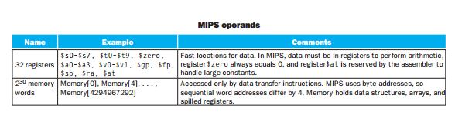
MIPS Operands

Slide 86
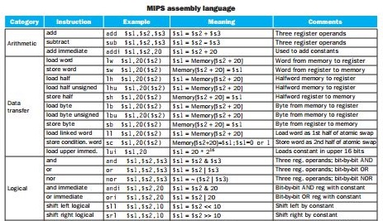
MIPS Assembly Language

Slide 87
MIPS Assembly Language

