Slide 1
CSE 305 Computer Architecture Arithmetic for Computers
Prepared by
Madhusudan Basak
Assistant Professor
CSE, BUET

Slide 2


Addition and Subtraction
Adding two positive numbers
Subtraction

Slide 3
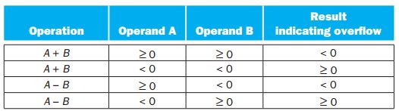
Overflow

Slide 4
Multiplication
Example
 |  |  |  | 0 | 0 | 1 | 1
 |  |  |  | 0 | 0 | 1 | 0
 |  |  |  | 0 | 0 | 0 | 0
 |  |  | 0 | 0 | 1 | 1
 |  | 0 | 0 | 0 | 0
 | 0 | 0 | 0 | 0
 | 0 | 0 | 0 | 0 | 1 | 1 | 0
Multiplicand
 |  |  |  | 0 | 0 | 1 | 1
 |  |  |  | 0 | 1 | 1 | 0
 |  |  |  | 0 | 0 | 0 | 0
 |  |  | 0 | 0 | 1 | 1
 |  | 0 | 0 | 1 | 1
 | 0 | 0 | 0 | 0
 | 0 | 0 | 1 | 0 | 0 | 1 | 0
Multiplier
Product

Slide 5
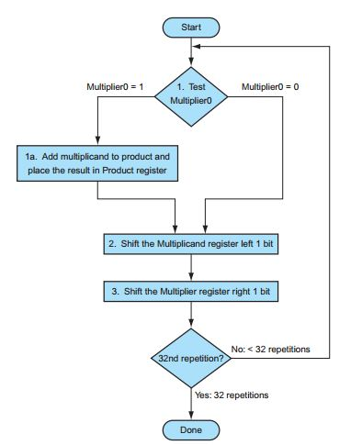
Flowchart
Multiplicand
 |  |  |  | 0 | 0 | 1 | 1
 |  |  |  | 0 | 1 | 1 | 0
 |  |  |  | 0 | 0 | 0 | 0
 |  |  | 0 | 0 | 1 | 1
 |  | 0 | 0 | 1 | 1
 | 0 | 0 | 0 | 0
 | 0 | 0 | 1 | 0 | 0 | 1 | 0
Multiplier
Product

Slide 6
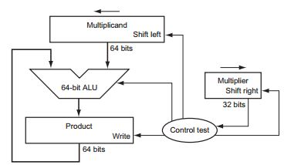
Hardware

Slide 7
Multiplication: Refined Hardware
Example
 |  |  |  | 0 | 0 | 1 | 1
 |  |  |  | 0 | 0 | 1 | 0
 |  |  |  | 0 | 0 | 0 | 0
 |  |  | 0 | 0 | 1 | 1
 |  | 0 | 0 | 0 | 0
 | 0 | 0 | 0 | 0
 | 0 | 0 | 0 | 0 | 1 | 1 | 0
Multiplicand
 |  |  |  | 0 | 0 | 1 | 1
 |  |  |  | 0 | 1 | 1 | 0
 |  |  |  | 0 | 0 | 0 | 0
 |  |  | 0 | 0 | 1 | 1
 |  | 0 | 0 | 1 | 1
 | 0 | 0 | 0 | 0
 | 0 | 0 | 1 | 0 | 0 | 1 | 0
Multiplier
Product

Slide 8
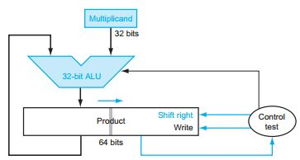
Start
Place the Multiplier in the right 32 bit of the product register (64 bit)
Product=1
1. Test Product0
Product=0
1a. Add Multiplicand to the left half of the product register and place the result in the left half of the product register
2. Shift the product register right 1 bit
32nd repetition?
No
Yes
Done

Slide 9
Signed Multiplication
Convert the multiplier and multiplicand to positive numbers and remember the original signs.
Run the algorithms for 31 iterations (excluding the sign bit)
Negate the final product if the original signs disagree

Slide 10
Multiply in MIPS
MIPS provides a separate pair of 32-bit register to contain the 64-bit product
HI: most-significant 32 bits
LO: least-significant 32-bits
MIPS Instructions
mult rs, rt / multu rs, rt
64-bit product in HI / LO
mfhi rd / mflo rd
Move from HI / LO to rd
Can test HI/LO value for different purpose (for example, using HI to see if product overflows 32 bits, using LO to see whether the result is EVEN or ODD)

Slide 11
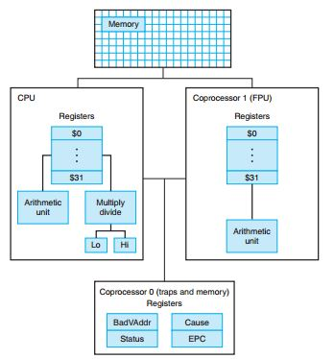
MIPS Processor
Consists of
an integer processing unit (CPU)
a collection of coprocessors that perform ancillary tasks or operate on other types of data

Slide 12
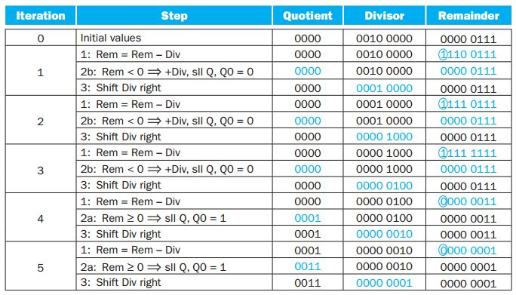
Division
Example:
Divisor
Dividend
Quotient
0 | 0 | 1 | 0 | 0 | 1 | 1 | 1 | 0 | 1 | 1
 |  |  |  | 0 | 1 | 0
 |  |  |  |  |  | 1 | 1
 |  |  |  |  |  | 1 | 0
 |  |  |  |  |  |  | 1
Remainder

Slide 13
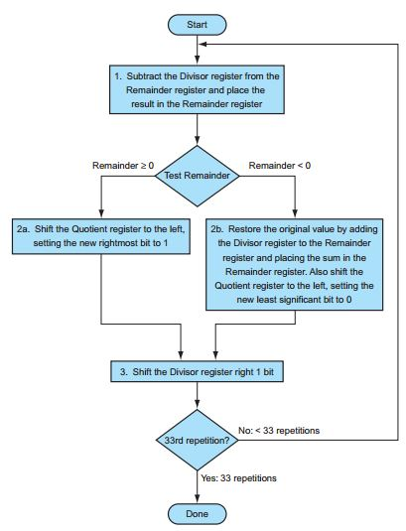
Division: Flowchart
Divisor
Dividend
Quotient
0 | 0 | 1 | 0 | 0 | 1 | 1 | 1 | 0 | 1 | 1
 |  |  |  | 0 | 1 | 0
 |  |  |  |  |  | 1 | 1
 |  |  |  |  |  | 1 | 0
 |  |  |  |  |  |  | 1
Remainder
Dividend = Quotient x Divisor + Remainder

Slide 14
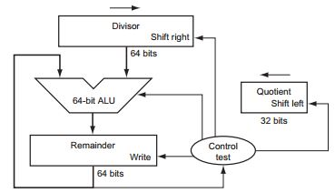
Division: Flowchart and Hardware

Slide 15
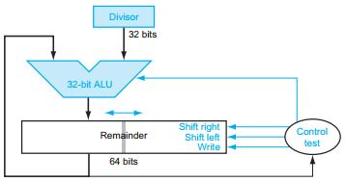
Start
Place Dividend in the right 32 bit of the Remainder register (64 bit)
1. Shift the Remainder register left 1 bit
2. Subtract the Divisor register from the left half of the Remainder register and place the result in the left half of the remainder register
Remainder>=0
3. Test Reminder
Remainder<0
3a. Set the new rightmost bit of the Remainder register to 1
3b. Restore the original value by adding the Divisor register to the left of the Remainder register and place the sum in the left half of the Remainder register. Also, set the rightmost bit 0.
32nd repetition?
No
Yes
Done

Slide 16
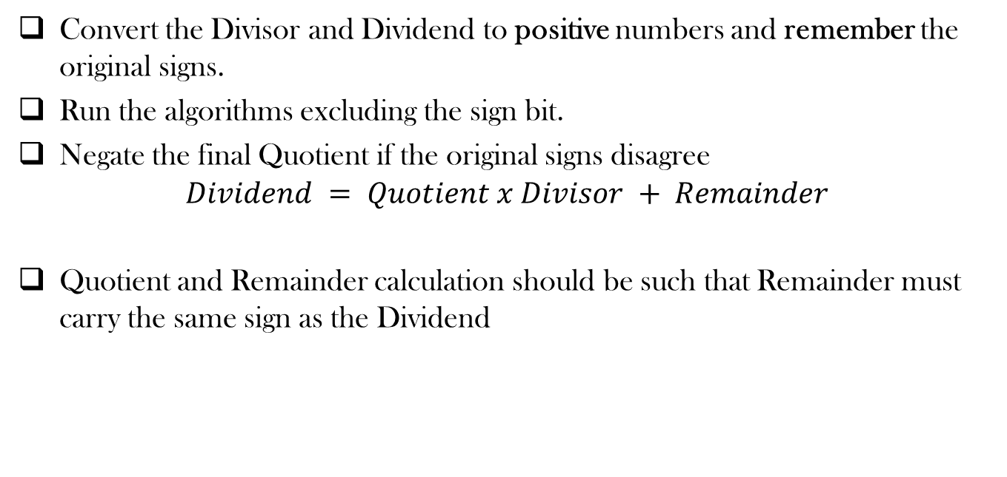
Signed Division
Convert the Divisor and Dividend to positive numbers and remember the original signs.
Run the algorithms excluding the sign bit.
Negate the final Quotient if the original signs disagree
$$Dividend = Quotient x Divisor + Remainder$$
Quotient and Remainder calculation should be such that Remainder must carry the same sign as the Dividend

Slide 17
Divide in MIPS
MIPS provides a separate pair of 32-bit Hi and 32-bit Lo registers for both multiply and divide and.
Hi: 32-bit remainder
Lo: 32-bit quotient
MIPS Instructions
div rs, rt / divu rs, rt
64-bit product in HI / LO
mfhi rd / mflo rd
Move from HI / LO to rd

Slide 18
MIPS Processor
Consists of
an integer processing unit (CPU)
a collection of coprocessors that perform ancillary tasks or operate on other types of data

Slide 19
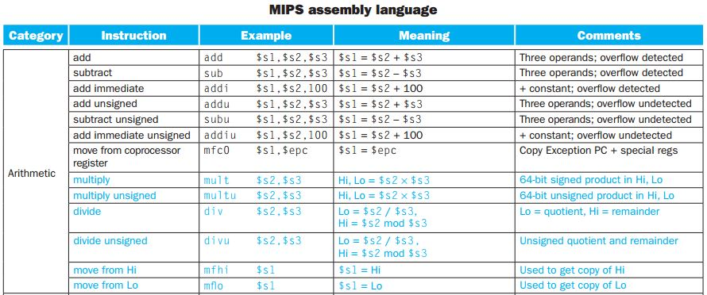
Arithmetic Operations in MIPS

Slide 20
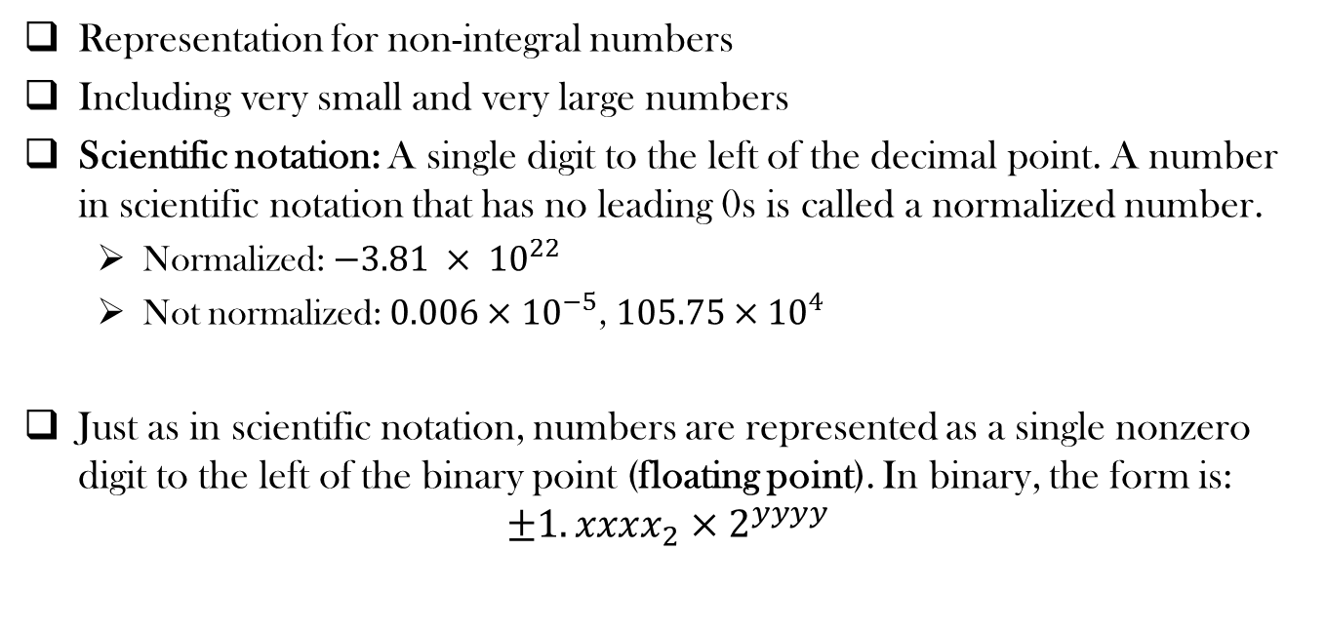
Floating Point
Representation for non-integral numbers
Including very small and very large numbers
Scientific notation: A single digit to the left of the decimal point. A number in scientific notation that has no leading 0s is called a normalized number.
Normalized: $−3.81 × {10}^{22}$
Not normalized: $0.006×{10}^{−5}$, $105.75×{10}^{4}$
Just as in scientific notation, numbers are represented as a single nonzero digit to the left of the binary point (floating point). In binary, the form is:
$$±1.xxxx_{2}×2^{yyyy}$$

Slide 21

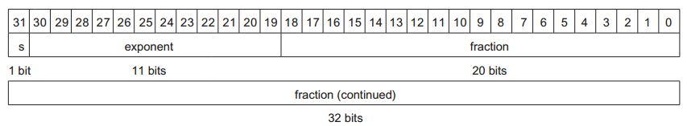
Floating Point Representation
IEEE 754 Floating Point Standard
Single precision floating point (32-bit)
Double precision floating point (64-bit)

Slide 22
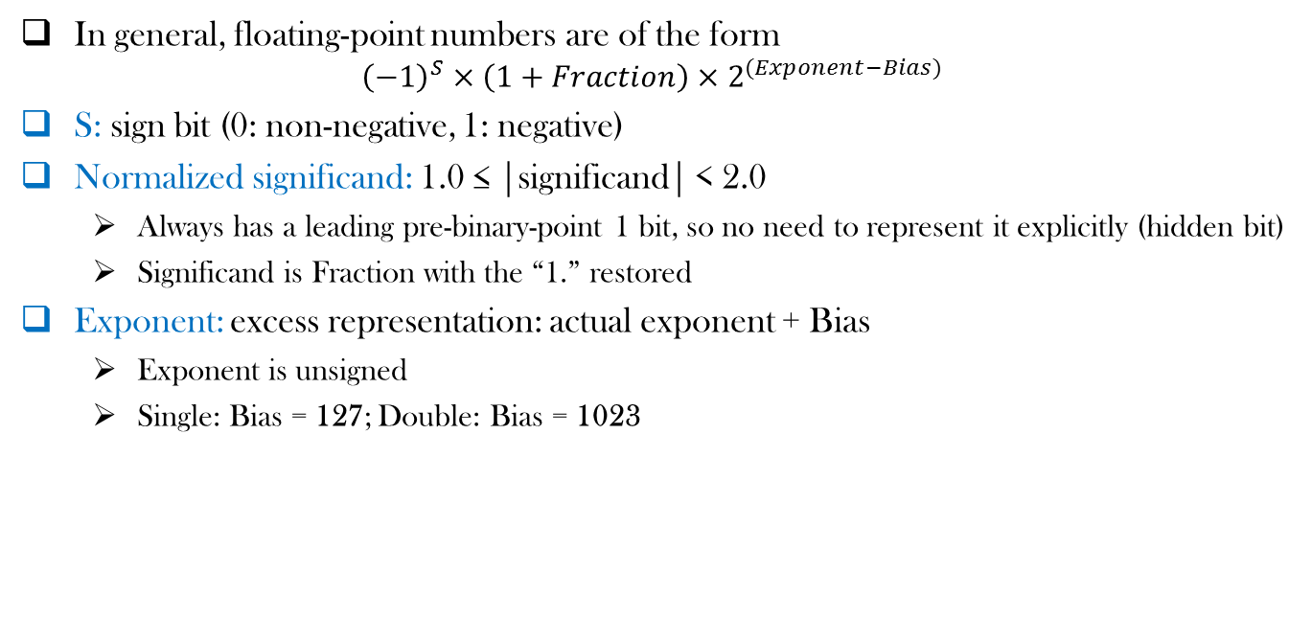
Floating Point Representation
In general, floating-point numbers are of the form
$${\left(−1\right)}^{S}×\left(1+Fraction\right)×2^{(Exponent−Bias)}$$
S: sign bit (0: non-negative, 1: negative)
Normalized significand: 1.0 ≤ |significand| < 2.0
Always has a leading pre-binary-point 1 bit, so no need to represent it explicitly (hidden bit)
Significand is Fraction with the “1.” restored
Exponent: excess representation: actual exponent + Bias
Exponent is unsigned
Single: Bias = 127; Double: Bias = 1023

Slide 23

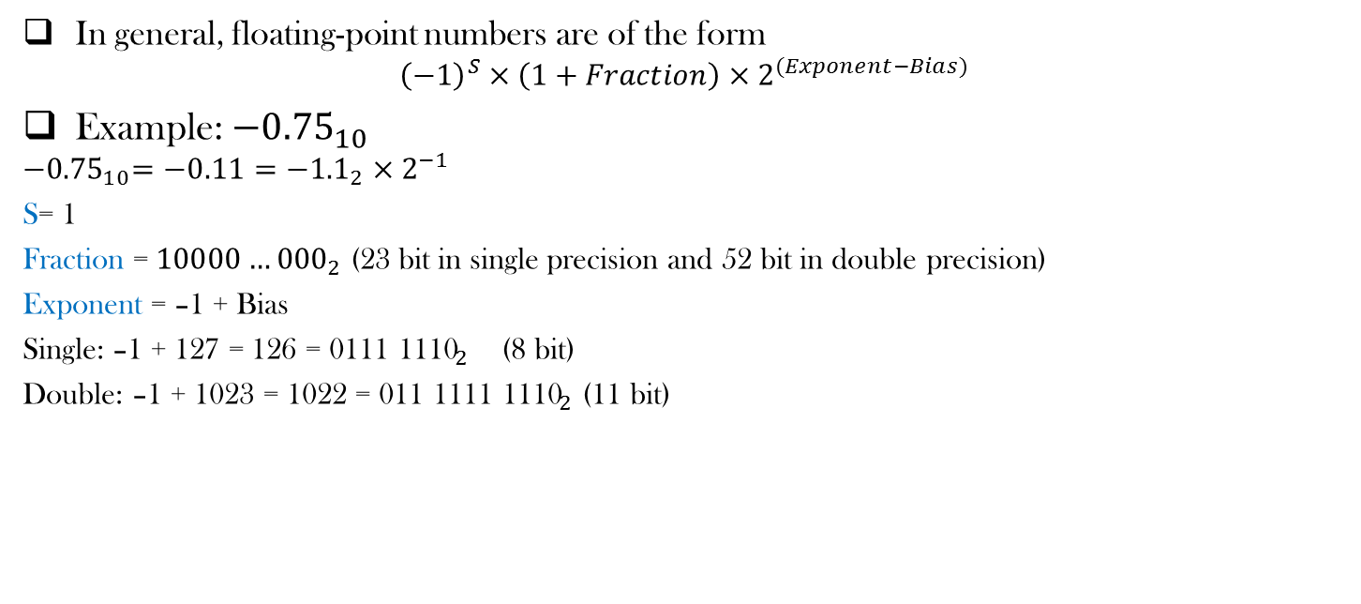
Floating Point Representation
In general, floating-point numbers are of the form
$${\left(−1\right)}^{S}×\left(1+Fraction\right)×2^{(Exponent−Bias)}$$
Example: ${−0.75}_{10}$
$${−0.75}_{10}=−0.11={−1.1}_{2}×2^{−1}$$
S= 1
Fraction = ${10000…000}_{2}$ (23 bit in single precision and 52 bit in double precision)
Exponent = –1 + Bias
Single: –1 + 127 = 126 = ${\text{0111 1110}}_{2}$ (8 bit)
Double: –1 + 1023 = 1022 = ${\text{011 1111 1110}}_{2}$ (11 bit)

Slide 24
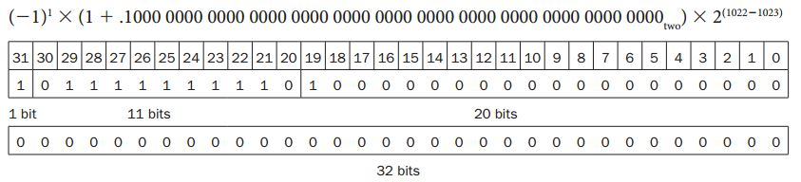

Floating Point Representation
In general, floating-point numbers are of the form
$${\left(−1\right)}^{S}×\left(1+Fraction\right)×2^{(Exponent−Bias)}$$
Example: ${−0.75}_{10}$
$${−0.75}_{10}=−0.11={−1.1}_{2}×2^{−1}$$
S= 1
Fraction = ${10000…000}_{2}$ (23 bit in single precision and 52 bit in double precision)
Exponent = –1 + Bias
Single: –1 + 127 = 126 = ${\text{0111 1110}}_{2}$ (8 bit)
Double: –1 + 1023 = 1022 = ${\text{011 1111 1110}}_{2}$ (11 bit)

Slide 25
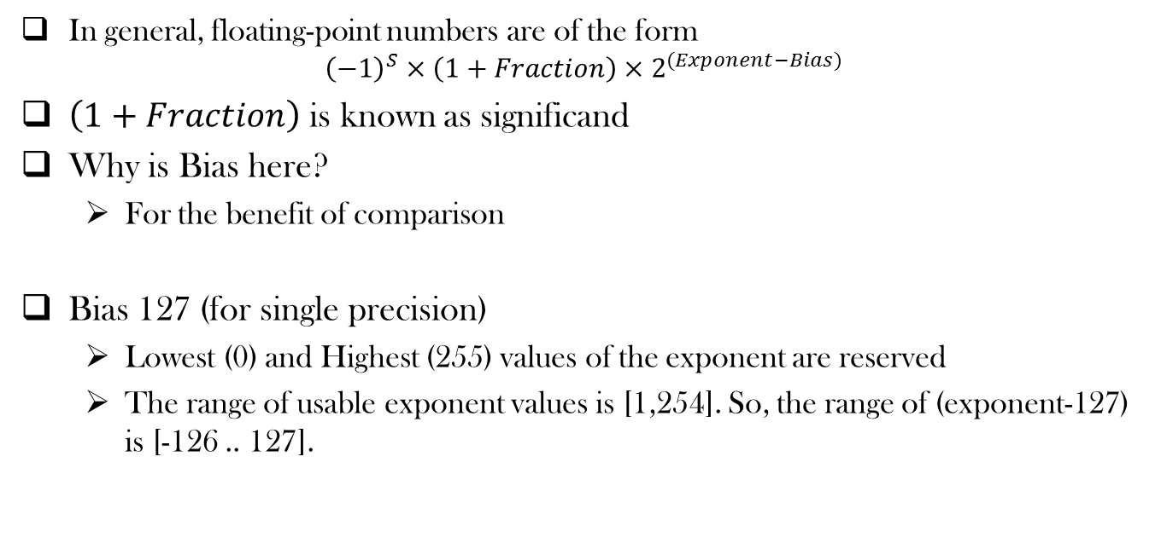
Floating Point Representation
In general, floating-point numbers are of the form
$${\left(−1\right)}^{S}×\left(1+Fraction\right)×2^{(Exponent−Bias)}$$
$\left(1+Fraction\right)$ is known as significand
Why is Bias here?
For the benefit of comparison
Bias 127 (for single precision)
Lowest (0) and Highest (255) values of the exponent are reserved
The range of usable exponent values is [1,254]. So, the range of (exponent-127) is [-126 .. 127].

Slide 26
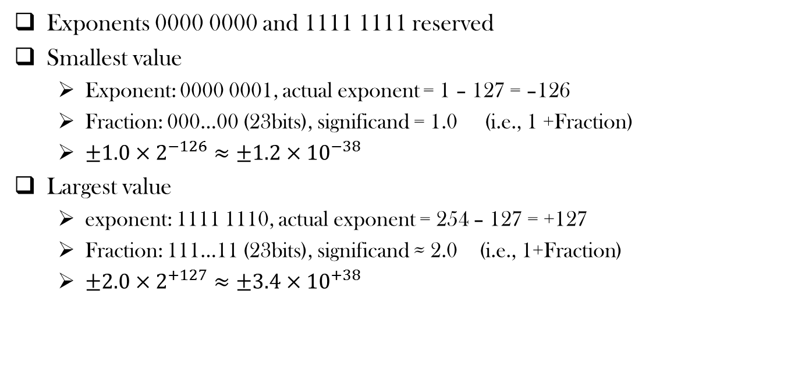
Single Precision Range
Exponents 0000 0000 and 1111 1111 reserved
Smallest value
Exponent: 0000 0001, actual exponent = 1 – 127 = –126
Fraction: 000…00 (23bits), significand = 1.0 (i.e., 1 +Fraction)
$±1.0×2^{−126}≈±1.2×{10}^{−38}$
Largest value
exponent: 1111 1110, actual exponent = 254 – 127 = +127
Fraction: 111…11 (23bits), significand ≈ 2.0 (i.e., 1+Fraction)
$±2.0×2^{+127}≈±3.4×{10}^{+38}$

Slide 27
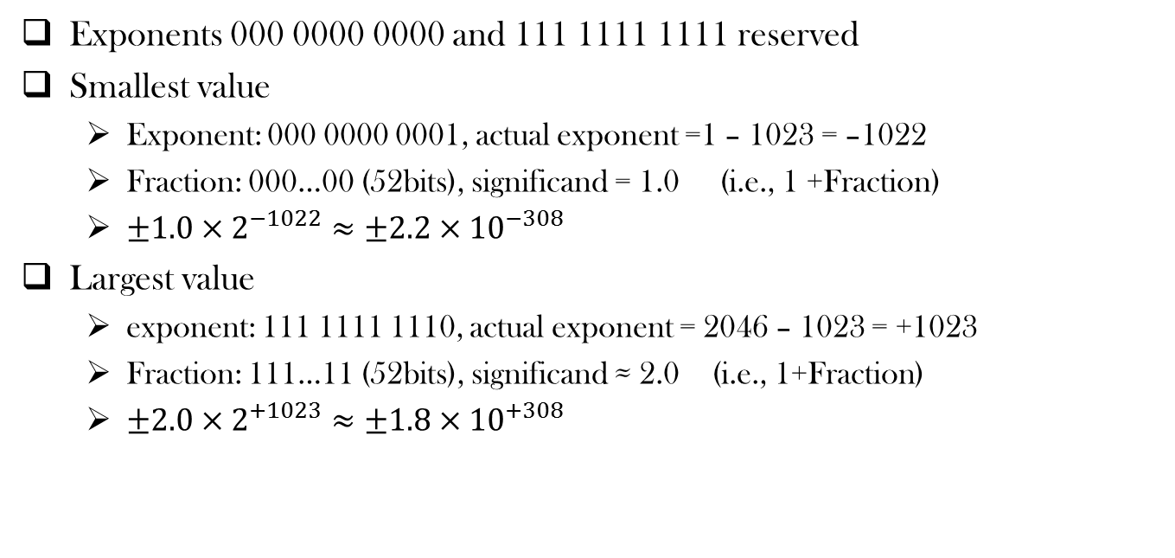
Double Precision Range
Exponents 000 0000 0000 and 111 1111 1111 reserved
Smallest value
Exponent: 000 0000 0001, actual exponent =1 – 1023 = –1022
Fraction: 000…00 (52bits), significand = 1.0 (i.e., 1 +Fraction)
$±1.0×2^{−1022}≈±2.2×{10}^{−308}$
Largest value
exponent: 111 1111 1110, actual exponent = 2046 – 1023 = +1023
Fraction: 111…11 (52bits), significand ≈ 2.0 (i.e., 1+Fraction)
$±2.0×2^{+1023}≈±1.8×{10}^{+308}$

Slide 28
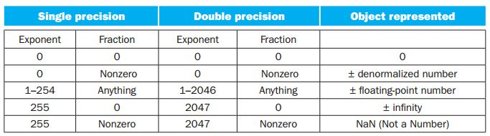
EEE 754 encoding of floating-point numbers

Slide 29
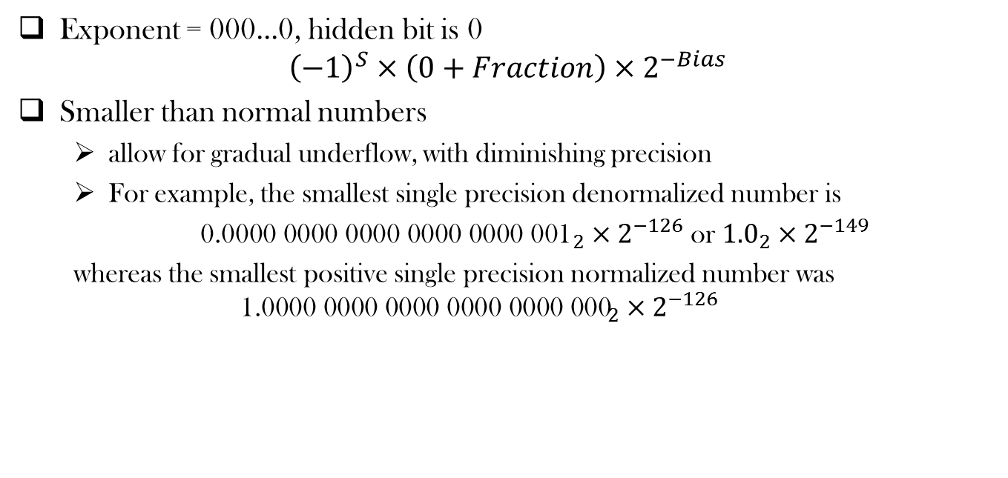
Denormal Number
Exponent = 000...0, hidden bit is 0 ${\left(−1\right)}^{S}×\left(0+Fraction\right)×2^{−Bias}$
Smaller than normal numbers
allow for gradual underflow, with diminishing precision
For example, the smallest single precision denormalized number is
${\text{0.0000 0000 0000 0000 0000 001}}_{2}×2^{−126}$ or ${1.0}_{2}×2^{−149}$
whereas the smallest positive single precision normalized number was
$${\text{1.0000 0000 0000 0000 0000 000}}_{2}×2^{−126}$$

Slide 30
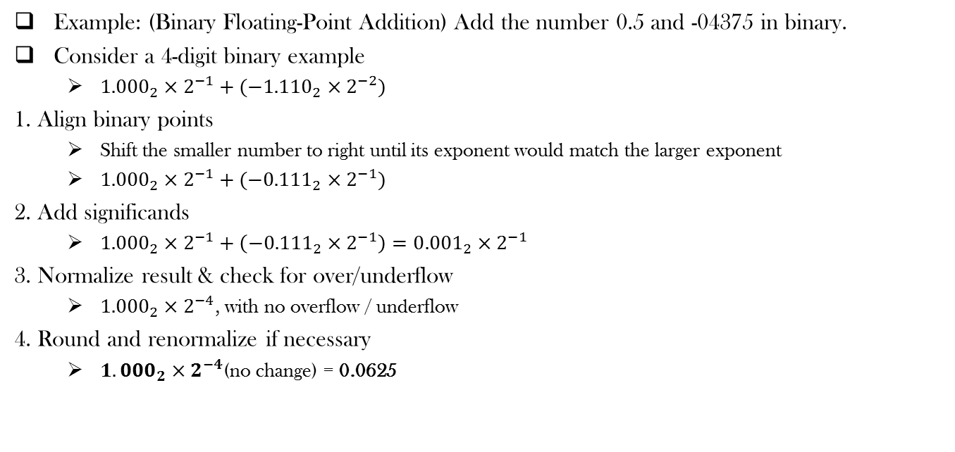
Floating Point Addition
Example: (Binary Floating-Point Addition) Add the number 0.5 and -04375 in binary.
Consider a 4-digit binary example
${1.000}_{2}×2^{−1}+({−1.110}_{2}×2^{−2})$
1. Align binary points
Shift the smaller number to right until its exponent would match the larger exponent
${1.000}_{2}×2^{−1}+({−0.111}_{2}×2^{−1})$
2. Add significands
${1.000}_{2}×2^{−1}+\left({−0.111}_{2}×2^{−1}\right)={0.001}_{2}×2^{−1}$
3. Normalize result & check for over/underflow
${1.000}_{2}×2^{−4}$, with no overflow / underflow
4. Round and renormalize if necessary
${1.000}_{2}×2^{−4}$(no change) = 0.0625

Slide 31
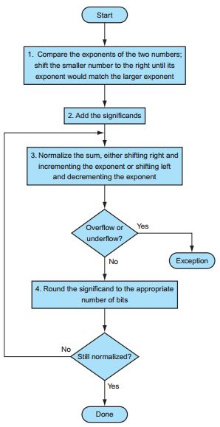
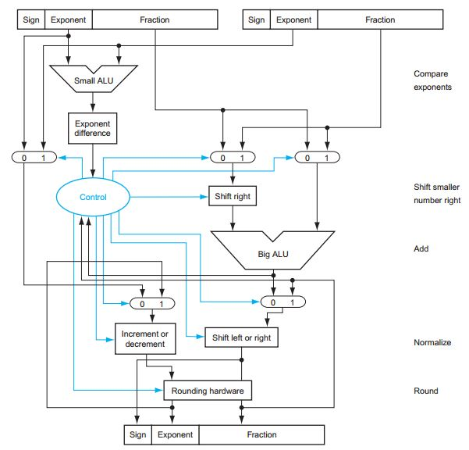

Slide 32
Associativity of FP Addition
Associativity: a+(b+c) = (a+b) + c
Is FP addition associative?
No

Slide 33
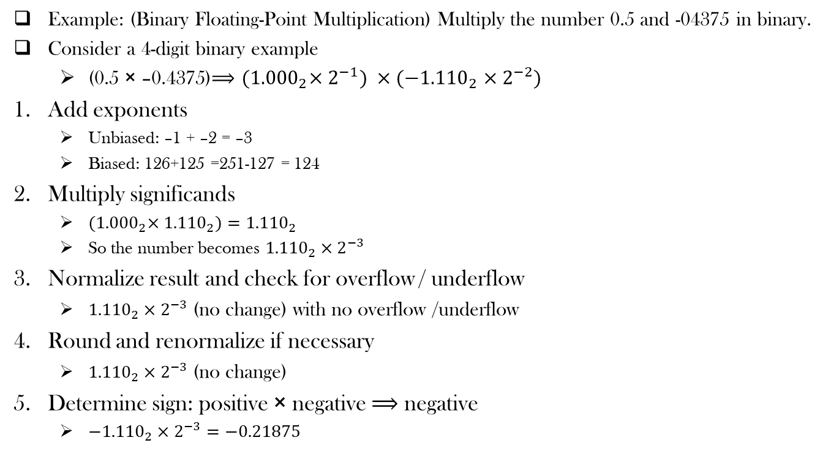
Floating Point Multiplication
Example: (Binary Floating-Point Multiplication) Multiply the number 0.5 and -04375 in binary.
Consider a 4-digit binary example
(0.5 × –0.4375)$⟹{(1.000}_{2}×2^{−1}) ×({−1.110}_{2}×2^{−2})$
Add exponents
Unbiased: –1 + –2 = –3
Biased: 126+125 =251-127 = 124
Multiply significands
${(1.000}_{2}×{1.110}_{2})={1.110}_{2}$
So the number becomes ${1.110}_{2}×2^{−3}$
Normalize result and check for overflow / underflow
${1.110}_{2}×2^{−3}$ (no change) with no overflow /underflow
Round and renormalize if necessary
${1.110}_{2}×2^{−3}$ (no change)
Determine sign: positive × negative $⟹$ negative
${−1.110}_{2}×2^{−3}=−0.21875$

Slide 34
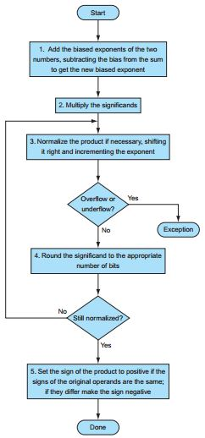

Slide 35
Rounding Bits
Guard and round digits, and sticky bit
When computing result, assume there are several extra digits available for shifting and computation. This improves accuracy of computation.
Guard digit: first extra digit/bit to the right of mantissa -- used for rounding addition results
Round digit: second extra digit/bit to the right of mantissa -- used for rounding multiplication results
Sticky bit: third extra digit/bit to the right of mantissa – used for resolving ties such as 0.50...00 vs. 0.50...01

Slide 36
Rounding Bits
Rounding using Guard and round digits, and sticky bit
G | R | S | Action
0 | 0 | 0 | Truncate
0 | 0 | 1 | Truncate
0 | 1 | 0 | Truncate
0 | 1 | 1 | Truncate
1 | 0 | 0 | Round to Even
1 | 0 | 1 | Round Up
1 | 1 | 0 | Round Up
1 | 1 | 1 | Round Up
1.100GRS
1.10001 = 1.53125
1.10010 = 1.56250
1.10011 = 1.59375

Slide 37
Floating-Point Instructions in MIPS
Floating-point hardware is coprocessor 1
Extends the ISA for floating point operations
Separate floating-point registers
32 single-precision: $f0, $f1, …, $f31
Paired for double-precision: $f0/$f1, $f2/$f3, …, $f30/$f31
Floating-point load and store instructions
Load word coprocessor 1 (lwc1), store word coprocessor 1 (swc1)
e.g., lwc1 $f2, 100($s2) # $f2 = Memory [$s2 + 100]

Slide 38
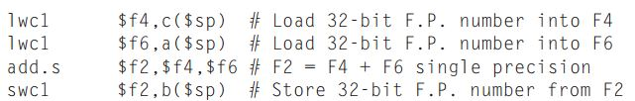
Single and Double Precision operations
A double precision register is really an even-odd pair of single precision registers, using the even register number as its name.
What if add.d was used?

Slide 39
Floating-Point Instructions in MIPS
Floating-point addition, single (add.s) and addition, double (add.d)
e.g., add.s $f0, $f4, $f6 # $f2 = $f4 + $f6
Floating-point subtraction, single (sub.s) and subtraction, double (sub.d)
e.g., sub.d $f2, $f4, $f6 # $f2 = $f4 - $f6
Floating-point multiplication, single (mul.s) and multiplication, double (mul.d)
e.g., mul.s $f2, $f4, $f6 # $f2 = $f4 X $f6
Floating-point division, single (div.s) and division, double (div.d)
e.g., div.d $f2, $f4, $f6 # $f2 = $f4 / $f6

Slide 40

Floating-Point Instructions in MIPS
Floating-point comparison, single (c.x.s) and comparison, double (c.x.d), where x may be equal (eq), not equal (neq), less than (lt), less than or equal (le), greater than (gt), or greater than or equal (ge)
e.g., c.lt.s $f2, $f4 # if ($f2 < $f4) cond = 1; else cond = 0
Floating-point branch, true (bc1t) and branch, false (bc1f)
e.g., bclt 25 # if (cond == 1) go to PC + 4 + 100
$c.eq.s$ $f2, $f4
$bc1f Else \#go to Else if i ≠ j$
$$add.s \$f6, \$f8, \$f10 \#f = g + h$$
$$j Exit$$
$$Else: sub.s \$f6, \$f8, \$f10 \#f = g−h$$
$$\begin{aligned}Exit:\end{aligned}$$
if (i==j)
f = g + h;
else
f = g – h;

Slide 41
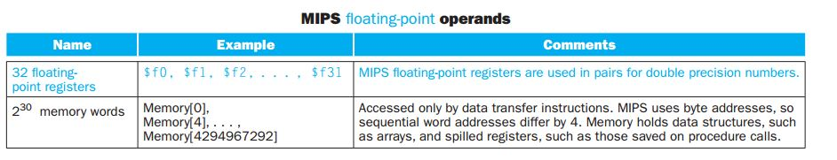
MIPS FP Operands

Slide 42
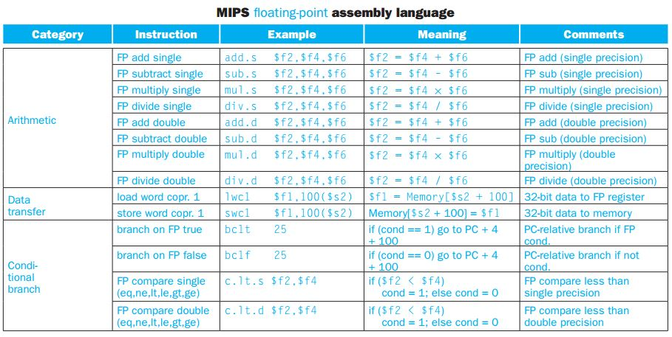
MIPS FP Operations

Slide 43
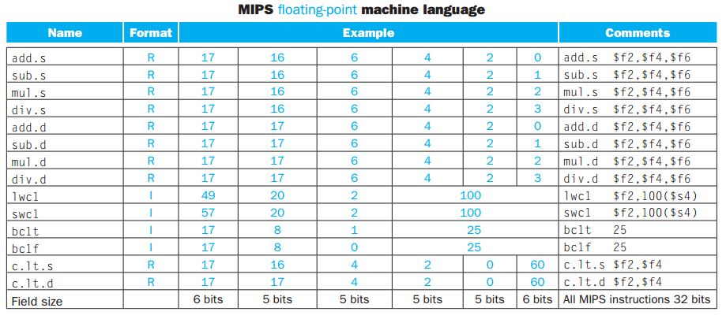
MIPS FP Instruction Format

Slide 44
Acknowledgements
These slides contain material developed and copyright by:
Lecture slides by Dr. Tanzima Hashem, Professor, CSE, BUET
Lecture slides by Mehnaz Tabassum Mahin, Assistant Professor, CSE, BUET
Lecture Notes by Kuo-pao Yang, Professor, Southeastern Louisiana University

Slide 45
References
Computer Organization and Design (5th edition) by David A. Patterson and John L. Hennessy
Chapter 3 (3.1-3.4, 3.12)

Slide 46
Thank You ☺

