Slide 1
Chapter 5
Large and Fast: Exploiting Memory Hierarchy

Slide 2
Principle of Locality
§5.1 Introduction
Programs access a small proportion of their address space at any time
Temporal locality
Items accessed recently are likely to be accessed again soon
e.g., instructions in a loop, induction variables
Spatial locality
Items near those accessed recently are likely to be accessed soon
E.g., sequential instruction access, array data

Slide 3
Taking Advantage of Locality
Memory hierarchy
Store everything on disk
Copy recently accessed (and nearby) items from disk to smaller DRAM memory
Main memory
Copy more recently accessed (and nearby) items from DRAM to smaller SRAM memory
Cache memory attached to CPU

Slide 4
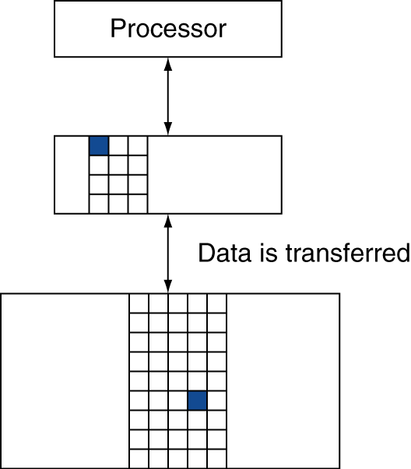
Memory Hierarchy Levels
Block (aka line): unit of copying
May be multiple words
If accessed data is present in upper level
Hit: access satisfied by upper level
Hit ratio: hits/accesses
If accessed data is absent
Miss: block copied from lower level
Time taken: miss penalty
Miss ratio: misses/accesses = 1 – hit ratio
Then accessed data supplied from upper level

Slide 5
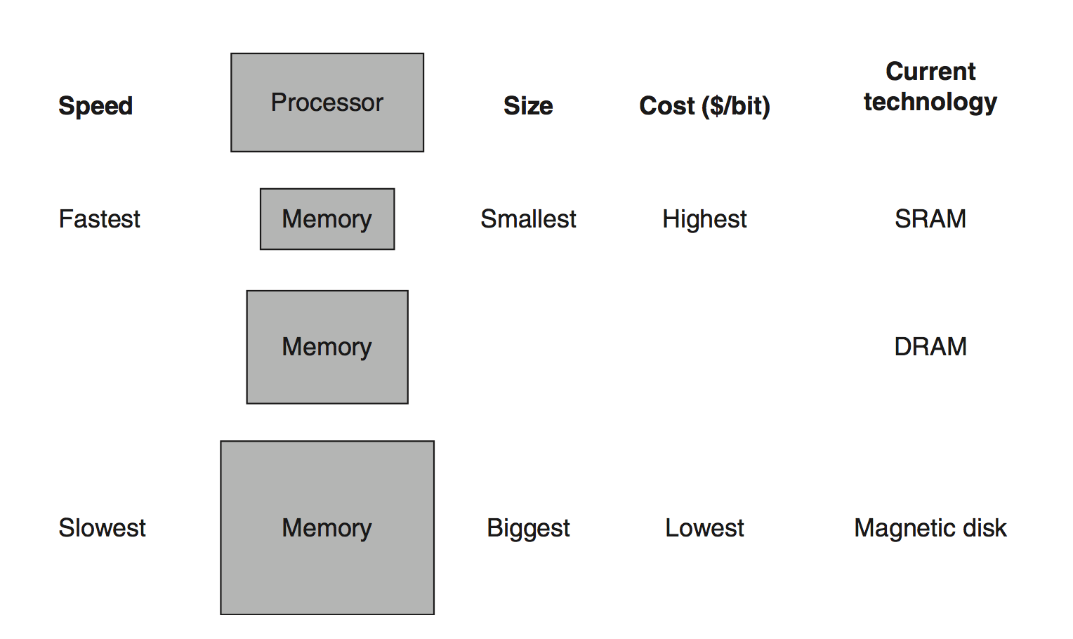
Basic Structure of Memory Hierarchy Levels

Slide 6
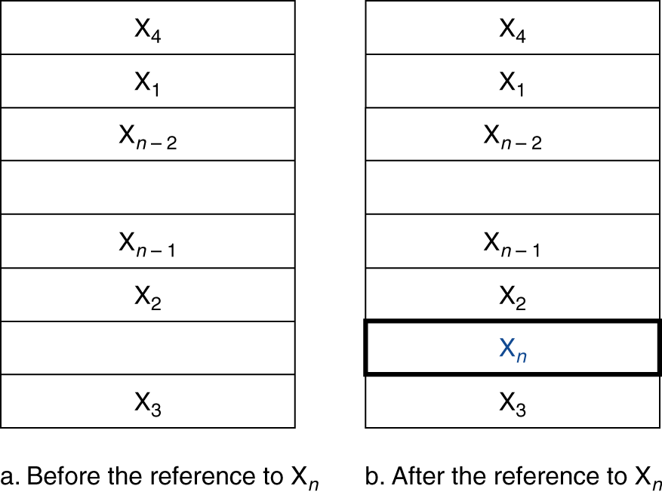
Cache Memory
Cache memory
The level of the memory hierarchy closest to the CPU
Given accesses X₁, …, X_{n–1}, X_{n}
§5.3 The Basics of Caches
How do we know if the data is present?
Where do we look?

Slide 7
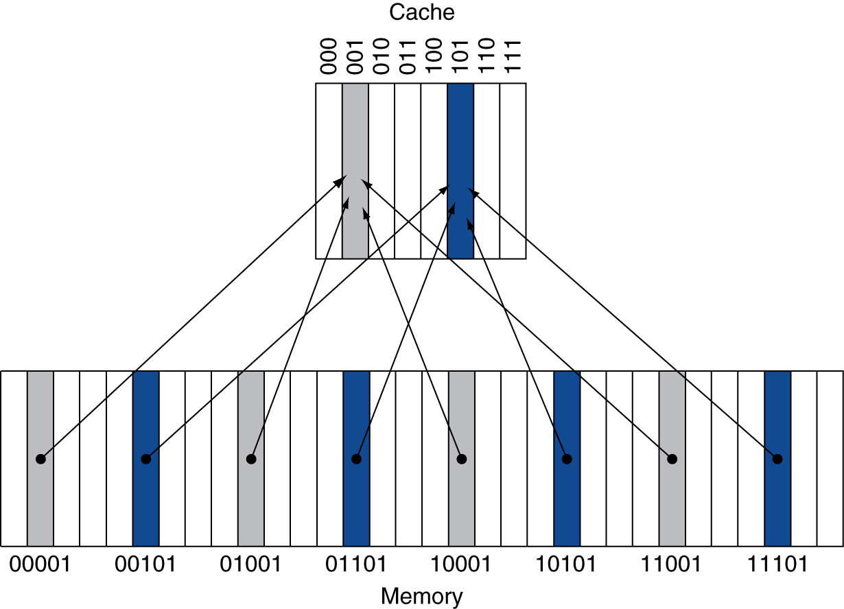
Direct Mapped Cache
Location determined by address
Direct mapped: A cache structure in which each memory location is mapped to exactly one location in the cache.
Mapping to a find a memory block in the cache =
(Block address) modulo (#Blocks in cache)
#Blocks is a power of 2
Use low-order address bits

Slide 8
Tags and Valid Bits
How do we know which particular block is stored in a cache location?
Store block address as well as the data
Actually, only need the high-order bits
Called the tag
What if there is no data in a location?
Valid bit: 1 = present, 0 = not present
Initially 0

Slide 9
Cache Example
8-blocks, 1 word/block, direct mapped
Initial state
22,
26,
22,
26,
16,
3,
16,
18,
16
Index | V | Tag | Data
000 | N
001 | N
010 | N
011 | N
100 | N
101 | N
110 | N
111 | N

Slide 10
Cache Example
Word addr | Binary addr | Hit/miss | Cache block
22 | 10 110 | Miss | 110
22,
26,
22,
26,
16,
3,
16,
18,
16
Index | V | Tag | Data
000 | N
001 | N
010 | N
011 | N
100 | N
101 | N
110 | Y | 10 | Mem[10110]
111 | N

Slide 11
Cache Example
Word addr | Binary addr | Hit/miss | Cache block
26 | 11 010 | Miss | 010
22,
26,
22,
26,
16,
3,
16,
18,
16
Index | V | Tag | Data
000 | N
001 | N
010 | Y | 11 | Mem[11010]
011 | N
100 | N
101 | N
110 | Y | 10 | Mem[10110]
111 | N

Slide 12
Cache Example
Word addr | Binary addr | Hit/miss | Cache block
22 | 10 110 | Hit | 110
26 | 11 010 | Hit | 010
22,
26,
22,
26,
16,
3,
16,
18,
16
Index | V | Tag | Data
000 | N
001 | N
010 | Y | 11 | Mem[11010]
011 | N
100 | N
101 | N
110 | Y | 10 | Mem[10110]
111 | N

Slide 13
Cache Example
Word addr | Binary addr | Hit/miss | Cache block
16 | 10 000 | Miss | 000
3 | 00 011 | Miss | 011
16 | 10 000 | Hit | 000
22,
26,
22,
26,
16,
3,
16,
18,
16
Index | V | Tag | Data
000 | Y | 10 | Mem[10000]
001 | N
010 | Y | 11 | Mem[11010]
011 | Y | 00 | Mem[00011]
100 | N
101 | N
110 | Y | 10 | Mem[10110]
111 | N

Slide 14
Cache Example
Word addr | Binary addr | Hit/miss | Cache block
18 | 10 010 | Miss | 010
22,
26,
22,
26,
16,
3,
16,
18,
16
Index | V | Tag | Data
000 | Y | 10 | Mem[10000]
001 | N
010 | Y | 10 | Mem[10010]
011 | Y | 00 | Mem[00011]
100 | N
101 | N
110 | Y | 10 | Mem[10110]
111 | N
010 | Y | 11 | Mem[11010]

Slide 15
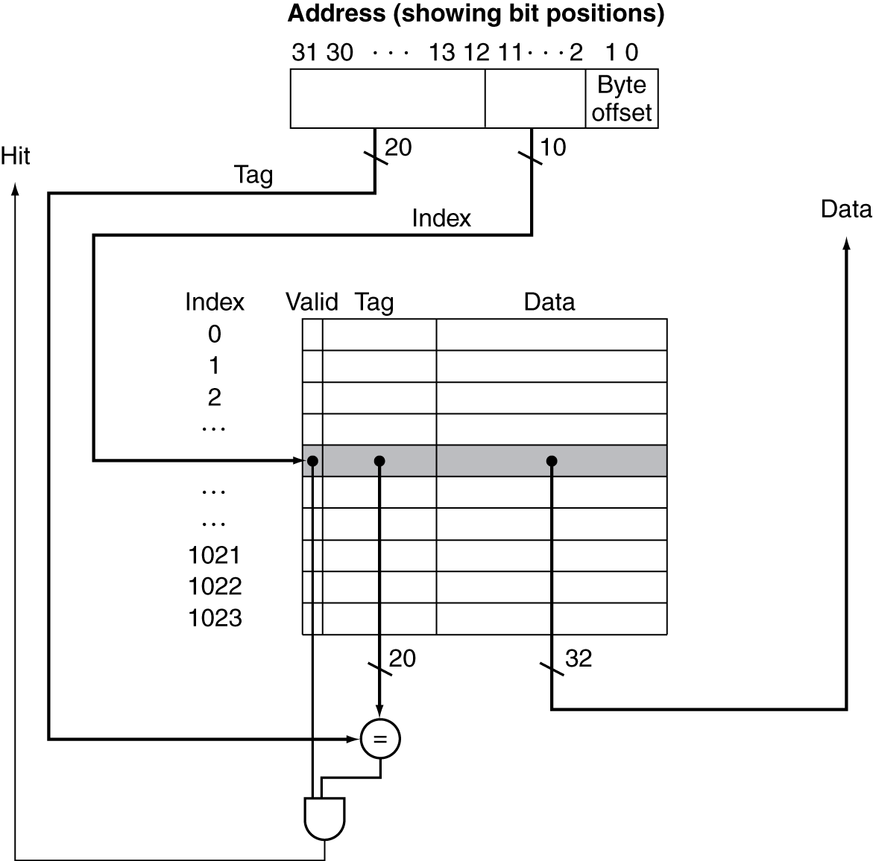
Address Subdivision

Slide 16
Total bits in a cache
v is the valid field size, i.e., 1
Size of
tag field
32-bit addresses
A direct-mapped cache
The cache size is 2^{n} blocks
so n bits are used for the index
The block size (b) is 2^{m} words (2^{m+2} bytes = 2^{m+2+3} bits)
m bits are used to access the words within the block
two bits are used for the byte part of the address
Total number of bits (C)
C = 2^{n} x (b + t + v)
t = 32 – (n + m + 2)
b = 2^{m+5}
C = 2^{n} x (2^{m+5} + 32 – (n + m + 2) + 1) = 2^{n} x (2^{m} x 32 + 32 –n - m -1)
Block
size

Slide 17
Total bits in a cache
n
How many total bits are required for a direct-mapped cache with 16 KiB of data and 4-word blocks (i.e., 16 bytes), assuming a 32-bit address?
16 KiB = 4 Ki Words = 1 Ki Blks = 2¹⁰ Blks
C = 1024 x (b + t + v) = 1024x(4x32 + t + 1) = 1024x(4x32 +18+1) = 147 Kilo bits
31
14
13
4
3
0
Tag
Index
Offset
18 bits
10 bits
4 bits

Slide 18
Example: Larger Block Size
Byte Address
64 blocks, 16 bytes/block
To what block number does address 1200 map?
Block address = ⎣1200/16⎦ = 75
Block number = 75 modulo 64 = 11
⎣byte address /
bytes per block⎦
31
10
9
4
3
0
Tag
Index
Offset
22 bits
6 bits
4 bits
64 blocks
16 bytes

Slide 19
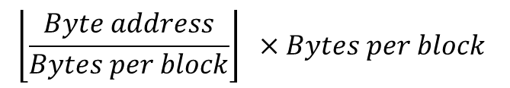
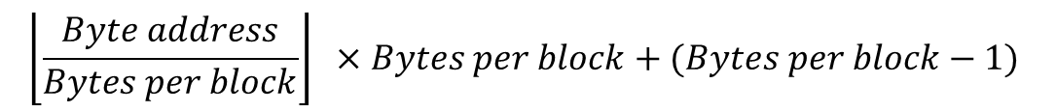
Example: Larger Block Size
Byte Address
64 blocks, 16 bytes/block
To what block number does address 1200 map?
Block address = ⎣1200/16⎦ = 75
Block number = 75 modulo 64 = 11
In fact Block 11 maps all addresses between 1200 and 1215.
0
Offset
4 bits
3
⎣byte address /
bytes per block⎦
4
Index
6 bits
9
10
Tag
22 bits
31

Slide 20
Block Size Considerations
Larger blocks should reduce miss rate
Due to spatial locality
But in a fixed-sized cache
Larger blocks ⇒ fewer of them
More competition ⇒ increased miss rate
Larger miss penalty
Larger blocks ⇒ Larger transfer time
Can override benefit of reduced miss rate
Early restart critical-word-first can help

Slide 21
Early restart
resume execution as soon as the requested word of the block is returned; Does not wait for the entire block
For instruction access, it works best
Instruction accesses are largely sequential
so if the memory system can deliver a word every clock cycle, the processor may be able to restart operation when the requested word is returned, with the memory system delivering new instruction words just in time.
This technique is usually less effective for data caches because it is likely that the words will be requested from the block in a less predictable

Slide 22
Critical Word First
Organizes the memory so that the requested word is transferred from the memory to the cache first.
The remainder of the block is then transferred, starting with the address after the requested word and wrapping around to the beginning of the block.
Can be slightly faster than early restart
but it is limited by the same properties that limit early restart.

Slide 23
Cache Misses
On cache hit, CPU proceeds normally
On cache miss
Stall the CPU pipeline
Fetch block from next level of hierarchy
Instruction cache miss
Restart instruction fetch
Data cache miss
Complete data access

Slide 24
Write-Through
On data-write hit, could just update the block in cache
But then cache and memory would be inconsistent
Write through: also update memory
But makes writes take longer
e.g., if base CPI = 1, 10% of instructions are stores, write to memory takes 100 cycles
Effective CPI = 1 + 0.1×100 = 11
Solution: write buffer
Holds data waiting to be written to memory
CPU continues immediately
Only stalls on write if write buffer is already full

Slide 25
Write-Back
Alternative: On data-write hit, just update the block in cache
Keep track of whether each block is dirty
When a dirty block is replaced
Write it back to memory
Can use a write buffer to allow replacing block to be read first

Slide 26
Write Allocation
What should happen on a write miss?
Alternatives for write-through
Allocate on miss: fetch the block
Write around: don’t fetch the block
Since programs often write a whole block before reading it (e.g., initialization)
For write-back
Usually fetch the block
(See next slides)
Write allocate
No Write
allocate

Slide 27
Advantage for write-through
we can write the data into the cache and then read the tag;
if the tag mismatches, then a miss occurs.
Because the cache is write-through, the overwriting of the block in the cache is not catastrophic
memory has the correct value and we can do it right.
THIS CANNOT BE DONE FOR WRITE BACK

Slide 28
Write Back
If we have a cache miss, we must first write the block back to memory if the data in the cache is modified.
stores require two cycles:
a cycle to check for a hit
followed by a cycle to actually perform the write
Alternative: Write Buffer to hold that data

Slide 29
Write Back- Write Buffer
write buffer holds the data to write in
effectively allowing the store to take only one cycle by pipelining it:
When a store buffer is used, the processor does the cache lookup and places the data in the store buffer during the normal cache access cycle.
Assuming a cache hit, the new data is written from the store buffer into the cache on the next unused cache access cycle.

Slide 30
Write Back- Write Buffer for miss
the modified block is moved to a write-back buffer associated with the cache in case of a miss
while the requested block is read from memory.
The write-back buffer is later written back to memory.
Assuming another miss does not occur immediately, this technique reduces the miss penalty

Slide 31
Example: Intrinsity FastMATH
Embedded MIPS processor
12-stage pipeline
Instruction and data access on each cycle
Split cache: separate I-cache and D-cache
Each 16KB: 256 blocks × 16 words/block
D-cache: write-through or write-back
SPEC2000 miss rates
I-cache: 0.4%
D-cache: 11.4%
Weighted average: 3.2%

Slide 32
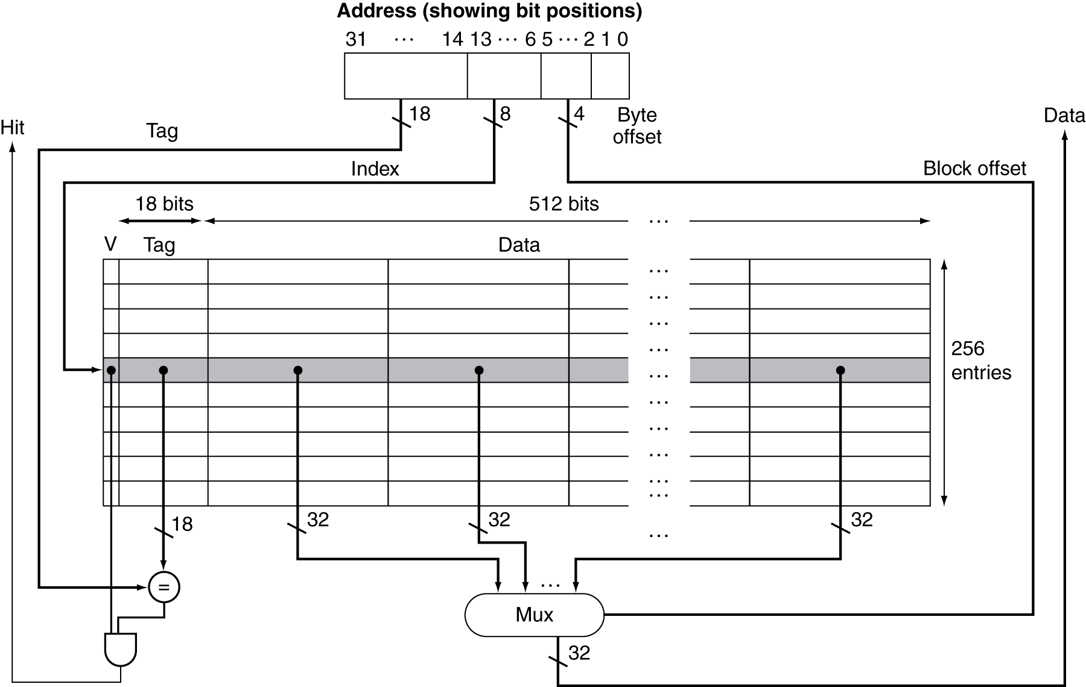
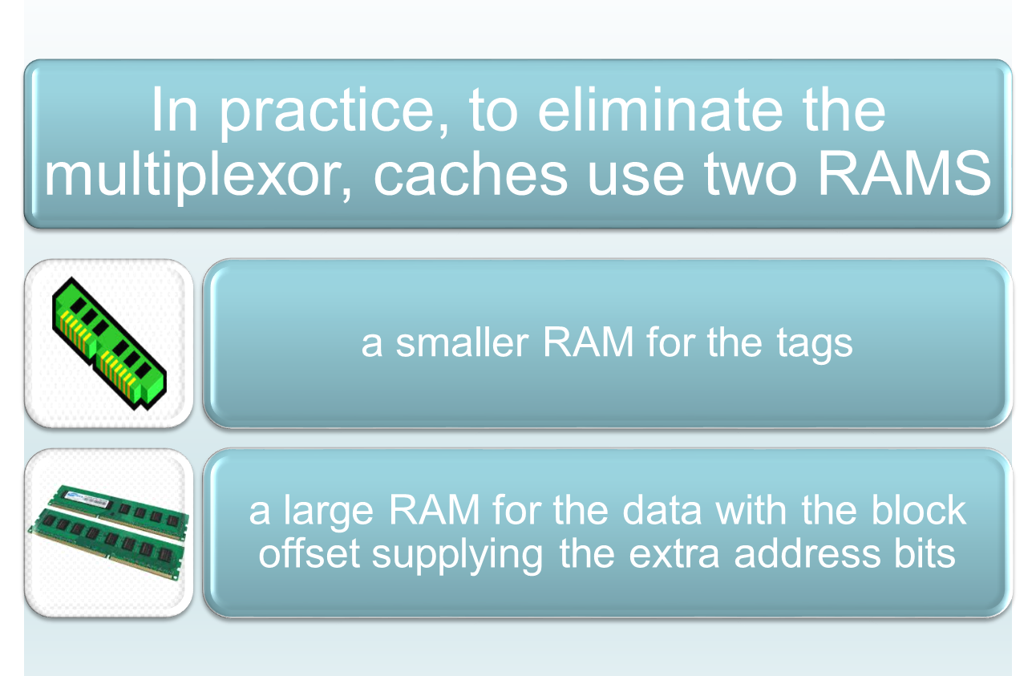
Example: Intrinsity FastMATH
256 blocks × 16 words/block

Slide 33
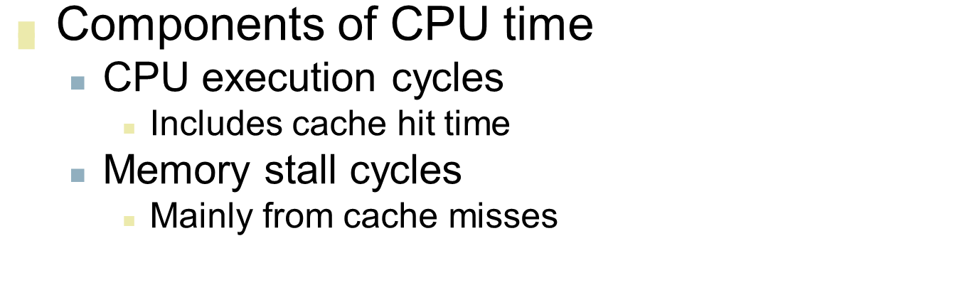
Measuring Cache Performance
§5.4 Measuring and Improving Cache Performance

Slide 34
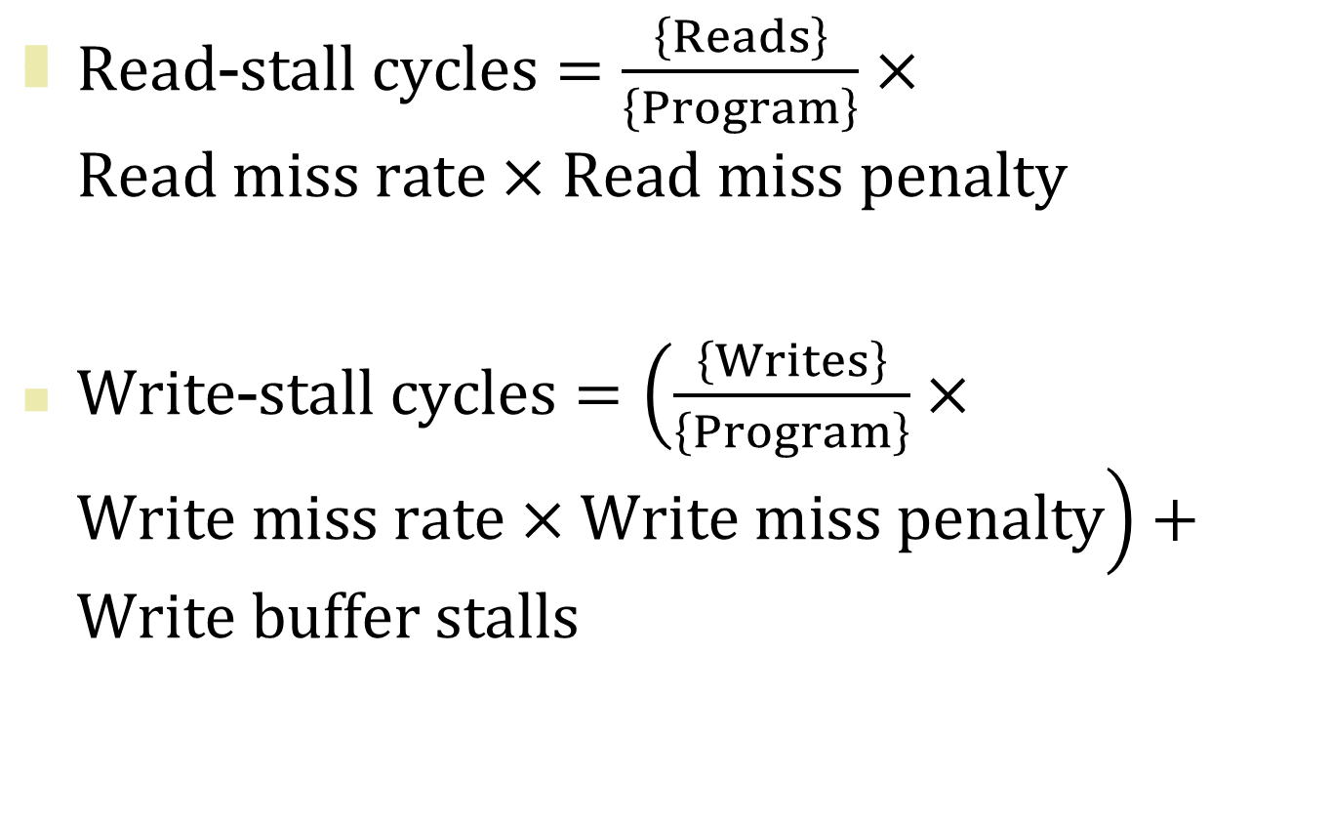
Measuring Cache Performance
For Write-through Cache

Slide 35
Notes: Write Buffer Stalls
Write buffer stalls depend
on the proximity of writes
and not just the frequency
Usually we can ignore write buffer stalls
in systems with 4 or more words depth
With a memory capable of accepting writes at a rate that significantly exceeds the average write frequency in programs (by a factor of 2)
If a system did not meet these criteria, it would not be well designed;
instead, the designer should have used either a deeper write buffer or a write-back organization
So not easy to
deduce an equation

Slide 36
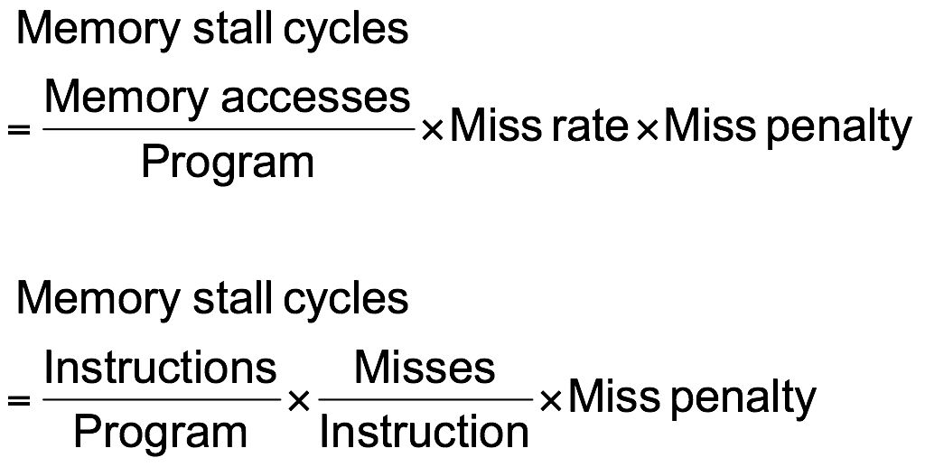
Measuring Cache Performance
With simplifying assumptions:
read and write miss penalties are same
In most write-through schemes this is the case
Write buffer stalls are negligible
§5.4 Measuring and Improving Cache Performance
For
Data
For
Instruction

Slide 37

Cache Performance Example
Given
miss rate: I-cache = 2% ; D-cache = 4%
Miss penalty = 100 cycles
Base CPI (ideal cache) = 2
Load & stores are 36% of instructions
Say total instruction: I
I-cache miss cycles: I × 0.02 × 100 = 2.00 × I
D-cache: I × 0.36 × 0.04 × 100 = 1.44 × I
Actual CPI = 2 + 2 + 1.44 = 5.44
Ideal CPU is 5.44/2 =2.72 times faster
How much
faster is a
processor
with a perfect
cache?

Slide 38
Amdahl’s Law
A rule stating that the performance enhancement possible with a given improvement is limited by the amount that the improved feature is used.
What happens if the processor is made faster, but the memory system is not?
The amount of time spent on memory stalls will take up an increasing fraction of the execution time

Slide 39
Cache Performance Example 2
Given
miss rate: I-cache = 2% ; D-cache = 4%
Miss penalty = 100 cycles
Base CPI (ideal cache) = 1
Load & stores are 36% of instructions
Say total instruction: I
I-cache miss cycles: I × 0.02 × 100 = 2.00 × I
D-cache: I × 0.36 × 0.04 × 100 = 1.44 × I
Actual CPI = 1 + 2 + 1.44 = 4.44
Ideal CPU is 4.44/1 =4.44 times faster
How much
faster is a
processor
with a perfect
cache?

Slide 40
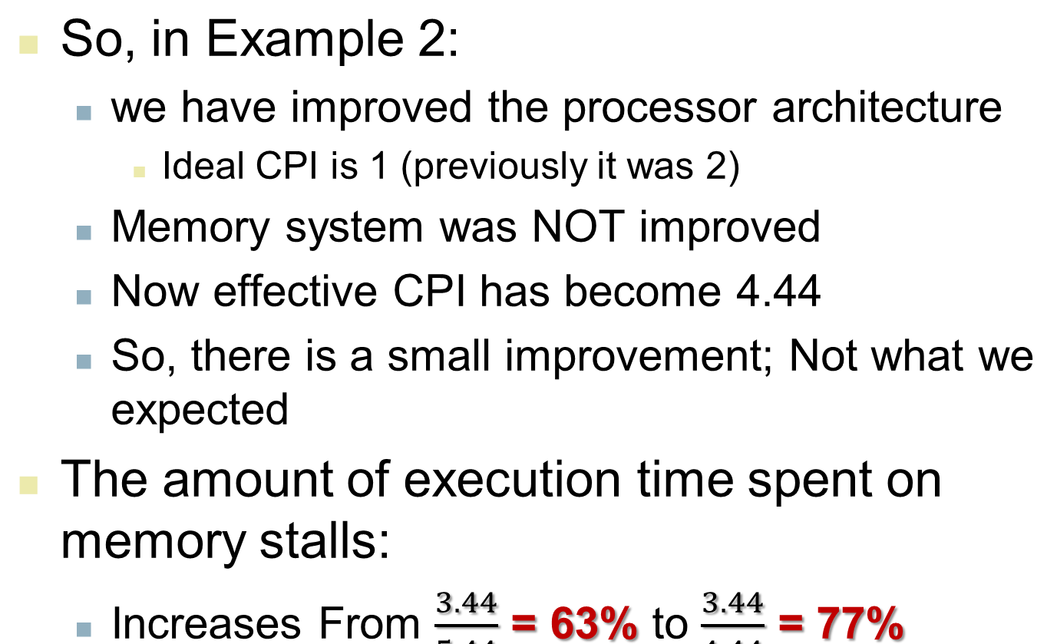
Lesson (re)Learned
Previously
it was 5.44
Performance lost increases

Slide 41
Average Access Time
Hit time is also important for performance
Average memory access time (AMAT)
AMAT = Hit time + Miss rate × Miss penalty
Example
CPU with 1ns clock, hit time = 1 cycle, miss penalty = 20 cycles, I-cache miss rate = 5%
AMAT = 1 + 0.05 × 20 = 2ns
2 cycles per instruction

Slide 42
Performance Summary
When CPU performance increased
Miss penalty becomes more significant
Decreasing base CPI
Greater proportion of time spent on memory stalls
Increasing clock rate
Memory stalls account for more CPU cycles
Can’t neglect cache behavior when evaluating system performance

Slide 43
Associative Caches
Fully associative
Allow a given block to go in any cache entry
Requires all entries to be searched at once
Comparator per entry (expensive)
n-way set associative
Each set contains n entries
Block number determines which set
(Block number) modulo (#Sets in cache)
Search all entries in a given set at once
n comparators (less expensive)

Slide 44
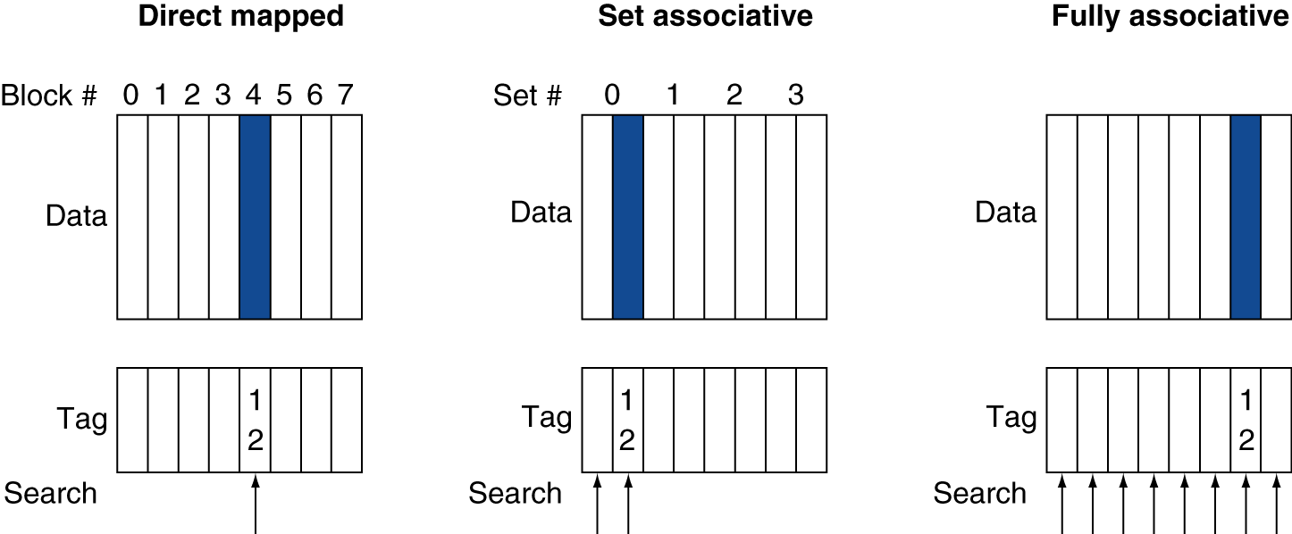
Associative Cache Example

Slide 45
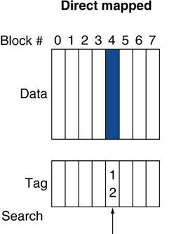
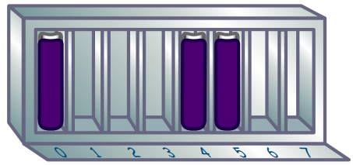

1-Way Set Associative
How many bits?
3 bits
A cache block can only go in one spot in the cache.
It makes a cache block very easy to find
but it‛s not very flexible about where to put the blocks.

Slide 46
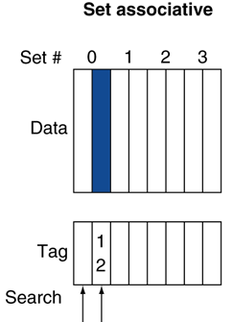
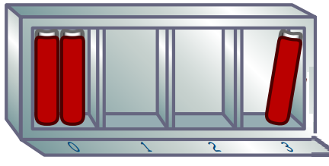
2-Way Set Associative
How many bits?
2 bits
This cache is made up of sets that can fit two blocks each.
The index is now used to find the set
The tag helps find the block within the set.

Slide 47
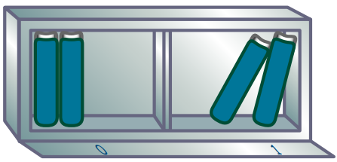
4-Way Set Associative
0 1
How many bits?
1 bit
Each set here fits four blocks,
So there are fewer sets.
As such, fewer index bits are needed.

Slide 48

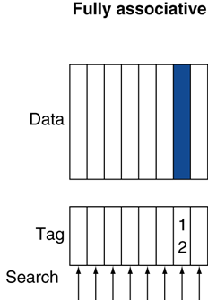


Fully Associative
How many bits?
0 bit
No index is needed, since a cache block can go anywhere in the cache.
Every tag must be compared when finding a block in the cache
but block placement is very flexible!

Slide 49
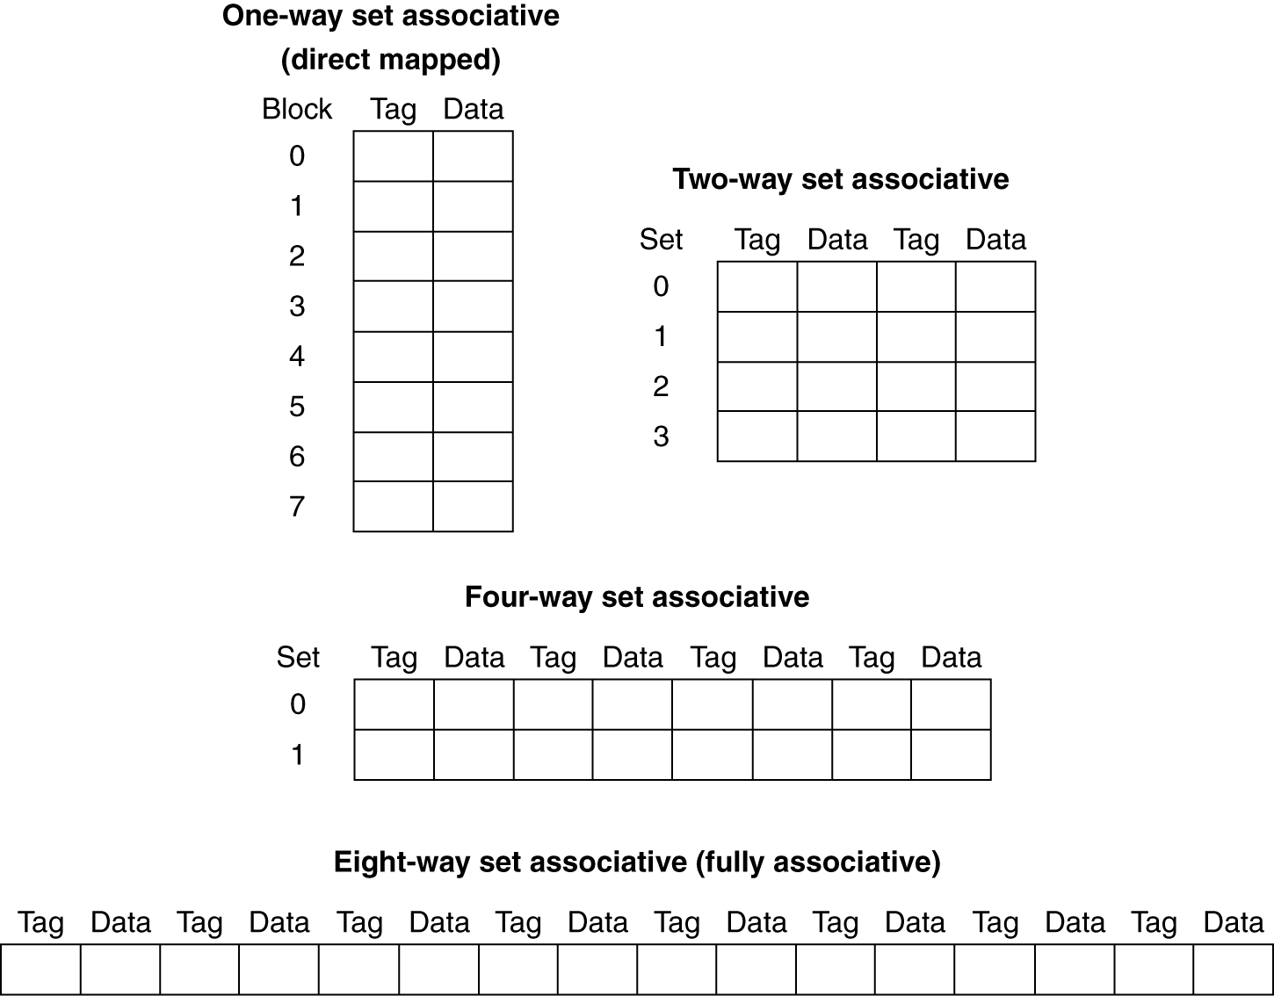
Spectrum of Associativity
For a cache with 8 entries

Slide 50
Associativity Example
Compare 4-block caches
Direct mapped, 2-way set associative, fully associative
Block access sequence: 0, 8, 0, 6, 8
Direct mapped
Block address | Cache index | Hit/miss | Cache content after access
 |  |  | 0 | 1 | 2 | 3
0 | 0 | miss | Mem[0]
8 | 0 | miss | Mem[8]
0 | 0 | miss | Mem[0]
6 | 2 | miss | Mem[0] |  | Mem[6]
8 | 0 | miss | Mem[8] |  | Mem[6]
0 modulo 4 = 0
8 modulo 4 = 0
0 modulo 4 = 0
6 modulo 4 = 2
8 modulo 4 = 0

Slide 51
Associativity Example
Compare 4-block caches
Direct mapped, 2-way set associative, fully associative
Block access sequence: 0, 8, 0, 6, 8
2-way set associative
Block address | Cache index | Hit/miss | Cache content after access
 |  |  | Set 0 |  | Set 1
0 | 0 | miss | Mem[0]
8 | 0 | miss | Mem[0] | Mem[8]
0 | 0 | hit | Mem[0] | Mem[8]
6 | 0 | miss | Mem[0] | Mem[6]
8 | 0 | miss | Mem[8] | Mem[6]
0 modulo 2 = 0
8 modulo 2 = 0
0 modulo 2 = 0
6 modulo 2 = 0
8 modulo 2 = 0

Slide 52
Associativity Example
Compare 4-block caches
Direct mapped, 2-way set associative, fully associative
Block access sequence: 0, 8, 0, 6, 8
Fully associative
Block address |  | Hit/miss | Cache content after access
0 |  | miss | Mem[0]
8 |  | miss | Mem[0] | Mem[8]
0 |  | hit | Mem[0] | Mem[8]
6 |  | miss | Mem[0] | Mem[8] | Mem[6]
8 |  | hit | Mem[0] | Mem[8] | Mem[6]

Slide 53
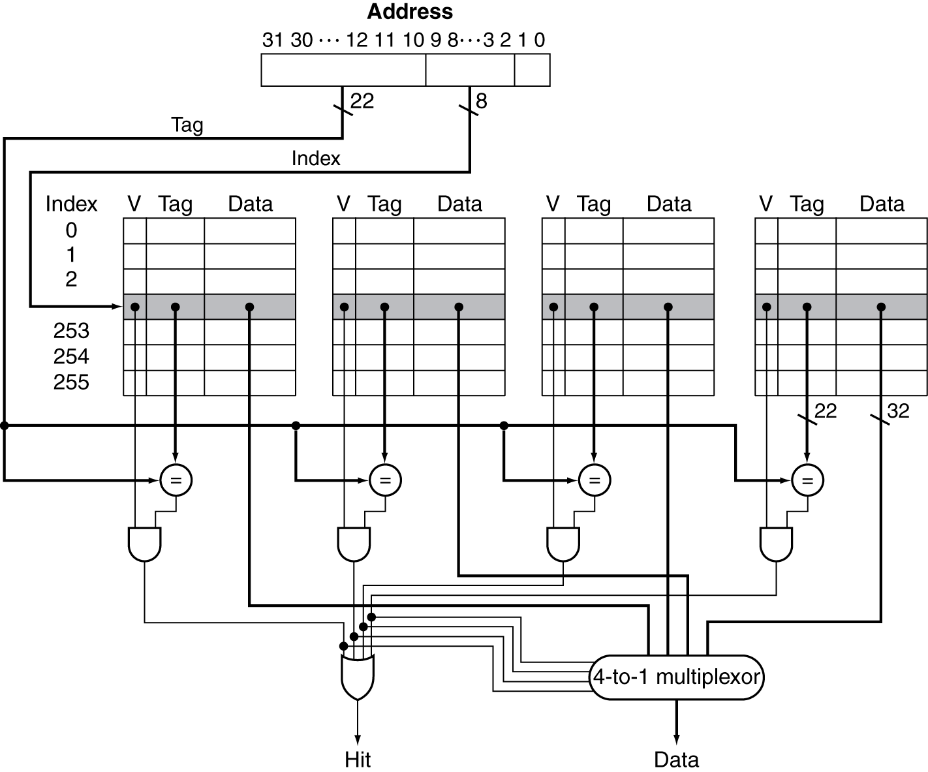
Set Associative Cache Organization
4-Way
An Alternate
Implementation:
Remove
the multiplexor
Enable
Signals

Slide 54
Replacement Policy
Direct mapped: no choice
Set associative
Prefer non-valid entry, if there is one
Otherwise, choose among entries in the set
Least-recently used (LRU)
Choose the one unused for the longest time
Simple for 2-way, manageable for 4-way, too hard beyond that
Random
Gives approximately the same performance as LRU for high associativity

Slide 55
Tags versus Set Associativity
Cache of 4096 blocks
a 4-word block size
32-bit address,
Find the total number of sets and the total number of tag bits for caches that are
direct mapped
two-way set associative
four-way set associative
fully associative.

Slide 56
Tags versus Set Associativity
4096 blocks; 32 bit address
4 words block = 16 (2⁴) Bytes block
So for tag + index 32 – 4 = 28 bits
28 bits (tag + Index) | 4 bits
16 bit tag | 12 bit index | 4 bits
Direct Mapped:
4096 (2¹²) 1-way set => 12 bit index
16 bit tag (28 -12)
4096 entries ⋅ 16 bit tag = 64 K bits tag

Slide 57
Tags versus Set Associativity
4096 blocks; 32 bit address
4 words block = 16 (2⁴) Bytes block
So for tag + index 32 – 4 = 28 bits
17 bit tag | 11 bit index | 4 bits
28 bits (tag + Index) | 4 bits
2-way set associative :
4096/2 = 2048 (2¹¹) sets => 11 bit index
17 bit tag (28 -11)
4096 entries ⋅ 17 bit tag = 68 K bits tag

Slide 58
Tags versus Set Associativity
4096 blocks; 32 bit address
4 words block = 16 (2⁴) Bytes block
So for tag + index 32 – 4 = 28 bits
18 bit tag | 10 bit index | 4 bits
28 bits (tag + Index) | 4 bits
4-way set associative :
4096/4 = 1024 (2¹⁰) sets => 10 bit index
18 bit tag (28 -10)
4096 entries ⋅ 18 bit tag = 72 K bits tag

Slide 59
Tags versus Set Associativity
4096 blocks; 32 bit address
4 words block = 16 (2⁴) Bytes block
So for tag + index 32 – 4 = 28 bits
28 bit tag | 4 bits
28 bits (tag + Index) | 4 bits
Fully set associative :
No index
28 bits tag (28 - 0)
4096 entries ⋅ 28 bit tag = 112 K bits tag

Slide 60
Tags versus Set Associativity
4096 blocks; 4-words block; 32-bit address
4-words block = 16 (2⁴) Bytes block
So, for tag + index has 32 – 4 = 28 bits.
28 bits (tag + Index) | 4 bits
Associativity | Tag bits (K)
Direct mapped (1 Way) | 64
2 Way Set Associative | 68
4 Way Set Associative | 72
Fully Associative | 112

Slide 61
Multilevel Caches
Primary cache attached to CPU
Small, but fast
Level-2 cache services misses from primary cache
Larger, slower, but still faster than main memory
Main memory services L-2 cache misses
Some high-end systems include L-3 cache

Slide 62
Multilevel Cache Example
Given
CPU base CPI = 1, clock rate = 4GHz
Miss rate/instruction @ primary cache = 2%
Main memory access time = 100ns
4 GHz => 0.25ns cycle length
With just primary cache
Miss penalty = 100ns/0.25ns = 400 cycles
Effective CPI = 1 + 0.02 × 400 = 9

Slide 63
Example (cont.)
Now add L-2 cache
Access time = 5ns
Global miss rate to main memory = 0.5%
Primary miss with L-2 hit
Penalty = 5ns/0.25ns = 20 cycles
Primary miss with L-2 miss
CPI = 1 + 0.02 × 20 + 0.005 × 400 = 3.4
Performance ratio = 9/3.4 = 2.6
CPU base CPI = 1,
clock rate = 4GHz
primary Miss rate = 2%

Slide 64
Multilevel Cache Considerations
Primary cache
Focus on minimal hit time
L-2 cache
Focus on low miss rate to avoid main memory access
Hit time has less overall impact
Results
L-1 cache usually smaller than a single cache
L-1 block size smaller than L-2 block size

Slide 65
Interactions with Advanced CPUs
Out-of-order CPUs can execute instructions during cache miss
Pending store stays in load/store unit
Dependent instructions wait in reservation stations
Independent instructions continue
Effect of miss depends on program data flow
Much harder to analyse
Use system simulation

Slide 66
Dependability
Service accomplishment
Service delivered as specified
§5.5 Dependable Memory Hierarchy
Fault: failure of a component
May or may not lead to system failure
Restoration
Failure
Service interruption
Deviation from specified service

Slide 67
Dependability Measures
Reliability: mean time to failure (MTTF)
Service interruption: mean time to repair (MTTR)
Mean time between failures
MTBF = MTTF + MTTR
Availability = MTTF / (MTTF + MTTR)
Improving Availability
Increase MTTF: fault avoidance, fault tolerance, fault forecasting
Reduce MTTR: improved tools and processes for diagnosis and repair

Slide 68
Nines of Availability
We want availability to be very high.
One shorthand is to quote the number of “nines of availability” per year.
# of Nines | % of uptime
One | 90
Two | 99
Three | 99.9
Four | 99.99
Five | 99.999

Slide 69
Nines of Availability
Given 365 days per year, which is 365 * 24 * 60 = 525,600 minutes.
Then the shorthand is decoded as follows:
90% => 525,600 * 0.1 downtime = 52560 minutes = 52560/(60*24) = 36.5 days.
# of Nines | % of uptime | Downtime/Year
One | 90 | 36.5 days
Two | 99 | 3.65 days
Three | 99.9 | 526 min
Four | 99.99 | 52.6 min
Five | 99.999 | 5.26 min

Slide 70
MTTF and AFR
MTTF is a reliability measure.
A related term is annual failure rate (AFR)
The percentage of devices that would be expected to fail in a year for a given MTTF.
Hours in a year / MTTF
When MTTF gets large it can be misleading
while AFR leads to better intuition

Slide 71
High MTTF and AFR
Some disks today are quoted to have a 1,000,000-hour MTTF.
1,000,000/(365 * 24) = 114 years
they practically never fail???
Warehouse scale computers that run Internet services such as Search might have 50,000 servers.
Assume each server has 2 disks.
How many disks we would expect to fail per year.

Slide 72
High MTTF and AFR
One year => 365 * 24 = 8760 hours.
A 1,000,000-hour MTTF means an AFR of 8760/1,000,000 = 0.876%.
We have 50000 * 2 = 100,000 disks
we would expect 0.00876 * 100,000 = 876 disks to fail per year
On average more than (876/365) 2 disk failures per day.

Slide 73
Virtual Memory
§5.7 Virtual Memory
Use main memory as a “cache” for secondary (disk) storage
Managed jointly by CPU hardware and the operating system (OS)
Programs share main memory
Each gets a private virtual address space holding its frequently used code and data
Protected from other programs
CPU and OS translate virtual addresses to physical addresses
VM “block” is called a page
VM translation “miss” is called a page fault

Slide 74
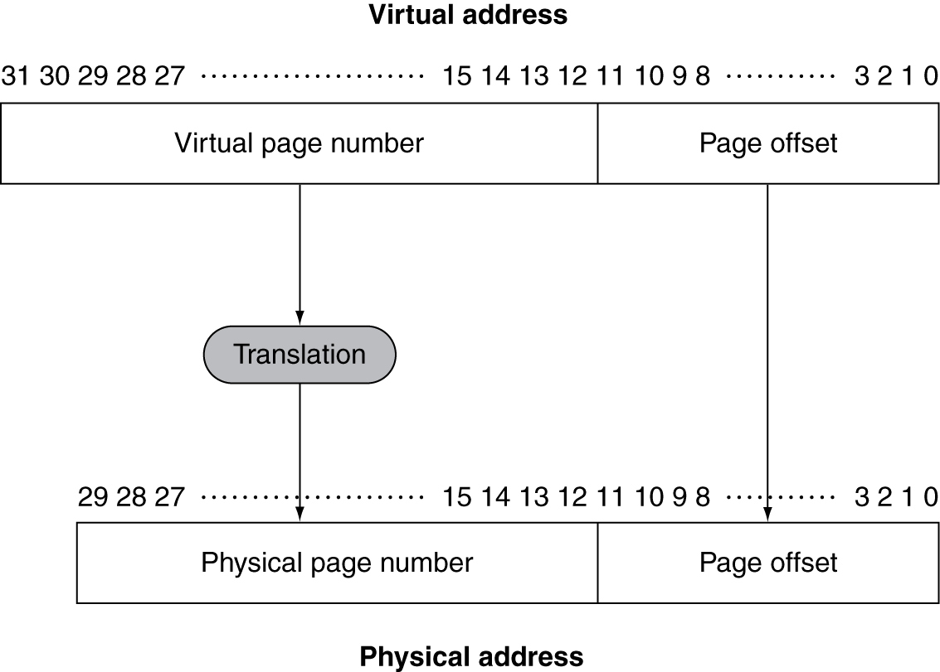
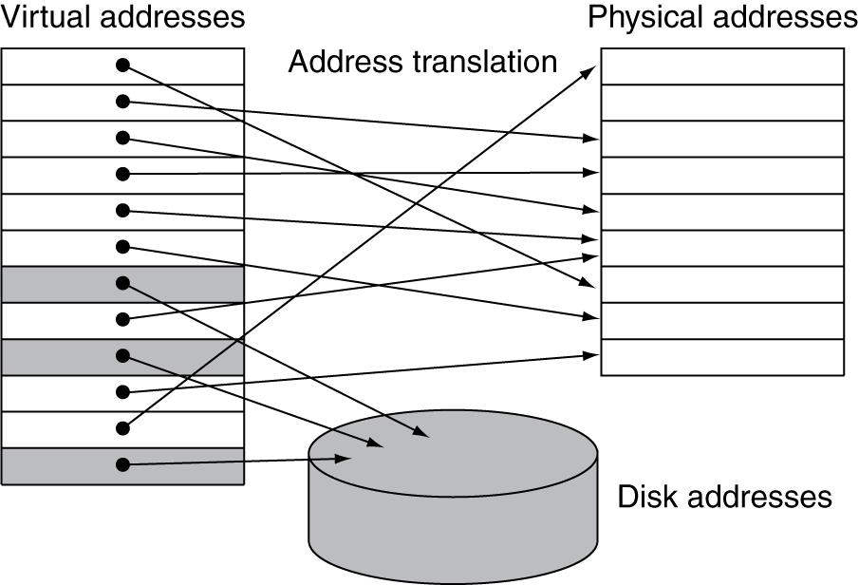
Address Translation
Fixed-size pages (e.g., 4K)

Slide 75
Page Fault Penalty
On page fault, the page must be fetched from disk
Takes millions of clock cycles
Handled by OS code
Try to minimize page fault rate
Fully associative placement
But this needs costly search!!!
Smart replacement algorithms

Slide 76
Page Tables
Stores placement information
Array of page table entries, indexed by virtual page number
Page table register in CPU points to page table in physical memory
If page is present in memory
PTE stores the physical page number
Plus other status bits (referenced, dirty, …)
If page is not present
PTE can refer to location in swap space on disk

Slide 77
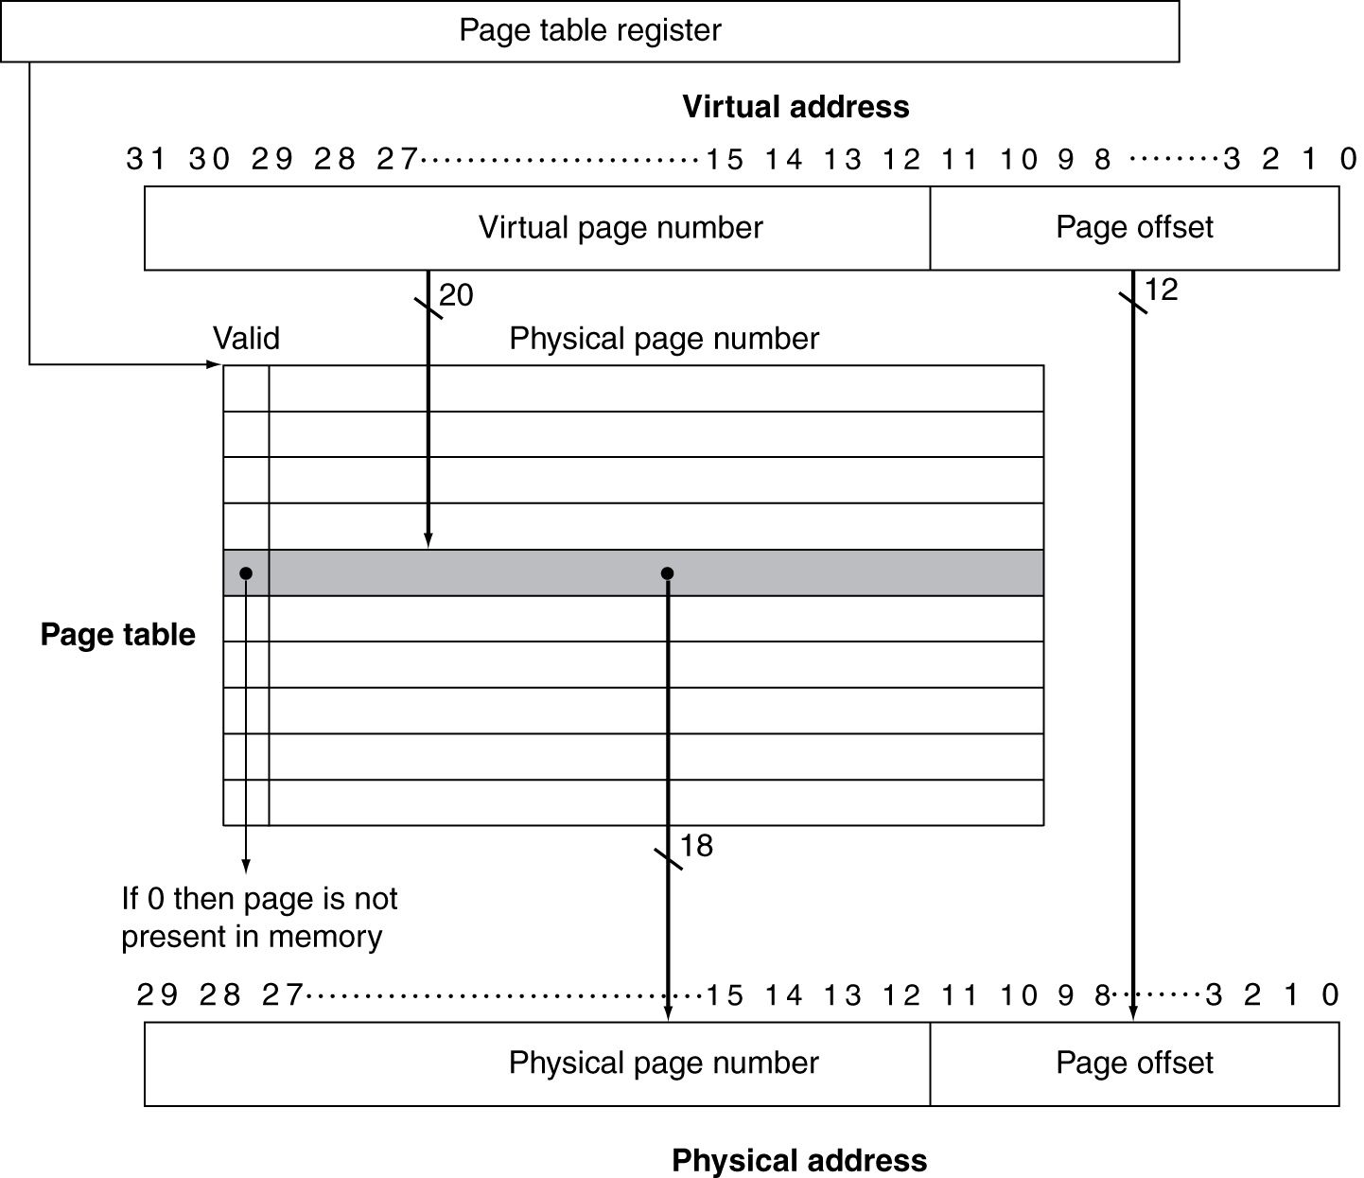
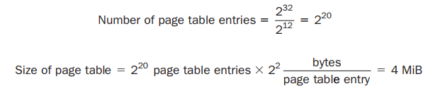
Translation Using a Page Table
What is
the size
of the
page table?
2²⁰ (= 1 M) entries
19 bits;
but 32 bits
wide usually

Slide 78
Page Table Size Issues
Size of page table => 4 MB (per process)
What about 100 processes
Each with its own page table?
What will happen if we have 64-bit addresses (according to prev. calc.)?
2^{(64 – 12)} = 2⁵² entries!!!
There are techniques to reduce the amount of storage required for the page table.
63………………………………………………………………………………………………….12 11………………….0
52 bits | 12 bits

Slide 79
Techniques: Limit Registers
Keep a limit register that restricts the size of the page table for a given process.
If the virtual page number becomes larger than the contents of the limit register, entries must be added to the page table.
This technique allows the page table to grow as a process consumes more space.
Thus, the page table will only be large if the process is using many pages of virtual address space.
This technique requires that the address space expand in only one direction.

Slide 80
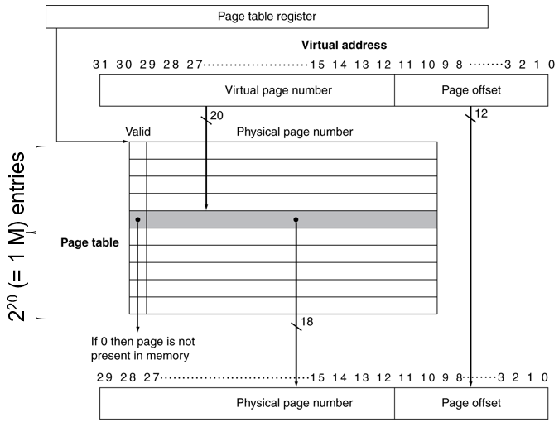
Techniques: Limit Registers
Limit Register

Slide 81
Techniques: Two Limits
Two separate page tables and two separate limits.
One grows from highest address down
One grows from lowest address up
So, address space is divided into 2 segments.
High-order bit of an address usually determines which segment
i.e., which page table to use for that address.
So, each segment can be as large as one-half of the address space.
A limit register for each segment specifies the current size of the segment, which grows in units of pages.
Stack
Heap
Allowing growth in only one direction is not sufficient

Slide 82
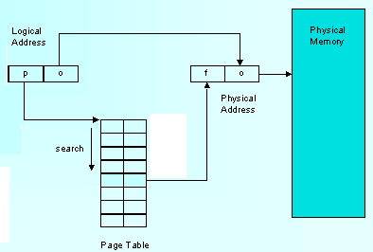
Techniques: Inverted Page Table
Keep only one entry per physical block (i.e., frame)
Such a structure is called an inverted page table.
we can no longer just index the page table.
So, the lookup process is slightly more complex
May apply a hashing function to the virtual address
To make the lookups faster

Slide 83
Techniques: Multiple Levels
The first level maps large fixed-size blocks of virtual address space
Each entry in the segment table:
indicates whether any pages in that segment are allocated
if so, points to a page table for that segment.
Address translation happens:
by first looking in the segment table, using the highest-order bits of the address.
If the segment address is valid, the next set of high-order bits is used to index the page table
Sometimes called segment

Slide 84
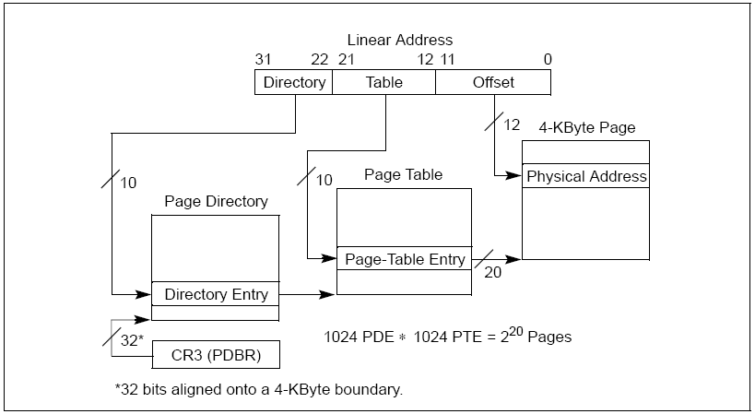
Techniques: Multiple Levels

Slide 85
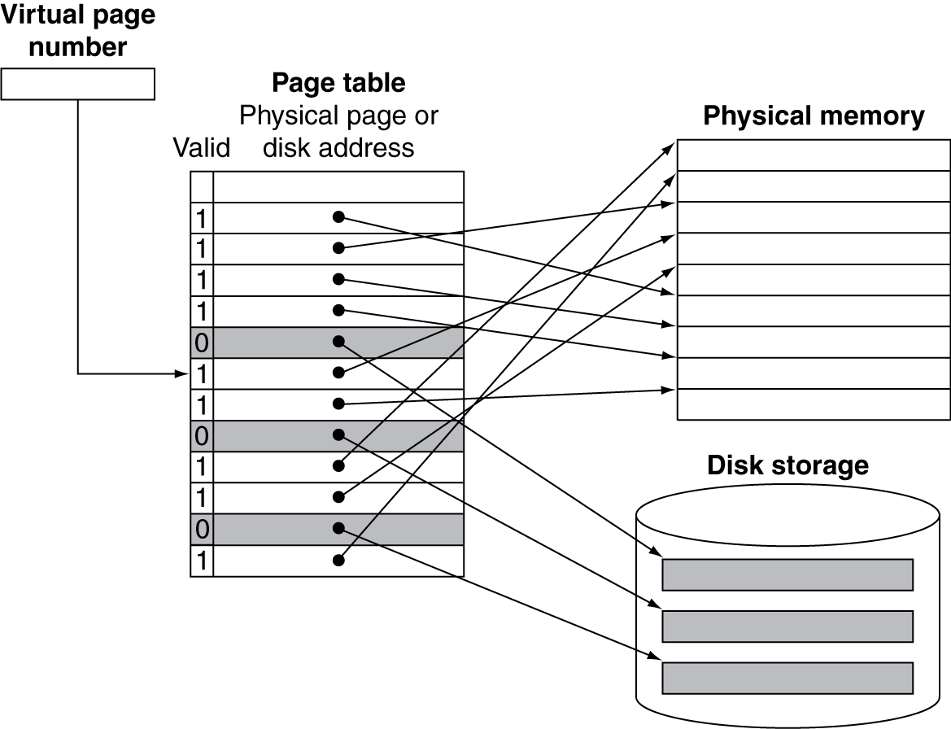
Mapping Pages to Storage

Slide 86
Page Fault
If the valid bit for a virtual page is off, a page fault occurs.
The operating system must be given control.
This transfer is done with the exception mechanism
OS must find the page in the next level of the hierarchy
and decide where to place the requested page in main memory.

Slide 87
Swap Space
Virtual addr. alone does not immediately tell us where the page is on disk.
OS usually creates the space on flash memory/disk for all the pages of a process
OS creates a data structure to record where each virtual page is stored on disk.
may be part of the page table
or an auxiliary data structure indexed in the same way as the page table
OS also creates a data structure that tracks
which processes and which virtual addresses use each physical page
Swap Space

Slide 88
Replacement and Writes
To reduce page fault rate, prefer least-recently used (LRU) replacement
Reference bit (aka use bit) in PTE set to 1 on access to page
Periodically cleared to 0 by OS
A page with reference bit = 0 has not been used recently
Disk writes take millions of cycles
Block at once, not individual locations
Write through is impractical
Use write-back
Dirty bit in PTE set when page is written

Slide 89
Fast Translation Using a TLB
Address translation would appear to require extra memory references
One to access the PTE
Then the actual memory access
But access to page tables has good locality
So use a fast cache of PTEs within the CPU
Called a Translation Look-aside Buffer (TLB)
Typical: 16–512 PTEs
Misses could be handled by hardware or software
Page Tables are
in main memory

Slide 90
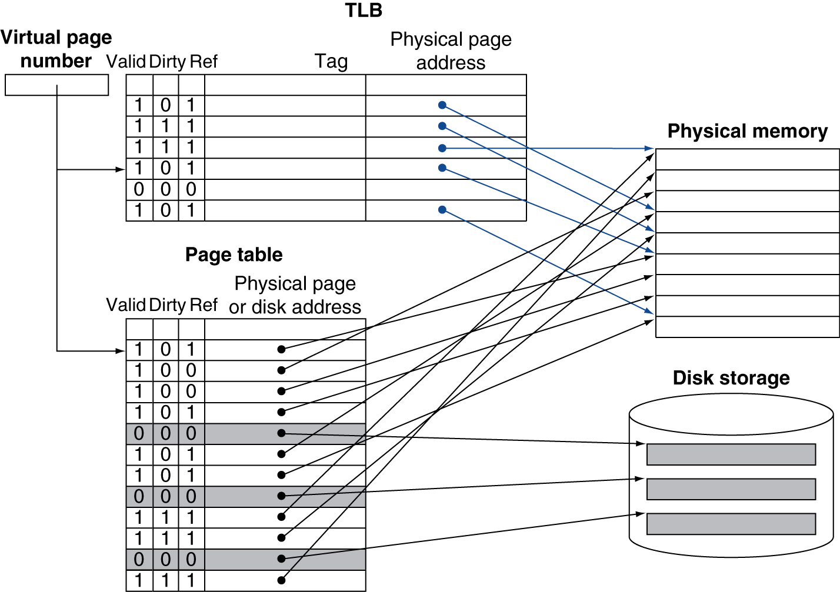
Fast Translation Using a TLB

Slide 91
TLB Misses
If page is in memory
Load the PTE from memory and retry
Could be handled in hardware
Can get complex for more complicated page table structures
Or in software
Raise a special exception, with optimized handler
If page is not in memory (page fault)
OS handles fetching the page and updating the page table
Then restart the faulting instruction

Slide 92
TLB Miss Handler
TLB miss indicates
Page present, but PTE not in TLB
Page not present
Handler copies PTE from memory to TLB
Then restarts instruction
If page not present, page fault will occur
The reference and dirty bits may change in TLB
So they must also be copied back to PTE for the TLB entry that is replaced
True Page Fault
Write-Back Scheme

Slide 93
TLB: Associativity
Lower Miss Rate
Some systems use small, fully associative TLBs
replacement choice becomes tricky
hardware LRU scheme is too expensive.
expensive software algorithm is also not feasible (unlike page faults)
Many systems provide some support for randomly choosing an entry to replace.
Other systems use large TLBs, often with small associativity.
Not so high search cost
TLB misses are much more frequent

Slide 94
Page Fault Handler
Use faulting virtual address to find PTE
Locate page on disk
Choose page to replace
If dirty, write to disk first
Read page into memory and update page table
Make process runnable again
Restart from faulting instruction

Slide 95
Intrinsity FastMATH TLB
4 KiB (2¹²) pages; 32-bit address space
So, virtual page number is (32 – 12 =) 20 bits long
Physical address is same size as virtual address.
TLB: 16 entries; fully associative
shared between the instruction and data
Each entry is 64 bits wide
a 20-bit tag (virtual page number for that TLB entry)
the corresponding physical page number (also 20 bits),
a valid bit, a dirty bit, and other bookkeeping bits.
Like most MIPS systems, it uses software to handle TLB misses.

Slide 96
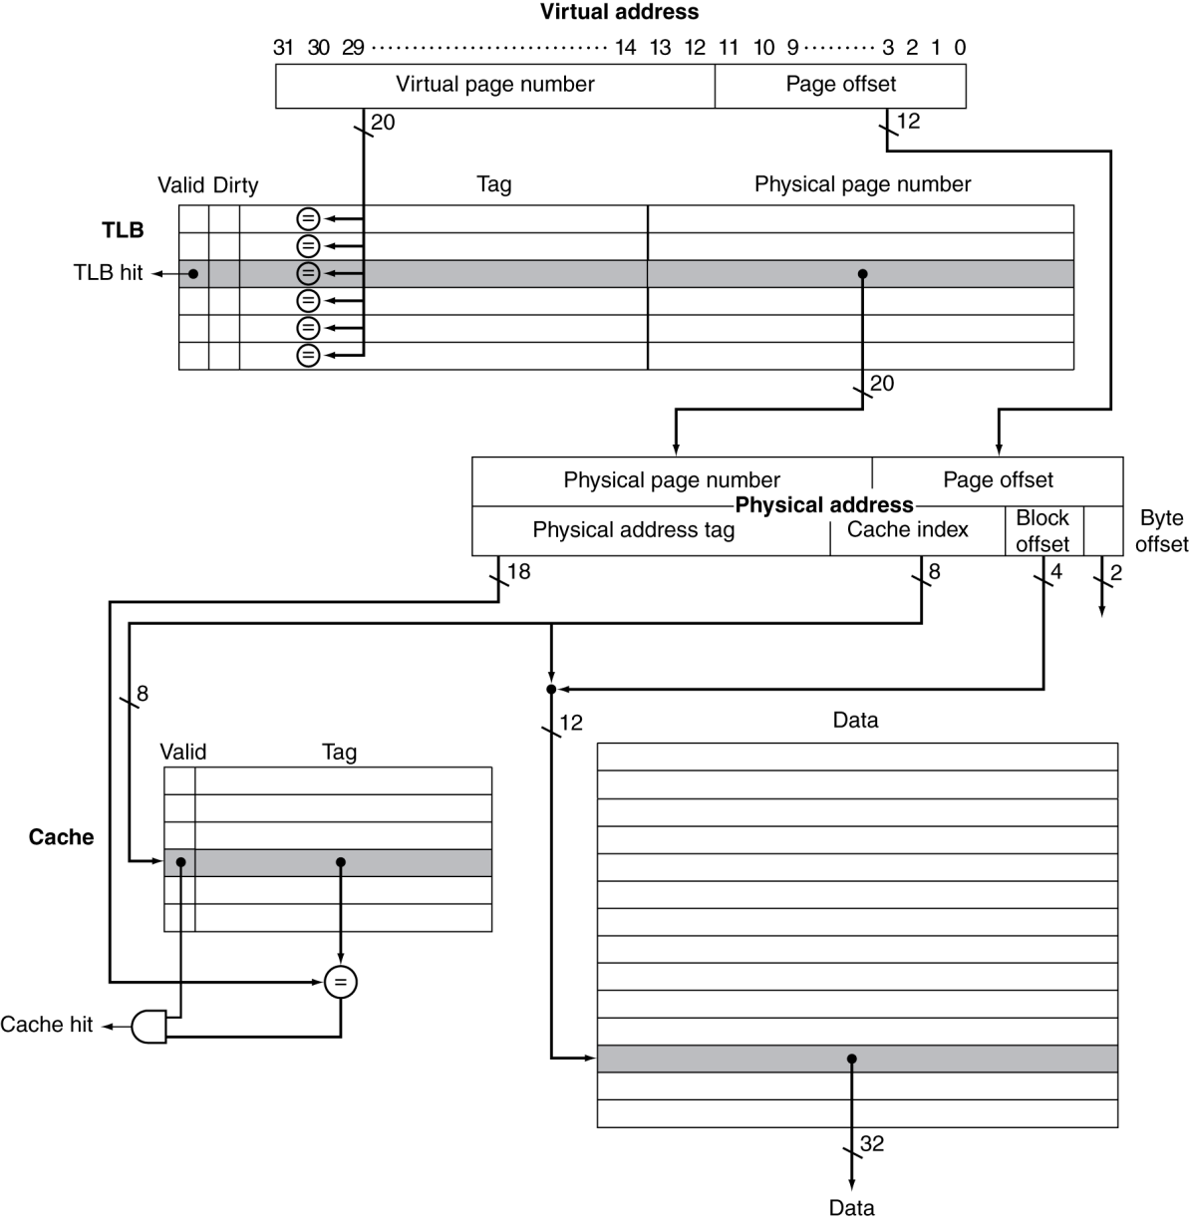
TLB and Cache Interaction
CAM
Implementation
Cache
256 blocks × 16 words/block

Slide 97
Content Addressable Memory (CAM)
CAM is a circuit that combines comparison and storage in a single device.
Does not supply an address and read a word like a RAM
you supply the data and the CAM looks to see if it has a copy and returns the index of the matching row.
With CAMs higher set associativity in cache can be implemented

Slide 98
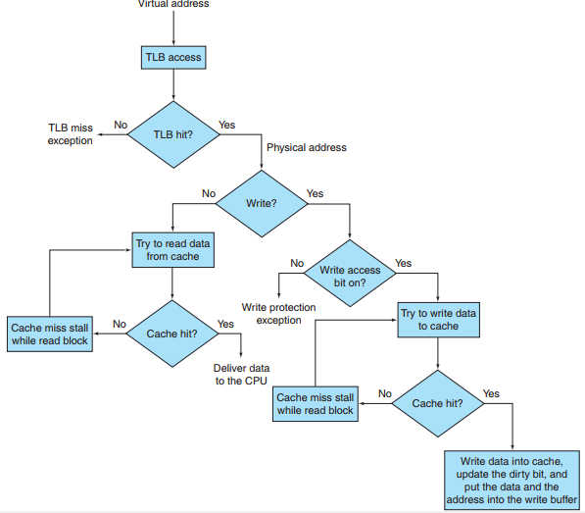
Processing a read or a write-through in the Intrinsity FastMATH TLB and cache

Slide 99
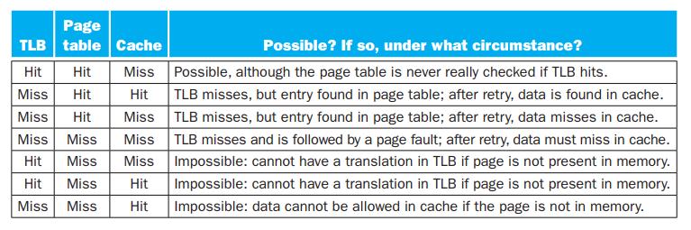
TLB, Cache and VM Events Combined

Slide 100
Physically Addressed Cache
Here, cache is “physically addressed” and “physically tagged”
Time to access memory for a cache hit include:
TLB access time
Cache access time
Of course, these accesses can be pipelined.

Slide 101
Virtually Indexed Cache
Alternatively, the processor can index the cache with a virtual address
Virtually indexed and Virtually tagged cache
Here, TLB is unused during the normal cache access
Reduce cache latency
Cache miss=> the processor needs to translate the address to a physical address
so that it can fetch the cache block from main memory.
VIVT

Slide 102
Aliasing in VIVT Cache
Aliasing occurs when the same object has two names
Two virtual addresses for the same page.
May happen for shared pages between processes
This ambiguity creates a problem:
A word on such a page may be cached in two different locations, each corresponding to different virtual addresses.
One program may write the data without the other program being aware that the data had changed.
Solution to Aliasing Issues
either introduce design limitations on the cache and TLB to reduce aliases
or require the operating system, and possibly the user, to take steps to ensure that aliases do not occur

Slide 103
Virtually Indexed Physically Tagged
Physical Tag using just the page-offset portion of the address, which is really a physical address since it is not translated
These designs, which are virtually indexed but physically tagged, attempt to achieve the performance advantages of virtually indexed caches with the architecturally simpler advantages of a physically addressed cache.
There is no alias problem in this case.

Slide 104
Memory Protection
Different tasks can share parts of their virtual address spaces
But need to protect against errant access
Requires OS assistance
Hardware support for OS protection
Privileged supervisor mode (aka kernel mode)
Privileged instructions
Page tables and other state information only accessible in supervisor mode
System call exception (e.g., syscall in MIPS)

Slide 105
Memory Protection: H/W Suport
Need to Support:
at least two modes:
Privileged supervisor mode (aka kernel mode)
User mode
Different Processor states:
Allow for a process to read only; No Write allowed
To write, privileged instructions are needed that are only available in supervisor mode
Page tables and other state information only accessible in supervisor mode
System call exception (e.g., syscall in MIPS):
This allows a process to change mode:
User mode => supervisor mode (and vice versa)

Slide 106
Memory Protection
Each process has its own virtual address space.
OS can keep the page tables organized so that the independent virtual pages map to disjoint physical pages
one process will not be able to access another’s data.
But what if the Process changes the mapping?
Page tables are placed in the protected address space of the OS
So, user process is refrained from changing the page table mapping.
But OS is able to modify the page tables.

Slide 107
Memory Sharing and Protection
OS assists processes for limited information sharing
OS can change the Page table as needed
The write access bit is used to restrict write
Can be changed only by OS
Example:
P2 wants P1 to access its page
P2 asks OS to create a page table entry for a virtual page in P1’s address space that points to the same physical page that P2 wants to share.
Any bits that determine the access rights for a page must be included in both the page table and the TLB because the page table is accessed only on a TLB miss.

Slide 108
Memory Protection: Context Switch
Context Switch: A changing of the internal state of the processor to allow a different process to use the processor
Suppose a context switch has occurred:
P1 was running; now P2 will run
OS must ensure that P2 cannot get access to P1’s page tables
Page Table register is changed
What about the TLB?
OS must clear the TLB entries that belong to P1
to protect the data of P1 and
to force the TLB to load the entries for P2.
If the process switch rate were high, this could be quite inefficient especially if context switch is frequent.

Slide 109
Memory Protection: Context Switch
A common alternative:
extend the virtual address space by adding a process identifier or task identifier.
The Intrinsity FastMATH has an 8-bit address space ID (ASID) field for this purpose.
This small field identifies the currently running process
it is kept in a register loaded by OS when it switches processes.
The process identifier is concatenated to the tag portion of the TLB
TLB hit occurs only if both the page number and the process identifier match.
This eliminates the need to clear the TLB in context switch
Similar problems can occur for a cache, since on a process switch the cache will contain data from the running process.

Slide 110
Exception Enable/Disable
Suppose we have a page fault exception and OS is handling it
What will happen, if a second exception occurs?
The control unit would overwrite the exception program counter, making it impossible to return to the instruction that caused the page fault!
We need the ability to disable and enable exceptions.
When an exception first occurs, the processor sets a bit that disables all other exceptions;
this could happen at the same time the processor sets the supervisor mode bit.
The OS will then save just enough state to allow it to recover if another exception occurs
the exception program counter (EPC) and Cause registers
The operating system can then re-enable exceptions.

Slide 111
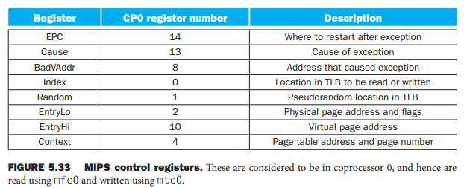
Special control registers that help with exceptions, TLB misses, and page faults
When a TLB miss occurs, the MIPS hardware saves the page number of the reference here.

Slide 112
TLB Miss in MIPS
TLB Miss exception invokes OS, which handles the miss in software.
Control is transferred to 8000 0000hex (TLB Miss Handler Address)
To find the physical address for the missing page, the TLB miss routine indexes the page table using the page number of the virtual address and the page table register
To make this indexing fast, MIPS hardware places the address of the Page Table Entry in a special Context Register
Thus, the first two instructions copy the Context register into the kernel temporary register $k1 and then load the page table entry from that address into $k1.
Recall that $k0 and $k1 are reserved for the operating system

Slide 113
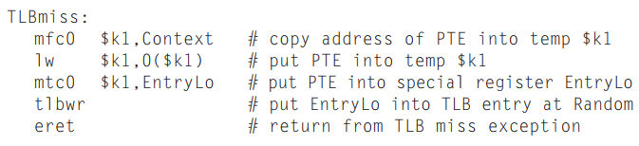
TLB Miss in MIPS
TLB miss handler does not check to see if the page table entry is valid.
If invalid, another and different exception occurs, and OS recognizes the page fault.
(frequent) TLB miss becomes fast
at a slight performance penalty for the (infrequent) page fault.
it transfers
control to
8000 0180h

Slide 114
The Memory Hierarchy
The BIG Picture
Common principles apply at all levels of the memory hierarchy
Based on notions of caching
At each level in the hierarchy
Block placement
Finding a block
Replacement on a miss
Write policy
§5.8 A Common Framework for Memory Hierarchies

Slide 115
Block Placement
Determined by associativity
Direct mapped (1-way associative)
One choice for placement
n-way set associative
n choices within a set
Fully associative
Any location
Higher associativity reduces miss rate
Increases complexity, cost, and access time

Slide 116
Finding a Block
Associativity | Location method | Tag comparisons
Direct mapped | Index | 1
n-way set associative | Set index, then search entries within the set | n
Fully associative | Search all entries | #entries
 | Full lookup table | 0
Hardware caches
Reduce comparisons to reduce cost
Virtual memory
Full table lookup makes full associativity feasible
Benefit in reduced miss rate

Slide 117
Replacement
Choice of entry to replace on a miss
Least recently used (LRU)
Complex and costly hardware for high associativity
Random
Close to LRU, easier to implement
Virtual memory
LRU approximation with hardware support

Slide 118
Write Policy
Write-through
Update both upper and lower levels
Simplifies replacement, but may require write buffer
Write-back
Update upper level only
Update lower level when block is replaced
Need to keep more state
Virtual memory
Only write-back is feasible, given disk write latency

Slide 119
Sources of Misses
Compulsory misses (aka cold start misses)
First access to a block
Capacity misses
Due to finite cache size
A replaced block is later accessed again
Conflict misses (aka collision misses)
In a non-fully associative cache
Due to competition for entries in a set
Would not occur in a fully associative cache of the same total size

Slide 120
Cache Design Trade-offs
Design change | Effect on miss rate | Negative performance effect
Increase cache size | Decrease capacity misses | May increase access time
Increase associativity | Decrease conflict misses | May increase access time
Increase block size | Decrease compulsory misses | Increases miss penalty. Very large block could increase miss rate.

Slide 121
Cache Control
Example cache characteristics
Direct-mapped, write-back, write allocate
Block size: 4 words (16 bytes)
Cache size: 16 KB (1024 blocks)
32-bit byte addresses
Valid bit and dirty bit per block
Blocking cache
CPU waits until access is complete
§5.9 Using a Finite State Machine to Control A Simple Cache
31
10
9
4
3
0
Tag
Index
Offset
18 bits
10 bits
4 bits

Slide 122
Interface Signals
Read/Write
Read/Write
Valid
Valid
Address
32
Address
32
CPU
Write Data
32
Cache
Write Data
128
Memory
Read Data
32
Read Data
128
Ready
Ready
Multiple cycles per access

Slide 123
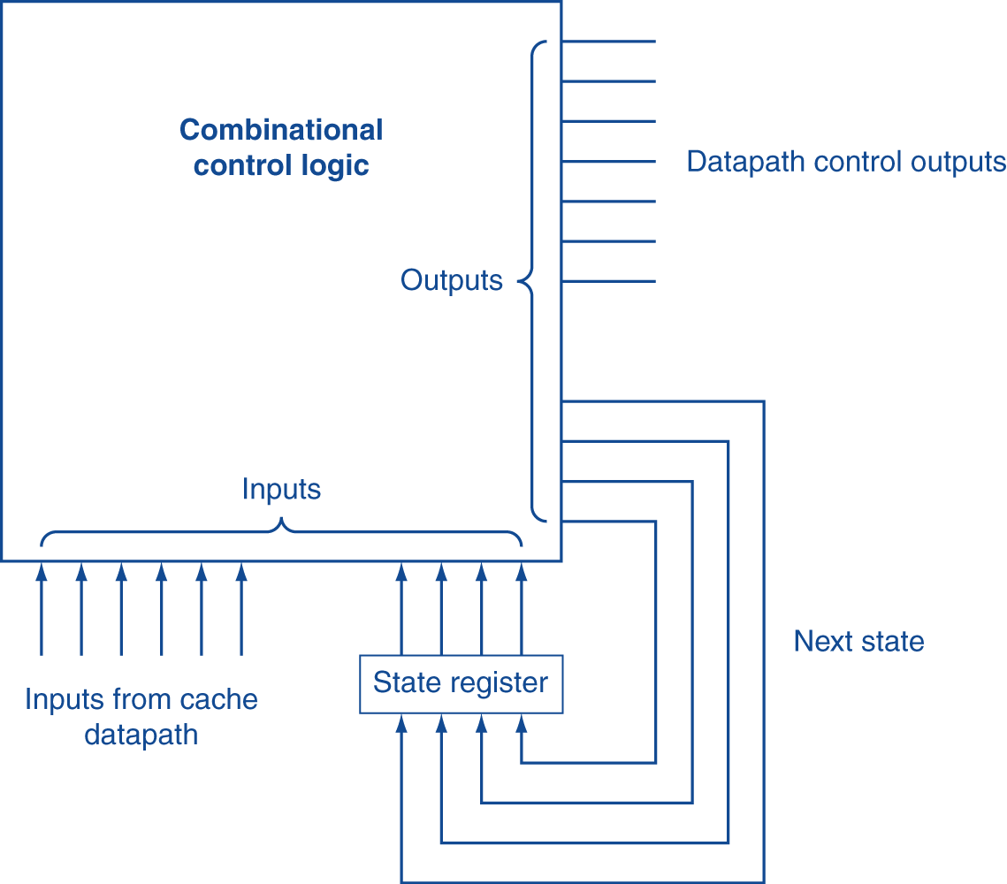
Finite State Machines
Use an FSM to sequence control steps
Set of states, transition on each clock edge
State values are binary encoded
Current state stored in a register
Next state = f_{n} (current state, current inputs)
Control output signals = f_{o} (current state)

Slide 124
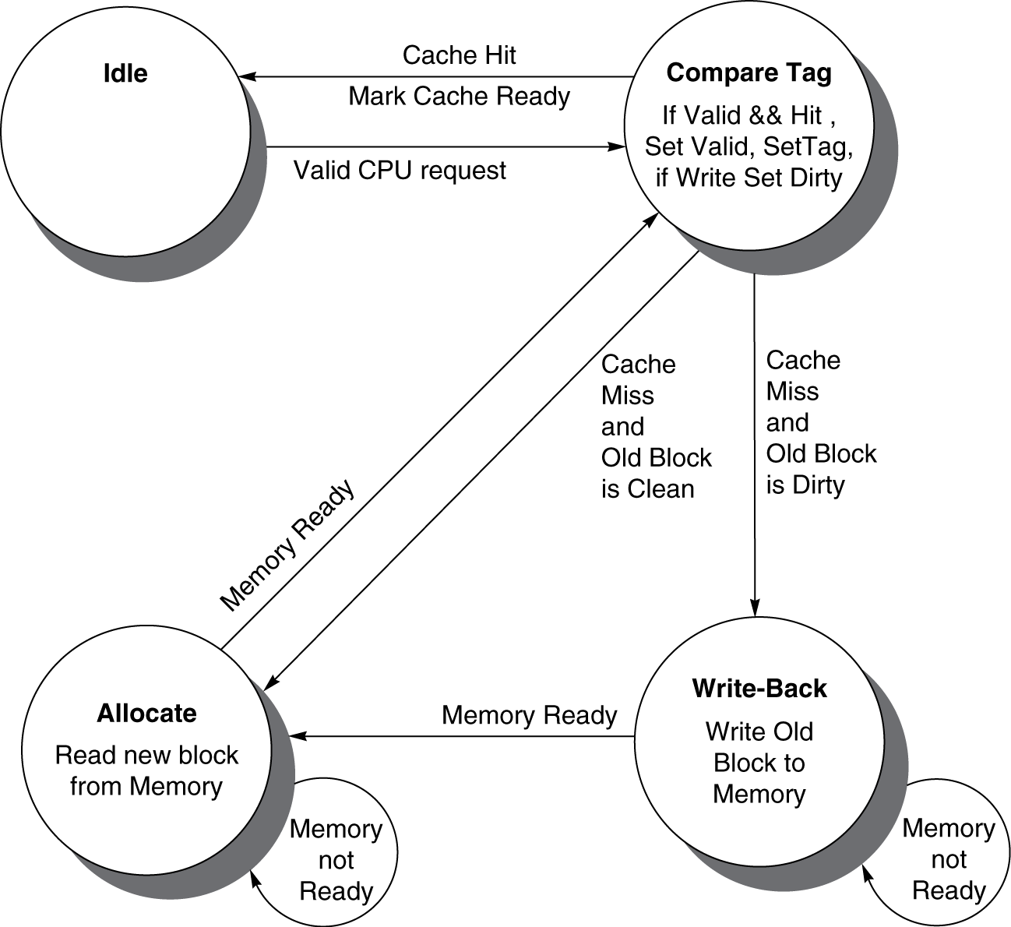
Cache Controller FSM
Could partition into separate states to reduce clock cycle time

