Slide 1
CSE 305 Computer Architecture Design of an ALU
Prepared by
Madhusudan Basak
Assistant Professor
CSE, BUET

Slide 2
ALU and the Processor
ALU stands for Arithmetic Logic Unit
A part of the processor or CPU

Slide 3












Some Terminologies Revisiting
Decoder, Encoder
2X4
Decoder
4X2
Encoder
E
E

Slide 4






Some Terminologies Revisiting
DeMUX, MUX
1X4
DeMUX
4X1
MUX

Slide 5
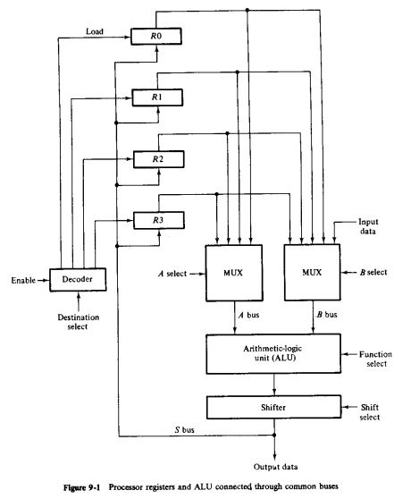
A Simplified Processor in Operation
0 0 0 1 1 0 1 1

Slide 6
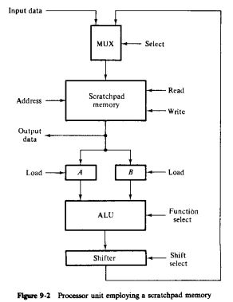

Simplified Processor with Scratchpad Memory

Slide 7
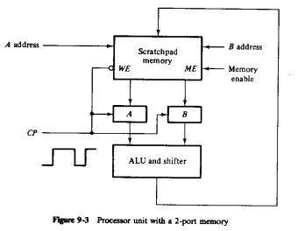
Simplified Processor with Scratchpad Memory

Slide 8
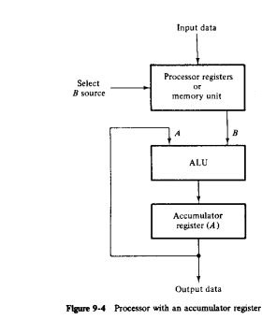

Simplified Processor with Accumulator

Slide 9
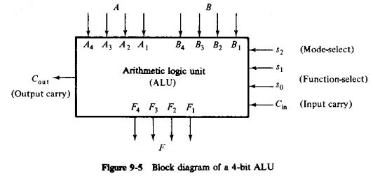
An ALU Unit
Can perform both Arithmetic and Logic Operations
Arithmetic/Logical Operation
Which Operation/Function
Helps Function-select to add more variants

Slide 10
Parallel Adder
Parallel adder
A number of full-adder circuits connected in cascade

Slide 11
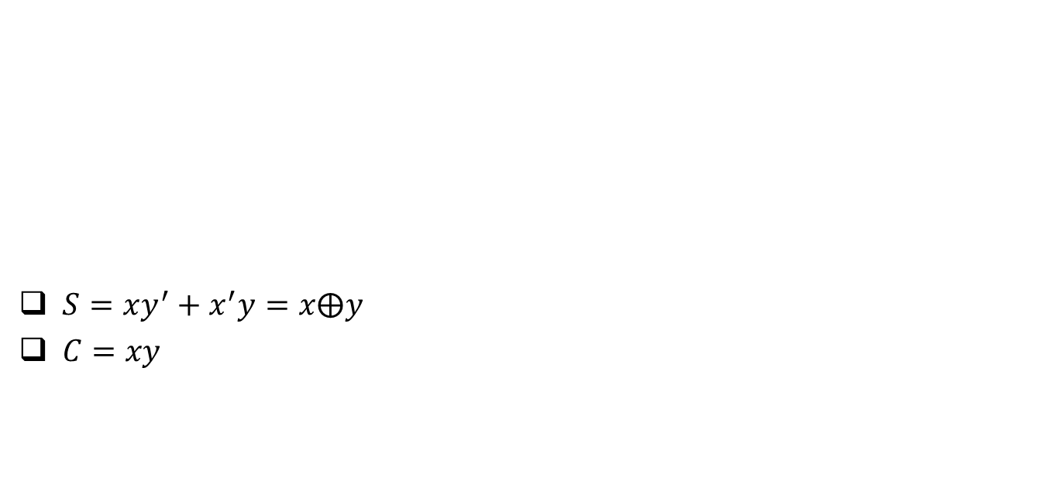
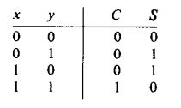
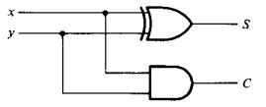
1-bit Half Adder

Slide 12
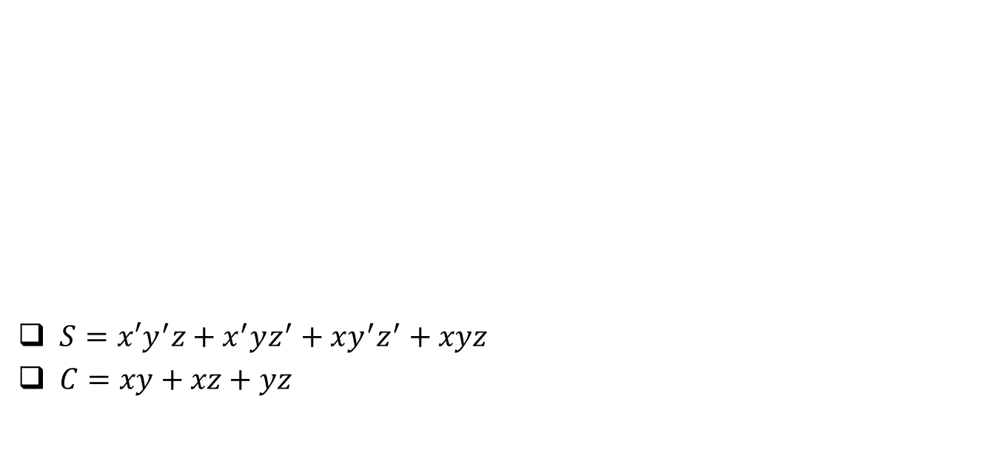
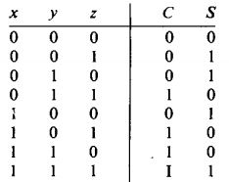
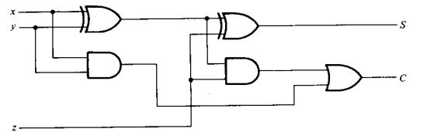


1-bit Full Adder

Slide 13
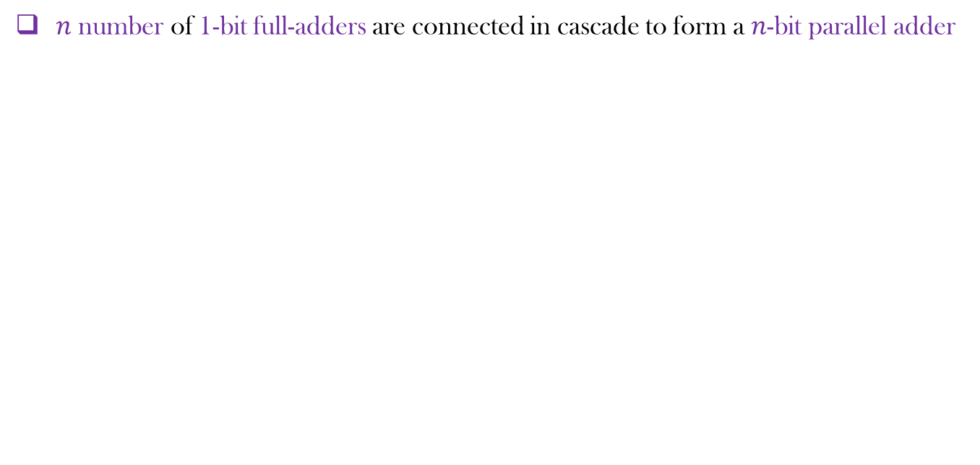
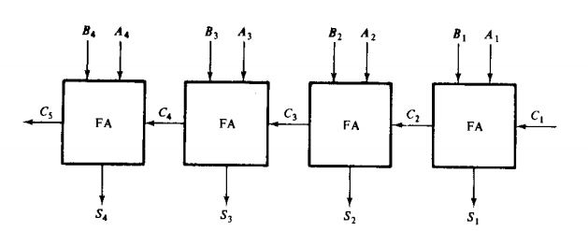
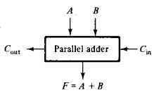
Parallel Adders

Slide 14
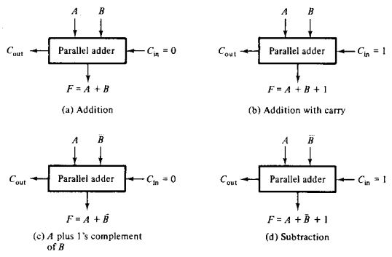
Arithmetic Operations by ALU

Slide 15
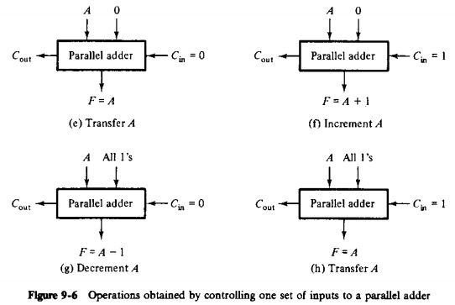
Arithmetic Operations by ALU

Slide 16
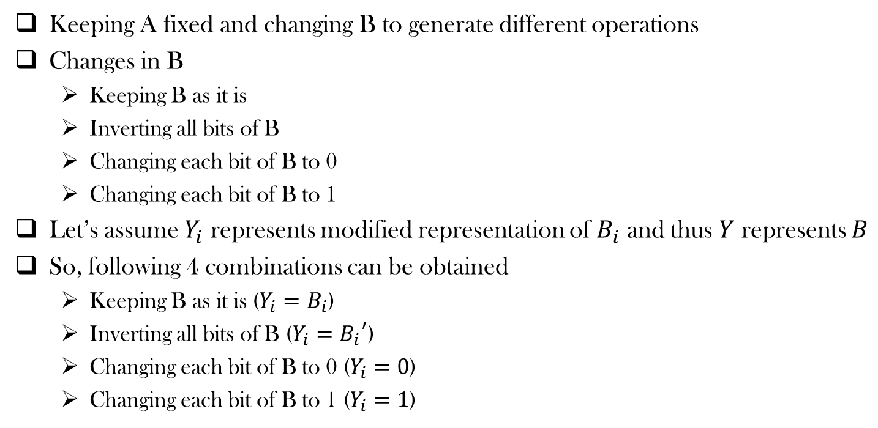
What are we doing?

Slide 17
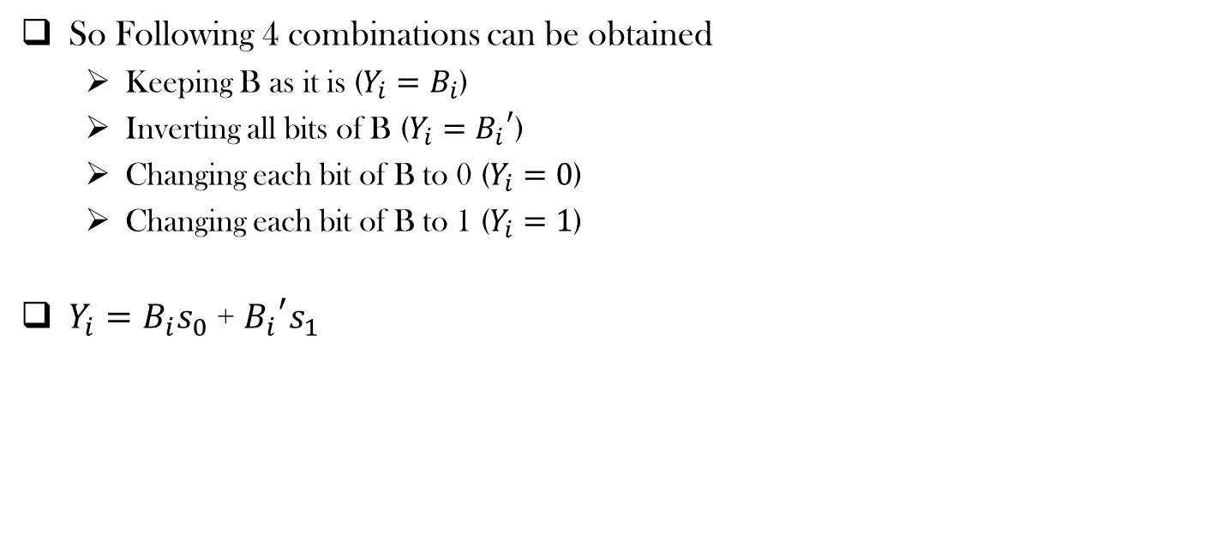
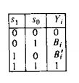
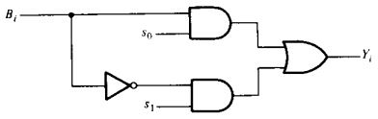
What are we doing?

Slide 18

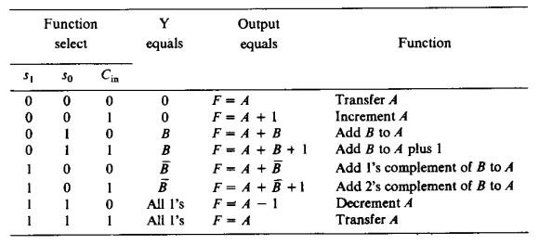
Function Table

Slide 19
Function Table: Designer’s perspective

Slide 20
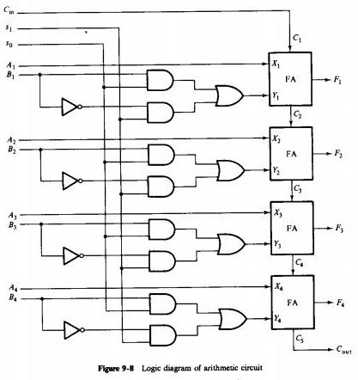

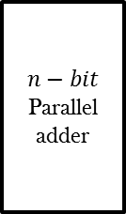




Logic Diagram of an independent Arithmetic Circuit
Selection Variables
…
Combinational Circuit

Slide 21
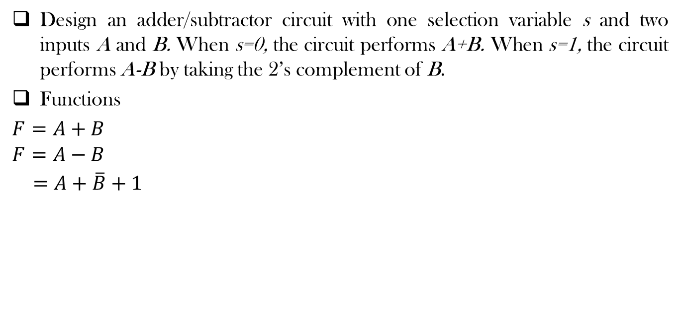







Design Example
Selection Variables
…
Combinational Circuit
s
0
1
s
0 | 0
1 | 1

Slide 22
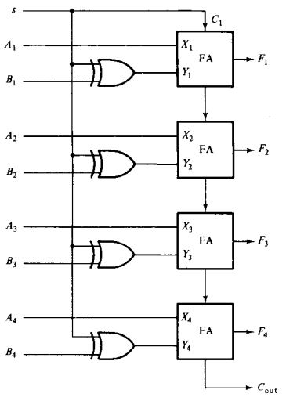
Design Example

Slide 23
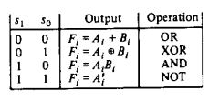
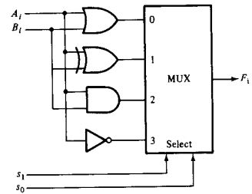
Designing a Logic Circuit
We shall implement three basic logical operations (AND, OR and NOT) and an XOR operation

Slide 24
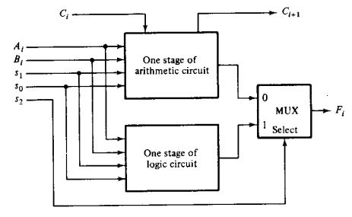
Designing a Logic Circuit
Let’s combine it with arithmetic operations

Slide 25
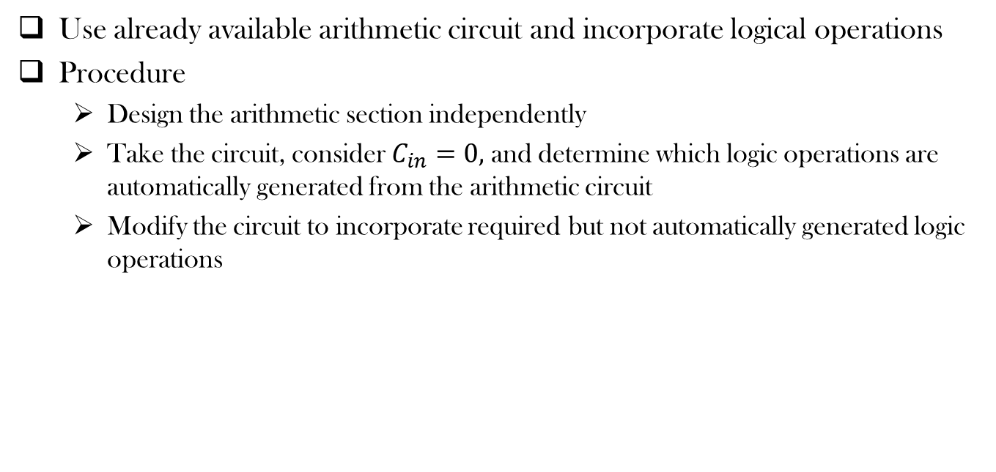
More Efficient Design

Slide 26
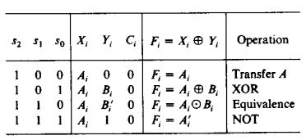
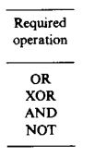
More Efficient Design
Use already available arithmetic circuit and incorporate logical operations

Slide 27
Incorporating remaining functions
Unresolved cases
1 | 0 | 0 |  | 0
1 | 1 | 0

Slide 28
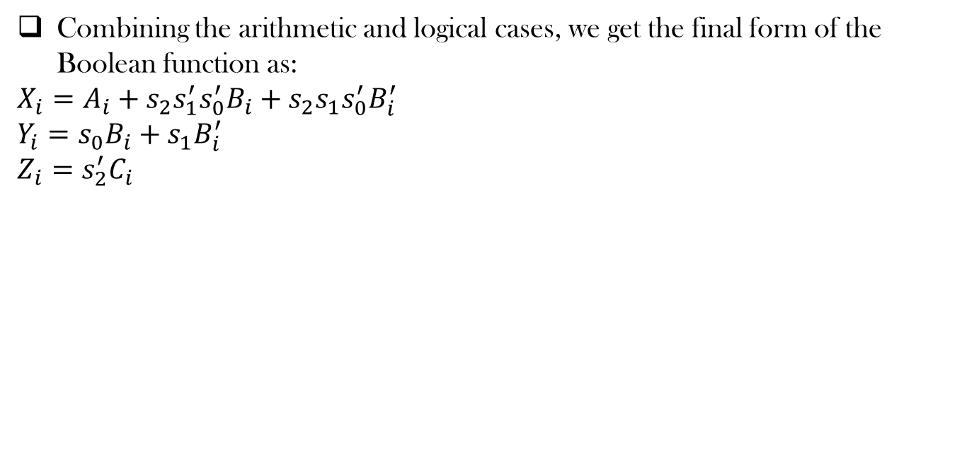
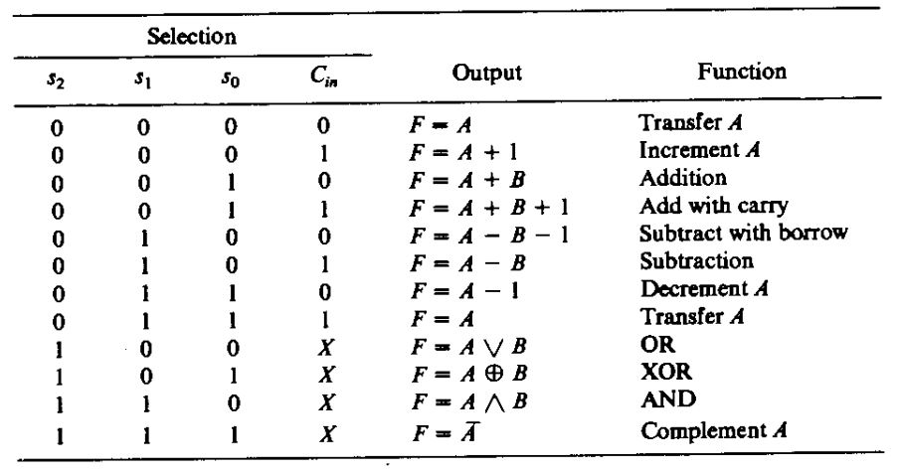
Final Boolean Functions

Slide 29
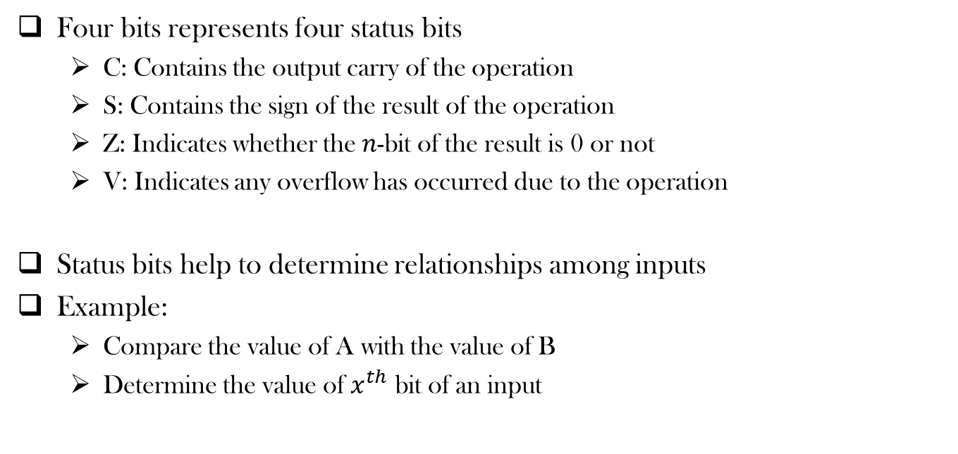
Status Register

Slide 30
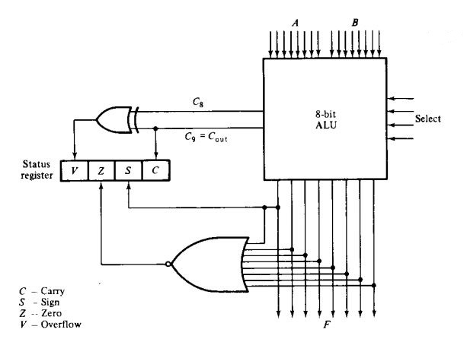
Status Register

Slide 31
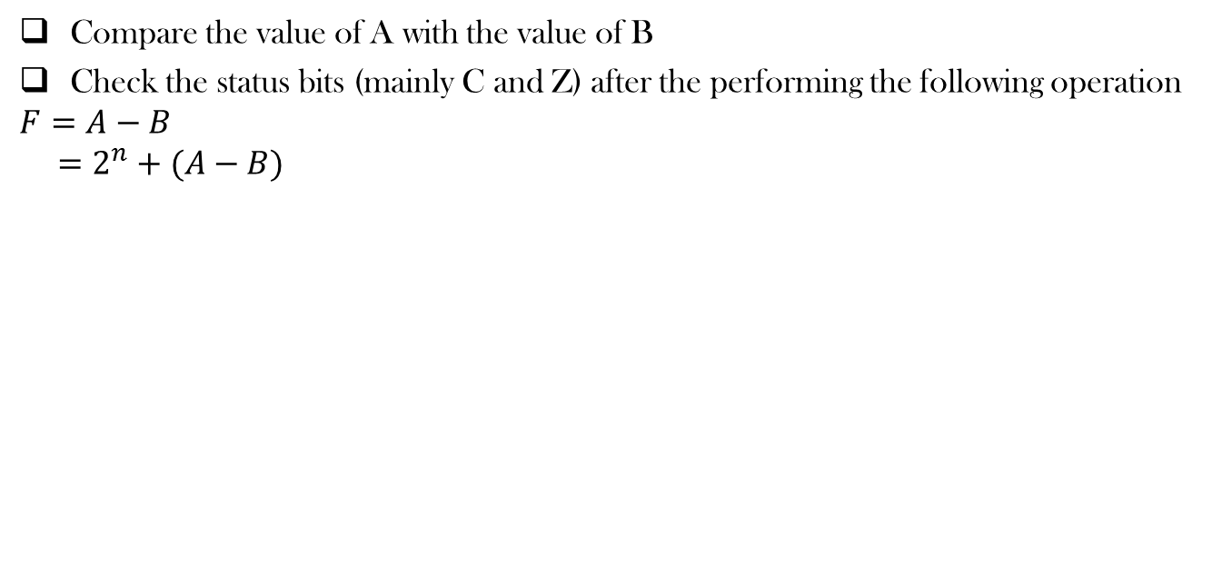
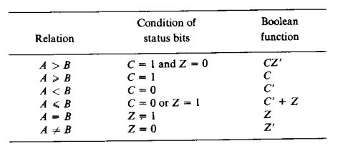
Comparing two unsigned numbers

Slide 32
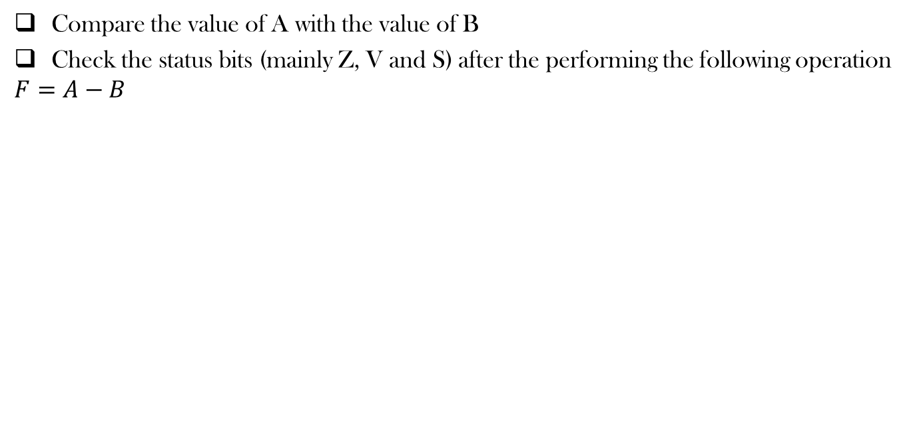
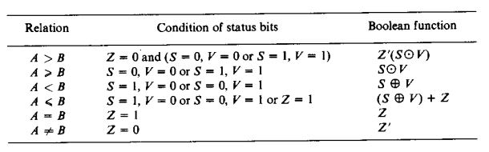
Comparing two signed numbers

Slide 33
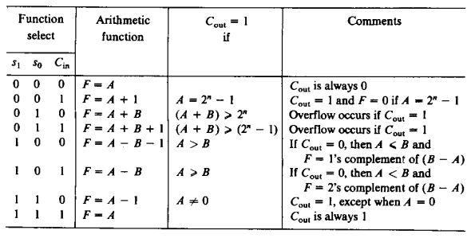
Effect of Output Carry

Slide 34
References
Digital Logic and Computer Design by M. Morris Mano
Chapter 9 (9.1-9.7)

Slide 35
Thank You ☺

