Slide 1
ParkCar
BPMN Diagram
B1-Group2
Presented By: 1805111 - Md Redwanul Karim
Group Members:
1805062
1805088
1805089
1805090
1805106
1805111

Slide 2
Modules
Space Registration
Search & Request
Payment
Complaint System

Slide 3
Pools & Lanes
Owner
System
Space Registration
Search & Book
Complaint & Review
Driver

Slide 4
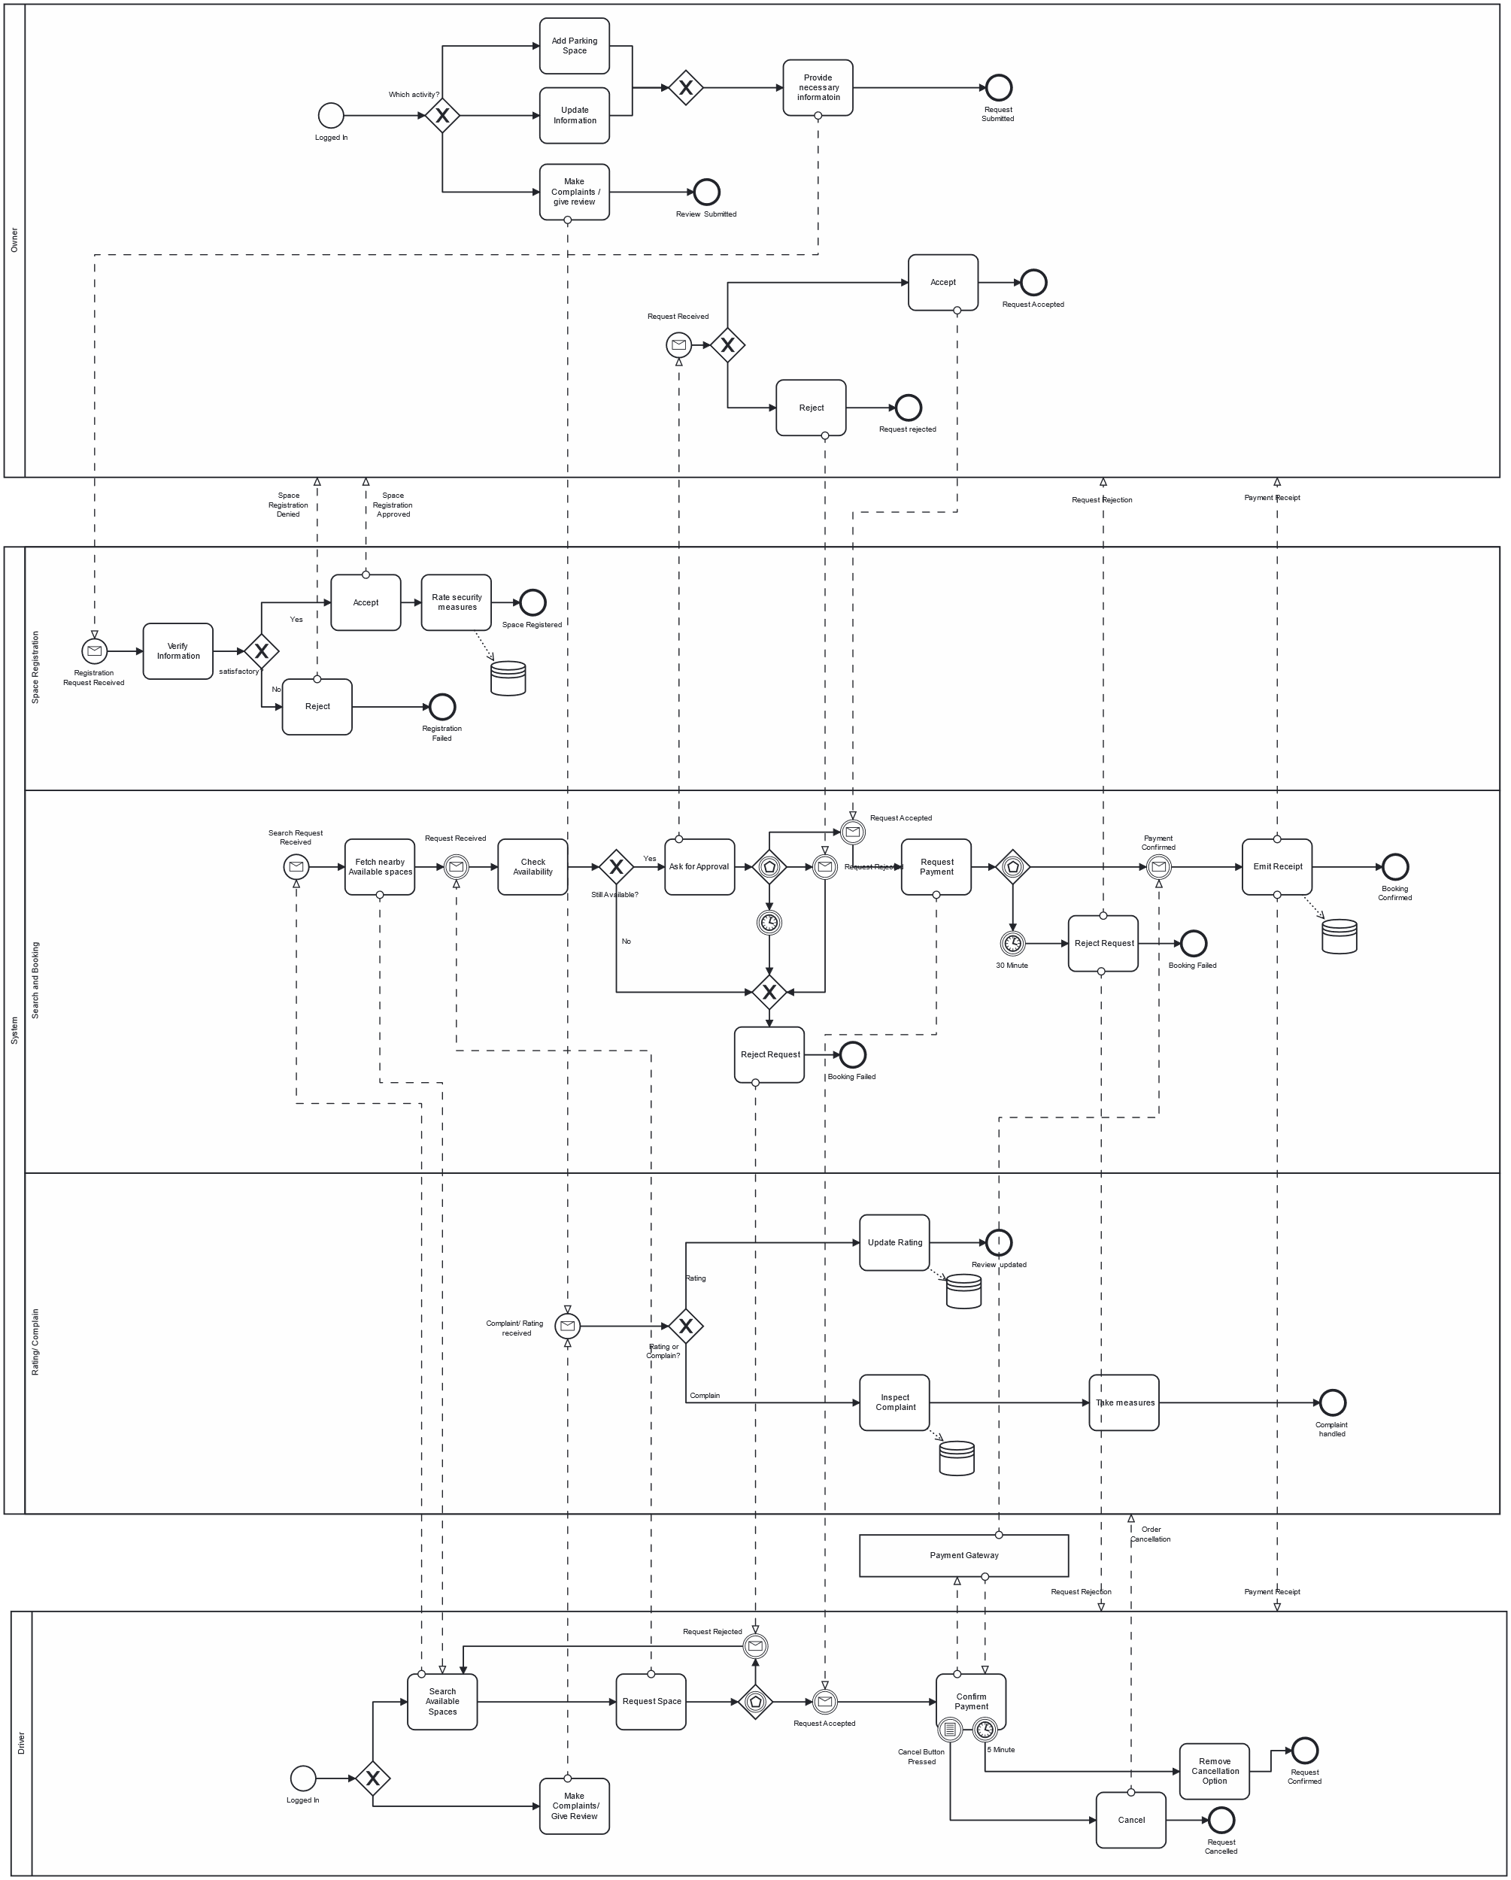
BPMN Diagram

Slide 5
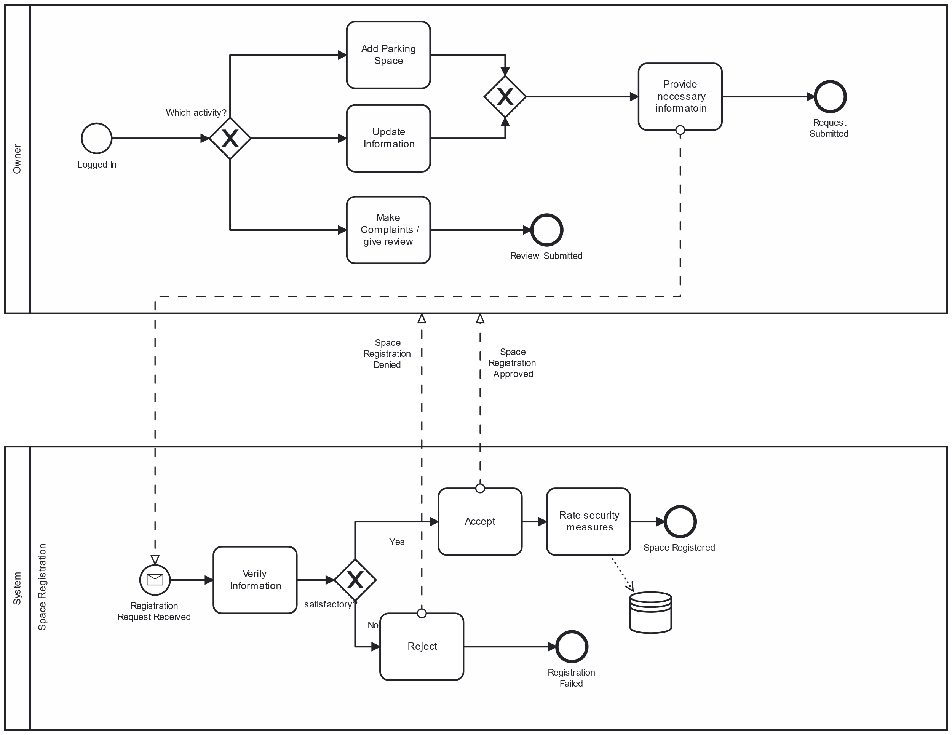
Space Registration

Slide 6
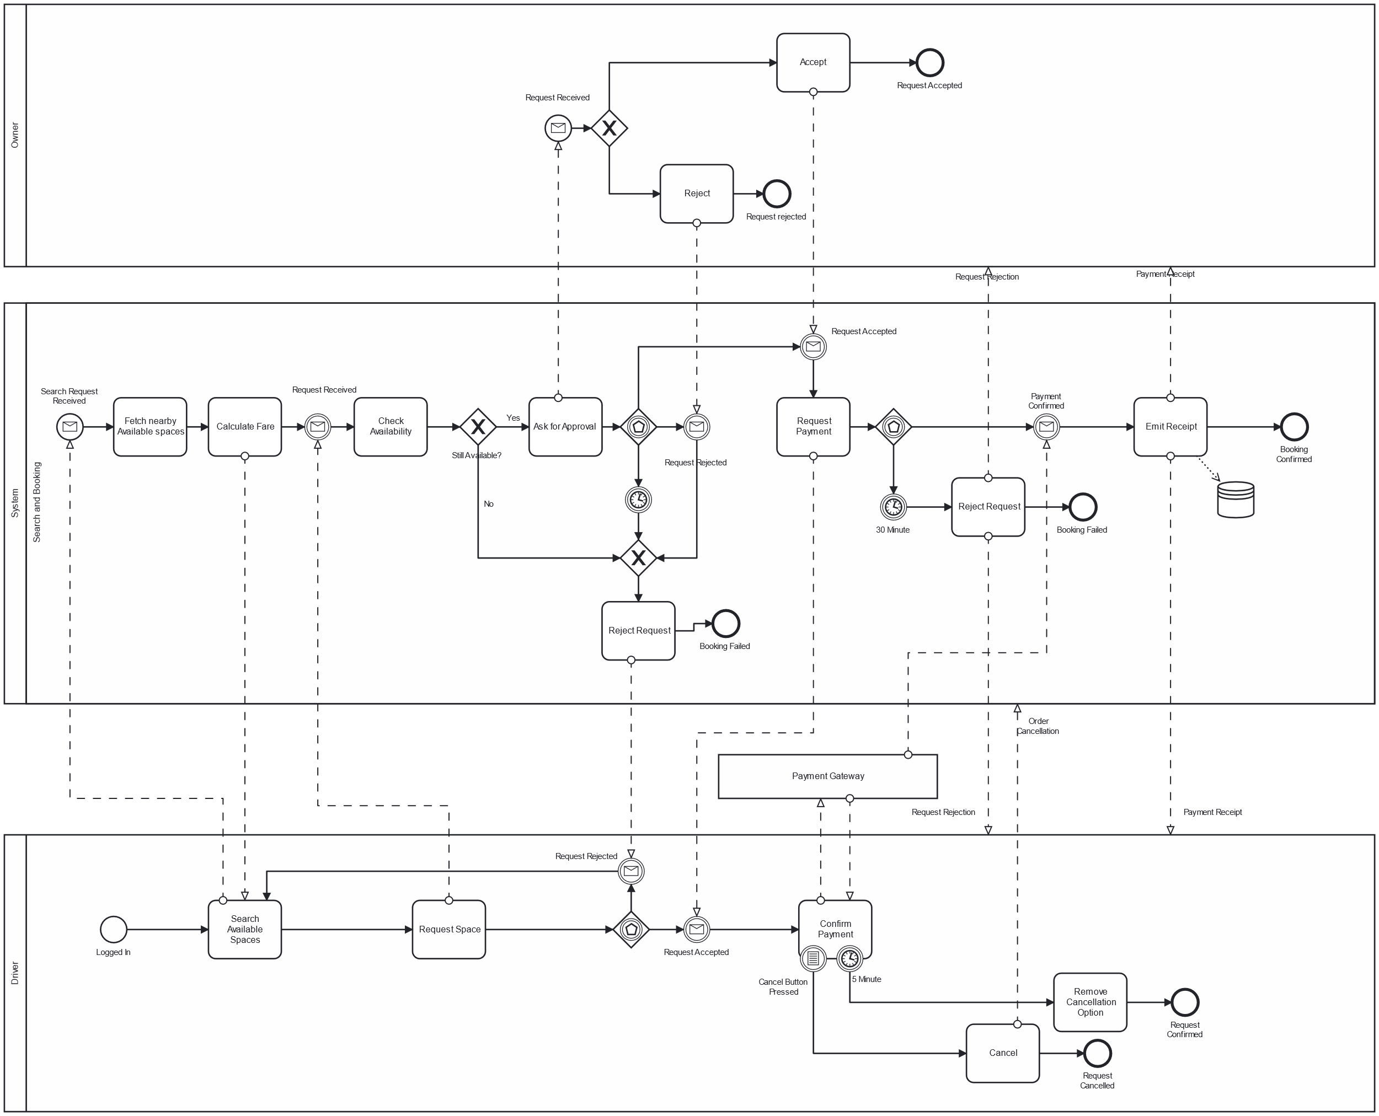
Search And Payment

Slide 7

Search

Slide 8
Approve

Slide 9
Payment

Slide 10
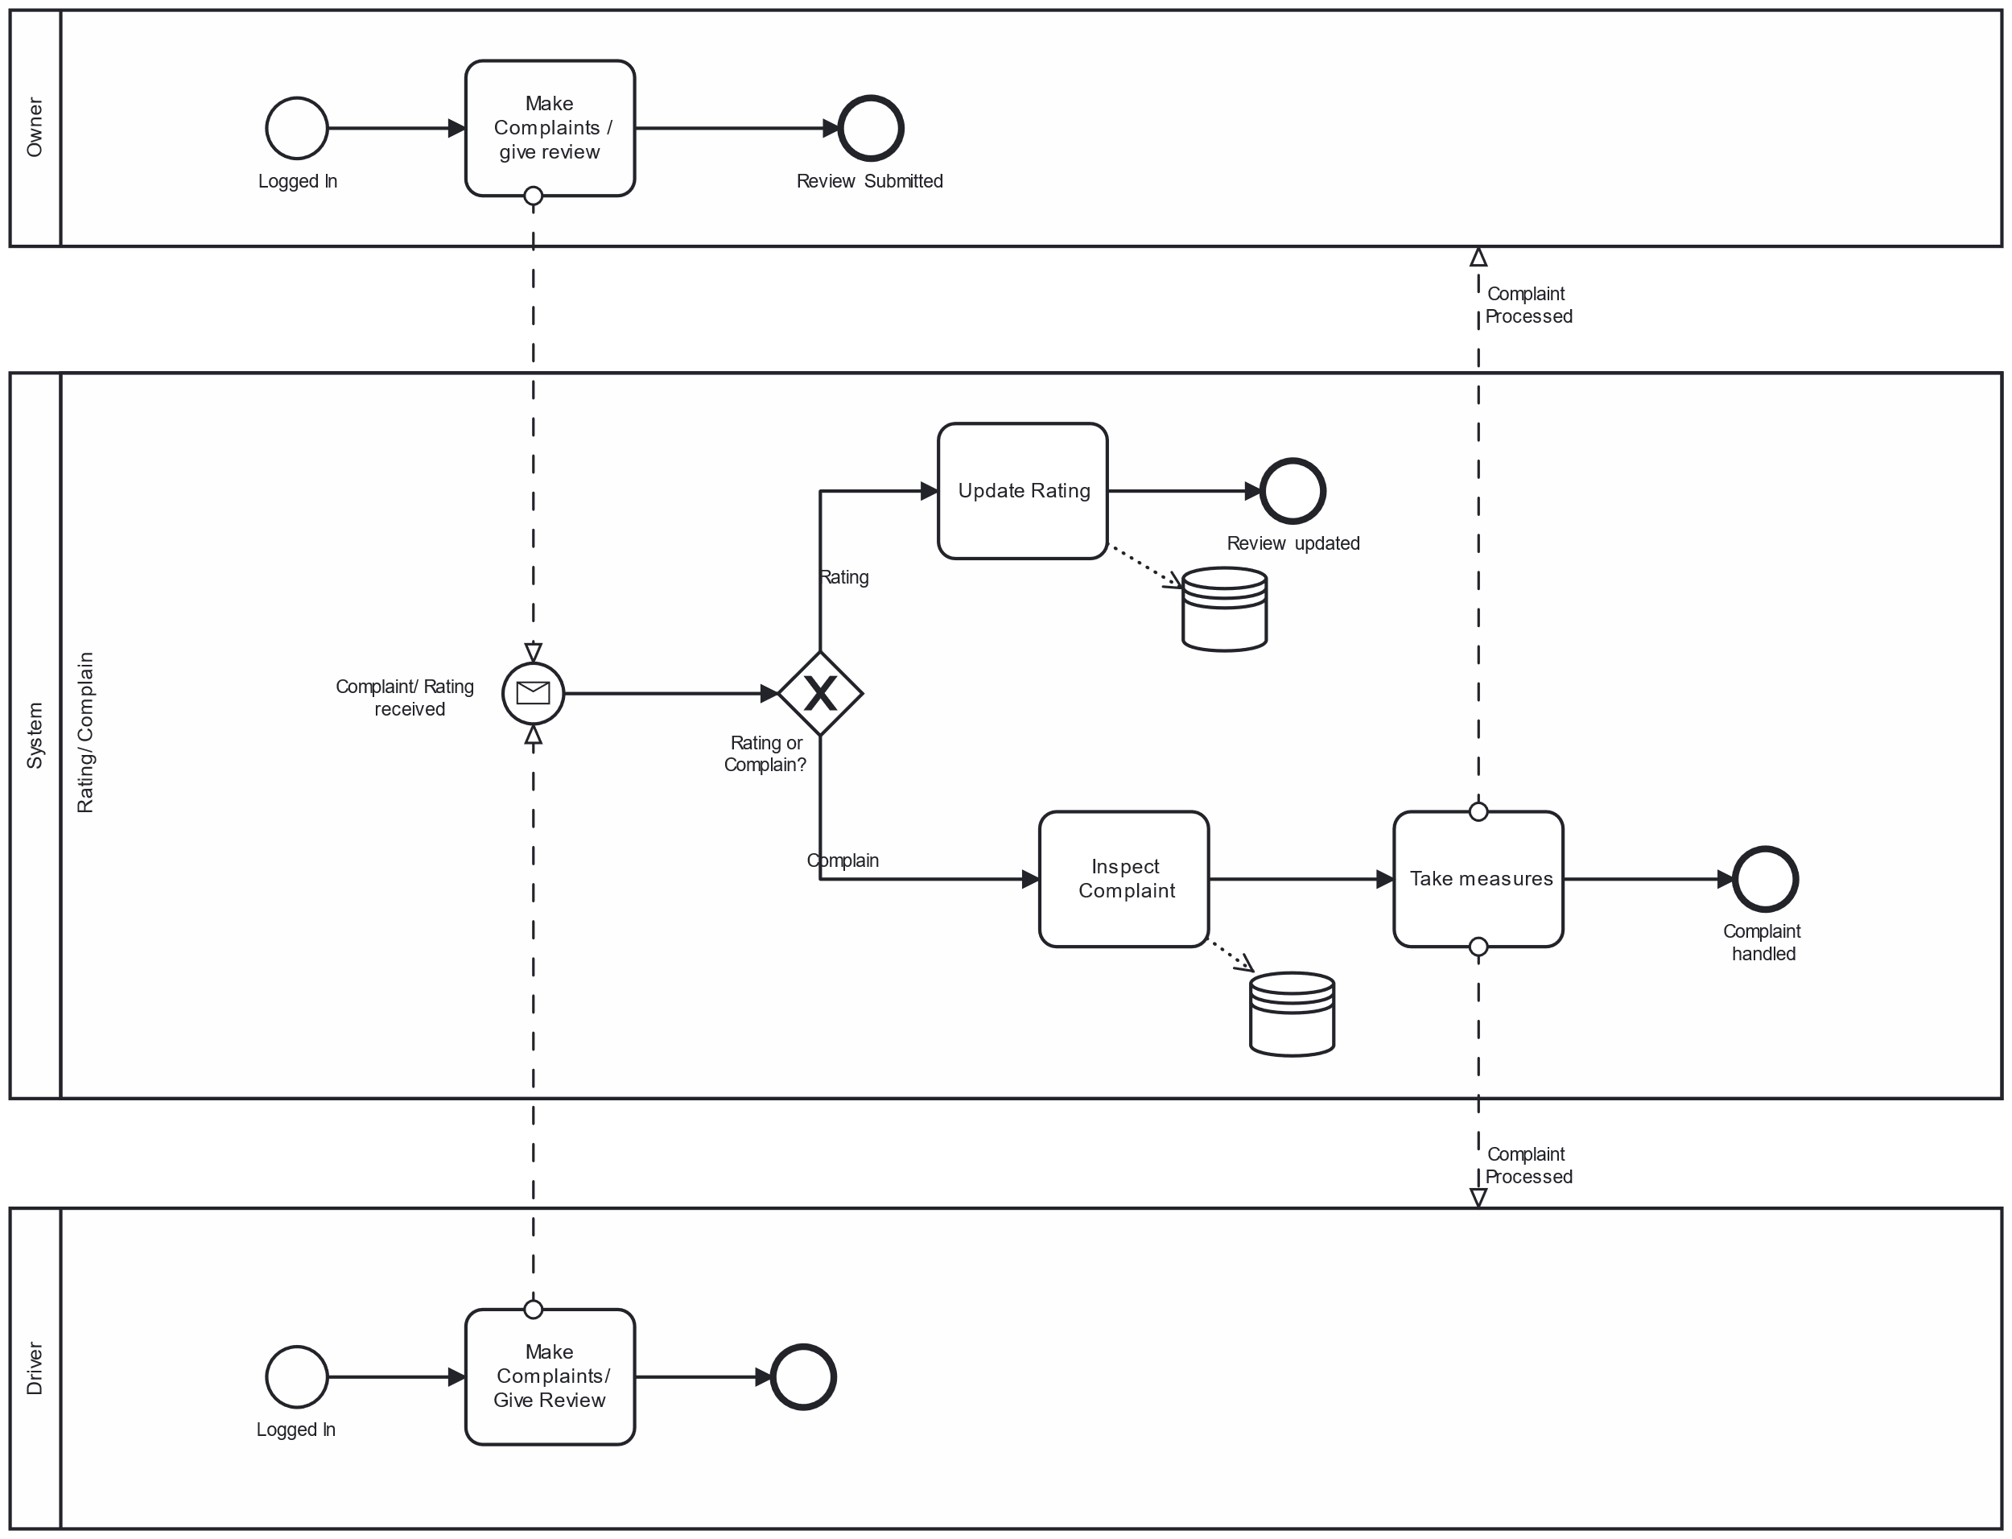
Complaint & Rating

Slide 11
Thank You

