Slide 1

ParkCar
Group B1-2
1805062
1805088
1805089
1805090
1805106
1805111

Slide 2
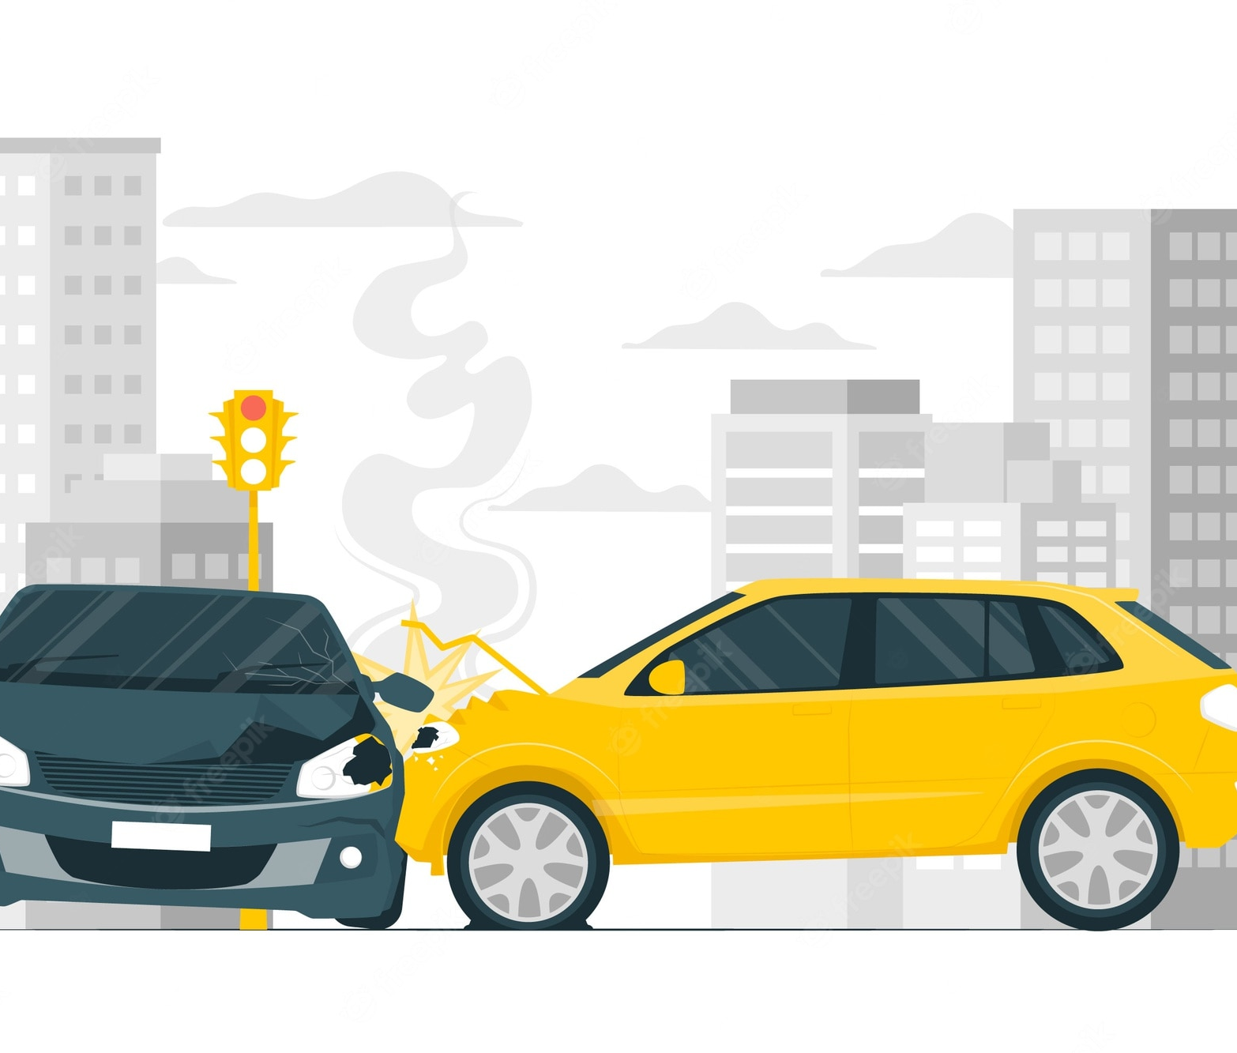

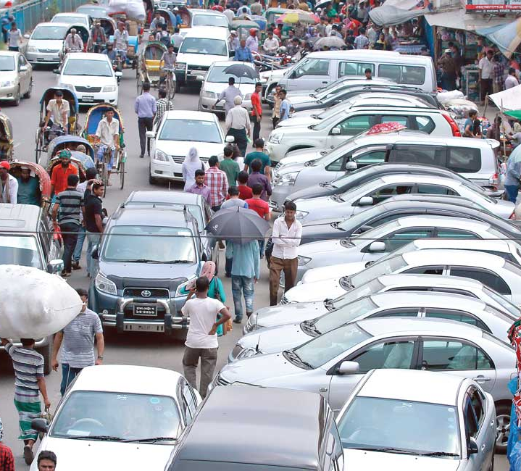
Motivation
Reducing Traffic Jam
Ensuring Car Safety
Preventing Accident
Utilization of Space
Avoiding Car theft
Self-employment

Slide 3

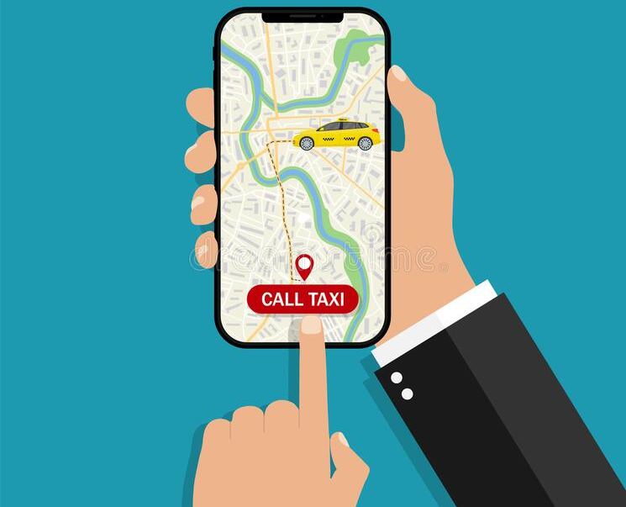
Modules
Parking Spot Registration
Search & Request
Payment/Rent
User Review & Complaint System
BOOK SPACE

Slide 4


Parking Spot Registration
Necessary information
Address
Security Measures
Verification
Proof of Ownership
In person

Slide 5


Search & Request
Available Spots on Map
Search parameters
Location
Time
Availability
Filter/Sort
Distance
Fare
Security

Slide 6
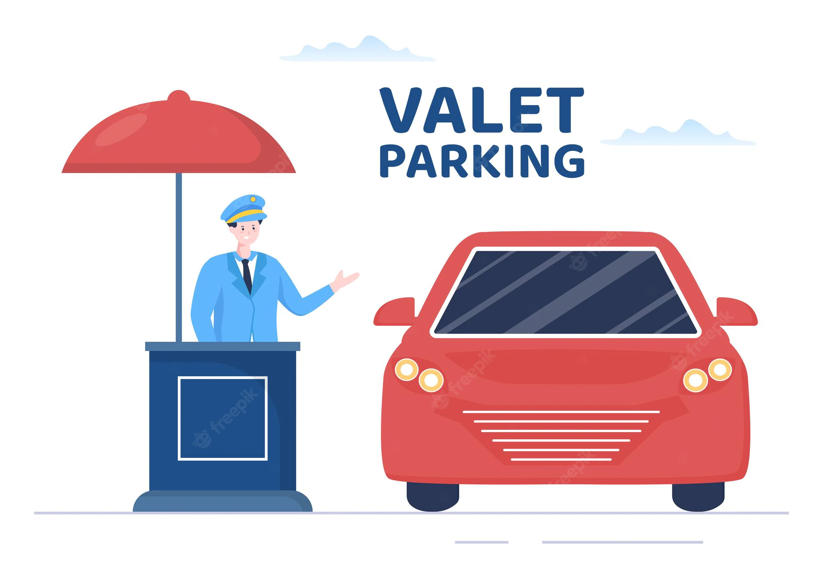

Payment
Rent
Rent Owner will decide base fare
Additional fare will be added according to time and location
Payment
Prepaid
Digital Financial Service
Receipt generation on Payment

Slide 7

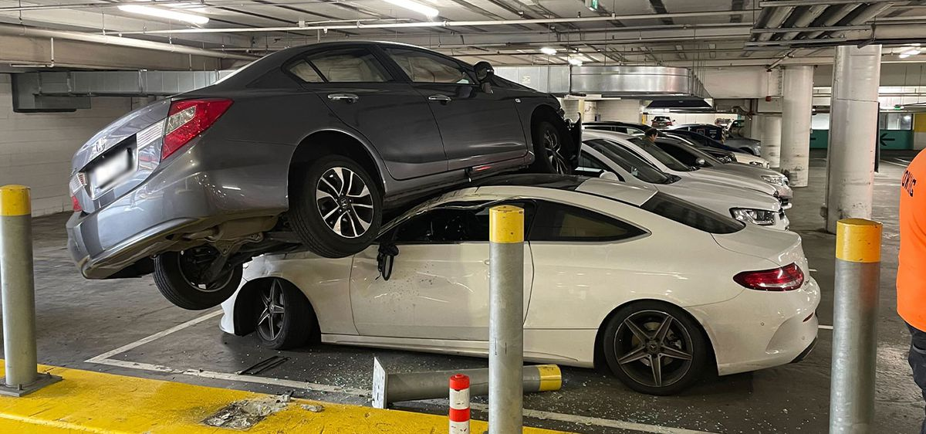
User Review & Complaint System
User Review
From both parties
Complaint System
Material Damages
Lack of Security

Slide 8

Opportunities
Huge untapped potential
Influx of users due to Digital Revolution
Currently no strong competition

Slide 9


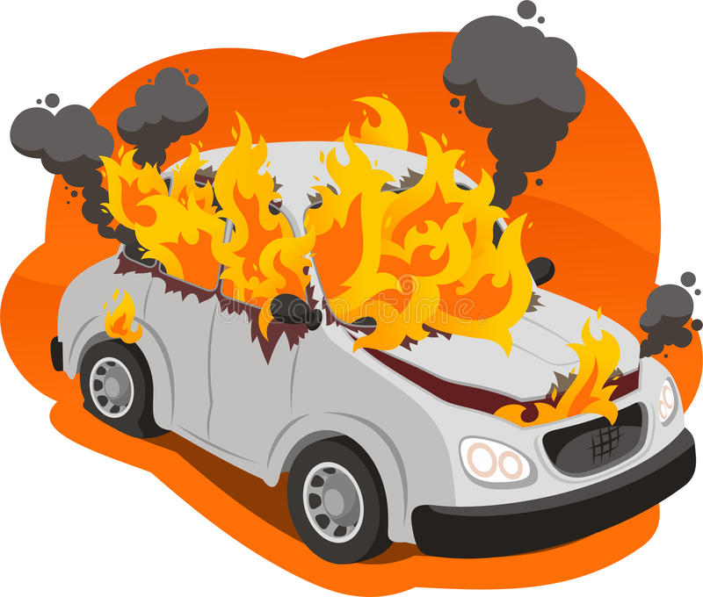
Threats
Security threat
Established companies can easily dominate the market

