Slide 1
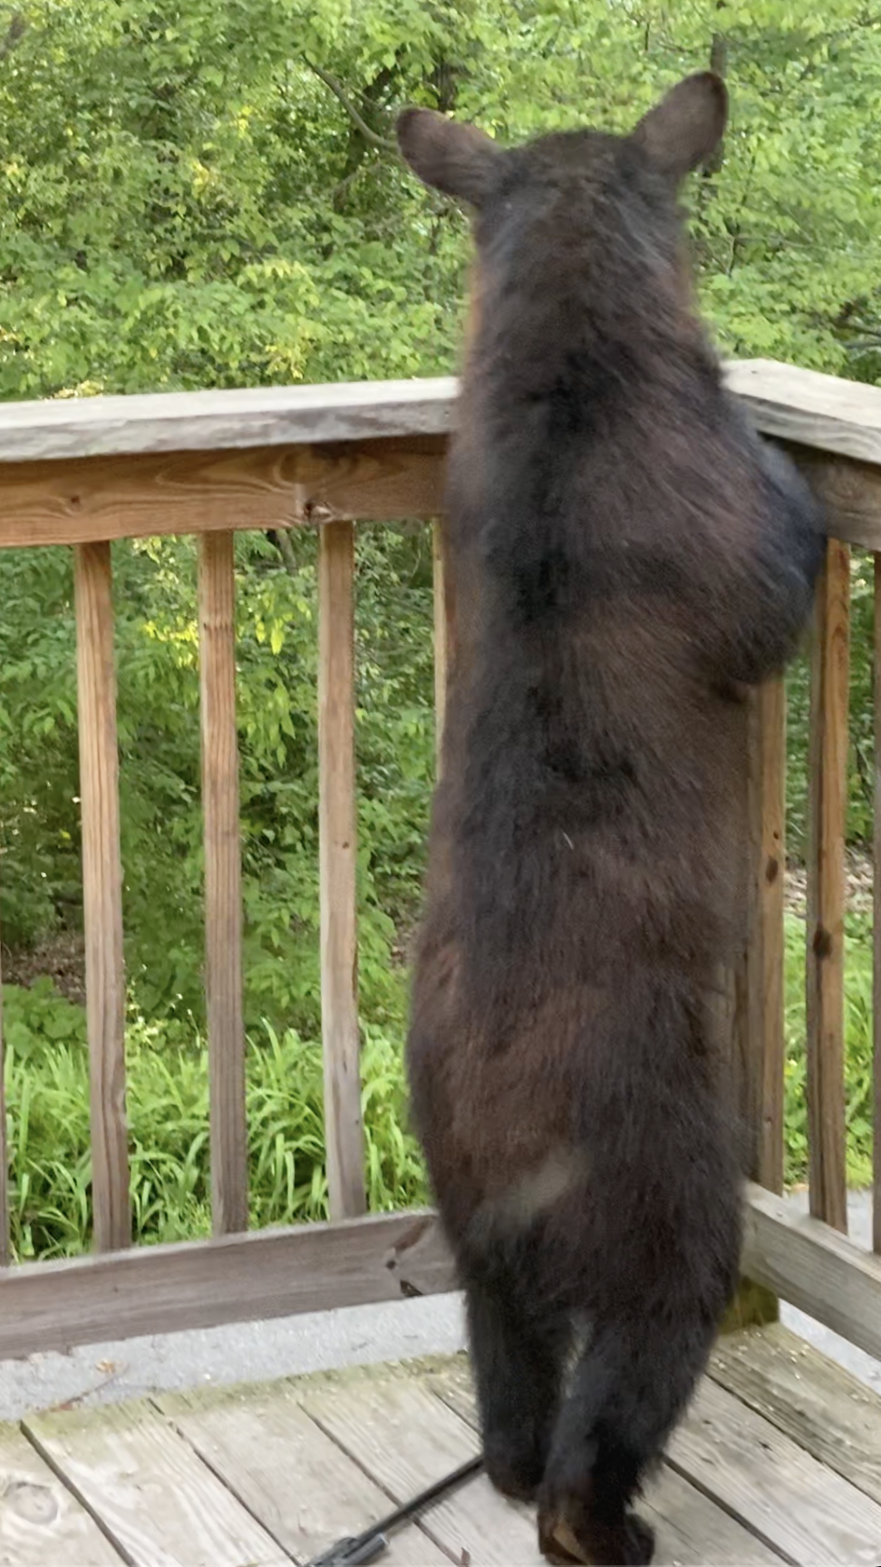
Day 3: Comparative and Phylogenomic Inferences
How we can use our consensus sequence from our raw reads to mapped reads or de novo assembly?
Comparative Genomics: The study of genomes within and between taxa to better understand structure, organization and biological function.
Evolutionary Genomics: The study of how genes and genomes change over time.
Phylogenomics: Tree-based Inferences of evolutionary histories of related taxa.

Slide 2
Phylogenomic Analyses of Host Species
Evolutionary history of species
Population structure and phylogeography
Historic and ongoing patterns of migration and gene flow
Genetic diversity within and between genomes
Detection of Inbreeding
Detection of hybridization
Endangered or relic species, subspecies and populations
Applications
Identification of genes involved in disease resistance and progression
Definition of patterns of evolution and selection within targeted genes
Identification of variants linked with disease pathogenicity in host
Predictive effects of pathogen emergence in naïve host populations or species

