Slide 1
CS6P05ES Computing Research Project · Interim Viva
Multi-Class Brain Tumour MRI Classification
CNNs, Fine-Tuned Models and Ensemble Learning, with an Explainable-AI Uncertainty Signal
Pattiyage Shehan Kavishka
E187041 · BSc (Hons) Data Science (Top-Up)
Supervisor: Ms. Hiruni Wimalaweera
London Metropolitan University · ESOFT Metro Campus
Notes:
Opening: Good morning. My project is a comparative study of three model families for brain tumour MRI classification, combined through ensemble learning and extended with an explainable uncertainty signal. This is the interim stage: I will show what is built, the results so far, how the code works, and what remains. Keep to the flow on the next slide.

Slide 2
Agenda
1
Problem and aim
Why automated brain tumour classification
2
Method and dataset
Three paradigms, one fair protocol
3
Models built
CNN, pretrained models, feature extraction, ensemble
4
Results so far
Interim accuracies and what they tell us
5
Explainable AI plan
The novel EAA-IoU agreement signal
6
System build and further work
Web application, timeline, next steps
Shehan Kavishka · E187041 · CS6P05ES Interim Viva
2
Notes:
State the flow in one breath so the panel knows the structure. Interim vivas are judged on a clear logical flow, honest progress, and understanding of your own code. I will spend most time on sections 3 and 5.

Slide 3
Problem and Motivation
MRI is central to brain tumour diagnosis, but reading scans manually is slow and varies between radiologists.
Four categories must be separated: glioma, meningioma, no tumour, pituitary. Mistakes change the treatment path.
Most published systems use a single model and give no signal of how confident or consistent that model is.
Clinical need: an accurate second opinion that also flags the cases it is unsure about.
9,047
MRI scans · 4 classes · 2,063 held-out test images
SCREENSHOT PLACEHOLDER
Four example MRI scans, one per class (from the Kaggle dataset)
Shehan Kavishka · E187041 · CS6P05ES Interim Viva
3
Notes:
Likely question: why is this worth doing when accuracy is already high in the literature? Answer: the gap is not raw accuracy, it is trust. My contribution is a per-image agreement signal that tells a clinician when the models disagree, which no reviewed paper provides without segmentation labels.

Slide 4
Aim and Objectives
Aim. Design, optimise and compare CNNs, fine-tuned models and ensemble learning for multi-class brain tumour classification under identical conditions, and deploy it as a clinical web application with an explainable uncertainty signal.
Evaluate CNN and classical methods for MRI feature extraction.
Build a modular framework integrating CNNs, pretrained models and classical classifiers.
Compare all models with one consistent metric set (accuracy, precision, recall, F1).
Develop the EAA-IoU inter-model agreement signal from Grad-CAM, with no boundary labels.
Deploy an interactive web application and document everything for reproducibility.
Shehan Kavishka · E187041 · CS6P05ES Interim Viva
4
Notes:
If asked which objective is the research contribution: objective 4 (EAA-IoU). The others are solid engineering and comparison; objective 4 is where novelty sits.

Slide 5
Methodology: One Framework, Three Paradigms
Custom CNN
Final class
4 classes
Confidence-weighted ensemble vote
MRI input
256 or 128 px
InceptionV3 / Xception
transfer learning
>
>
>
EAA-IoU alert
uncertainty
Classical ML on features
RF + DT + SVM
Positivist, deductive, mixed-methods design: quantitative metrics now, clinician feedback later.
Every model shares one data loader, one normalisation, one seed and the official test split, so the comparison is fair.
Shehan Kavishka · E187041 · CS6P05ES Interim Viva
5
Notes:
Method question: why compare three families instead of just using the best one? Answer: the research question is explicitly comparative, and the three architecturally different backbones are also what makes the inter-model agreement signal meaningful. Fairness question: I standardised preprocessing precisely so differences are due to the model, not the pipeline.

Slide 6
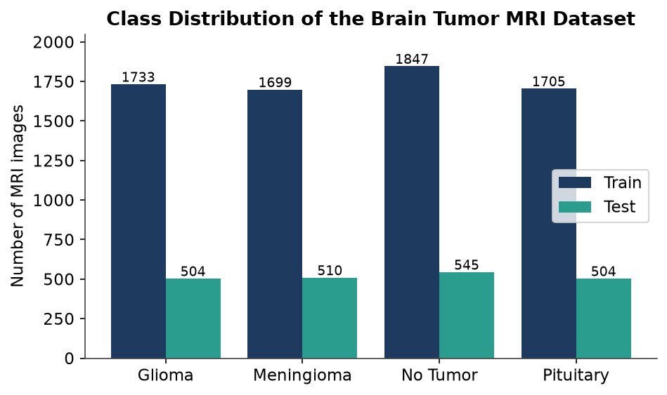
Dataset and Preprocessing
Class | Train | Test
Glioma | 1,733 | 504
Meningioma | 1,699 | 510
No Tumour | 1,847 | 545
Pituitary | 1,705 | 504
Total | 6,984 | 2,063
Resize to the model input size, normalise pixels to 0 to 1.
Stratified split keeps class balance.
Official test folder held out, used only for final scoring.
Class distribution across the train and test splits
Shehan Kavishka · E187041 · CS6P05ES Interim Viva
6
Notes:
Question: is the dataset balanced? Answer: roughly, each class is 1,700 to 1,850 training images, so no heavy imbalance; I still use stratified sampling and report per-class metrics. Question: data leakage? Answer: the official test folder is never seen in training or validation.

Slide 7
What Is Built, What Remains
Completed
In progress and pending
Standardised, reproducible training framework
Custom CNN trained and evaluated
Classical ML baseline on raw pixels
InceptionV3 transfer learning
Classical ensembles on CNN / Inception features
Models and result galleries hosted on Hugging Face
Xception fine-tuning
Six-model integrated ensemble and confidence-weighted vote
EAA-IoU explainability and validation
Streamlit / FastAPI web application (scaffold built)
Qualitative evaluation with clinicians
Shehan Kavishka · E187041 · CS6P05ES Interim Viva
7
Notes:
Be honest here. Interim marks reward an accurate self-assessment. I am on schedule: phases 1 and 2 of the plan are essentially done, and I added value by rewriting the experiments into a single reproducible framework.

Slide 8
Model 1: Custom CNN
training/models/cnn.py
def build_cnn(input_size, feat_layer_name='dense'):
model = models.Sequential([
layers.Conv2D(32,(3,3),activation='relu',
input_shape=(input_size,input_size,3)),
layers.MaxPooling2D((2,2)),
# three more Conv + MaxPool blocks ...
layers.Flatten(),
layers.Dense(256,activation='relu',
name=feat_layer_name), # feature layer
layers.Dropout(0.5),
layers.Dense(4,activation='softmax'),
])
model.compile(optimizer='adam',
loss='sparse_categorical_crossentropy',
metrics=['accuracy'])
return model
Four convolution and pooling blocks learn tumour texture from coarse to fine.
The named Dense(256) layer is kept as a feature point, reused later (Slide 10).
Dropout 0.5 reduces over-fitting; softmax gives four class probabilities.
Trained 20 epochs, Adam. Test accuracy 91.18 percent, the strongest single model.
Shehan Kavishka · E187041 · CS6P05ES Interim Viva
8
Notes:
How the code works: Sequential stacks the layers; name= fixes the layer name so I can address it later for feature extraction. Why sparse_categorical_crossentropy: labels are integers 0 to 3, not one-hot. Why dropout: training accuracy reached ~99 percent, so I regularise. Likely question: why not augment? That is planned next phase to close the train/test gap.

Slide 9
Model 2: Pretrained Models (Transfer Learning)
training/models/transfer.py
def build_inception_standalone(size=256):
base = InceptionV3(input_shape=(size,size,3),
weights='imagenet', include_top=False)
base.trainable = False # freeze backbone
x = GlobalAveragePooling2D()(base.output)
out = Dense(4, activation='softmax',
name='dense')(x) # new head
return Model(base.input, out)
InceptionV3 is pretrained on ImageNet, so it already detects edges, shapes and textures.
include_top=False drops its 1000-class head; I add my own 4-class head.
trainable=False freezes the backbone, so only the small head is learned. This is fast and works with limited medical data.
InceptionV3 84.63 percent; Xception is the next model to train.
Shehan Kavishka · E187041 · CS6P05ES Interim Viva
9
Notes:
Why transfer learning: I have only ~7,000 images; training a deep network from scratch would over-fit. ImageNet features transfer well to MRI texture. Question: why freeze rather than fine-tune all layers? For the interim I froze for speed and a clean baseline; selective unfreezing is a planned improvement. Xception uses the identical pattern, which is why adding it is low risk.

Slide 10
How We Extract the Dense Layer (Features)
training/evaluate.py
from tensorflow.keras.models import Model
def extract_features(model, layer_name, X):
extractor = Model(
inputs = model.input,
outputs= model.get_layer(layer_name).output)
return extractor.predict(X) # (N, 256) vectors
A new Model is built that shares the same input but stops at the named layer.
It outputs the 256-number activation vector, a compact summary of the image.
No retraining: it reuses the trained weights and just reads an inner layer.
These vectors feed the classical classifiers on the next slide.
MRI
image
Frozen backbone
Dense(256)
feature vector
>
>
Shehan Kavishka · E187041 · CS6P05ES Interim Viva
10
Notes:
This is a question they will ask. Key idea: get_layer(name).output gives a symbolic handle to an intermediate tensor; wrapping it in a new Model turns that layer into an output. CNN uses layer "dense", InceptionV3 "dense_2", Xception "dense_3" (I named them explicitly so they are stable). Why 256 features and not 65,536 raw pixels: the deep layer is a learned, low-dimensional representation, which classical models handle far better.

Slide 11
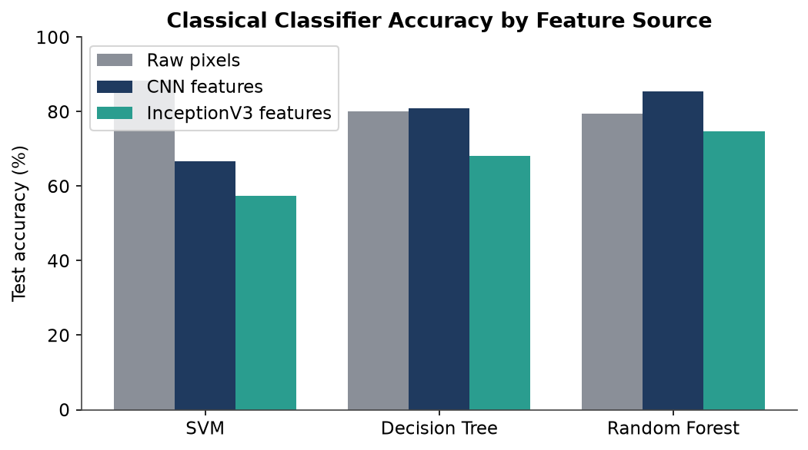
Model 3: Classical Ensemble on Features
training/models/classical.py
rf = RandomForestClassifier(n_estimators=100)
dt = DecisionTreeClassifier()
svm = SVC(probability=True)
ensemble = VotingClassifier(
estimators=[('rf',rf),('dt',dt),('svm',svm)],
voting='soft') # average probabilities
ensemble.fit(train_feats, y_train)
Soft voting averages the three classifiers probabilities, then picks the top class.
Feature source matters: CNN features gave the best classical result (RF 85.45 percent).
CNN feature ensemble 83.71 percent; Inception feature ensemble 71.20 percent.
Classical accuracy by feature source
Shehan Kavishka · E187041 · CS6P05ES Interim Viva
11
Notes:
Why soft not hard voting: soft uses probability confidence, so a very sure model counts more; this needs probability=True on the SVM. Observation: raw-pixel SVM (88.26 percent) beat the CNN-feature ensemble, which I discuss honestly; the deep features help RF and DT a lot but not SVM. I also fixed a bug where the original notebook used a Decision Tree in place of the Random Forest.

Slide 12
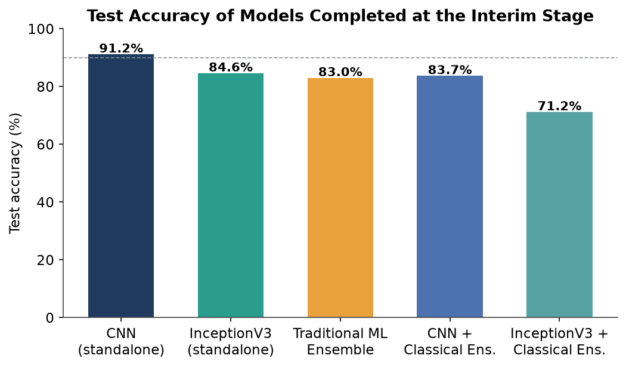
Results So Far
Reading the results
Custom CNN is strongest so far at 91.18 percent.
Raw-pixel SVM is a strong classical baseline at 88.26 percent.
Glioma is the hardest class, most often confused with meningioma.
This motivates the agreement signal: disagreement should concentrate on glioma.
Interim test accuracy
Shehan Kavishka · E187041 · CS6P05ES Interim Viva
12
Notes:
Question: your final report claims 98.2 percent for the full ensemble, why is it not here? Answer: that is the six-model ensemble, which needs Xception; at the interim I report only the models actually completed, honestly. Question: why does CNN beat the pretrained models? The frozen pretrained heads are undertrained at the interim; fine-tuning and the ensemble are expected to close this.

Slide 13
Explainable AI: EAA-IoU Agreement (Novel)
webapp/xai_engine.py
def iou_score(a, b, t=0.5):
a, b = a>=t, b>=t # binarise heatmaps
return (a & b).sum() / (a | b).sum()
# per image: Grad-CAM from CNN, Xception, Inception
eaa = mean([iou(A,B), iou(A,C), iou(B,C)])
if eaa < 0.40: flag_for_radiologist()
Grad-CAM shows where each model looked. I compute the overlap (IoU) between the three maps.
The mean pairwise IoU is one agreement score per image.
Low agreement means the models disagree on the tumour location, so the case is flagged.
Novelty: agreement is measured between models, needing no radiologist-drawn boundaries.
3 Grad-CAM maps
CNN · Xcp · Inc
Pairwise IoU
mean = EAA-IoU
Escalate if low
clinical safety
>
>
Shehan Kavishka · E187041 · CS6P05ES Interim Viva
13
Notes:
This is the research contribution, be ready to defend novelty. Prior ensemble-CAM work compares a model map to a radiologist bounding box (needs labels). Mine compares models to each other, so it is self-supervised. Hypothesis I will test on 2,063 images: low EAA-IoU correlates with misclassification. Question: is IoU the right metric? It is standard for region overlap; threshold t is tunable and I will report sensitivity to it.

Slide 14
How the Software Is Built
Training modules
config · data · models · train
Hugging Face Hub
weights + results
Web app
FastAPI + React / Streamlit
>
>
Training is modular Python: one config file fixes every hyperparameter and path.
Trained models are versioned on Hugging Face; the app downloads them on first run.
The app runs all models, builds Grad-CAM maps, computes the vote and the EAA-IoU alert.
SCREENSHOT PLACEHOLDER
Web application screenshot: upload, prediction, confidence, Grad-CAM panels, class probabilities
Shehan Kavishka · E187041 · CS6P05ES Interim Viva
14
Notes:
How you built it: separation of concerns. Training code is independent of the app; the app only consumes saved models. Why Hugging Face: model files exceed GitHub limits, and it also hosts the result galleries. Known issue I can speak to: the deployed app needs HF_REPO_ID set to auto-download the models, otherwise it reports no models loaded. Insert a real screenshot of the running app here before the viva.

Slide 15
Further Work and Timeline
Train Xception and complete the six-model integrated ensemble.
Implement confidence-weighted voting for a real per-prediction confidence.
Build and validate EAA-IoU on all test images, with class-wise analysis.
Finish the web application and collect clinician feedback.
Phase | Status
1 Research and planning | Complete
2 Individual models | CNN, classical, Inception done
3 Ensemble framework | In progress
4 Evaluation | Partially done
5 Application | Scaffold built
6 Documentation | Ongoing
On schedule against the 16-week plan
Shehan Kavishka · E187041 · CS6P05ES Interim Viva
15
Notes:
Risk question: what if EAA-IoU does not correlate with error? Answer: that is still a valid, reportable research finding, and the confidence-weighted vote remains a useful deliverable. Compute risk for Xception is handled with cloud GPU. End on confidence that the project finishes on time.

Slide 16
Summary
A fair, standardised comparison of CNN, pretrained and classical models is built and evaluated.
Custom CNN leads at 91.18 percent; results so far are consistent and reproducible.
The novel EAA-IoU agreement signal and the web application are the focus of the next phase.
Thank you. Questions and discussion.
Notes:
Anticipated questions to rehearse: (1) Why these three architectures? comparative RQ + diverse backbones for agreement. (2) What exactly is novel? inter-model Grad-CAM IoU as a label-free uncertainty signal. (3) How does feature extraction work in code? Model(inputs, outputs=get_layer(name).output). (4) Why is the pretrained model weaker than the CNN? frozen heads undertrained; fine-tuning next. (5) Why 98.2 percent is not shown? needs Xception, reported honestly at interim. (6) How is the software structured? training modules, Hugging Face hosting, FastAPI/Streamlit app. (7) Fairness? one pipeline, one seed, official test split. (8) Ethics? public anonymised data, decision-support not replacement.

