Slide 1
O
OGILVY MEDIA
Ogilvy Orbit
The Media Buying Records System,
explained for Managers.
A read-only tour of the analytics you oversee, with every chart on every screen explained: what it shows, how to read it, and what data drives it.
Prepared for the Managers team 2026

Slide 2
O
01
THE MANAGER'S VIEW
Oversight, without the spreadsheets
Orbit gives you a live, read only window into billings and performance across every agency you own.

Slide 3
THE BIG PICTURE
One console for oversight
As a Manager you do not enter data. You review it, across agencies, the moment it lands.
1
2
3
See every account
Read the story in charts
Report and export
Read access spans all agencies assigned to you, with billings, pacing and performance in one place.
Dashboards turn raw schedules into trends, splits and rankings you can act on in a review.
Pull branded Excel and PDF reports for any agency, client or channel on demand.
Ogilvy Orbit Manager Guide
THE MANAGER'S VIEW
03 / 41

Slide 4
YOUR ACCESS
What a Manager can reach
You have read access across every agency assigned to you. You cannot edit records, which keeps the numbers you review clean and trustworthy.
Executive Dashboard
Spend Analytics
Your home: billings and pacing across agencies
Deep charts and breakdowns of committed spend
Deep Dashboard
Channel Intelligence
Multi year trends and property performance
Spend and trends for any single channel
Client Dashboard
Agencies & Clients
A per client analytics view for reviews
The full roster you oversee
Reports
Database
Branded Excel and PDF exports on demand
The underlying schedule records, read only
Ogilvy Orbit Manager Guide
GETTING ORIENTED
04 / 41

Slide 5
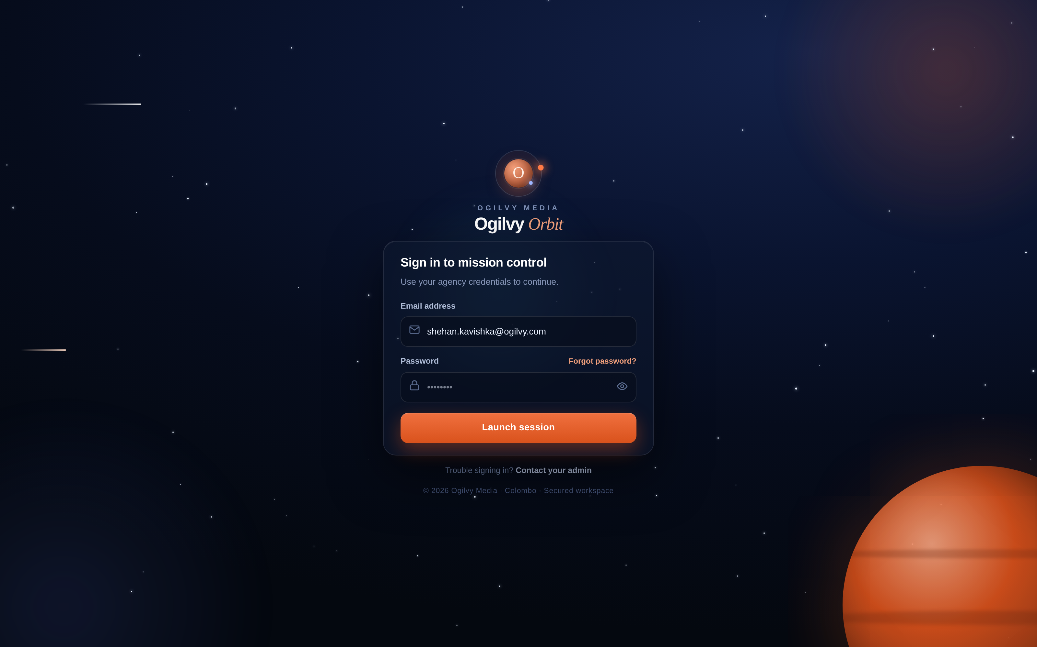
SIGNING IN
Your secure sign in
You sign in with your agency email and a private password. Orbit remembers nothing you should not see.
WHAT YOU CAN DO HERE
Sign in with your Ogilvy email and password
Reset a forgotten password from the same screen
Set a fresh password on your very first sign in
Read access only, so records stay protected
Tip Your role is read only by design, which keeps every number you review trustworthy.
Ogilvy Orbit Manager Guide
THE MANAGER'S VIEW
05 / 41

Slide 6
O
02
YOUR SCREENS AT A GLANCE
Six screens you will live in
A quick orientation to each screen before we open up every chart on them.

Slide 7
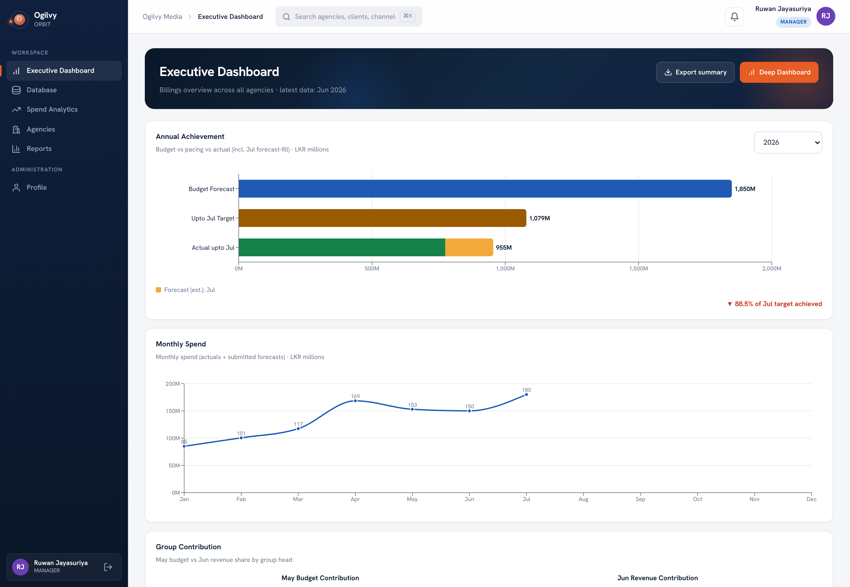
EXECUTIVE DASHBOARD
Executive Dashboard
Your home screen. A billings overview across all agencies, anchored to the latest month with data.
WHAT YOU CAN DO HERE
Lead with Annual Achievement: budget, pacing, actual
Follow company spend on the Monthly Spend line
Compare agencies, mediums and team contribution
Export a branded summary in one click
Ogilvy Orbit Manager Guide
YOUR SCREENS
07 / 41

Slide 8
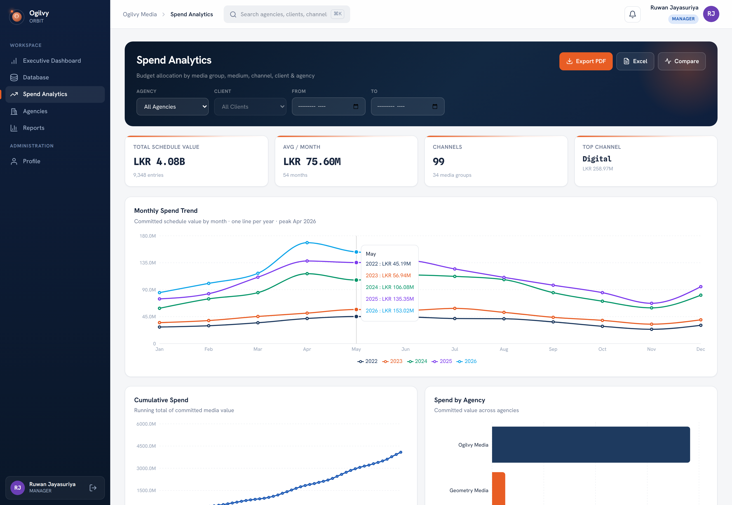
SPEND ANALYTICS
Spend Analytics
The deepest analytics screen. Filter by agency, client and date, then read spend from every angle.
WHAT YOU CAN DO HERE
Twelve charts covering trend, mix, tenure and more
Filter by agency, client and month range
Cross filter the channel views from the medium donut
Export the whole view to Excel or PDF
Ogilvy Orbit Manager Guide
YOUR SCREENS
08 / 41

Slide 9
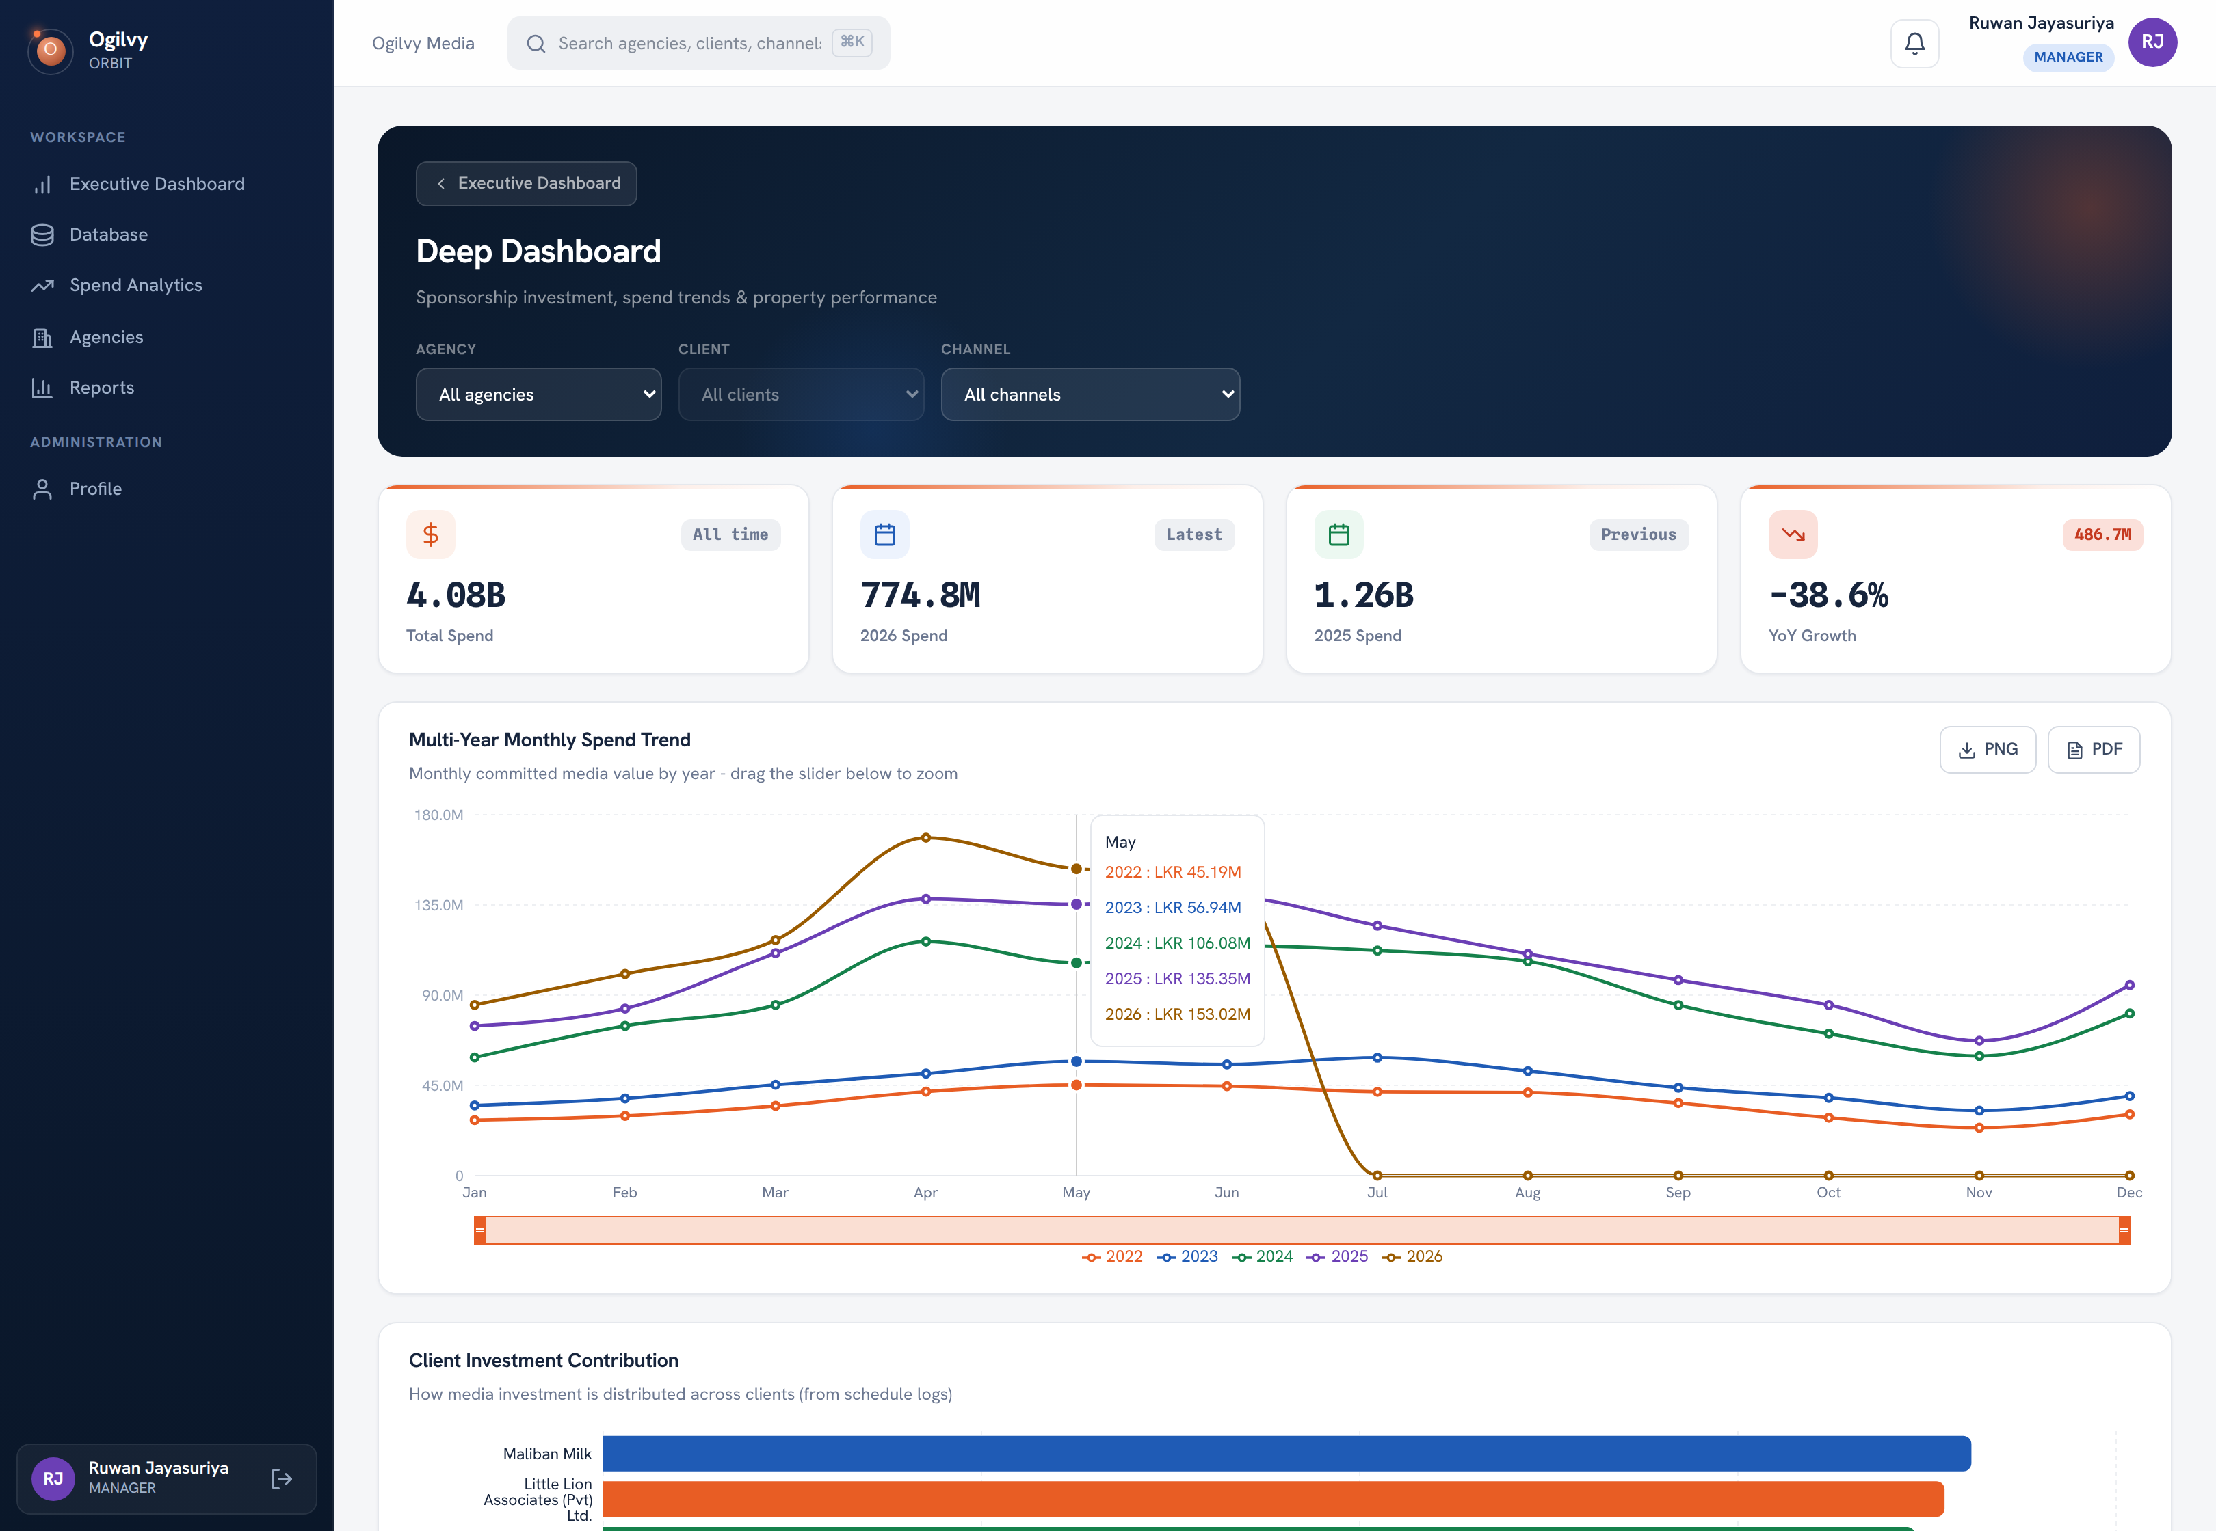
DEEP DASHBOARD
Deep Dashboard
A drill down for multi year trends, client contribution and property level performance.
WHAT YOU CAN DO HERE
Overlay several years on one trend, with a zoom brush
Rank clients and channels by their contribution
Sort a property table, including bonus yield
Export the detail to Excel or PDF
Ogilvy Orbit Manager Guide
YOUR SCREENS
09 / 41

Slide 10
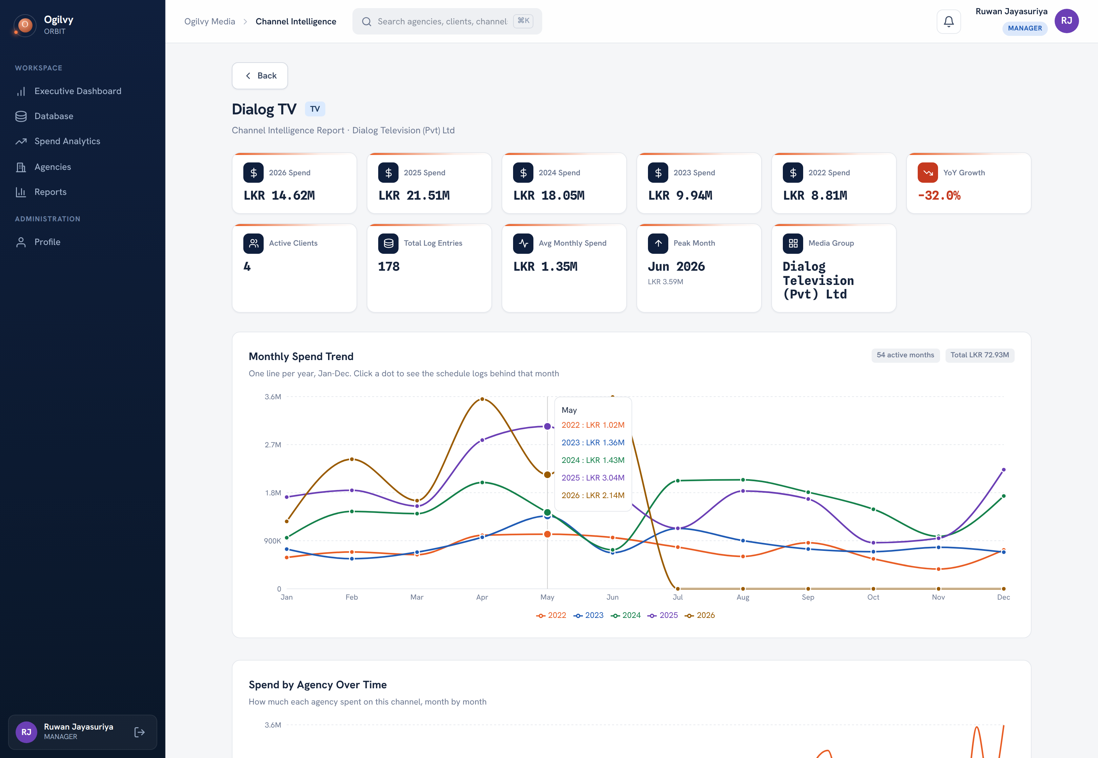
CHANNEL INTELLIGENCE
Channel Intelligence
A full read on a single channel across every client and agency, so you review from evidence.
WHAT YOU CAN DO HERE
Read spend, growth and the peak month per channel
Trace any month back to the schedules behind it
See which agencies drive the channel over time
Spot how concentrated the channel's clients are
Ogilvy Orbit Manager Guide
YOUR SCREENS
10 / 41

Slide 11
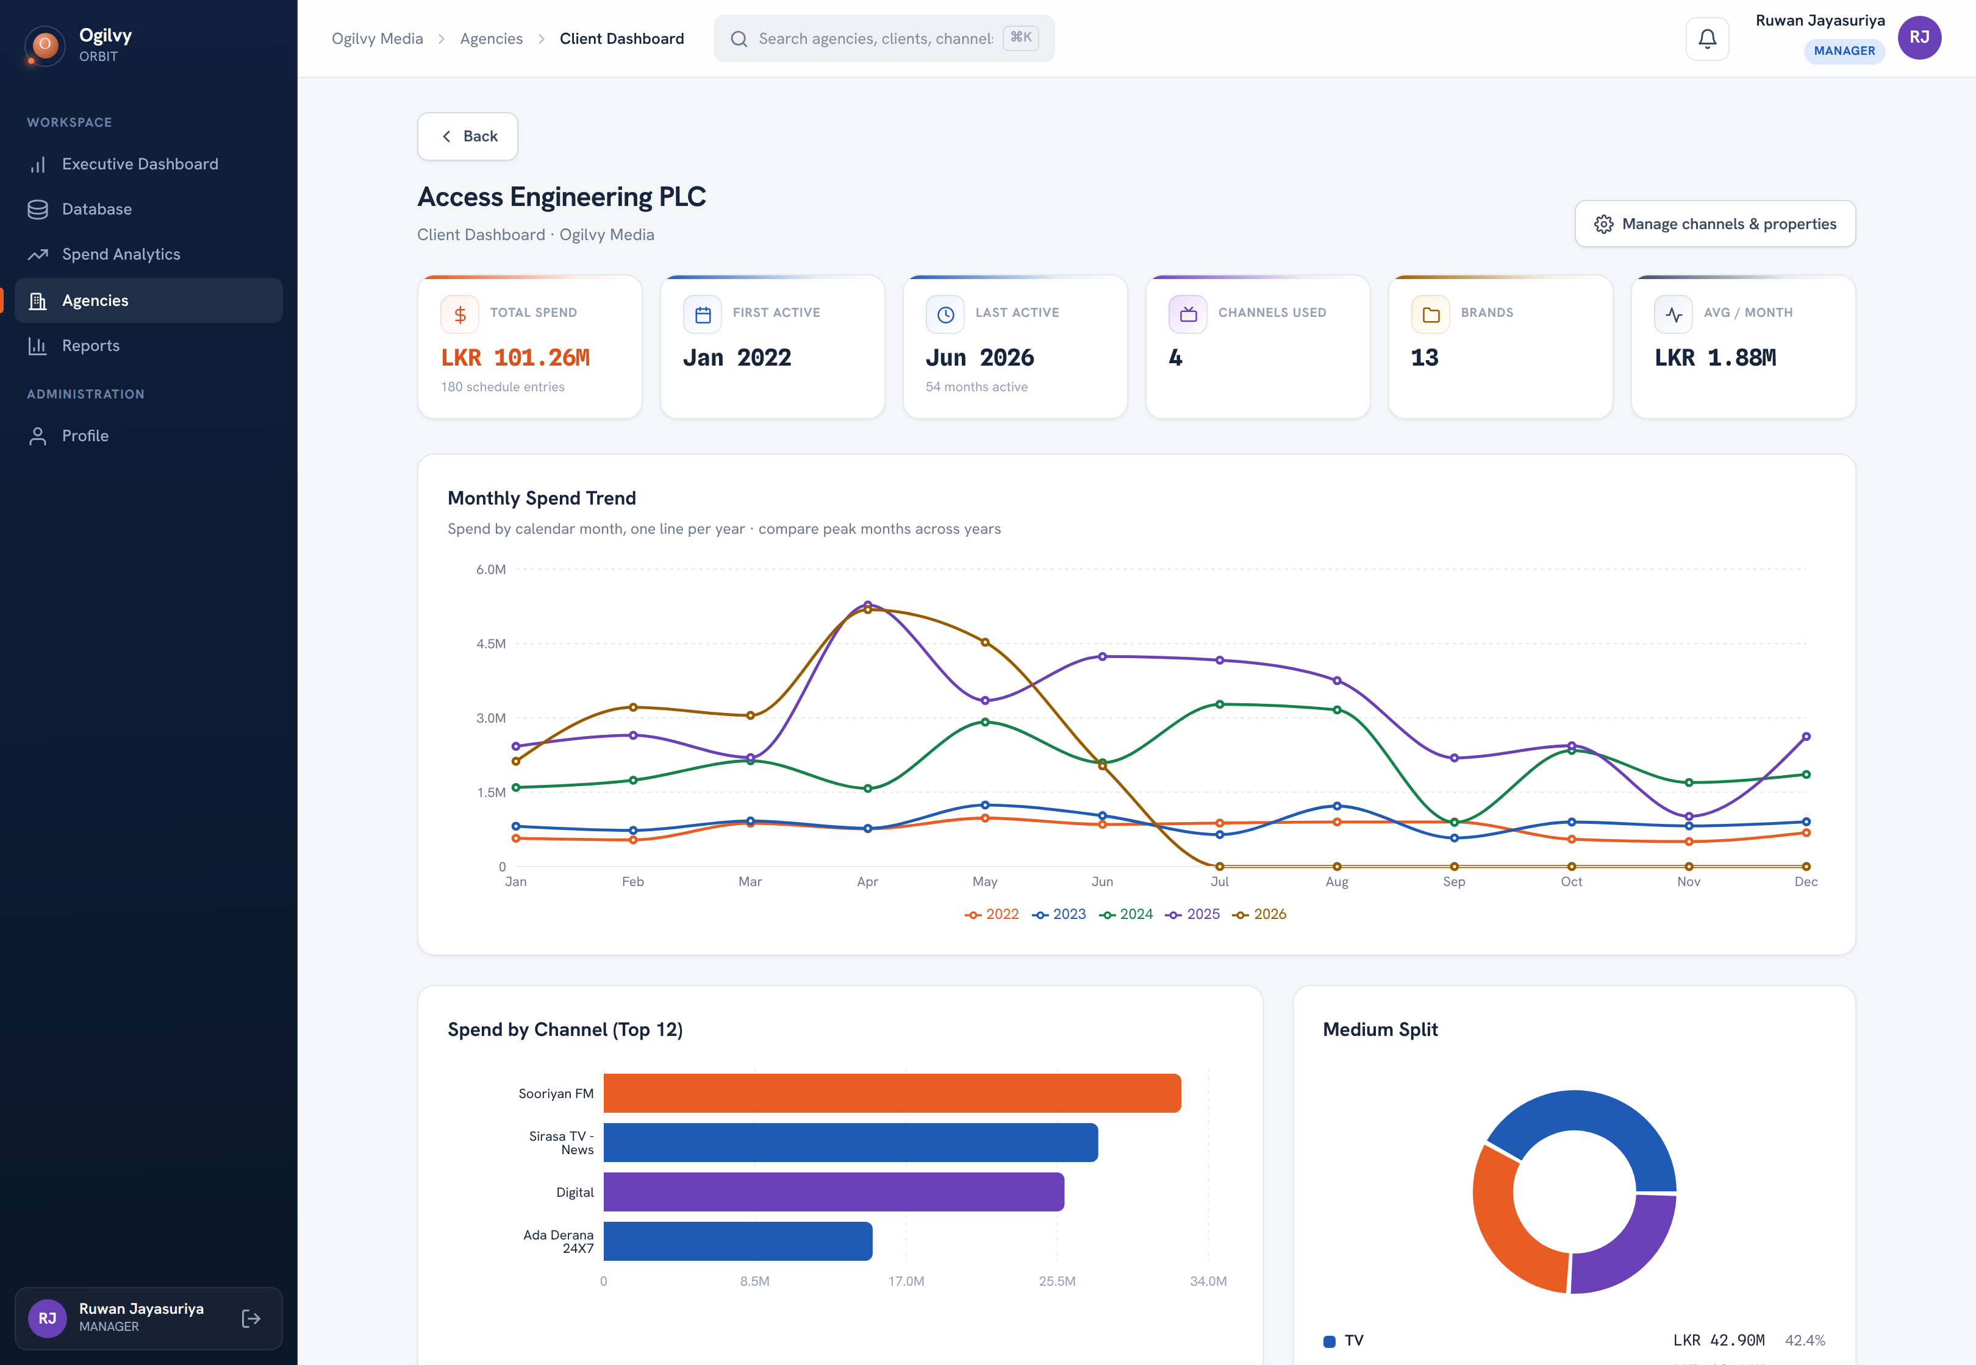
CLIENT DASHBOARD
Client Dashboard
A focused analytics view for one client, so you can walk into any client review prepared.
WHAT YOU CAN DO HERE
See the client's spend trend across years
Read their channel and medium mix at a glance
Understand where a client is growing or slowing
Ogilvy Orbit Manager Guide
YOUR SCREENS
11 / 41

Slide 12
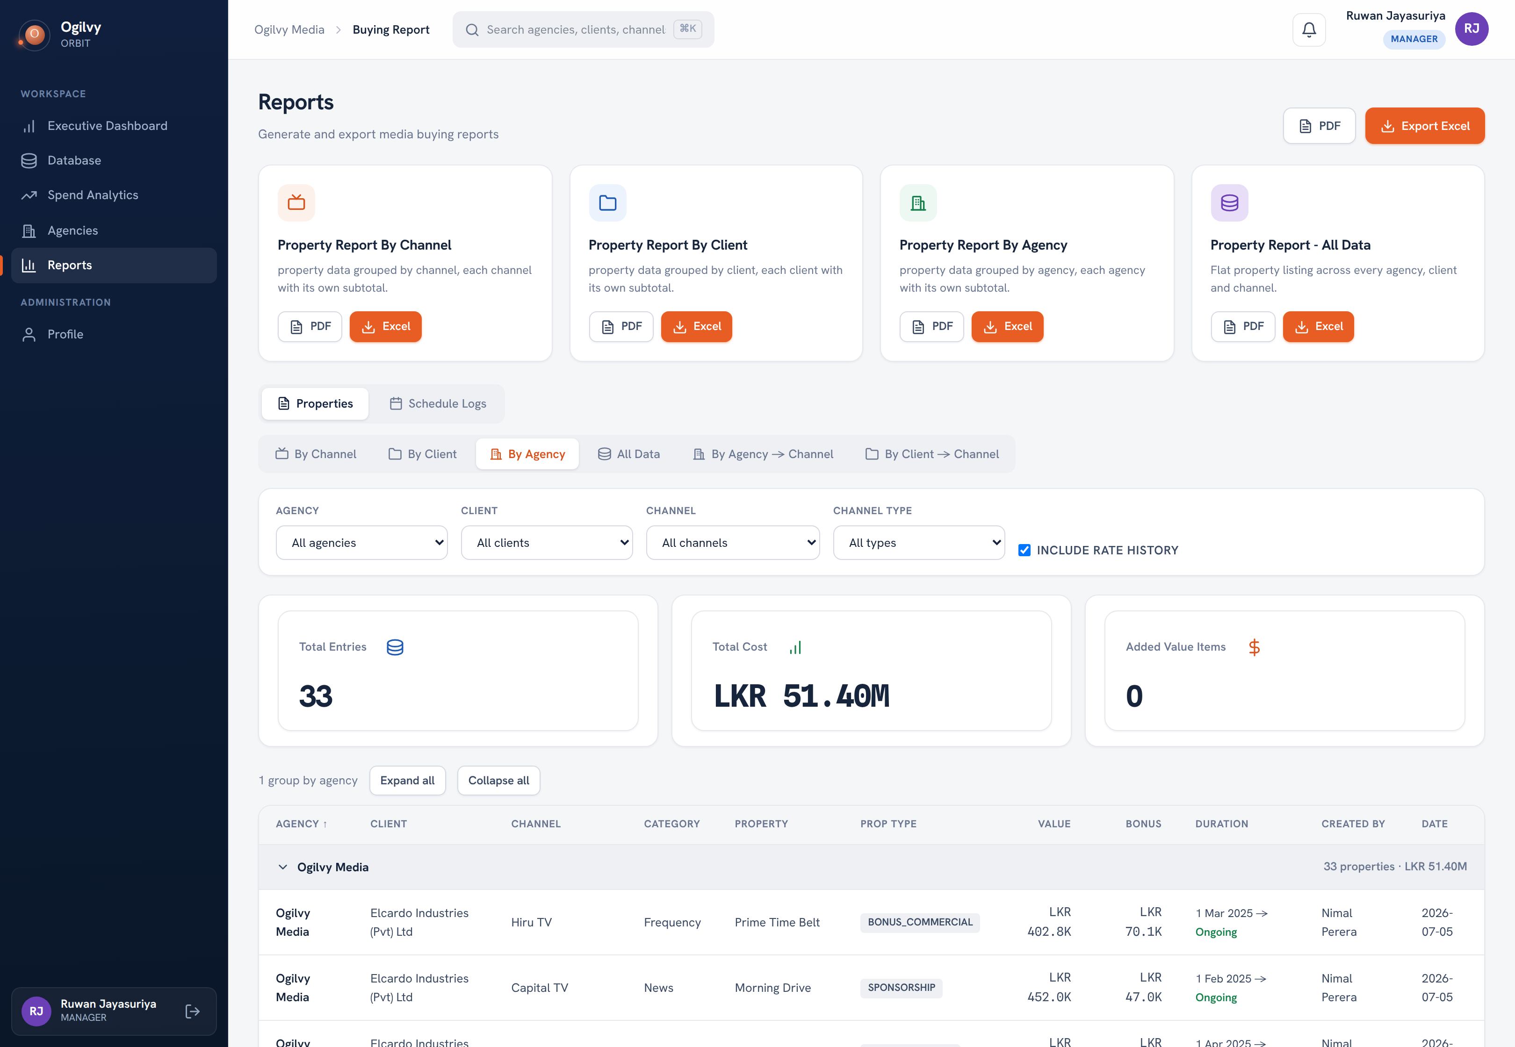
REPORTS
Reports
Generate branded, shareable reports for any agency, client or channel, in Excel or PDF.
WHAT YOU CAN DO HERE
Choose an agency, client or channel to report on
Include rate history and property timelines
Download as branded Excel or PDF
Share a clean document with stakeholders
Ogilvy Orbit Manager Guide
YOUR SCREENS
12 / 41

Slide 13
O
03
EVERY CHART, EXPLAINED
Reading every chart, one at a time
For each chart: what it shows, how to read it, and the data that drives it. Grouped by the screen it lives on.

Slide 14
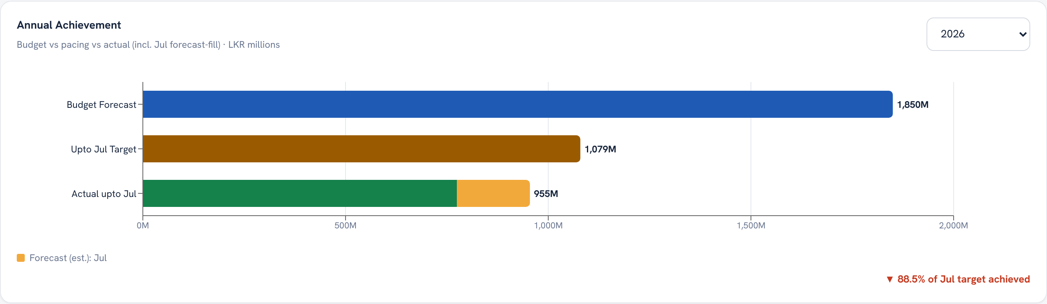
EXECUTIVE DASHBOARD · CHART
Annual Achievement
WHAT IT SHOWS
The year's budget target, the target you should have reached by this month, and actual billings so far, all in LKR millions.
HOW TO READ IT
Compare the green Actual bar against the amber pacing target. The chip reads the percent of the pacing target achieved. The lighter tip on Actual is forecast fill for months not yet closed.
WHAT DRIVES IT
The Annual Target set by admins, confirmed schedule billings, and Group Head forecasts for the gap month.
Ogilvy Orbit Manager Guide
EVERY CHART EXPLAINED
14 / 41

Slide 15
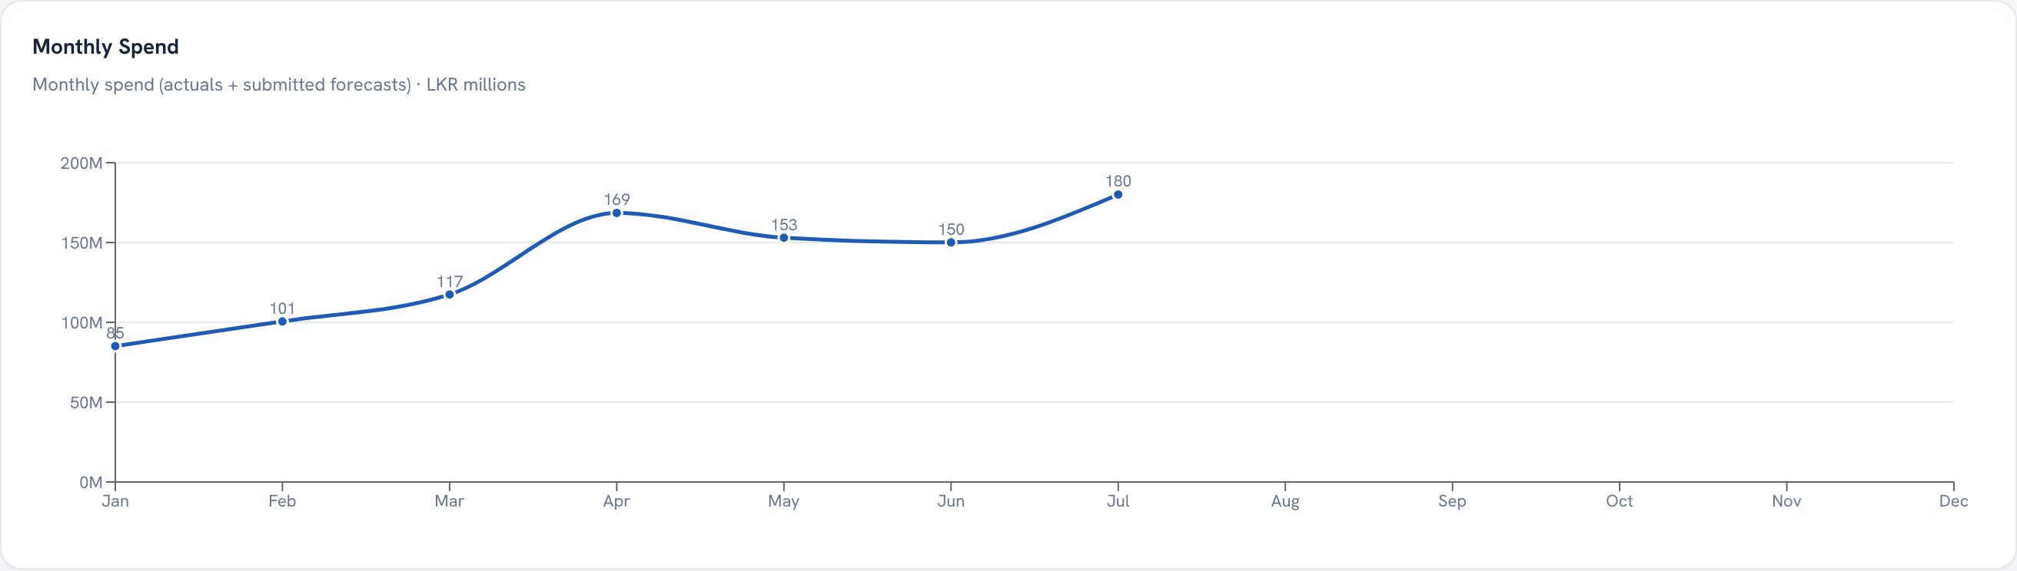
EXECUTIVE DASHBOARD · CHART
Monthly Spend
WHAT IT SHOWS
Company wide spend for each month of the selected year, with the coming month shown as a forecast point.
HOW TO READ IT
Follow the line for pace and seasonality. The final point is a forecast until real schedules arrive, then it switches to actual on its own.
WHAT DRIVES IT
Confirmed schedule billings, plus Group Head forecasts for the upcoming month.
Ogilvy Orbit Manager Guide
EVERY CHART EXPLAINED
15 / 41

Slide 16
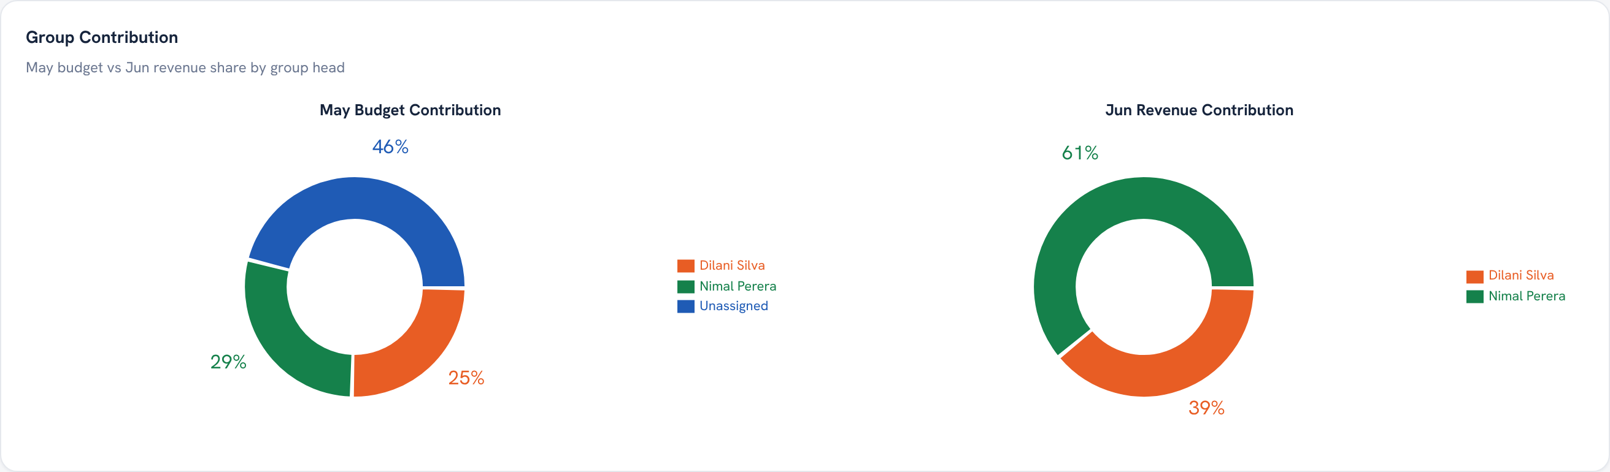
EXECUTIVE DASHBOARD · CHART
Group Contribution
WHAT IT SHOWS
Two donuts by group head: Budget, from schedule logs for the month before the latest data month, and Revenue, entered by an admin for the following month.
HOW TO READ IT
Read each head's share of the month. Unassigned clients show as a blue slice on Budget only. Colours are stable, so the same head is the same colour on both donuts.
WHAT DRIVES IT
Budget from schedule billings per group head; Revenue from the admin's Group Revenue entries (Admin, Group Revenue tab).
Ogilvy Orbit Manager Guide
EVERY CHART EXPLAINED
16 / 41

Slide 17
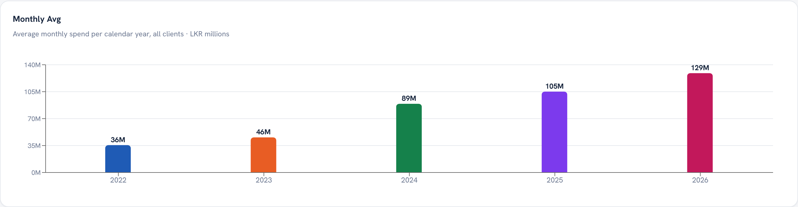
EXECUTIVE DASHBOARD · CHART
Monthly Avg
WHAT IT SHOWS
The average monthly spend for each calendar year, one bar per year.
HOW TO READ IT
A taller bar is a higher run rate that year. A part year divides by only the months that have data, so partial years stay comparable.
WHAT DRIVES IT
Each year's total billings divided by its number of months with data.
Ogilvy Orbit Manager Guide
EVERY CHART EXPLAINED
17 / 41

Slide 18
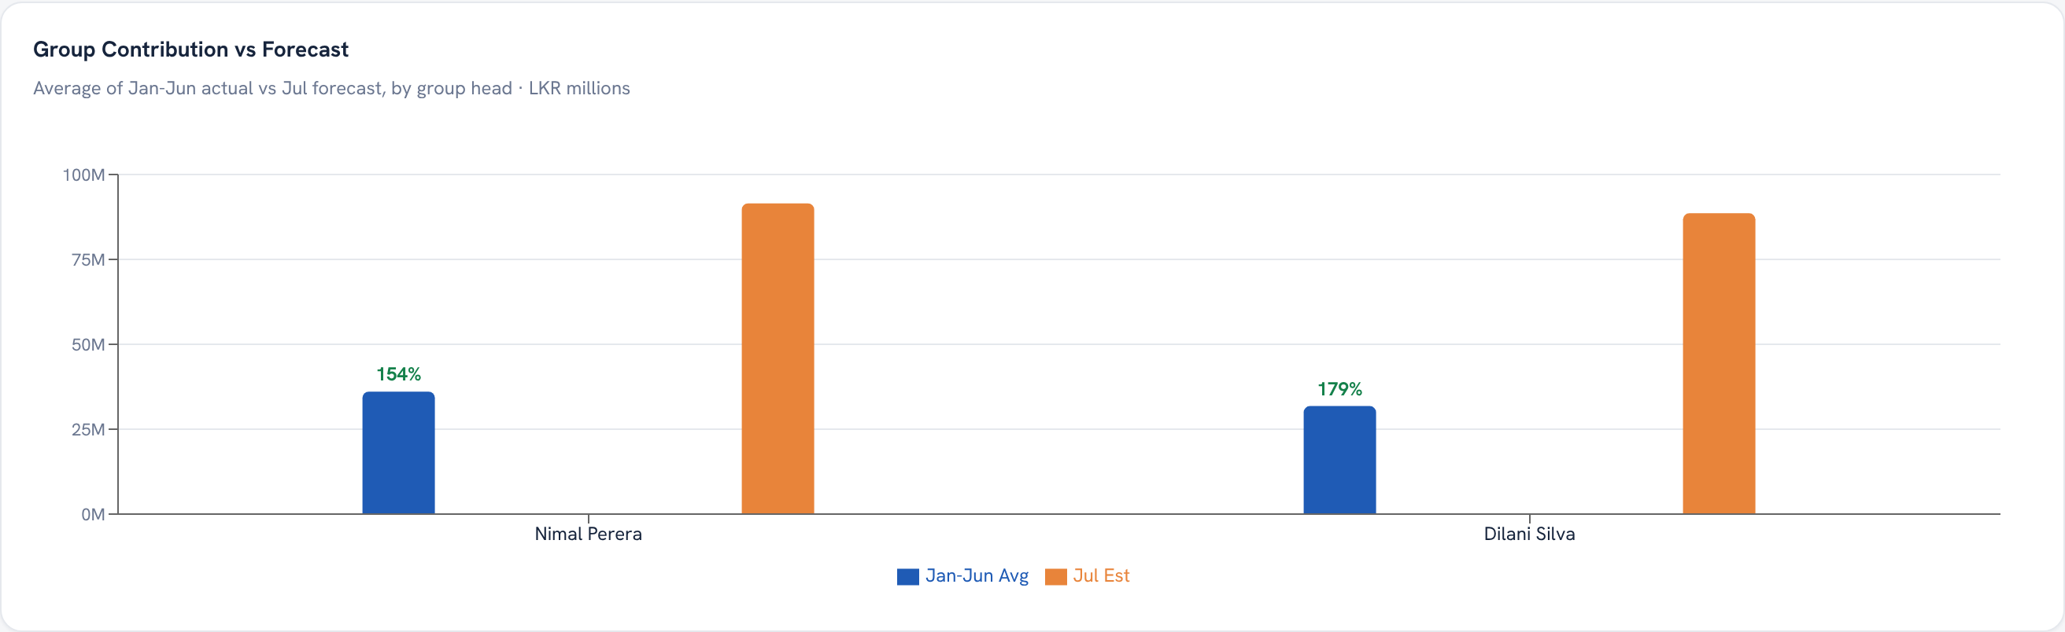
EXECUTIVE DASHBOARD · CHART
Group Contribution vs Forecast
WHAT IT SHOWS
Per group head, the average of every actual month so far this year (blue) against that head's forecast for the next month (orange).
HOW TO READ IT
Compare the two bars for each head. The percent above the shorter bar is the change: green for growth, red for a drop.
WHAT DRIVES IT
Actual from schedule billings averaged over the year to date; forecast from Group Head submissions for the coming month.
Ogilvy Orbit Manager Guide
EVERY CHART EXPLAINED
18 / 41

Slide 19
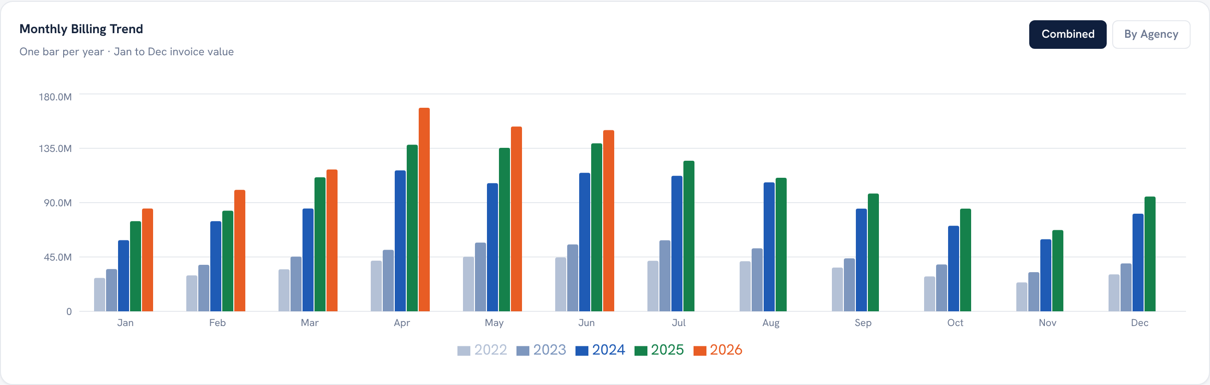
EXECUTIVE DASHBOARD · CHART
Monthly Billing Trend
WHAT IT SHOWS
In the Combined view, one bar per year plotted against a fixed Jan to Dec axis, so every year compares side by side. A By Agency view is also available.
HOW TO READ IT
Read a month top to bottom to compare years. A partial year only draws bars for the months it has.
WHAT DRIVES IT
Schedule billings totalled by invoice month, pivoted into one series per year.
Ogilvy Orbit Manager Guide
EVERY CHART EXPLAINED
19 / 41

Slide 20
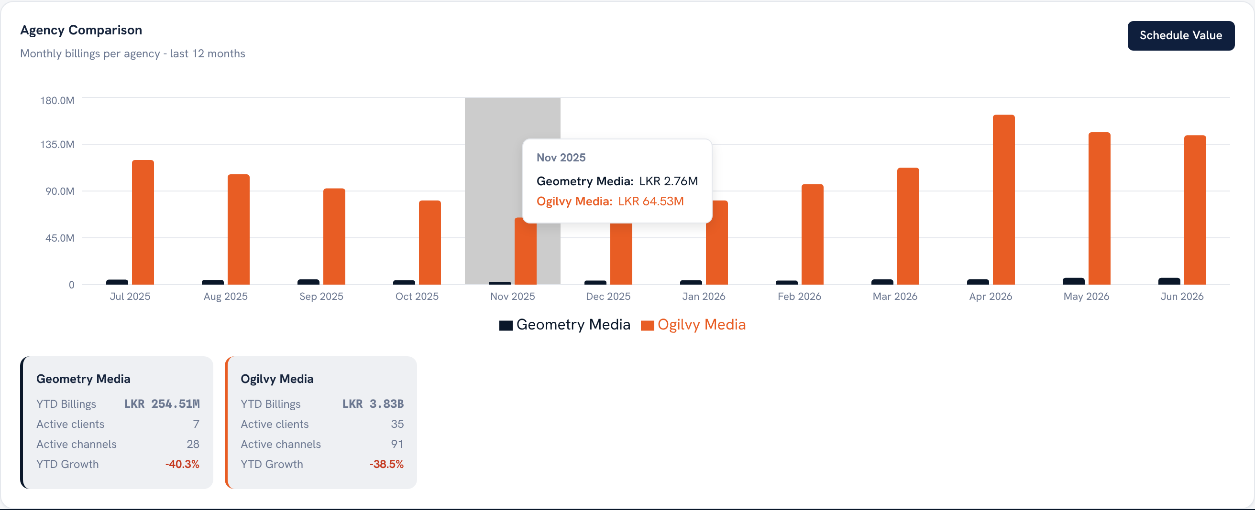
EXECUTIVE DASHBOARD · CHART
Agency Comparison
WHAT IT SHOWS
Monthly billings per agency over the last 12 months, with a summary card for each agency below.
HOW TO READ IT
Compare bar heights month by month to see which agency paces ahead. The cards read each agency's totals and growth.
WHAT DRIVES IT
Schedule billings grouped by agency.
Ogilvy Orbit Manager Guide
EVERY CHART EXPLAINED
20 / 41

Slide 21
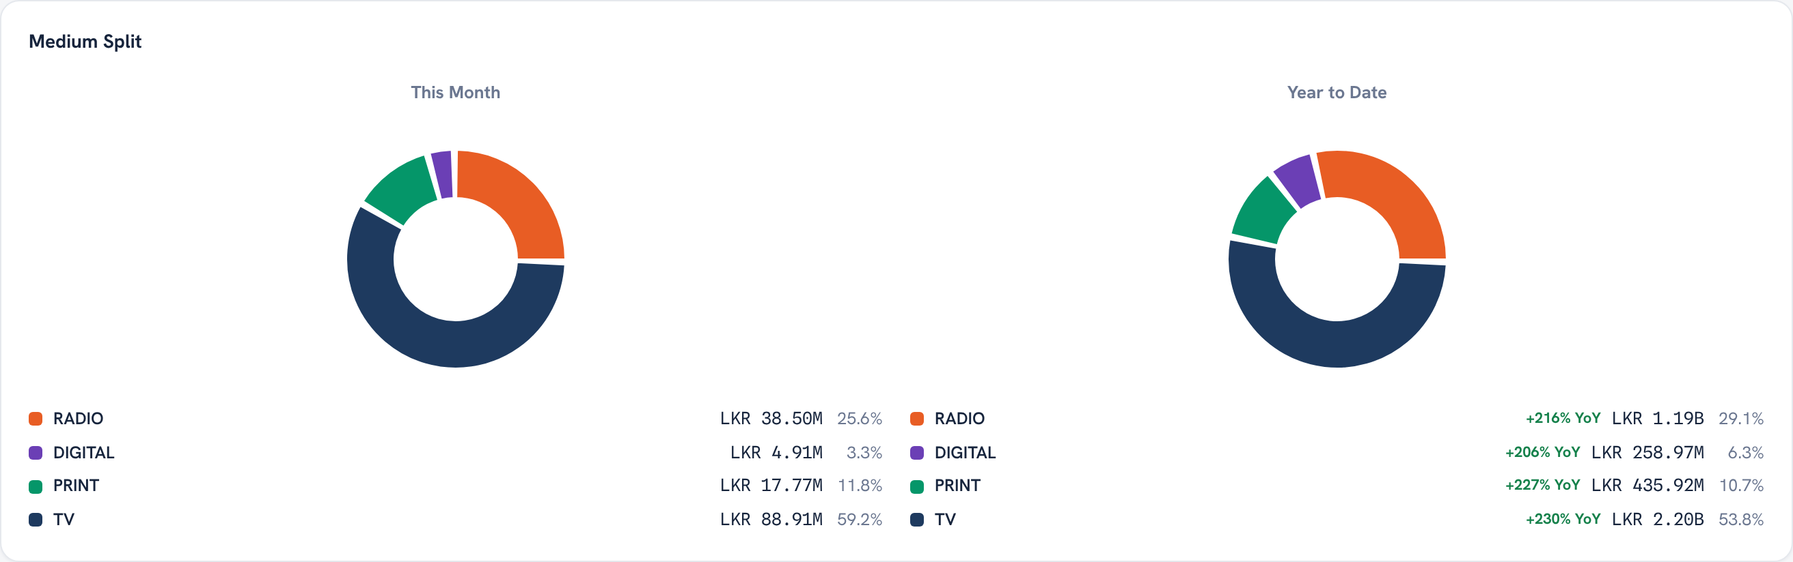
EXECUTIVE DASHBOARD · CHART
Medium Split
WHAT IT SHOWS
Two donuts, this month and year to date, each split by medium with the value and share per medium.
HOW TO READ IT
The ring shows where money goes by channel type. Compare this month against the year to spot a shift toward or away from a medium.
WHAT DRIVES IT
Schedule billings grouped by medium.
Ogilvy Orbit Manager Guide
EVERY CHART EXPLAINED
21 / 41

Slide 22
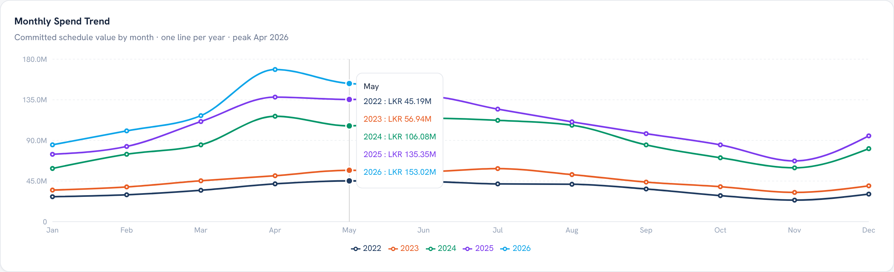
SPEND ANALYTICS · CHART
Monthly Spend Trend
WHAT IT SHOWS
One line per year on a fixed Jan to Dec axis, so the years overlay for easy comparison.
HOW TO READ IT
Read vertically to compare the same month across years. A higher line means a stronger year at that point.
WHAT DRIVES IT
Committed schedule value by month, pivoted into one series per year.
Ogilvy Orbit Manager Guide
EVERY CHART EXPLAINED
22 / 41

Slide 23
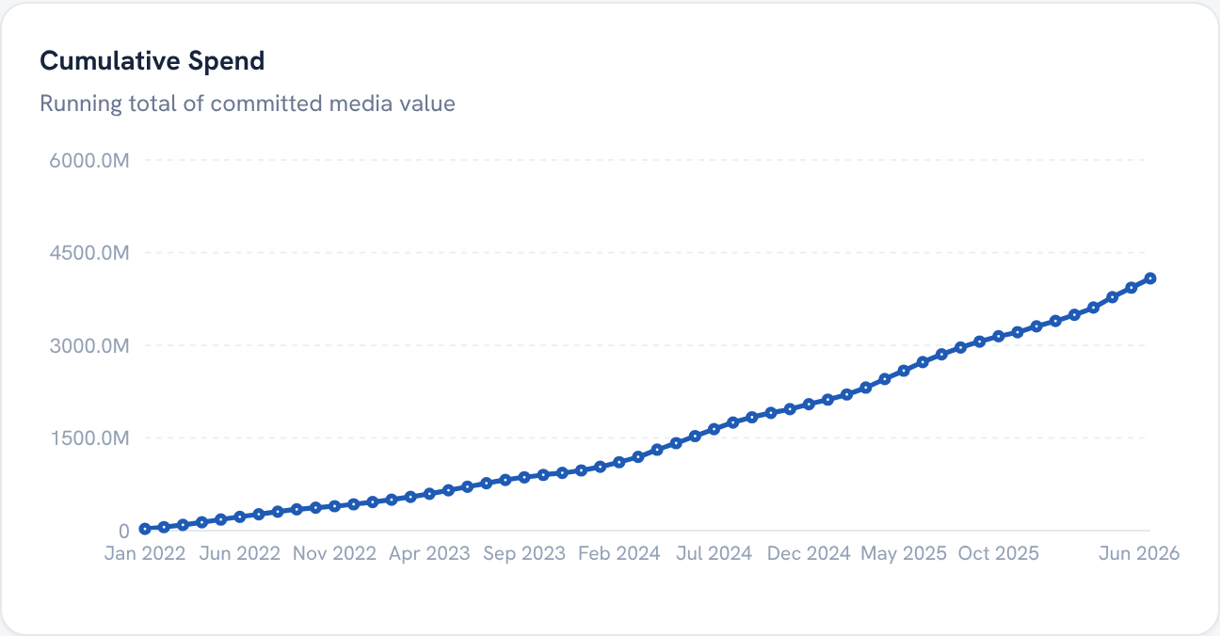
SPEND ANALYTICS · CHART
Cumulative Spend
WHAT IT SHOWS
The running total of committed media value building up across the period.
HOW TO READ IT
A steeper slope means faster spending. Flat stretches are quiet months.
WHAT DRIVES IT
Schedule value accumulated month by month.
Ogilvy Orbit Manager Guide
EVERY CHART EXPLAINED
23 / 41

Slide 24
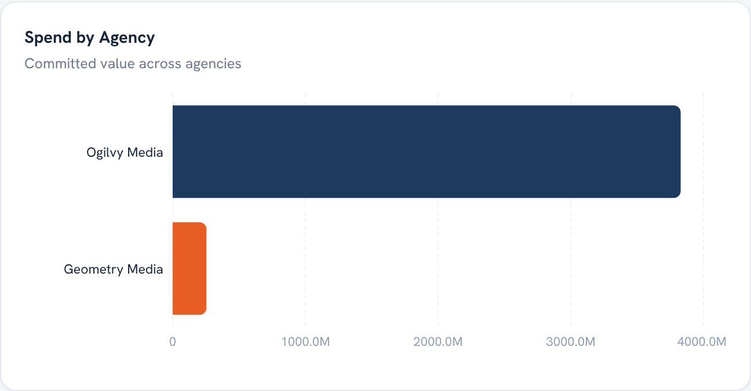
SPEND ANALYTICS · CHART
Spend by Agency
WHAT IT SHOWS
Total committed value per agency, as horizontal bars.
HOW TO READ IT
The longest bar is the biggest agency by spend. It sizes each agency at a glance.
WHAT DRIVES IT
Schedule value grouped by agency across the filtered period.
Ogilvy Orbit Manager Guide
EVERY CHART EXPLAINED
24 / 41

Slide 25
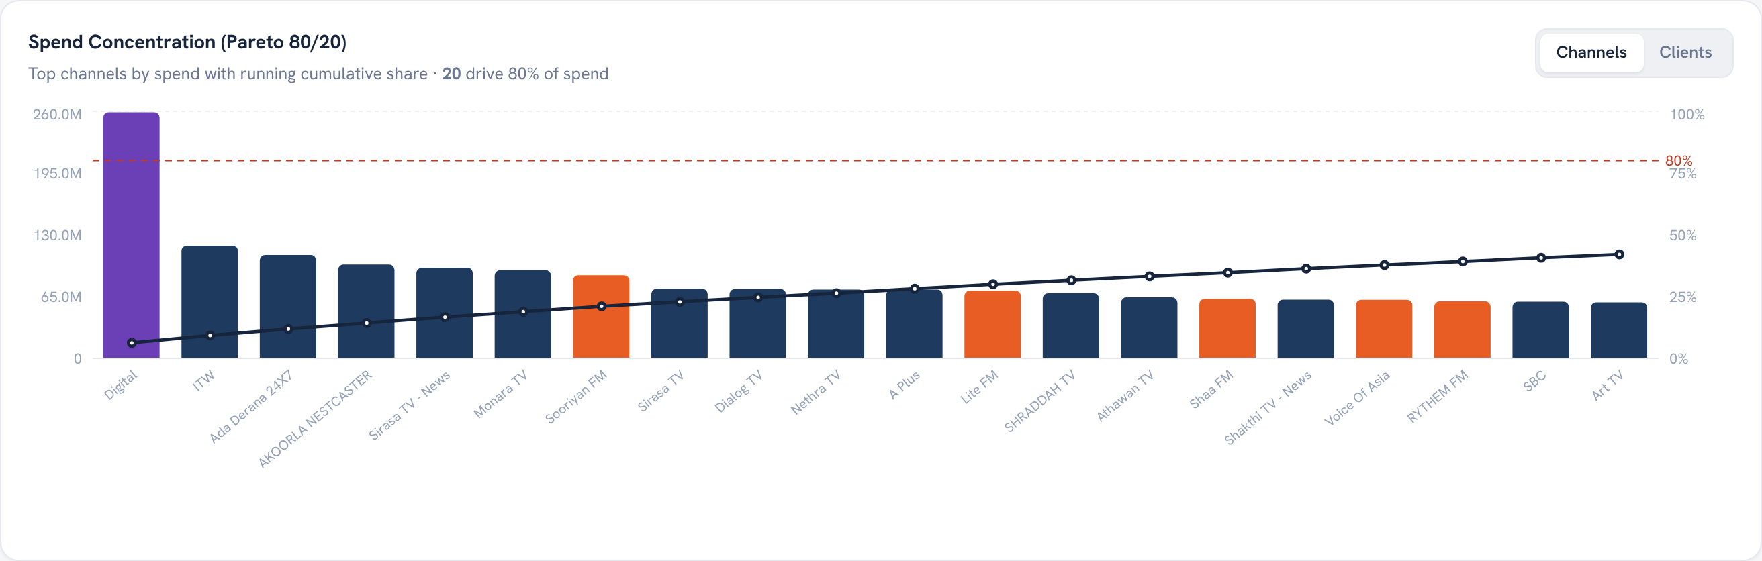
SPEND ANALYTICS · CHART
Spend Concentration (Pareto)
WHAT IT SHOWS
Channels ranked by spend as bars, with a cumulative percentage line and an 80 percent reference line.
HOW TO READ IT
Where the line crosses 80 percent tells you how few channels make up most of the spend.
WHAT DRIVES IT
Per channel spend, sorted high to low, with a running cumulative share.
Ogilvy Orbit Manager Guide
EVERY CHART EXPLAINED
25 / 41

Slide 26
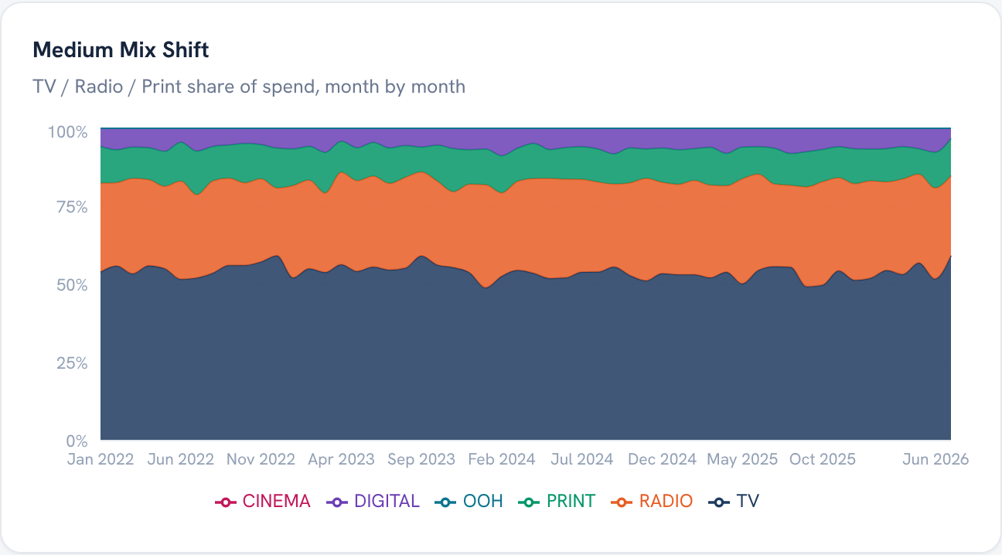
SPEND ANALYTICS · CHART
Medium Mix Shift
WHAT IT SHOWS
A 100 percent stacked area showing each medium's share of spend, month by month.
HOW TO READ IT
Each band is a medium. A widening band means that medium is taking a larger share over time.
WHAT DRIVES IT
Monthly spend by medium, normalised to 100 percent.
Ogilvy Orbit Manager Guide
EVERY CHART EXPLAINED
26 / 41

Slide 27
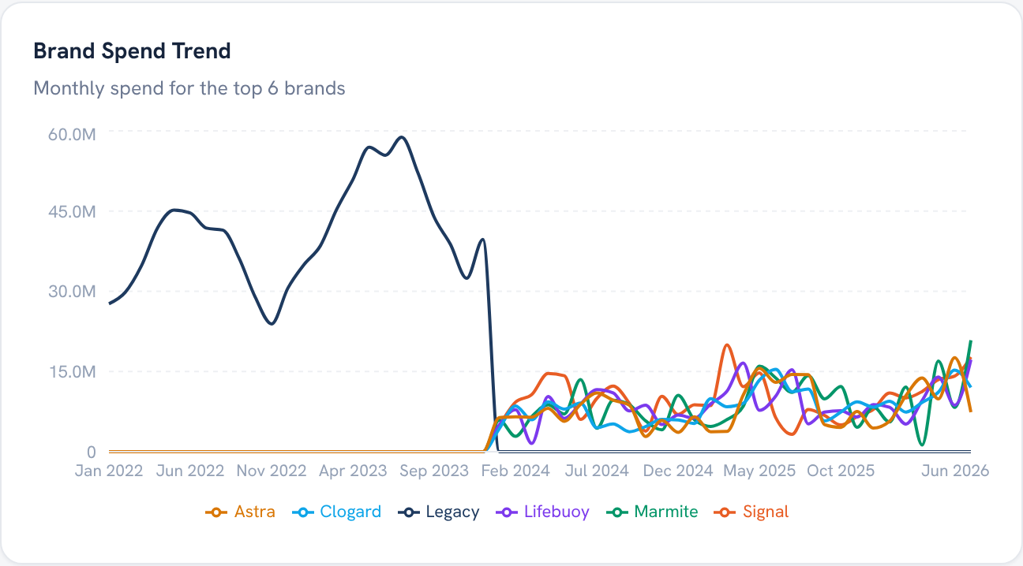
SPEND ANALYTICS · CHART
Brand Spend Trend
WHAT IT SHOWS
Monthly spend for the top brands, one line each.
HOW TO READ IT
Track a brand's line for momentum. Crossing lines show one brand overtaking another.
WHAT DRIVES IT
Schedule billings that carry a brand name, for the leading brands.
Ogilvy Orbit Manager Guide
EVERY CHART EXPLAINED
27 / 41

Slide 28
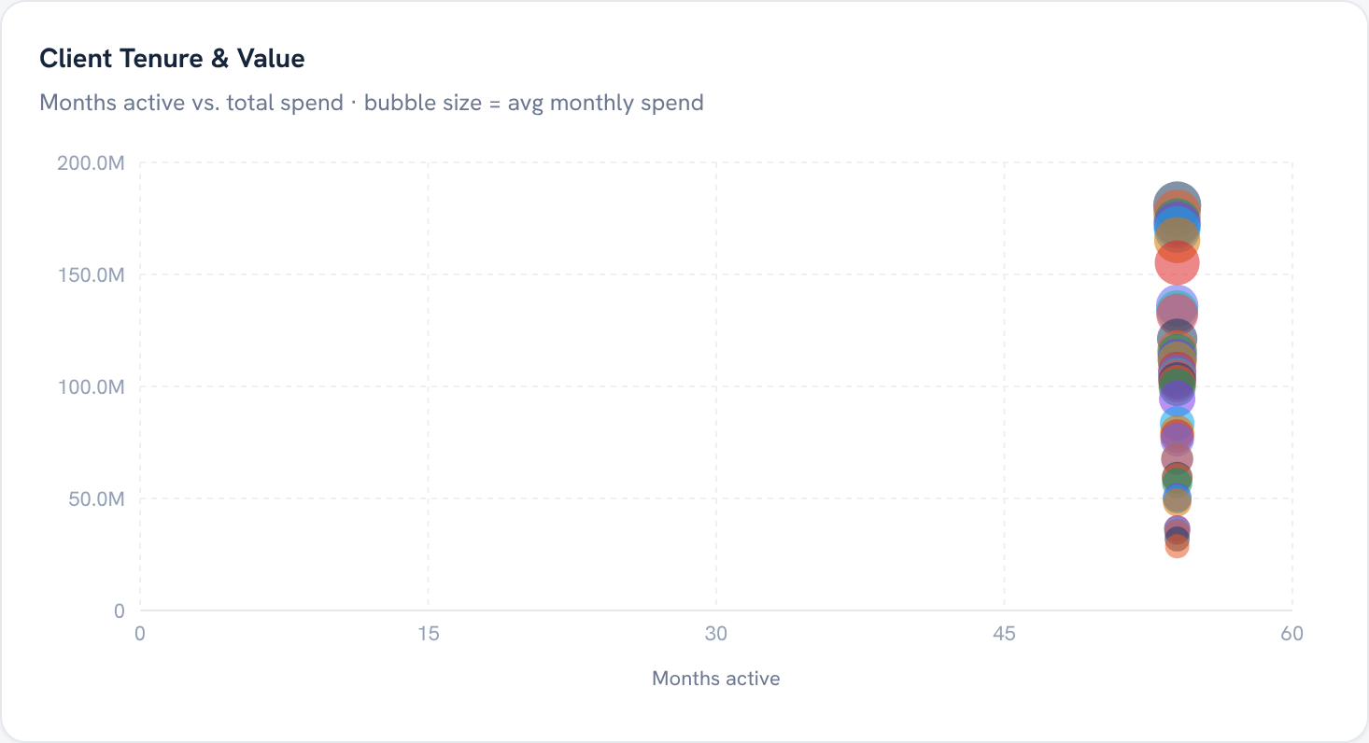
SPEND ANALYTICS · CHART
Client Tenure & Value
WHAT IT SHOWS
One bubble per client, plotting months active against total spend, with bubble size for average monthly spend.
HOW TO READ IT
Top right is a long standing, high value client. A larger bubble spends more heavily each month.
WHAT DRIVES IT
Each client's active span, total spend and monthly average.
Ogilvy Orbit Manager Guide
EVERY CHART EXPLAINED
28 / 41

Slide 29
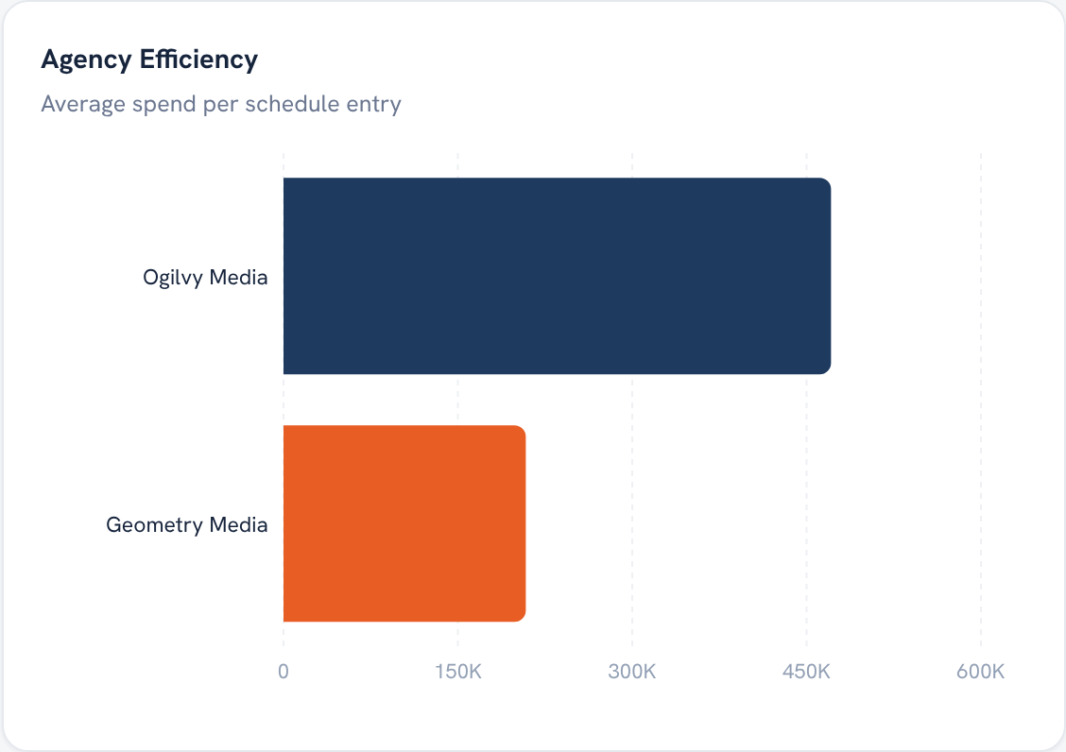
SPEND ANALYTICS · CHART
Agency Efficiency
WHAT IT SHOWS
Average spend per schedule entry for each agency.
HOW TO READ IT
A longer bar means each logged line carries more value on average, a rough read on deal size.
WHAT DRIVES IT
Agency total spend divided by its number of schedule entries.
Ogilvy Orbit Manager Guide
EVERY CHART EXPLAINED
29 / 41

Slide 30
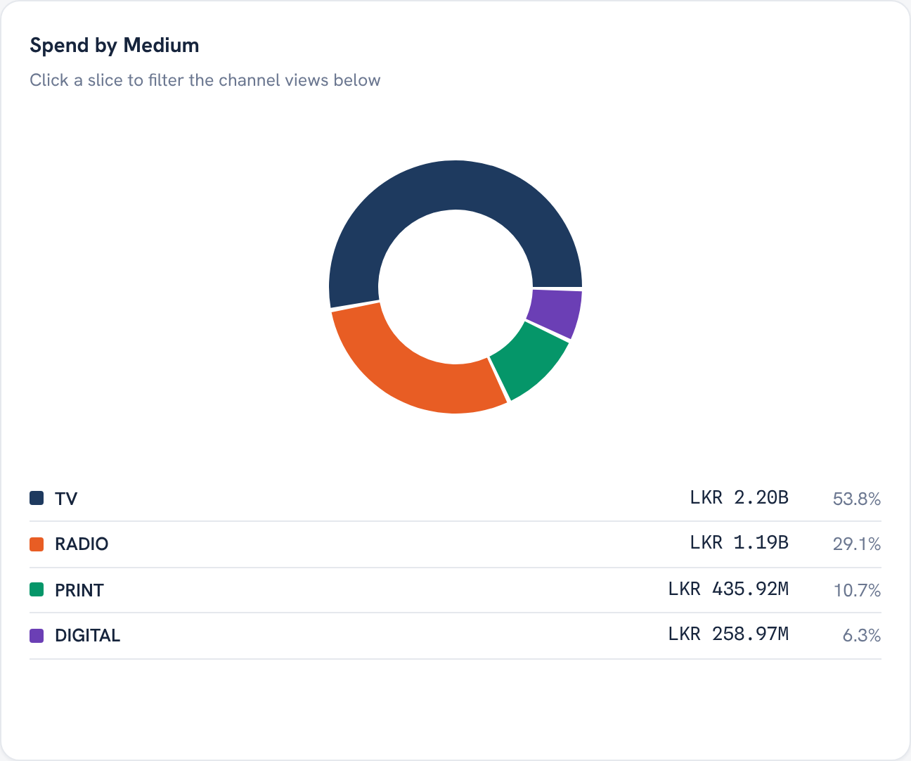
SPEND ANALYTICS · CHART
Spend by Medium
WHAT IT SHOWS
A donut of total spend split by medium, with the value and share of each.
HOW TO READ IT
Click a slice to filter the channel views below it. The ring shows the balance across channel types.
WHAT DRIVES IT
Schedule value grouped by medium.
Ogilvy Orbit Manager Guide
EVERY CHART EXPLAINED
30 / 41

Slide 31
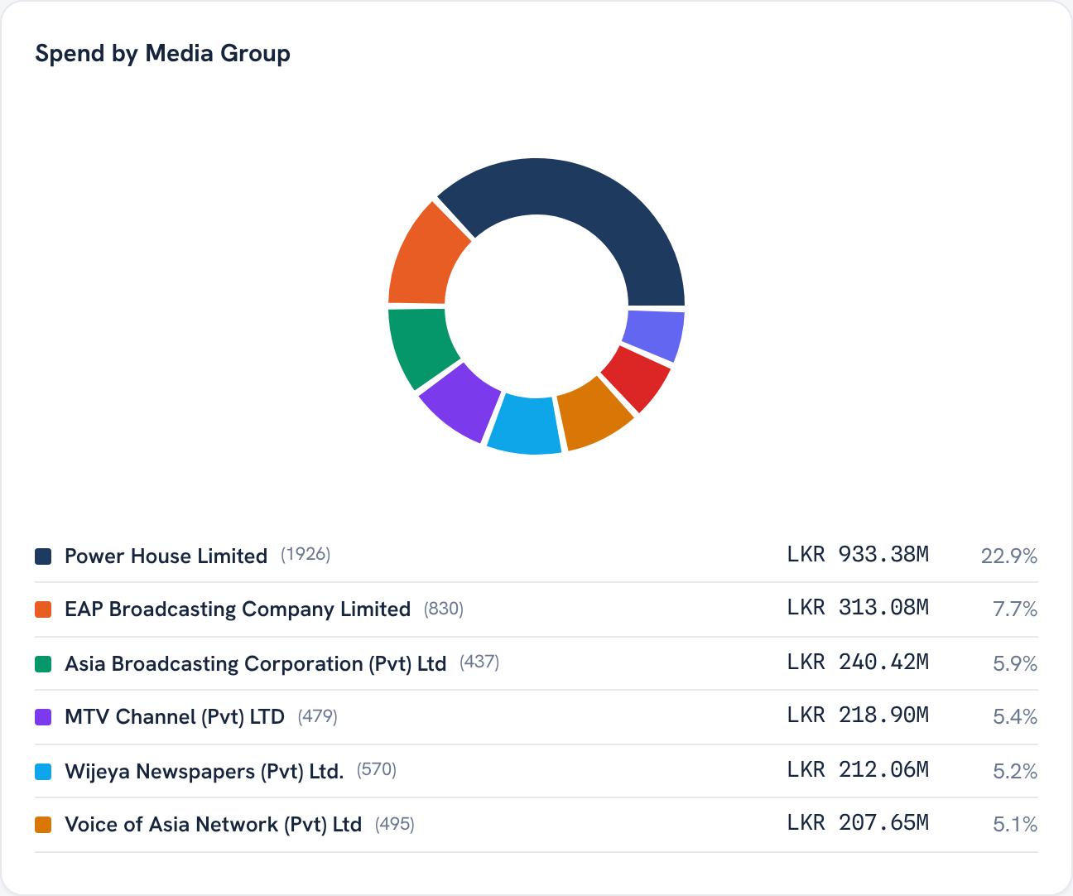
SPEND ANALYTICS · CHART
Spend by Media Group
WHAT IT SHOWS
A donut of spend split by media group, the broadcaster or publisher behind the channels.
HOW TO READ IT
The largest slice is your biggest media owner relationship by value.
WHAT DRIVES IT
Schedule value grouped by media group.
Ogilvy Orbit Manager Guide
EVERY CHART EXPLAINED
31 / 41

Slide 32
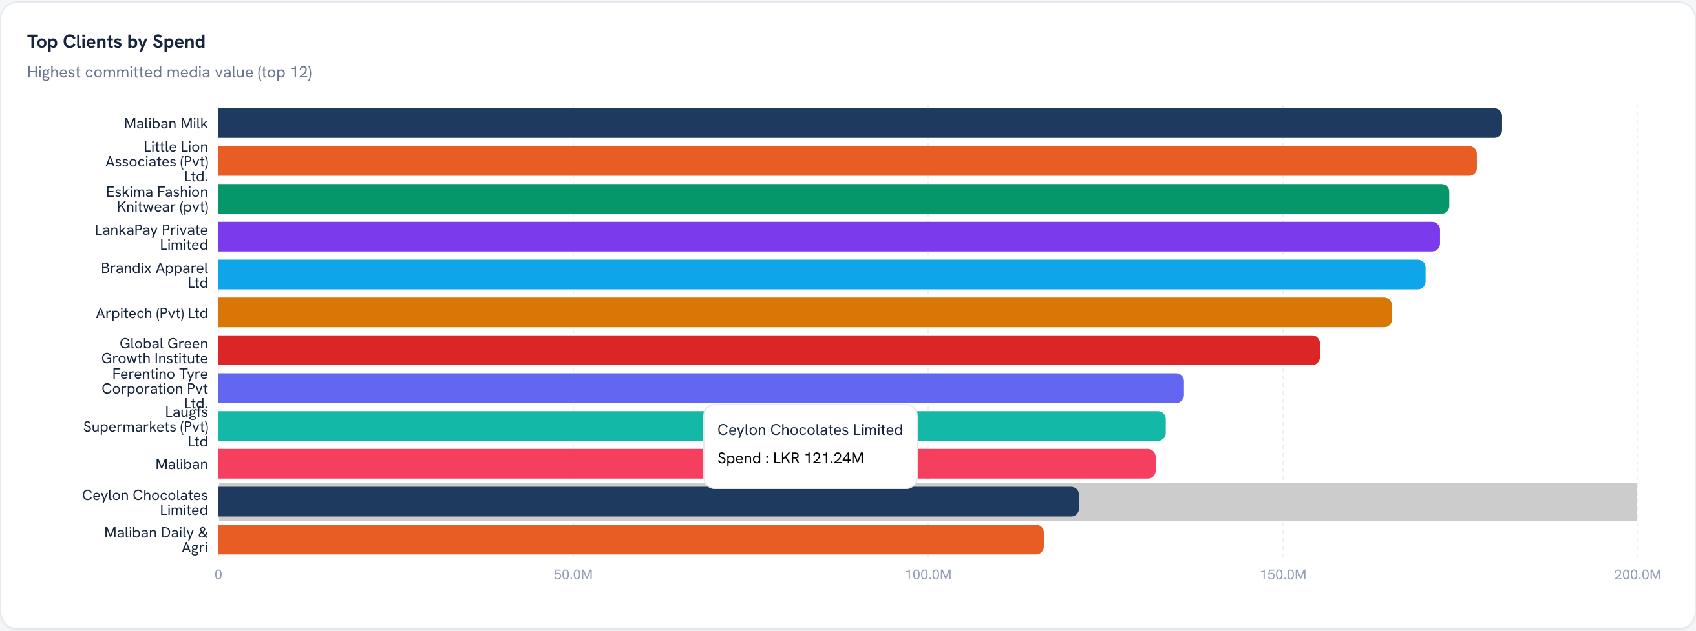
SPEND ANALYTICS · CHART
Top Clients by Spend
WHAT IT SHOWS
Clients ranked by committed spend, as horizontal bars.
HOW TO READ IT
The longest bars are your largest accounts. Hover any bar for the exact value.
WHAT DRIVES IT
Schedule value grouped by client.
Ogilvy Orbit Manager Guide
EVERY CHART EXPLAINED
32 / 41

Slide 33
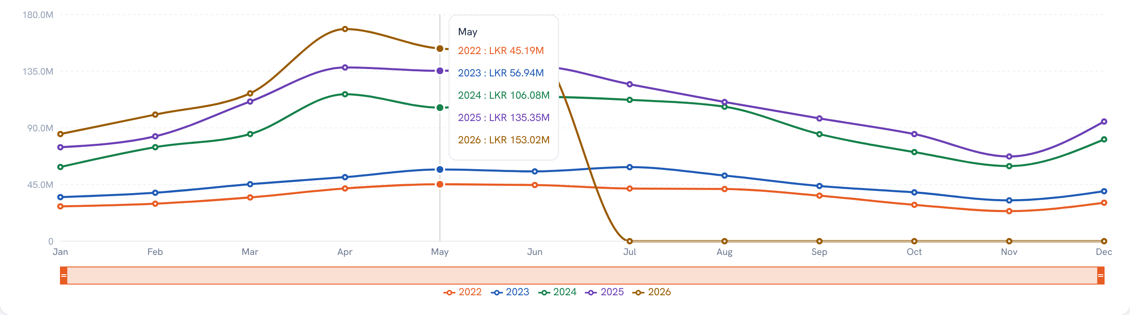
DEEP DASHBOARD · CHART
Multi Year Monthly Trend
WHAT IT SHOWS
Monthly spend with one line per year, plus a brush to zoom into a range.
HOW TO READ IT
Overlay the years to compare seasonality. Drag the brush along the bottom to focus on a window.
WHAT DRIVES IT
Monthly spend under the active agency, client and channel filters.
Ogilvy Orbit Manager Guide
EVERY CHART EXPLAINED
33 / 41

Slide 34
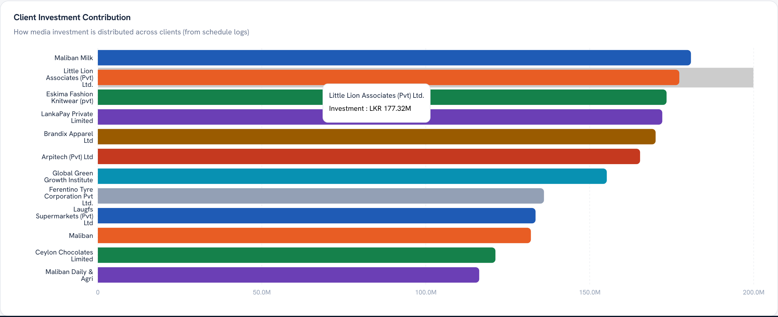
DEEP DASHBOARD · CHART
Client Investment Contribution
WHAT IT SHOWS
Each client's contribution to total spend, as ranked horizontal bars.
HOW TO READ IT
The longest bars carry your portfolio. A short tail of small clients sits at the bottom.
WHAT DRIVES IT
Per client spend under the active filters.
Ogilvy Orbit Manager Guide
EVERY CHART EXPLAINED
34 / 41

Slide 35
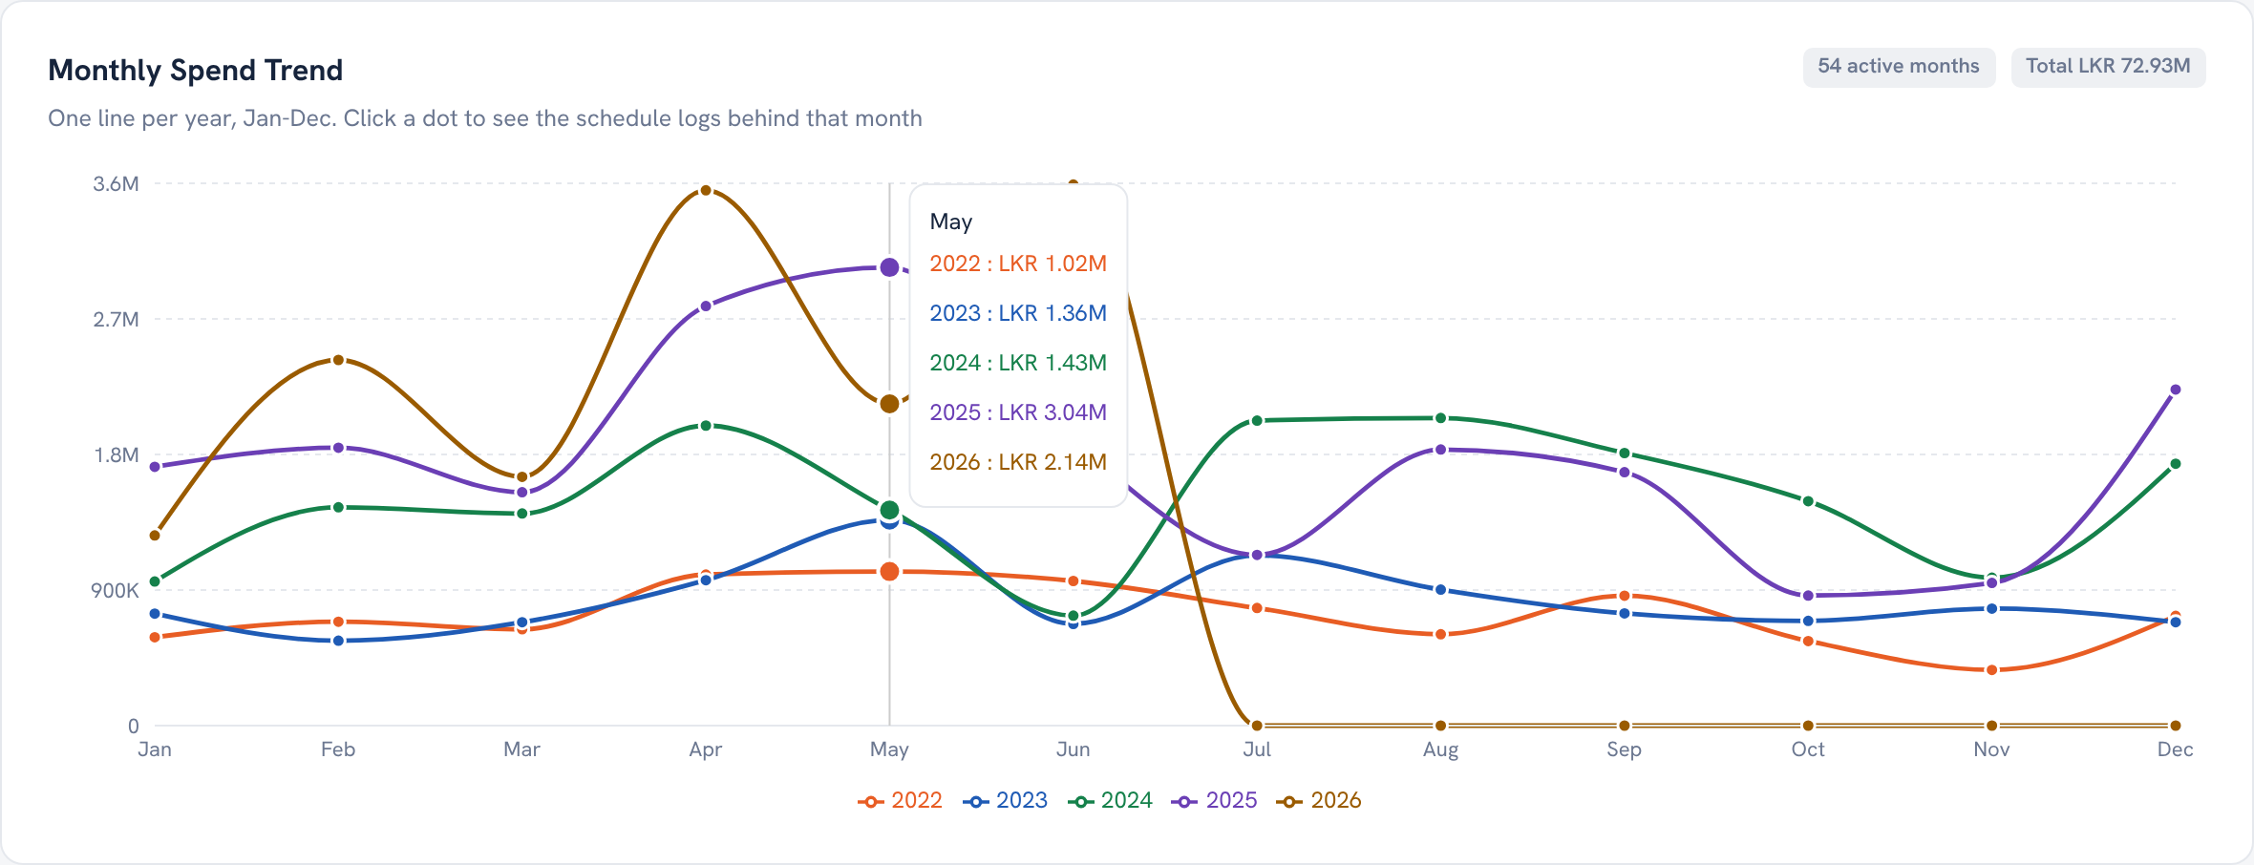
CHANNEL INTELLIGENCE · CHART
Monthly Spend Trend
WHAT IT SHOWS
Spend on this single channel, one line per year on a Jan to Dec axis.
HOW TO READ IT
Compare the years for this channel. Click any point to open the schedules behind that month.
WHAT DRIVES IT
Schedule value on the selected channel, pivoted by year.
Ogilvy Orbit Manager Guide
EVERY CHART EXPLAINED
35 / 41

Slide 36
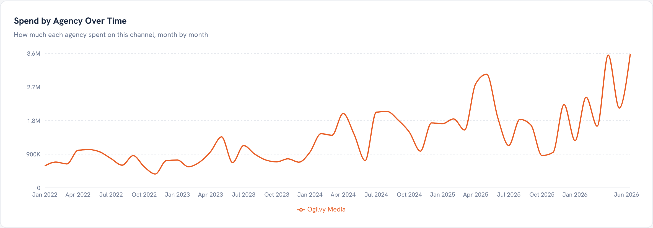
CHANNEL INTELLIGENCE · CHART
Spend by Agency Over Time
WHAT IT SHOWS
Monthly spend on this channel, split by agency.
HOW TO READ IT
See which agency drives this channel, and when their investment rises or falls.
WHAT DRIVES IT
Channel spend grouped by agency and month.
Ogilvy Orbit Manager Guide
EVERY CHART EXPLAINED
36 / 41

Slide 37
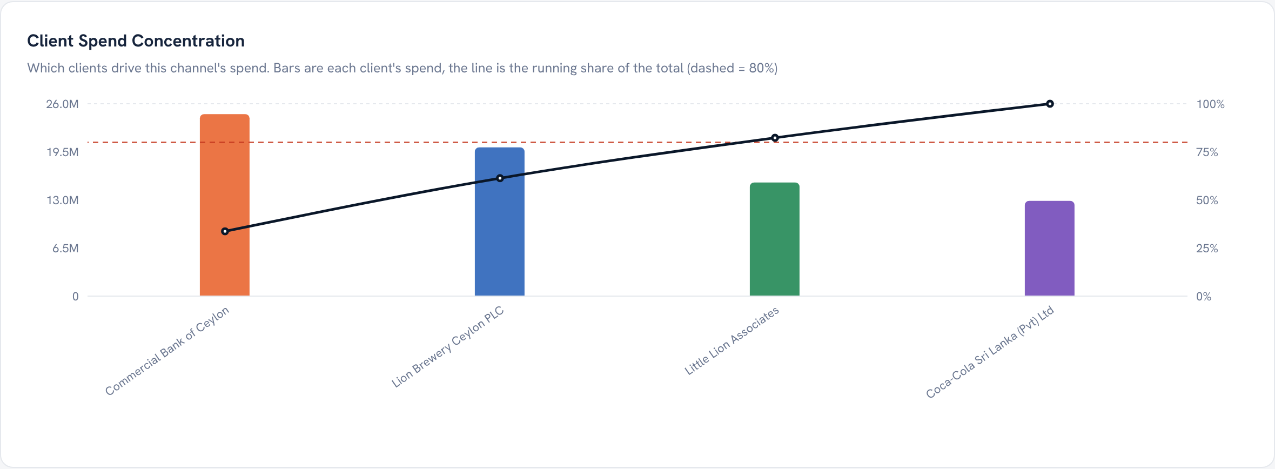
CHANNEL INTELLIGENCE · CHART
Client Spend Concentration
WHAT IT SHOWS
A Pareto of the clients on this channel: bars plus a cumulative line and an 80 percent marker.
HOW TO READ IT
See whether a handful of clients account for most of the channel's spend.
WHAT DRIVES IT
Per client spend on this channel, sorted high to low.
Ogilvy Orbit Manager Guide
EVERY CHART EXPLAINED
37 / 41

Slide 38
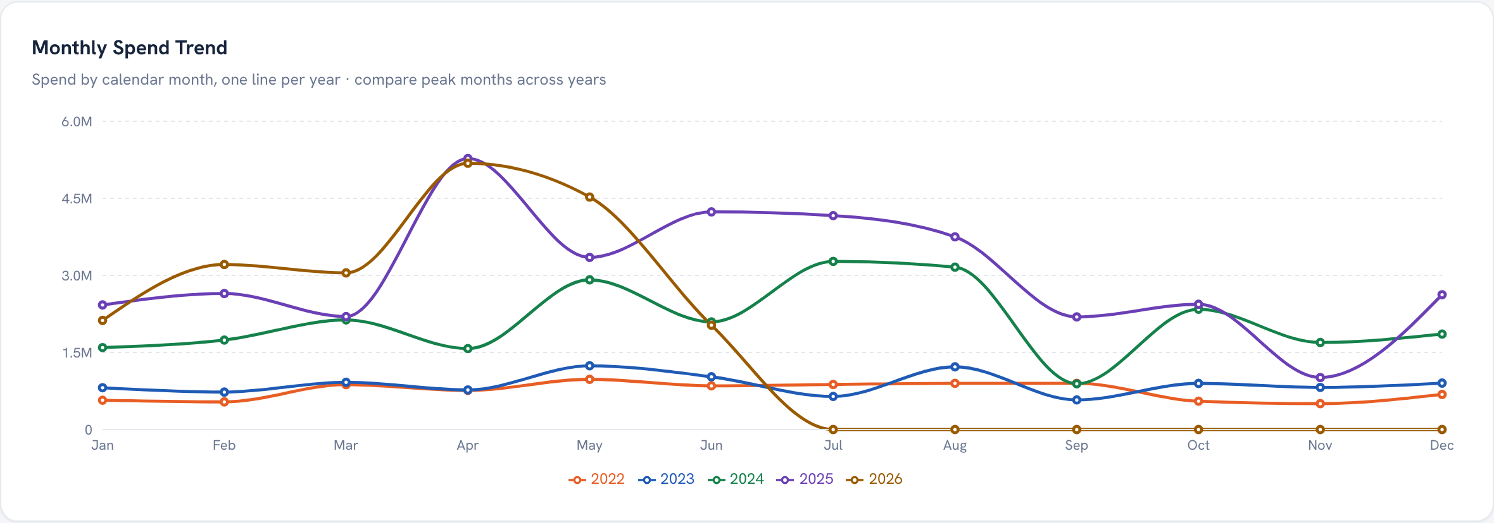
CLIENT DASHBOARD · CHART
Monthly Spend Trend
WHAT IT SHOWS
This client's spend, one line per year on a Jan to Dec axis.
HOW TO READ IT
Compare the client's years side by side to read growth or slowdown.
WHAT DRIVES IT
The client's schedule value by month.
Ogilvy Orbit Manager Guide
EVERY CHART EXPLAINED
38 / 41

Slide 39
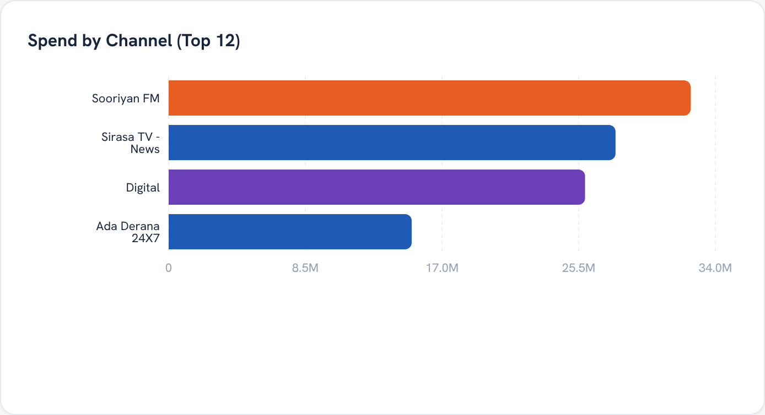
CLIENT DASHBOARD · CHART
Spend by Channel
WHAT IT SHOWS
The client's top channels, ranked by spend.
HOW TO READ IT
The longest bar is where this client invests most of its budget.
WHAT DRIVES IT
The client's schedule value grouped by channel.
Ogilvy Orbit Manager Guide
EVERY CHART EXPLAINED
39 / 41

Slide 40
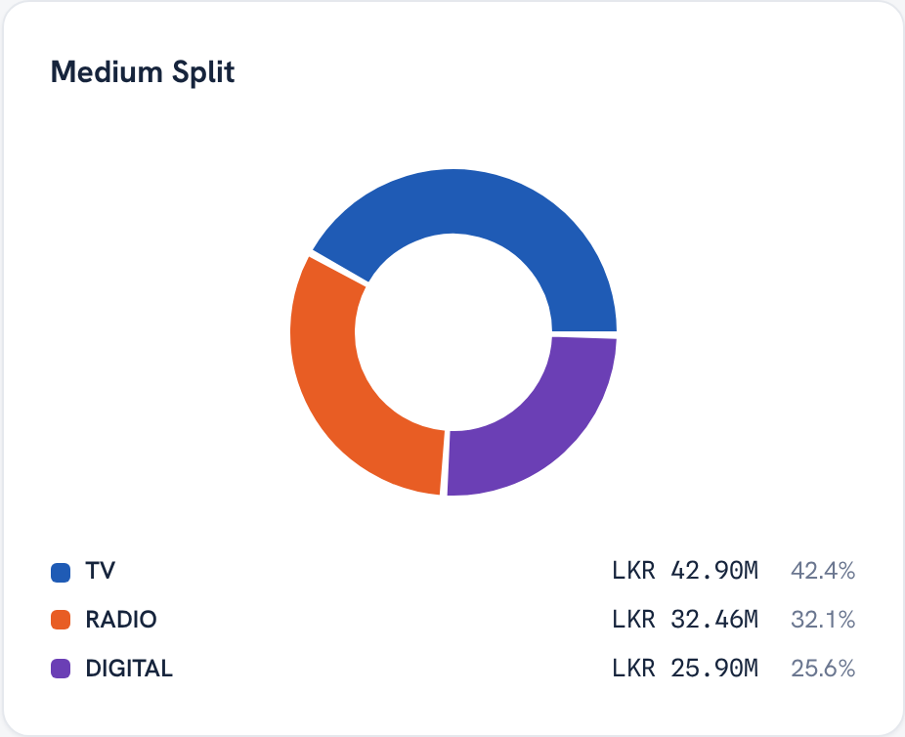
CLIENT DASHBOARD · CHART
Medium Split
WHAT IT SHOWS
A donut of this client's spend by medium.
HOW TO READ IT
The ring shows how the client balances TV, Radio, Print and Digital.
WHAT DRIVES IT
The client's schedule value grouped by medium.
Ogilvy Orbit Manager Guide
EVERY CHART EXPLAINED
40 / 41

Slide 41
O
Now every chart tells you something.
Open the Executive Dashboard, read the trend, split and ranking on each screen, and export a report whenever leadership asks. The data is always live and always yours to review.
Questions on any screen reach the media team through your admin.

