Slide 1
O
OGILVY MEDIA
Ogilvy Orbit
The Media Buying Records System,
explained for Planners.
A focused guide to your part of Orbit: keeping your clients' schedule records current, recording the deals you strike, and reading the spend you own.
Prepared for the Planners team 2026

Slide 2
O
01
YOUR ROLE
A tight scope, done thoroughly
You keep your clients' records accurate and record the deals behind them. Small remit, high impact.

Slide 3
THE BIG PICTURE
Three things you own
As a Planner you are the source of truth for your accounts. Everything downstream depends on what you enter.
1
2
3
Keep records current
Record the deals
Read your accounts
Add and edit each of your clients' schedule records, so spend is always up to date.
Capture properties and negotiated deal terms on the channels you buy.
Use live analytics to understand your clients' spend before any review.
Ogilvy Orbit Planner Guide
YOUR ROLE
03 / 19

Slide 4
YOUR ACCESS
What a Planner can reach
Your scope is deliberately tight: the clients assigned to you. On those clients you can add and edit records, and read their analytics. Everything is scoped to your accounts.
Database
Client & Channel pages
Add and edit your clients' schedule records
Manage channels on your clients
Properties
Deal terms
Record a deal's value, bonus and dates
Log discount and bonus per year
Spend Analytics
Client Dashboard
Charts of your clients' committed spend
A per client analytics view
Channel Intelligence
Profile
Spend and trends for any channel
Your details and password
Ogilvy Orbit Planner Guide
GETTING ORIENTED
04 / 19

Slide 5
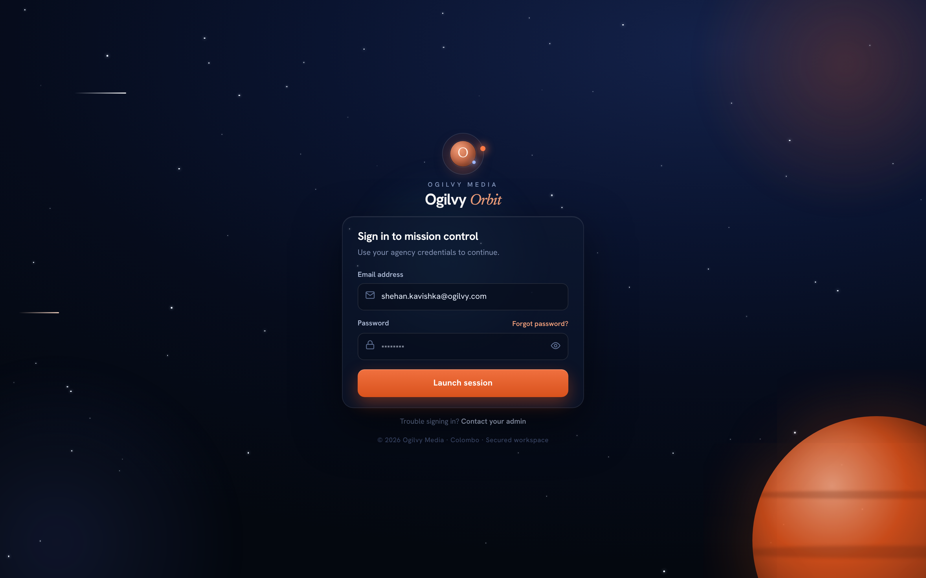
SIGNING IN
Your secure sign in
You sign in with your agency email and a private password. Orbit only opens the accounts assigned to you.
WHAT YOU CAN DO HERE
Sign in with your Ogilvy email and password
Reset a forgotten password from the same screen
Set a fresh password on your very first sign in
Every session is protected and times out safely
Tip On your first login you will be asked to choose a new password.
Ogilvy Orbit Planner Guide
YOUR ROLE
05 / 19

Slide 6
O
02
RECORDING THE WORK
Keeping the records right
Your home is the schedule database. This is where the numbers begin.

Slide 7
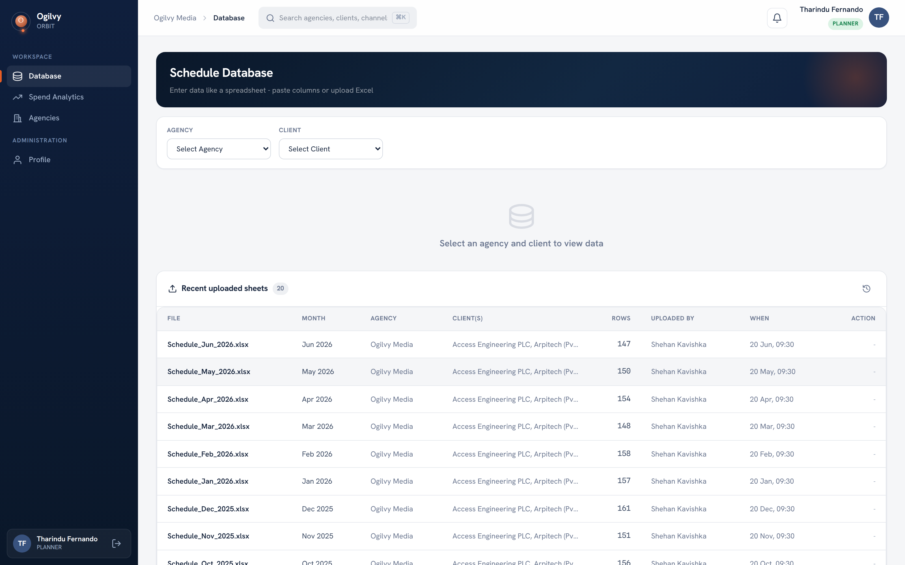
DATABASE
The schedule database
Your home screen. Every uploaded schedule sheet lands here. Recent uploads and a search sit up top.
WHAT YOU CAN DO HERE
See every recently uploaded sheet at a glance
Pick your agency and a client to open its records
Search within a client by RO number or brand
Jump into a client to add or edit rows
Ogilvy Orbit Planner Guide
RECORDING THE WORK
07 / 19

Slide 8
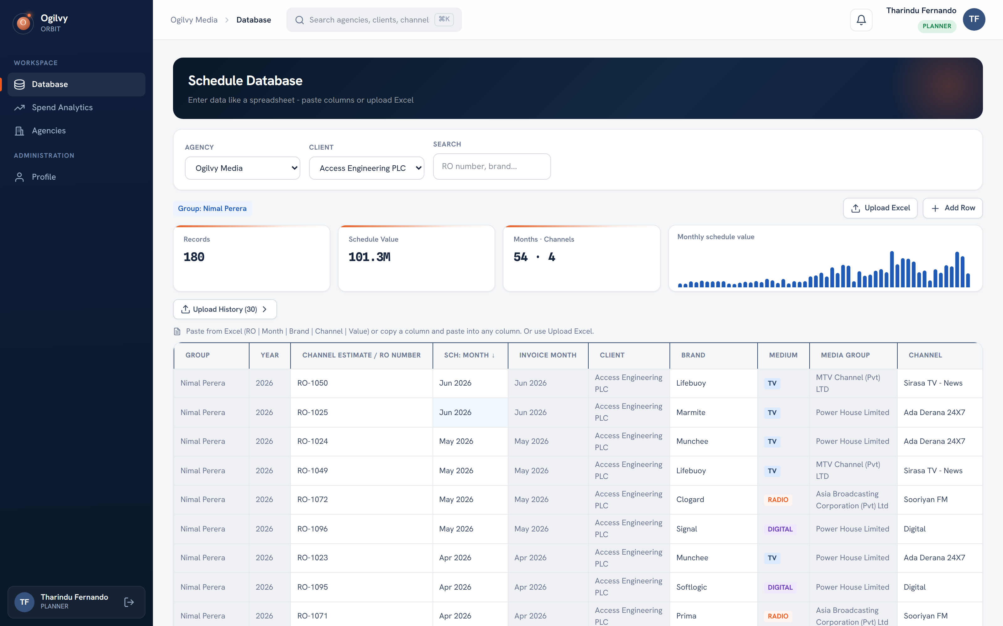
DATA ENTRY
Entering schedule data
With a client open, you get a spreadsheet of its records plus a live overview of value, months and channels.
WHAT YOU CAN DO HERE
Add a row and type straight into the grid
Paste columns copied from Excel in one go
Upload an Excel sheet and map the columns
Watch records, value and the mini chart update live
Tip Everything you enter flows straight into every chart across Orbit.
Ogilvy Orbit Planner Guide
RECORDING THE WORK
08 / 19

Slide 9
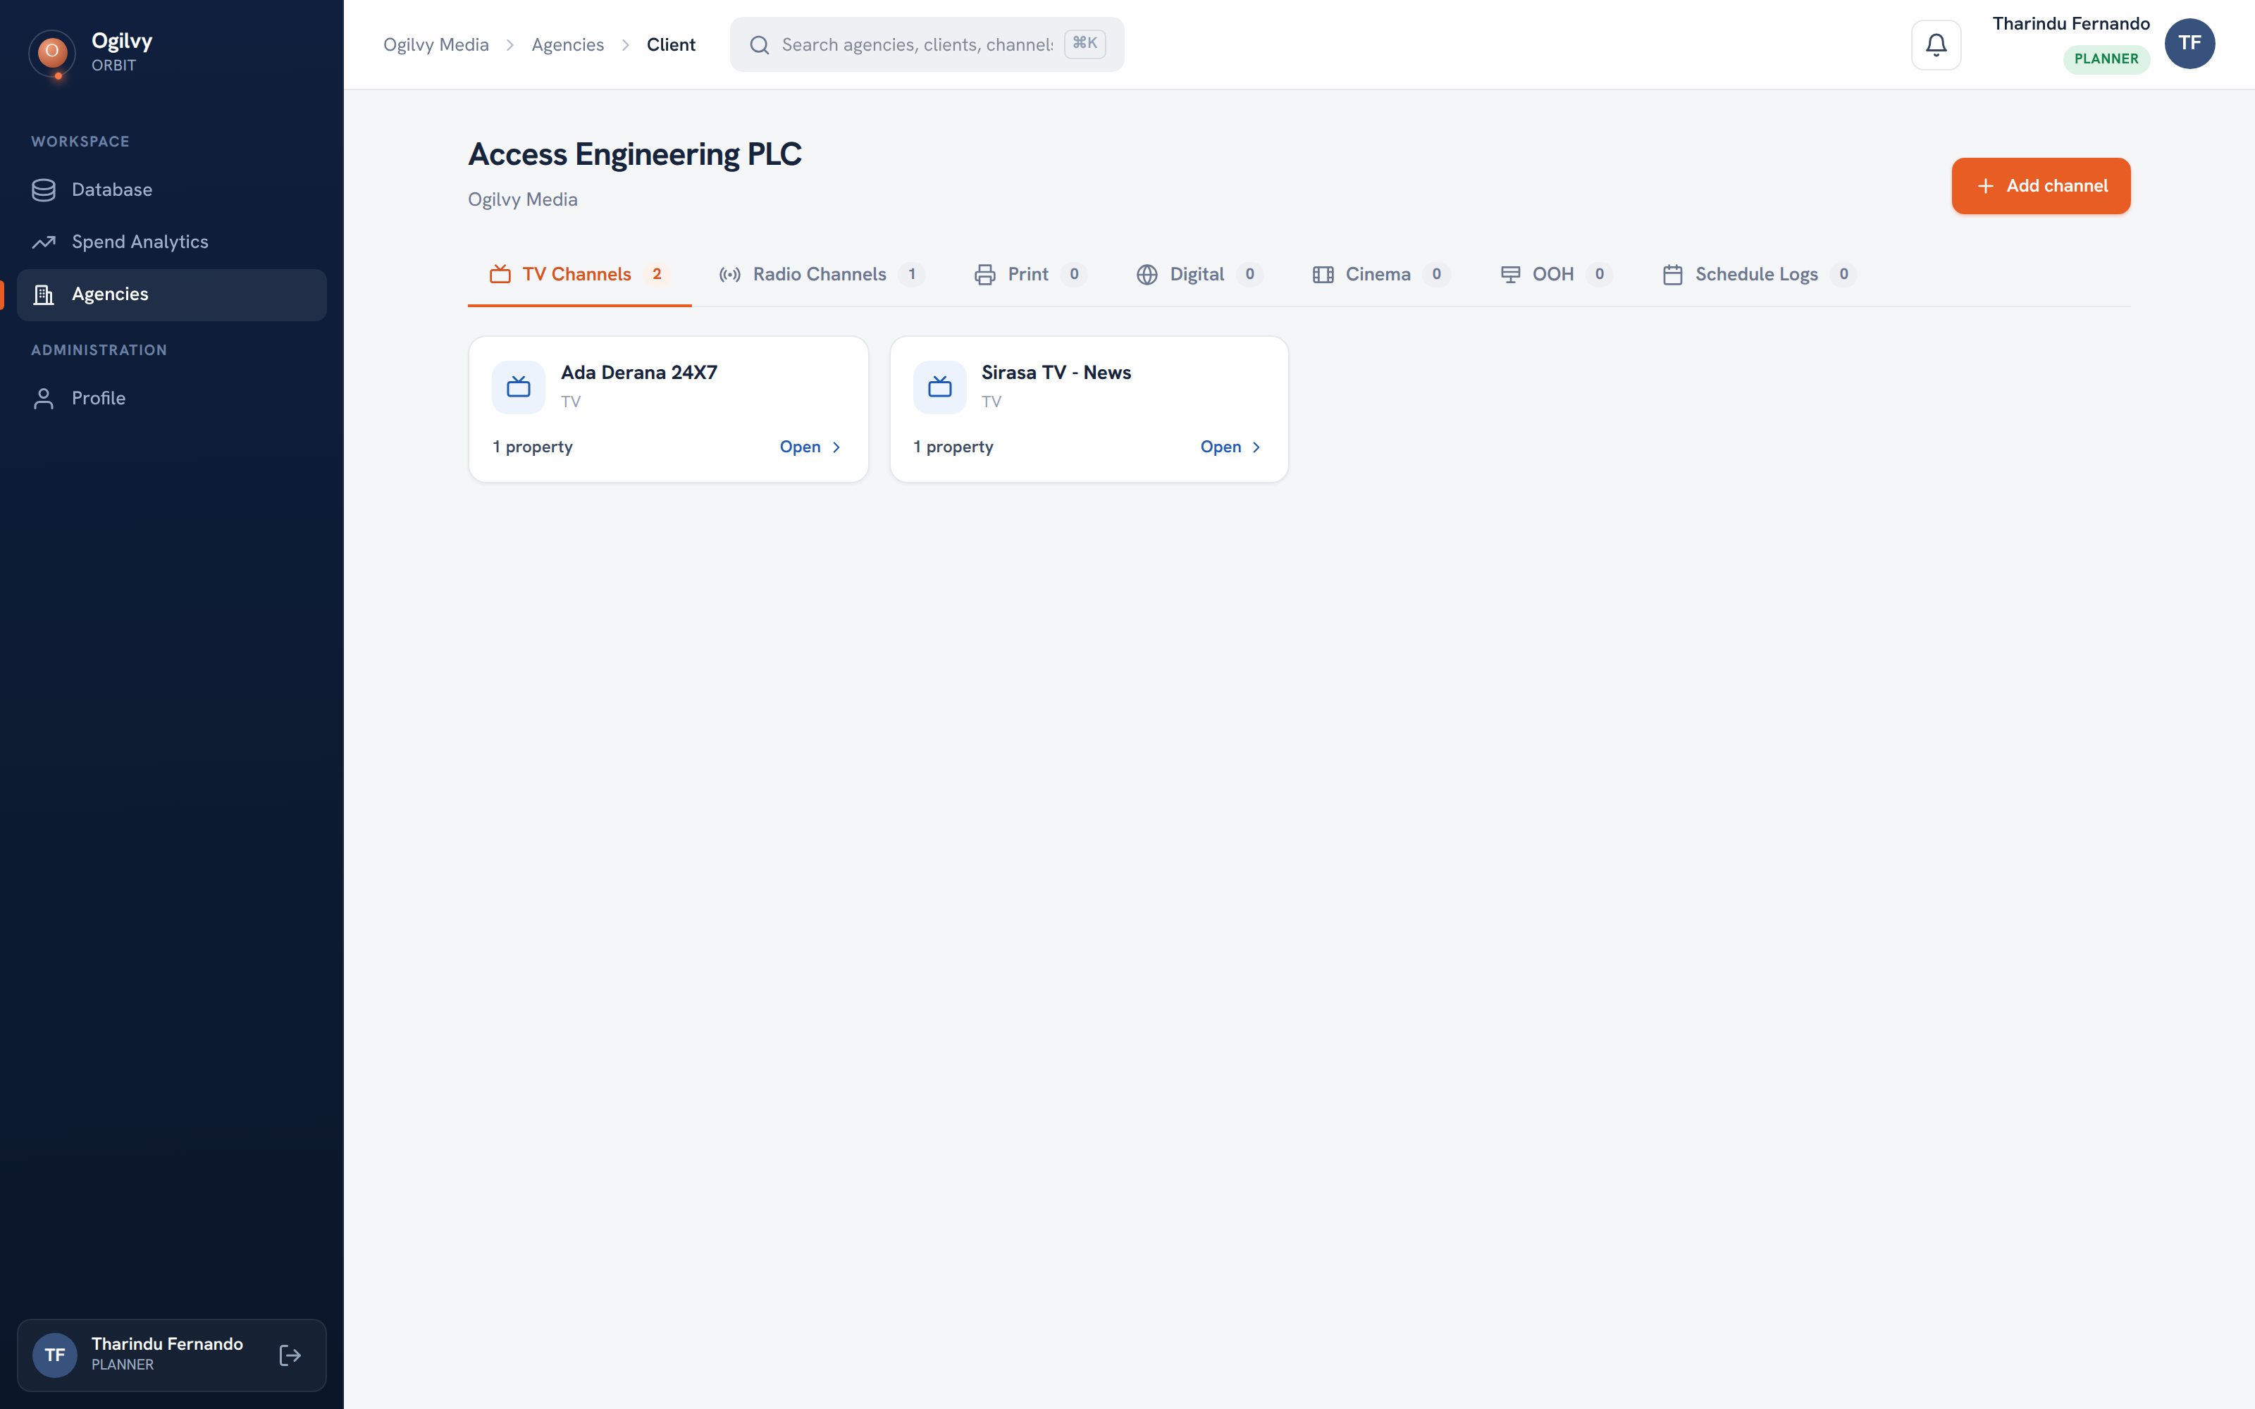
CLIENT DETAIL
Your client's channels
Open a client to see its channels, grouped by medium, each showing how many properties it holds.
WHAT YOU CAN DO HERE
See channels split across TV, Radio, Print and more
Add a new channel to a client when you win one
Open any channel to record its deals
Read the property count on every channel card
Ogilvy Orbit Planner Guide
RECORDING THE WORK
09 / 19

Slide 10
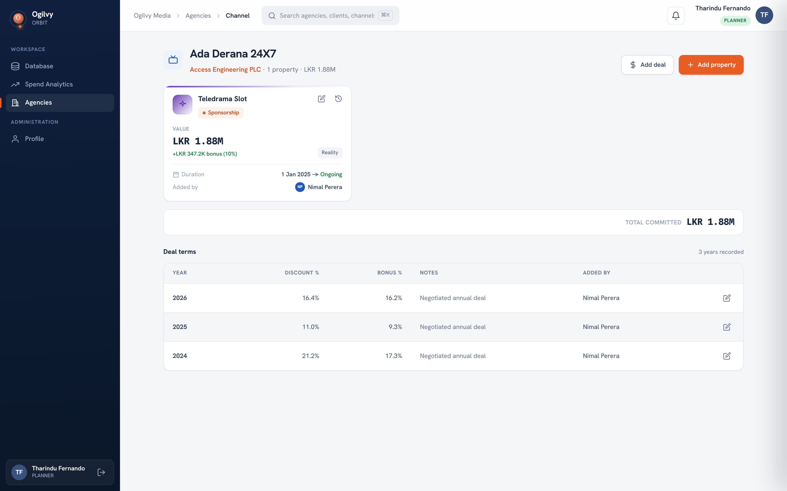
CHANNEL DETAIL
Properties and deal terms
On a channel you record the deals you strike: properties, and the discount and bonus terms per year.
WHAT YOU CAN DO HERE
See each property with its value, bonus and dates
Record discount and bonus terms year by year
Keep a full history of what was agreed and when
Edit a property or term as the deal moves
Tip Recording terms here means nothing about a deal lives only in your inbox.
Ogilvy Orbit Planner Guide
RECORDING THE WORK
10 / 19

Slide 11
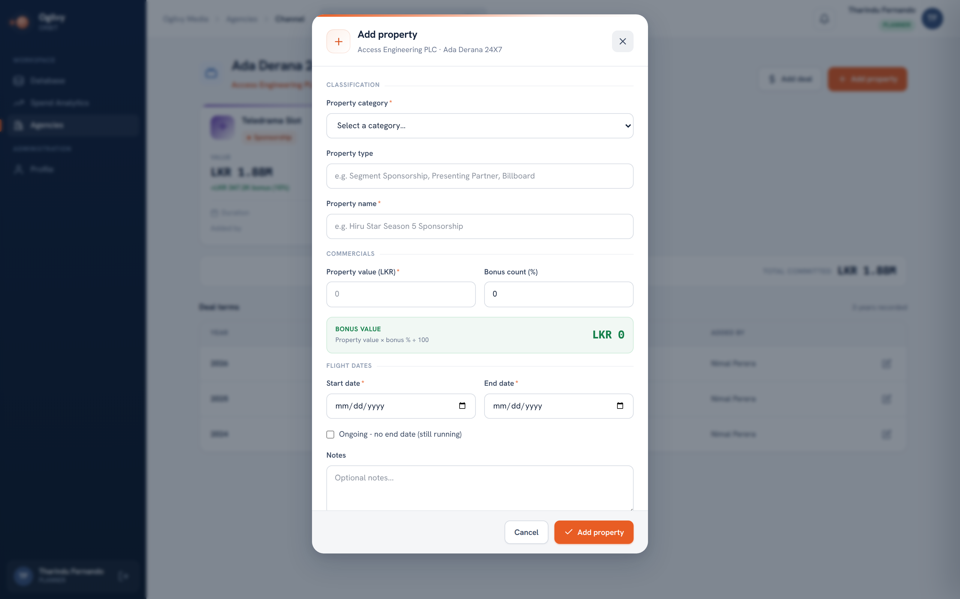
ADD A PROPERTY
Recording a property
The Add property form captures a deal in full, and computes the bonus value for you as you type.
WHAT YOU CAN DO HERE
Pick a category and name the property
Enter the value and a bonus percentage
Set the flight dates, or mark it ongoing
Save, and it appears on the channel at once
Ogilvy Orbit Planner Guide
RECORDING THE WORK
11 / 19

Slide 12
O
03
READING YOUR ACCOUNTS
Knowing your numbers
The same records you enter come back to you as charts, scoped to your clients.

Slide 13
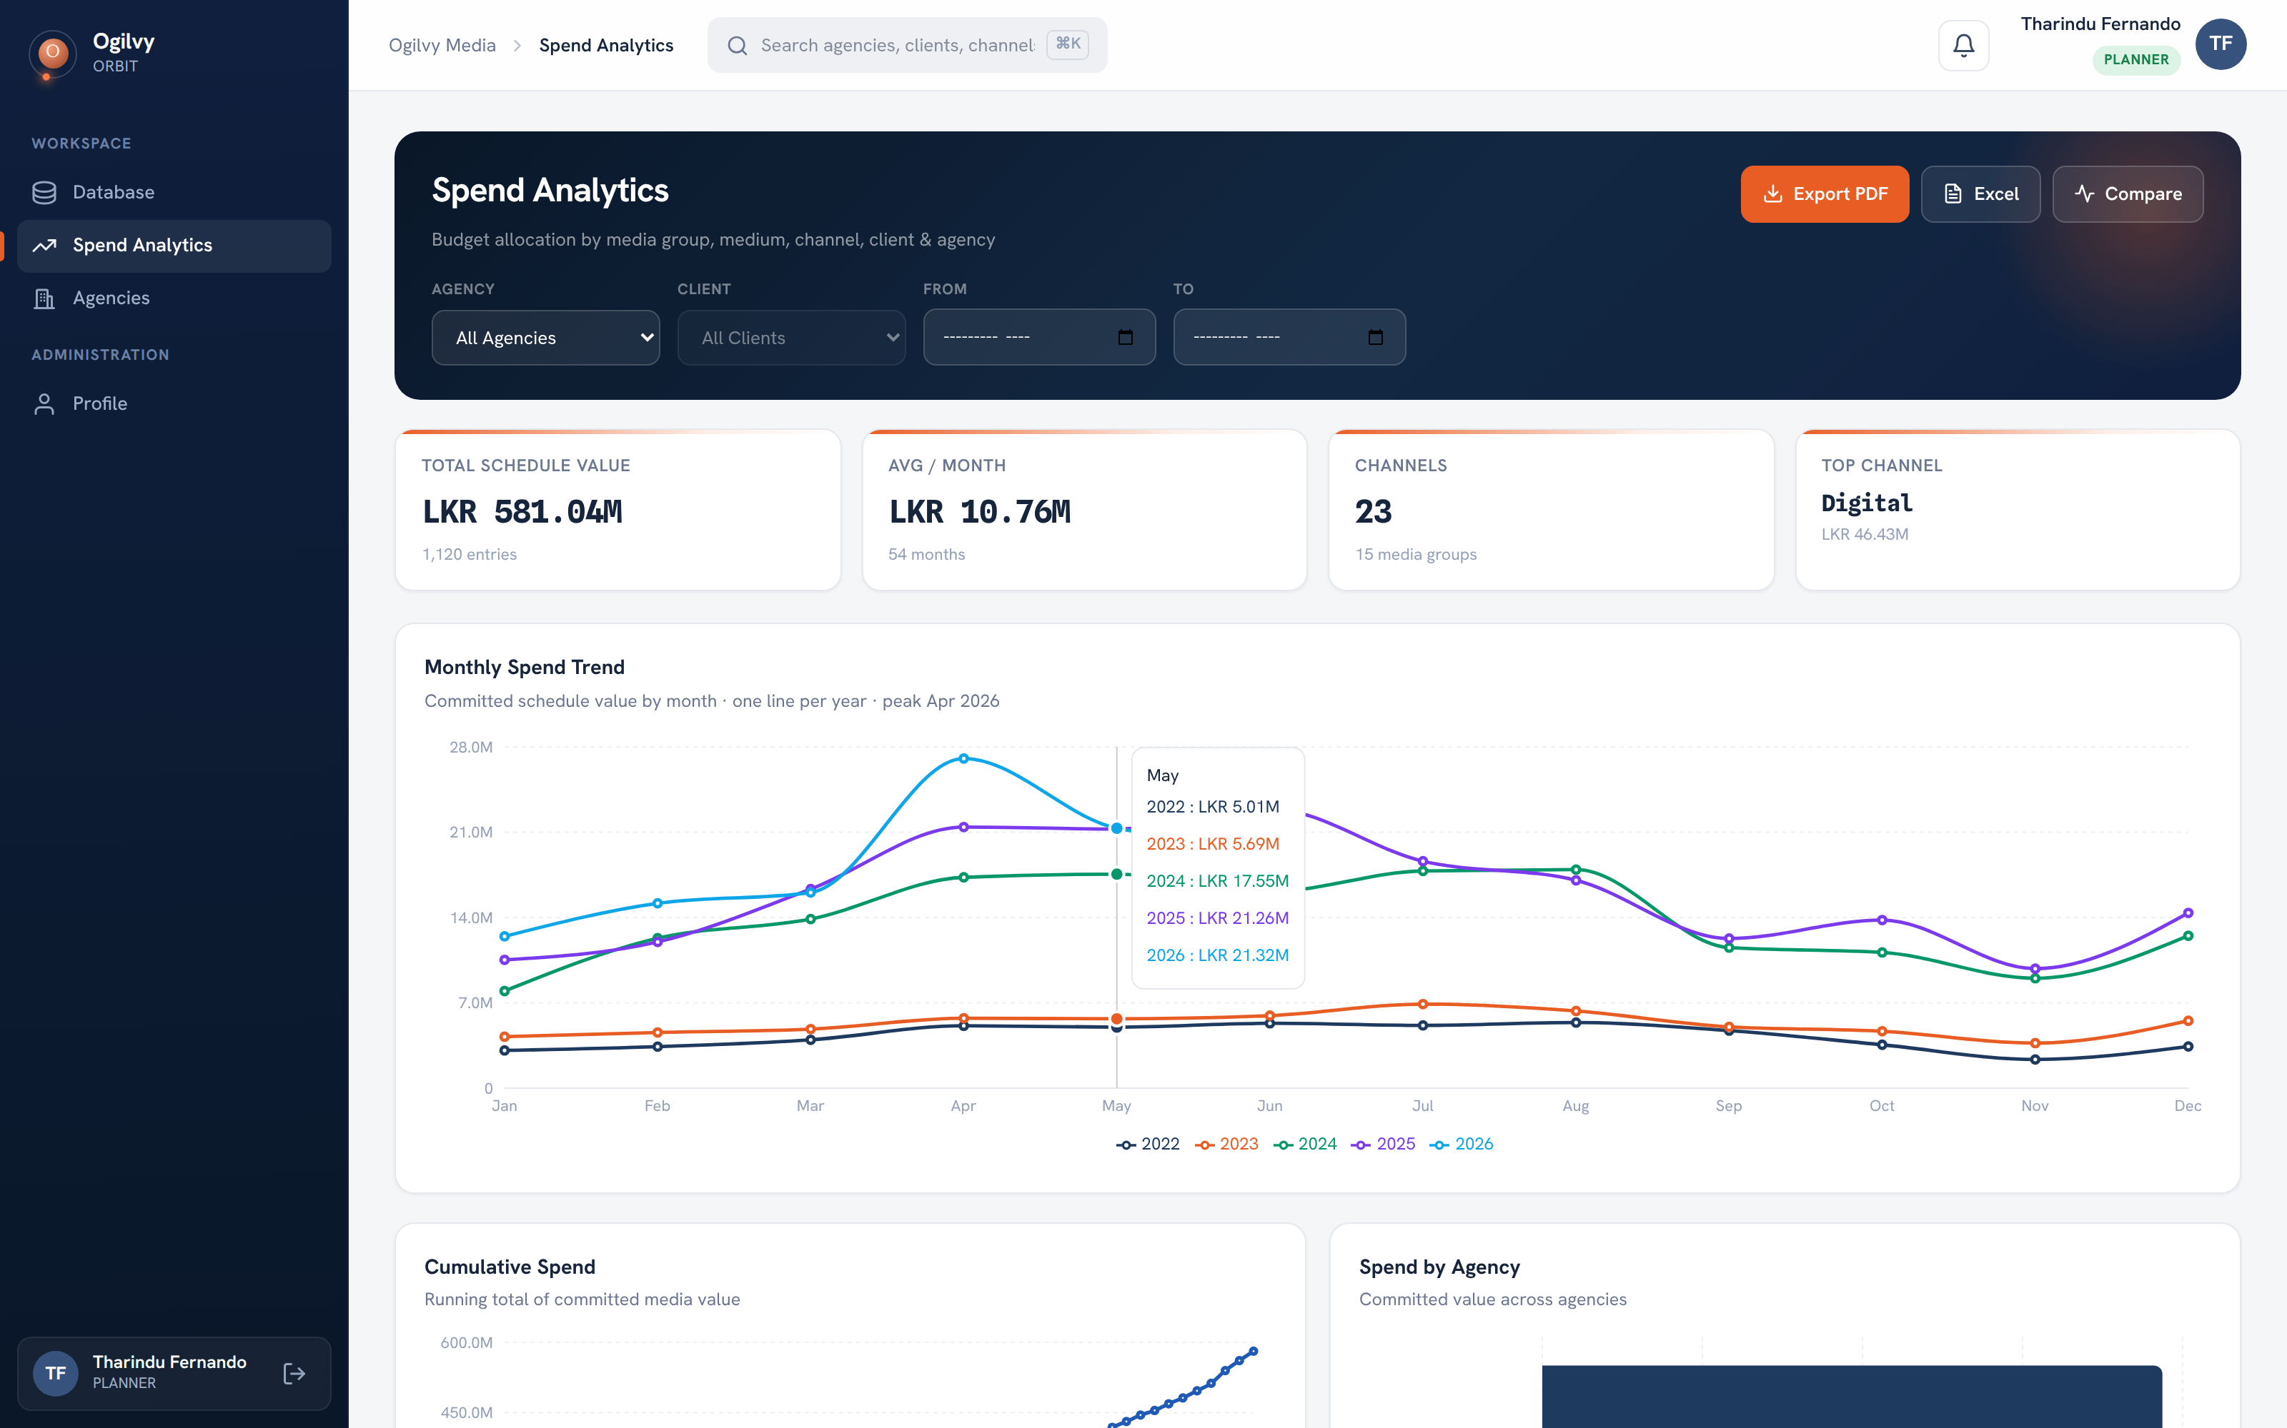
SPEND ANALYTICS
Spend analytics
A live picture of your clients' committed media value across months, media, channels and clients.
WHAT YOU CAN DO HERE
Read total committed value and monthly average
Compare spend year over year on one trend chart
Break spend down by medium, channel and client
Export the full view to Excel or PDF
Tip You only see your own clients, so the totals are yours to act on.
Ogilvy Orbit Planner Guide
READING YOUR ACCOUNTS
13 / 19

Slide 14
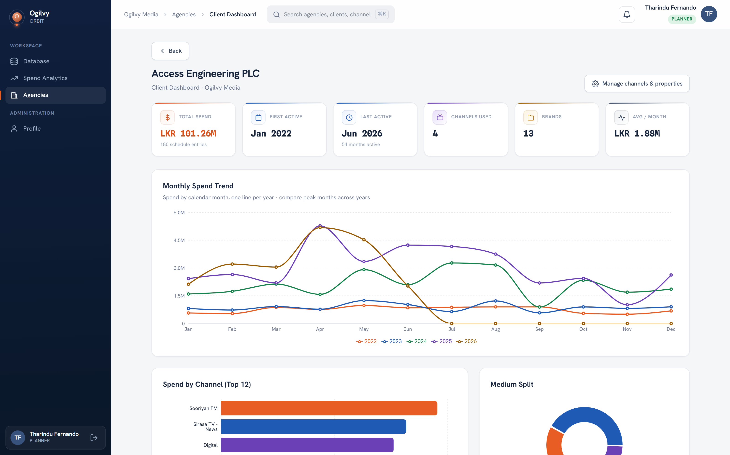
CLIENT DASHBOARD
The client dashboard
A focused analytics view for one client, so you can walk into any client review prepared.
WHAT YOU CAN DO HERE
See the client story in charts, not spreadsheets
Track spend trends and channel mix over time
Spot where a client is growing or slowing
Ogilvy Orbit Planner Guide
READING YOUR ACCOUNTS
14 / 19

Slide 15
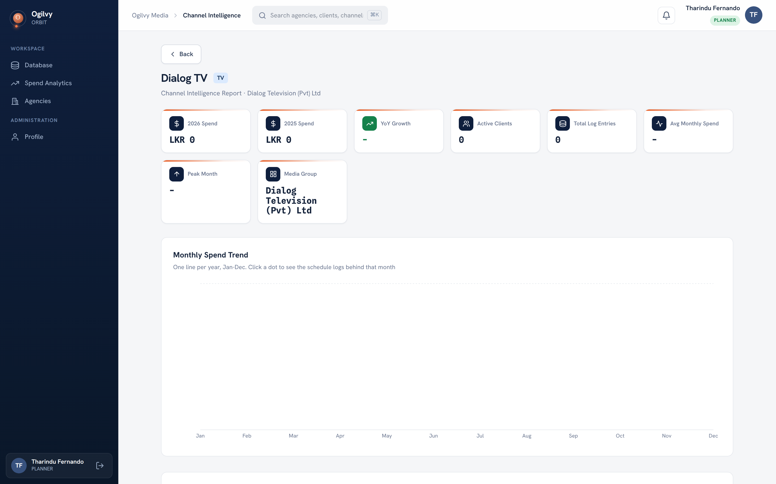
CHANNEL INTELLIGENCE
Channel intelligence
A deep read on a single channel, so you know the market before you negotiate a rate.
WHAT YOU CAN DO HERE
See spend on a channel across recent years
Read year over year growth and the peak month
Trace any month back to the schedules behind it
Know how many clients use the channel
Ogilvy Orbit Planner Guide
READING YOUR ACCOUNTS
15 / 19

Slide 16
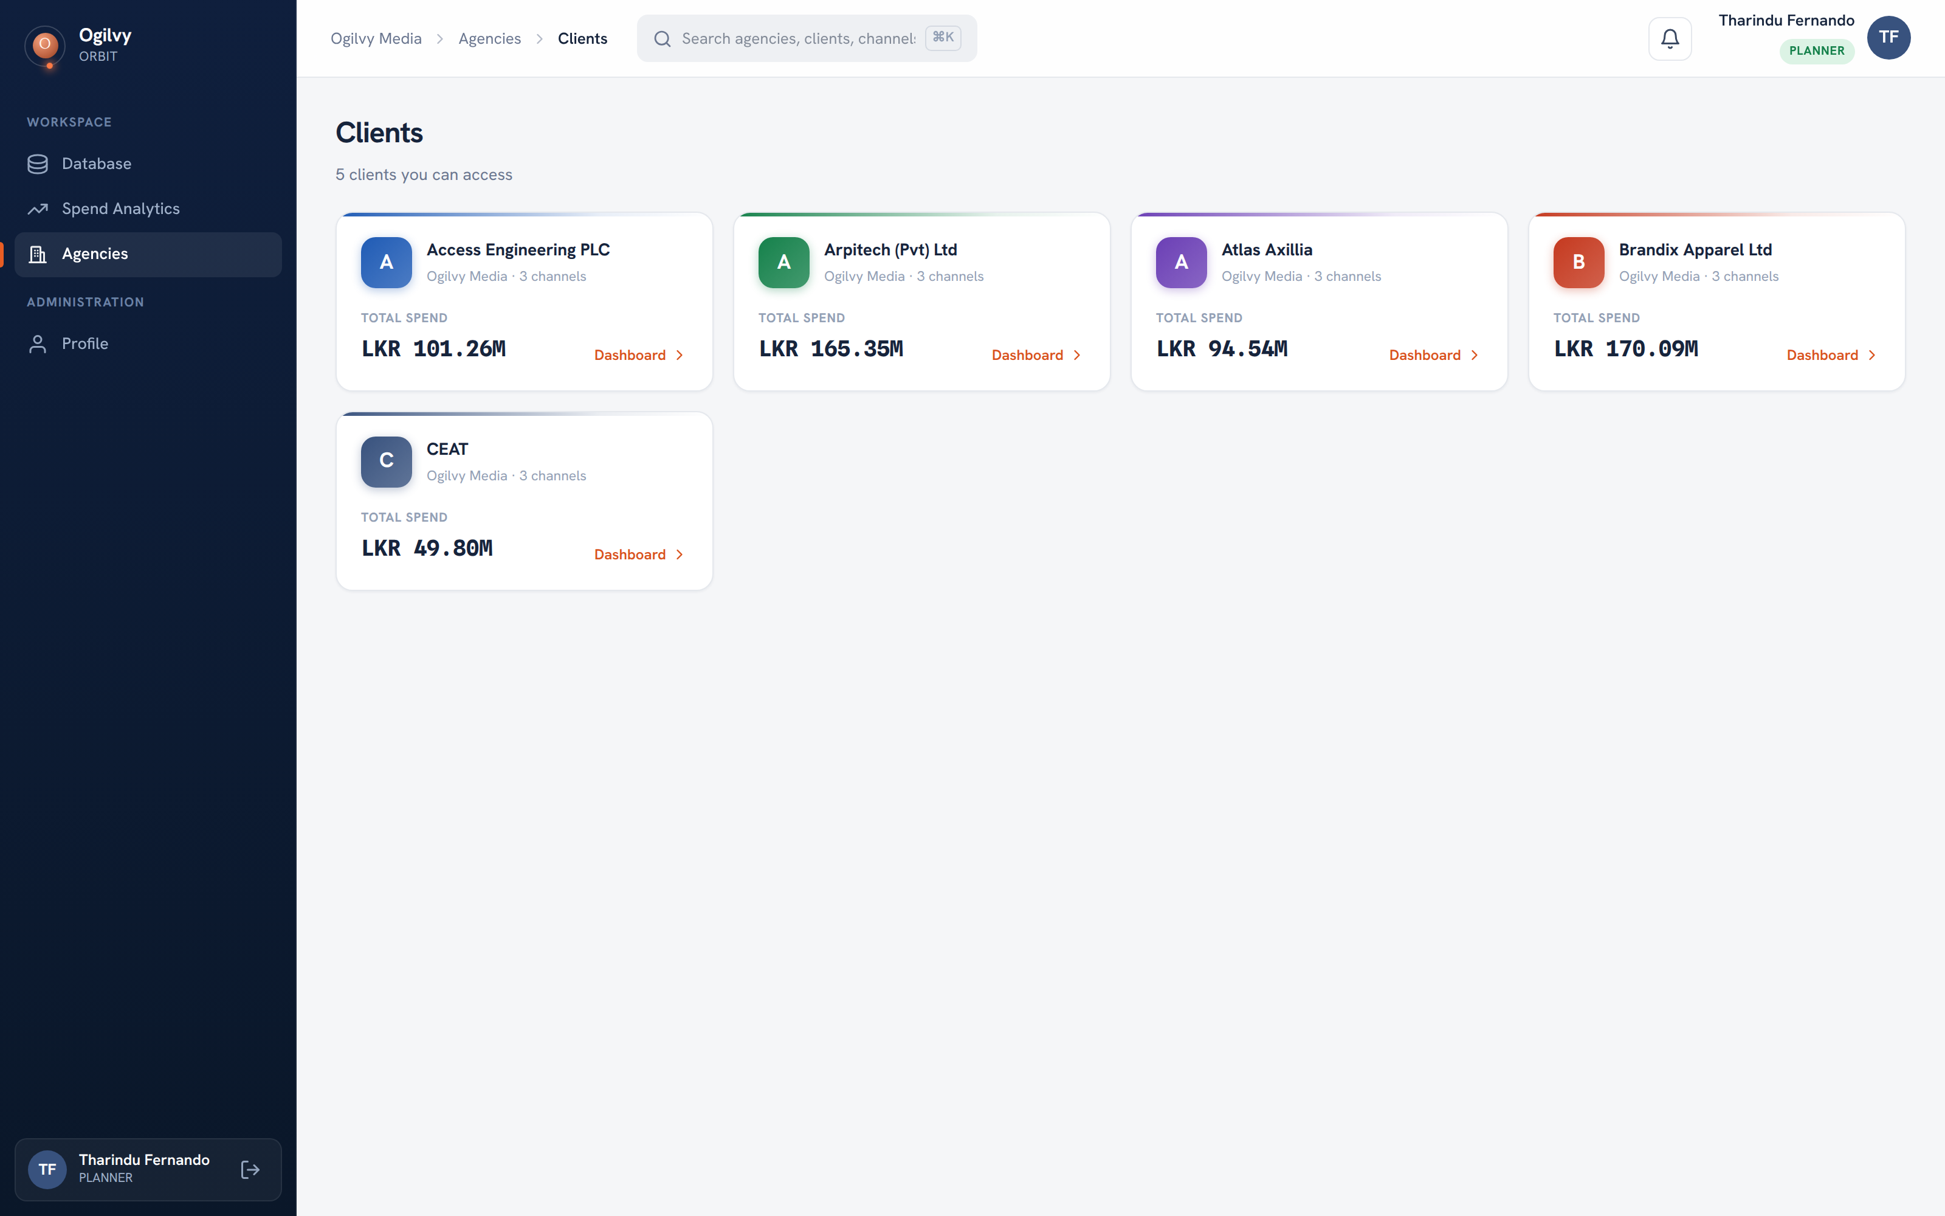
YOUR CLIENTS
Finding your accounts
Your agency and client lists are the quick way in. Both are scoped to the accounts assigned to you.
WHAT YOU CAN DO HERE
Open your agency to see its client roster
Browse or search the clients assigned to you
Open a client to reach its records and channels
Jump to a client dashboard in one click
Ogilvy Orbit Planner Guide
READING YOUR ACCOUNTS
16 / 19

Slide 17
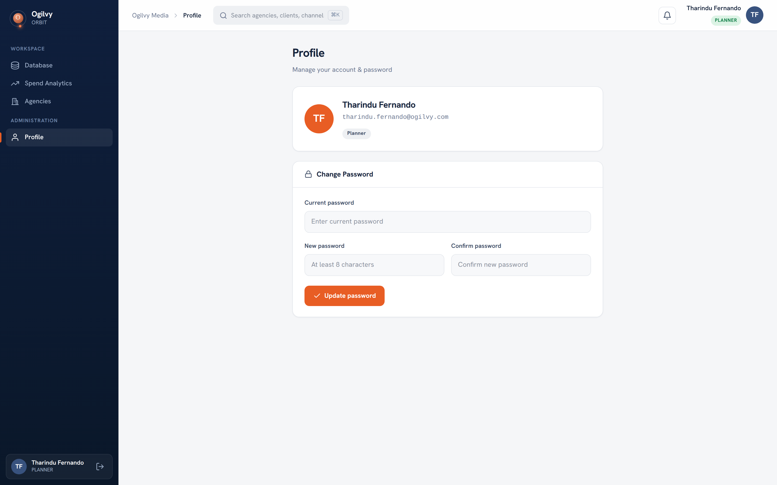
PROFILE
Your profile and security
Keep your own details current and your account secure from a single screen.
WHAT YOU CAN DO HERE
Review your name, role and contact email
Change your password whenever you need to
Sign out safely from any device
Ogilvy Orbit Planner Guide
READING YOUR ACCOUNTS
17 / 19

Slide 18
A SIMPLE RHYTHM
Your week in Orbit
Three light habits keep your accounts accurate and review ready.
1
2
3
Log
Record
Read
Add or paste each client's schedule as it is confirmed, so records never fall behind.
Capture properties and deal terms on the channel while the negotiation is fresh.
Open Spend Analytics and your client dashboards before any review, so you know the numbers.
Ogilvy Orbit Planner Guide
READING YOUR ACCOUNTS
18 / 19

Slide 19
O
Your records run the show.
Keep your clients' schedules current and their deals recorded, and every chart, report and review upstream is built on numbers you can stand behind.
Questions on any screen reach the media team through your admin.

