Slide 1
O
OGILVY MEDIA
Ogilvy Orbit
The Media Buying Records System,
explained for Super Admins.
The full tour: every dashboard, the finance and negotiation screens, planning, media packages, and the admin controls that run the whole system.
Prepared for Super Admins 2026

Slide 2
O
01
FULL CONTROL
One console for the whole system
Every screen, every agency, every user. Nothing is scoped away from you.

Slide 3
THE BIG PICTURE
Three jobs, all yours
As a Super Admin you own the record, the money view and the system itself.
1
2
3
See everything
Run the money
Control the system
Every dashboard and analytics view, across all agencies, unrestricted.
Profit on confirmed spend and the negotiation intelligence behind every deal.
Users, teams, clients, channels, commissions and the master data underneath.
Ogilvy Orbit Super Admin Guide
FULL CONTROL
03 / 29

Slide 4
YOUR ACCESS
What a Super Admin can reach
Everything, with nothing scoped away. You see all agencies, run the finance and negotiation views, drive planning, and control every user, team and record.
Executive Dashboard
Deep Dashboard
Spend Analytics
Company-wide billings and pacing
Multi year drill down and property table
Every angle on committed spend
Channel Intelligence
Reports
Profit
Deep read on any single channel
Branded Excel and PDF on demand
Agency profit on confirmed spend
Media Buying
Forecasting & Insights
Media Packages
Negotiation intelligence and deals
Collect, override and analyse forecasts
Build, send and track proposals
Database
Admin
Profile
All records, plus multi client import
Users, teams, agencies, clients, channels
Your details and password
Ogilvy Orbit Super Admin Guide
FULL CONTROL
04 / 29

Slide 5
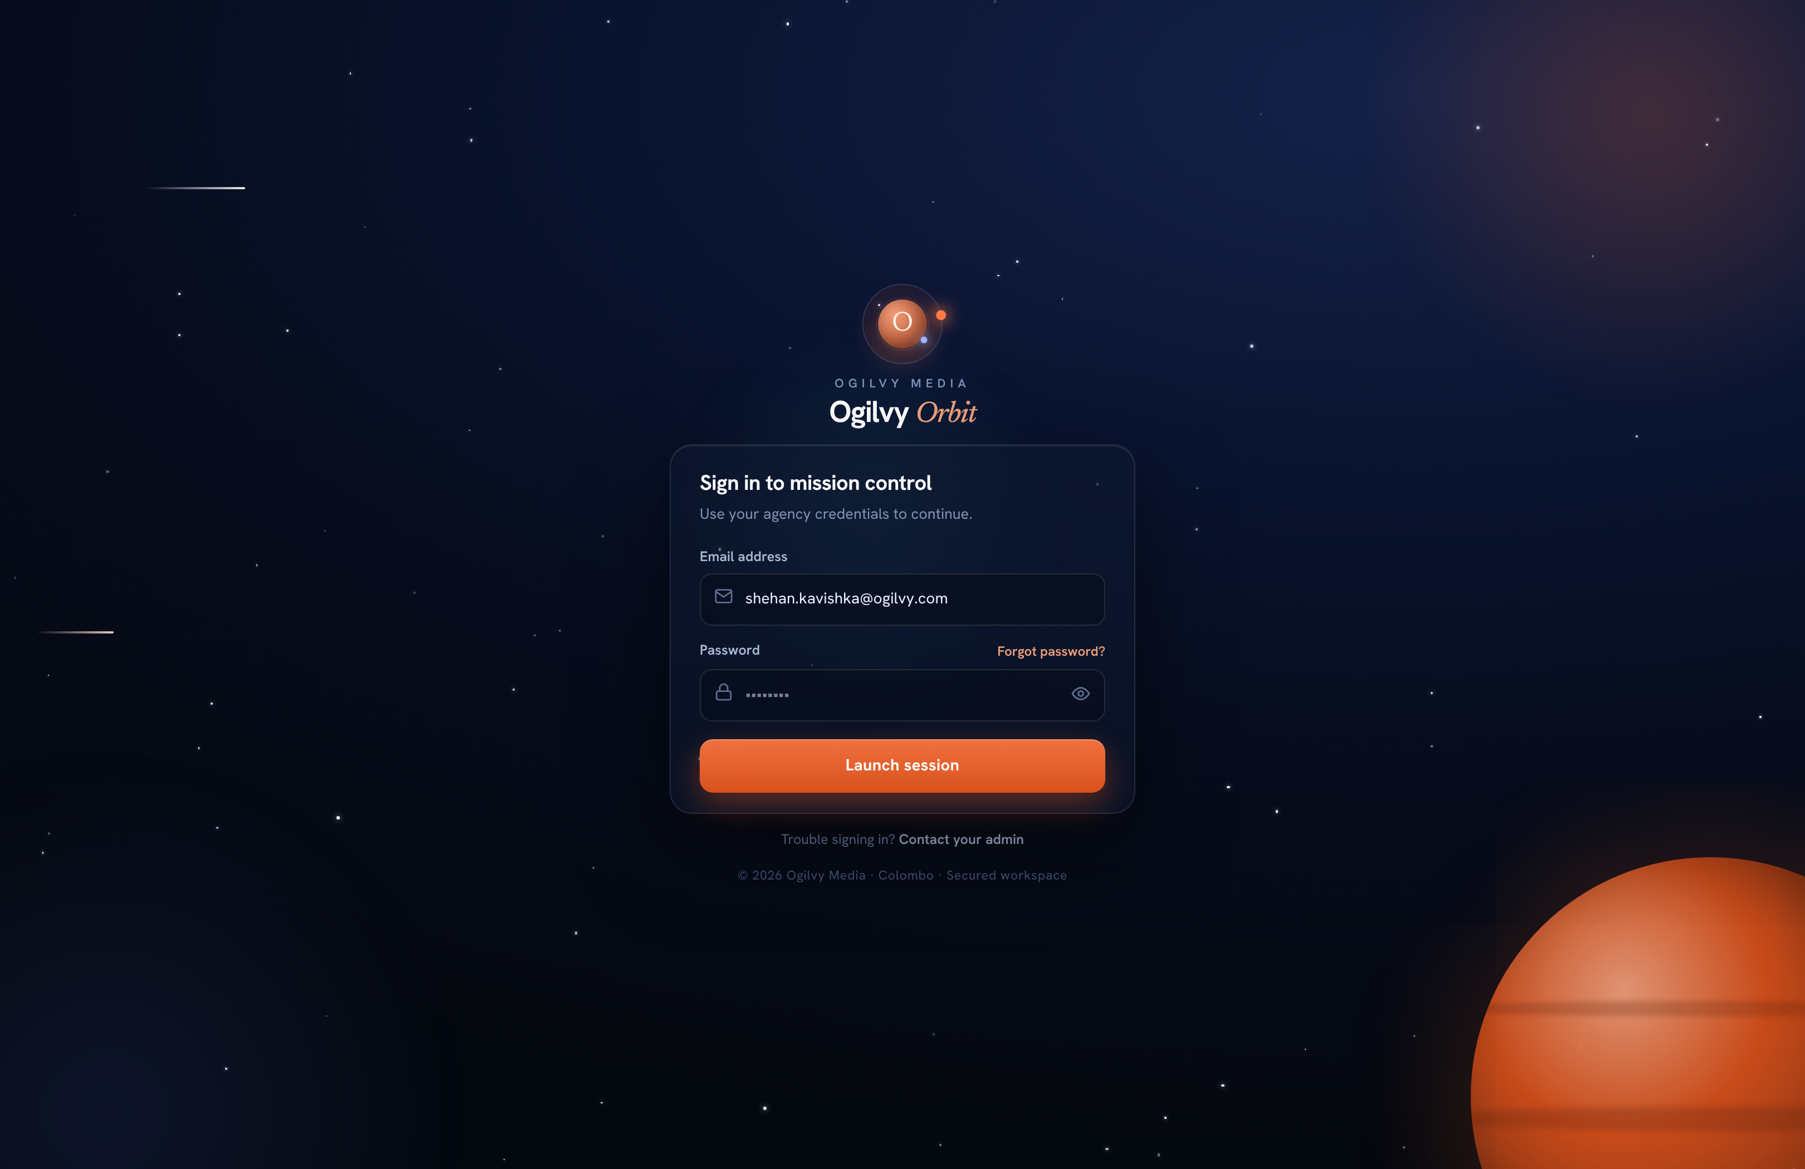
SIGNING IN
Your secure sign in
You sign in with your agency email and a private password. Admin routes are protected on the server, not just hidden in the app.
WHAT YOU CAN DO HERE
Sign in with your Ogilvy email and password
Reset a forgotten password from the same screen
Every admin action is role checked server side
Sessions are revocable and time out safely
Ogilvy Orbit Super Admin Guide
FULL CONTROL
05 / 29

Slide 6
O
02
COMMAND & ANALYTICS
Seeing the whole company
The dashboards you lead reviews from, all reading live from the records.

Slide 7
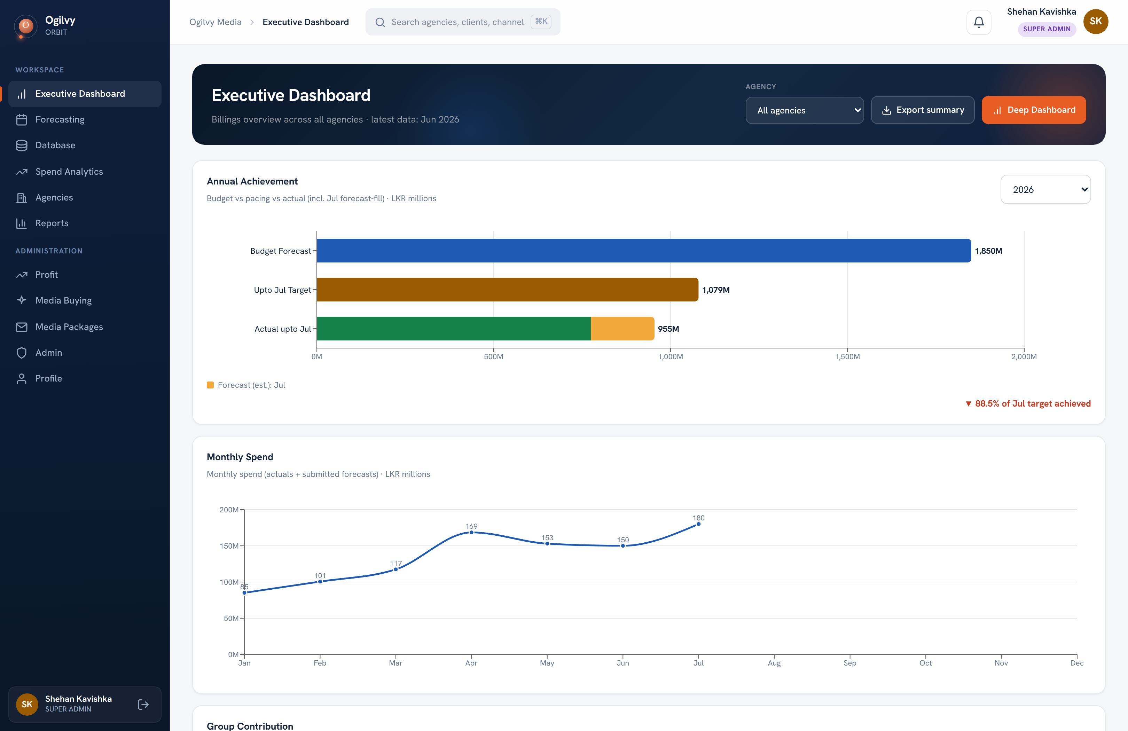
EXECUTIVE DASHBOARD
Executive Dashboard
Your home. A billings overview across every agency, with pacing against the annual target.
WHAT YOU CAN DO HERE
Lead with Annual Achievement: budget, pacing, actual
Read Group Contribution: Budget vs Revenue by head
Compare agencies, mediums and monthly billing
Export a branded summary in one click
Ogilvy Orbit Super Admin Guide
COMMAND & ANALYTICS
07 / 29

Slide 8
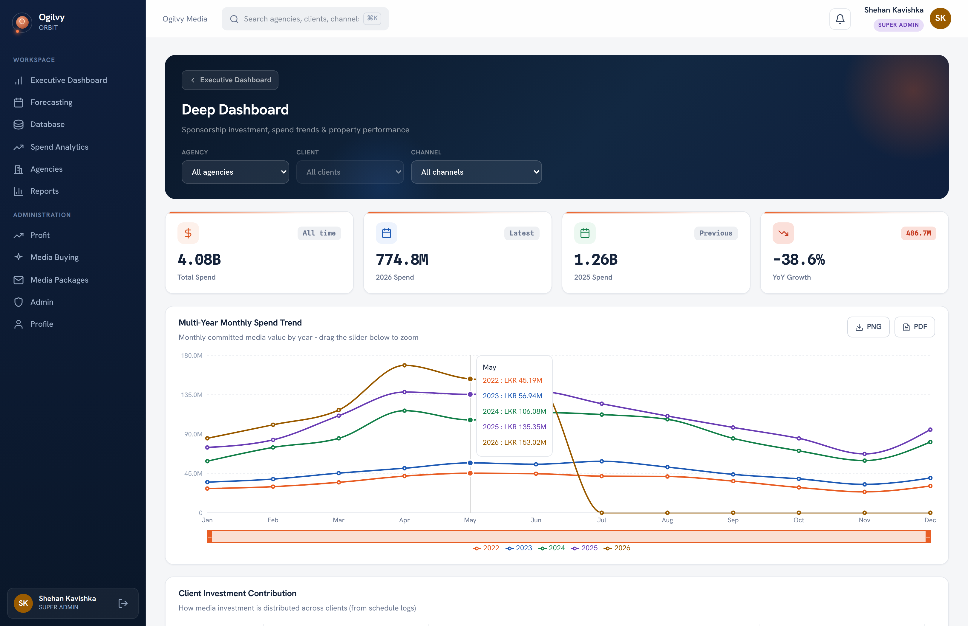
DEEP DASHBOARD
Deep Dashboard
A drill down for multi year trends, client contribution and property level performance.
WHAT YOU CAN DO HERE
Overlay several years on one trend, with a zoom brush
Rank clients and channels by contribution
Sort a property table, including bonus yield
Filter by agency, client and channel together
Ogilvy Orbit Super Admin Guide
COMMAND & ANALYTICS
08 / 29

Slide 9
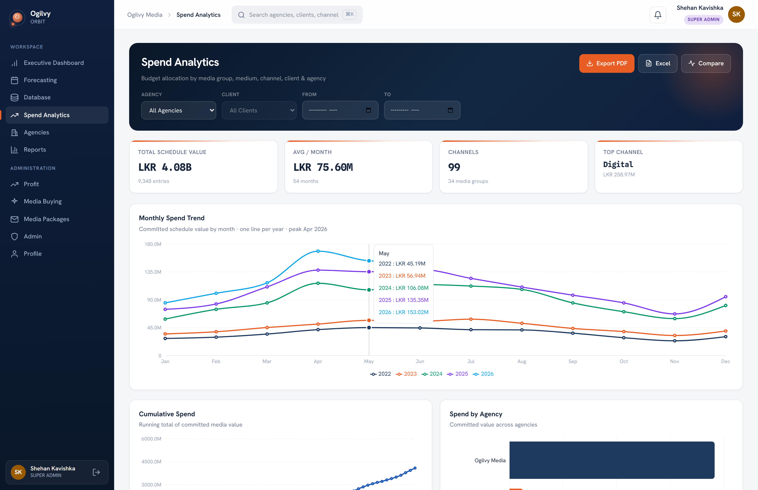
SPEND ANALYTICS
Spend Analytics
The deepest analytics screen, unrestricted across every agency and client.
WHAT YOU CAN DO HERE
A dozen charts covering trend, mix and tenure
Filter by agency, client and month range
Cross filter the channel views from the donut
Export the whole view to Excel or PDF
Ogilvy Orbit Super Admin Guide
COMMAND & ANALYTICS
09 / 29

Slide 10
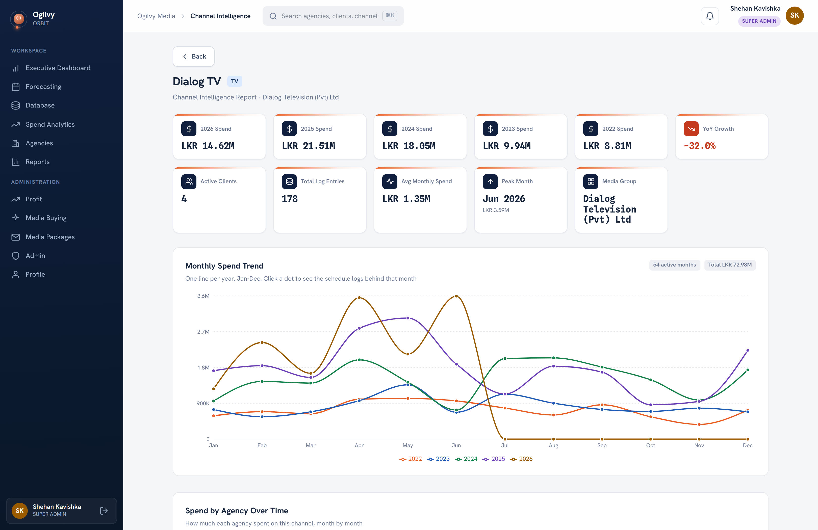
CHANNEL INTELLIGENCE
Channel Intelligence
A full read on a single channel across every client and agency.
WHAT YOU CAN DO HERE
Read spend, growth and the peak month per channel
Trace any month back to the schedules behind it
See which agencies drive the channel over time
Gauge how concentrated the channel's clients are
Ogilvy Orbit Super Admin Guide
COMMAND & ANALYTICS
10 / 29

Slide 11
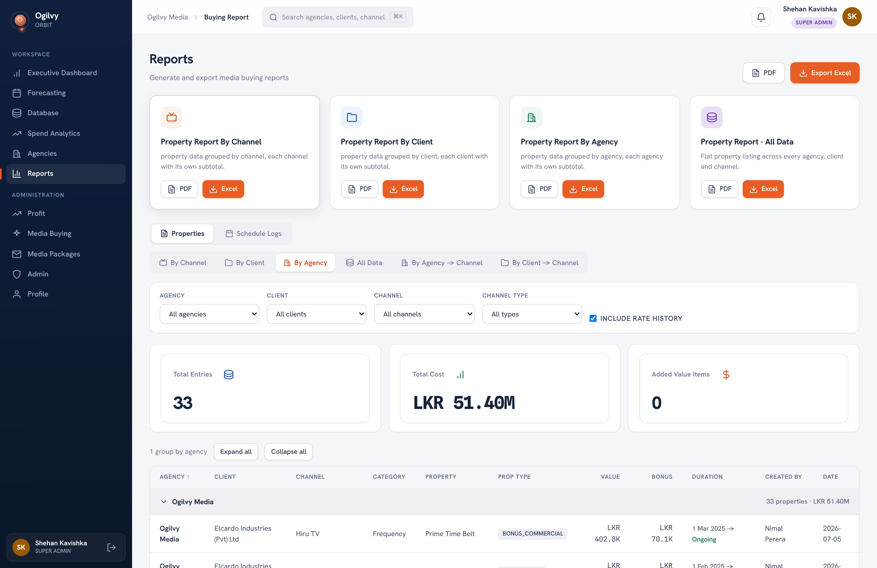
REPORTS
Reports
Generate branded, shareable reports for any agency, client or channel, in Excel or PDF.
WHAT YOU CAN DO HERE
Report by client, agency or canonical channel
Include rate history and property timelines
Download as branded Excel or PDF
Hand a clean document to any stakeholder
Ogilvy Orbit Super Admin Guide
COMMAND & ANALYTICS
11 / 29

Slide 12
O
03
THE MONEY
Profit and negotiation
The two finance screens only you can see.

Slide 13
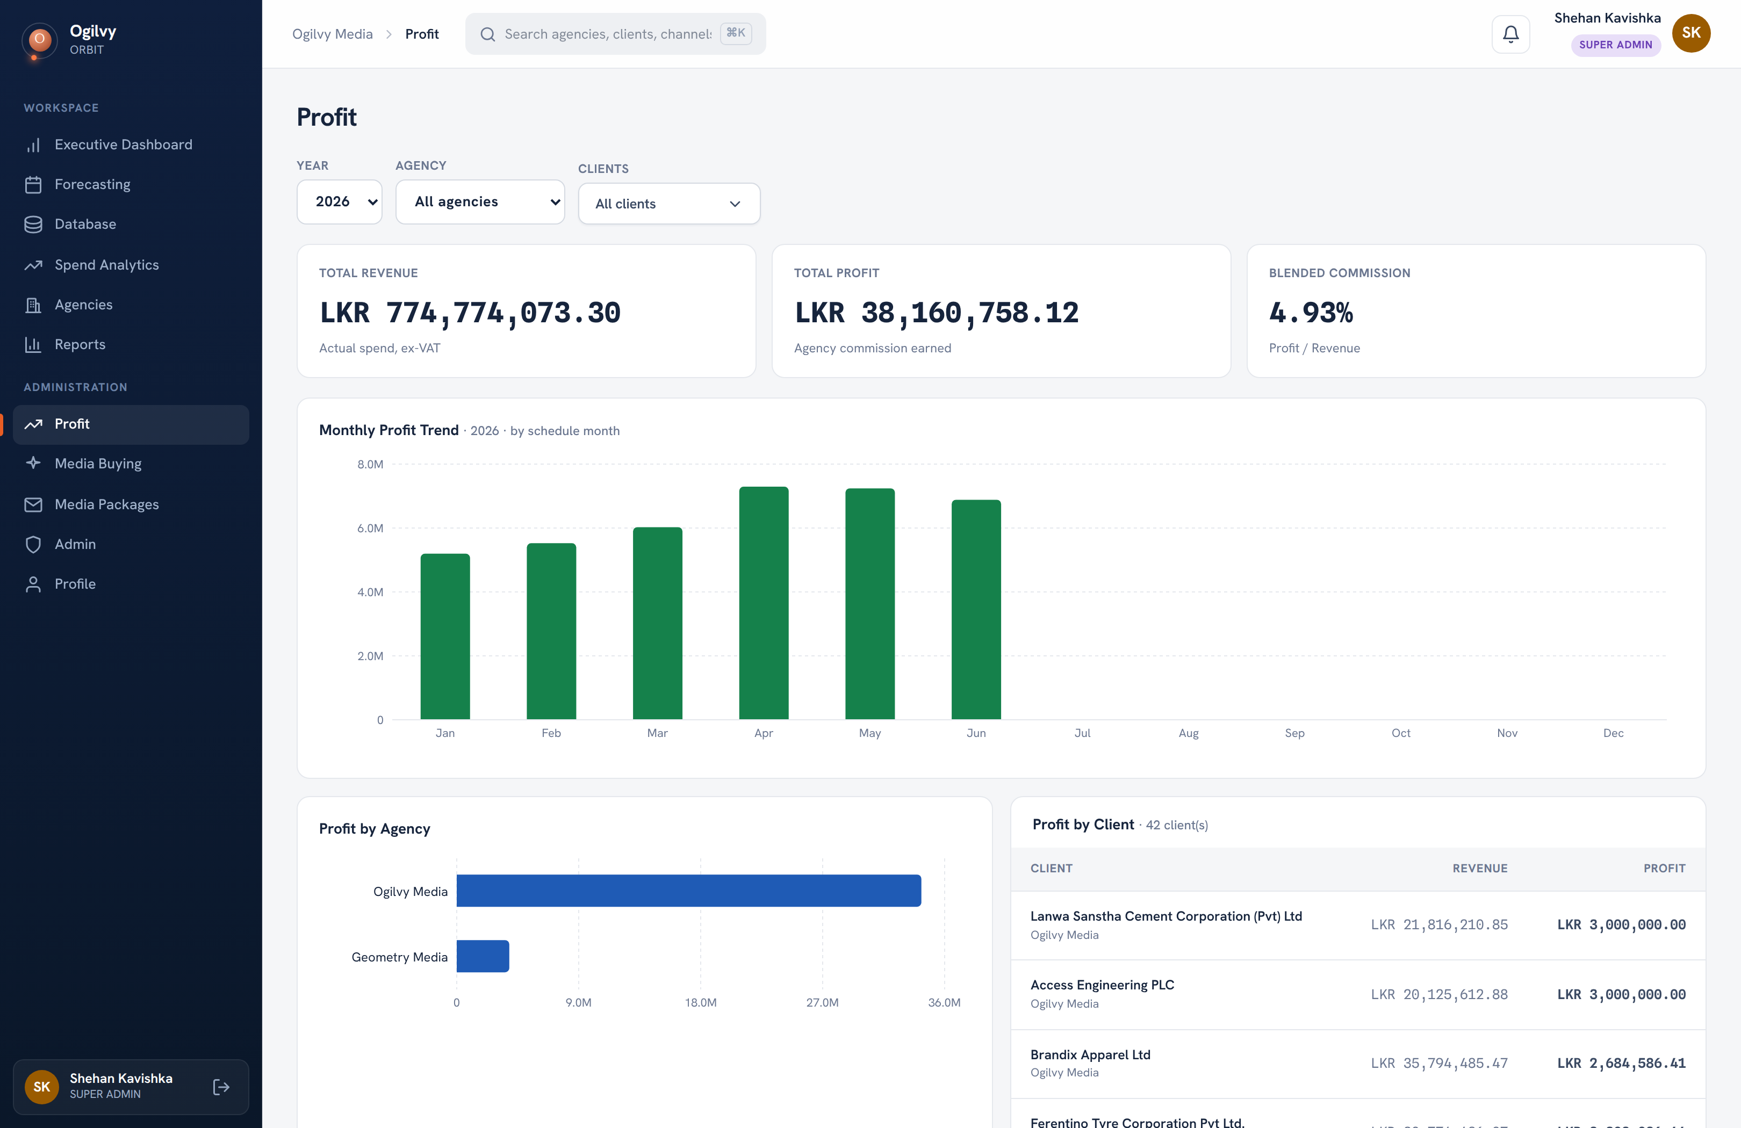
PROFIT
Profit
Agency profit on confirmed actual spend only. Commission is snapshotted onto each record at entry, so history never shifts.
WHAT YOU CAN DO HERE
Three cards: Revenue, Profit, Blended percent
Monthly profit trend and profit by agency
Expand any client for its month by month profit
Filter by year, agency and client
Tip Commission is frozen at entry, so a later rate change never rewrites past profit.
Ogilvy Orbit Super Admin Guide
THE MONEY
13 / 29

Slide 14
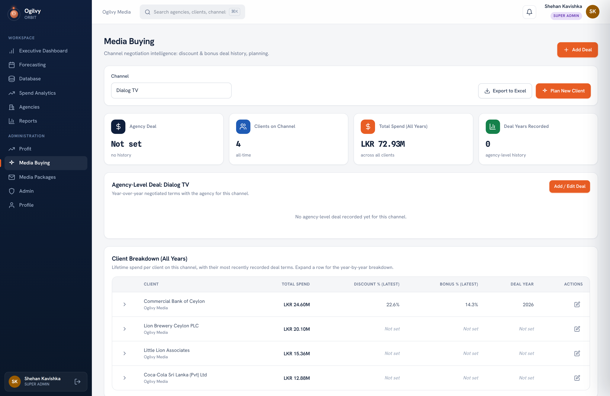
MEDIA BUYING
Media Buying
Negotiation intelligence per channel: agency and client discount and bonus deals, year over year, plus a planner.
WHAT YOU CAN DO HERE
Track discount and bonus deals by agency and client
See year over year trend arrows on each deal
Read a client breakdown of lifetime spend
Plan a new client's terms against comparable ones
Ogilvy Orbit Super Admin Guide
THE MONEY
14 / 29

Slide 15
O
04
PLANNING
Collecting and analysing forecasts
You collect what group heads submit, override where needed, and analyse the result.

Slide 16
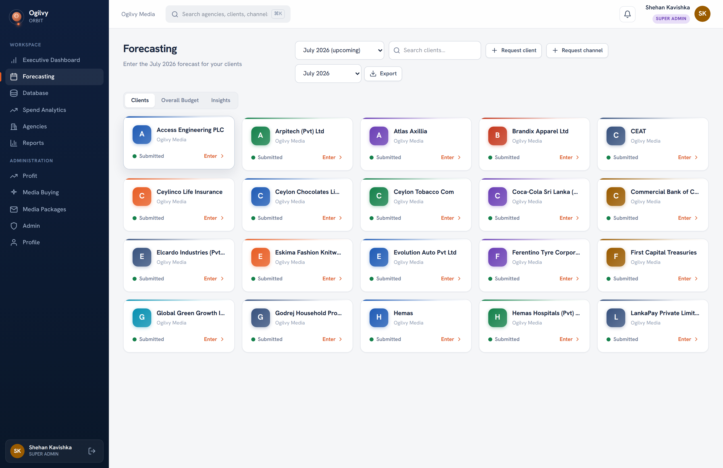
FORECASTING
Forecasting
Group heads submit the coming month here. As admin you can target any month and override any client.
WHAT YOU CAN DO HERE
See every client and its Submitted or Pending status
Target any month, not just the upcoming one
Enter or correct a client's per channel numbers
Approve client and channel requests from heads
Ogilvy Orbit Super Admin Guide
PLANNING
16 / 29

Slide 17
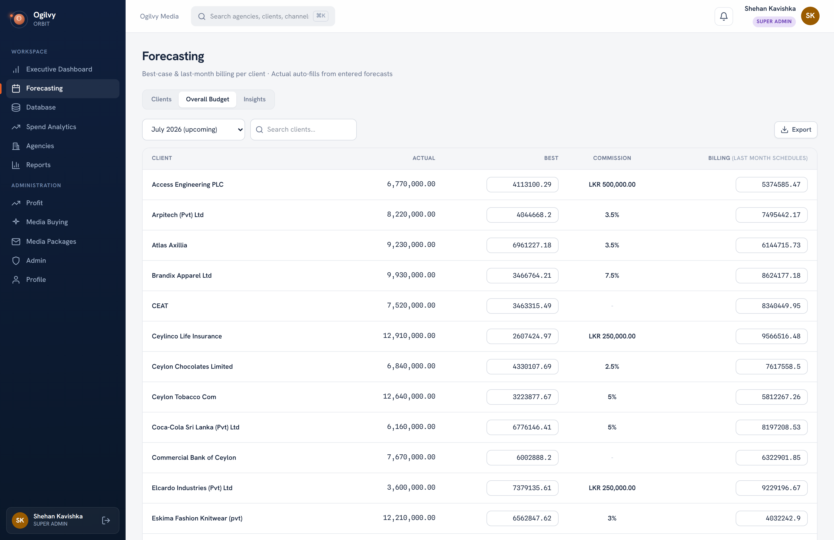
OVERALL BUDGET
Overall Budget
The per client worksheet: actual auto filled from forecasts, plus best case, commission and last month billing.
WHAT YOU CAN DO HERE
Read actual auto filled from entered forecasts
See best case and last month billing per client
Commission comes from each client's Admin setting
Export the worksheet to Excel
Ogilvy Orbit Super Admin Guide
PLANNING
17 / 29

Slide 18
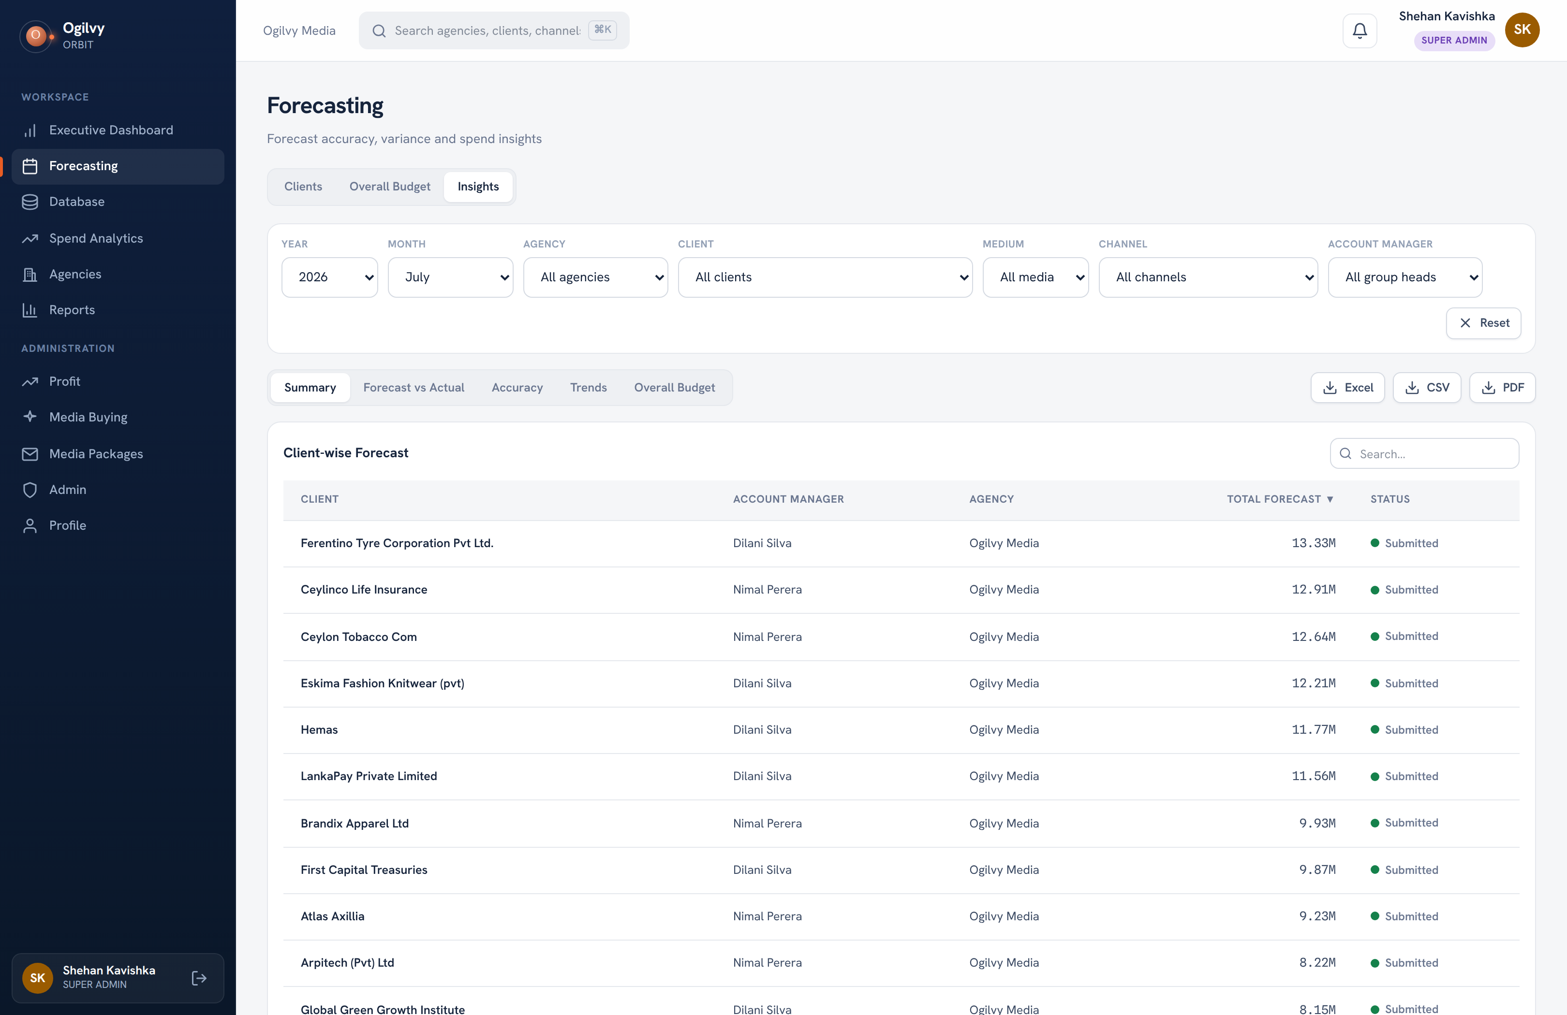
FORECASTING INSIGHTS
Forecasting Insights
An admin only analytics suite over the forecasts: summary, forecast vs actual, accuracy, trends and budget.
WHAT YOU CAN DO HERE
Filter by year, month, agency, client and manager
Read forecast vs actual variance at client or channel
See forecast accuracy and best and least accurate
Export every view to Excel, CSV or PDF
Ogilvy Orbit Super Admin Guide
PLANNING
18 / 29

Slide 19
O
05
DATA & COLLABORATION
The records and the proposals
Where the data comes in, and how packages go out.

Slide 20
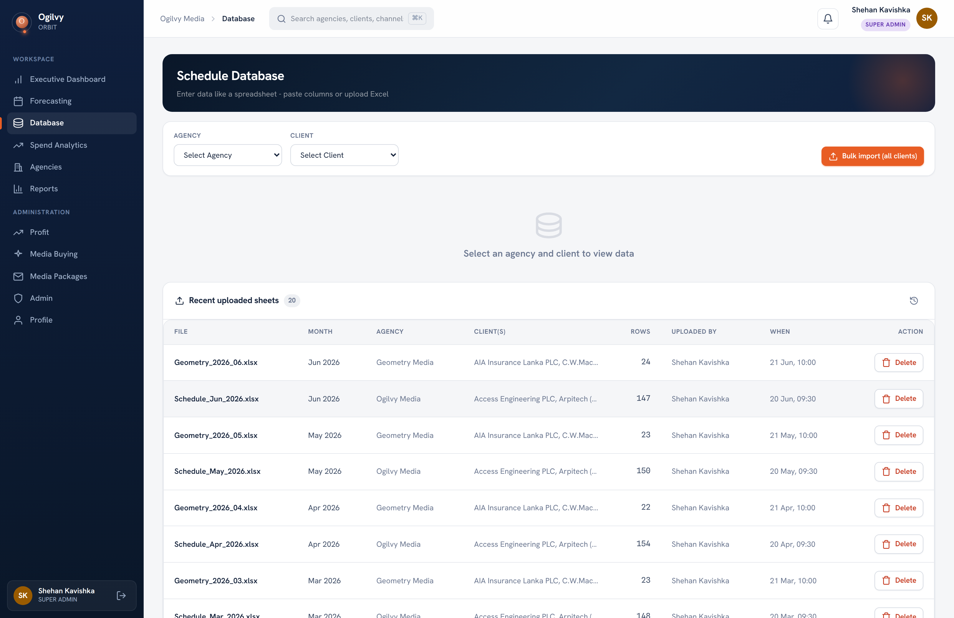
DATABASE
The schedule database
Every schedule record lives here. Beyond per client entry, you can import one file covering every client at once.
WHAT YOU CAN DO HERE
Open any client's records and edit in the grid
Import all clients from a single Excel file
Resolve clients and channels by name on import
Duplicate rows are detected before anything saves
Tip The multi client import handles tens of thousands of rows in one pass.
Ogilvy Orbit Super Admin Guide
DATA & COLLABORATION
20 / 29

Slide 21
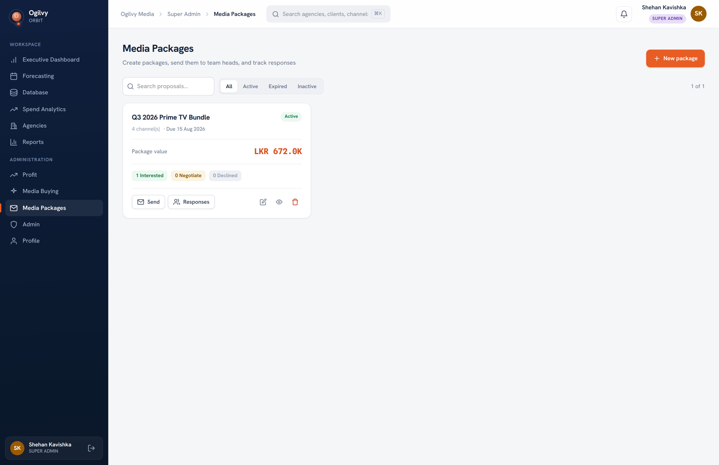
MEDIA PACKAGES
Media Packages
Build a channel package, send it to group heads, and track every response in one place.
WHAT YOU CAN DO HERE
Build a package of channels and rates
Set a proposal deadline, past which it closes
Send to group heads by email and in app
Track interest, follow up and booked status
Ogilvy Orbit Super Admin Guide
DATA & COLLABORATION
21 / 29

Slide 22
O
06
ADMINISTRATION
Running the system
The controls that decide who sees what, and keep the master data clean.

Slide 23
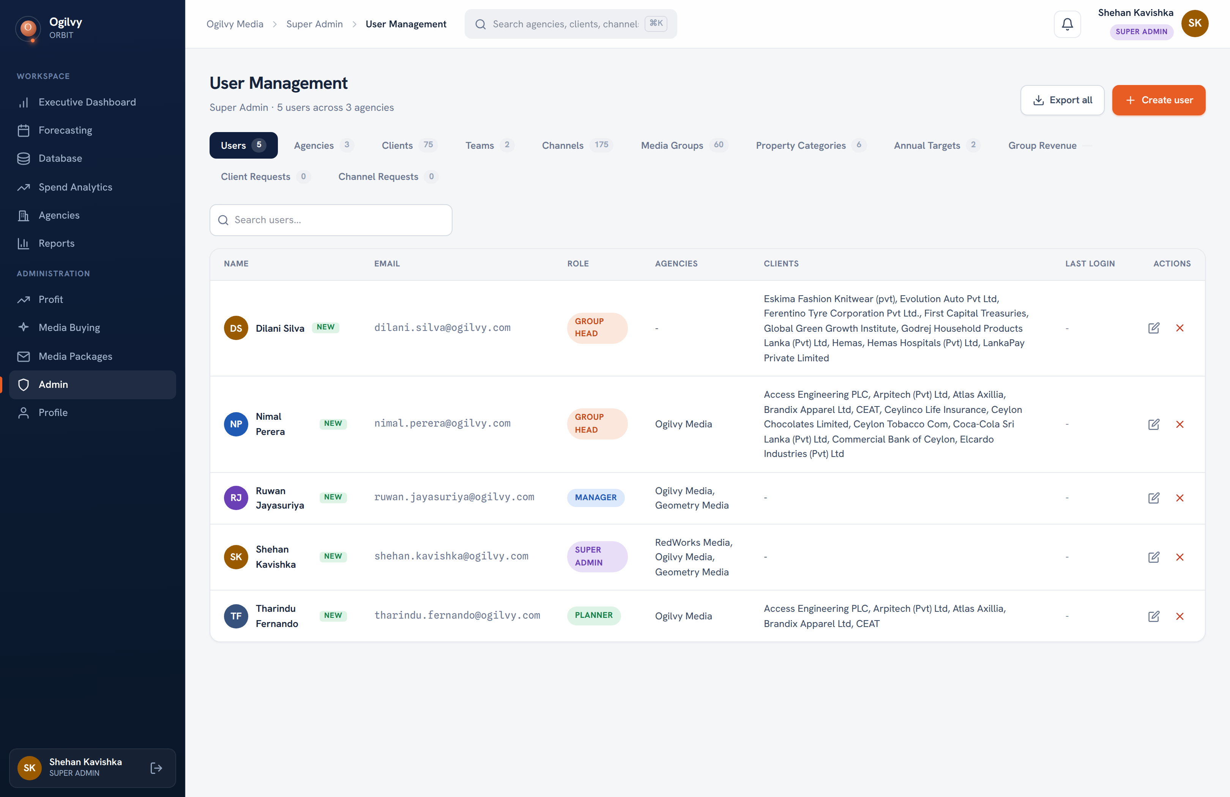
USERS
Users and roles
Create users, set their role, and assign the agencies or clients they can reach.
WHAT YOU CAN DO HERE
Create a user and set their role
Assign agencies to managers
Assign clients directly to heads and planners
Export every admin dataset to one workbook
Ogilvy Orbit Super Admin Guide
ADMINISTRATION
23 / 29

Slide 24
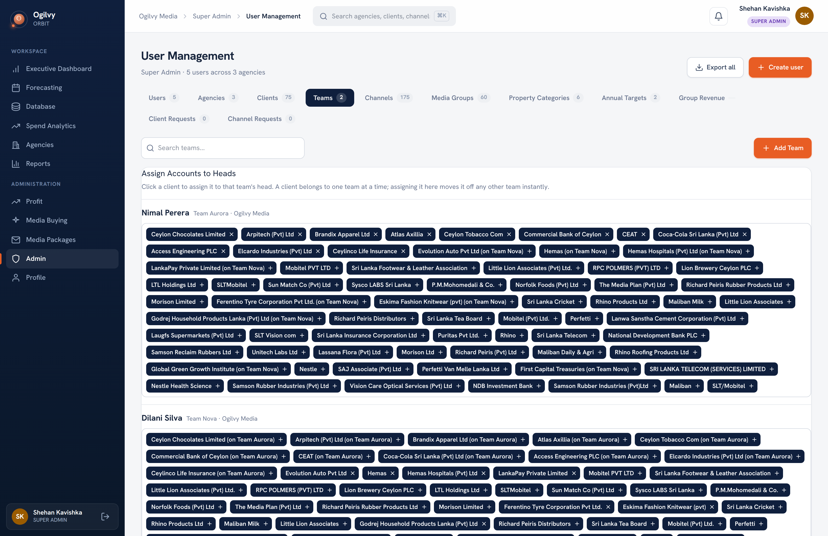
TEAMS
Teams and heads
Group clients into teams under a head. The Assign Accounts to Heads card reassigns clients with one click.
WHAT YOU CAN DO HERE
Create a team and name its group head
Assign clients to a team as instant chips
A client belongs to exactly one team at a time
Team structure drives the group contribution views
Ogilvy Orbit Super Admin Guide
ADMINISTRATION
24 / 29

Slide 25
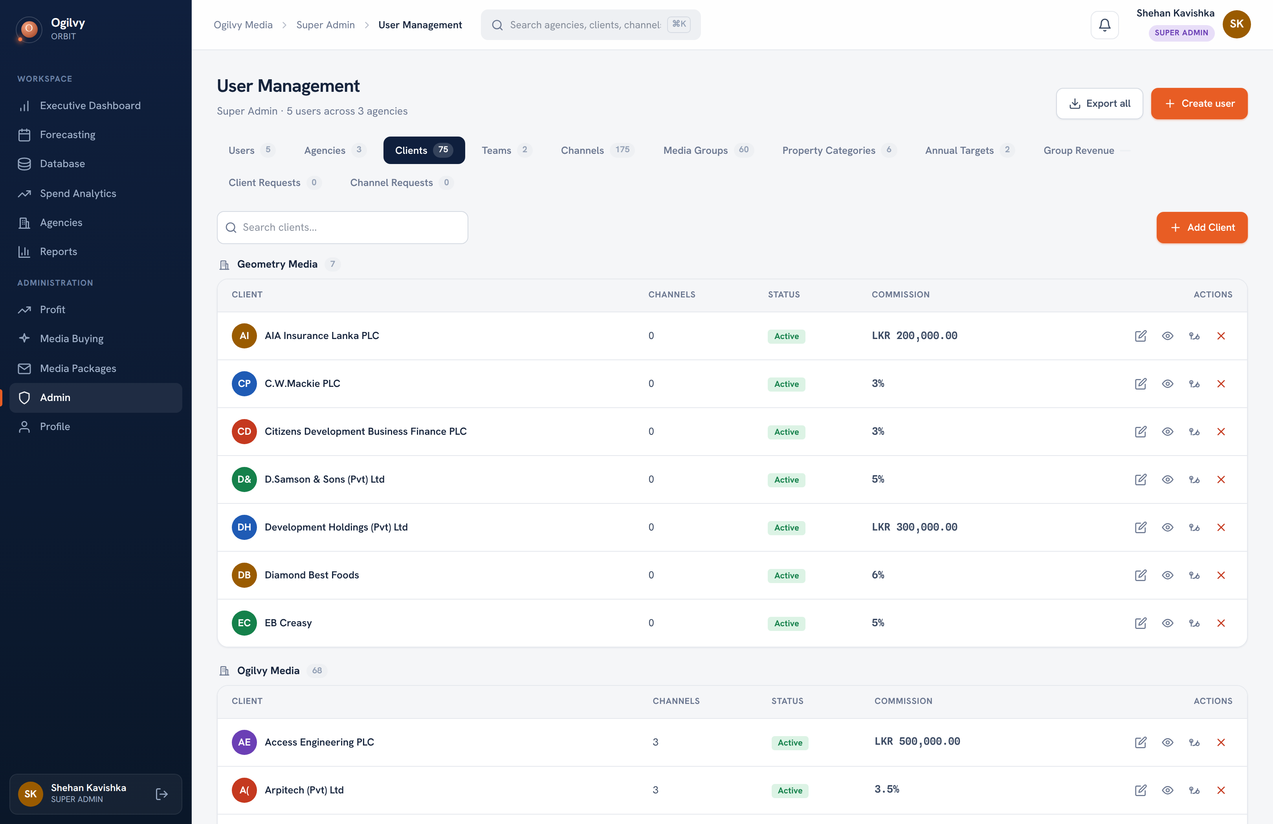
CLIENTS
Clients and commission
Manage every client, including the agency commission that drives the Profit screen.
WHAT YOU CAN DO HERE
Add, edit or move a client between agencies
Set commission as a percent or a fixed AOR fee
Choose how a rate change applies to past records
Merge duplicate clients in one transaction
Ogilvy Orbit Super Admin Guide
ADMINISTRATION
25 / 29

Slide 26
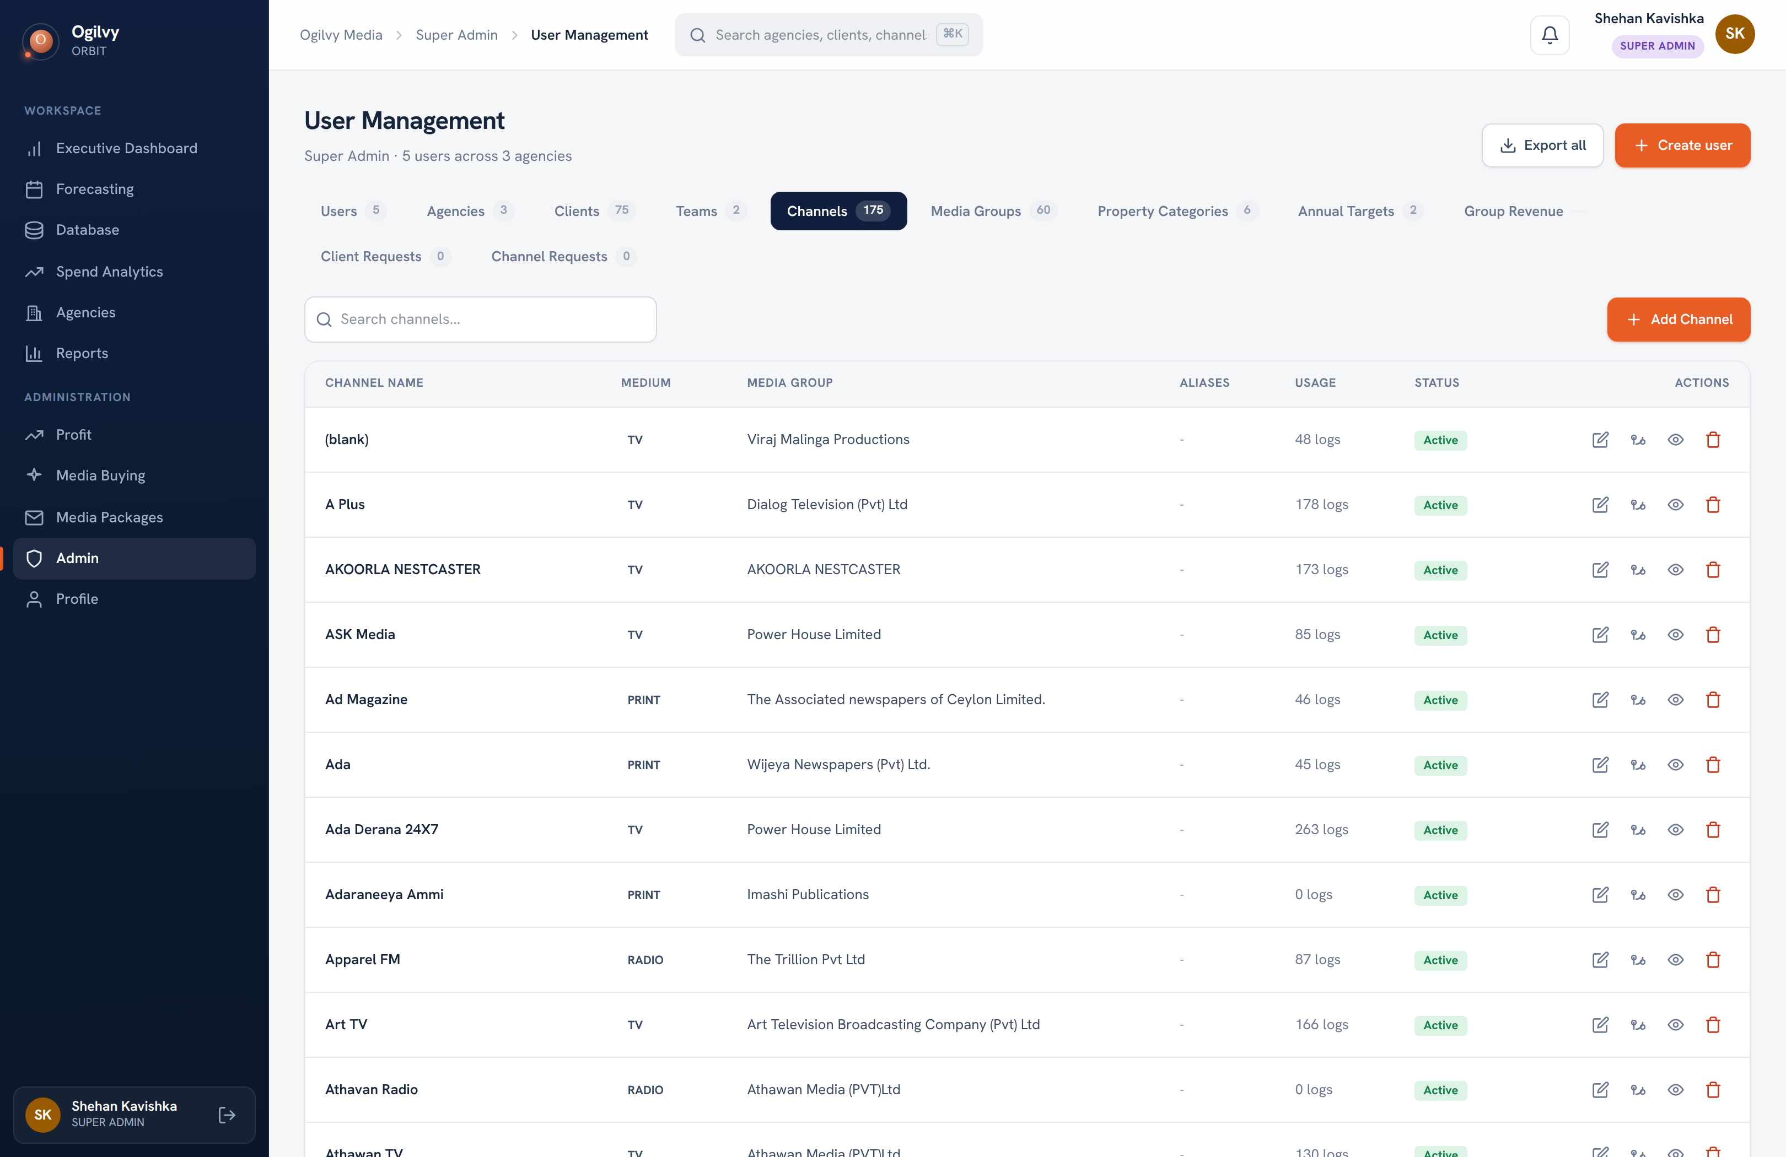
CHANNELS
Channel master data
The canonical registry of every channel, with a per row merge to consolidate duplicates.
WHAT YOU CAN DO HERE
See every channel with its medium and media group
Merge duplicate channels onto one master
Reactivate a channel that was auto hidden
Aliases let imports resolve messy names
Ogilvy Orbit Super Admin Guide
ADMINISTRATION
26 / 29

Slide 27
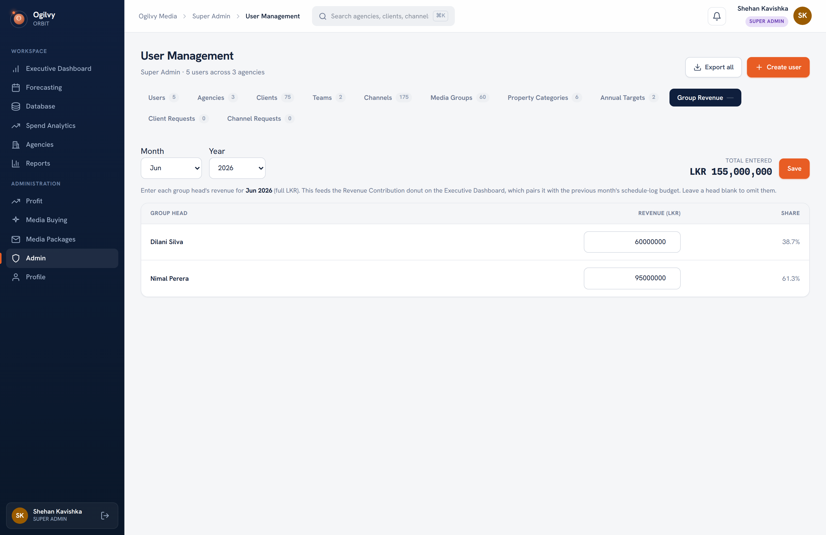
GROUP REVENUE
Group revenue entry
Enter each group head's revenue for a month. This drives the Revenue donut on the Executive Dashboard.
WHAT YOU CAN DO HERE
Pick a month, defaulting to the one the chart reads
Type a figure per group head, with live shares
A running total keeps the entry honest
Saving updates the dashboard at once
Ogilvy Orbit Super Admin Guide
ADMINISTRATION
27 / 29

Slide 28
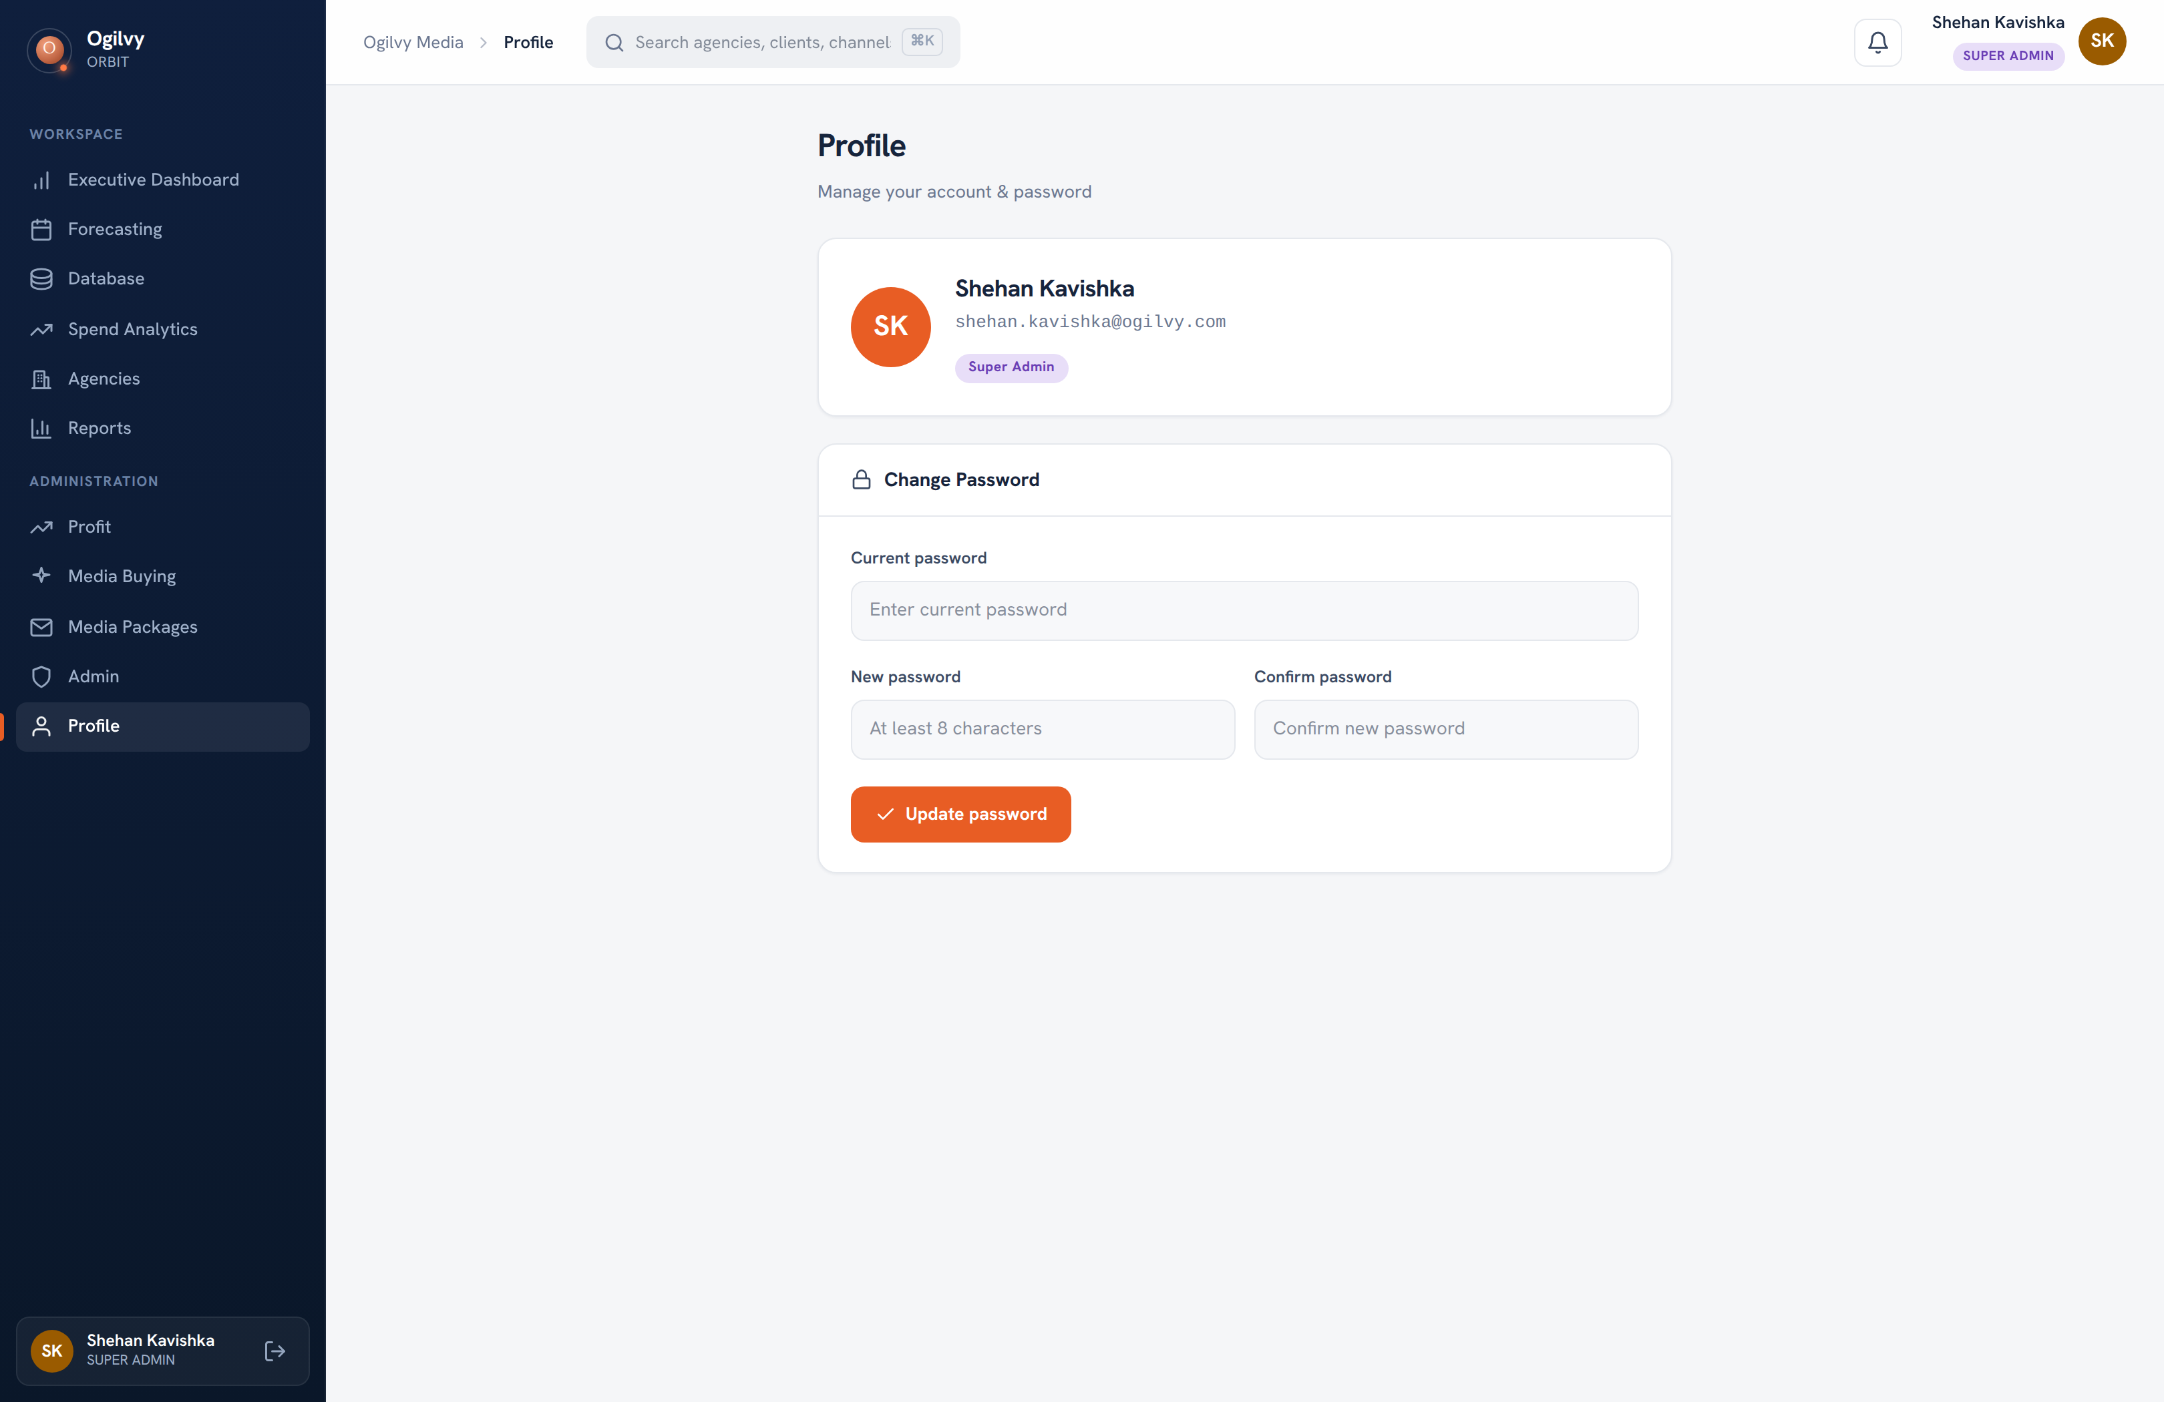
PROFILE
Your profile and security
Keep your own details current and your account secure from a single screen.
WHAT YOU CAN DO HERE
Review your name, role and contact email
Change your password whenever you need to
Sign out safely from any device
Ogilvy Orbit Super Admin Guide
ADMINISTRATION
28 / 29

Slide 29
O
You run the whole thing.
From the executive view down to a single user's role, Orbit is yours to steer. Keep the master data clean, the commissions current, and every screen you have just seen stays trustworthy for everyone below you.
Questions on any screen reach the media team through your admin.

