Slide 1
O
OGILVY MEDIA
Ogilvy Orbit
The Media Buying Records System,
explained for Group Heads.
Everything you can see, plan and do inside Orbit, from your schedule records to forecasts and media proposals.
Prepared for the Group Heads team 2026

Slide 2
O
01
GETTING ORIENTED
What Orbit is, and what it is for
A shared home for every media buying record, from first schedule to final report.

Slide 3
THE BIG PICTURE
One system, three jobs
Orbit replaces scattered spreadsheets with a single, always current record of your media activity.
1
2
3
A single record
Live analytics
Plan and share
Every schedule, channel, property and deal for your clients lives in one place, entered once and kept current.
The moment a schedule is logged, spend charts, trends and channel views update on their own.
Enter forecasts for the month ahead and respond to media proposals sent to you, all in app.
Ogilvy Orbit Group Head Guide
GETTING ORIENTED
03 / 27

Slide 4
YOUR ACCESS
What a Group Head can reach
Orbit shows you the accounts that belong to your team, and every screen is scoped to your own clients. Leadership tools such as the Executive Dashboard, Reports and Admin are not part of your view.
Database
Spend Analytics
Your schedule records, month by month
Charts and breakdowns of committed spend
Agencies & Clients
Channel Detail
Your client roster and their channels
Properties, deal terms and rate cards
Channel Intelligence
Forecasting
Per channel spend trends for your clients
The upcoming month, entered per channel
Overall Budget
Media Packages
Best case and last month billing per client
Proposals shared with you to respond to
Ogilvy Orbit Group Head Guide
GETTING ORIENTED
04 / 27

Slide 5
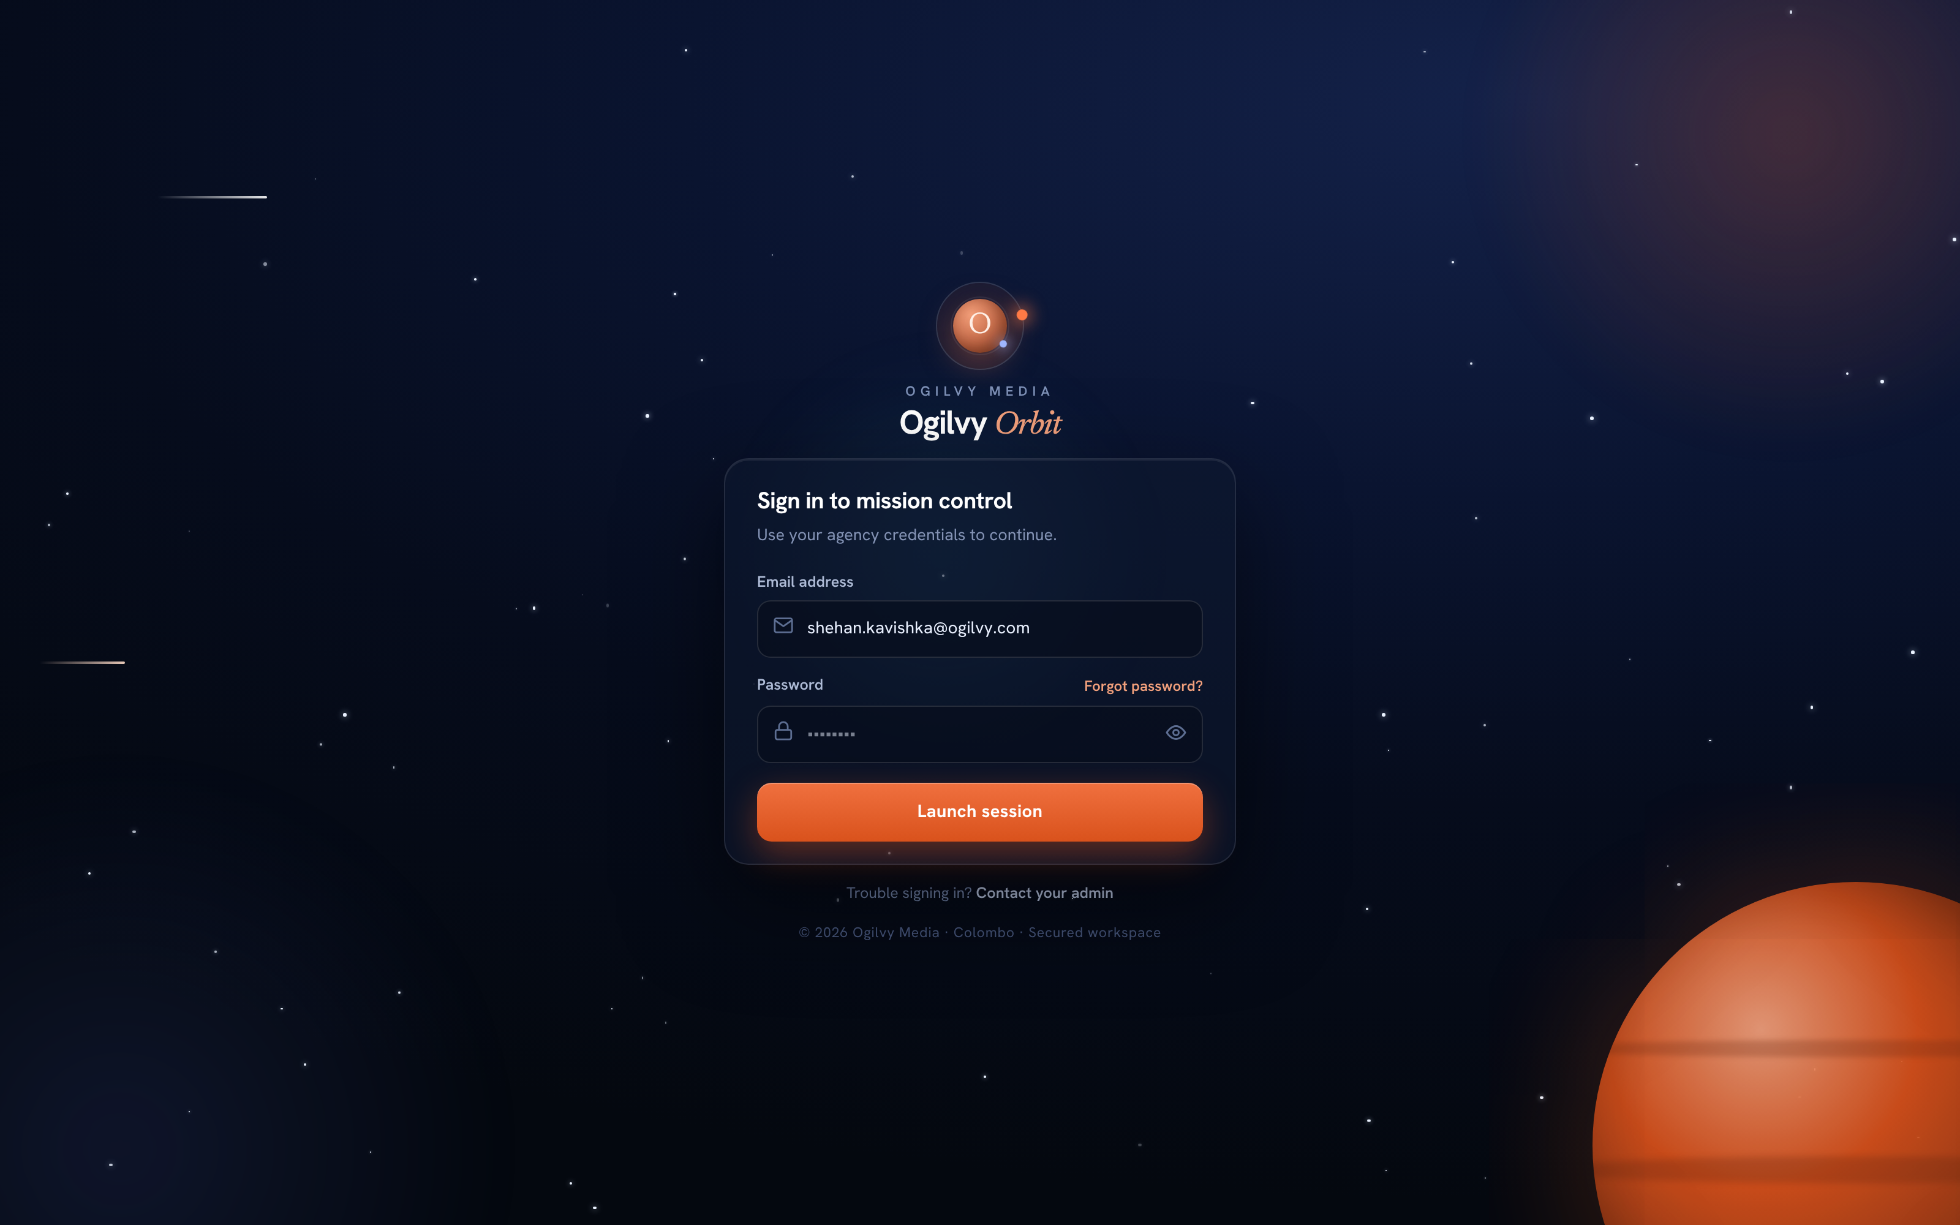
SIGNING IN
Your secure sign in
Orbit is your mission control. You sign in with your agency email and a private password.
WHAT YOU CAN DO HERE
Sign in with your Ogilvy email and password
Reset a forgotten password from the same screen
Set a fresh password on your very first sign in
Every session is protected and times out safely
Tip On your first login you will be asked to choose a new password.
Ogilvy Orbit Group Head Guide
GETTING ORIENTED
05 / 27

Slide 6
O
02
YOUR DAILY WORKSPACE
The screens you will use most
Where your records live, and how the numbers turn into insight.

Slide 7
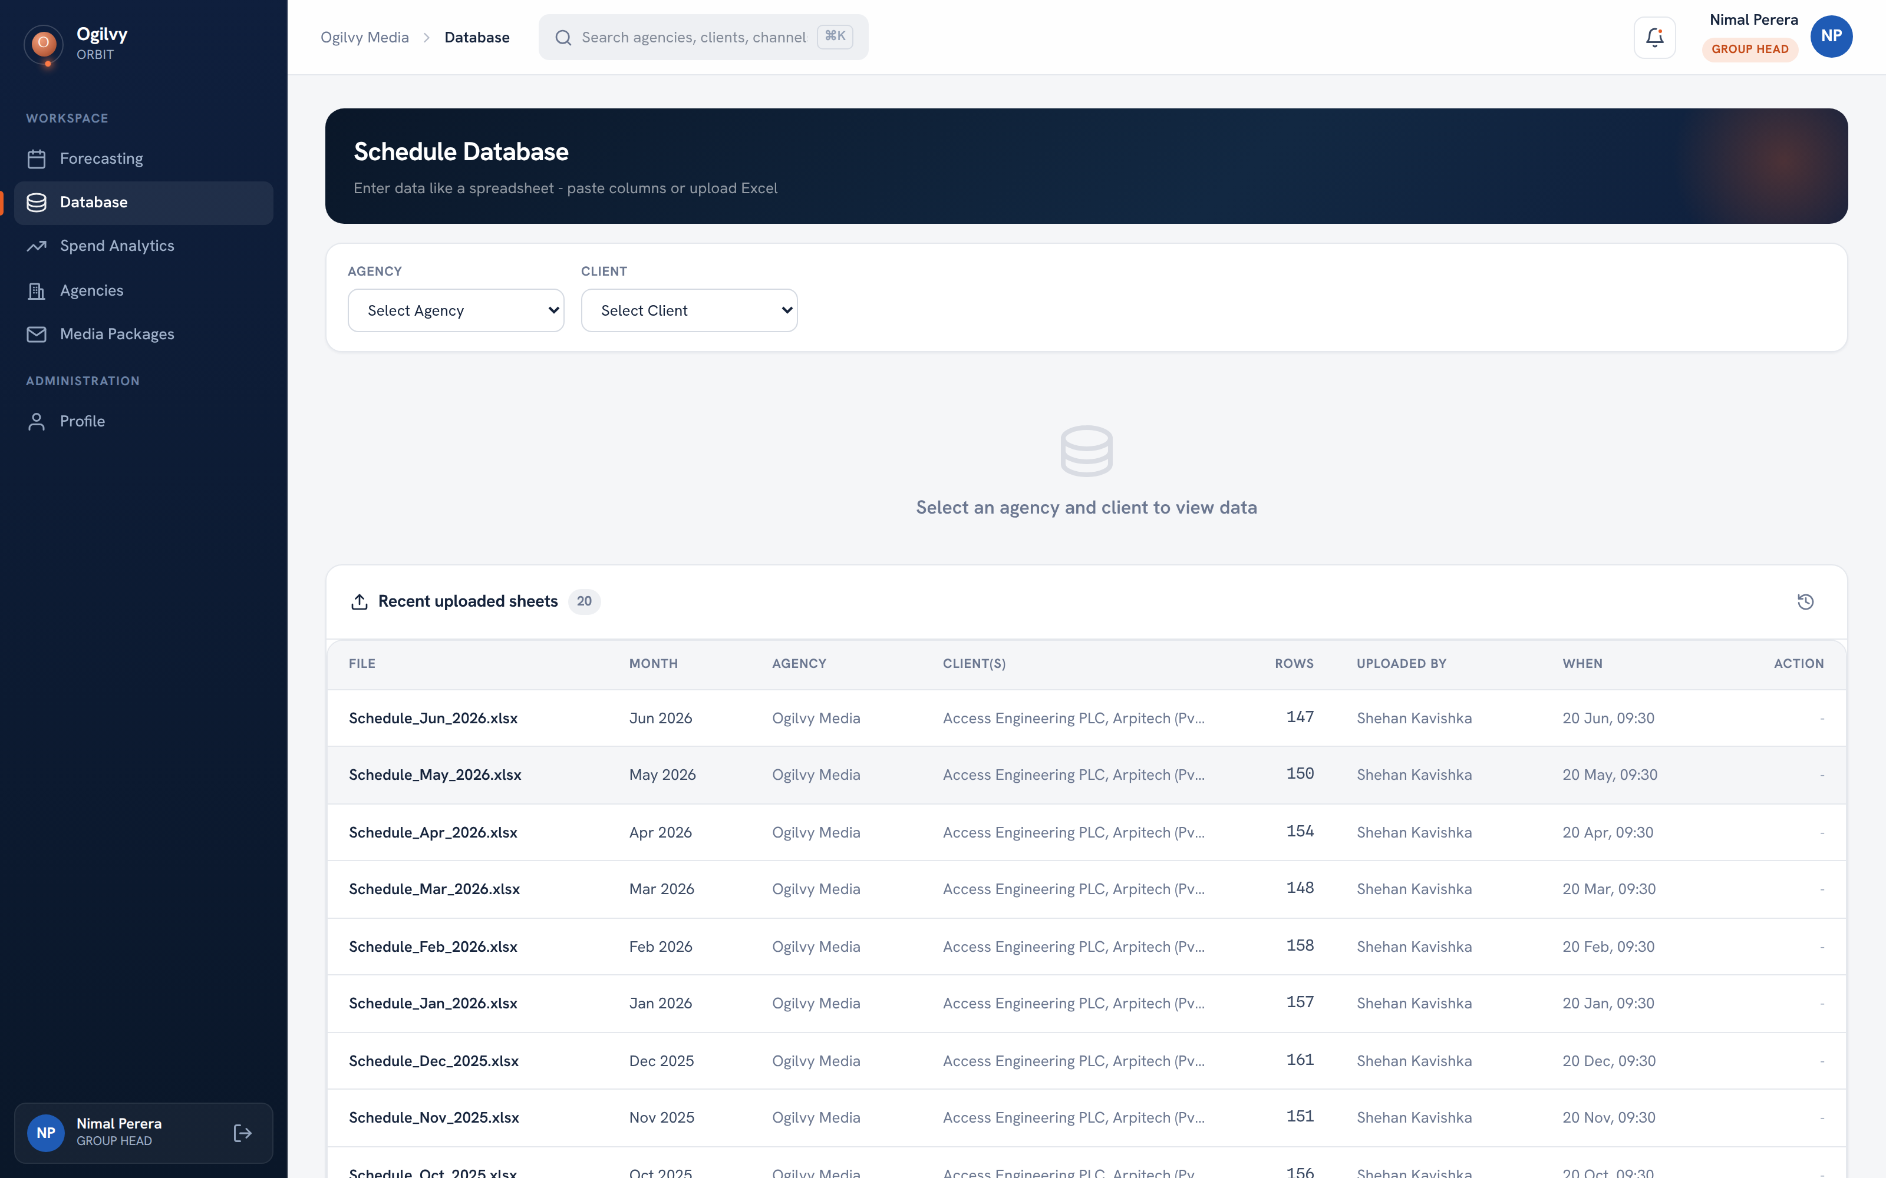
DATABASE
The schedule database
Your home screen. Every uploaded schedule sheet lands here, organised by month and client.
WHAT YOU CAN DO HERE
See every recently uploaded sheet at a glance
Pick an agency and client to view their records
Paste columns or upload an Excel sheet directly
Track how many rows each month contributed
Tip Rows you add flow straight into every chart across Orbit.
Ogilvy Orbit Group Head Guide
DAILY WORKSPACE
07 / 27

Slide 8
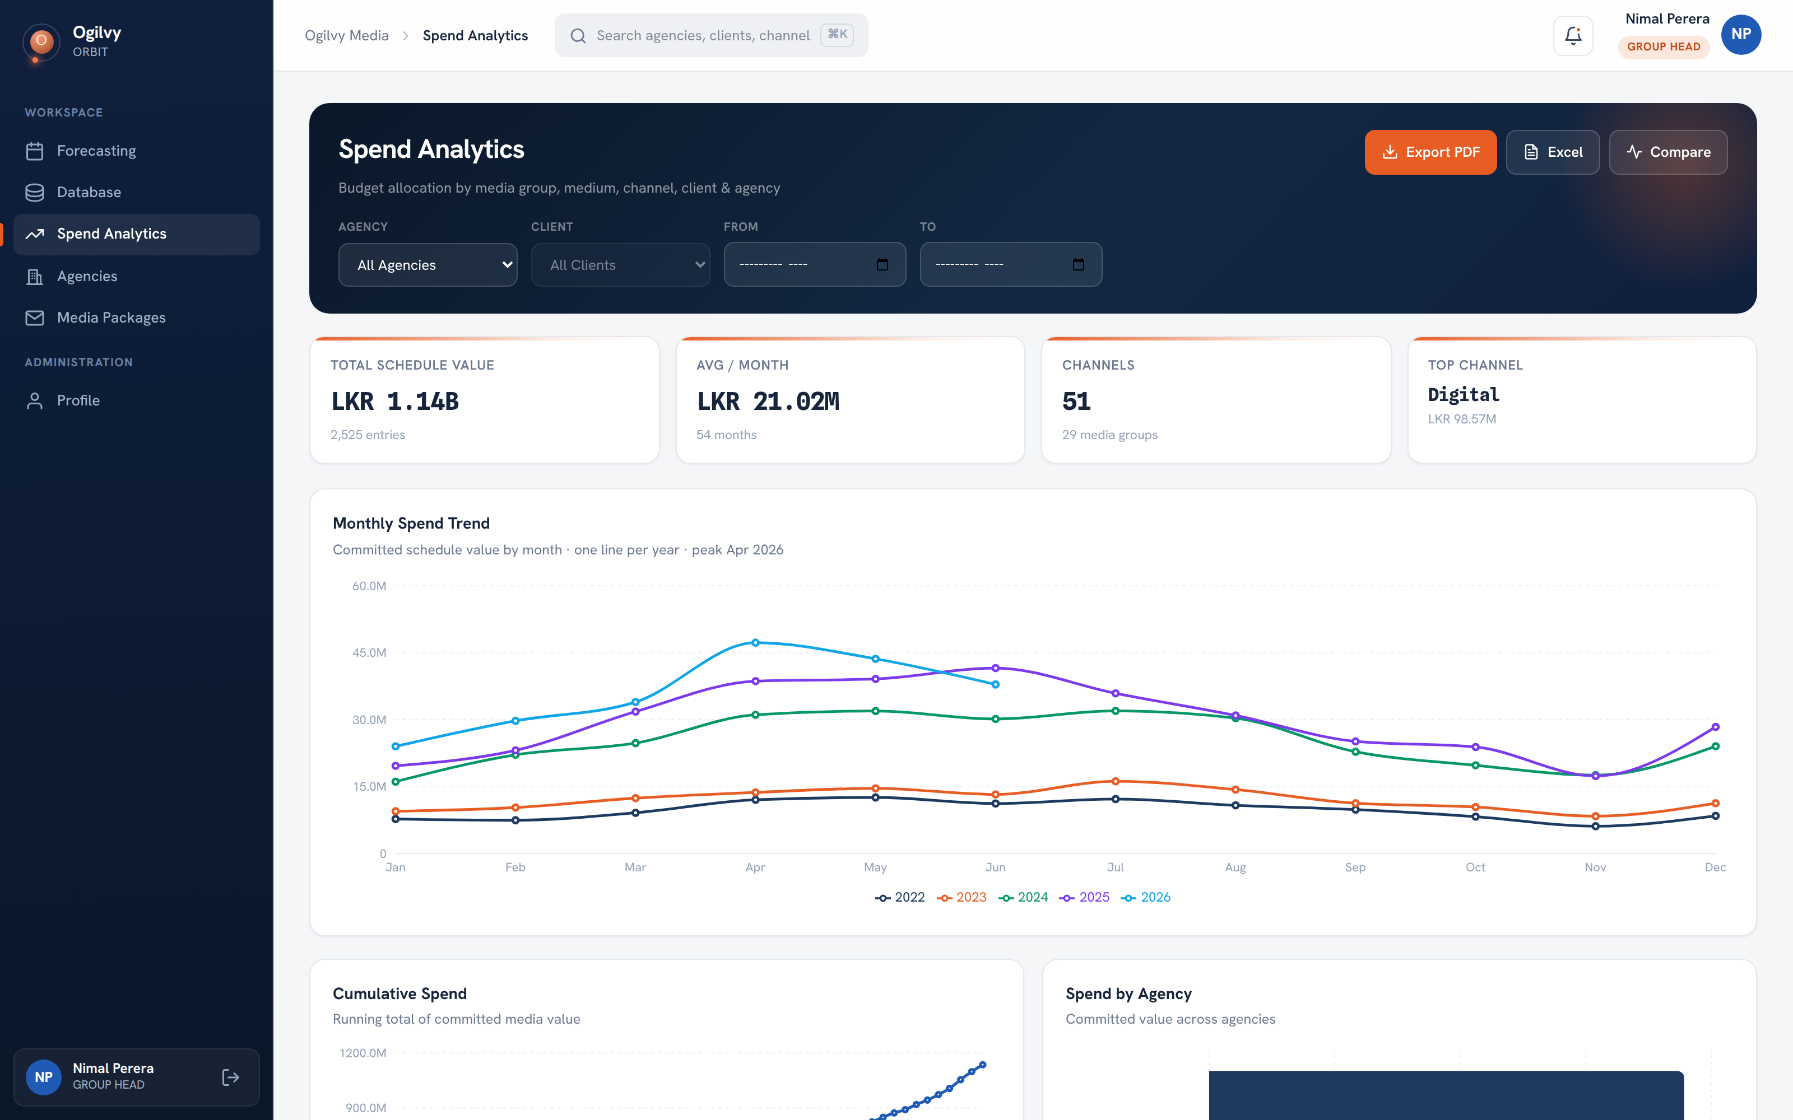
SPEND ANALYTICS
Spend analytics
A live picture of your committed media value across months, media, channels and clients.
WHAT YOU CAN DO HERE
Read total committed value and monthly average
Compare spend year over year on one trend chart
Break spend down by medium, channel and client
Export the full view to Excel or PDF
Tip You only see your own clients, so the totals are yours to act on.
Ogilvy Orbit Group Head Guide
DAILY WORKSPACE
08 / 27

Slide 9
SPEND ANALYTICS
Spend Analytics, chart by chart
Every chart is scoped to your own clients, so the numbers you read are the numbers you own.
Agency Annual Achievement — Your agency budget vs the target to date, with actual plus forecast fill and a % badge.
Monthly Spend Trend — One line per year on a fixed Jan to Dec axis, so years compare side by side.
Cumulative Spend — The running total of committed value building up across the year.
Medium Mix Shift — A 100% stacked area showing how the TV, Radio and Print share moves over time.
Brand and Client views — Brand spend trend lines, a client tenure and value bubble, and a flighting calendar.
Medium and Media Group donuts — Share of spend by medium; click a slice to cross filter the channel view.
Spend by Channel and Client — Ranked, clickable lists that jump to Channel Intelligence or the Client Dashboard.
Deals and Properties, plus export — Every negotiated term for your clients, with one click Excel and PDF export.
Ogilvy Orbit Group Head Guide
DAILY WORKSPACE
09 / 27

Slide 10
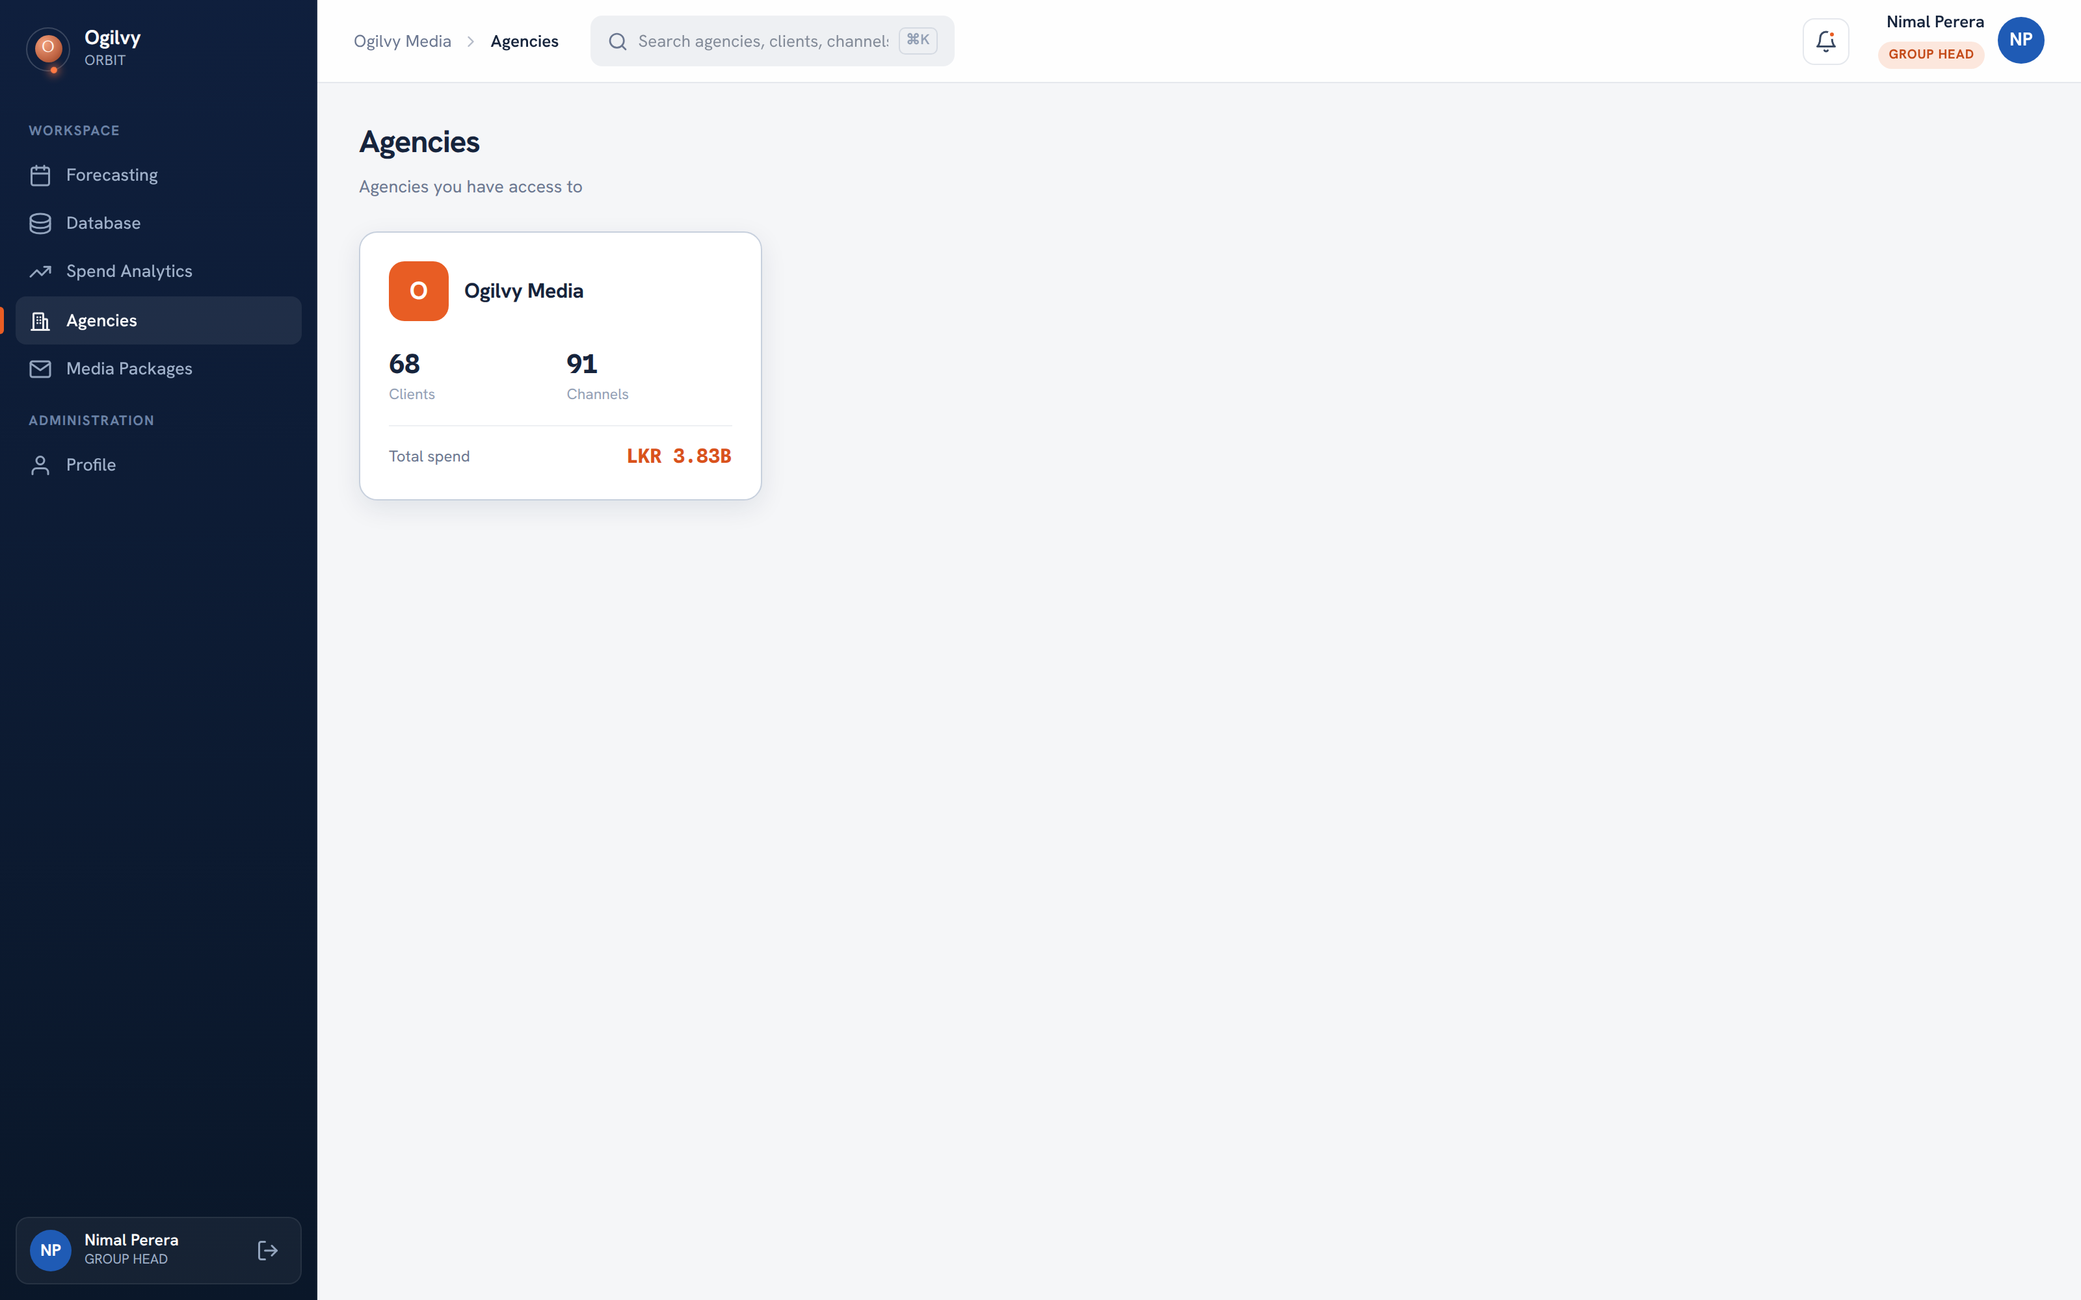
AGENCIES
Agencies overview
A quick way into your book of business, starting from the agency your clients sit under.
WHAT YOU CAN DO HERE
Open an agency to see its client roster
Read committed spend and channel counts
Move from agency to client in one click
Ogilvy Orbit Group Head Guide
DAILY WORKSPACE
10 / 27

Slide 11
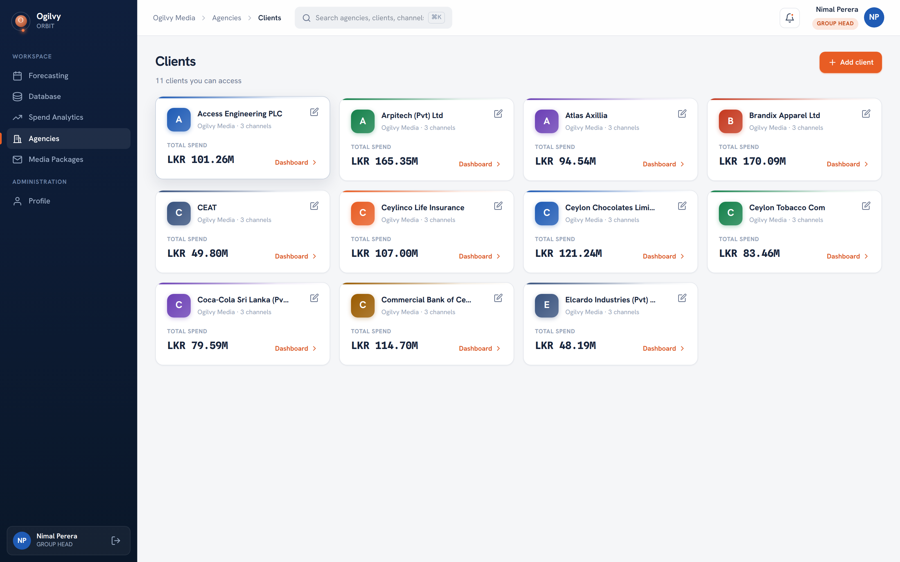
CLIENTS
Your client list
Every client your team manages, in one searchable place.
WHAT YOU CAN DO HERE
Browse all of the clients assigned to you
Search by name to jump to an account fast
Open a client to see its channels and records
Ogilvy Orbit Group Head Guide
DAILY WORKSPACE
11 / 27

Slide 12
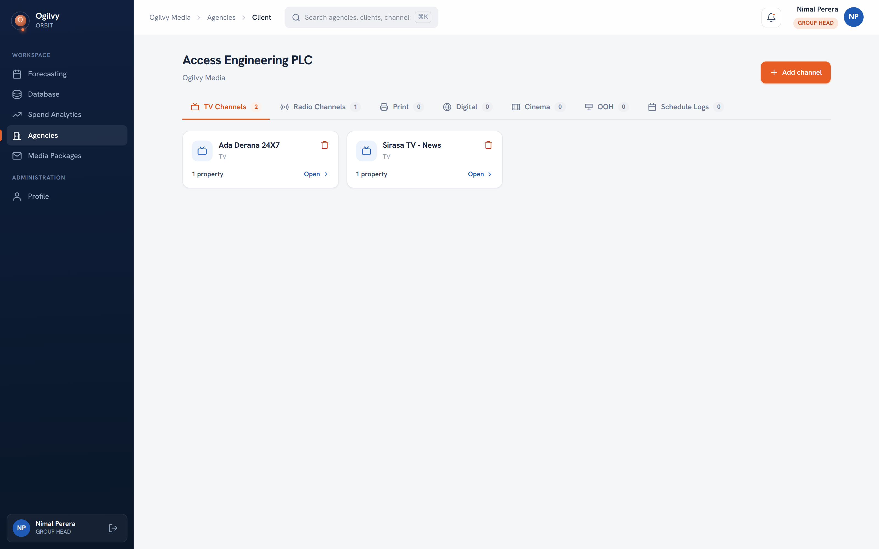
CLIENT DETAIL
Inside a client
Each client opens to its channels, grouped by medium, with a tab for schedule records.
WHAT YOU CAN DO HERE
See channels split across TV, Radio, Print and more
Add a new channel to a client when you win one
Open any channel to view its properties
Read the property count on every channel card
Ogilvy Orbit Group Head Guide
DAILY WORKSPACE
12 / 27

Slide 13
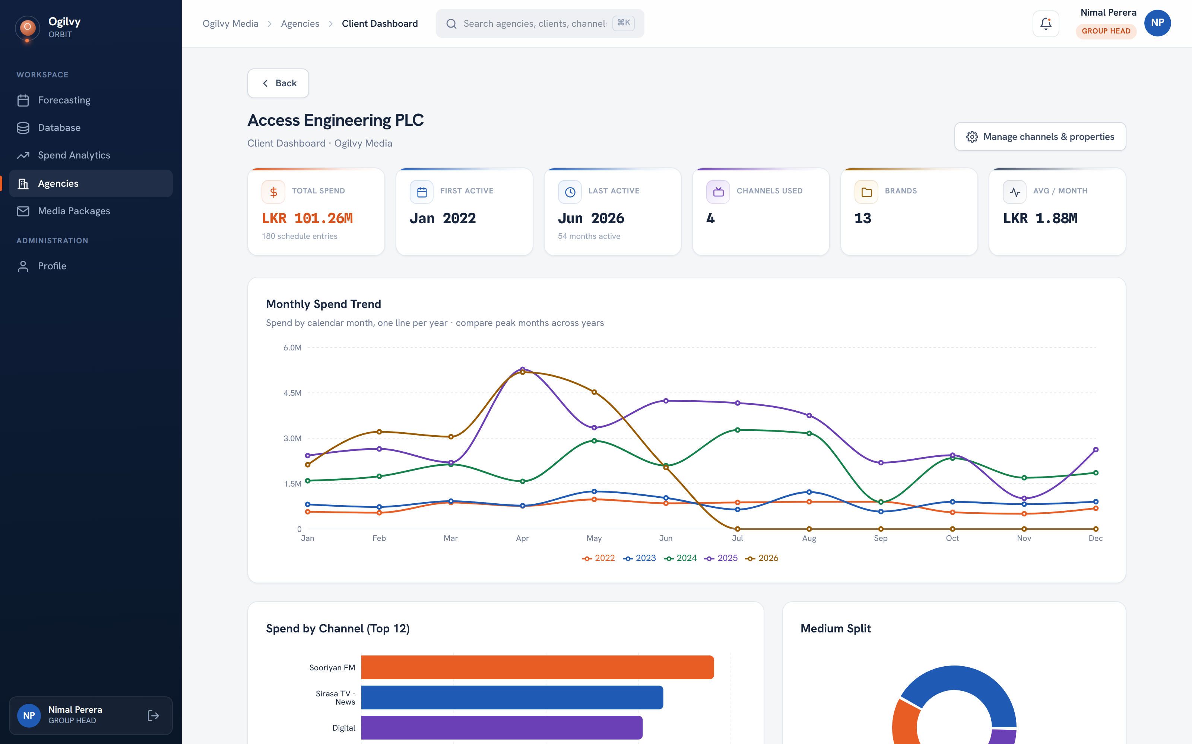
CLIENT DASHBOARD
The client dashboard
A focused analytics view for one client, so you can walk into any review prepared.
WHAT YOU CAN DO HERE
See the client story in charts, not spreadsheets
Track spend trends and channel mix over time
Spot where a client is growing or slowing
Ogilvy Orbit Group Head Guide
DAILY WORKSPACE
13 / 27

Slide 14
CLIENT DASHBOARD
The Client Dashboard, in detail
A focused, chart led view of a single client, so you walk into any review prepared.
Spend trend and channel mix — How the client investment moves month to month and where it goes.
Year over year growth — This year to date against the same months last year, so growth is like for like.
Channel Directory — Every channel the client uses, laid out as cards you can scan at a glance.
Contacts on each card — The channel rep name, email and mobile you captured on the channel.
Deal terms on each card — The discount and bonus terms recorded for that client and channel.
Rate cards on each card — View or download the channel latest negotiated rate card, right from the card.
Click through to intelligence — Open any channel straight into Channel Intelligence for the deeper read.
Ogilvy Orbit Group Head Guide
DAILY WORKSPACE
14 / 27

Slide 15
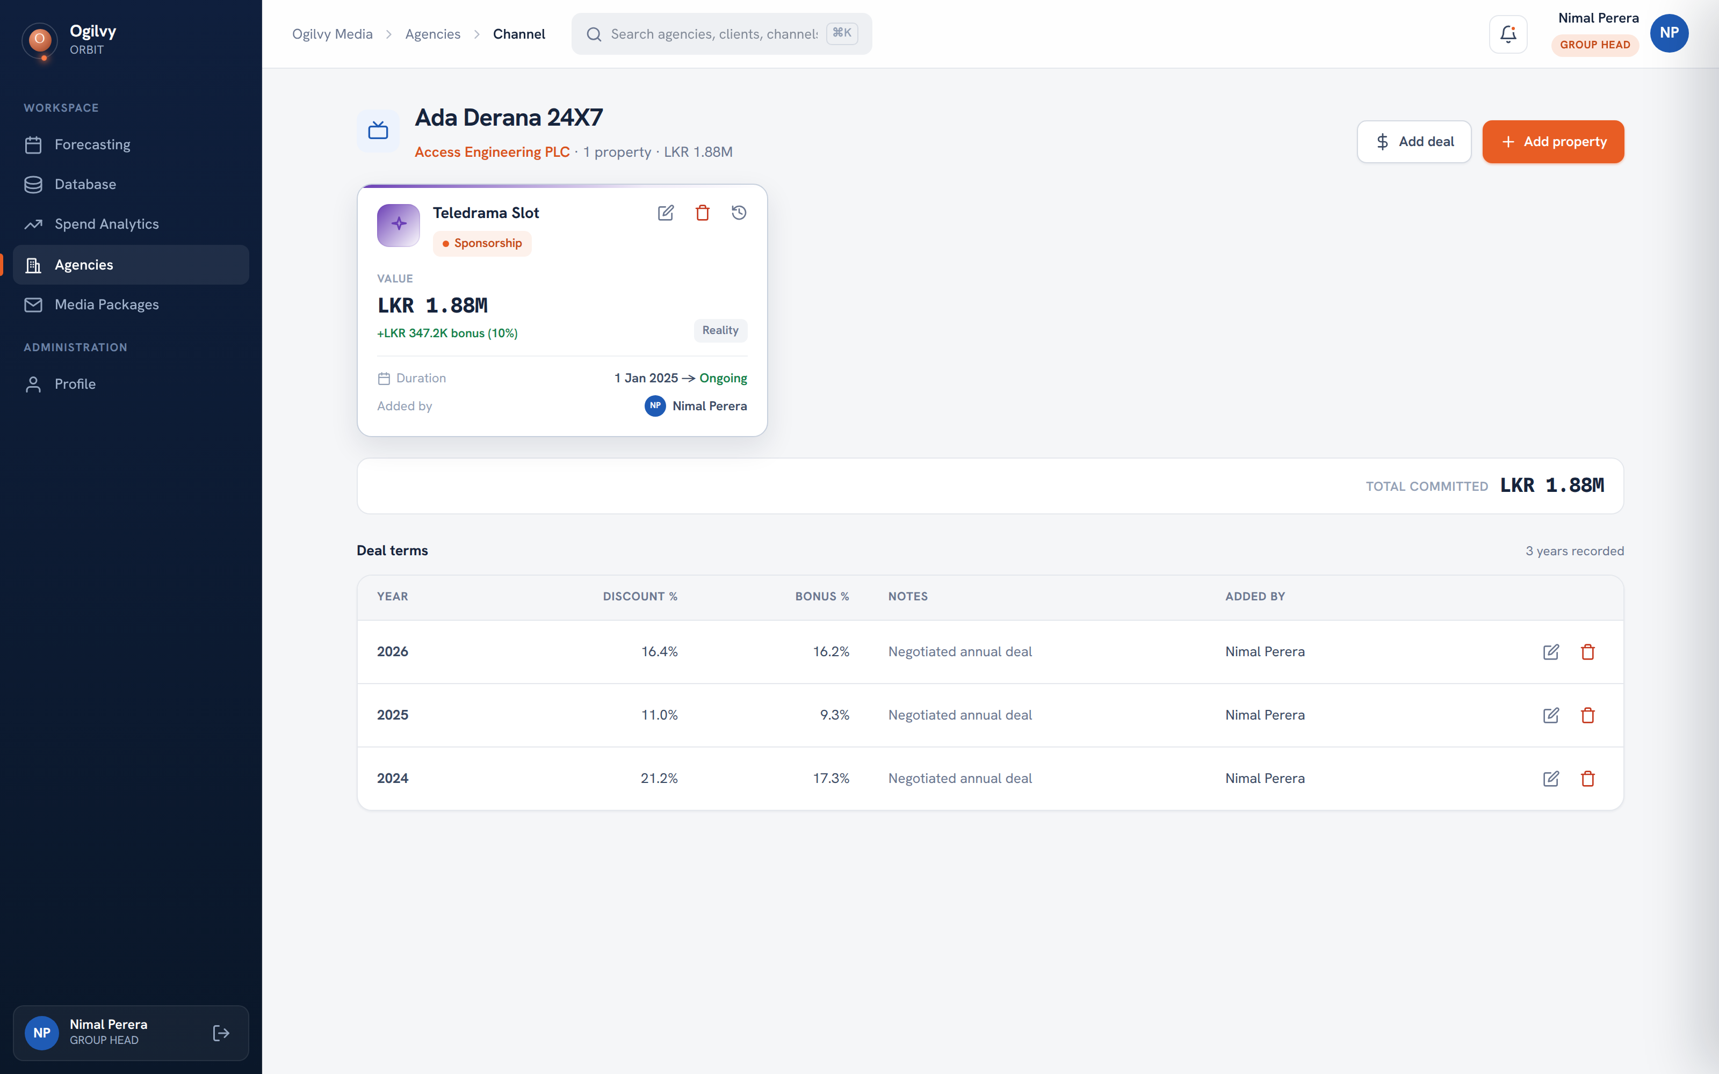
CHANNEL DETAIL
Properties and deal terms
The channel view records the deals you strike, both as properties and as yearly negotiated terms.
WHAT YOU CAN DO HERE
Log a property with its value, bonus and dates
Record discount and bonus terms year by year
Keep a full history of what was agreed and when
Edit or remove terms as negotiations move
Tip Recording terms here means nothing about a deal lives only in your inbox.
Ogilvy Orbit Group Head Guide
DAILY WORKSPACE
15 / 27

Slide 16
RATE CARDS
Rate cards, where you work
Each channel negotiated rate card, kept in one place and always shown as the newest version.
On the channel — Open a channel inside your client to see its current rate card.
On Channel Intelligence — The channel header shows the latest rate card with a download link.
On the Client Dashboard — Each channel card in the directory links straight to its rate card.
Always the latest — When a rate card is updated, Orbit shows the newest and keeps older versions.
View or download — Open it inline or save the PDF or file to share with your client.
Managed centrally — The admin team uploads rate cards; you always see the current one for your channels.
Ogilvy Orbit Group Head Guide
DAILY WORKSPACE
16 / 27

Slide 17
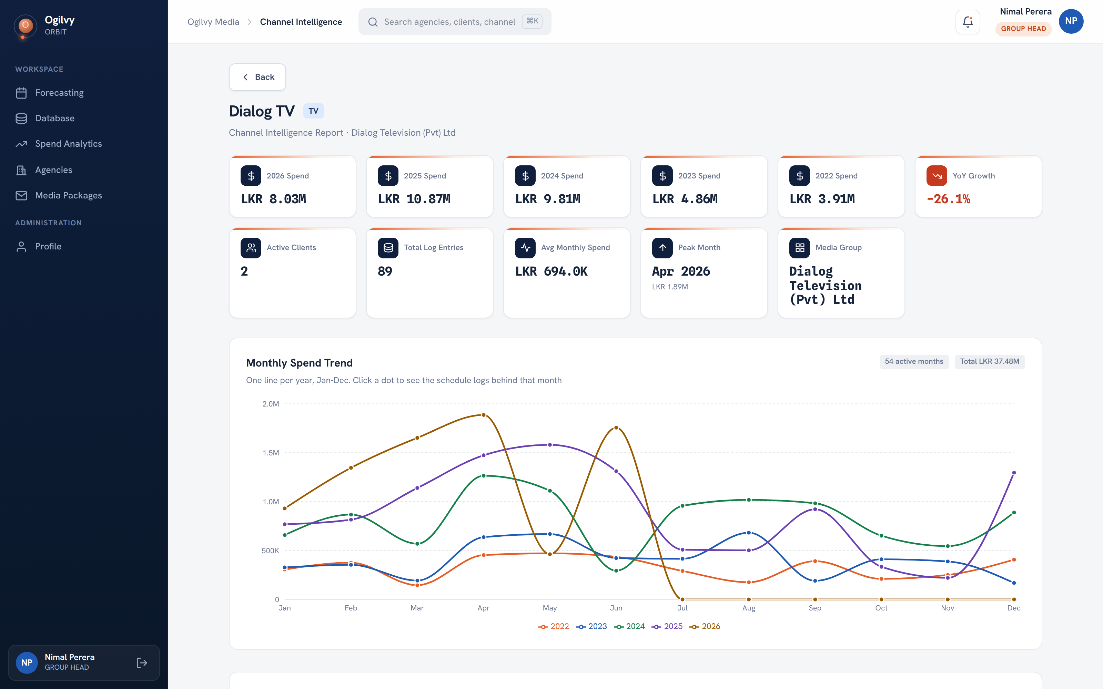
CHANNEL INTELLIGENCE
Channel intelligence
A deep read on a single channel across your clients, so you negotiate from evidence.
WHAT YOU CAN DO HERE
See spend on a channel across recent years
Read year over year growth and the peak month
Trace any month back to the schedules behind it
Know how many of your clients use the channel
Ogilvy Orbit Group Head Guide
DAILY WORKSPACE
17 / 27

Slide 18
CHANNEL INTELLIGENCE
Channel Intelligence, chart by chart
A deep, evidence led read on one channel across your clients, so you negotiate from proof.
Spend cards by year — One card per recent year, plus the peak month and year over year growth.
Monthly Spend Trend — One line per year on a Jan to Dec axis; click a dot to drill into that month.
Month drill down — Trace any month back to the exact schedules, grouped by client, that built it.
Spend by Agency over time — A multi line view of how each agency spend on the channel has moved.
Client Concentration (Pareto) — Which clients make up the channel spend, with the 80% reference line.
Clients on this Channel — Every client using it, each shown with its own rep contact.
Property History Timeline — The full audit trail of deal terms agreed and changed over time.
Rate card — View or download the channel latest rate card, with earlier versions kept.
Ogilvy Orbit Group Head Guide
DAILY WORKSPACE
18 / 27

Slide 19
O
03
PLANNING & FORECASTING
Telling Orbit what comes next
Your forecasts set the pace the whole company measures against.

Slide 20
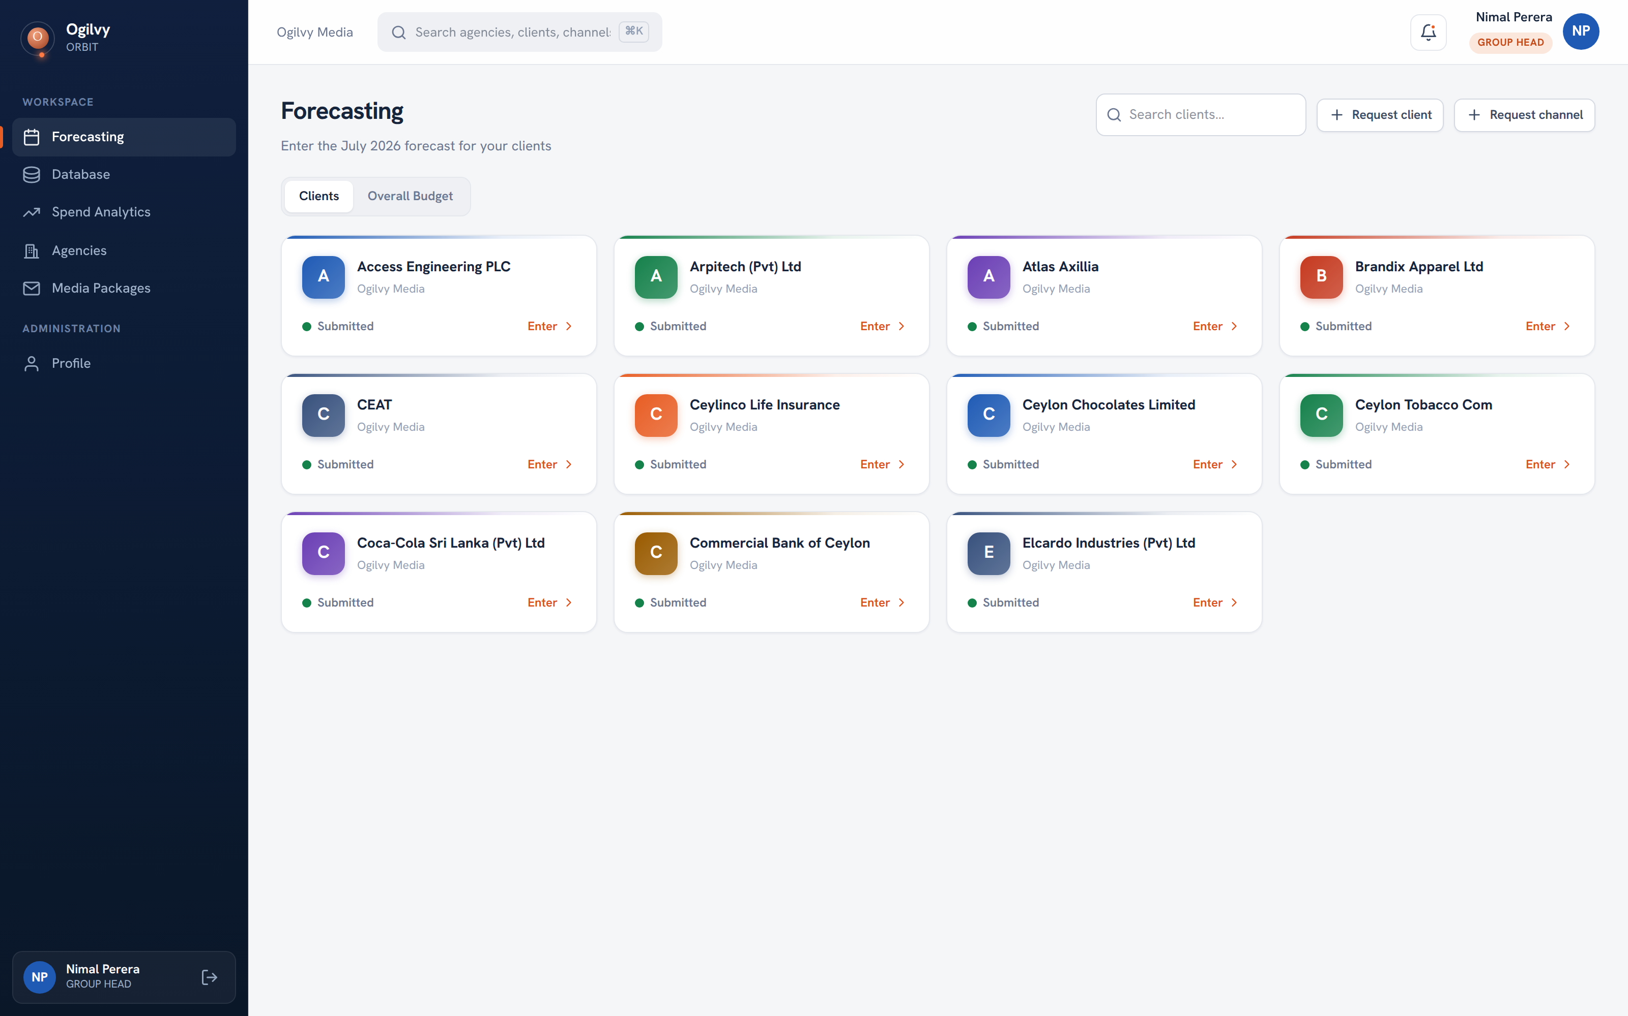
FORECASTING
Forecasting your month
Each cycle, Orbit asks you for the coming month. Your clients appear as cards with a clear status.
WHAT YOU CAN DO HERE
See every client you need to forecast for
Read Submitted or Pending at a glance
Open a client to enter its numbers
Request a new client or channel when needed
Tip The month rolls forward on the 15th, so you always plan the right one.
Ogilvy Orbit Group Head Guide
PLANNING & FORECASTING
20 / 27

Slide 21
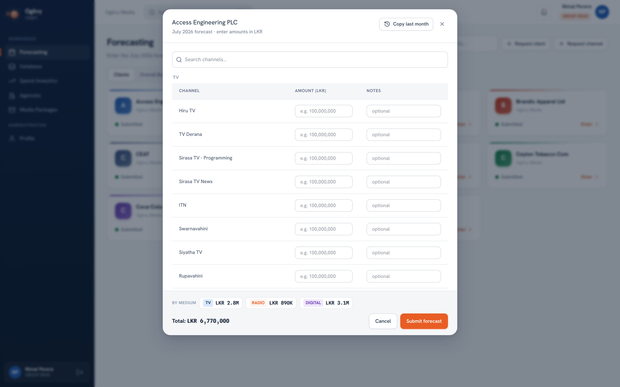
FORECAST ENTRY
Entering a forecast
Inside a client, you set an amount per channel. Orbit adds it up and splits it by medium as you go.
WHAT YOU CAN DO HERE
Enter an amount for each channel you will use
Add a short note against any line
Copy last month to start from a known base
Submit once the total looks right
Ogilvy Orbit Group Head Guide
PLANNING & FORECASTING
21 / 27

Slide 22
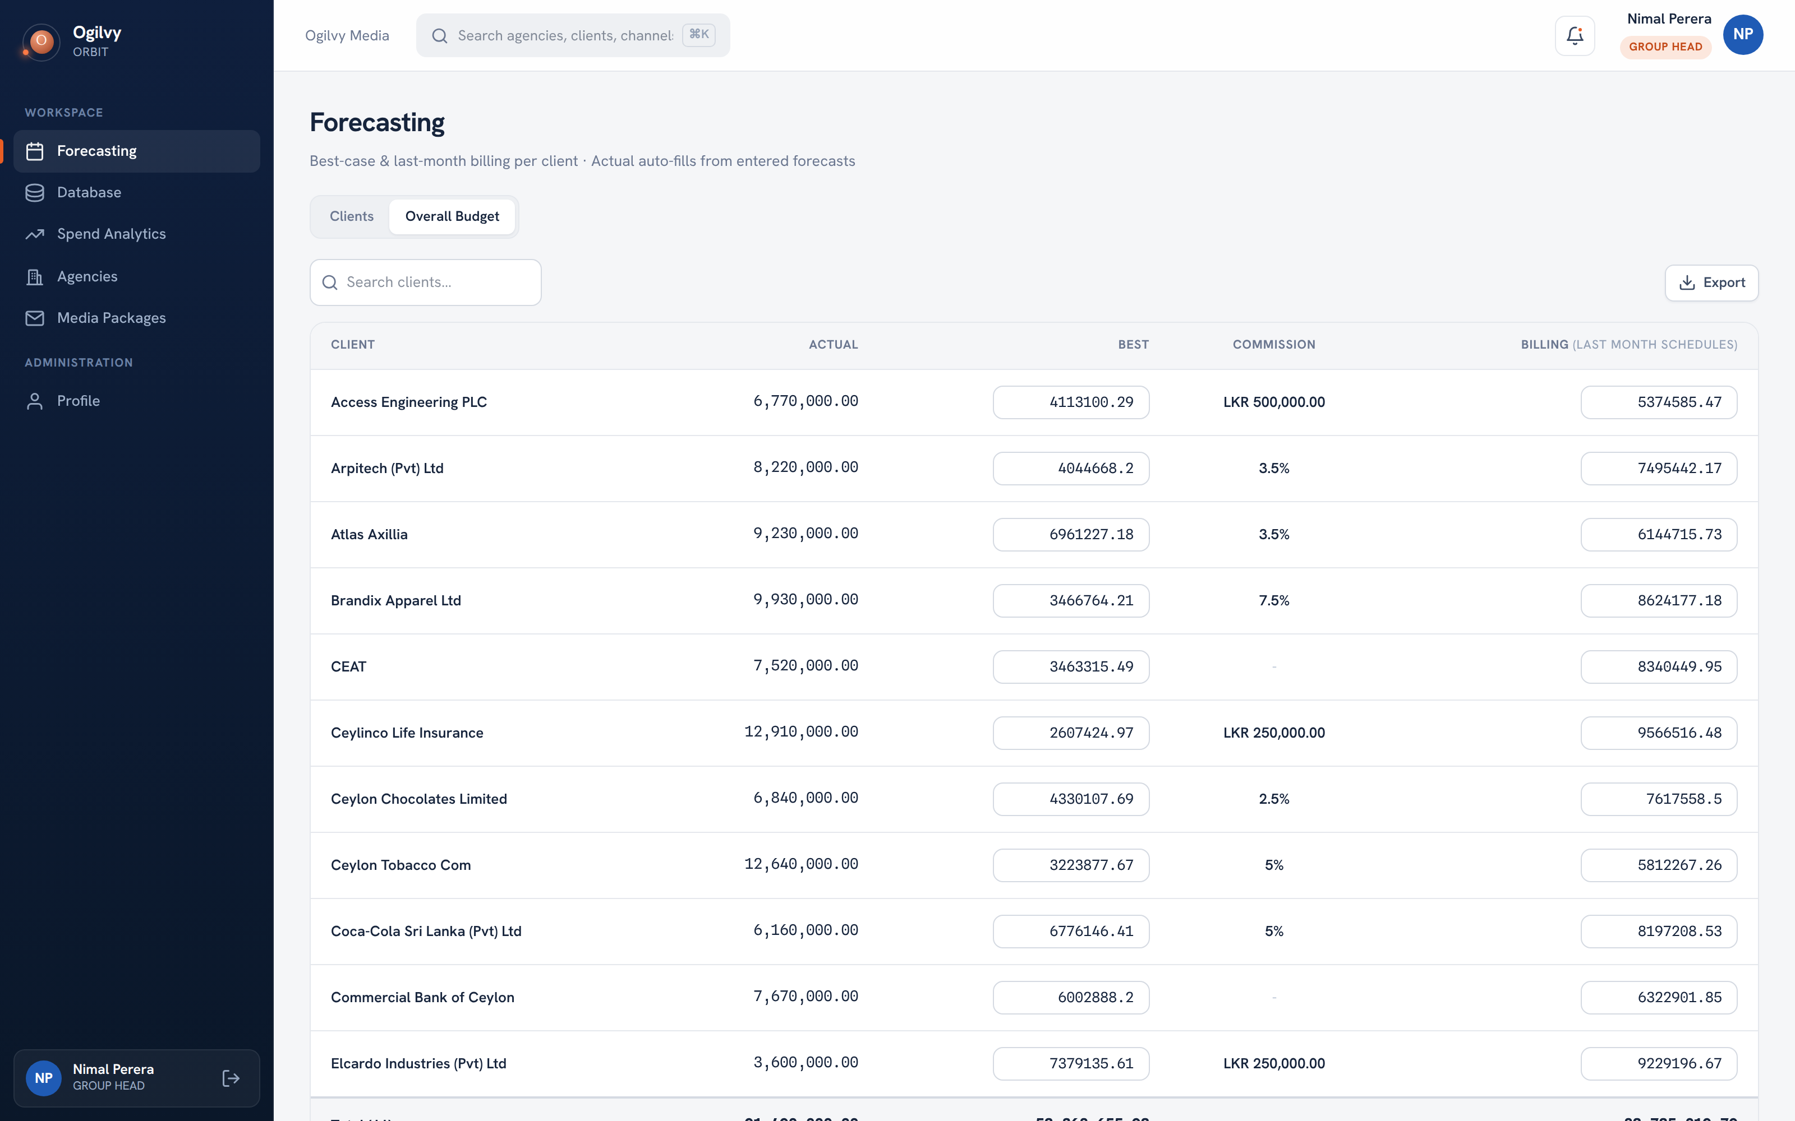
OVERALL BUDGET
The overall budget worksheet
A per client worksheet that mirrors your reference sheet: actual, best case, commission and last month billing.
WHAT YOU CAN DO HERE
See actual auto filled from your forecasts
Enter a best case figure for each client
Record last month billing beside it
Read commission and running totals per client
Tip Best case and billing save on their own as you type, so nothing is lost.
Ogilvy Orbit Group Head Guide
PLANNING & FORECASTING
22 / 27

Slide 23
O
04
COLLABORATION & ACCOUNT
Working with the media team
How proposals reach you, and how you keep your own account in order.

Slide 24
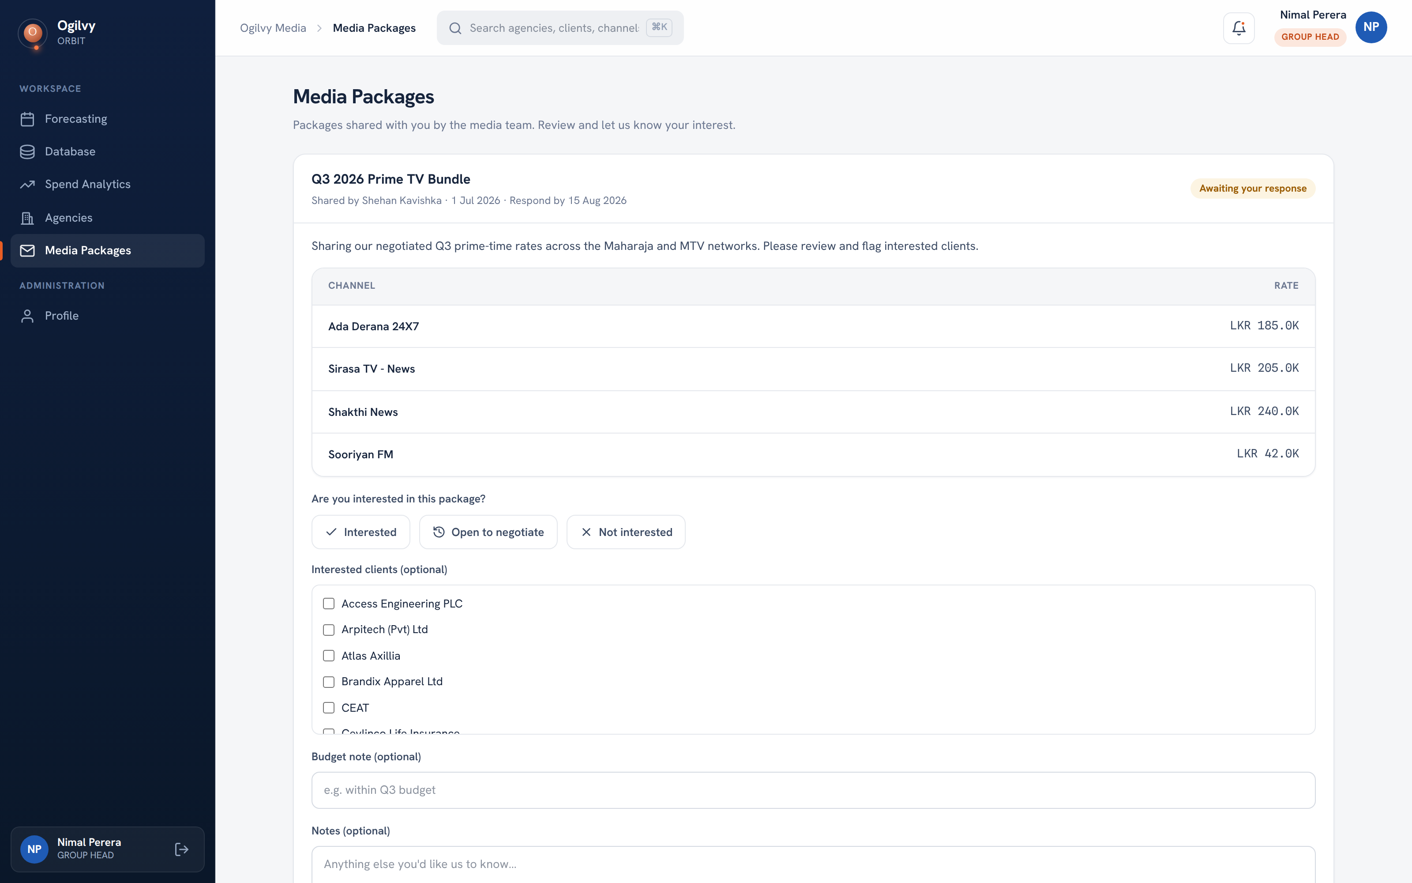
MEDIA PACKAGES
Media packages
When the media team negotiates a bundle, it arrives here for you to review and respond to.
WHAT YOU CAN DO HERE
Read the channels and rates in each package
Reply Interested, Open to negotiate or Not interested
Flag exactly which of your clients are keen
Add a budget note or comment for the team
Tip Your response and follow up status are visible to the media team instantly.
Ogilvy Orbit Group Head Guide
COLLABORATION & ACCOUNT
24 / 27

Slide 25
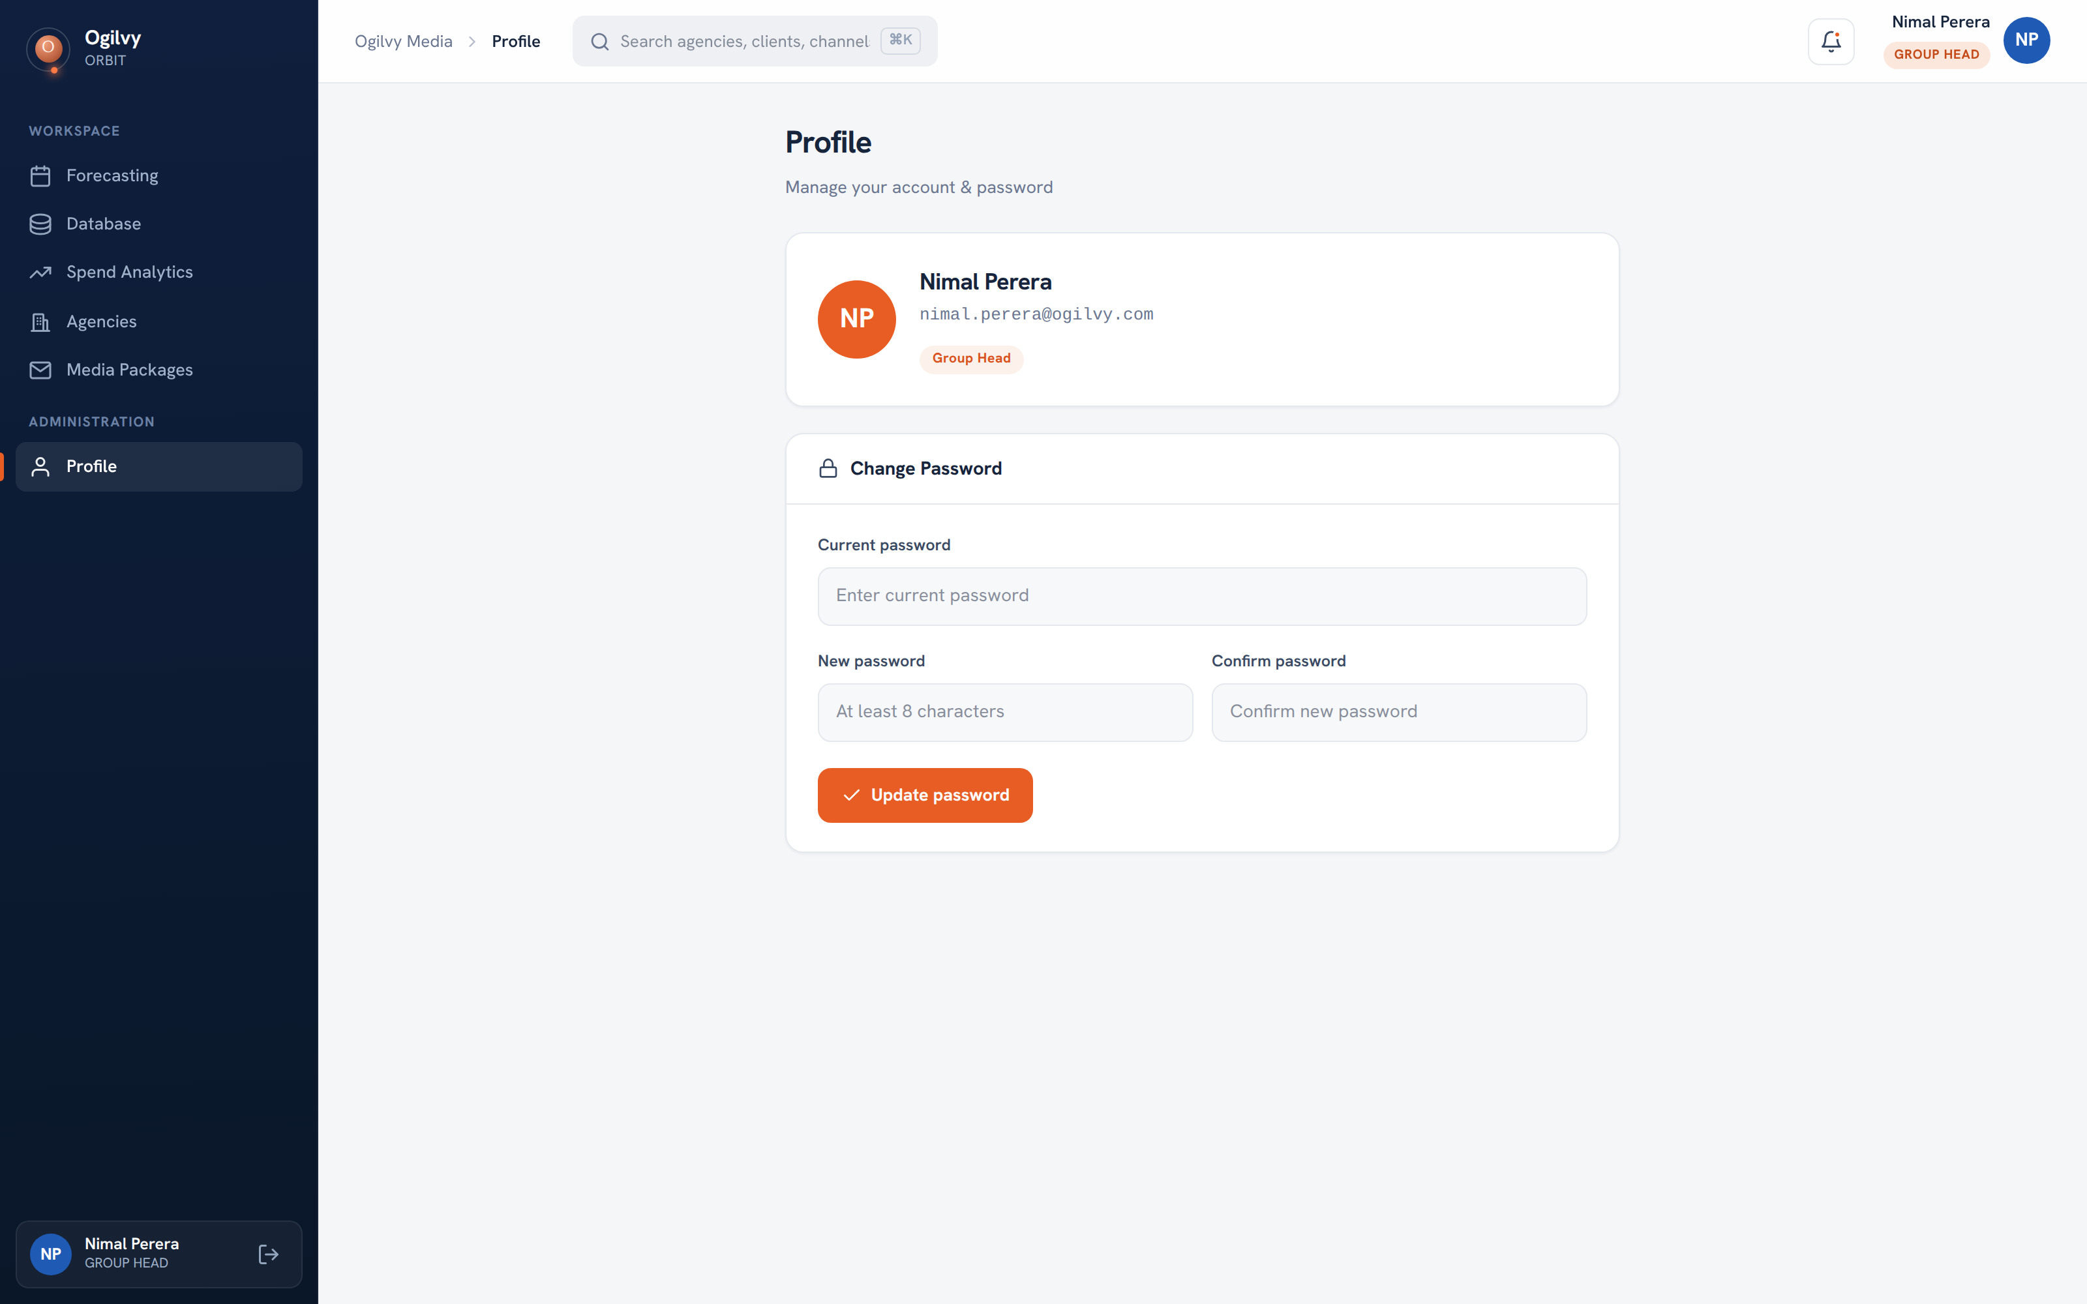
PROFILE
Your profile and security
Keep your own details current and your account secure from a single screen.
WHAT YOU CAN DO HERE
Review your name, role and contact email
Change your password whenever you need to
Sign out safely from any device
Ogilvy Orbit Group Head Guide
COLLABORATION & ACCOUNT
25 / 27

Slide 26
A SIMPLE RHYTHM
Your month in Orbit
Four light habits keep your accounts accurate and your planning effortless.
1
2
3
4
Log
Read
Record
Plan
Upload or paste each client's schedule as it is confirmed, so records stay current.
Open Spend Analytics and your client dashboards before reviews to know your numbers.
Capture negotiated deal terms and properties on the channel while they are fresh.
Enter next month's forecast and overall budget before the cycle closes.
Ogilvy Orbit Group Head Guide
COLLABORATION & ACCOUNT
26 / 27

Slide 27
O
You are ready to fly.
Sign in at your Orbit workspace, open your clients, and keep each month current. Your forecasts and records feed every report the leadership team sees.
Questions on any screen reach the media team through your admin.

