Slide 1
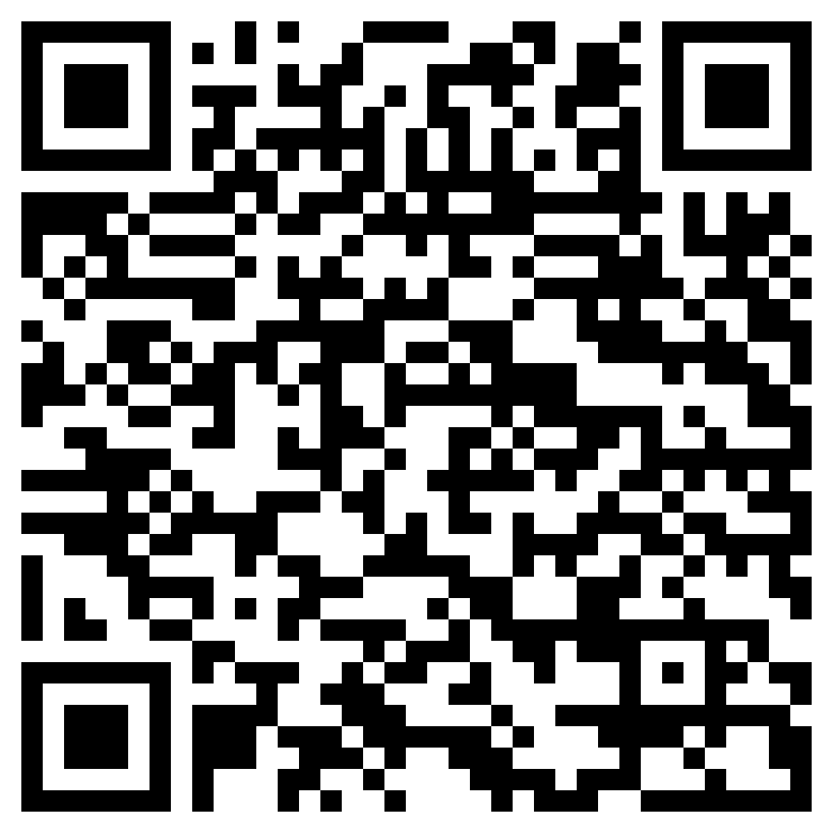
Impact of FoV of VR headsets on Pilot control Behaviour
RECRUITING EXPERIMENT PARTICIPANTS!
Put on a VR headset and control a simulation of a helicopter in hover!
Try and keep the helicopter stationary in the face of a strong wind and with various fields of view (FOVs)
Help us gain insight into how pilots’ performance is affected by changing FOVs and how they adapt
Since this experiment involves the use of VR headsets, we prefer participants who have had no previous history of motion sickness!!
Interested? Scan the QR code below to sign up
Or send an email to sbinali@tudelft.nl

