Slide 1
Data Structures and Algorithm
By Asma Qaiser

Slide 2


Slide 3
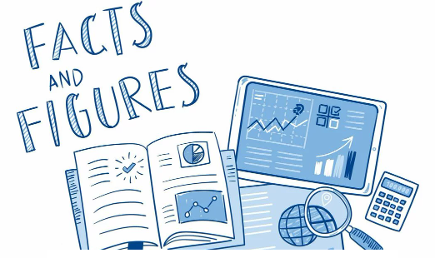

Slide 4
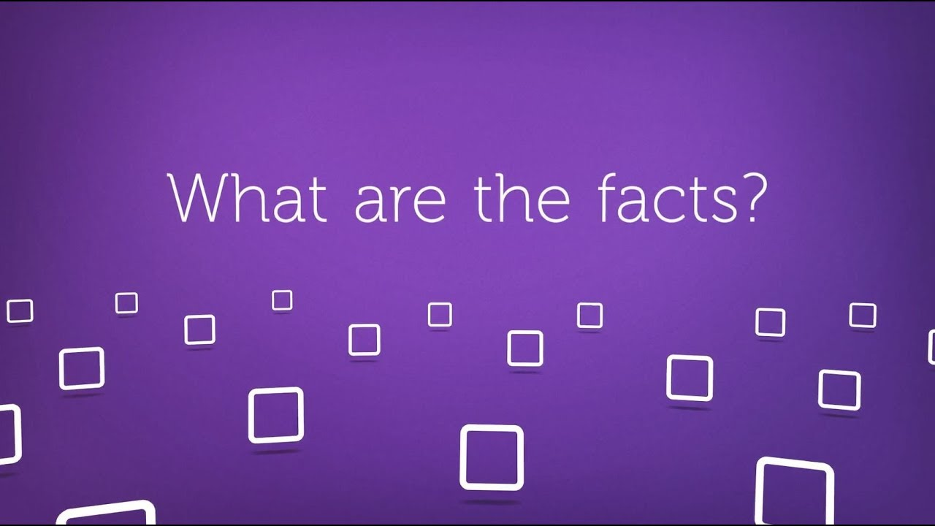
What is fact?

Slide 5
Facts
An entity that can’t be changed or denied.
or
An existence that can’t be denied is a fact.

Slide 6

Examples

Slide 7


Slide 8
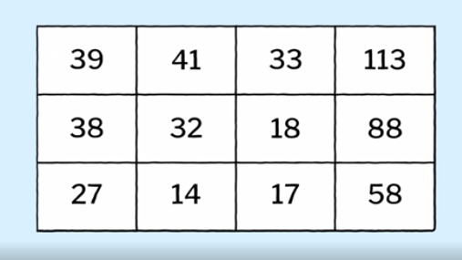

Slide 9
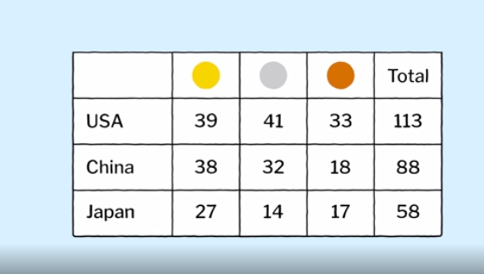

Slide 10
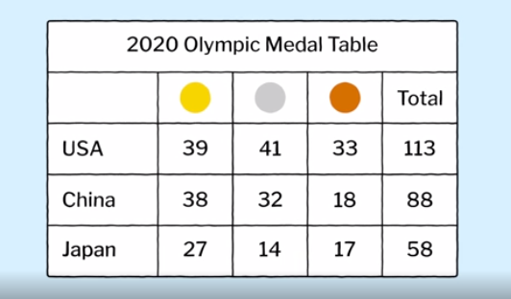

Slide 11
Data
Data is a raw information
Data is always meaningless.
We cannot consume data directly to bring information out of it.

Slide 12


Slide 13
Information
Information remove the meaninglessness of the data.
To get the information from the data we need to process the data.

Slide 14
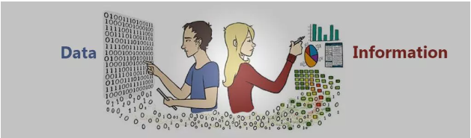

Slide 15
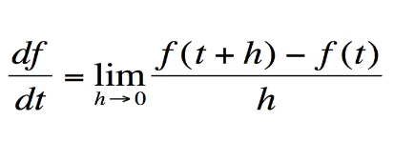

Slide 16
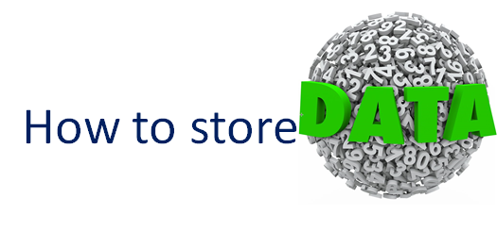

Slide 17


Slide 18
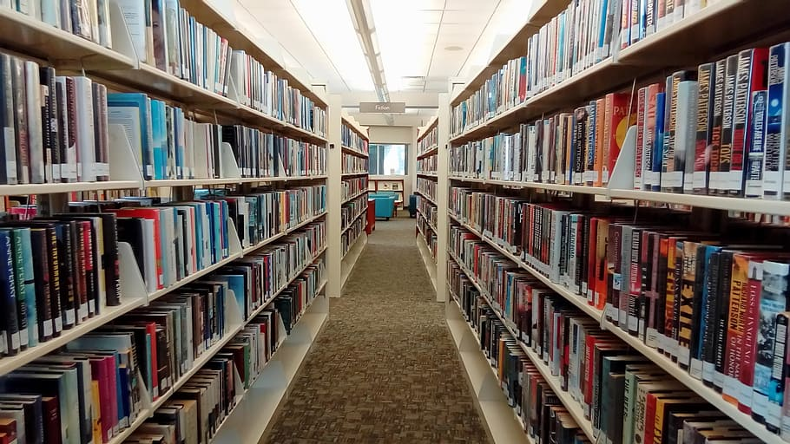

Slide 19
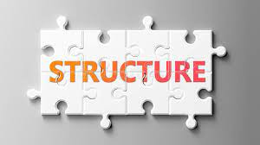

Slide 20
What are Data Structures?
Data structure is a storage that is used to store and organize data. It is a way of arranging data on a computer so that it can be accessed and updated efficiently.

Slide 21
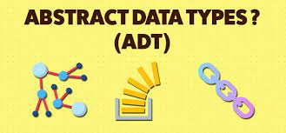

Slide 22
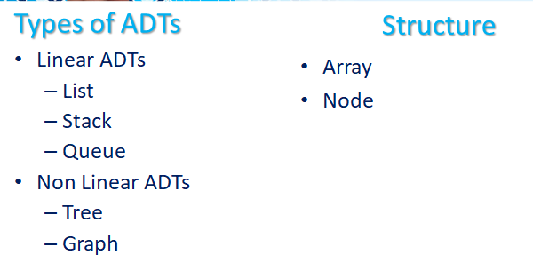

Slide 23
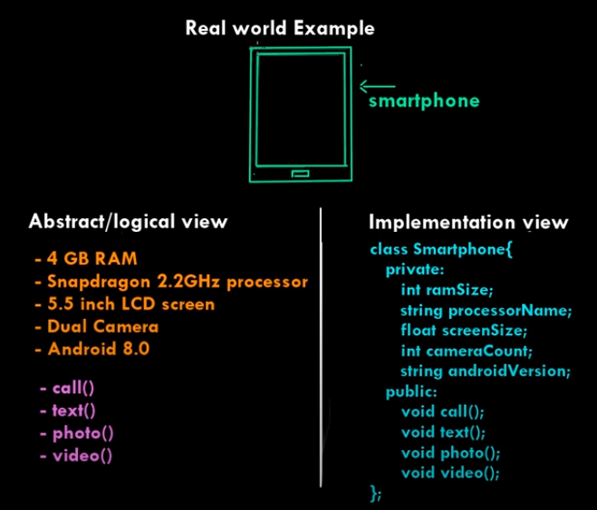

Slide 24
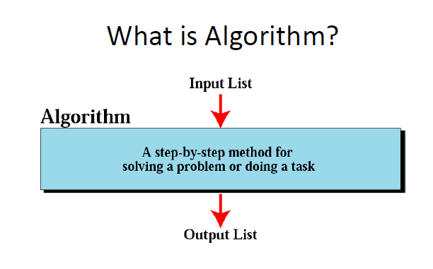

Slide 25
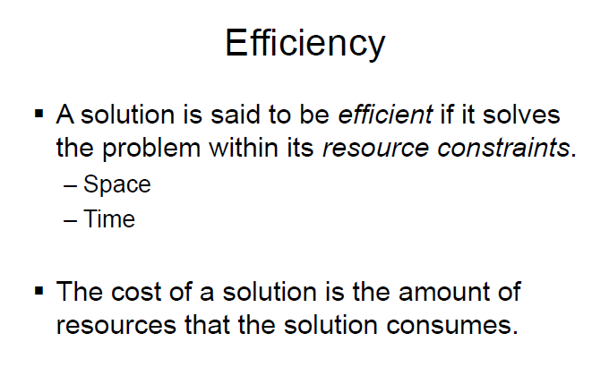

Slide 26


