Slide 1
Introduction to Java
Java is a high-level, object-oriented programming language that is widely used for building applications across various platforms.
Its versatility, robustness, and security features make it a popular choice among developers.
It was developed in 1991 by Sun Microsystems.
One of the founders of JAVA was James Gosling.
A JAVA program is basically made up of two things:
Functions:
It is a grouped code which will do something for you.
It can be called as many times as you want.
Calling a plumber to repair pipelines in your home.
Classes:
It is a combination of functions.
e.g House Hold Repair is a class.
in which there are many categories:
a) A plumber
b) A carpenter
c) A painter and many other household repairs.

Slide 2
Classes and Objects
A class is a template from which many objects are made.
For example a form is a template in which name, address, age, phone number are written.
When you fill that form, you create an entity so it is an object of the class form.
Public Class Main {
Public static void main (Strings[] args)
{
System.out.println(“Hello World”);
}
Main is a class over here
Small main is a function over here.
Public means all public can access it. Everybody can use this method.
Naming Conventions:
Class is always defined in terms of capital letters, it is called PascalConvention.
E.g AddTwoNumbers.
For functions we use camelCase Convention (first letter is small).
E.g addTwoNumbers.

Slide 3
Variables and Data Types in Java Programming
Just like we have some rules that we follow to speak English (the grammar), we have some rules to
follow while writing a Java program. This set of these rules is called syntax. It’s like Vocabulary and
Grammar of Java.
Variables
A variable is a container that stores a value.
This value can be changed during the execution of the program.
Example: int number = 8; (Here, int is a data type, the number is the variable name,
and 8 is the value it contains/stores).
Rules for declaring a variable name
We can choose a name while declaring a Java variable if the following rules are followed:
Must not begin with a digit. (E.g., 1num is an invalid variable)
Name is case sensitive. (Num and num are different)
Should not be a keyword (like Void,If).
White space is not allowed. (int number one is invalid)
Can contain alphabets, $character, _character, and digits(num1, num2) if the other conditions are met.

Slide 4
Data Types:
Data types in Java fall under the following categories
Primitive Data Types (Intrinsic)
Non-Primitive Data Types (Derived)
Primitive Data Types:
Java is statically typed, i.e., variables must be declared before use. Java supports 8 primitive data types:
Data Type | Size | Value Range
1. Byte | 1 byte | -128 to 127
2. short | 1 byte | -32,768 to 32,767
3. int | 2 byte | -2,147,483,648 to 2,147,483,647
4. float | 4 byte | 3.40282347 x 10³⁸ to 1.40239846 x 10⁻⁴⁵
5. long | 8 byte | -9,223,372,036,854,775,808 to 9,223,372,036,854,775,807
6. double | 8 byte | 1.7976931348623157 x 10³⁰⁸, 4.9406564584124654 x 10⁻³²⁴
7. char | 2 byte | 0 to 65,535
8. boolean | Depends on JVM | True or False

Slide 5
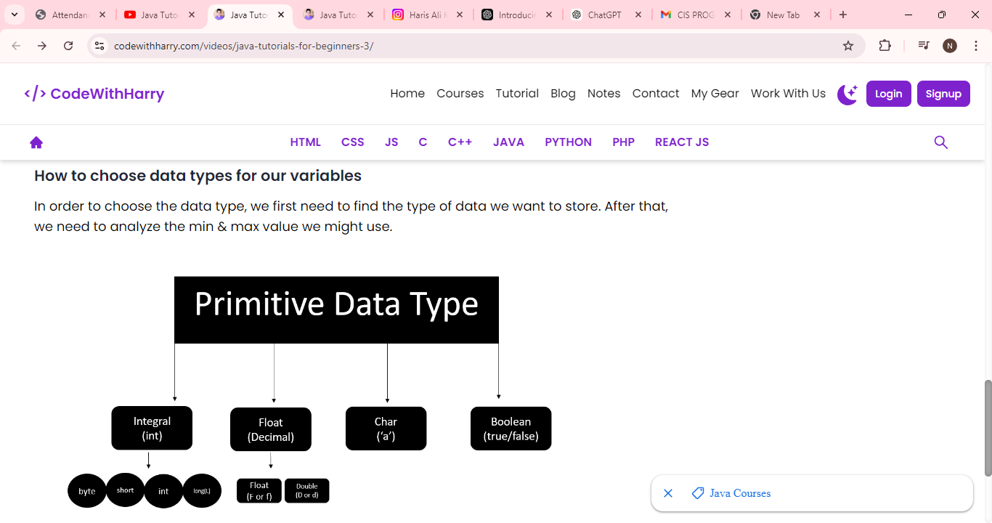

Slide 6
Java Tutorial: Literals in Java
Literals
A constant value that can be assigned to the variable is called a literal.
101 – Integer literal
10.1f – float literal
10.1 – double literal (default type for decimals)
‘A’ – character literal
true – Boolean literal
“Harry” – String literal
Keywords
Words that are reserved and used by the Java compiler. They cannot be used as an Identifier.

Slide 7
public class CWH_04_literals {
public static void main(String[] args)
{ byte age = 34;
int age2 = 56;
short age3 = 87;
long ageDino = 5666666666666L;
char ch = 'A’;
float f1 = 5.6f;
double d1 = 4.66;
boolean a = true;
System.out.print(age);
String str = “Sumbul";
System.out.println(str);
}
}
System is a class
Out and print are functions and methods.

Slide 8
Types of operators :
Arithmetic Operators :
Arithmetic operators are used to perform mathematical operations such as addition, division, etc on expressions.
Arithmetic operators cannot work with Booleans.
% operator can work on floats and doubles.
Let x=7 and y=2
Comparison Operators :
Operator | Description | Example
+ (Addition) | Used to add two numbers | x + y = 9
- (Subtraction) | Used to subtract the right-hand side value from the left-hand side value | x - y = 5
* (Multiplication) | Used to multiply two values. | x * y = 14
/ (Division) | Used to divide left-hand Value by right-hand value. | x / y = 3
% (Modulus) | Used to print the remainder after dividing the left-hand side value from the right-hand side value. | x % y = 1
++ (Increment) | Increases the value of operand by 1. | x++ = 1
-- (Decrement) | Decreases the value of operand by 1. | y-- = 1

Slide 9
Comparison Operators :
As the name suggests, these operators are used to compare two operands.
Let x=7 and y=2
Operator | Description | Example
== (Equal to) | Checks if two operands are equal. Returns a boolean value. | x == y --> False
!= (Not equal | Checks if two operands are not equal. Returns a boolean value. | x != y --> True
> (Greater than) | Checks if the left-hand side value is greater than the right-hand side value. Returns a boolean value. | x > y --> True
< (Less than) | Checks if the left-hand side value is smaller than the right-hand side value. Returns a boolean value. | x < y --> False
>=(Greater than or equal to) | Checks if the left-hand side value is greater than or equal to the right-hand side value. Returns a boolean value. | x >= y --> True
<= (Less than or equal to) | Checks if the left-hand side value is less than or equal to the right-hand side value. Returns a boolean value. | x <= y -->False

Slide 10
Logical Operators :
These operators determine the logic in an expression containing two or more values or variables.
Let x = 8 and y =2
&& (logical and) | Returns true if both operands are true. | x<y && x!=y --> True
|| (logical or) | Returns true if any of the operand is true. | x<y && x==y --> True
! (logical not) | Returns true if the result of the expression is false and vice-versa | !(x<y && x==y) --> False

