Slide 1
☁
CloudDrive
Scalable File Storage on AWS — a Mini Google Drive
Final-Year Cloud Computing Project
Team: Shehriyar Ali Rustam · Touseef Abbas · Abdul Ahad
github.com/Shehriyar-Ali-Rustam/clouddrive

Slide 2
MOTIVATION
The Problem & Our Solution
• Storing and sharing files across devices and people is a universal need.
• Traditional apps stream every file through the server — it becomes a bottleneck and a single point of failure.
– So it cannot scale to many users or large files.
• CloudDrive solves this with cloud object storage (Amazon S3) and pre-signed URLs.
– The browser sends file bytes directly to S3 — the server stays light and scalable.
CloudDrive — Scalable File Storage on AWS
1

Slide 3
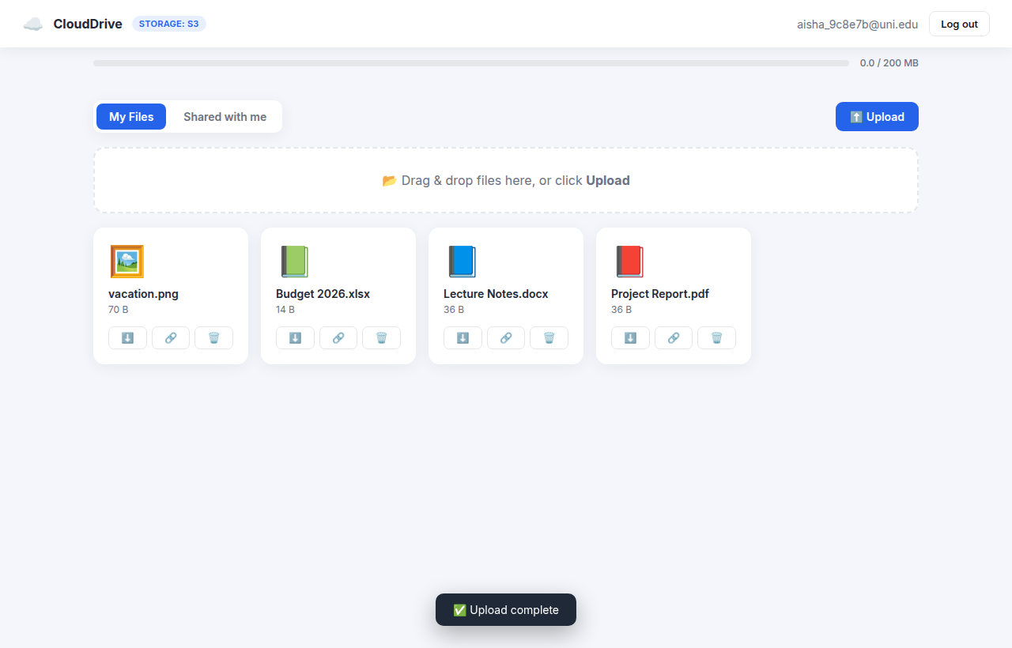
OVERVIEW
What is CloudDrive?
• A secure, cloud-based 'Mini Google Drive'.
• Sign up, upload, organise, download files.
• Share with users or via public expiring links.
• Per-user storage quotas & isolation.
• Runs on real AWS S3; deployable via Docker.
CloudDrive — Scalable File Storage on AWS
2

Slide 4
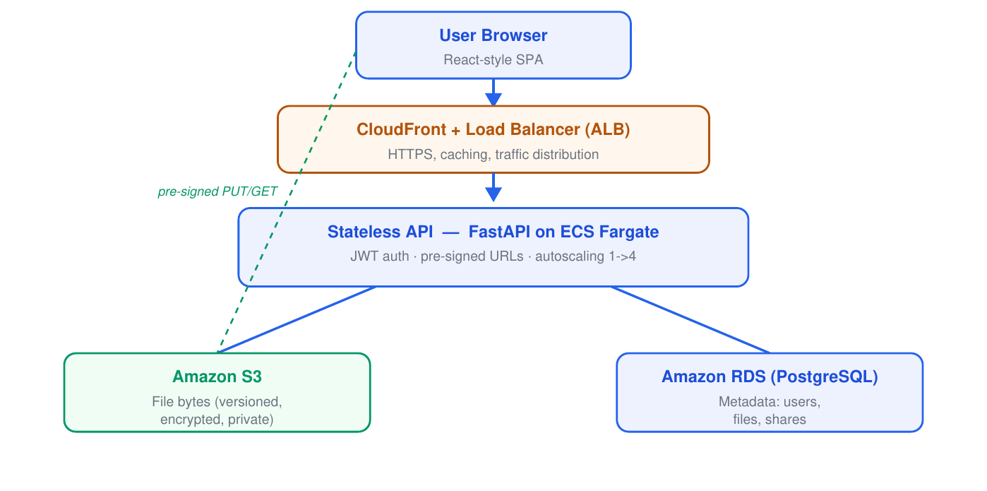
HOW IT FITS TOGETHER
System Architecture
• Browser → CDN/Load Balancer → stateless API.
• API on ECS Fargate (autoscaling).
• Metadata in PostgreSQL (RDS).
• File bytes in Amazon S3.
– Browser talks to S3 directly via pre-signed URLs.
CloudDrive — Scalable File Storage on AWS
3

Slide 5
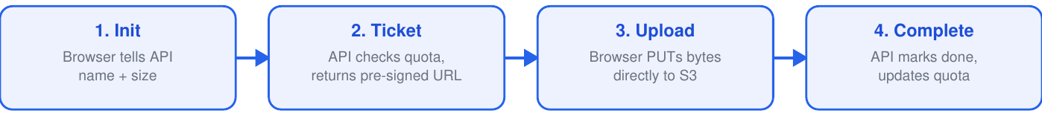
WHY IT SCALES
The Core Idea — Pre-signed URLs
• The API never streams file bytes — it issues a short-lived signed 'permission slip'.
• The browser uploads/downloads straight to Amazon S3.
• Result: a stateless API you can run in many copies and autoscale — the heart of cloud design.
CloudDrive — Scalable File Storage on AWS
4

Slide 6
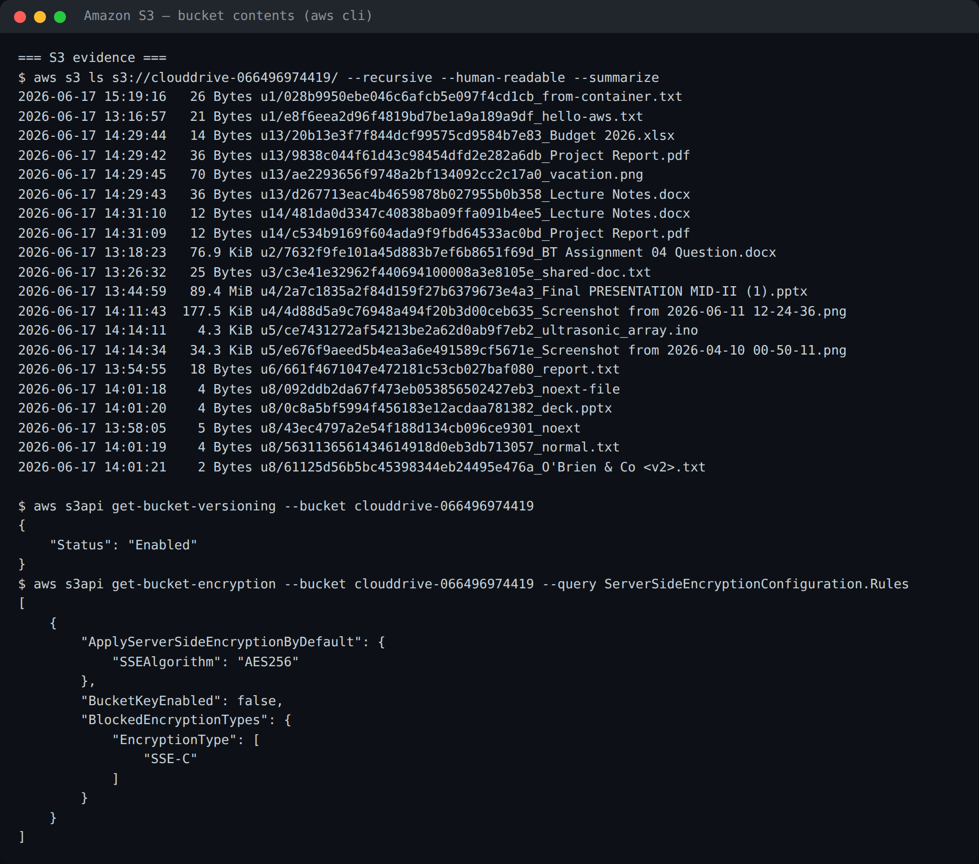
CLOUD STORAGE — LIVE
Running on Real Amazon S3
• Files stored as objects in S3.
• Bucket versioning enabled.
• AES-256 encryption at rest.
• All public access blocked.
– Verified live via the AWS CLI.
CloudDrive — Scalable File Storage on AWS
5

Slide 7
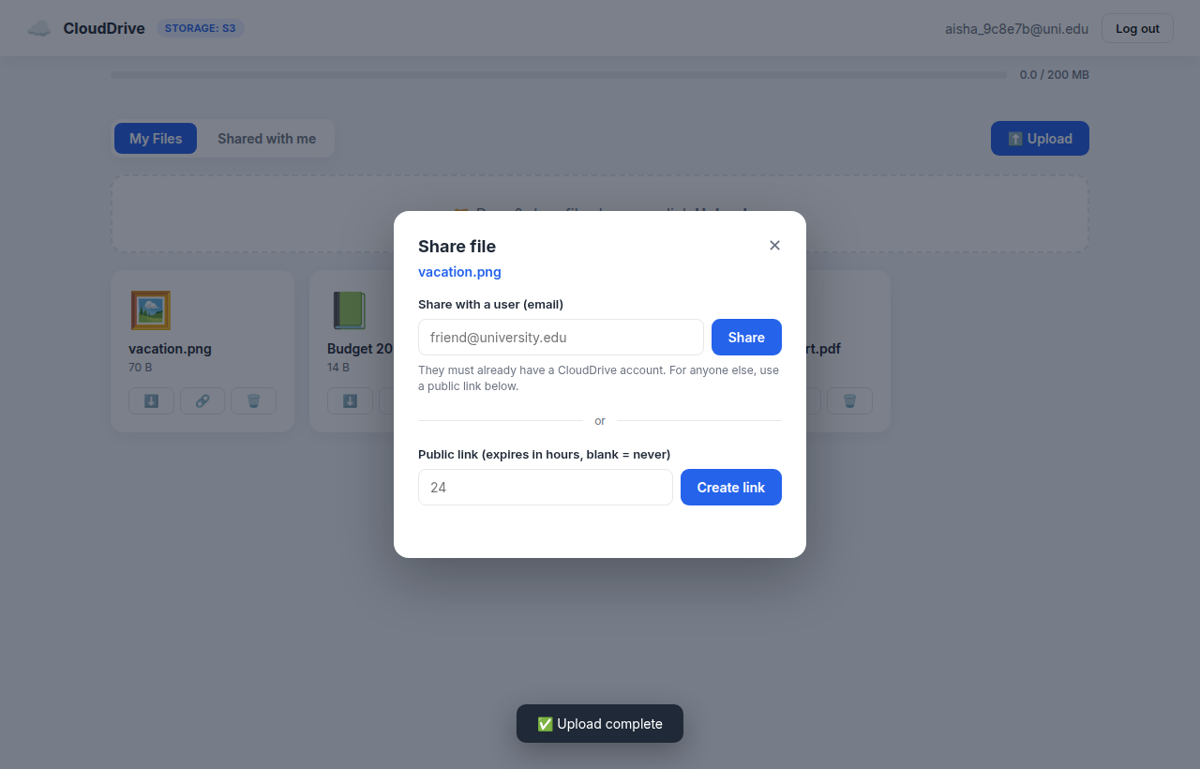
FEATURE
Secure Sharing & Collaboration
• Share a file with a registered user by email.
• Generate a public link with optional expiry.
• A 'Shared with me' view for received files.
• Downloads use short-lived pre-signed URLs scoped to one file.
• Public links redirect straight to storage.
CloudDrive — Scalable File Storage on AWS
6

Slide 8
WHAT WE USED
Technology Stack
Backend
Storage & Data
Security
Cloud / DevOps
• Python 3.12
• FastAPI
• Uvicorn
• SQLAlchemy
• Pydantic
• Amazon S3
• boto3
• PostgreSQL
• SQLite
• JWT (python-jose)
• bcrypt
• AWS IAM
• Terraform
• Docker
• ECS · ALB · VPC · ECR
• GitHub Actions
• Render · Cloudflare
CloudDrive — Scalable File Storage on AWS
7

Slide 9
DEFENCE IN DEPTH
Security Model
• Passwords hashed with bcrypt — never stored in plain text.
• Stateless authentication with signed, expiring JWTs.
• Pre-signed URLs: time-limited (15 min) and scoped to one object.
• Private S3 bucket, encrypted at rest (AES-256).
• IAM least-privilege — the app touches only its own bucket.
• Per-user isolation — every query filtered by owner.
CloudDrive — Scalable File Storage on AWS
8

Slide 10
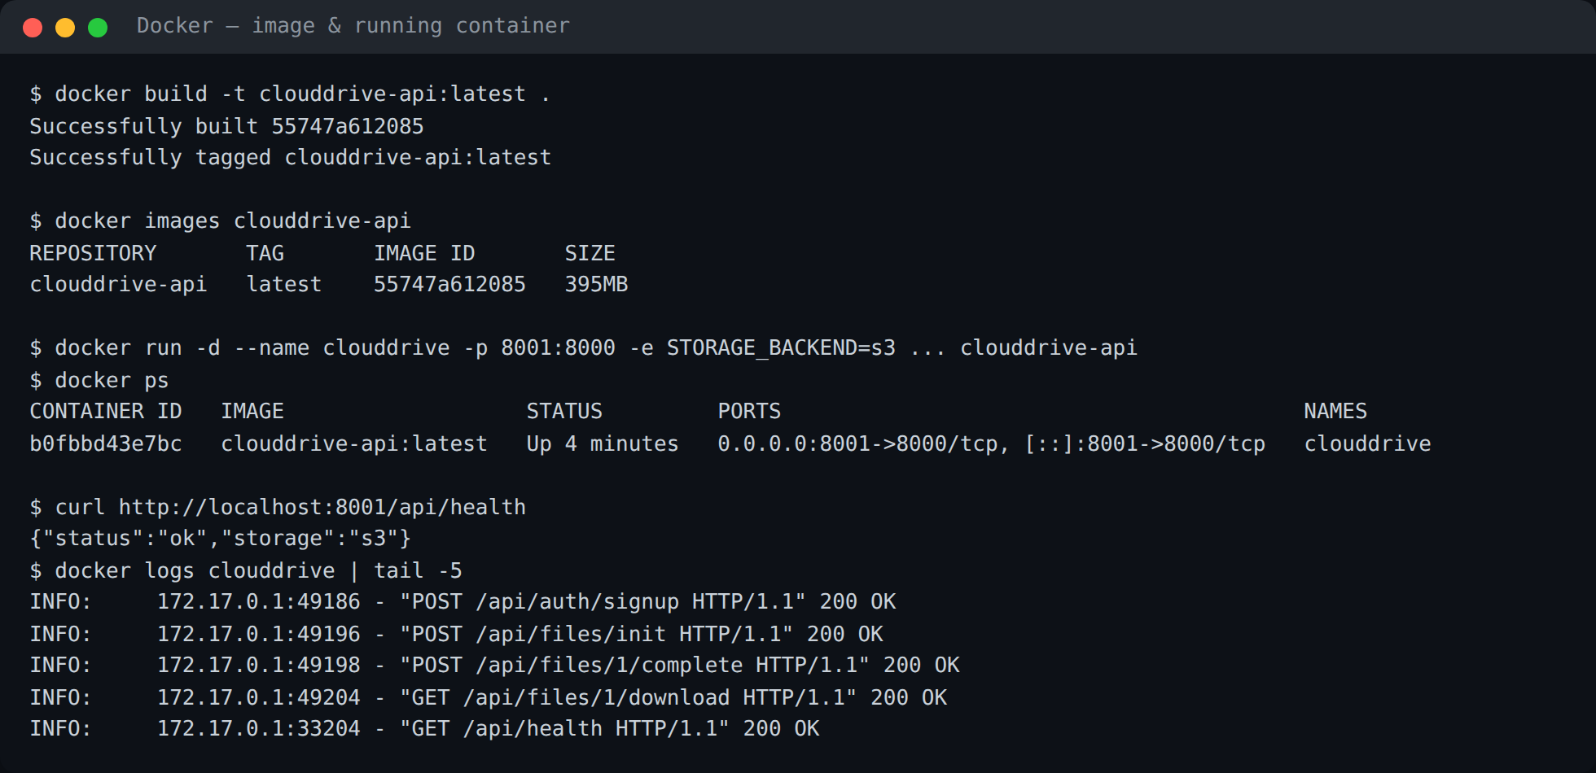
PORTABLE & DEPLOYABLE
Containerized with Docker
• One Dockerfile packages the whole app.
• Built image: clouddrive-api (395 MB).
• Runs identically locally and on AWS ECS.
– Image stored in Amazon ECR.
– Verified running live on S3.
CloudDrive — Scalable File Storage on AWS
9

Slide 11
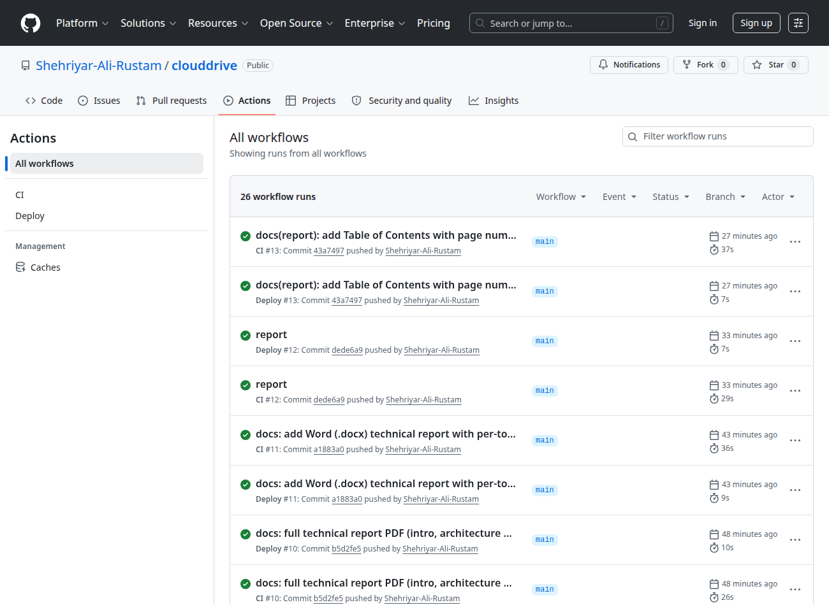
AUTOMATED DELIVERY
CI/CD Pipeline
• GitHub Actions on every push.
• CI: runs all 19 tests.
• Deploy: build image → ECR → ECS.
– Green across all runs.
CloudDrive — Scalable File Storage on AWS
10

Slide 12
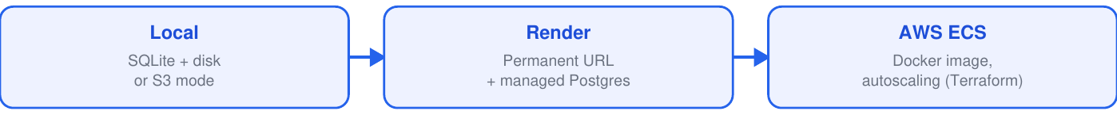
FLEXIBLE, ALL ON S3
Deployment Options
• Local (Docker / dev) · Render (permanent URL + managed Postgres) · AWS ECS (autoscaling, Terraform).
• All three share the same Amazon S3 storage.
• A Cloudflare tunnel exposes a public HTTPS URL for live demos.
CloudDrive — Scalable File Storage on AWS
11

Slide 13
CONFIDENCE
Testing & Quality
• 19 automated tests (pytest) — all passing.
– Authentication — signup, login, wrong password, duplicate email (6).
– Files — upload lifecycle, quota, delete, user isolation (7).
– Sharing & security — user share, public link, tampered/expired URL (6).
• Run automatically in CI on every push.
• Terraform validated; Docker image builds & runs.
CloudDrive — Scalable File Storage on AWS
12

Slide 14
THREE MODULES
The Team — Who Built What
Module | Member | Cloud / DevOps slice
Authentication & User Accounts | Touseef Abbas | Security · IAM · CI
File Storage & Upload/Download | Shehriyar Ali Rustam | Amazon S3 · Terraform
Sharing & Collaboration | Abdul Ahad | Docker · Deployment · Networking
One collective report + three individual module reports.
CloudDrive — Scalable File Storage on AWS
13

Slide 15
SEE IT RUNNING
Live Demo
bash demo.sh → public HTTPS URL
• Open the link on a laptop and a phone — same app, real cloud.
• Upload a file → see it appear in the AWS S3 console.
• Create a public link → download from another device.
• Show the file uploading directly to S3 (DevTools) — the pre-signed URL in action.
CloudDrive — Scalable File Storage on AWS
14

Slide 16
WRAP-UP
Conclusion & Future Work
• A complete, working, tested cloud application on real AWS S3.
• Demonstrates object storage, pre-signed URLs, managed databases, stateless scalable services, IaC and CI/CD.
• Fully reproducible from version control.
• Future: multipart upload for huge files; file previews & search; team workspaces.
CloudDrive — Scalable File Storage on AWS
15

Slide 17
Thank You
Questions?
github.com/Shehriyar-Ali-Rustam/clouddrive

