Slide 1

GOOGLE PLAY STORE APP ANALYSIS
( BDA Project )
TEAM-
Riyanchhi Agrawal (1BM17CS076)
Shehyaaz Khan Nayazi (1BM17CS094)

Slide 2
Outline
Introduction
Technologies
Dataset
Attributes
Application
Features
Data Visualization and Analysis

Slide 3
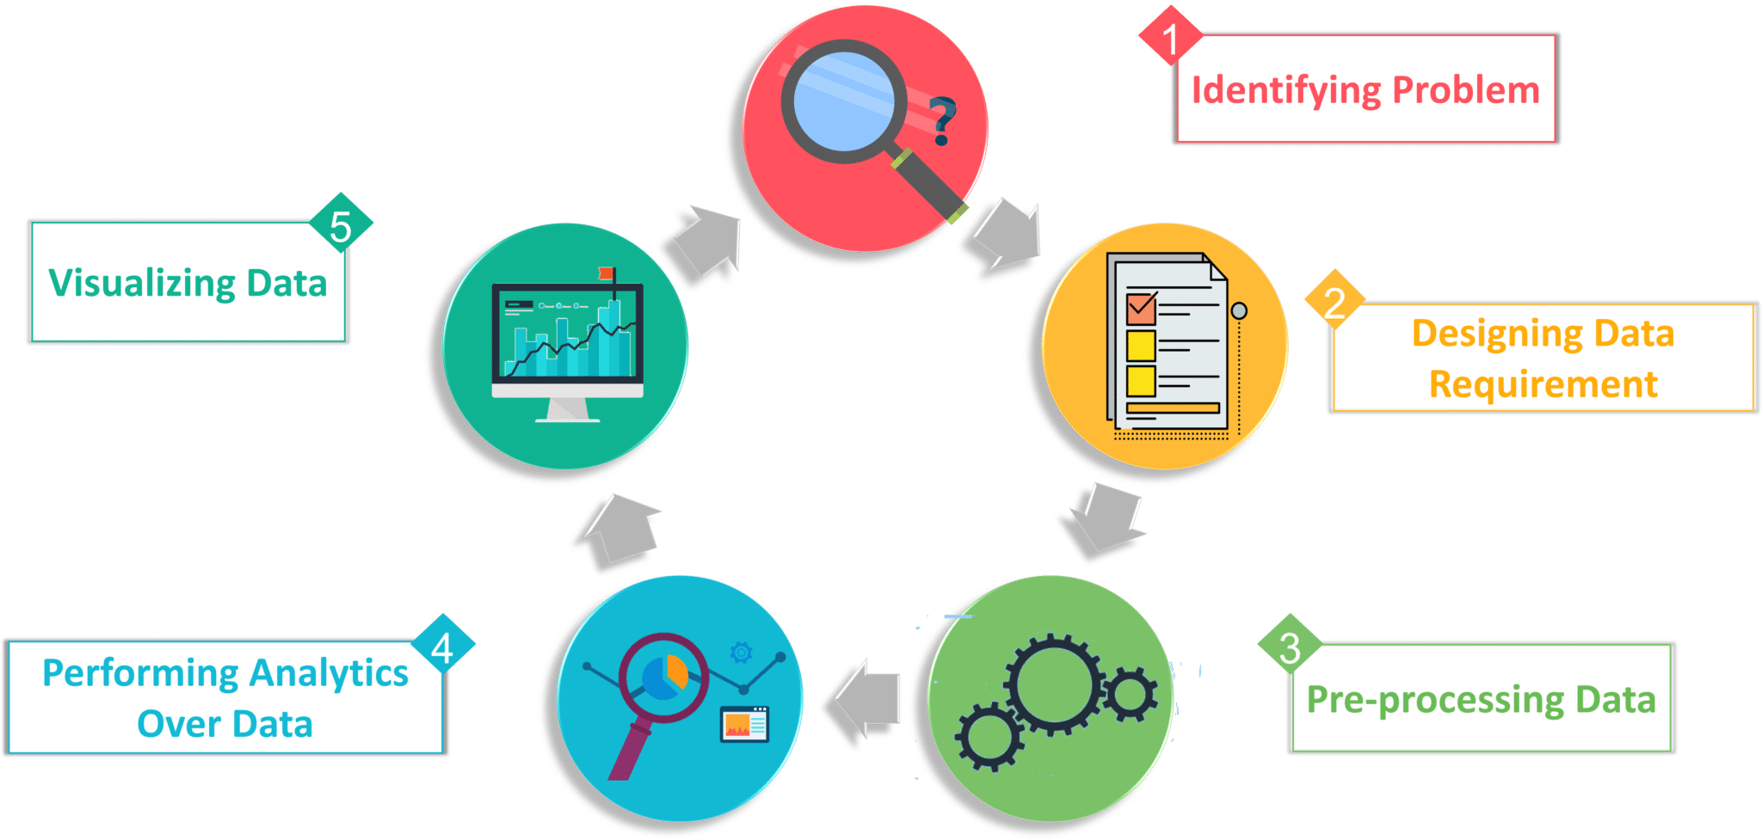
Introduction
Analysis of data examines large and different types of data and study their growth and development.
It involves three major stages-
Pre-processing the data
Performing Analytics over data
Visualizing the data.
Here we analyze the data on apps present in google playstore and based on certain logic we process the data from above mentioned stages.

Slide 4
Technologies
Libraries used-
Pymongo (MongoDB driver for Python)
PyQt5
Pandas
Numpy
Matplotlib
MongoDB (Backend NoSQL Database)

Slide 5
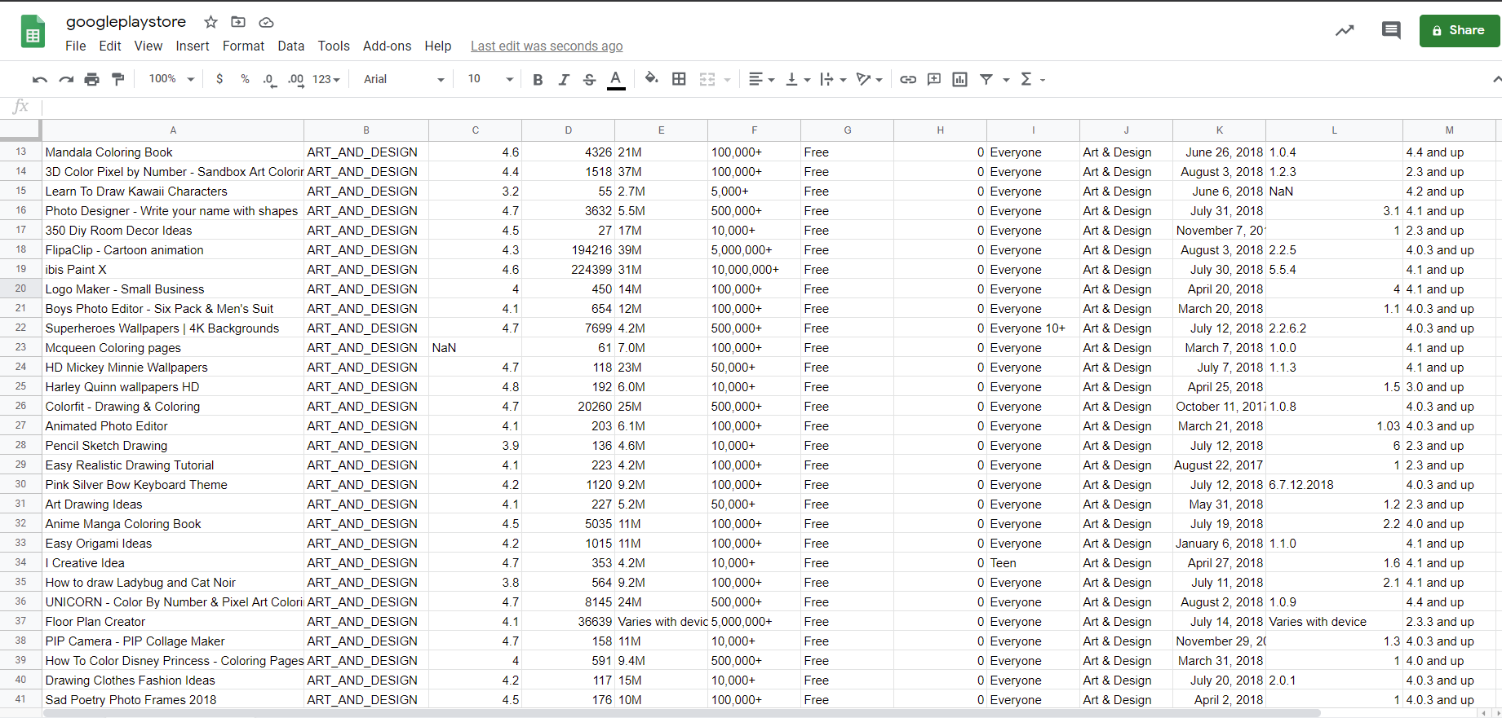
Description & Reference
Dataset
An structured data set which is used to perform various analysis and operation on 4470 records with 13 attributes.
Source - https://www.kaggle.com/lava18/google-play-store-apps/download

Slide 6
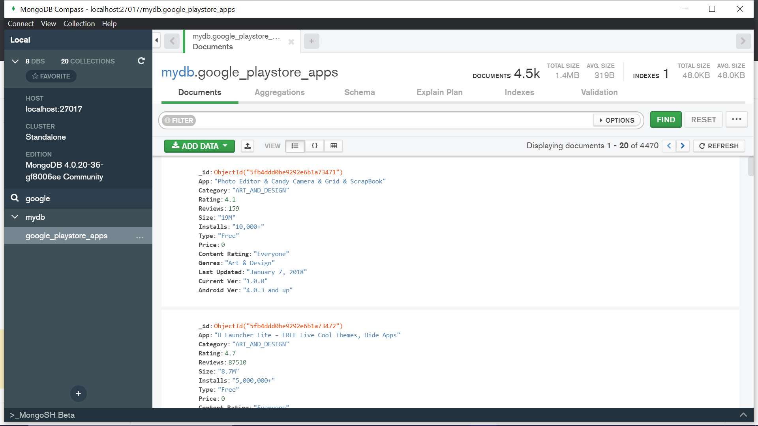
Data Stored

Slide 7
Dataset
Dataset
The dataset contains following columns -
Attributes
App - Application name on Google Playstore
Category - General category to which the app belongs.
Rating - App rating ranges between 0 to 5.
Reviews - No. of user reviews.
Size - Size of the app in MB..
Installs - No.of Installs.
Type - App is capitalized or not.
Price - Based on Type charging amount of the particular app. (in $)
Content Rating - Based on user age period access given by developer.
Genres - A more detailed category to which the application belongs
Last Updated - Date on which the app was last updated
Current Ver - Current version of the app
Android Ver - Android version supported by the app

Slide 8
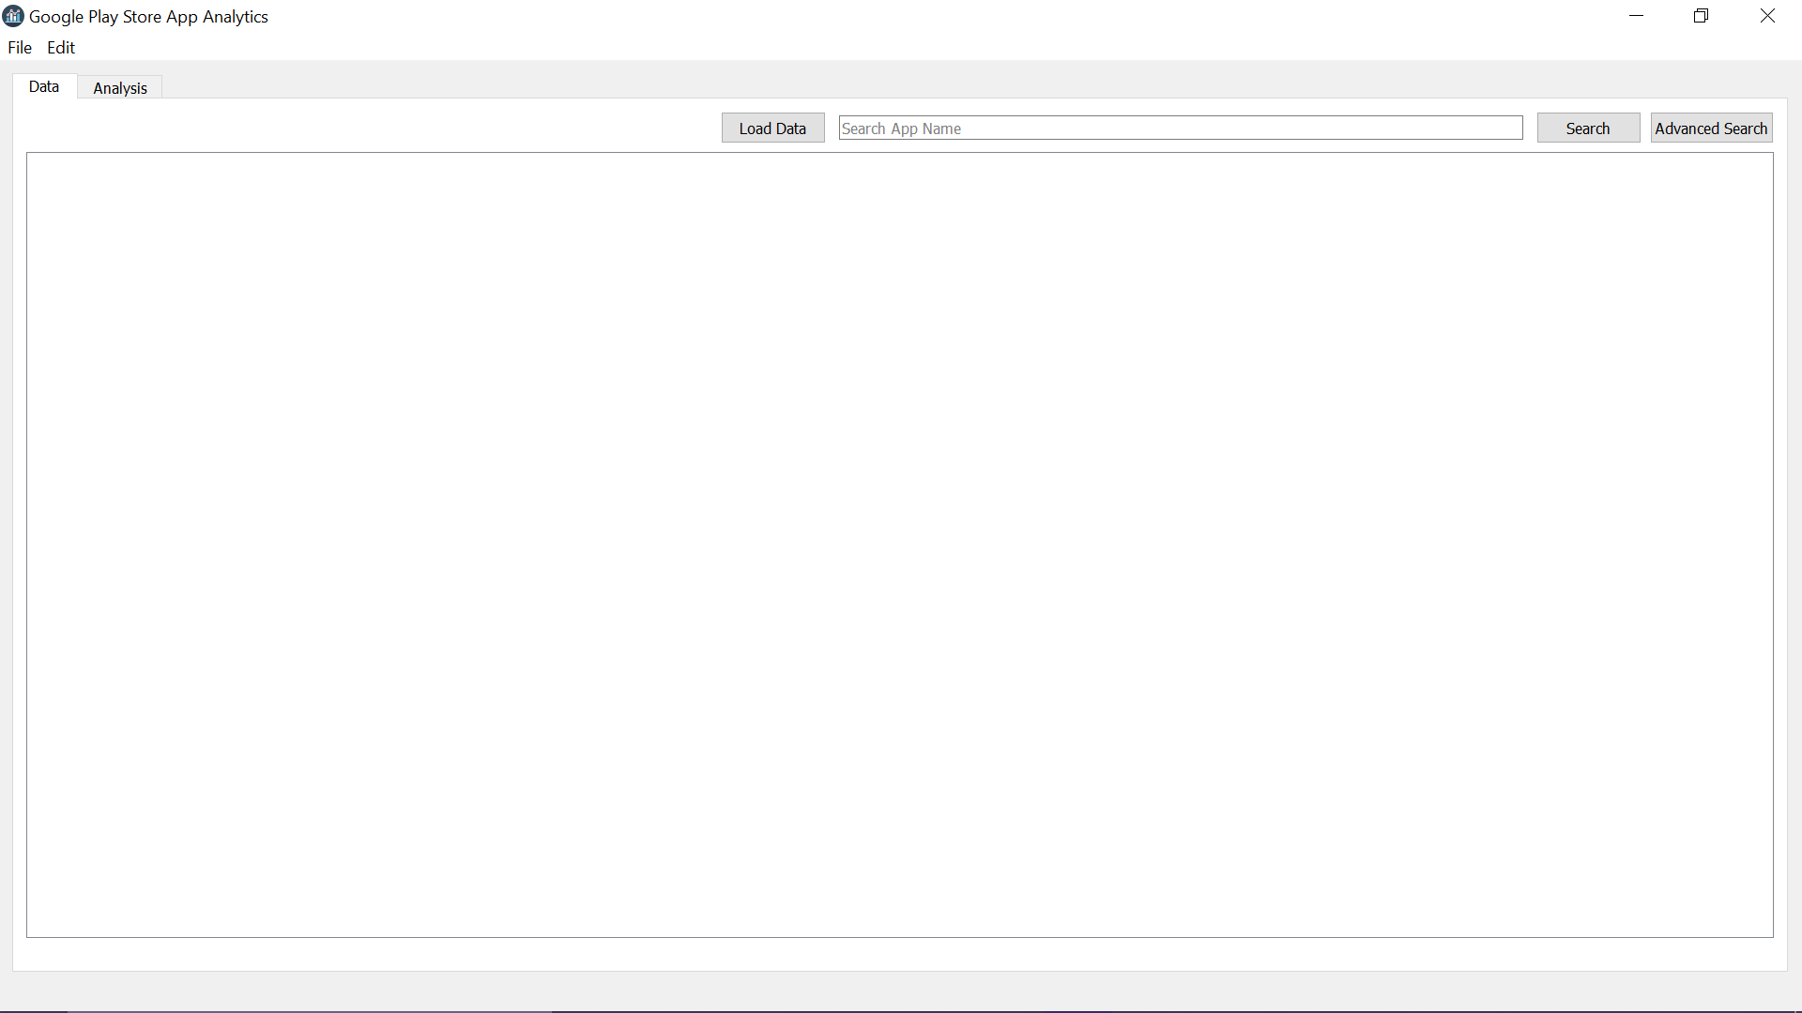
Application
With the help of QT Designer front-end of Application is built to give better user experience on data manipulation & analysis.

Slide 9
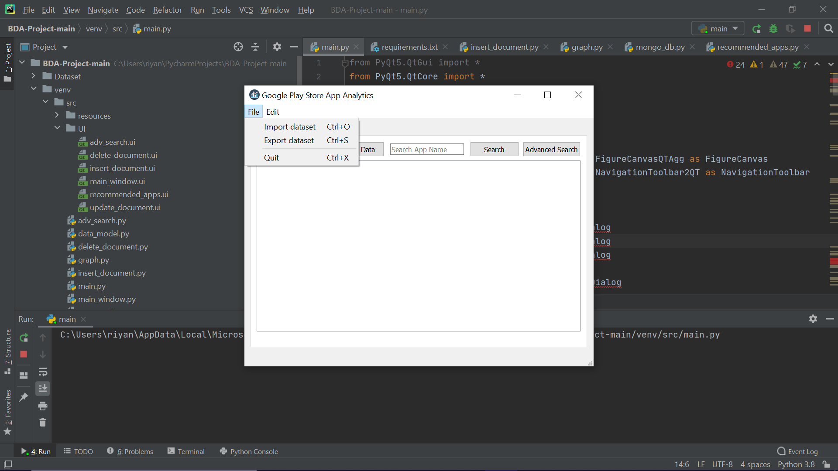
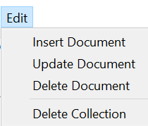
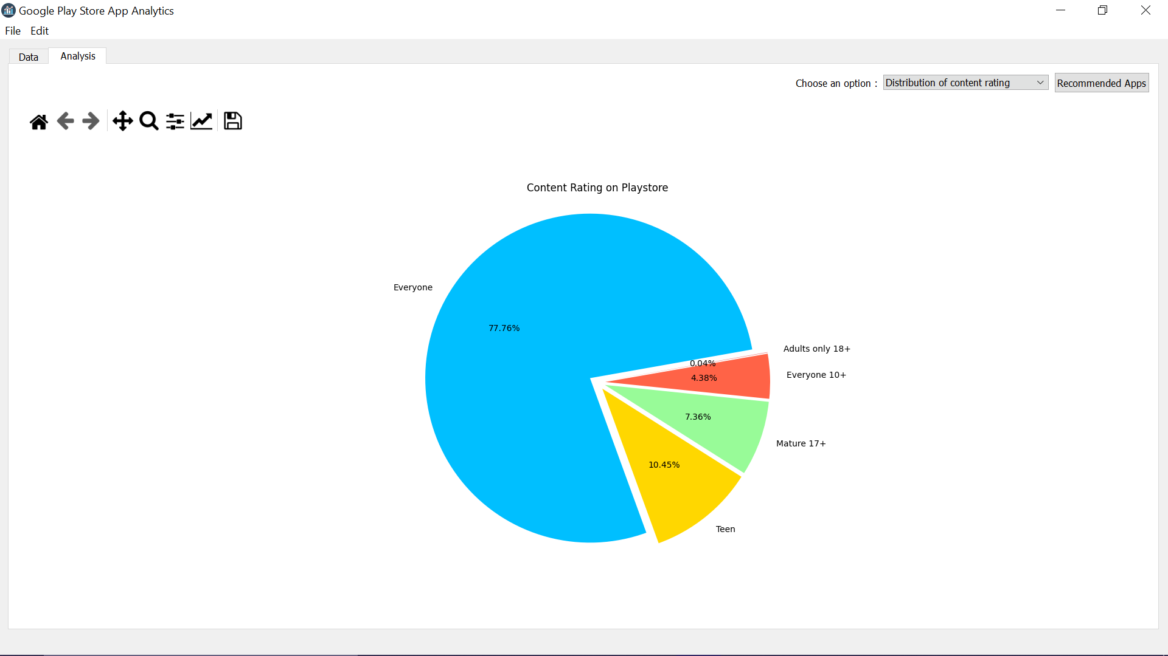
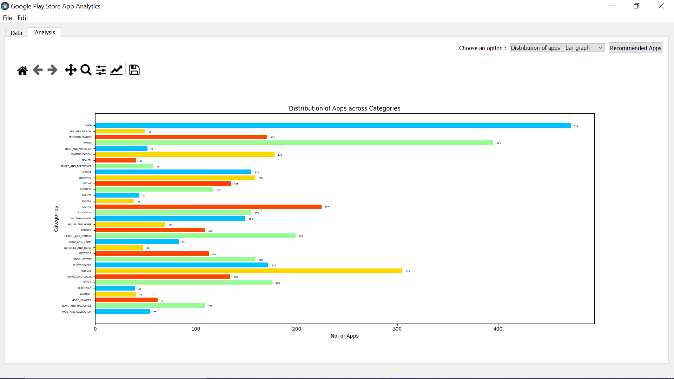
Features
Import / Export Dataset
Insert Document
Delete Document(s)
Update Document(s)
Delete Collection
Perform Analysis (using graphs)
Recommendations (using Demographic
Filtering)

Slide 10
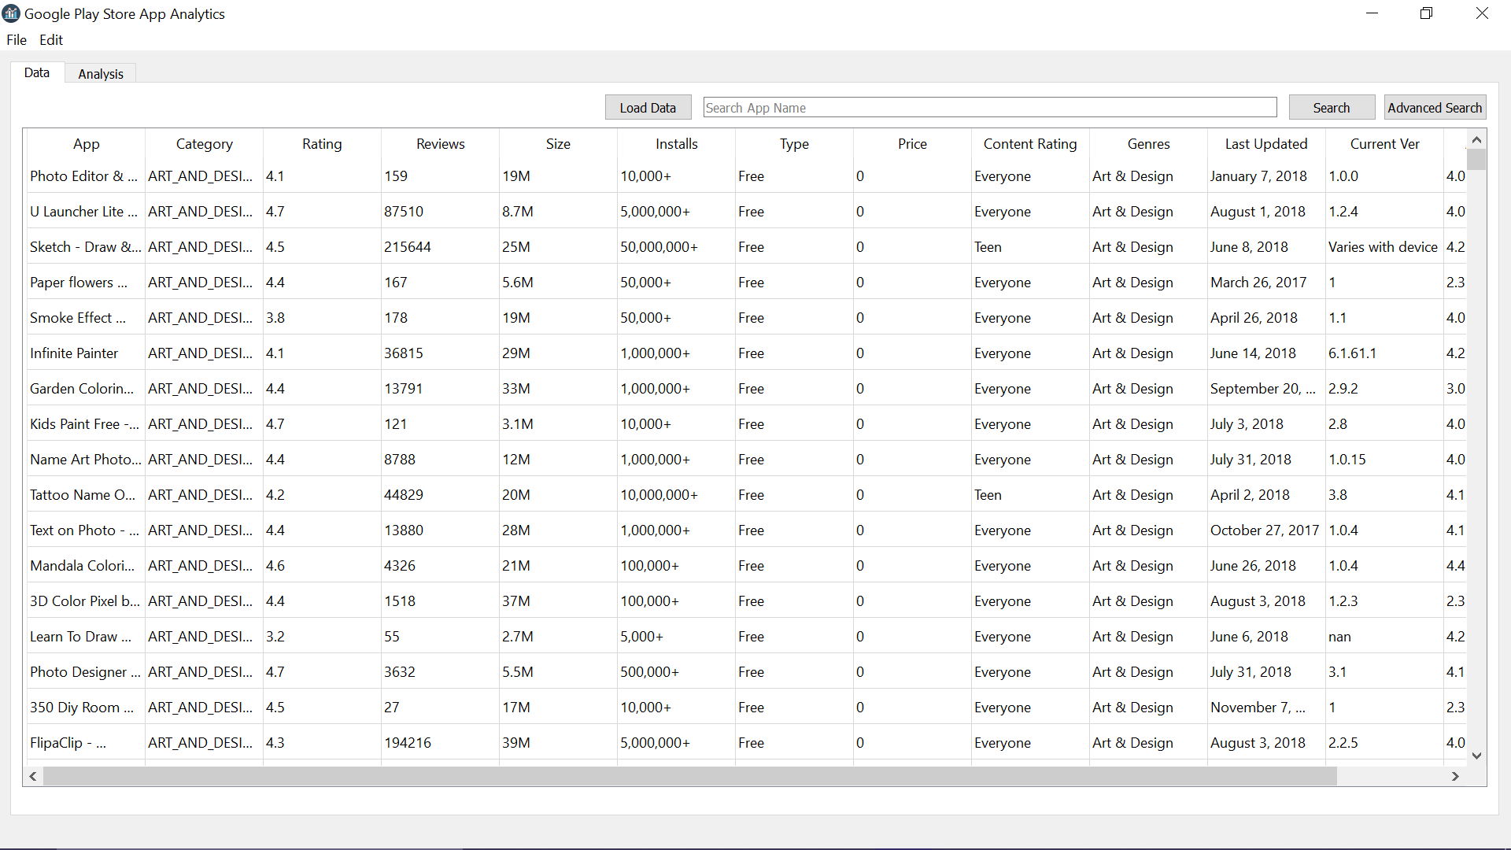
Loading Data
Data is loaded from mongoDB in the table format.

Slide 11
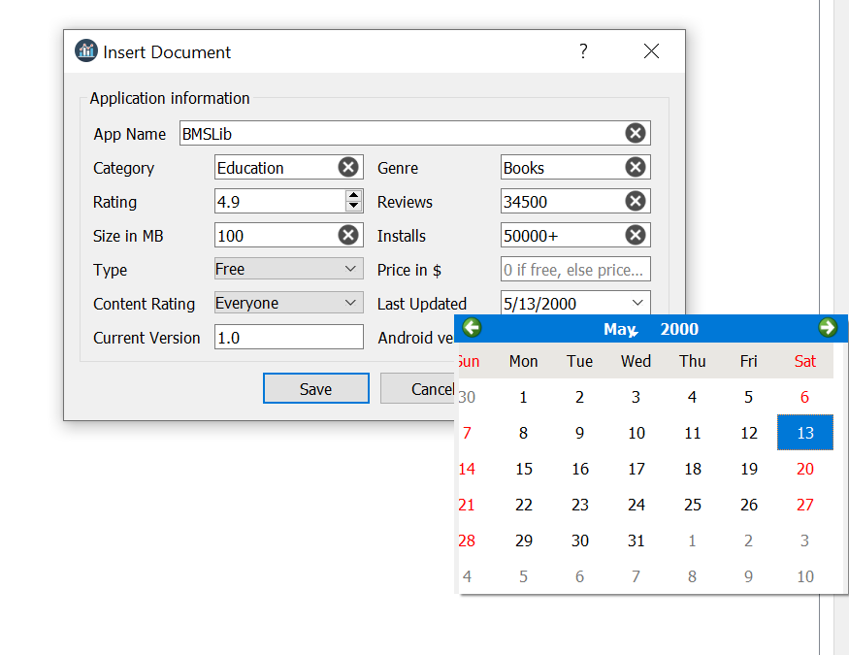
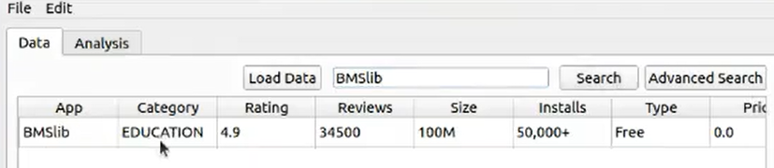
Insert Document
On Selecting “Insert Document”, a form will open to take values as an input for attributes and create a record on submitting.

Slide 12
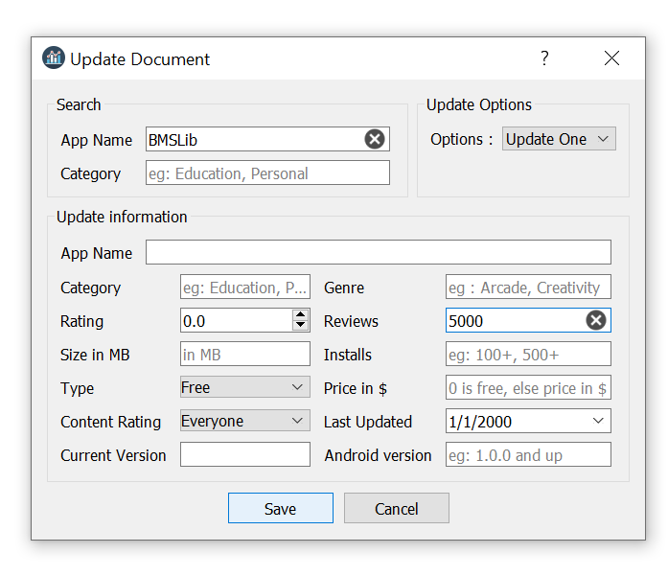
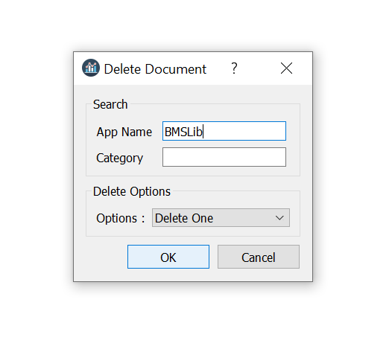
Update/Delete Document

Slide 13
Data Visualization Analysis
1. Bar graph of distribution of apps across Category.
2. Pie chart of free and paid apps.
3. Pie chart of Content rating in each category.
4. Bar graph of android version.
5. Histogram of Rating.
6. Boxplot of Installs.
7. Ratings vs Size.

Slide 14
Distribution of Apps across Category
-Bar Graph
The graph is created with help of pandas and matplotlib library from mongoDB Query and from the graph its shows that highest number of Apps falls in top 3 category - Game, Family, Medical.

Slide 15
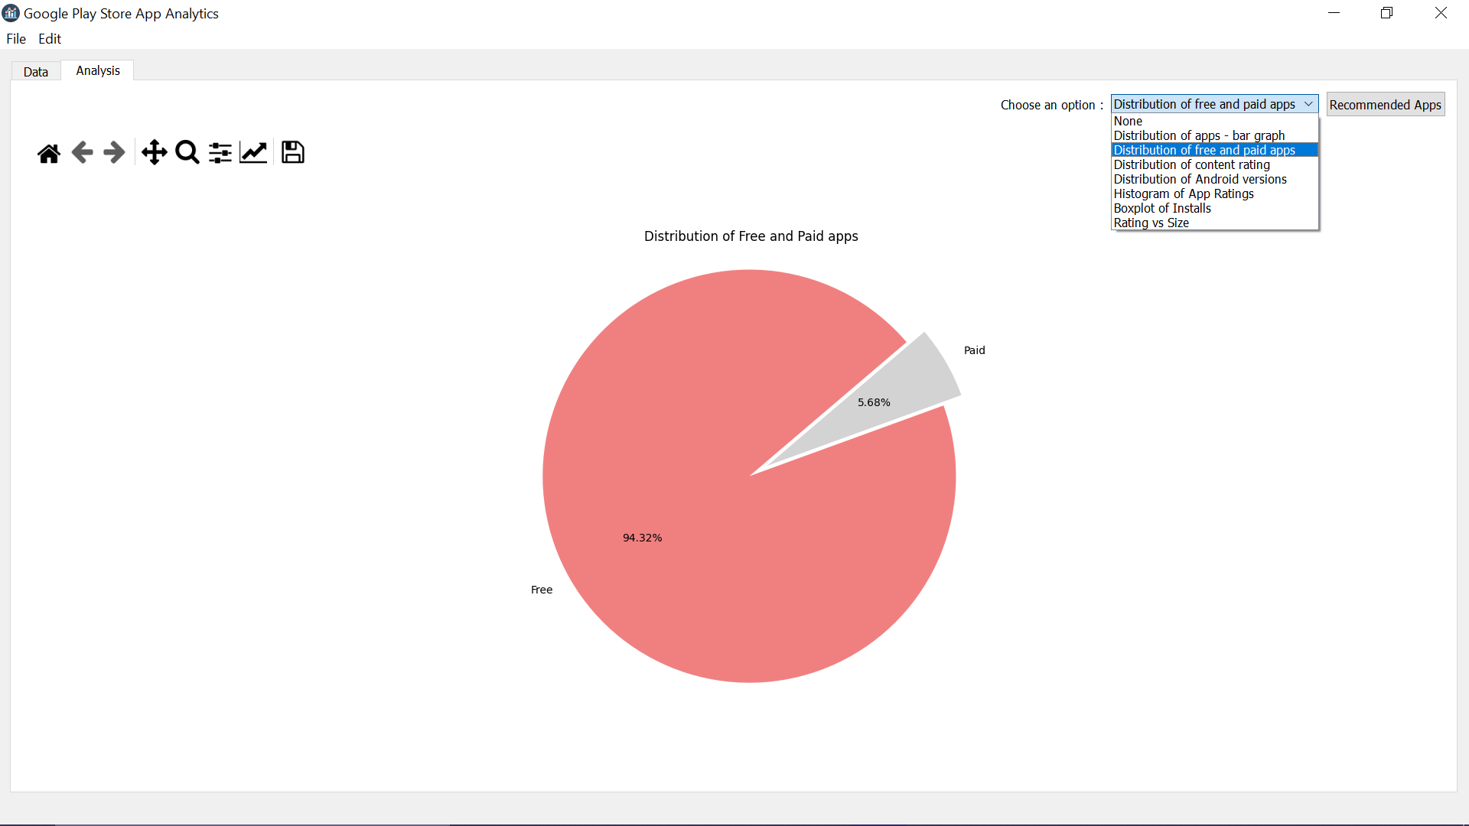
Distribution of Apps based on Type
-Pie Chart
Pie-chart is created with help of pandas and matplotlib library from mongoDB Query and from the graph its shows that largest number of Apps are Free (>94%) and exploding portion consists of paid Apps(<6%).

Slide 16
Distribution of content Rating of Apps
-Pie Chart
Pie-chart is created with help of pandas and matplotlib library from mongoDB Query and from the graph its shows that largest number of Apps have “Everyone”(including all age group) as content rating (77.76%) and exploding portion have others.

Slide 17
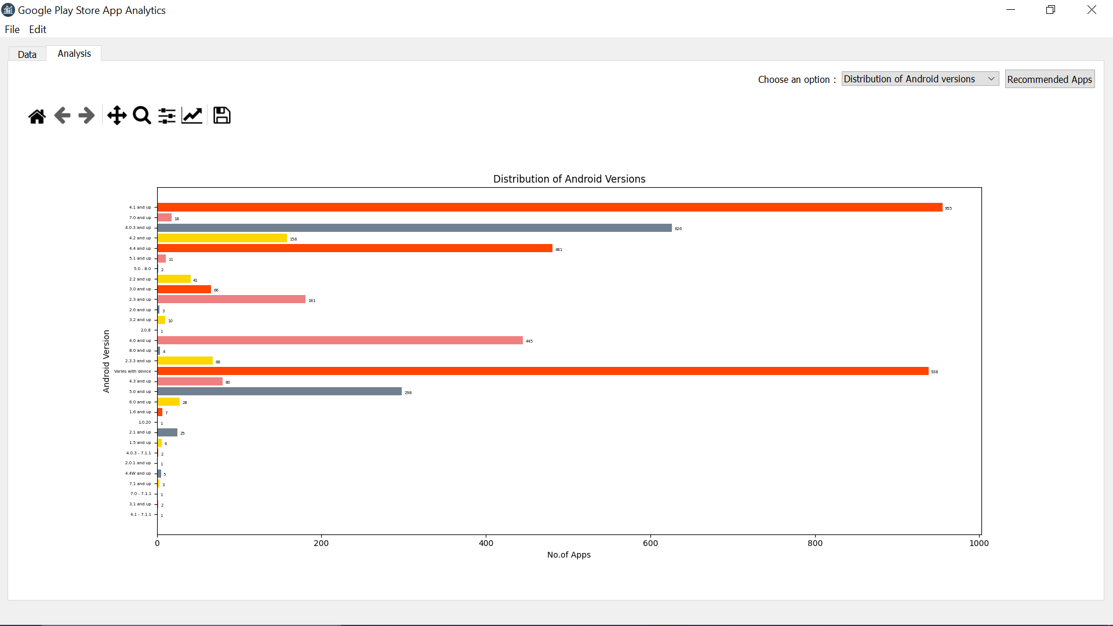
Distribution of Android Version of Apps
-Bar Graph
From the graph its shows that highest number of Apps contains the version 4.1 or above ( >900 ) or have variable version based on device and very few have 2.1 or above ( ~1 ) .

Slide 18
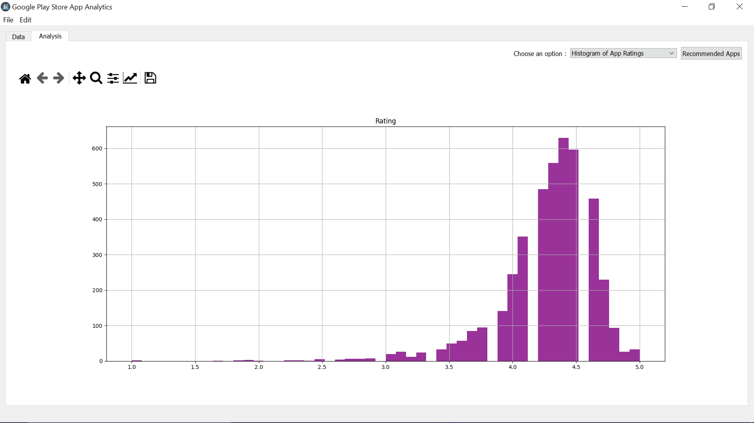
Graph Representation based on App Rating
-Histogram
Histogram is a visual representation of the distribution of numerical data in range.
It is created with help of pandas and matplotlib library where data extracted from mongoDB Query .The graph shows that highest number of rated Apps falls in the range of 4.0 - 4.5.

Slide 19
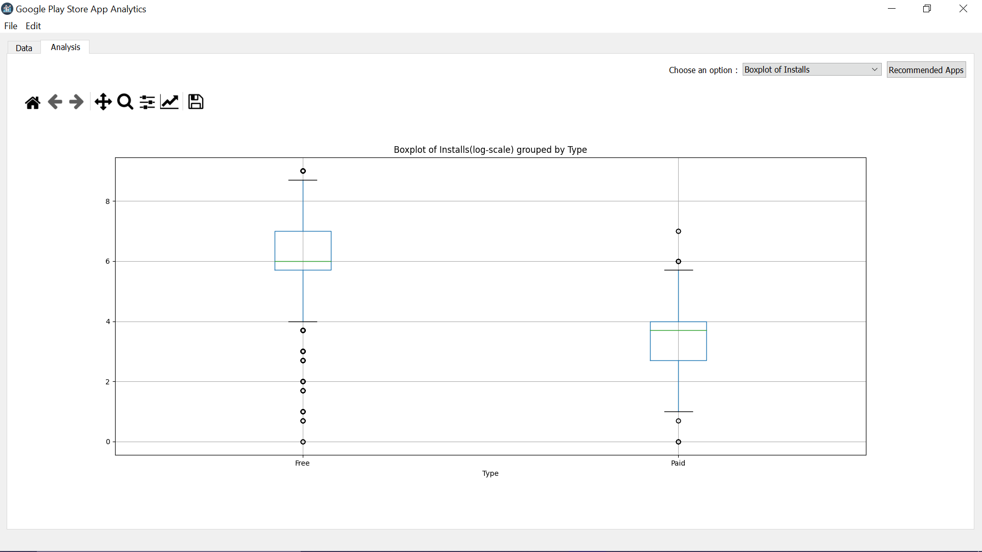
Distribution of Installs group by App Type
-Box Plot
Summary Free Paid
Median 6.0 3.7
IQR ( 5.7 - 7.0 ) ( 2.7 - 4.0 )
Box plot is a visual representation of the distribution of numerical data of number of Installs by Type of App in range. It is created by extracting data from mongoDB Query .The graph shows two batches of two types paid and free.

Slide 20
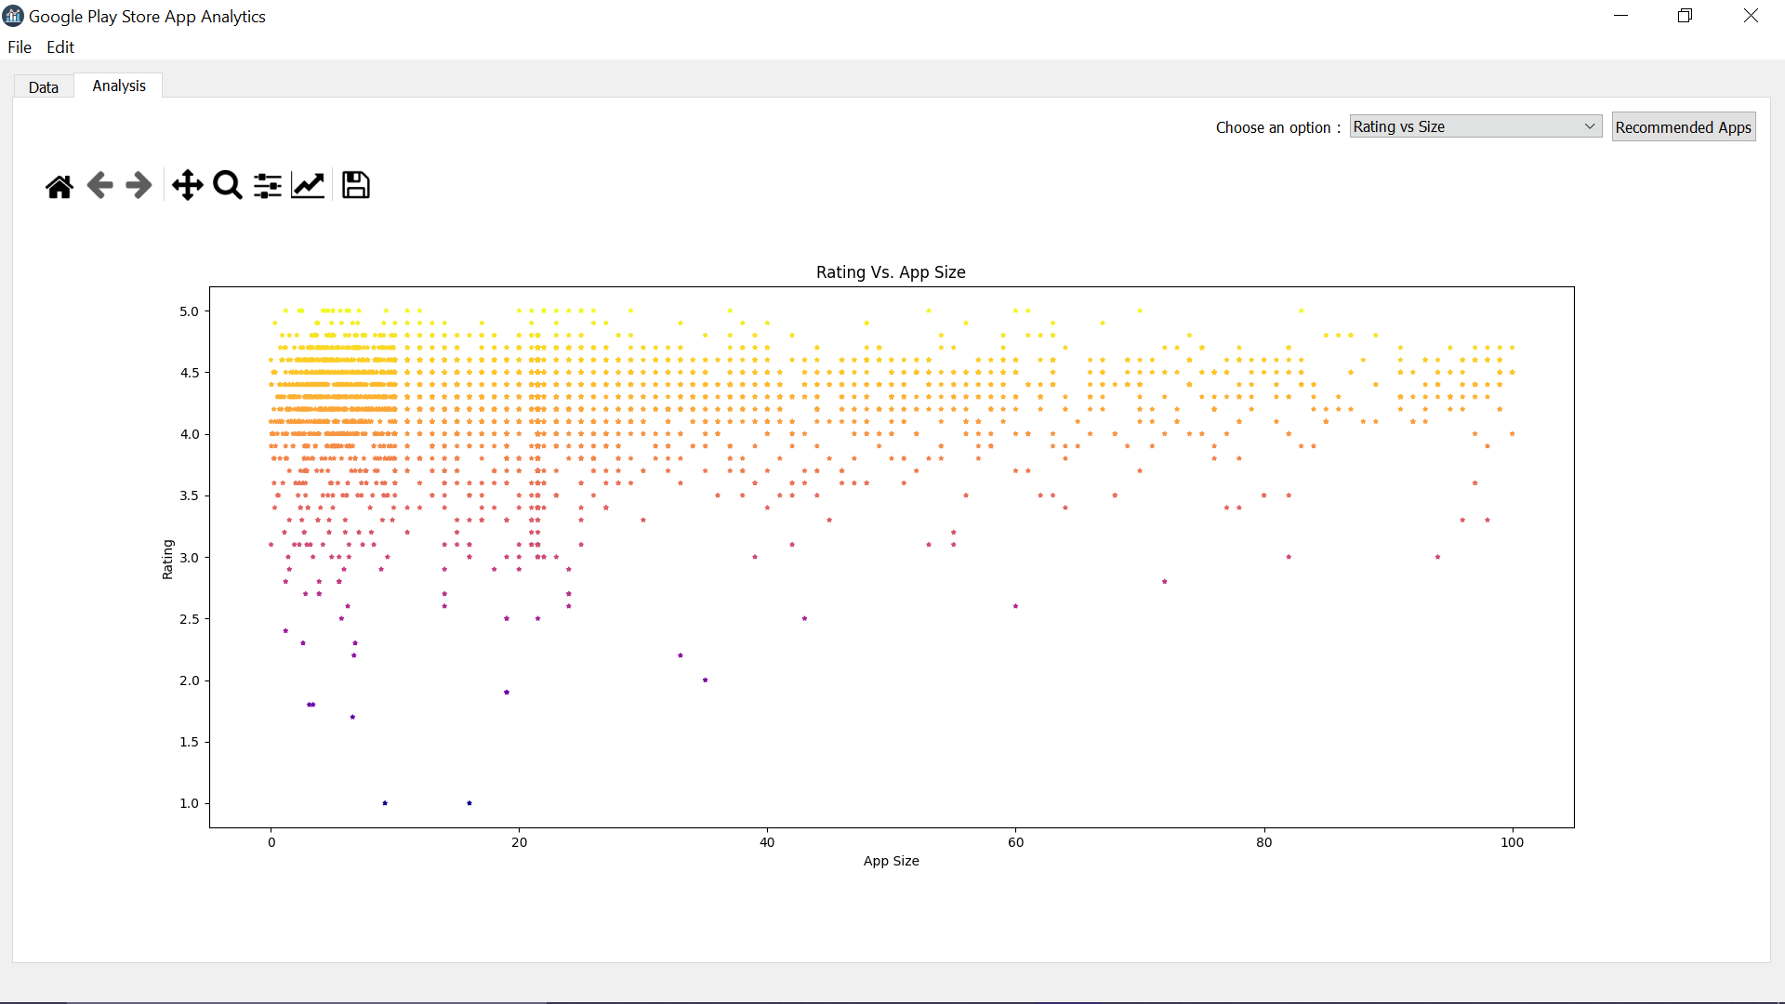
Graph Representation of Rating vs Size
-Scatterplot
Scatterplot is a visual representation of the distribution of numerical data. It is created with help of pandas and matplotlib library where data extracted from mongoDB Query.
The pattern shows that the lesser the size of the app gives more user satisfaction resulting highest rating (~ 5.0 ).

Slide 21
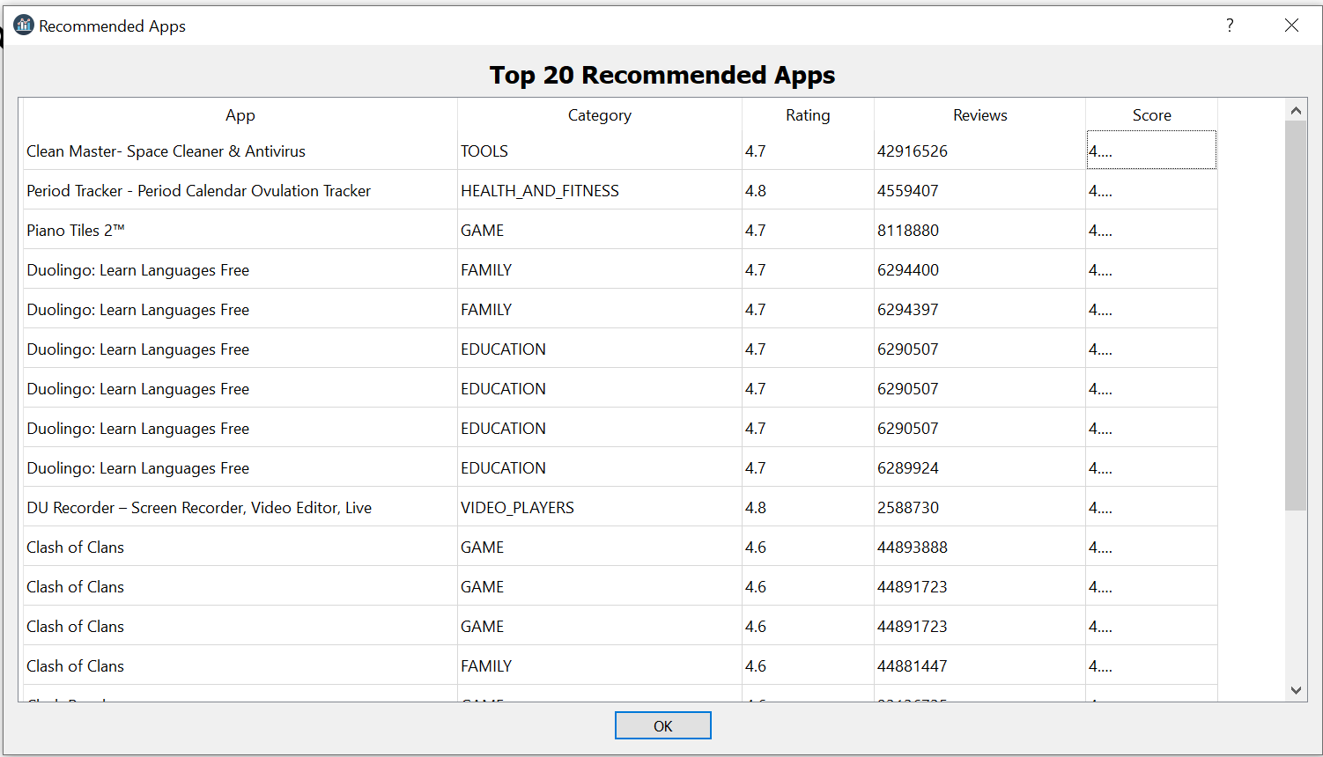
Data Recommendation based on Analysis
Demographic filtering is used to generate top 20 recommended Apps. Based on Rating and Reviews, a score is generated and using the score we can rank the records.
“ Clean Master- Space Cleaner & Antivirus ” is the most recommended app with rating 4.7 and highest number of reviews 4,29,16,526.

Slide 22

End of Presentation
THANK-YOU
https://github.com/Shehyaaz/BDA-Project

