Slide 1
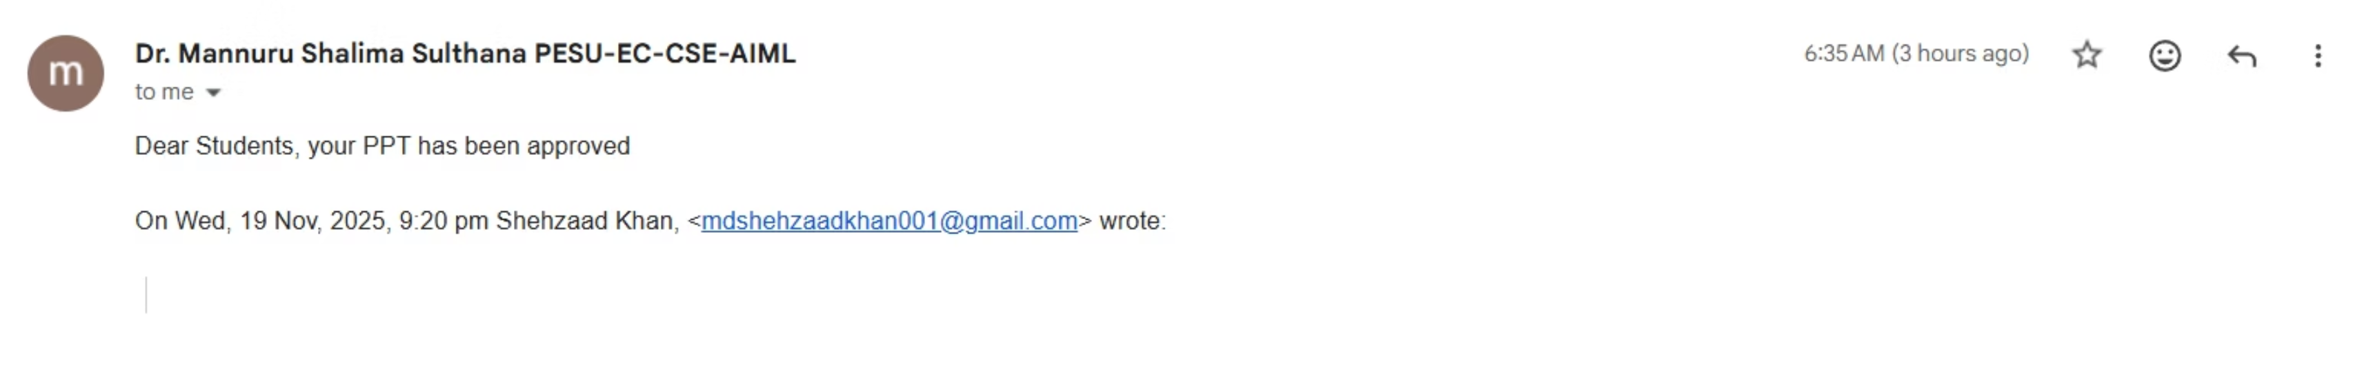


Slide 2
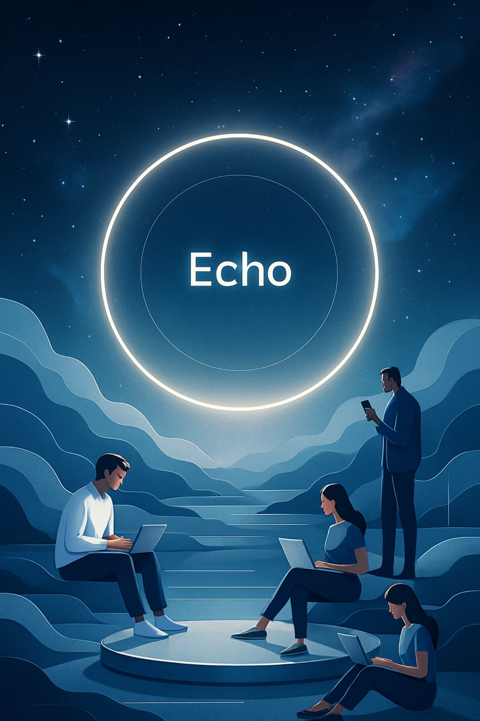
Capstone Project Phase – 1 (END-SEMESTER)
Project Details
Project Team
Project Title: E.C.H.O – Efficient Contextualized History Orchestrator
Arjun Sai N (PES2UG23CS091)
Mohammed Mir Fazlai Ali (PES2UG23CS346)
Mohammed Shehzaad Khan (PES2UG23CS349)
Project ID: 92
Project Guide: Dr. M. Shalima Sulthana
Mrigank Jain (PES2UG23CS352)

Slide 3

Agenda
Introduction and Motivation
Problem Statement
Abstract and Scope
Suggestions from Review – 1
Research / Technology gap and Challenges
Objectives
Literature Survey / Existing System
References

Slide 4


Introduction and
Motivation
The Challenge: Information Overload & Fragmentation
In today's digital era, we're constantly bombarded with information. Navigating through countless platforms like Gmail, browsing history, and YouTube playlists fragments our digital memory, leading to wasted time and cognitive overload. This widespread issue reduces productivity and overall well-being.
Echo: Your Unified AI Memory Logger
Echo was conceived to address this challenge head-on. Our motivation is to create a single, AI-powered platform that unifies your entire digital memory. By bringing all your fragmented information into one intelligent system, Echo drives enhanced productivity and promotes a greater sense of digital well-being.

Slide 5





Problem Statement: The Digital Memory Crisis
In our hyper-connected world, the promise of instant information often leads to the reality of digital chaos. We're facing a profound "digital memory crisis," where valuable insights and resources are constantly overlooked or lost.
Fragmented Digital Landscape
Inefficient Manual Search
Our digital lives are spread across a multitude of platforms. Critical information from Chrome browsing sessions, important details buried deep in endless Gmail threads, and valuable insights from countless YouTube videos are all siloed. This constant scattering of data makes it nearly impossible to maintain a cohesive understanding of our digital interactions.
The traditional method of finding previously viewed content is fraught with inefficiency. Users spend hours each week painstakingly searching through different apps, struggling to recall keywords or the exact platform where a piece of information was encountered. This manual process is not only slow but often unsuccessful, leading to frustration and wasted effort.
Significant Time & Productivity Drain
Lost Insights & Digital Clutter
This fragmentation and search inefficiency directly translate into a massive drain on time and productivity. Studies suggest professionals spend up to 2.5 hours per day searching for information. The effort spent rediscovering resources disrupts workflow, hinders focus, and diverts mental energy from more critical tasks, impacting overall output and job satisfaction.
Without a unified memory, important insights gained from past research, conversations, or content consumption are easily forgotten or lost in the digital clutter. This prevents us from building upon previous knowledge, leading to missed opportunities, duplicated efforts, and a growing sense of being overwhelmed by the sheer volume of unorganized digital assets. The result is reduced learning, innovation, and overall digital well-being.

Slide 6
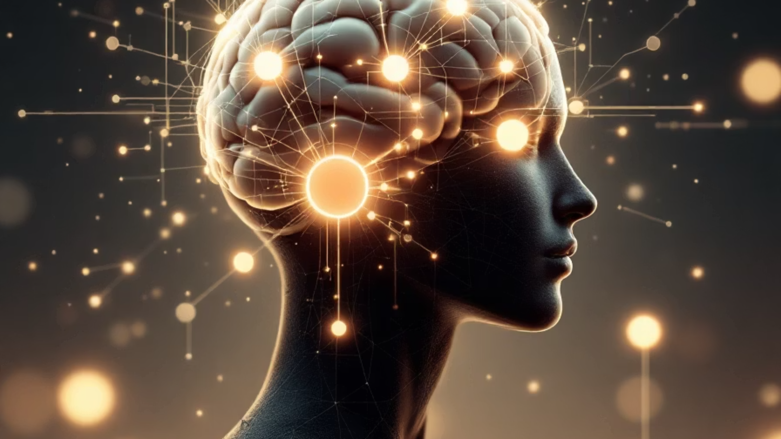




Abstract and Scope: Introducing Echo
Echo transforms your digital experience by creating a personalized, AI-powered memory of your online interactions. It's designed to bring clarity and control back to your hyper-connected world.
What Echo Is: Your AI Memory Extension
Echo is a Chrome-native extension that seamlessly integrates with your browsing, email, and video activity across Chrome, Gmail, and YouTube. It collects this activity into a privacy-first, AI-powered digital memory.
Key Capabilities: Intelligent Recall & Insights
Instant Recall: Find any page, mail, or video you've encountered using natural language search.
Personal Analytics: View insightful dashboards of your digital activity.
Habit Analysis: Automatically understand your online patterns.
Wellbeing Nudges: Receive smart reminders for healthier digital habits.
Technical Scope: Robust & Private Foundation
Full Integration: Seamlessly works across browser and cloud platforms.
Secure Storage: Offers on-device or serverless storage options.
Visual Dashboards: Intuitive visualizations for your digital landscape.
Privacy Controls: User-centric design ensures your data privacy is paramount.

Slide 7




Review 1 Feedback: Key Insights and Strategic Responses
We received valuable feedback from Review 1, which praised the project's innovative core idea and provided constructive suggestions for refinement and strategic development.
Acknowledged Innovation
Deeper Research & Complexity Analysis
Comprehensive Feature Implementation
The core concept was recognized as highly creative and promising. This positive validation strengthens our commitment to developing Echo's unique value proposition.
Suggestion to undertake more extensive research into relevant academic papers and to thoroughly map out the inherent complexities of integrating AI-powered memory functions across diverse digital platforms.
Emphasis on ensuring all proposed features and requirements are fully delivered in the final product, rather than prioritizing a subset, to fulfill the project's ambitious vision comprehensively.
Addressing the Feedback: Our Action Plan
We are actively integrating these suggestions into our development roadmap to enhance Echo's robustness and ensure its successful delivery:
Enhanced Research Phase: Initiating a dedicated research sprint to explore advanced literature and benchmark existing solutions for complexity management.

Slide 8

Research/Technology Gap and Challenges
Current solutions lack cross-platform unification and NLP-based recall for private, personal activities. Digital wellbeing often focuses on time spent, not on the intent or context.
Key challenges include:
Reliable data ingestion and synchronization
Instant, context-aware search (not just keyword)
Secure storage and privacy protection
Designing nudges that are helpful, not intrusive

Slide 9
Major TECHNOLOGY GAPS
Lack of Cross-Source Semantic Retrieval
Absence of Unified Personal Knowledge Graphs
No True Natural Language Retrieval for Personal Data
No Semantic Correlation Between Activities
Current systems cannot perform semantic search across Gmail + YouTube + Browsing history simultaneously. Each platform has its own search engine, but no unified semantic memory exists. Echo fills this gap by building a single vector-based memory combining all sources.
Most tools store data separately (emails, videos, browsing logs). There is no system that automatically builds a personal, cross-platform knowledge graph connecting past emails, watched videos, past browsing activities, topics and intent
Current platforms use keywords, filters, manual searching. There is no system that understands questions like: “Which articles did I read while researching internships?” Echo closes this gap using converting API ingestions to vector embeddings.
YouTube, Chrome, and Gmail work independently. There is no technology today that correlates: time, topic similarity, behavior, cross-platform patterns
Example gap: “During math exam , what videos do I usually watch and what emails do I receive?” Echo fills this gap by merging temporally aligned vectors.

Slide 10
COMPETITOR ANALYSIS
Google Gemini
Microsoft Recall
Rewind AI
Comet
Cannot access Chrome history; cannot combine Gmail + YouTube + browsing; no unified memory layer; no persistent personal database; no personalized analytics.
Works only on Copilot+ hardware; privacy concerns; no Gmail API or YouTube API; only captures screen, not structured semantic data.
Doesn't truly integrate Gmail or YouTube via API; relies on screen capture; not cross- platform; heavy resource usage; no Chrome-extension chat interface
Integrations are not deeply semantic: they sync raw data but do not support RAG-based natural-language querying across combined sources. No unified cross- source analytics.

Slide 11
Project Objectives & Roadmap
1. Chrome Extension Development
2. AI Integration for Semantic Recall
3. Personalized Wellbeing Analytics
Build a robust Chrome extension to unify personal digital activities across key platforms like Gmail, YouTube, and general web browsing, moving beyond mere time tracking to capture intent and context.
Integrate advanced AI models (GPT/Claude) to enable semantic understanding and recall of personal information, allowing users to find content based on context and intent rather than just keywords.
Design intuitive dashboards that provide personalized insights into digital habits, supporting digital wellbeing through actionable analytics and non-intrusive nudges.
Deliverables: Functional Chrome extension, seamless integration with Gmail, YouTube, and browser history APIs.
Deliverables: AI model training and deployment, semantic search engine, natural language query processing.
Deliverables: User-facing dashboards with customizable visualizations, personalized insights engine, notification system for wellbeing nudges.
Success Criteria:Extension reliably tracks and contextualizes user activity across Gmail, YouTube, and browsing history without performance issues or privacy breaches.
Success Criteria: 85% accuracy in contextual information retrieval; reduce search time by 50% for users compared to traditional keyword search.
Success Criteria: 75% positive user feedback on the helpfulness of insights; 20% reduction in reported digital fatigue among regular users.
4. Privacy-Preserving Storage & Retrieval
5. Deployment, Testing & Refinement
Develop a highly secure architecture for storing and retrieving personal data, ensuring end-to-end privacy and compliance with global data protection regulations.
Implement an agile deployment process, rigorous testing protocols, and a continuous feedback loop to iteratively refine user-facing features and ensure a high-quality product.
Deliverables: Encrypted local and cloud storage solutions, robust access control mechanisms, privacy policy and user consent flows.
Deliverables: Staged deployment pipeline, comprehensive UAT plan, user feedback collection system, rapid iteration cycles.
Success Criteria: Zero data breaches or unauthorized access incidents; 100% compliance with GDPR and CCPA requirements.
Success Criteria:System is deployed smoothly across stages, passes all UAT tests, and incorporates user feedback effectively to enhance stability and user experience.

Slide 12
Literature Survey
Recent research advances AI-powered personal memory search and wellbeing analytics, but most systems lack true multi-platform integration and user privacy. Echo aims to solve these gaps with unified, semantic, and actionable memory recall across browser, Gmail, and YouTube.
Unified structure and content search.: Makes it easier to search for information across emails, folders, and notes by combining different types of data.
Retrieval-Augmented Generation.: Uses AI to get relevant answers by fetching and generating responses from stored information, improving accuracy.
Microsoft Patent: Lets you search your browser history with AI that understands your question, making it faster to find past websites.
JMIR Review: Explains how AI tools can track your digital habits and help you improve your screen-time balance.
browsing behavior analysis: Analyzes browsing behaviors using data mining, helping figure out patterns of productivity and distraction.
PersonaRAG Contextual Agents.: Introduces agents that give personalized responses and recommendations by understanding a user's context and information needs.

Slide 13

Literature Survey – Table
Details of Paper (Title, Author, Conference/Journal)
Methodology Used
Result
Limitations
Cognitive Workspace: Active Memory Management for LLMs – Chen, K., et al., 2025 (arXiv)
Empirical study on AI memory mechanisms. Uses long-context retention and active memory filtering to keep only important past interactions.
Demonstrates that AI can retain relevant context over long sessions, improving response continuity .
Designed mainly for conversational AI, not for digital history or multi-platform data. Requires high computation for storing extended memory.
Retrieval-Augmented Generation, Lewis et al. - NeurIPS
AI model fetches supporting info before reply
Answers are more accurate and backed by data
Not made for personal info
Microsoft, "Smart Browser History Search," U.S. Patent WO2022265744A1, 2022.
Uses NLP and semantic indexing
Lets users ask natural questions about web history
Works only for browsing history
Review: Human-Centered AI for Wellbeing, - JMIR
Compares AI digital wellbeing tools
Shows AI can help manage screen time and habits
Tools are often hard to customize
Browsing Behaviour Analysis, IJ 2019- IEEE
Data mining on browsing logs
Finds patterns of focus and distraction online
Only analyzes browser, not email
PersonaRAG Contextual Agents, Li et al. - arXiv
Agents tailor answers using user context
Gives more personal and helpful recommendations
Prototype, not in wide use
On Memory Construction and Retrieval for Personalized Conversational Agents, Zhang et al. - arXiv
Segments conversation by topic and compresses/denoises each segment
Finds relevant, noise-free memories for better personalized agent responses
Needs accurate topic detection and good compression; newer method
Machine Learning for Web Content Classification, Proc. IEEE ICMLA, 2020
SVM, Naive Bayes, Random Forest comparison. TF-IDF (10K features). 9 web categories
SVM: 91.2% accuracy (best). Per-category: Adult 96.8%, News 94.2%, Shopping 92.1%
Fixed categories; no personalization; static model; web-only

Slide 14

DATASET EXPLORATION
AVAILABILITY
SOURCE
SIZE
Real-time, dynamically generated
Chrome browsing activity (URLs, metadata)
Grows continuously with usage
Private & user-specific
High-dimensional (text + embeddings)
Never publicly accessible
Gmail threads & message metadata
Includes behavioural interaction logs
Continuously updating data stream
YouTube watch history & video data
Scales to thousands of events weekly
Not sourced from static repositories
Chrome Extension content scripts
Designed for heavy user activity patterns
API-based ingestion (History, Gmail, YT APIs)

Slide 15

DATA PREPROCESSING
Based on the nature and sources of the data (web pages, emails, video metadata), the required preprocessing for the AI model:
Data Ingestion and Synchronization
API/Extension Polling and Synchronization: Implementing reliable mechanisms to ingest and synchronize data in real-time from different APIs (Gmail, YouTube, Chrome History) and the Chrome Extension scripts. This ensures all fragmented data is collected accurately.
Cleaning and Standardization
Noise Removal: Removing elements from scraped web content and emails that are irrelevant to the context (e.g., website headers/footers, ads, email signatures, redundant forwarding text).
URL Standardization: Canonicalizing URLs (e.g., removing tracking parameters or utm tags) to treat the same page accessed slightly differently as a single memory item.
Timestamp Normalization: Ensuring all activity logs (from Chrome, Gmail, YouTube) use a uniform time zone and format for accurate timeline analysis.

Slide 16

DATA PREPROCESSING
Feature Extraction and Natural Language Processing (NLP)
Text Extraction: Extracting the main body text from web pages, the subject and body from emails, and titles/descriptions from videos.
Tokenization: Breaking down the extracted text into words, sentences, or sub-word units, which is a prerequisite for most NLP tasks.
Contextualization and Tagging: Generating metadata that goes beyond mere time tracking to capture intent and context. This could involve auto-tagging content (e.g., "Research," "Entertainment," "Work-related") or identifying key entities (names, dates, organizations).
Text Embedding Generation: Using techniques like Large Language Models (LLMs) or other advanced AI models to convert the textual data into high-dimensional vectors (embeddings). These embeddings are crucial for semantic understanding and natural language search/recall.
Privacy and Security Preprocessing
Encryption: Implementing strong encryption on the data, especially since the project emphasizes on-device or serverless secure storage and robust privacy controls.
Anonymization/Pseudonymization (If Needed): While the data is user-specific, if any part of the processing requires sharing information across services or models, techniques to de-identify highly sensitive personal information would be necessary to ensure compliance with privacy regulations.

Slide 17

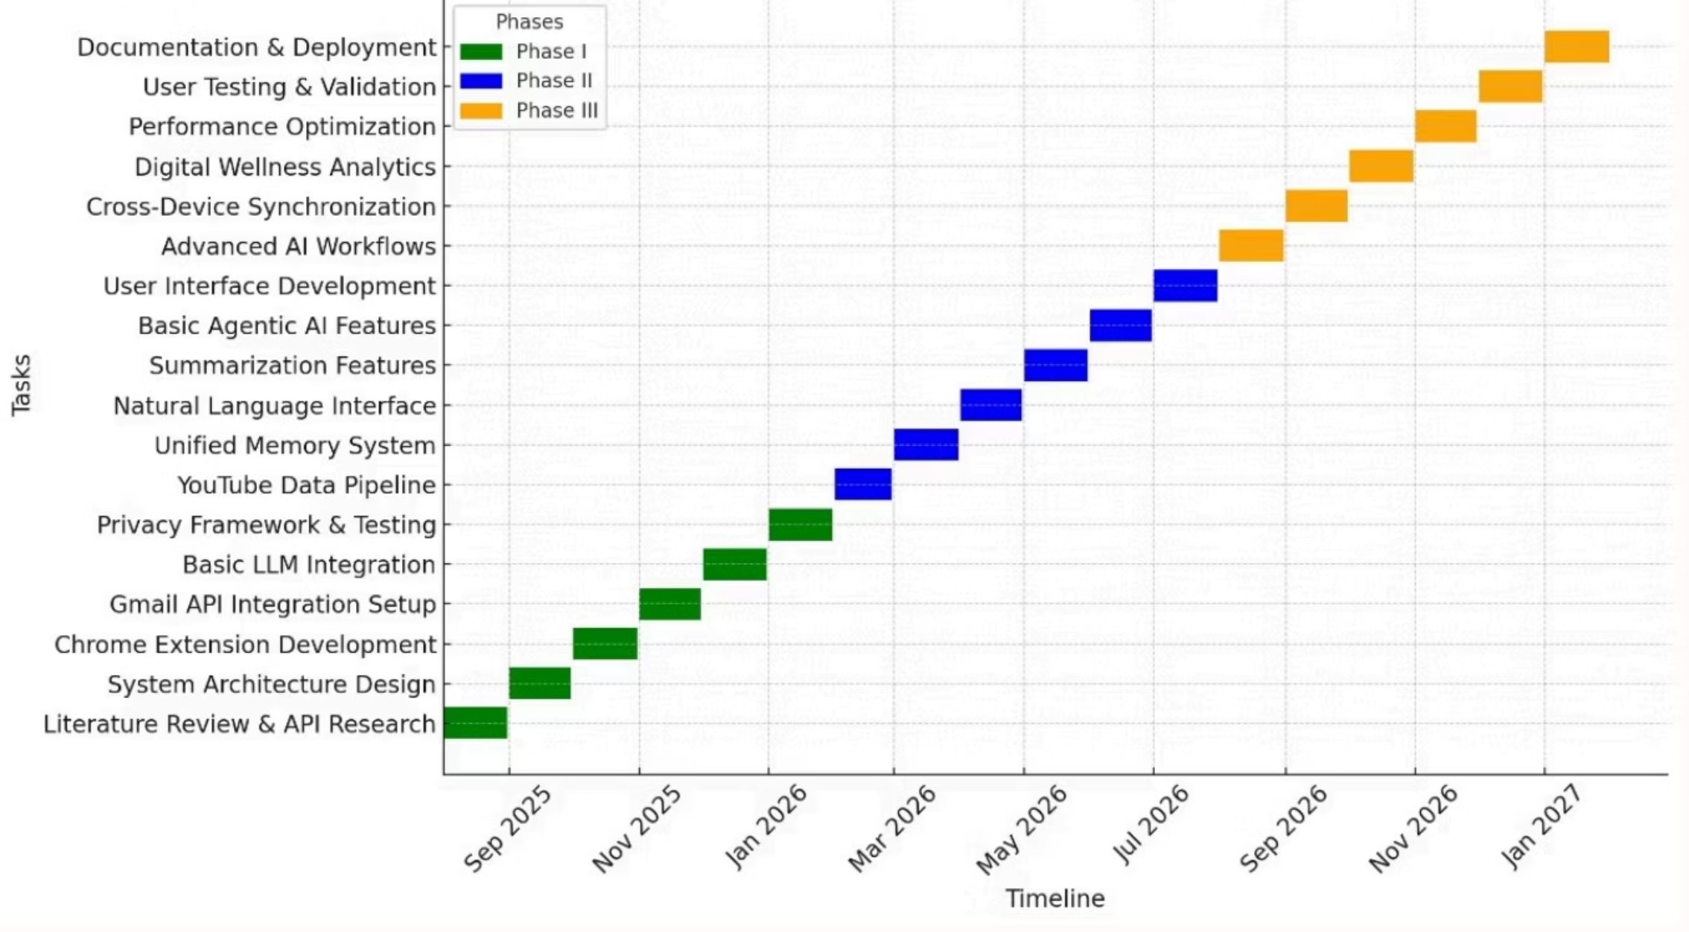
Capstone Phases and Timeline

Slide 18




Capstone Phases and Timeline
Arjun Sai N
Mohammed Mir Fazlai Ali
Main Responsibility: Chrome Extension & Unified Search
Main Responsibility: Analytics & Digital Wellbeing Module
Key Tasks and Deliverables: Setup extension, API integration, unified search features, data flow, permissions
Key Tasks and Deliverables: Design and implement activity analytics, wellbeing reports, regret button, summaries, dashboard for behavioral nudges
Mohammed Shehzaad Khan
Mrigank Jain
Main Responsibility: UI/UX & AI/ML Integration
Main Responsibility: Testing, Documentation & Security
Key Tasks and Deliverables: Create interface mockups/design, frontend widgets/dashboard, notifications, natural language module/AI engine, “One-Click AI Summarizer”, browser automation features
Key Tasks and Deliverables: Oversee security/privacy practices, coordinate comprehensive testing (unit/integration), write and maintain documentation, support onboarding new features/add-ons
01
02
03
Capstone-I: Foundation
Capstone-II: Core Features
Capstone-III: Advanced & Deployment
Literature Review & Gap Analysis
Unified Memory System (Chrome, Gmail, YouTube)
Full Chrome Extension (Regret/Reminder)
UI Prototype (History/Recall)
LLM-powered Recall & Summarization
Cross-device Synchronization
Data Flow & Security Design
User Analytics & Behavior Tracking
User Pilot Study & Feedback
Initial Privacy Testing
Intermediate Testing & Validation
Final Stable Deployment
API Integration (Gmail, Chrome, YouTube)
System Design & Testing Documentation
Technical Report & Presentation
First Proof of Concept (History + Email)

Slide 19




Echo: Redefining Digital Memory
Over the past few months, tech giants like Microsoft, Google, and others have launched ambitious tools, validating the critical need for digital memory solutions. However, despite the hype, these systems consistently fall short of achieving true unified recall across browsing, email, and video platforms. Here's why:
Microsoft Recall
Comet Browser
Relies on continuous screenshots, failing to link emails, browsing, or video history. Struggles with context and raises significant privacy concerns due to its data collection methods.
Connects Gmail and YouTube but uses isolated API calls, preventing genuine cross-source insights like "emails related to videos I watched." Heavily dependent on cloud infrastructure and tracking.
ChatGPT Atlas / Browser Assistants
Google Gemini
Offers AI assistance but critically lacks integration with Gmail history, YouTube watch data, or comprehensive Chrome browsing history, providing an incomplete memory solution.
Currently supports only limited Gmail tasks, offering no multi-platform recall capabilities for a truly unified digital memory experience.
Why Echo Stands Alone: Unmatched Innovation
Echo doesn't just fill the gaps; it redefines what's possible in personal digital memory. We offer a comprehensive, privacy-first solution that truly unifies your digital world:
True Cross-Source Correlation
Local-First, Privacy-First Design
Insightful Wellbeing & Behavioral Analytics
Achieve seamless recall across Gmail, YouTube, and browser history, all indexed in one powerful, unified system.
Enjoy unparalleled privacy with our architecture that operates without screenshot capture , keeping your data secure and personal.
Gain valuable insights into your digital habits with metrics on focus time, media consumption, and overload indicators, empowering healthier digital choices.
Academic Value & Advanced Technology
Hardware-Agnostic & Cross-Device Compatibility
Built on cutting-edge research, featuring optimal O(log N) search, privacy-preserving RAG, and multi-source semantic indexing for superior performance.
Unlike competitors tied to specific hardware or browsers, Echo works seamlessly across all your devices, adapting to modern browsing patterns like YouTube Shorts.

Slide 20
Conclusion
The current wave of "unified recall" tools confirms the urgency of this problem. However, none achieve true unification, often relying on flawed methods like screenshots or lacking personal data integration. Echo uniquely delivers a privacy-preserving, semantically unified, cross-platform personal memory system, backed by rigorous academic research. While competitors validate the market, Echo claims the uncharted territory: true unified recall with wellbeing intelligence, designed through principled research rather than rushed commercial deployment.
Future Vision (Planned & Possible Add-Ons):
One-Click AI Summaries: Instantly summarize any webpage or video you're viewing with a single click—no copy-paste needed.
Automation of Common Tasks: Seamlessly order food, book tickets, save important resources, or schedule meetings without ever leaving Echo.
Echo: Because your digital memory deserves to be more than just a grain lost in the husk. It deserves to be a powerful, organized, and truly yours.

Slide 21

References
[1] P. Lewis et al., "Retrieval-augmented generation for knowledge-intensive NLP tasks," in Proc. NeurIPS, 2020.
[2] K. Chen et al., "Cognitive Workspace: Active Memory Management for LLMs—An Empirical Study of Functional Infinite Context," arXiv preprint arXiv:2508.13171, 2025.
[3] J. Li, T. Zhao, and W. Xu, "PersonaRAG: Enhancing retrieval-augmented generation systems with user-centric agents," arXiv preprint arXiv:2407.09394, 2024.
[4] Microsoft, "Smart Browser History Search," U.S. Patent WO2022265744A1, 2022.
[5] "Browsing Behaviour Analysis," in Proc. IJ Conf., IEEE, 2019.
[6] "Review: Human-Centered AI for Wellbeing," J. Medical Internet Research (JMIR), 2024.
[7] H. Zhang, Y. Li, and W. Xu, "On memory construction and retrieval for personalized conversational agents," arXiv preprint arXiv:2502.05589, 2025.
[8] "Machine Learning for Web Content Classification," in Proc. IEEE Int. Conf. Machine Learning and Applications (ICMLA), 2020, DOI: 10.1109/ICMLA52953.2020.9259833.

