Slide 1
Day 3 API Integration and Data Migration

Slide 2
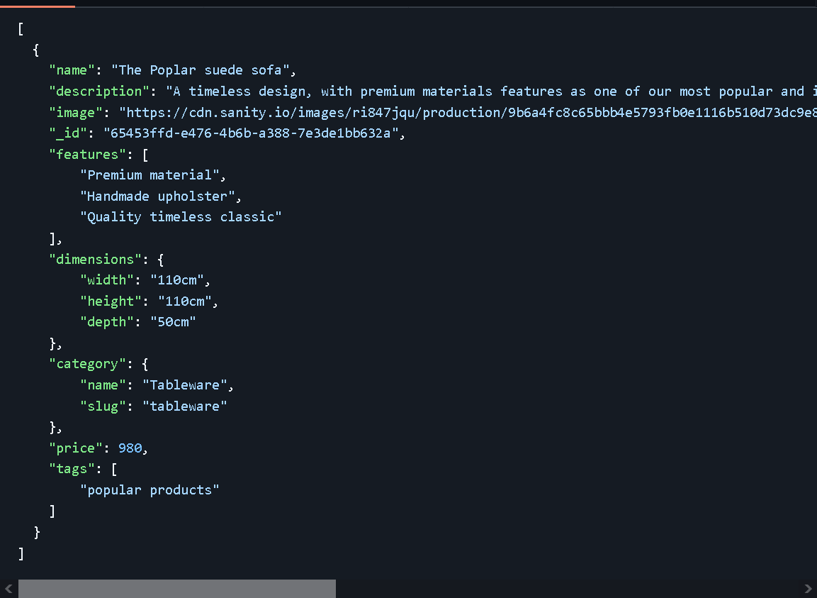
API Example.json

Slide 3
Migrate API Data into Sanity

Slide 4
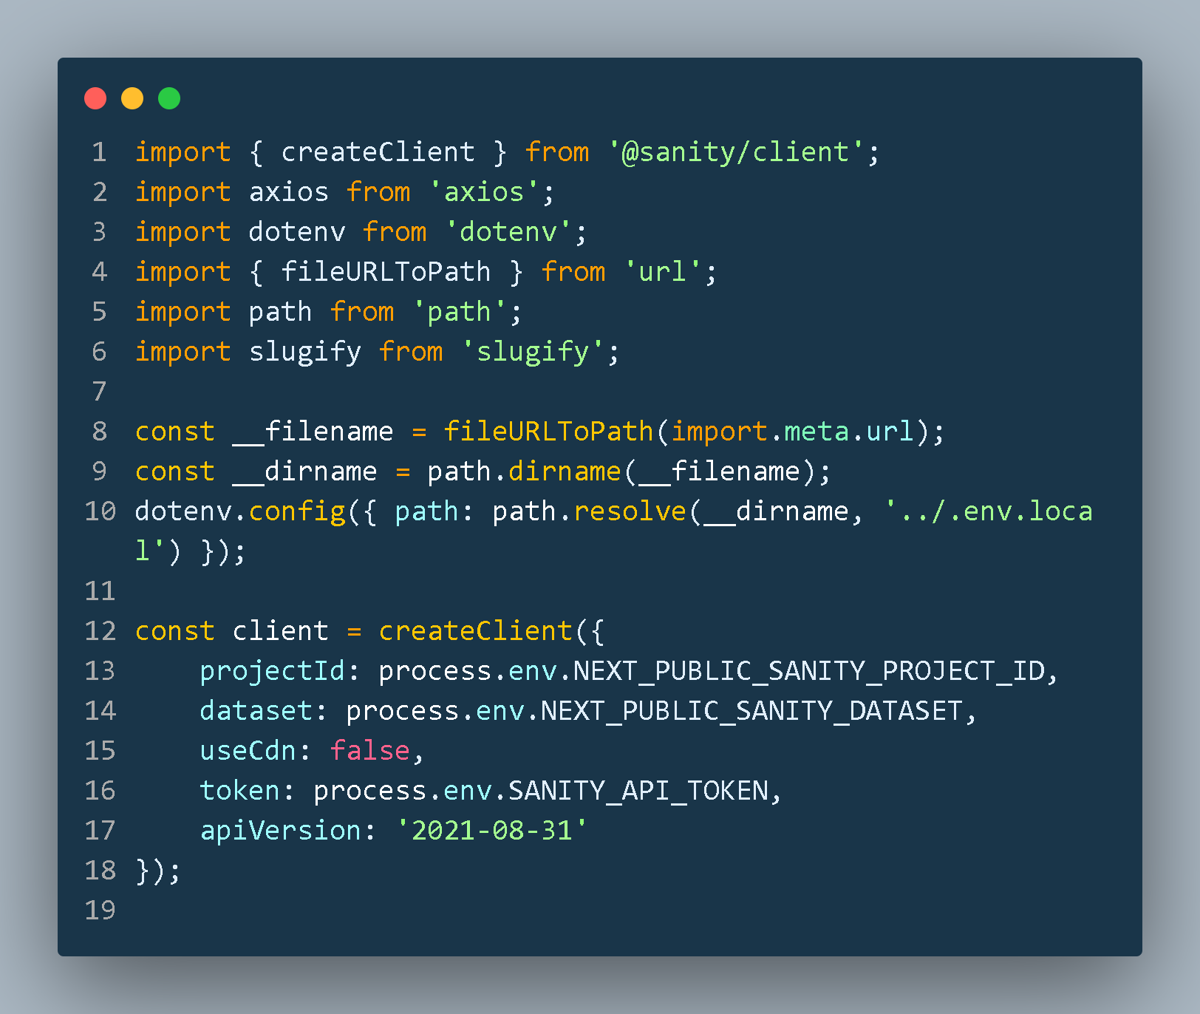
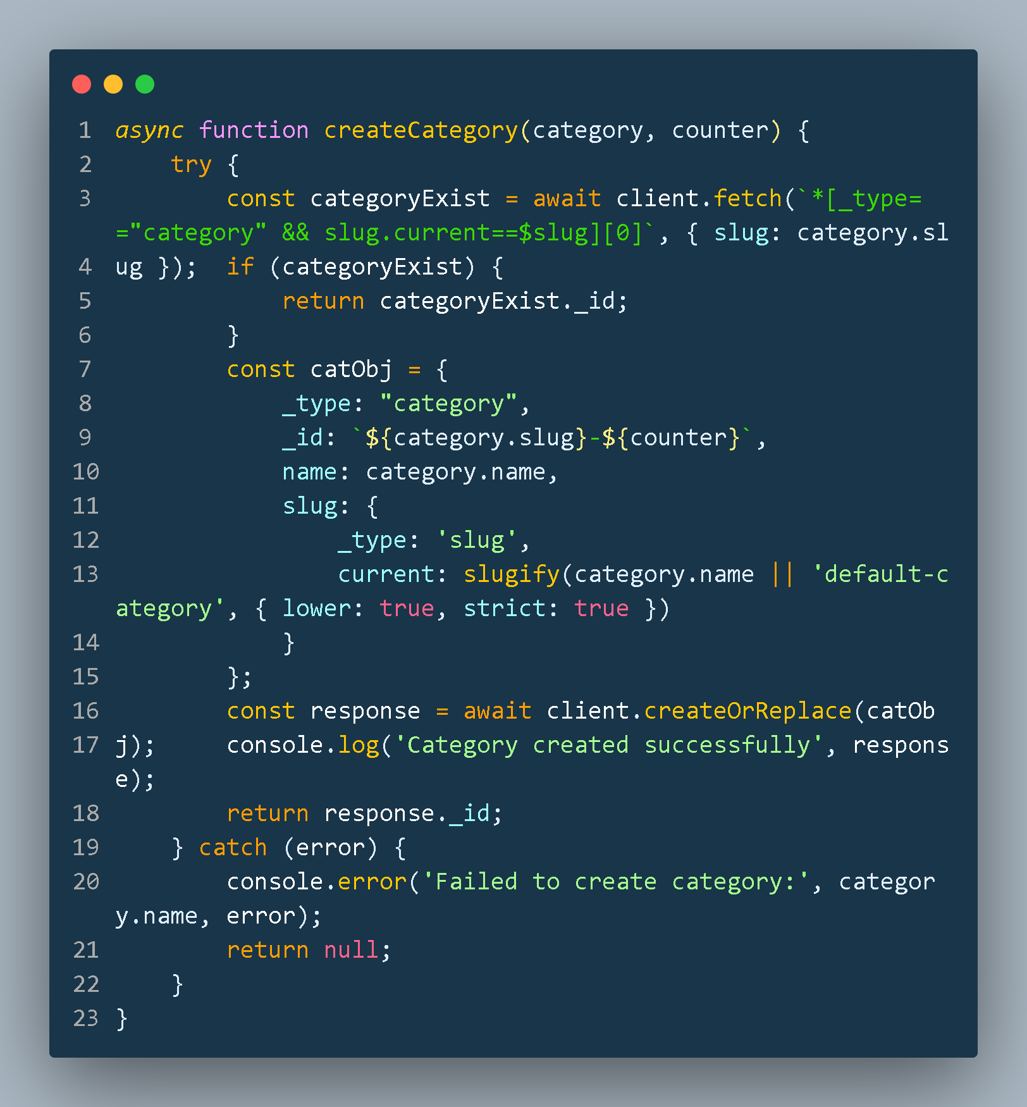
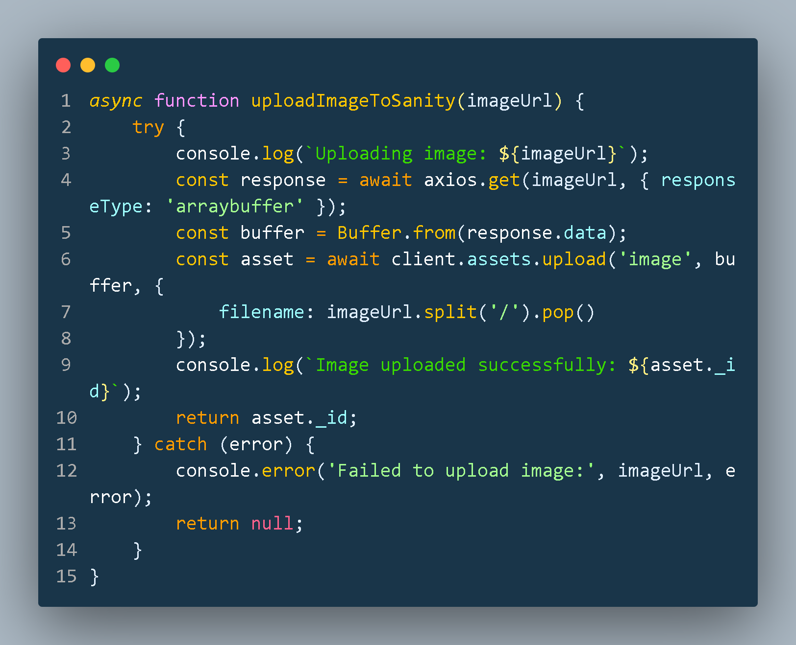

Slide 5
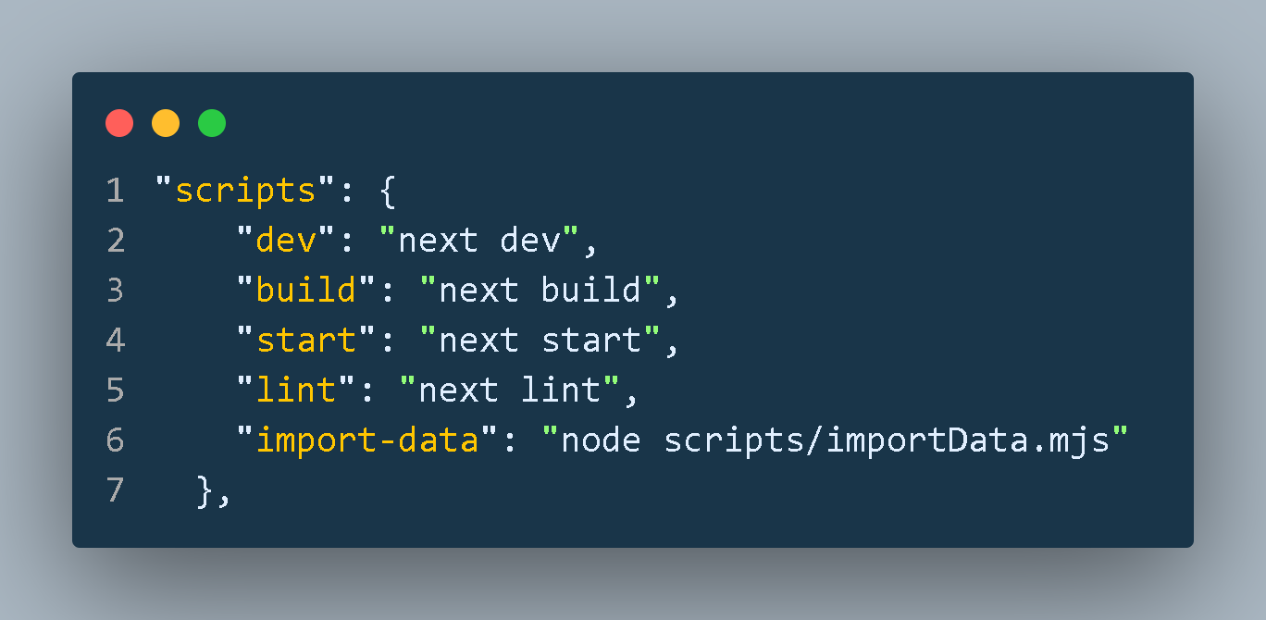
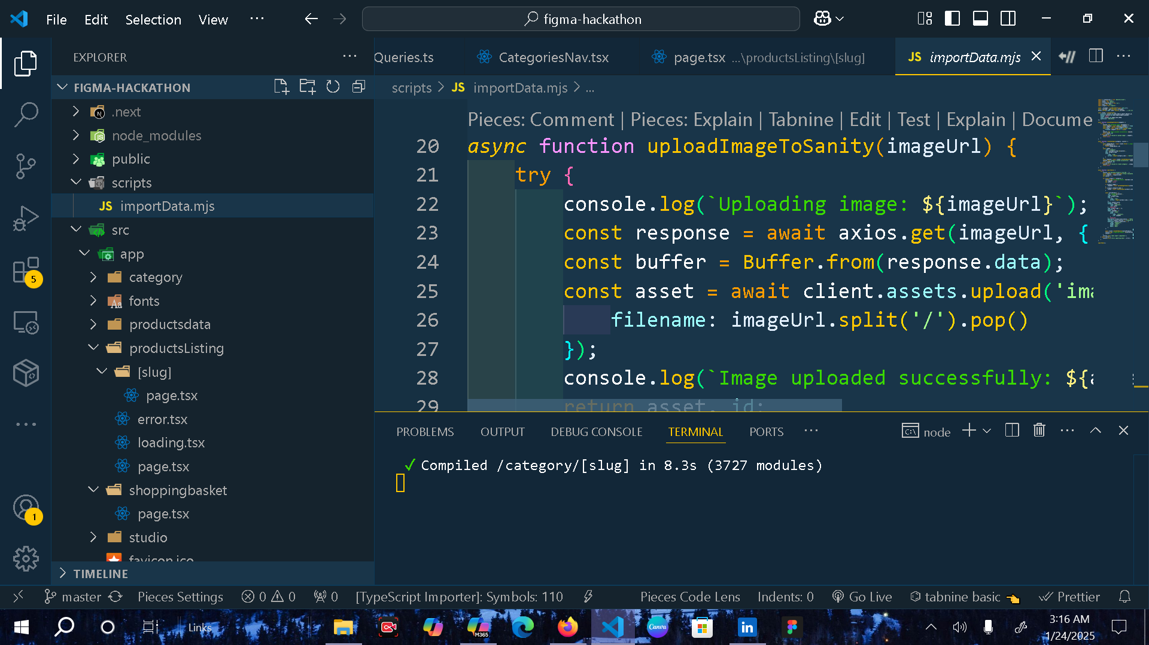
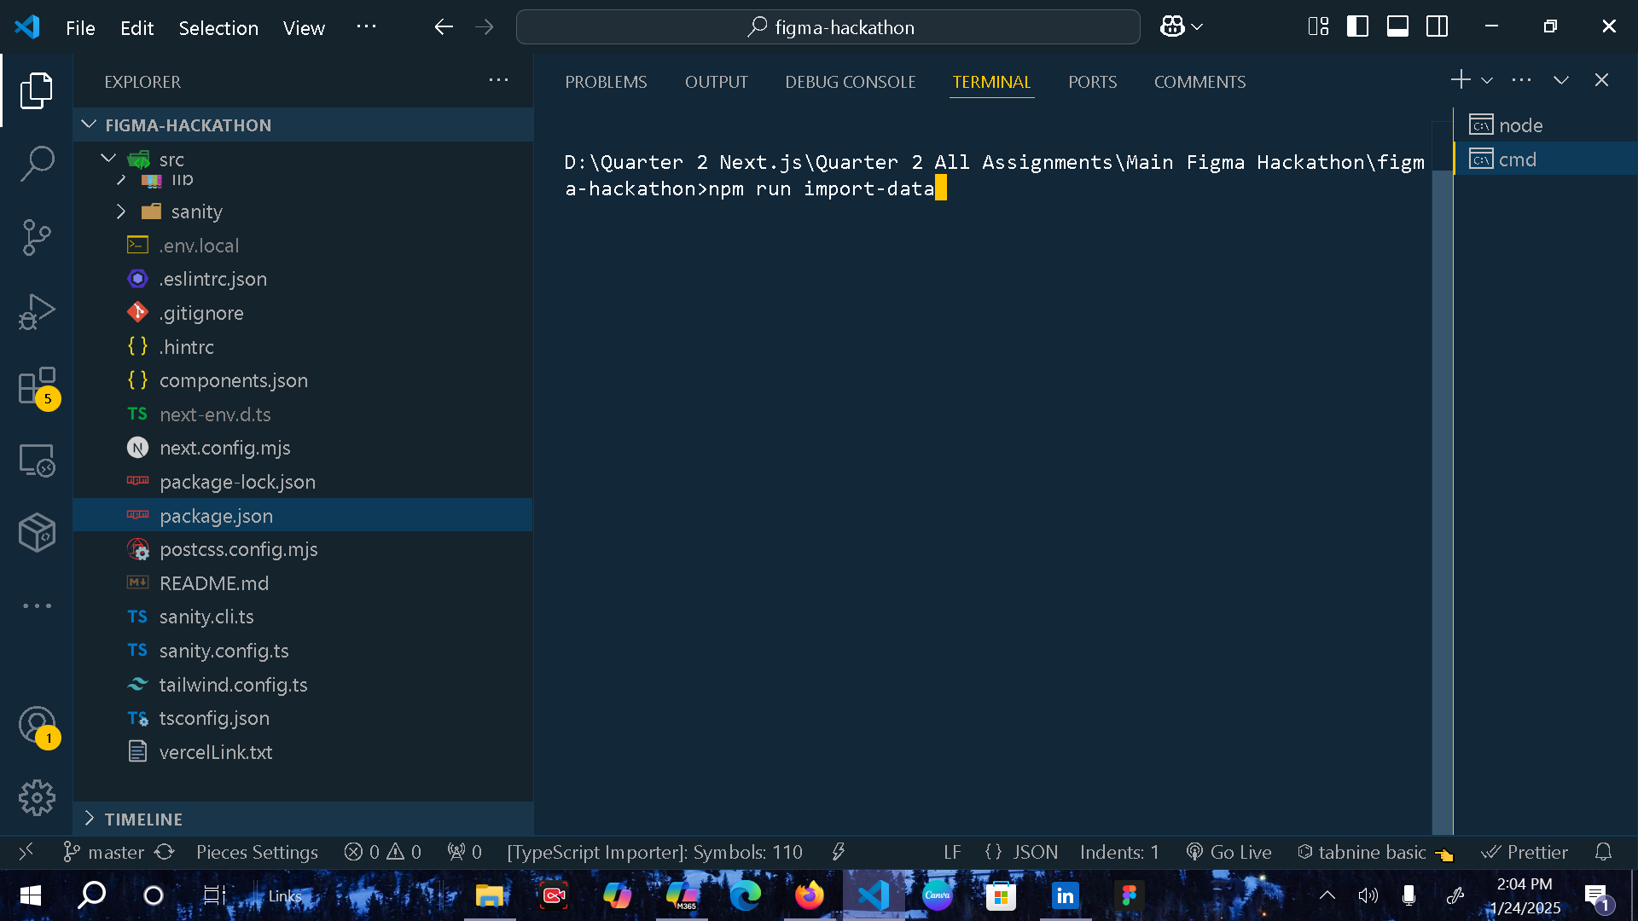
Run API Script
Create a scripts folder outside of src folder and create a file for import api data with .mjs extensioninside the scripts folder
2) Then add this line of code in package.json file inside scripts object to create a npm command
3) Now run this command in terminal to migrate data from an API to Sanity

Slide 6
The Data Migration Completed Successfully and Imported in Sanity

Slide 7
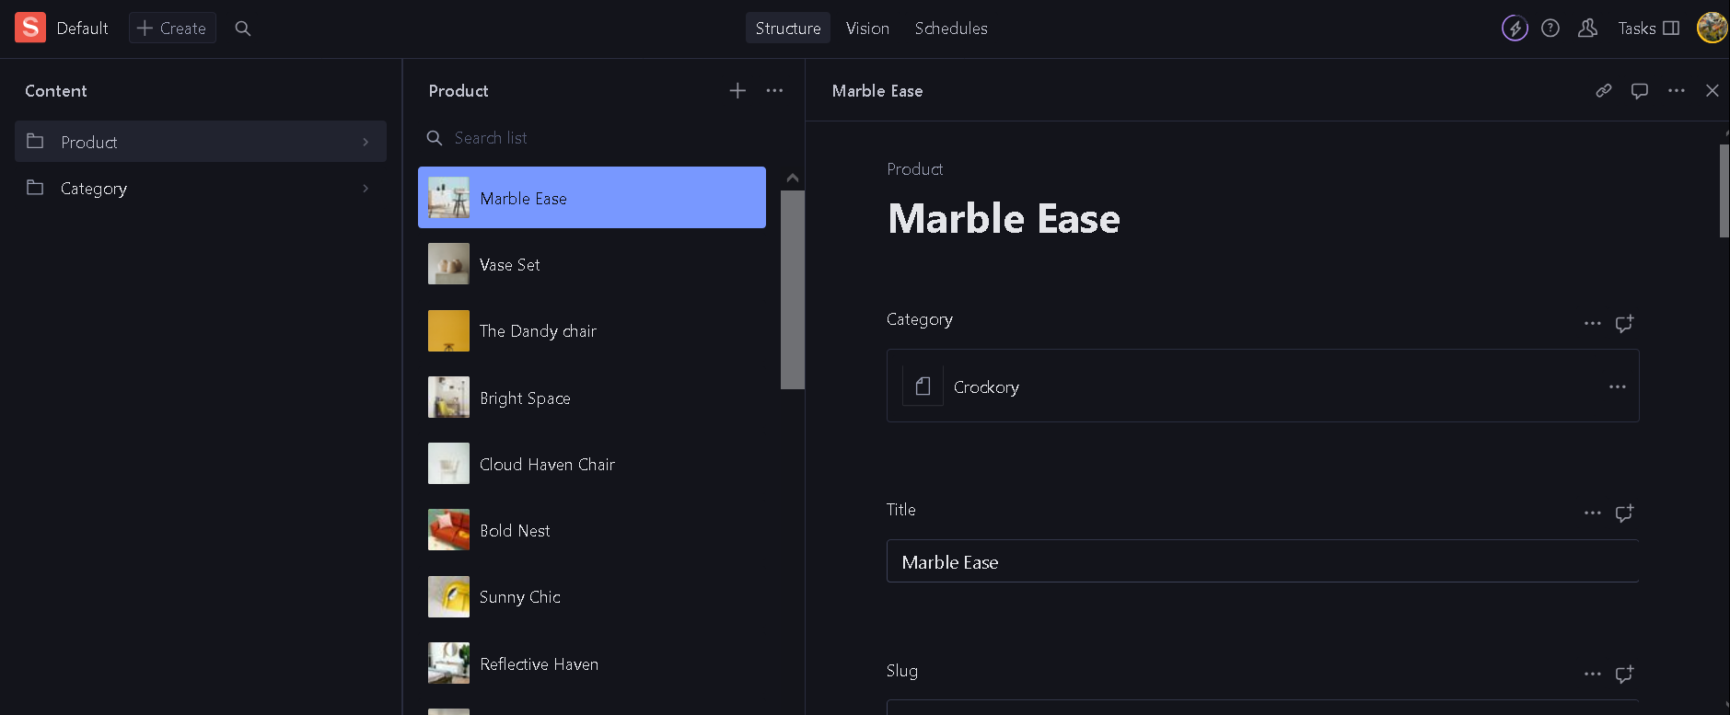
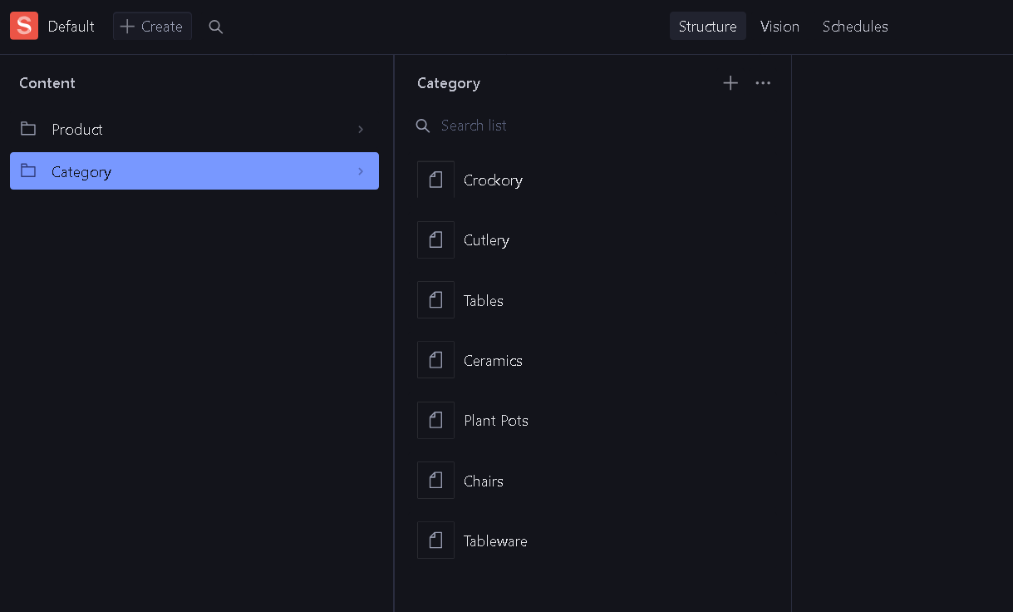
Sanity Studio
Product
Category

