Slide 1

Day 2 Planning The Technical Foundation

Slide 2
In this document I am going to describe the technical foundation of an E-commerce website and the Workflow, Client and Server and how the work lfow actually works and what are the core features in UI and What is Required for Server to Build an actually working Marketplace of General E-commerce Website,

Slide 3
Project Brief
This e-commerce project is designed to provide users with a comprehensive online shopping platform. It offers a wide variety of product categories and features roles for different types of users, ensuring a smooth and secure shopping experience.

Slide 4
Tech Stack
Client
Nextjs, React, Tailwind
Server
Nextjs, React, Sanity
Shipment/Order Tracking
ShipEngine
Payment Gateway
Strapi

Slide 5
System Actors/Roles
This System has Three Actors:
Admin
Costumer
Global User

Slide 6
Admin
We all known that admin is the most powerful actor in every system. Similarly in this system admin is the most powerful actor. Admin is responsible for all of the action which are mention below:​
Add Category
Delet Category
Edit Category
Add Product
Modify Product
Delet Product
Accept Orders
Read Complaints
View Costumers
Update Costumer Status

Slide 7
Costumer
The customer is a lead actor. Customer’s Action are mention below:
Register
Login
View Product
Place Order
Cancel Order
View Category
View Filter Data
Submit Complaint
Payment
Global User
A person who can submit complaint without registering into the system.

Slide 8
Client
Register/Login
Review/Complain
No Register/Login
View Products
Add to Cart
View Products
Update Cart
View Cart
Review/Complain
Place Order
Payment

Slide 9
Server
Admin DashBoard
Update Inventory
Add Product
Read Complaint
Add Category
Edit Product
View Costumer
Delete Category
Modify Product
Update Costumer Status
Edit Category
Accept Orders

Slide 10
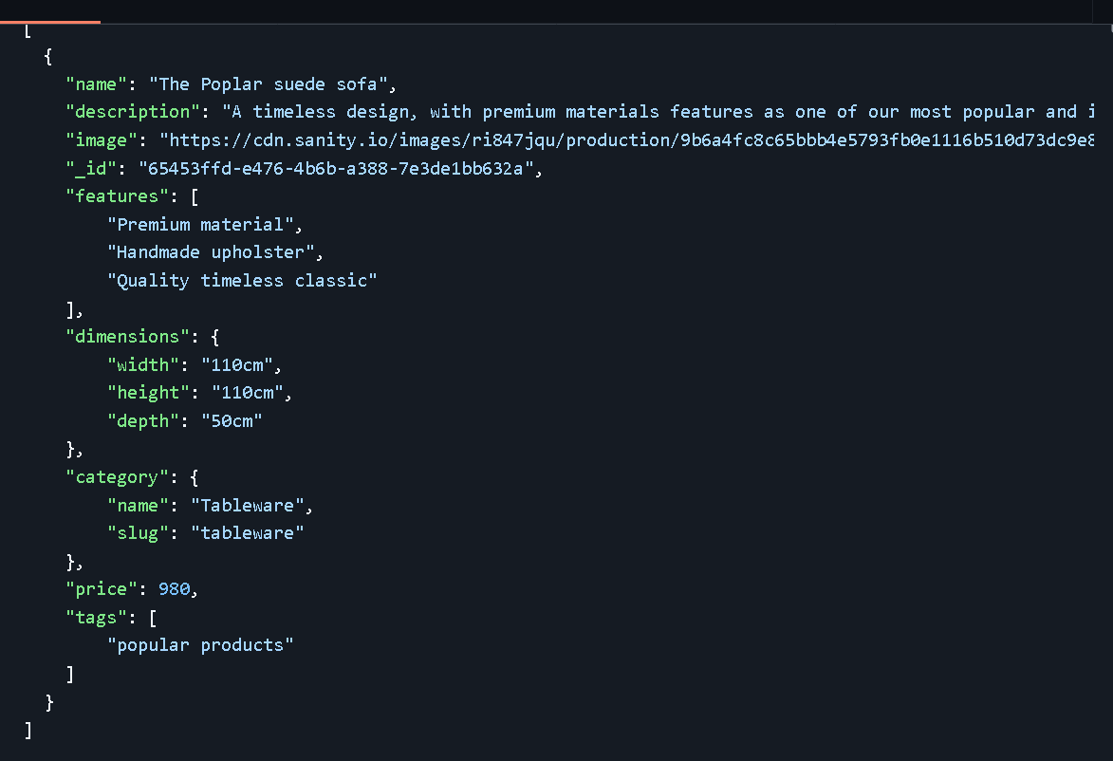
API Example Data Json

Slide 11
Sanity Schema for products

Slide 12
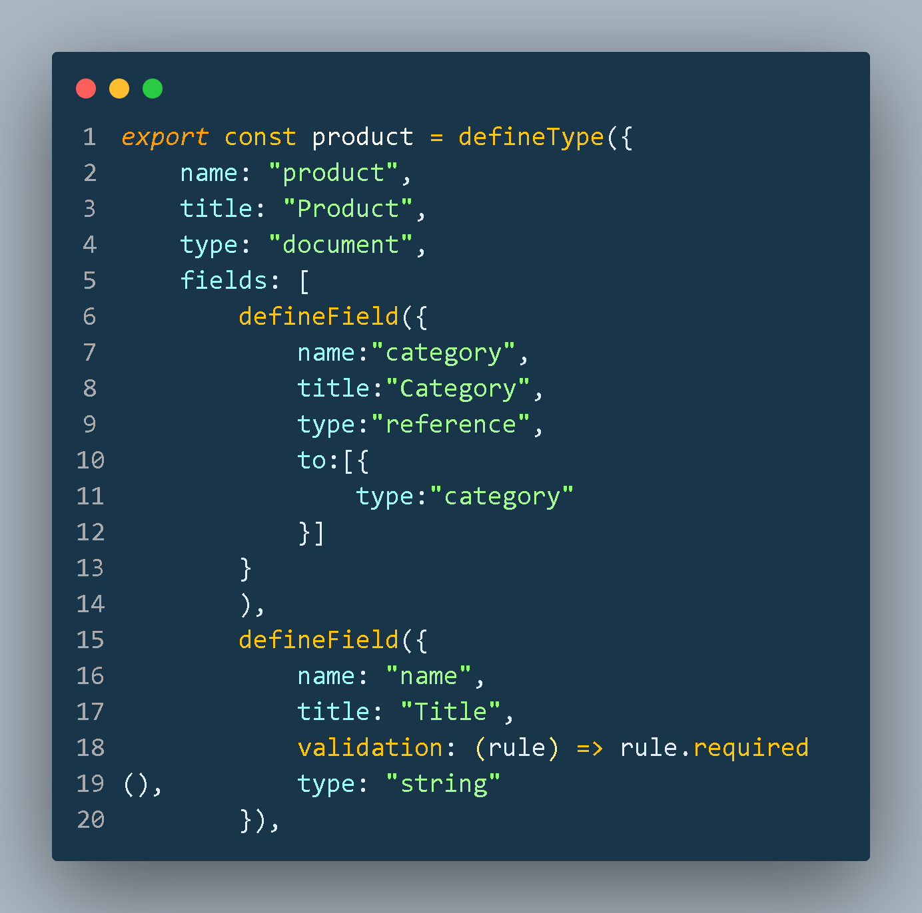
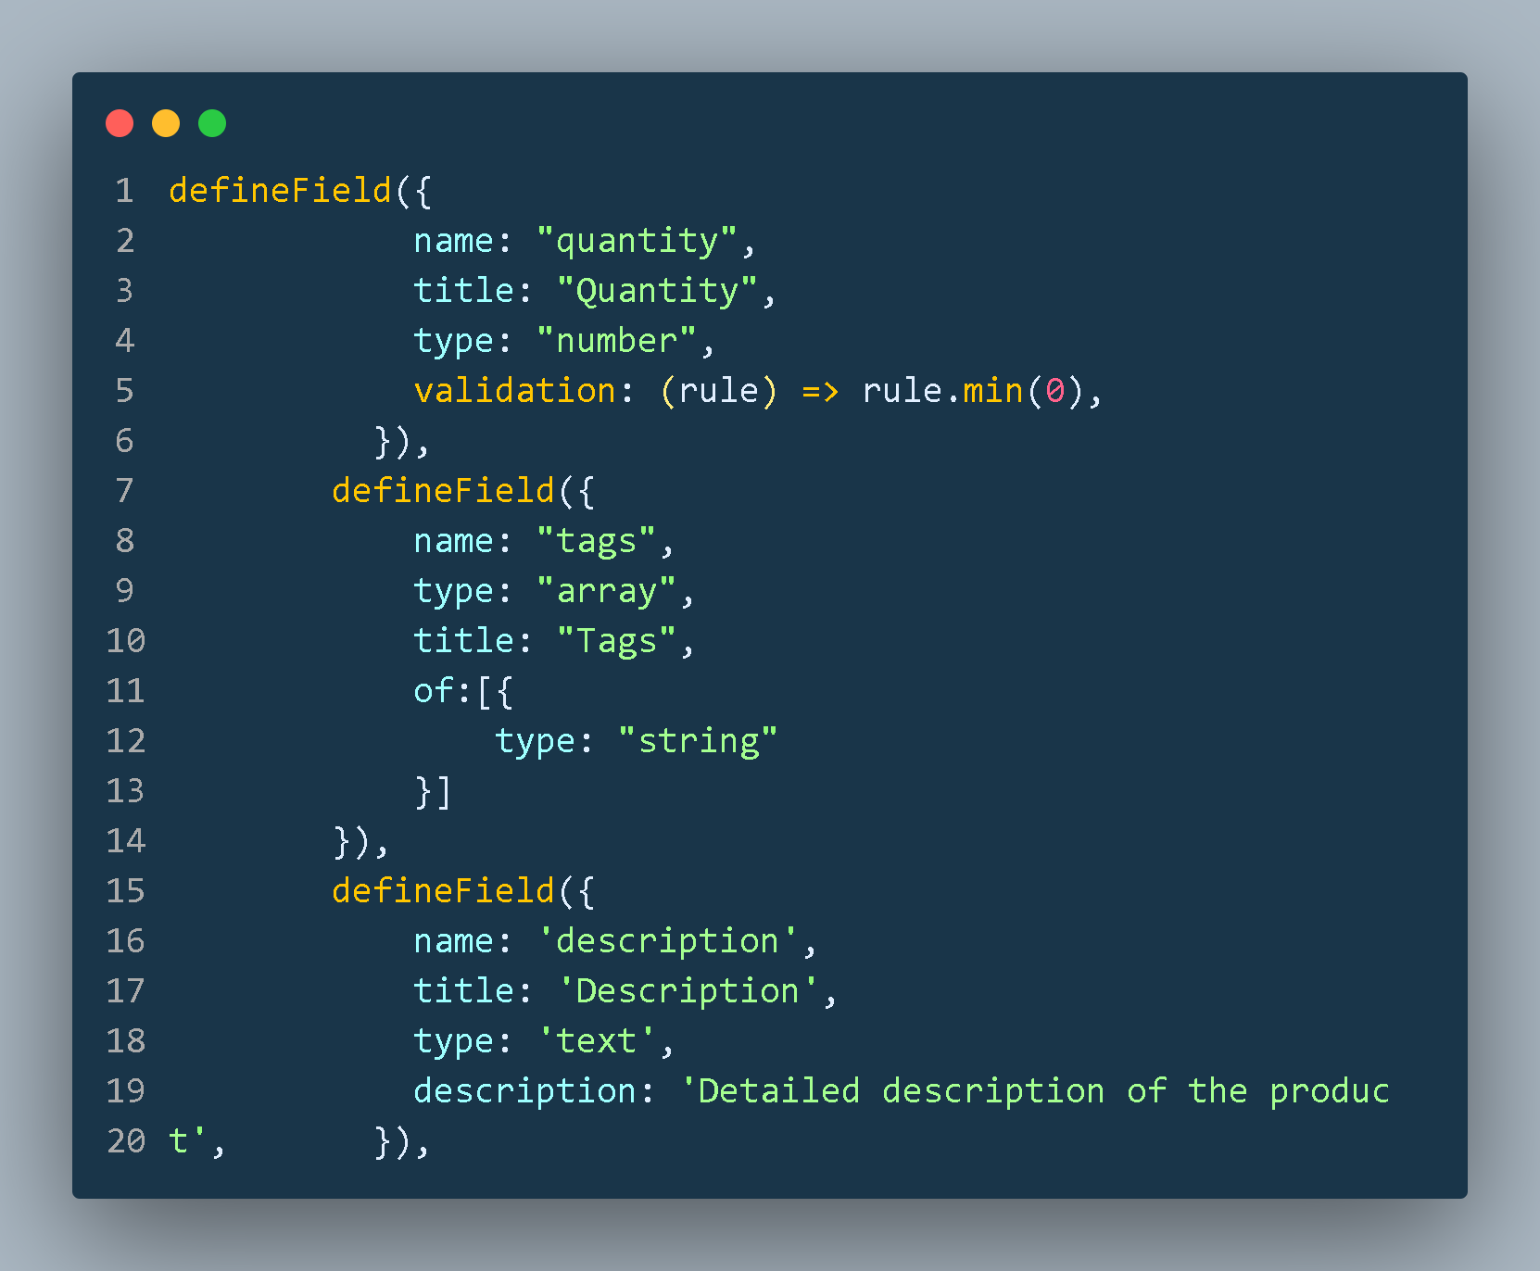
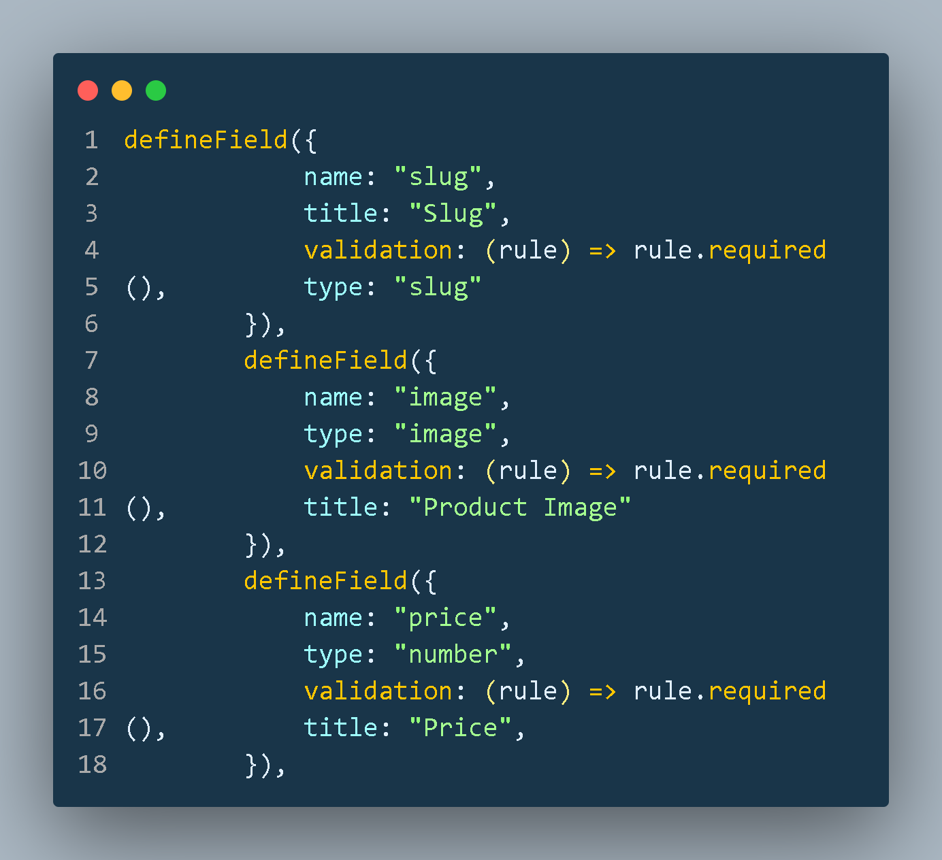
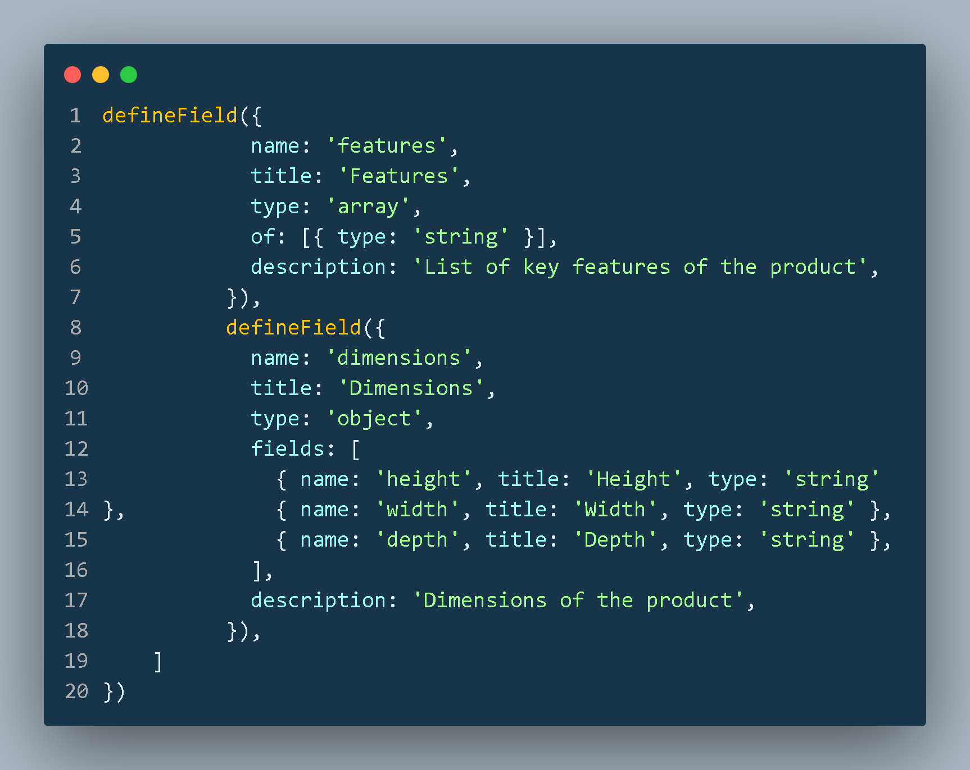

Slide 13
Sanity Schema for category

Slide 14
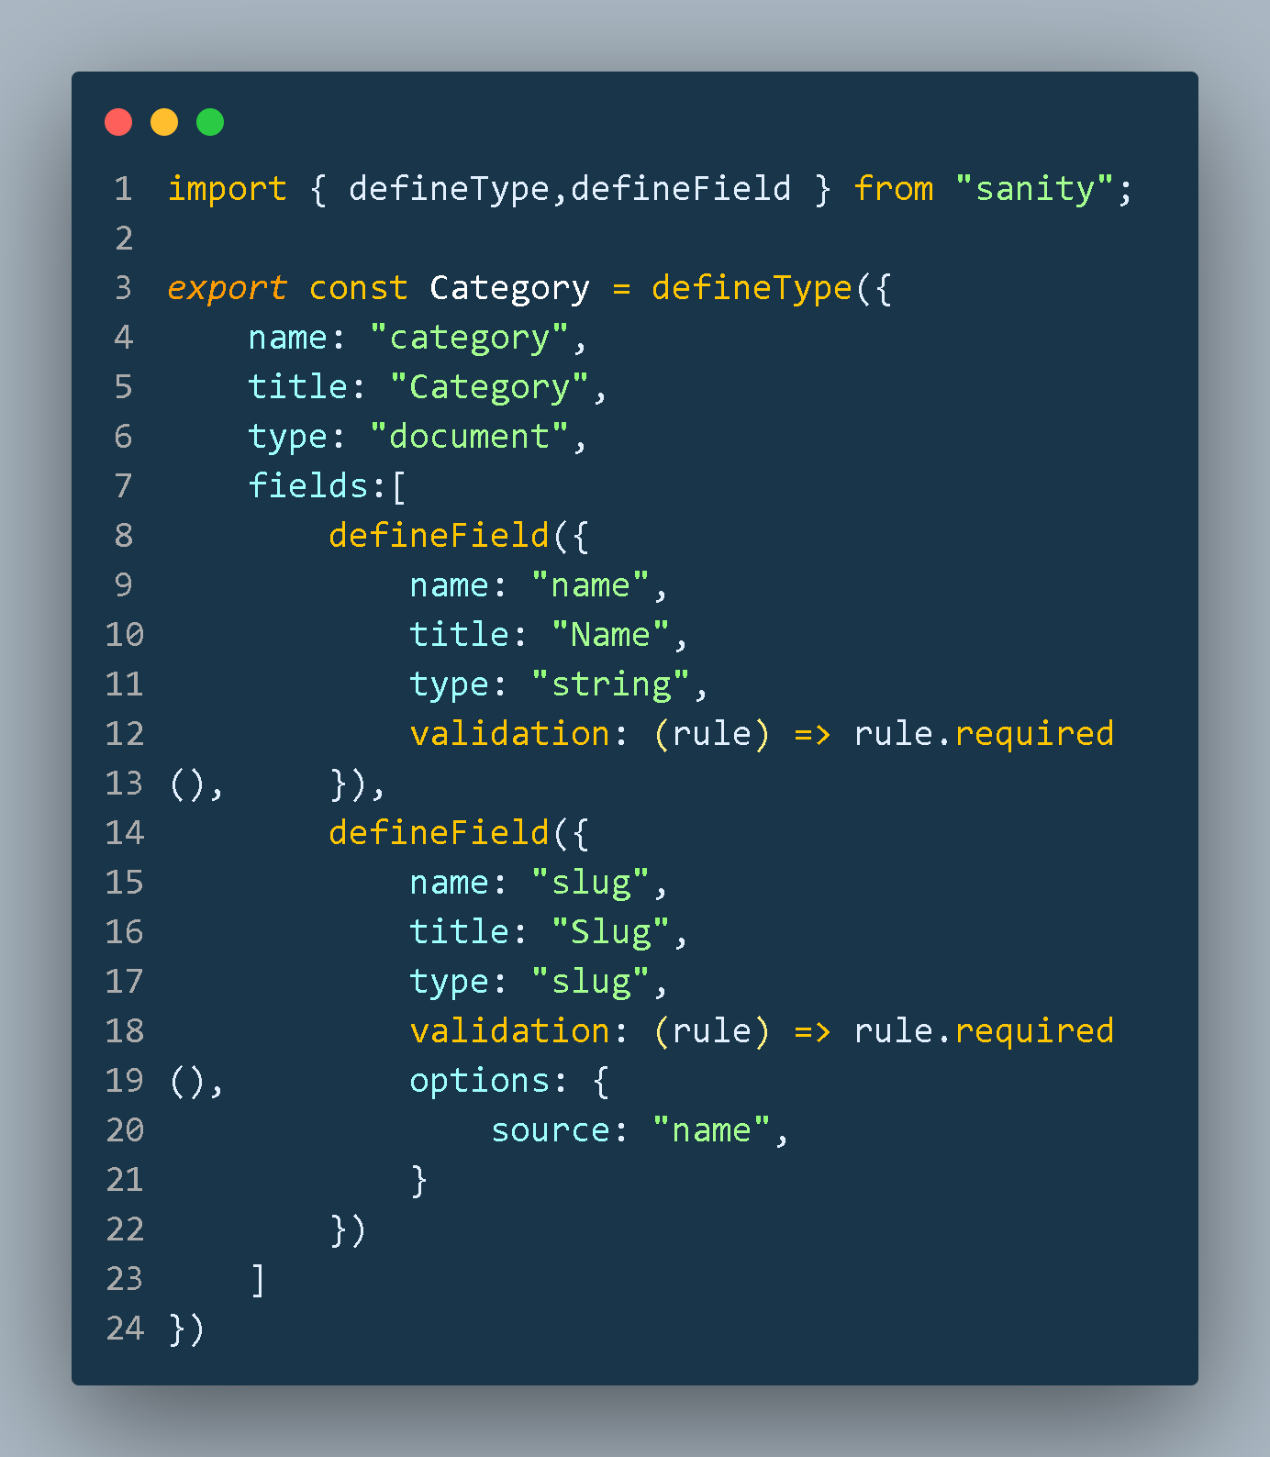

Slide 15
Final Work Flow Diagram

Slide 16
Marketplace
User
Admin
Frontend/
Browser
Backend/
Server
Sanity Studio
Home
Category
Products
Cart
Top
Selling
Category 1
View
Cart
Remove
Item
Add Products
Remove Products
New
Arrivals
Category 2
Add to Cart
Update
Cart
Manage Category
Accept Orders
Categories
Category 3
Check out
& Order
Cancel Orders
Update Stocks
Add to Watchlist
Complaint
Category 4

