Slide 1

Project Title: House Buying & Selling with Price Prediction
30% Presentation Template
Shehzad Ahmad (SP23-BSE-088)
M. Ahmad Khan (SP23-BSE-137)
Abbas Khan (SP23-BSE-115)
Supervisor:
Ahmed Ali
Department of Computer Science
COMSATS University Islamabad, Abbottabad Campus

Slide 2
Agenda of the Presentation
1. Brief Introduction
2. Scope
3. Functional Requirements
4. Non-Functional Requirements
5. User Goals
6. Use Cases
7. Use Case Diagram
8. Class Diagram
9. Sequence Diagram
10. System Sequence Diagram
11. Activity / State Machine Diagram
12. ER Diagram
13. Package Diagram
14. Deployment Diagram
15. Decision Table & Pseudocode
16. Schedule (Gantt Chart)
17. 1st Iteration Details (30%)
18. 2nd Iteration Details (60%)
19. Conclusion

Slide 3
Brief Introduction
House Buying & Selling is an AI-powered real estate platform that helps users confidently buy, sell, and rent properties. Inspired by platforms such as Zameen.com, it combines location-based search and verified listings with an AI price-prediction engine that estimates fair market value from property features, location, and historical sales trends. Buyers receive personalized recommendations and mortgage guidance, while sellers get optimal pricing suggestions and listing analytics — all supported by real-time AI chatbot assistance.
• Delivered as both a Web application and a Mobile application (Android / iOS)
• AI-driven price prediction with a confidence score for every listing
• Personalized recommendations for buyers and sellers alike
• In-app messaging, mortgage calculator, and AI chatbot support

Slide 4
Scope
In Scope — What the system WILL do
• Web application and mobile application (Android / iOS)
• Property search with filters and map-based discovery
• AI-based price prediction with a confidence range
• Personalized AI recommendations for buyers & sellers
• Listing management, analytics, and legal-document upload
• In-app messaging, mortgage calculator, and AI chatbot
• Alerts / notifications and a role-based admin panel

Slide 5
Functional Requirements
FR1. Users shall register/login with role-based access (Buyer, Seller, Agent, Admin) with email/phone verification.
FR2. Users shall search & filter properties by location, price, area, bedrooms, and type, with map-based results.
FR3. The system shall generate an AI price prediction with a confidence score/range for any listed property.
FR4. The system shall flag listings as over-priced or under-priced relative to the AI estimate.
FR5. The system shall recommend personalized properties to buyers based on search & browsing history.
FR6. The system shall suggest an optimal listing price and value-boosting improvements to sellers.
FR7. Sellers/Agents shall add, edit, and delete listings with photos, videos, and descriptions.
FR8. Buyers shall save favorites, schedule site visits, and message sellers/agents in-app.
FR9. The system shall provide an AI chatbot to assist with search, pricing, and mortgage queries.
FR10. The system shall calculate mortgage installments from loan amount, interest rate, and tenure.
FR11. The system shall send alerts for price drops, new matching listings, and visit reminders.
FR12. Sellers/Agents shall view listing analytics such as views, inquiries, and leads.
FR13. Admins shall approve/reject listings and manage reported content and user accounts.
FR14. Users shall upload and track legal documents (ownership proof, NOC) for a property.
FR15. The system shall display location-intelligence price-trend heatmaps by area.

Slide 6
Non-Functional Requirements
Performance: Search results and AI price predictions shall return within 3 seconds under normal load.
Scalability: The architecture (microservices + cloud) shall scale to 100,000+ concurrent users.
Security: User data and transactions shall be protected via TLS encryption and role-based access control.
Availability: The platform shall maintain 99.5% uptime, hosted on AWS/Google Cloud with auto-scaling.
Usability: The UI shall be intuitive, require no training, and be responsive across phones, tablets, and PCs.
Reliability: Every AI prediction shall include a confidence score so users can judge its trustworthiness.
Maintainability: Modular microservices shall allow independent updates, testing, and bug fixes.
Compatibility: The mobile app shall run on Android & iOS; the web app on all major browsers.
Localization: The system shall support English, Urdu, and regional languages.

Slide 7
User Goals
As a Buyer, I want to…
• Find the right property quickly using smart filters & map search
• Know a fair price before making an offer
• Get personalized recommendations that match preferences
• Communicate easily with sellers/agents and schedule visits
• Estimate affordability via the mortgage calculator
As a Seller/Agent, I want to…
• List a property quickly with rich media and details
• Price the property optimally using AI suggestions
• Track views, leads, and inquiries via analytics
• Build trust through a verified profile and badges
As an Admin, I want to…
• Maintain listing quality via approval & moderation
• Monitor platform health and user activity
• Handle reported content and spam quickly

Slide 8
Use Cases
Buyer
1. Register & Login
2. Search & Filter Properties
3. View Map & Nearby Places
4. View Property Detail Page
5. Get AI Price Prediction
6. View Personalized Recommendations
7. Save Favorite Properties
8. Schedule Site Visit
9. Chat with Seller/Agent
10. Use AI Chatbot Assistant
11. Calculate Mortgage
12. Receive Alerts & Notifications
Seller / Agent
1. Register & Login
2. Add / Edit / Delete Listing
3. Upload Legal Documents
4. View Listing Analytics
5. Get Optimal Listing Price Suggestion
6. Chat with Buyer
Admin
1. Manage Users & Roles
2. Approve / Reject Listings
3. Manage Reported Content
4. View Platform Statistics

Slide 9
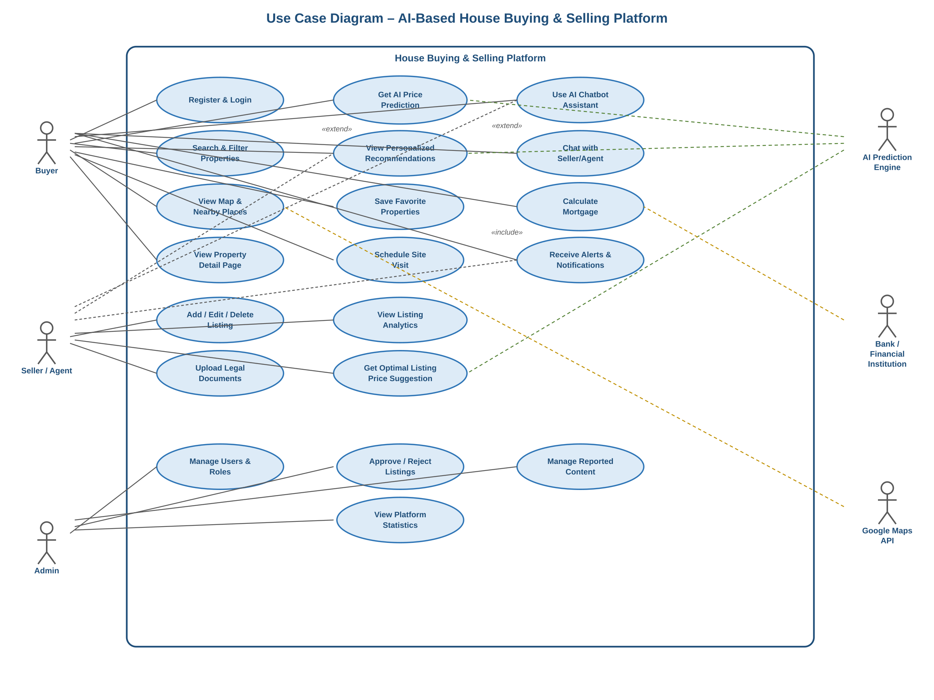
Use Case Diagram

Slide 10
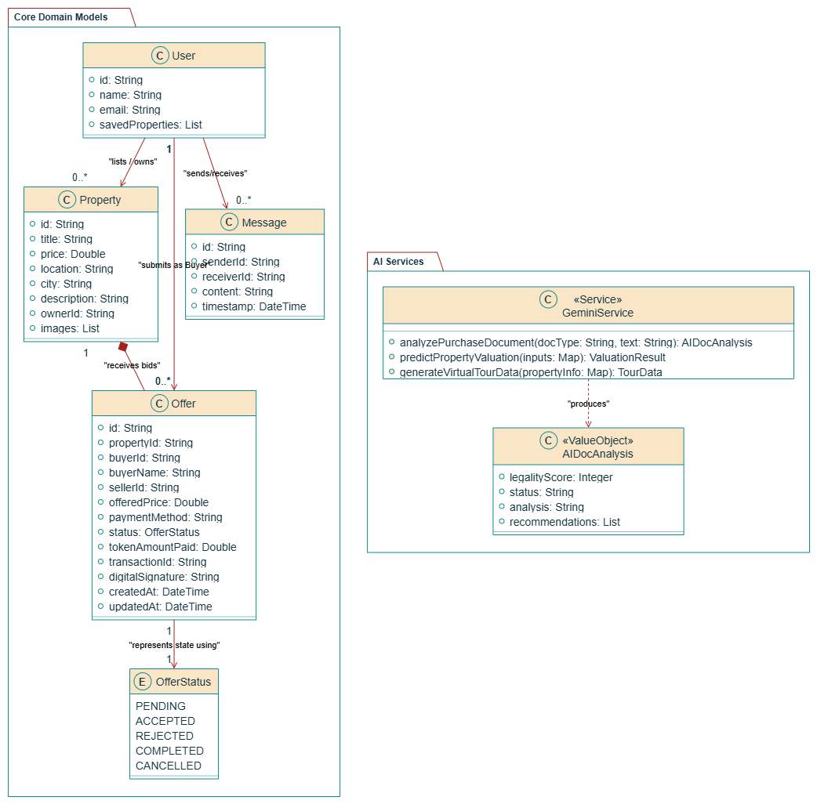
Class Diagram

Slide 11
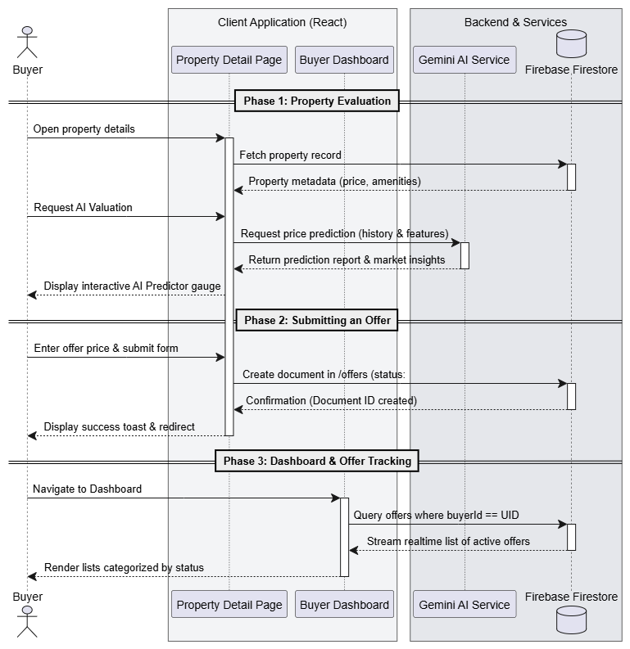
Sequence Diagram For Buyer

Slide 12
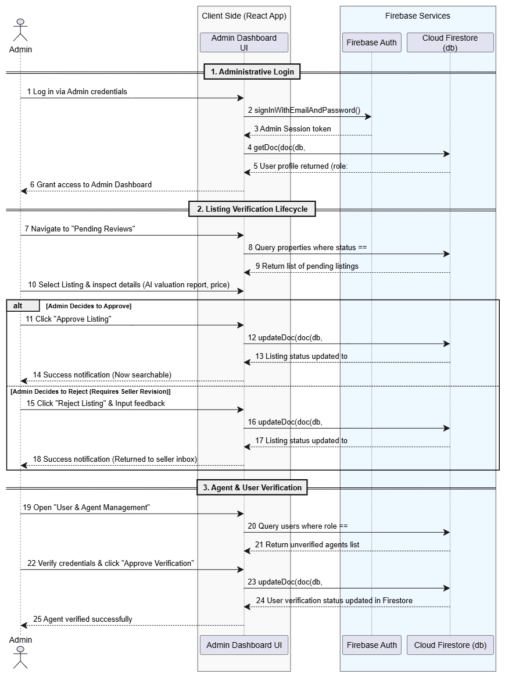
For Admin

Slide 13
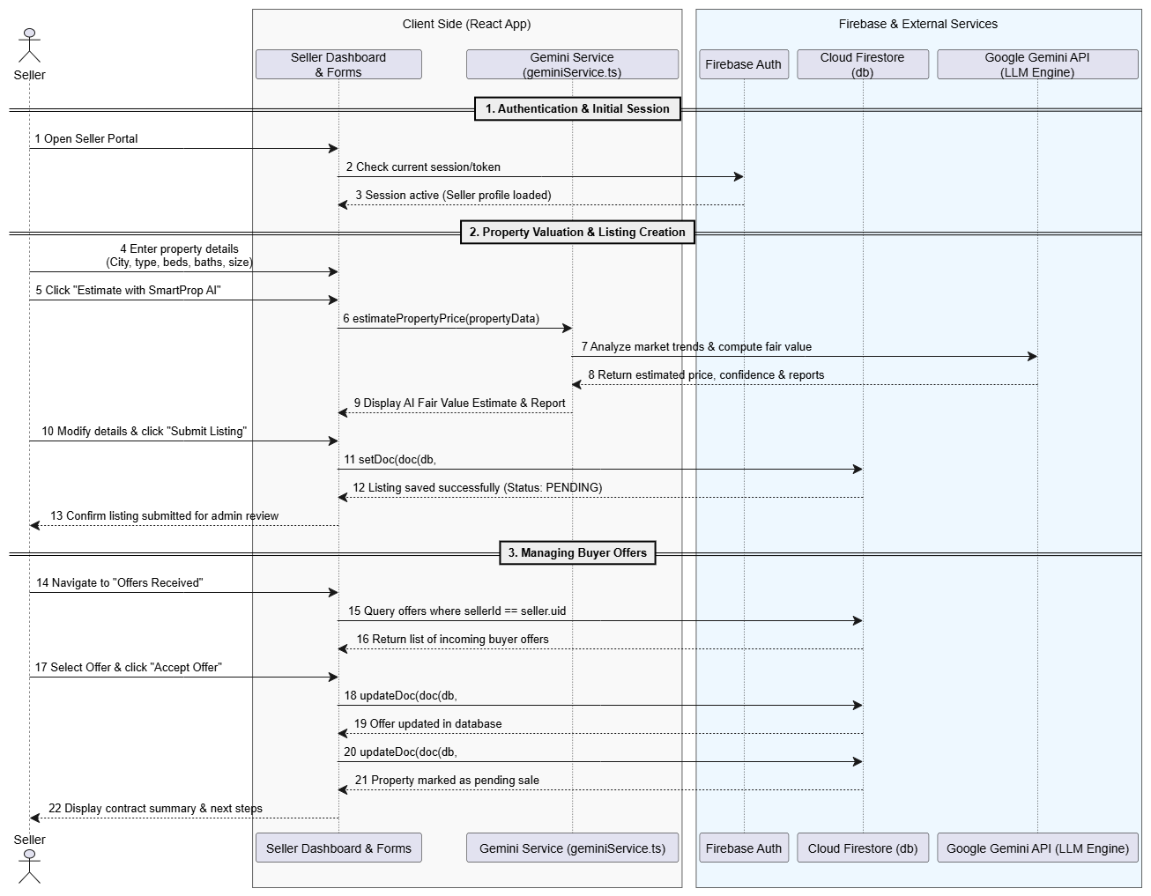
For Seller

Slide 14
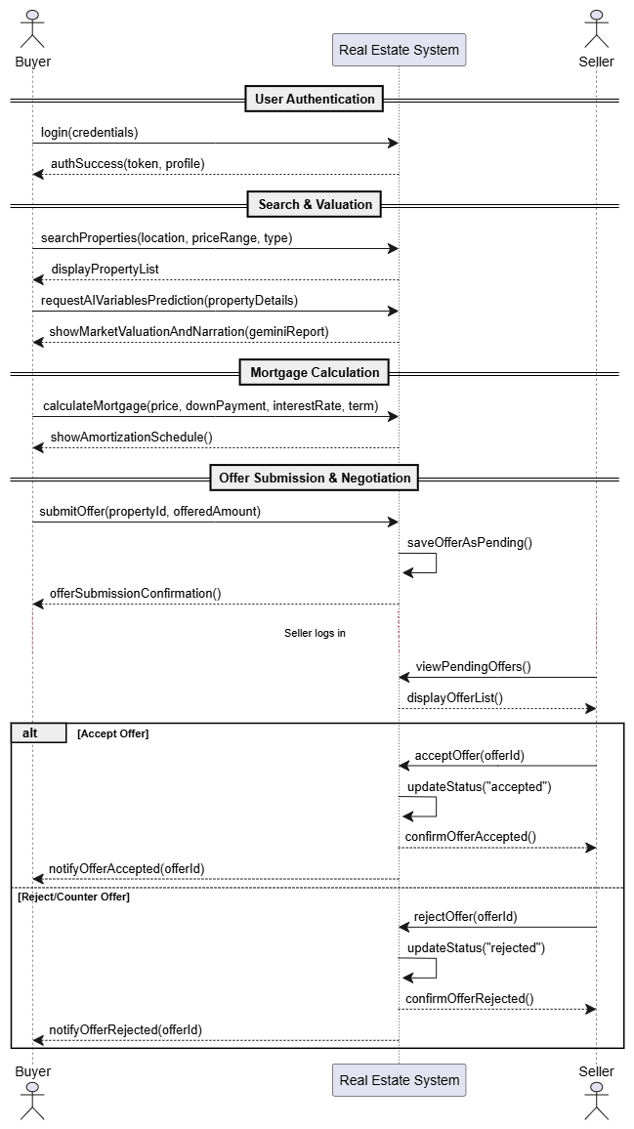
System Sequence Diagram

Slide 15
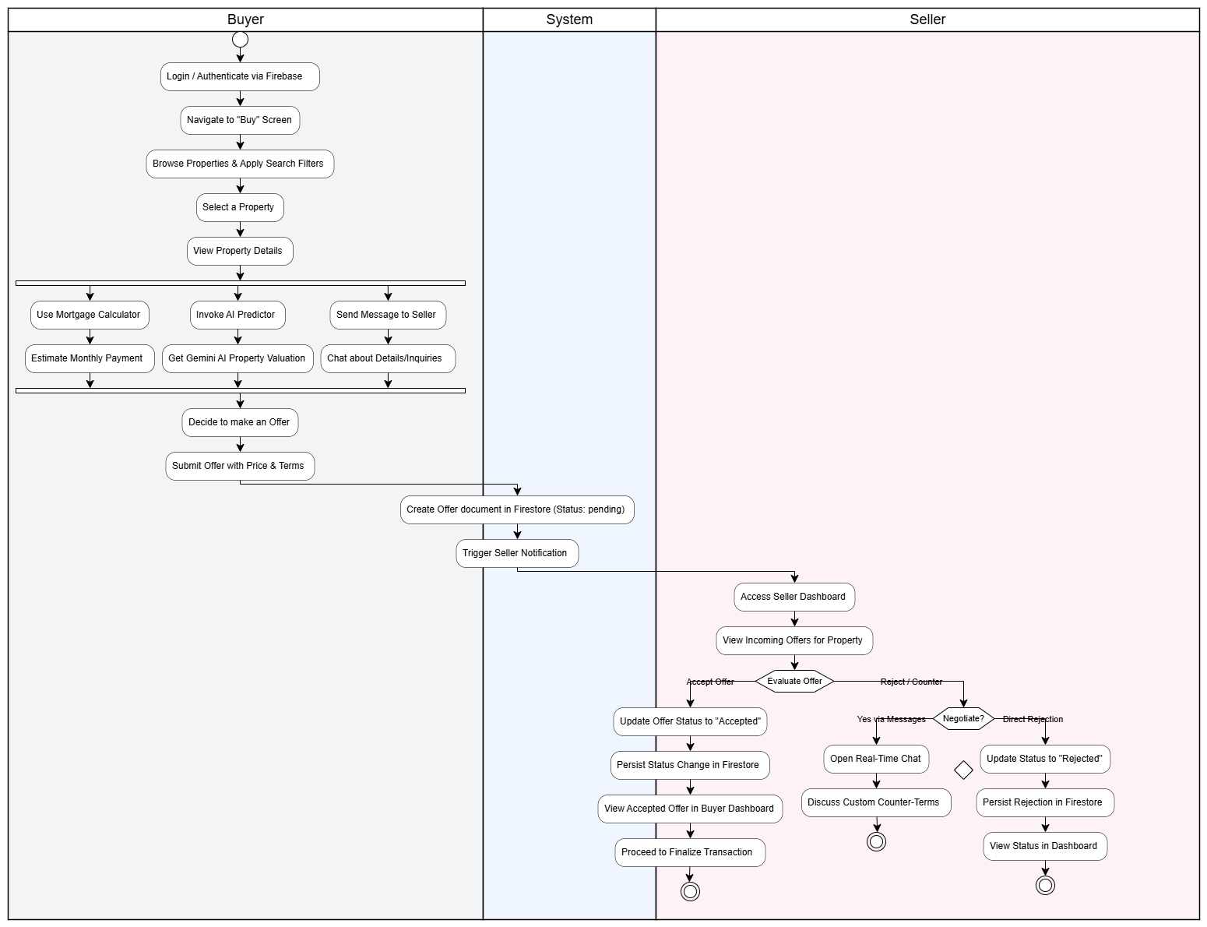
Activity/State Machine Diagram

Slide 16
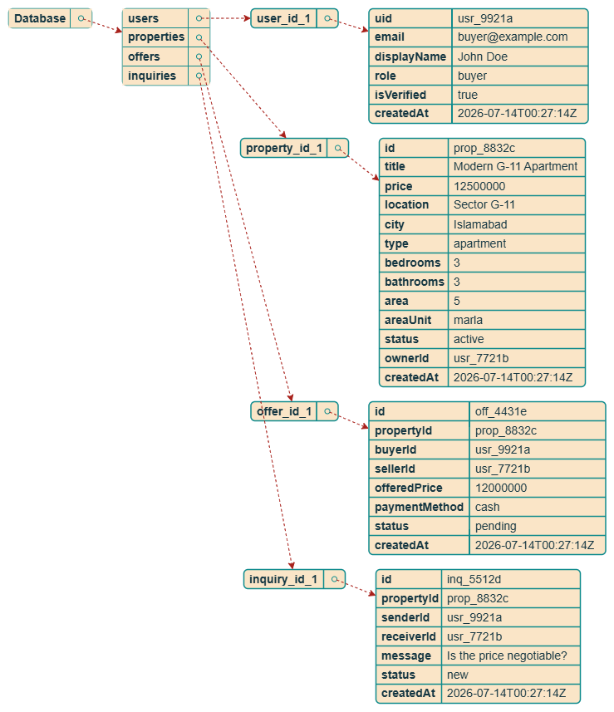
Json Tree

Slide 17
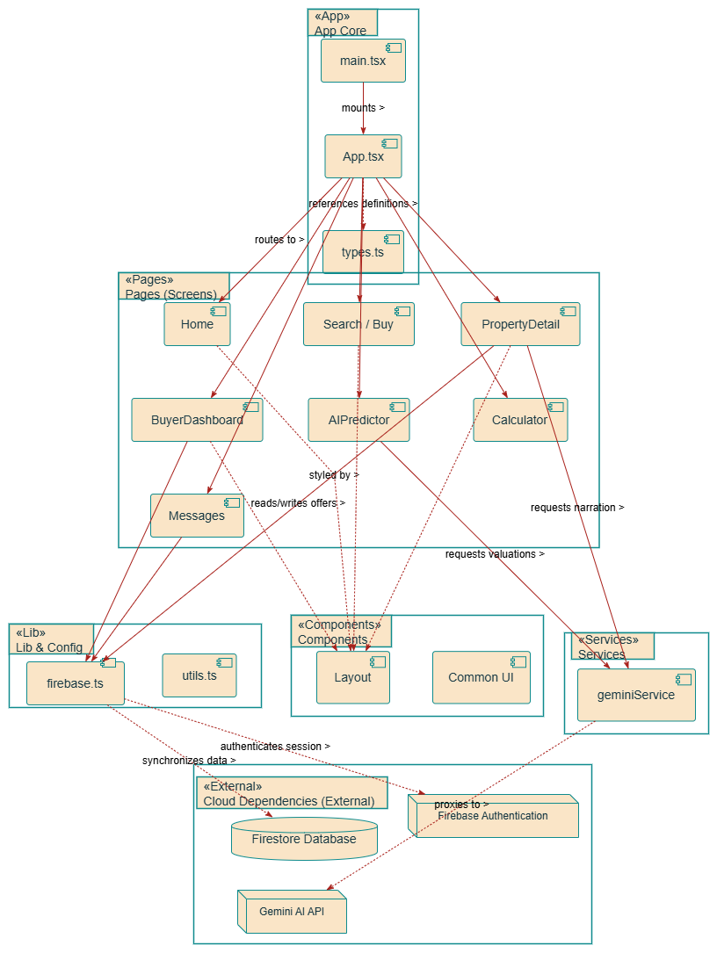
Package Diagram

Slide 18
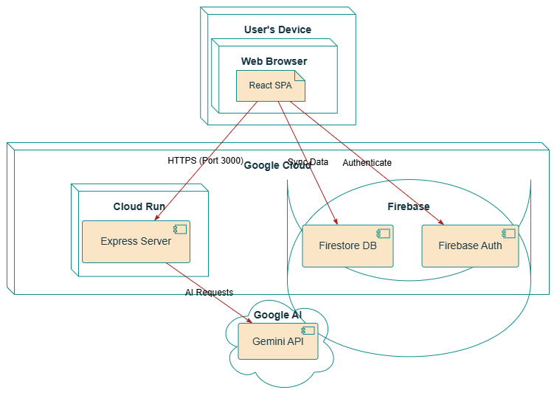
Deployment Diagram

Slide 19
Pseudocode
1. System Architecture & Context Flow
[User Browser]
│
▼
[React Router (App.tsx)] ──► [Layout Component (Navbar, Footer, Main Frame)]
│
├─► [Auth.tsx] ─────────────► Firebase Authentication
├─► [Search / Detail] ──────► Firestore Database (Properties DB)
├─► [Messages.tsx] ─────────► Firestore Database (Real-time Messaging DB)
├─► [Calculator.tsx] ───────► Formula Engine (Mortgage / Amortization)
└─► [AIPredictor.tsx] ──────► Gemini AI Model (Fair Price Range / Market Insights)

Slide 20
2. Global Core Services & Configurations
INITIALIZE Firebase Client:
CONFIG = ReadEnvironmentVariables()
APP = InitializeFirebaseApp(CONFIG)
EXPORT AUTH = GetFirebaseAuthInstance(APP)
EXPORT FIRESTORE = GetFirestoreDatabaseInstance(APP)

Slide 21
User Identity Portal
COMPONENT AuthPage:
STATE email = ""
STATE password = ""
STATE isSignUp = false
STATE error = null
ON SubmitForm():
TRY:
IF isSignUp IS true:
CALL AUTH.CreateUserWithEmailAndPassword(email, password)
ELSE:
CALL AUTH.SignInWithEmailAndPassword(email, password)
REDIRECT to UserDashboard or Homepage
CATCH (err):
SET error = err.message
RENDER:
Form UI (Email, Password)
Button: Toggle SignIn / SignUp State

Slide 22
Interactive Property Finder
COMPONENT SearchPage:
STATE queryText = ""
STATE filters = { priceRange: [min, max], bedrooms: null, type: "all" }
STATE properties = []
STATE activeMapCoordinates = null
EFFECT OnMount():
// Pull baseline listings from Firestore
UNSUBSCRIBE = FIRESTORE.SubscribeToCollection("properties", (snapshot) => {
SET properties = snapshot.map(doc => doc.data())
})
RETURN UNSUBSCRIBE
FUNCTION ApplyClientFilters(listings):
RETURN listings.FILTER(p =>
p.title.Contains(queryText) AND
p.price >= filters.priceRange.min AND
p.price <= filters.priceRange.max AND
(filters.bedrooms == null OR p.bedrooms == filters.bedrooms)
)
RENDER:
Filter Toolbar (Sliding Drawers, Dropdowns)
Map Split-Pane & Grid Cards of Match Listings

Slide 23
AI Predictive Valuation Engine
COMPONENT AIPredictor:
STATE inputDetails = { location: "", area: 5, areaUnit: "Marla", bedrooms: 3, bathrooms: 3, type: "House" }
STATE predictionResult = null
STATE isLoading = false
ON TriggerAIAnalysis():
SET isLoading = true
TRY:
RESULT = CALL predictPropertyPrice(inputDetails)
SET predictionResult = RESULT
CATCH (err):
DISPLAY Notification("AI Service Temporarily Offline")
FINALLY:
SET isLoading = false
RENDER:
Property Specification Cards (Inputs)
IF isLoading: Display Animated Shimmer Effects
IF predictionResult:
Display Estimated price with custom gauge meters
Display AI narrative insights on current localization trends

Slide 24
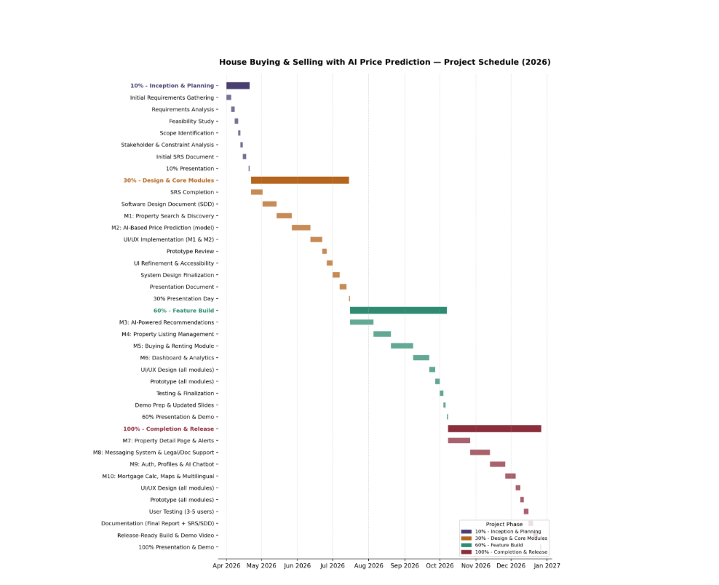
Schedule
Gantt Chart

Slide 25
Details of 1st Iteration (30%)
Work Completed:
2 Core Modules Developed – Functionally designed and coded as per initial requirements.
SRS Document – Complete Software Requirements Specification covering functional and non-functional requirements, user stories, and system constraints.
SDD Document – Detailed Software Design Document including system architecture, module design, database schema, and interface specifications.
Diagrams – Created essential UML diagrams such as Use Case, Class, Sequence, and ER diagrams to visualize system structure and workflows.

Slide 26
Details of 2nd Iteration (60%)
What will completed as per Gantt Chart in 60%

Slide 27
Conclusion
In summary, the project has achieved its first major milestone with the on-time delivery of two core modules, SRS, SDD, and all critical design diagrams. This phase has finalized the 'what' and 'how' of the system, providing clear traceability from requirements to design. The documentation and prototypes are aligned, and no major blockers have been identified. We are ready to proceed to the next sprint with a stable and validated baseline.

