Slide 1
GURU NANAK DEV ENGINEERING COLLEGE, LUDHIANA
Department of Computer Science and Engineering | B.Tech TR-103 Industrial Training
ATTENDIQ (FACEMARK)
AI-Powered Biometric Attendance System for Tuition Centres
In-Memory Ephemeral Facial Recognition | DPDP Act 2023 Compliance | Sub-Second Multi-Face Matching
SUBMITTED BY
Mohd Shehzad
Univ. Roll No. (URN): 2302612
Branch Roll No. (CRN): 2315157
Degree & Branch: B.Tech — Computer Science & Engg.
Academic Semester: 7th Semester (Evaluation of TR-103)
TRAINING ORGANIZATION
Techversys Solutions Pvt. Ltd., Mohali
Training Period: 24 June 2026 – 22 July 2026 (4 Weeks)
Confirmation Ref No: TCV-2496-2026 (Dated: 16/06/2026)
Industry Supervisor: Mr. Sushil Kumar (Lead Technical Architect)
Technology Track: Full Stack Development & Deep Learning
Notes:
Good morning respected professors and evaluation committee members. My name is Mohd Shehzad, University Roll Number 2302612, Class Roll Number 2315157. Today I am presenting my B.Tech 4-Week Industrial Training (TR-103) project completed at Techversys Solutions Pvt. Ltd., Mohali. The project is titled 'AttendIQ' (also audited as FaceMark), an AI-Powered Biometric Attendance System specially designed for private tuition centres and coaching institutes, implementing in-memory zero-disk facial recognition and strict DPDP Act 2023 compliance.

Slide 2
01 | INDUSTRIAL TRAINING PROFILE
Training Overview & 4-Week Engineering Roadmap
02/18
ORGANIZATION DETAILS
Techversys Solutions Pvt. Ltd.
• Corporate Facility: Phase 8-B, Sector 74, Mohali, Punjab.
• Mentorship: Under Mr. Sushil Kumar (Lead Technical Architect).
• Training Domain: Enterprise Full Stack Web Systems, Computer Vision Pipelines, and Scalable Cloud Architectures.
• Daily Training Diary: Maintained daily and published live on GitHub Pages with automated CI workflows.
• Outcome: Production-ready enterprise attendance web platform running multi-container Docker workloads.
WEEK 1: Architecture, Backend & Relational Data Model
• Finalized system specifications for coaching academies.
• Provisioned Python 3.11, FastAPI ASGI, and PostgreSQL 15.
• Designed 8 normalized database entities with SQLAlchemy 2.0 ORM.
• Implemented Alembic migrations 0001 & 0002 + JWT authentication.
WEEK 2: Deep Biometrics Engine & Vector Embeddings
• Integrated InsightFace RetinaFace localization & ArcFace feature extraction.
• Built in-memory pipeline: EXIF auto-rotation, safety checks, L2 normalization.
• Implemented cosine similarity via NumPy scalar dot products.
• Developed greedy bipartite assignment for 1-student-to-1-face matching.
WEEK 3: Verification UI & Tamper-Resistant Audit Logging
• Developed React 18 / Vite frontend with interactive HTML5 canvas.
• Color-coded bounding overlays (Green: matched, Amber: review, Red: unknown).
• Implemented 24-hour automatic session locking policy.
• Designed immutable attendance_audit_logs table with mandatory reason logging.
WEEK 4: Multi-Tenant Workspaces, Analytics & Deployment
• Added multi-tenant self-registration for independent tutors (Alembic 0006).
• Built Recharts trend charts, 28-day heatmaps, and instant CSV export.
• Authored 46 automated Pytest tests achieving 84% total code coverage.
• Configured multi-stage Docker Compose (Nginx, FastAPI, PostgreSQL).
Notes:
During my 4-week industrial training from 24 June to 22 July 2026 at Techversys Solutions Mohali, the project was executed across four structured sprints: Week 1 focused on data modeling and authentication; Week 2 on the InsightFace deep learning pipeline; Week 3 on frontend interactive canvas verification and 24-hour session locking; and Week 4 on multi-tenancy, analytics, automated testing with 84% coverage, and Docker production containerization.

Slide 3
02 | MOTIVATION & BACKGROUND
Operational Friction in Tuition Centres & Coaching Academies
03/18
15% CLASS TIME WASTED
Instructional Time Loss
Manual roll calling takes 5–10 minutes per lecture. In 45-minute batches, up to 15% of high-value instructional time is squandered on administrative record-keeping.
ZERO AUDIT INTEGRITY
Proxy Calling & Buddy Punching
Paper registers and verbal roll calls are prone to proxy attendance, buddy punching, and retroactive unauthorized tampering by students or clerical staff.
₹15,000–₹50,000 SCANNERS
Expensive Hardware Bottlenecks
Dedicated fingerprint or RFID turnstiles impose heavy capital expenses, require physical contact (hygiene concern), and cause severe entrance congestion.
HOURS OF INFORMATION LAG
Delayed Parent Communication
Manual systems notify parents hours after class or omit notices completely, delaying timely parental intervention when students skip lectures.
DPDP ACT NON-COMPLIANCE
Biometric Privacy & Cloud Exposure
Commercial cloud computer vision APIs (AWS Rekognition / Azure Face) store raw facial photos on external servers, violating the Digital Personal Data Protection Act, 2023.
Notes:
Why did we build AttendIQ? Tuition centres face 5 distinct operational pain points: First, losing 15% of class time to roll calling; Second, proxy calling; Third, high cost of hardware scanners; Fourth, delayed parent alerting; And most critically, biometric privacy: commercial cloud face recognition APIs store raw photos on third-party servers, which violates the DPDP Act 2023. AttendIQ solves all 5 issues without requiring expensive hardware.

Slide 4
03 | OBJECTIVES & PRINCIPLES
System Objectives & Engineering Design Philosophy
04/18
OBJECTIVE 01
Zero-Disk Ephemeral Biometrics
Architect an in-memory computer vision inference pipeline where raw classroom photos exist purely in volatile RAM buffers and are immediately garbage-collected post-inference.
Key Impact: Zero raw facial photographs are ever persisted to server storage, database blobs, or cloud buckets.
OBJECTIVE 02
Sub-Second Multi-Face Recognition
Detect, crop, extract 512-dimensional facial feature vectors, and perform greedy bipartite matching for 20–30 students from a single wide-angle classroom photo in under 1.5 seconds.
Key Impact: Operates smoothly on standard commodity CPU hardware without requiring dedicated GPU infrastructure.
OBJECTIVE 03
Interactive Visual Verification & Override
Render client-side HTML5 canvas bounding box overlays color-coded by confidence (Green >= 0.45, Amber 0.35-0.45, Red < 0.35).
Key Impact: Enables the tutor to visually audit and perform 1-click manual overrides before locking the attendance session.
OBJECTIVE 04
Tamper-Resistant Session Locking & Auditability
Enforce automatic 24-hour session locking to guarantee non-repudiation.
Key Impact: Any retrospective administrative unlock mandates a documented justification and logs full history into an immutable audit table.
Notes:
Our system was built upon four uncompromising engineering objectives: 1. Zero-disk ephemeral processing for data protection; 2. Sub-second group attendance for 20-30 students on standard commodity CPUs; 3. Interactive visual verification via color-coded bounding boxes; 4. Tamper-proof session locking with immutable audit trails to prevent fraud.

Slide 5
04 | COMPETITIVE BENCHMARK
Comparative Analysis: Traditional vs Existing vs AttendIQ
05/18
Evaluation Metric | Manual Paper Register | Biometric Scanners (RFID/Fingerprint) | Commercial Cloud Face APIs | Proposed AttendIQ System
Capture Mechanism | Calling roll numbers verbally | Single-student touch contact | Individual portrait upload | Single wide group classroom photo
Batch Execution Speed | 5 to 10 minutes | 3–5 secs / student (bottleneck) | 3–5 seconds per face | Sub-second (< 1.5s for 25+ faces)
Dedicated Hardware Cost | ₹0 (Paper sheets) | ₹15,000 – ₹50,000 per room | Specialized cameras / tablets | ₹0 (Operates on teacher phone/laptop)
Biometric Image Persistence | None | Proprietary template format | Persistent cloud photo storage | Zero-Disk Ephemeral (RAM only)
DPDP Act 2023 Compliance | Not applicable | No explicit consent tracking | Risky (Cross-border data transit) | 100% Compliant (Explicit Consent & Purge)
Tamper Resistance | Zero (Overwritten easily) | Medium (Device dependent) | Medium (Vendor cloud) | 24h Auto-Lock & Immutable Audit Log
At-Risk Student Alerts | Manual tallying at month end | Periodic manual exports | Requires custom software layer | Real-Time < 75% alerts & 1-click WhatsApp
Notes:
Here is the head-to-head comparison between AttendIQ and existing solutions: Notice column 5: AttendIQ achieves sub-second recognition for an entire batch without any specialized biometric hardware. Unlike commercial cloud APIs, AttendIQ never stores facial images on disk or cloud, guaranteeing full compliance with India's DPDP Act 2023.

Slide 6
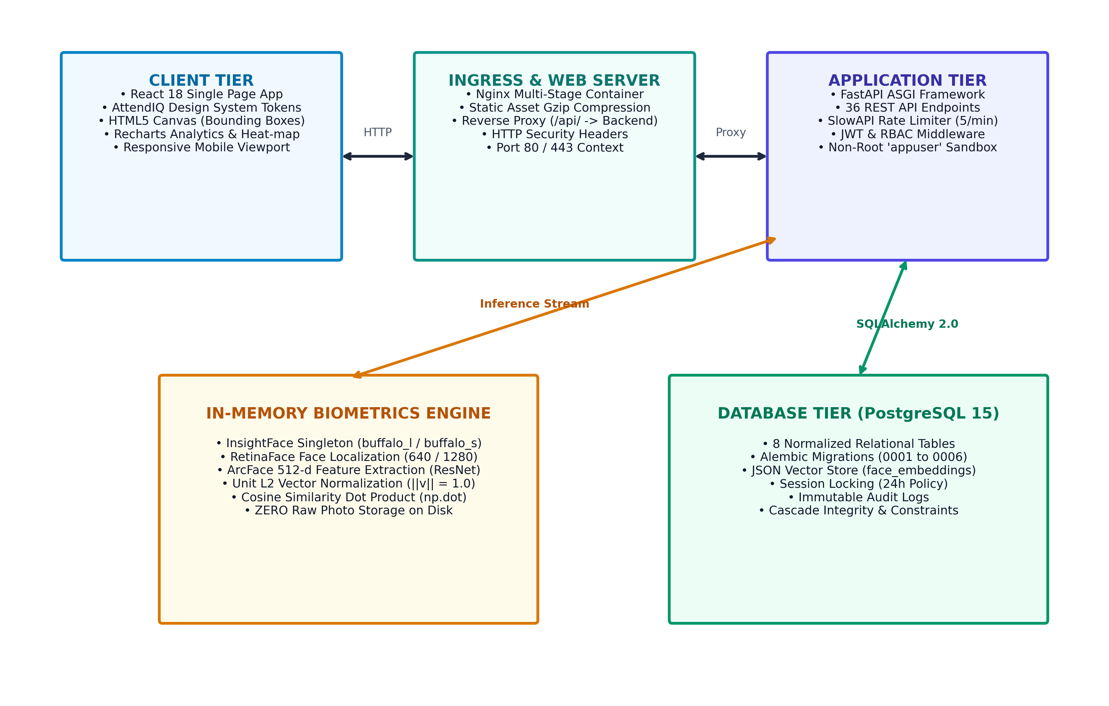
05 | SYSTEM ARCHITECTURE
Three-Tier Microservices-Ready System Architecture
06/18
Presentation Tier (Frontend)
• React 18.2 with Vite (Sub-second HMR & ESM build)
• Recharts for trendlines and batch comparisons
• Interactive HTML5 Canvas for real-time bounding boxes
• Custom CSS design tokens with Light/Dark mode engine
Application Tier (FastAPI Backend)
• Asynchronous ASGI web framework (Python 3.11)
• Uvicorn ASGI server with 1 worker (RAM capped to 1.5GB)
• SlowAPI rate limiter (5 req/min on login endpoints)
• JWT authentication & Role-Based Access Control (Admin/Teacher)
Biometrics & Machine Learning Tier
• InsightFace 0.7.3 (RetinaFace localization + ArcFace ResNet)
• ONNX Runtime with CPUExecutionProvider (Zero GPU cost)
• 512-dimensional vector extraction & L2 normalization
• NumPy vector dot products for sub-millisecond similarity
Persistence Tier (PostgreSQL 15)
• 8 normalized relational tables with foreign key cascades
• SQLAlchemy 2.0 Declarative ORM & Pydantic schemas
• Alembic versioned migrations (0001 through 0006)
• JSON column for 512-d float vectors (zero image storage)
Notes:
This slide presents the end-to-end 3-tier system architecture: On the left, the architectural diagram shows the separation of concerns: The React 18 client communicates over REST with the FastAPI backend. The backend leverages InsightFace and ONNX Runtime running on CPUExecutionProvider, which eliminates the need for expensive GPU hardware while maintaining sub-second inference speeds. The data tier uses PostgreSQL 15 managed with Alembic version-controlled migrations.

Slide 7
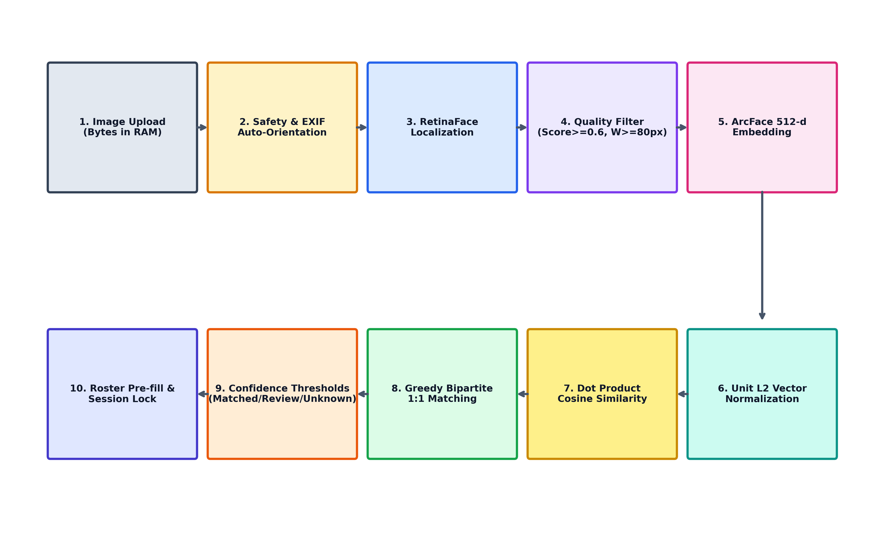
06 | BIOMETRIC MACHINE LEARNING
In-Memory Deep Learning Facial Recognition Pipeline
07/18
1. Ingestion & Security Guardrails
Decodes bytes in RAM (io.BytesIO). Validates extension, limits upload to 10MB, and enforces 40-Megapixel ceiling to thwart decompression bomb DOS attacks.
2. EXIF Auto-Orientation & Preprocessing
Applies ImageOps.exif_transpose to correct smartphone rotation angles. Converts Pillow RGB buffer into OpenCV BGR matrix without writing to disk.
3. RetinaFace Localization & Landmark Detection
Uses InsightFace RetinaFace CNN. Wide photos use RECOGNITION_DET_SIZE=1280 to capture rear row faces. Filters low-confidence faces (det_score < 0.6) and small crops (< 80px).
4. ArcFace 512-d Feature Extraction & L2 Norm
Deep CNN extracts 512 facial landmarks into floating-point vectors. Vectors are L2 normalized to unit spheres (||v|| = 1.0).
5. Cosine Similarity & Greedy Bipartite Matching
Because vectors are normalized, Cosine Similarity simplifies to dot product: np.dot(u, v). Greedy assignment pairs highest score while preventing 1 face matching 2 students.
6. Tri-State Threshold Classification
• Score >= 0.45: Matched (Green Bounding Box, Auto Present)
• 0.35 - 0.45: Review (Amber Box, Teacher Audit)
• Score < 0.35: Unknown (Red Box, Visitor / Unassigned)
Notes:
This slide explains the mathematical and algorithmic pipeline of our biometric engine: When a classroom photo is uploaded, it resides solely in RAM. We apply EXIF normalization, detect faces with RetinaFace, extract 512-dimensional vectors with ArcFace, and normalize them to unit length. Because vectors are unit normalized, cosine similarity is computed directly via NumPy scalar dot products. We then run a greedy bipartite matching algorithm to ensure each face is assigned to exactly one enrolled student.

Slide 8
07 | DATABASE DESIGN
PostgreSQL Relational Schema & Alembic Migrations
08/18
USERS
RBAC & Authentication
• id (PK, Integer), email (Unique, indexed)
• hashed_password (bcrypt cost 12)
• full_name, institution_name, phone
• role ('admin', 'teacher'), is_active
STUDENTS
Student Profile & DPDP Consent
• id (PK), roll_number (Indexed)
• full_name, email, phone, parent_phone
• consent_given (Boolean), consent_at (UTC)
• creator_id (FK -> users.id), is_active
BATCHES
Course Cohorts & Tutors
• id (PK), name (Indexed), subject
• description, teacher_id (FK -> users.id)
• created_at (DateTime with timezone)
ENROLLMENTS
Many-to-Many Association
• id (PK), student_id (FK -> students)
• batch_id (FK -> batches)
• UNIQUE(student_id, batch_id) constraint
• enrolled_at (DateTime UTC)
FACE_EMBEDDINGS
Biometric Vector Storage
• id (PK), student_id (FK -> students, CASCADE)
• embedding_data (JSON: 512-d float list)
• Zero image bytes or file paths stored
• Purged automatically on consent revocation
ATTENDANCE_SESSIONS
Session Governance & Locks
• id (PK), batch_id (FK), taken_by_user_id (FK)
• session_date (Date), status ('completed')
• UNIQUE(batch_id, session_date) (HTTP 409)
• is_locked (Boolean), unlock_reason (String)
ATTENDANCE_RECORDS
Attendance Status Records
• id (PK), session_id (FK), student_id (FK)
• status ('present', 'absent', 'late')
• method ('face_recognition', 'manual')
• confidence_score (Float), is_confirmed (Bool)
ATTENDANCE_AUDIT_LOGS
Immutable Audit Trail
• id (PK), session_id (FK), student_id (FK)
• changed_by_user_id (FK -> users.id)
• previous_status, new_status, action
• reason (String 500), timestamp (DateTime UTC)
Notes:
Our database utilizes 8 normalized relational tables in PostgreSQL: Important architectural safeguards include: 1. UNIQUE(creator_id, roll_number) to enforce multi-tenant isolation; 2. UNIQUE(batch_id, session_date) to prevent double attendance marking; 3. In the face_embeddings table, we store only the 512-dimensional float arrays inside a JSON column—no raw photos; 4. And the attendance_audit_logs table records every single manual status override with the tutor ID, timestamp, and justification.

Slide 9
08 | FUNCTIONAL ARCHITECTURE
Core System Modules & End-to-End Operational Workflows
09/18
MODULE 1
Multi-Tenant Workspaces & Role-Based Access Control
• Self-service tutor registration to spin up isolated coaching workspaces.
• Admin role has institutional oversight, teacher reassignment, and biometric purges.
• Tutor role has scoped visibility: only accesses their own students, batches, and sessions.
• API endpoints secured with stateless HMAC-SHA256 (HS256) JWT access tokens.
MODULE 2
Student Directory & DPDP Consent Engine
• Student enrollment with full contact info and parent phone numbers.
• Biometric consent flag (students.consent_given) must be True before face capture.
• Face enrollment supports 1 to 5 training photos to build composite embeddings.
• Immediate biometric purge upon consent revocation (POST /purge-inactive-faces).
MODULE 3
Interactive Verification & Manual Overrides
• Single group classroom photo processed ephemerally in RAM in < 1.5 seconds.
• High-confidence matches (>= 0.45) auto-marked Present with Green bounding box.
• Borderline matches (0.35–0.45) flagged with Amber bounding box for review.
• Interactive HTML5 canvas allows tutors to toggle status or assign unrecognized faces.
MODULE 4
Session Governance & Analytics Reporting
• 24-hour automatic session locking prevents retroactive manipulation.
• Administrative unlocking requires mandatory logged justification.
• Real-time at-risk student detection (< 75% attendance or >= 3 consecutive absences).
• Dynamic Recharts visual trendlines and one-click batch CSV exports.
Notes:
Here is the functional breakdown into four core modules: Module 1 handles multi-tenant workspace isolation and JWT RBAC; Module 2 manages student records and DPDP consent tracking; Module 3 executes the interactive canvas verification with color-coded bounding boxes; and Module 4 enforces 24-hour session locking and provides visual attendance analytics.

Slide 10
09 | SECURITY & GOVERNANCE
Privacy-by-Design & DPDP Act 2023 Statutory Compliance
10/18
ZERO RAW IMAGE RETENTION
Privacy-by-Design Architecture
• Raw classroom photos exist only in memory buffers (io.BytesIO) during inference.
• Bounding box thumbnails are created via ephemeral browser object URLs (URL.createObjectURL).
• Zero photos are written to server disk, database BLOBs, or cloud storage buckets.
DPDP ACT 2023 STATUTORY COMPLIANCE
Biometric Data Rights & Consent
• Explicit consent flag (consent_given) must be granted before face extraction is allowed.
• Right to Withdraw Consent: Revoking consent immediately deletes all stored 512-d embeddings.
• Inactive student retention purge endpoint (POST /privacy/purge-inactive-faces).
CREDENTIAL & RATE-LIMITING DEFENSE
Robust Application Security
• Password hashing with bcrypt (cost factor 12) utilizing cryptographic per-user salts.
• Stateless HMAC-SHA256 (HS256) JWT access tokens (1440 min expiry) containing scoped roles.
• SlowAPI token bucket rate limiting (5 req/min) protects /auth/login against brute-force attacks.
CONTAINER HARDENING & TAMPER PROOFING
Infrastructure Security Controls
• Least-privilege Docker execution: Backend container runs as unprivileged USER appuser (UID 1000).
• Single Uvicorn worker bounds container RAM usage to ~1.5 GB, preventing memory exhaustion.
• 24-hour automatic session locking and permanent attendance_audit_logs logging.
Notes:
Security and privacy were primary design criteria for AttendIQ: India's DPDP Act 2023 requires explicit consent for biometric processing. We implement this through: 1. Zero raw image retention—photos are processed in RAM and never saved to disk; 2. An explicit consent flag that, if revoked, instantly purges the student's 512-d mathematical embeddings; 3. SlowAPI brute-force protection limiting login to 5 attempts per minute; 4. And unprivileged non-root container execution under Docker.

Slide 11
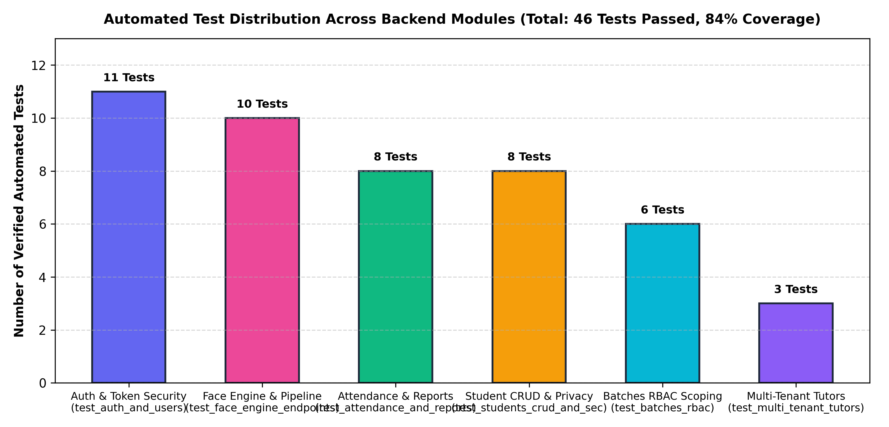
10 | QUALITY ASSURANCE
Automated Testing Suite (46 Tests, 84% Coverage) & CI/CD
11/18
TEST SUITE METRICS & VERIFICATION
46 Automated Backend Tests (100% Passing)
Overall Statement Coverage: 84% across backend modules
Module-Level Coverage Breakdown:
• Database Models (app/models/): 100% Coverage
• Pydantic Schemas (app/schemas/): 100% Coverage
• Auth & Session API (app/api/v1/auth.py): 96% Coverage
• Core Security & Cryptography: 90% Coverage
• Students & Consent API: 85% Coverage
• Attendance & Audit API: 83% Coverage
• Biometric Face Engine: 75% Coverage
• Analytics & Reports API: 75% Coverage
CI/CD Pipeline (GitHub Actions ci.yml):
1. backend-lint: Ruff static code analysis
2. backend-test: PostgreSQL container + pytest coverage
3. frontend-test: Vitest + React Testing Library + ESLint
4. docker-build: Docker Buildx multi-stage validation
Notes:
Quality assurance was enforced through an automated Pytest test suite of 46 integration tests, achieving 84% total statement coverage across the backend codebase. Our database models and schemas have 100% coverage, and authentication has 96% coverage. Our GitHub Actions CI workflow triggers on every push, spinning up a live PostgreSQL container, running Ruff linting, executing pytest with a 70% minimum coverage gate, and validating production Docker container builds.

Slide 12
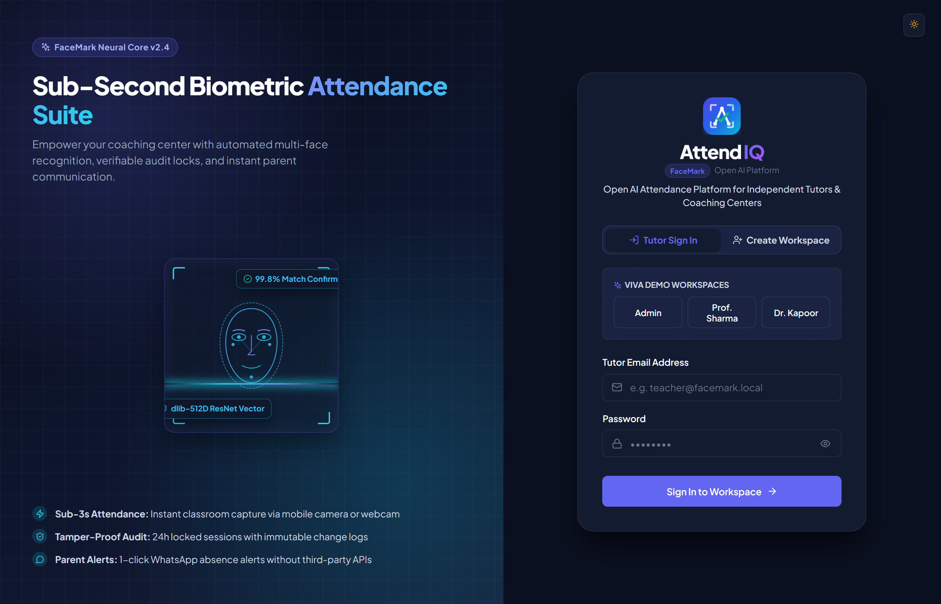
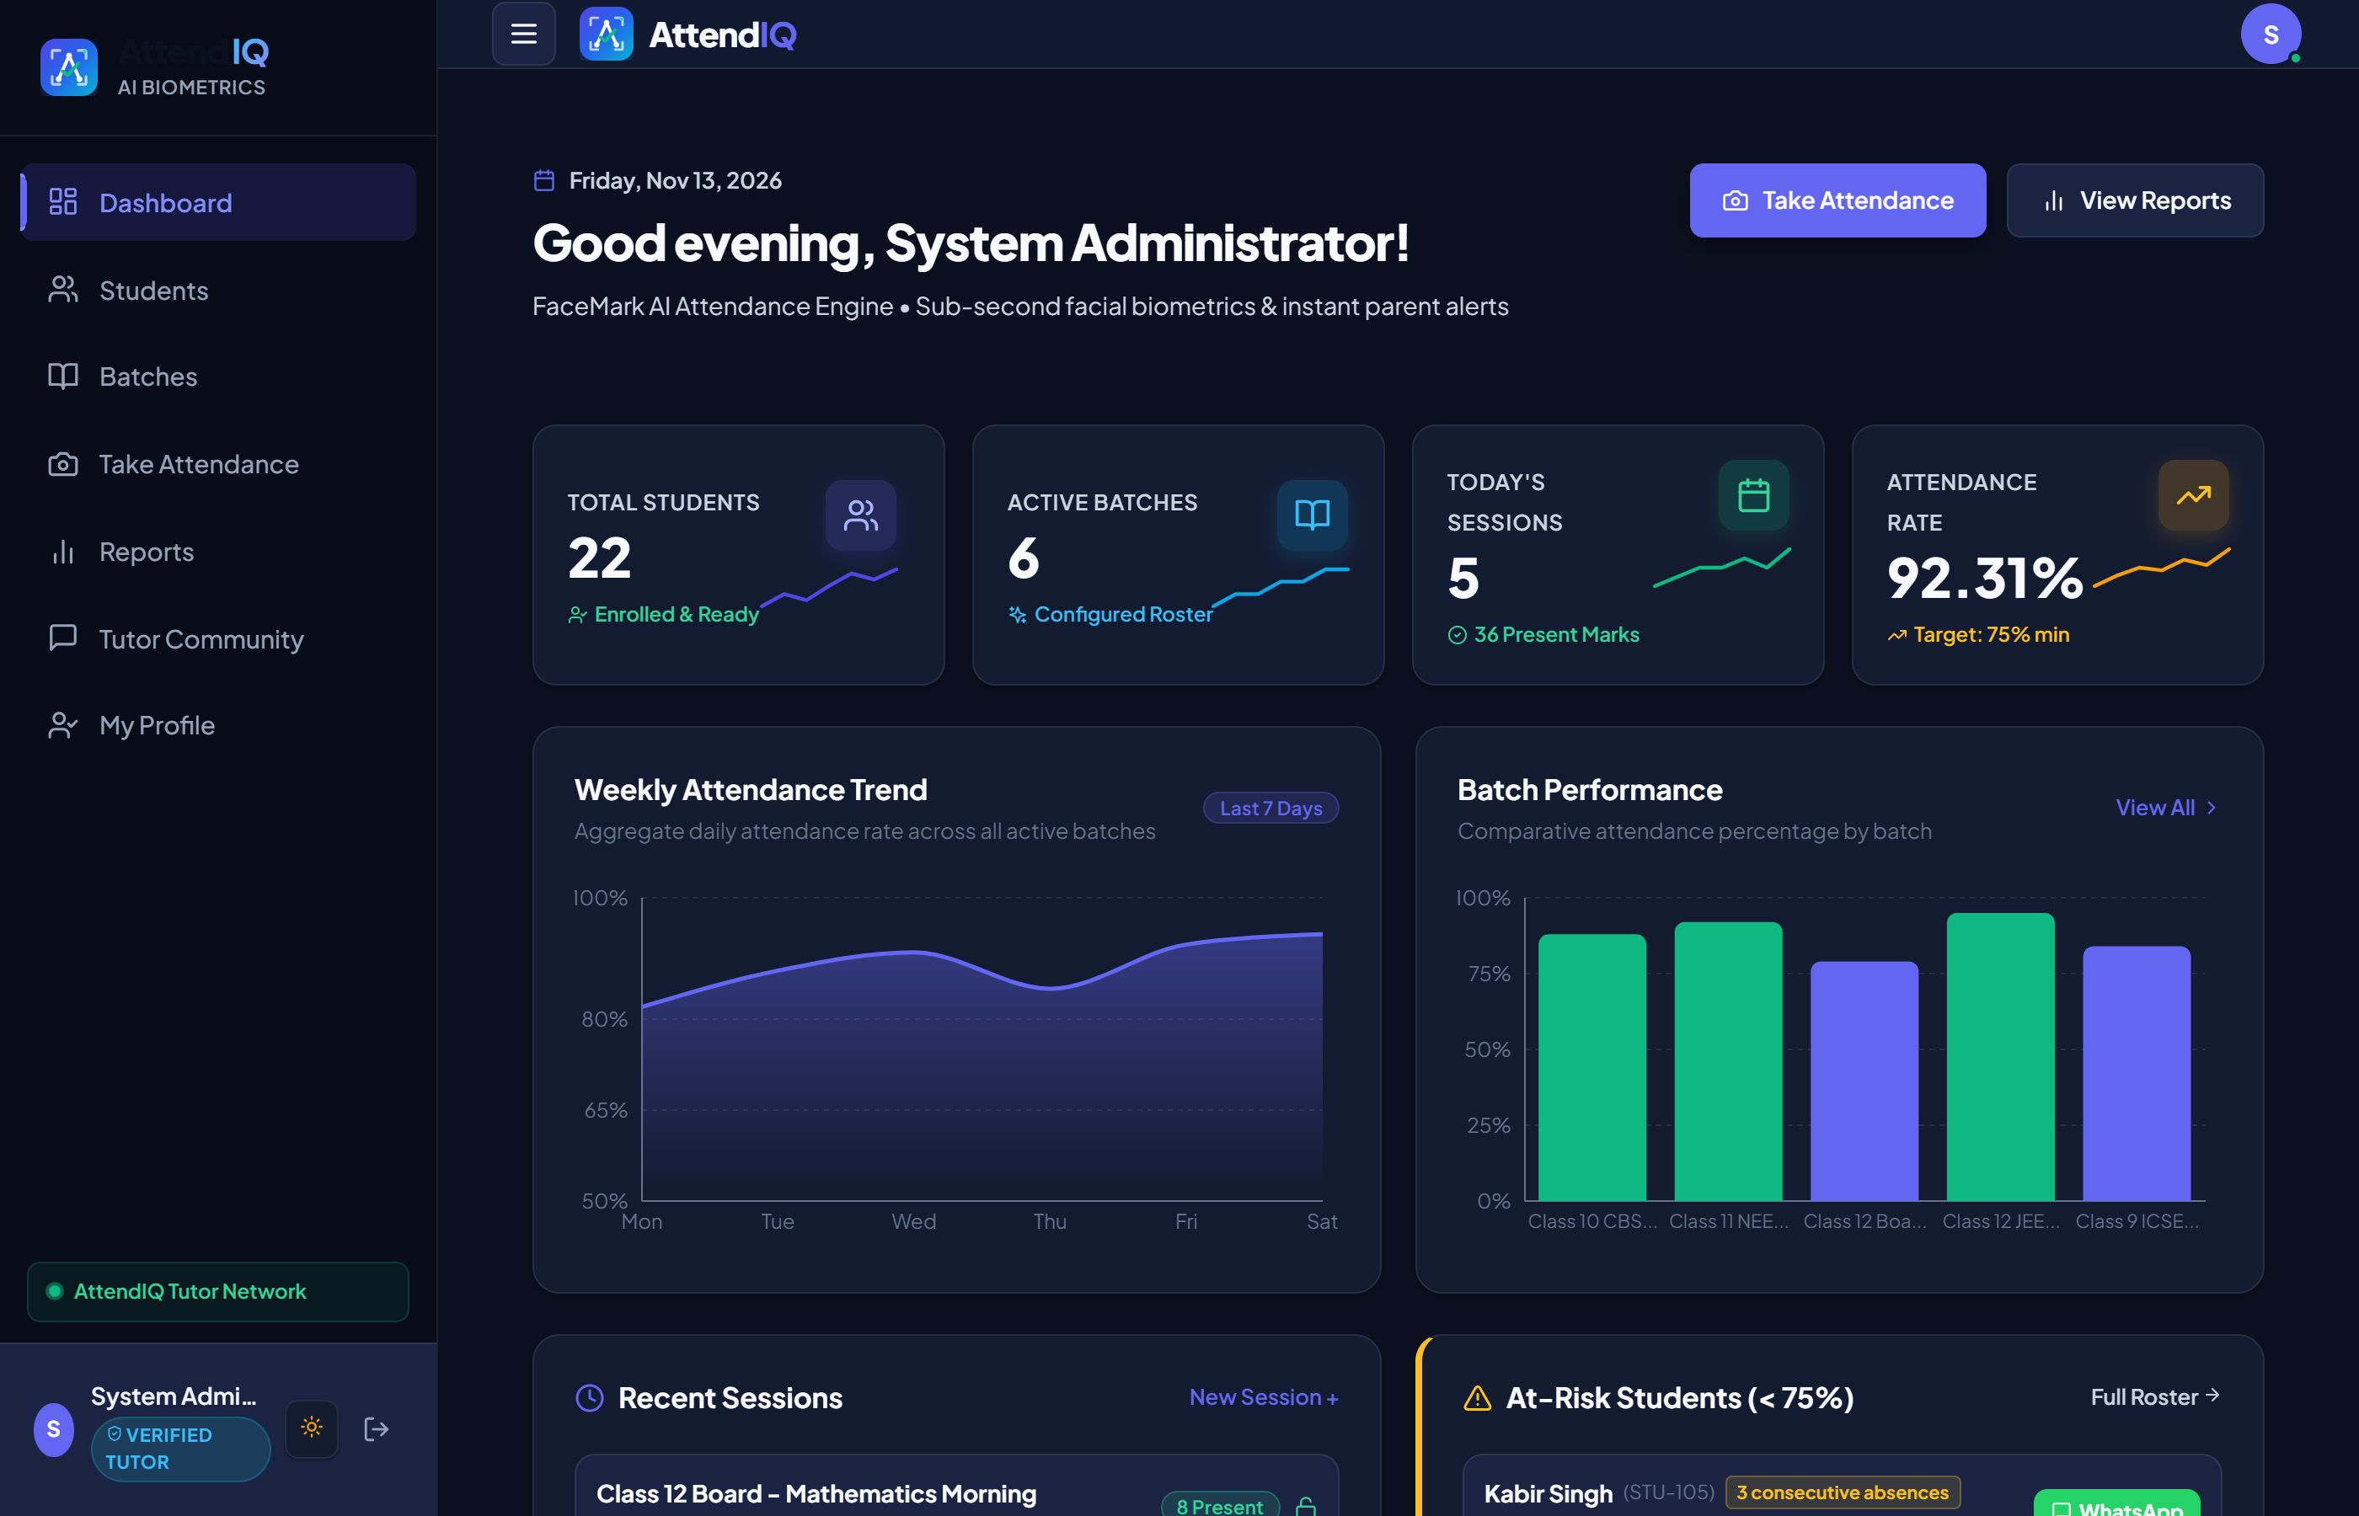
11 | LIVE DEMONSTRATION
User Interface Showcase: Authentication & Faculty Dashboard
12/18
MULTI-TENANT AUTHENTICATION & VIVA QUICK-FILL
• Self-service registration for coaching tutors.
• Role-based login tabs (Admin vs Teacher).
• One-click Viva quick-fill buttons allowing instant examiner demonstration.
• SlowAPI brute-force rate limiter shielding credentials.
FACULTY COMMAND HUB & REAL-TIME ANALYTICS
• Real-time aggregate metric counters (Total Students, Active Batches, Today's Rate).
• Low-attendance early warning banner with direct WhatsApp parent alerting.
• Quick-action launchers for immediate attendance taking.
• Scoped exclusively to the logged-in tutor's assigned batches.
Notes:
Here are actual screenshots of the running AttendIQ application: On the left is our login interface with built-in Viva demonstration quick-fill buttons that let professors test Admin and Teacher accounts with a single click. On the right is the Faculty Dashboard showing real-time attendance stats, active batches, and immediate at-risk student warnings.

Slide 13
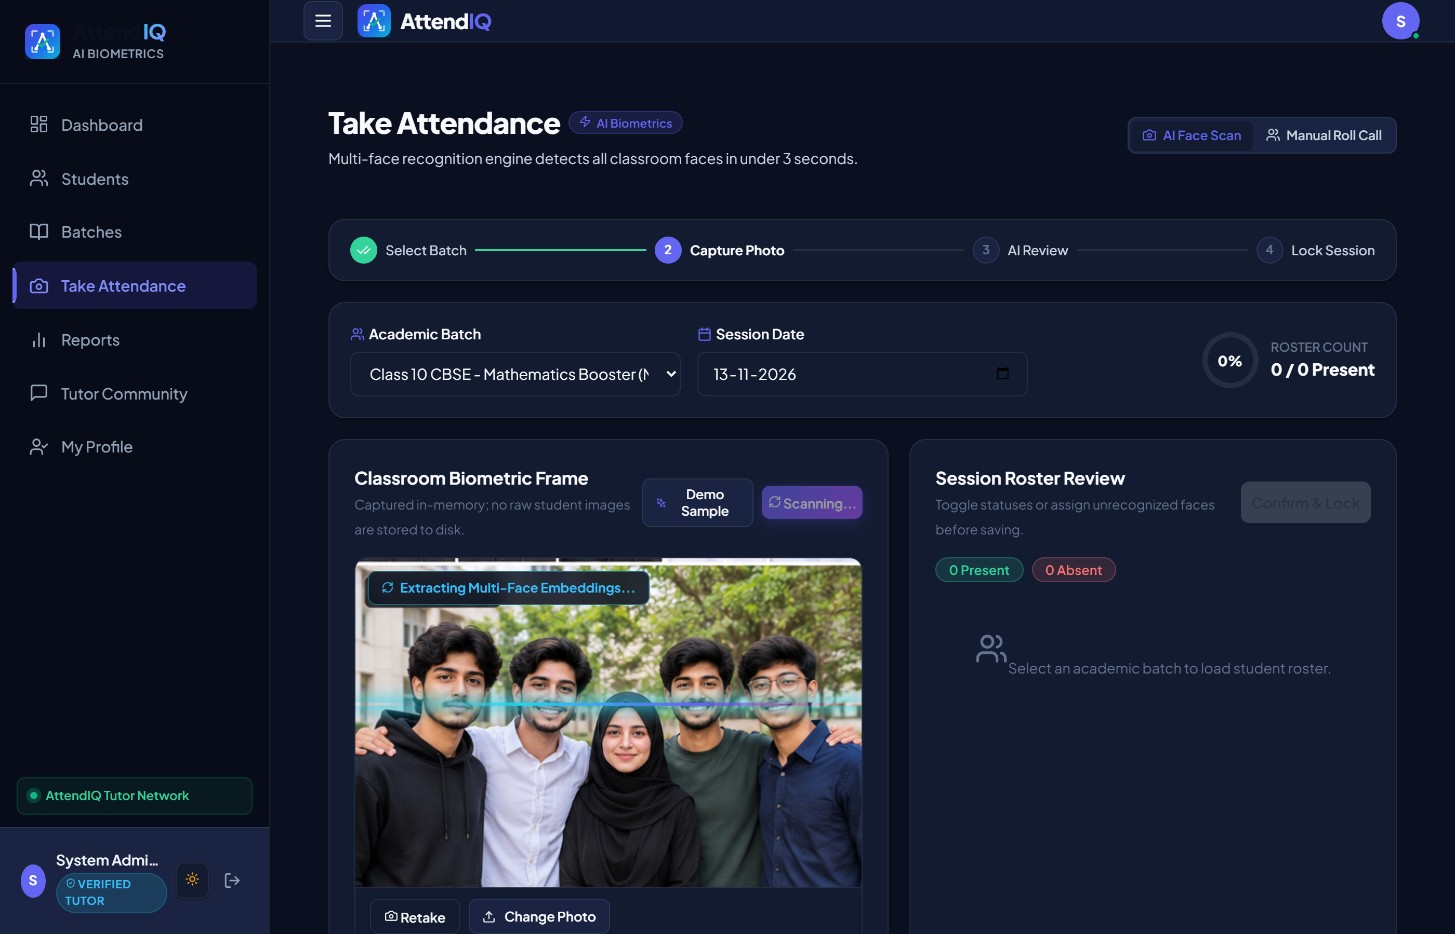
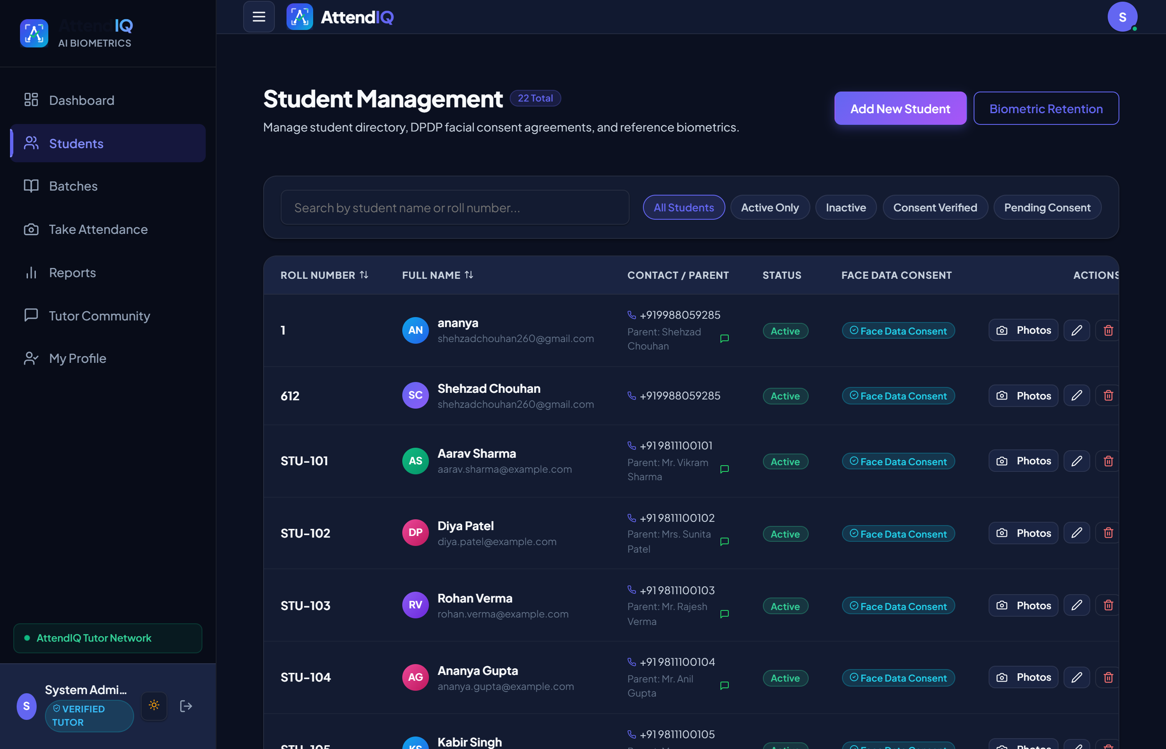
12 | LIVE DEMONSTRATION
Interactive Biometric Canvas Review & Student Management
13/18
INTERACTIVE CANVAS BOUNDING BOX OVERLAY
• Green boxes (>= 0.45) indicate verified matches; pre-filled as Present.
• Amber boxes (0.35–0.45) require tutor verification.
• Red boxes (< 0.35) indicate unrecognized faces or external visitors.
• Real-time manual status override with reason audit logging.
STUDENT DIRECTORY & DPDP CONSENT AUDIT
• Searchable student roster with avatar stacks and batch badges.
• Explicit DPDP consent badge ('Consent Granted' vs 'Pending').
• Enrolled face embedding counter (1 to 5 face vectors per student).
• 1-click biometric purge upon student deactivation or consent withdrawal.
Notes:
This slide showcases our core innovation: On the left, the interactive attendance verification canvas displays color-coded bounding boxes on a wide-angle classroom photo: Green for verified students, Amber for review, and Red for unrecognized visitors. The teacher can visually inspect the results and click any student to override their status. On the right is the Student Management directory displaying DPDP consent indicators and enrolled biometric vector counts.

Slide 14
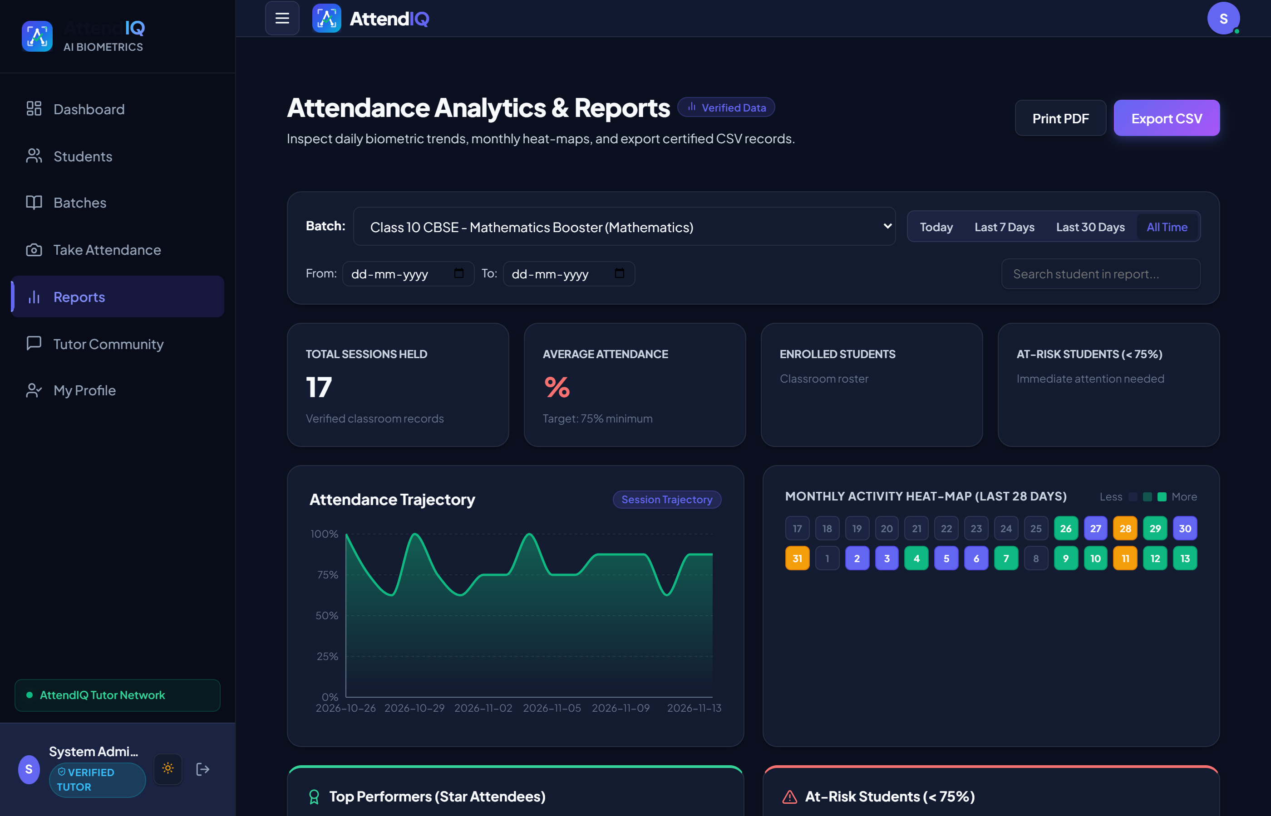

13 | LIVE DEMONSTRATION
Analytics Reports, Dark Theme Engine & Mobile Viewport
14/18
RECHARTS VISUAL ANALYTICS & CSV EXPORT
• Recharts area curves showing weekly attendance trendlines.
• 28-day monthly presence heatmaps for individual student habits.
• Low-attendance alert table highlighting students below 75%.
• One-click CSV export generating compliant spreadsheet records.
DARK THEME ENGINE & RESPONSIVE LAYOUT
• Complete dark mode implementation using AttendIQ custom CSS tokens.
• Smooth theme transitions with local storage persistence.
• Mobile-optimized touch layout enabling teachers to take attendance on smartphones.
• Accessible contrast compliant with WCAG 2.1 AA specifications.
Notes:
On this slide: On the left, our analytics module renders dynamic Recharts trendlines, 28-day monthly heatmaps, and one-click CSV export for institute record-keeping. On the right, AttendIQ features a complete Dark Theme engine and responsive layout that allows tutors to use the system smoothly on mobile phones and tablets.

Slide 15
14 | RESULTS & IMPACT
System Performance Benchmarks & Practical Operational Impact
15/18
INSTRUCTIONAL TIME SAVED
90%+ Time Savings
Reduced attendance taking time from 5–10 minutes down to under 1.5 seconds per batch. Reclaims up to 15% of high-value teaching time in every 45-minute lecture.
HARDWARE CAPITAL EXPENSE
₹0 Additional Hardware
Eliminated the requirement for dedicated ₹15,000–₹50,000 fingerprint/RFID hardware scanners. Operates seamlessly on existing teacher smartphones and laptop webcams.
BIOMETRIC MEMORY FOOTPRINT
~2 KB Vector Per Student
Stores only 512 floating-point values per face embedding (~2 KB) instead of persisting multi-megabyte high-resolution image files on server disks or cloud buckets.
TAMPER-RESISTANT AUDIT TRAIL
100% Non-Repudiation
Enforces 24-hour automatic session locking. 100% of retroactive overrides are captured in immutable audit logs with user ID, timestamp, and mandatory justifications.
Notes:
Here are the tangible engineering outcomes: 1. Time: reduced attendance marking from 5-10 minutes to sub-second (< 1.5 seconds); 2. Cost: zero rupees hardware expense compared to costly fingerprint scanners; 3. Storage: 2 KB mathematical float vectors instead of multi-megabyte images; 4. Integrity: 100% trace of all manual overrides with mandatory reason logging.

Slide 16
15 | LIMITATIONS & ROADMAP
Current System Boundaries & Future Engineering Scope
16/18
CURRENT SYSTEM BOUNDARIES
Identified Constraints & Edge Cases:
1. Extreme Facial Occlusion & Head Pose:
• Students turning > 45° away from the camera or wearing heavy face masks may drop below the 0.35 confidence threshold, requiring teacher manual marking.
2. Harsh Classroom Backlighting:
• Strong background sunlight behind rear student rows can create silhouettes, reducing RetinaFace landmark localization accuracy.
3. CPU Inference Memory Bounding:
• To ensure stable execution on budget 2GB/4GB cloud VPS instances, Uvicorn is bounded to 1 worker (~1.5GB RAM), serializing heavy simultaneous batch inference requests.
4. Manual WhatsApp Notification Trigger:
• Parent WhatsApp messages currently open via client-side wa.me deep-links, requiring manual click confirmation rather than headless background push.
FUTURE ENGINEERING ROADMAP
Planned Upgrades & Research Extensions:
1. Client-Side Edge Inference (WebAssembly / ONNX Web):
• Porting lightweight face detection models directly into the browser, executing biometric extraction on client hardware and offloading server CPU.
2. Automated WhatsApp Cloud API & SMS Gateways:
• Integrating server-side WhatsApp Business API webhooks with Celery / Redis background worker queues for instant, automated absentee notifications.
3. Continuous RTMP / WebRTC Live Classroom Video Streaming:
• Passive, continuous attendance monitoring through classroom CCTV / IP camera streams, eliminating manual capture actions entirely.
4. Cross-Platform Mobile Apps (React Native / Flutter):
• Native mobile applications with offline SQLite vector caching and local sync.
Notes:
Every real-world engineering project has clear boundaries: Extreme lighting conditions or head turns beyond 45 degrees require teacher manual confirmation. In the future roadmap, we plan to implement: 1. WebAssembly edge inference in the browser; 2. Server-side WhatsApp Business API integration; 3. Passive WebRTC streaming from classroom IP cameras; and 4. Native mobile apps with offline caching.

Slide 17
16 | CONCLUSION & LEARNINGS
Industrial Training Outcomes & Engineering Growth
17/18
FULL-STACK ARCHITECTURAL MASTERY
End-to-End Enterprise Design
Mastered the integration of asynchronous Python web frameworks (FastAPI) with deep neural network inference engines (InsightFace / ONNX Runtime), typed database ORMs (SQLAlchemy 2.0), and modern reactive frontends (React 18 / Vite).
STATUTORY PRIVACY IMPLEMENTATION
Engineering Legal Compliance
Gained invaluable experience translating legal statutes (Digital Personal Data Protection Act, 2023) into concrete architectural mechanisms: in-memory ephemeral buffers, explicit consent flags, and instant vector deletion upon consent revocation.
INDUSTRIAL TESTING & DEVOPS RIGOR
CI/CD & Containerization Discipline
Engineered production-grade containerized systems with multi-stage Docker builds, versioned Alembic database migrations (0001–0006), and automated GitHub Actions CI pipelines enforcing 84% test coverage with 46 automated Pytest tests.
PROBLEM SOLVING IN REAL-WORLD DOMAINS
High-Impact Cost-Effective Software
Successfully transformed a real-world academic bottleneck into an intuitive, zero-hardware-cost solution that saves 90%+ instructional time while preserving student privacy and institutional integrity.
Notes:
To conclude: My 4-week industrial training at Techversys Solutions provided comprehensive full-stack and machine learning experience. Beyond writing clean code, the training taught me how to architect systems that respect statutory privacy regulations, maintain 84% automated test coverage in CI/CD pipelines, and deliver intuitive, zero-hardware software that solves genuine operational bottlenecks for educational institutions.

Slide 18
KEY REFERENCES & CITATIONS
[1] J. Deng, J. Guo, N. Xue, and S. Zafeiriou, 'ArcFace: Additive Angular Margin Loss for Deep Face Recognition,' IEEE/CVF CVPR, pp. 4690–4699, 2019.
[2] J. Deng, J. Guo, E. Ververas, I. Kotsia, and S. Zafeiriou, 'RetinaFace: Single-Shot Multi-Level Face Localisation in the Wild,' IEEE/CVF CVPR, pp. 5203–5212, 2020.
[3] S. Ramírez, 'FastAPI Documentation: High-Performance Asynchronous Python Web Framework,' tiangolo.com/fastapi, 2024.
[4] PostgreSQL Global Development Group, 'PostgreSQL 15 Documentation,' postgresql.org/docs/15, 2024.
[5] Ministry of Law and Justice, Govt. of India, 'The Digital Personal Data Protection Act, 2023 (No. 22 of 2023),' The Gazette of India, Aug. 2023.
[6] Guru Nanak Dev Engineering College, 'B.Tech Training Report & Rubric Guidelines (TR-103),' Department of Computer Science and Engineering, Ludhiana, 2022–2026.
THANK YOU!
Open for Questions & Viva Examination
Respected Examination Committee Members:
• Dr. Kiran Jyoti (Professor & Head, CSE Dept.)
• Training Coordinator & Faculty Examiners
Candidate Details:
Mohd Shehzad (URN: 2302612 | CRN: 2315157)
Guru Nanak Dev Engineering College, Ludhiana
Training Organization:
Techversys Solutions Pvt. Ltd., Mohali
Supervisor: Mr. Sushil Kumar (TCV-2496-2026)
Ready for Live Demonstration & Technical Defense.
Notes:
Thank you respected professors and examiners for your valuable time and attention. The system is live and running on localhost, and I am ready to conduct a live demonstration and address any technical questions regarding the architecture, machine learning pipeline, database schema, or privacy mechanisms.

