Slide 1
Hopmonk - Customer Life Time Value
CUTE03
By Sheik Basha

Slide 2
Agenda
Problem Statement
Data Set
Plots
Linear Regression Model & Error Metrics
Random Forest Model & Error Metrics
CART model & Error Metrics
XG Boost Model & Error metrics
SVM Model & Error Metrics
Comparison of Best Models

Slide 3
Problem Statement
Identify and target only specific customer groups that will turn out to be most profitable.
“Retain and Acquire more customers and increase profits”
Minimize operation costs
Generate Insights from customer data to segment the customers

Slide 4
Data Set
121 variables from the data
Easy: 4
Medium: 79 (Used functions)
Difficult: 38 (Derived from data given in files)
Extracted 27 features using Step Aic
Reduce in dimensionality
Correlated variables have been removed
* File to see all variables: Group13-Cute2-ExtractedVariables.txt

Slide 5
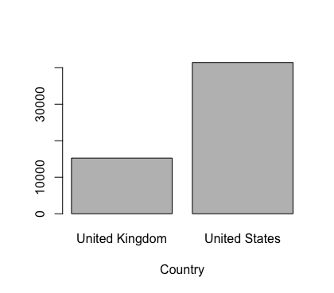
Plots

Slide 6
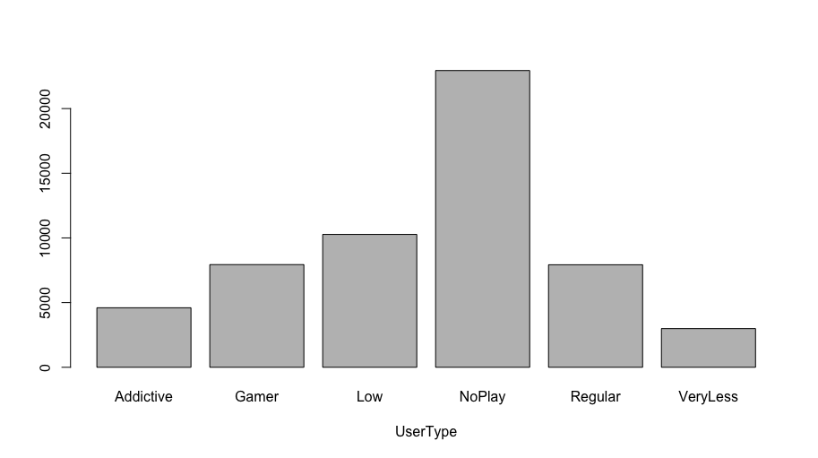
Plots

Slide 7
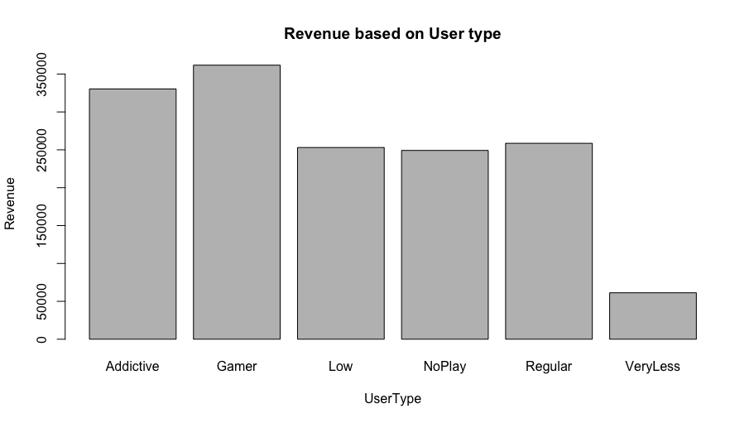
Plots

Slide 8
Linear Regression Model
Predicting Total Revenue per customer based on extracted variables
Ran on all extracted variables
Reduced variables based on significant attributes and data knowledge
Final model is on 27 attributes
Median RMSE 15.17350936
 | LinReg_TrainTransform | LinReg_TestTransform
mape | 0.405172999 | 0.124943724

Slide 9
Regression Error Metrics
 | LinReg_Train | LinReg_Test | AICLinReg_Train | AICLinReg_Test | LinReg_TrainTransform | LinReg_TestTransform
mae | 9.083272156 | 8.938421365 | 9.093590099 | 8.940703145 | 1.347059523 | 0.393628235
mse | 216.0489939 | 229.8263704 | 216.4519598 | 230.2353864 | 2.405607436 | 0.463730108
rmse | 14.69860517 | 15.16002541 | 14.71230641 | 15.17350936 | 1.551002075 | 0.680977319
mape | 2.630651335 | 2.491325444 | 2.659793831 | 2.494933761 | 0.405172999 | 0.124943724

Slide 10
Random Forest
Ran Random Forest on 27 Variables extracted from Step AIC.
Log Transformation on Target Variable
Tuned the model using nTree and mtry.
Median RMSE 0.48515
 | RF_Train30_9 | RF_Test30_9
mape | 0.045284533 | 0.078922934

Slide 11
Random Forest Error Metrics
 | RF_Train50_5 | RF_Test50_5 | RF_Train30_9 | RF_Test30_9 | RF_Train50_3 | RF_Test50_3
mae | 0.174194747 | 0.250184177 | 0.139657983 | 0.249295395 | 0.225101652 | 0.269462803
mse | 0.127508339 | 0.227193217 | 0.085352658 | 0.232872752 | 0.185686578 | 0.246158583
rmse | 0.357083098 | 0.476647897 | 0.292151773 | 0.482568909 | 0.430913655 | 0.496143712
mape | 0.056502747 | 0.078153373 | 0.045284533 | 0.078922934 | 0.072341871 | 0.084047101
 | RF_Train10_6 | RF_Test10_6 | RF_Train20_3 | RF_Test20_3
mae | 0.16964318 | 0.261219717 | 0.237475091 | 0.280226171
mse | 0.116165456 | 0.235371322 | 0.20440121 | 0.264713494
rmse | 0.340830538 | 0.485150824 | 0.452107521 | 0.514503153
mape | 0.055051862 | 0.082274161 | 0.076280372 | 0.087583863

Slide 12
CART
Built the Regression model using rpart.
Log Transformed the target Variable.
Tuned the model using complexity parameter cp and minSplit.
MEDIAN RMSE 0.506
 | TrainCP0.0001 | TestCP0.0001
mape | 0.079702954 | 0.08216484

Slide 13
CART Error Metrics
 | TrainCP0.01 | TestCP0.01 | TrainCP0.001 | TestCP0.001 | TrainCP0.0001 | TestCP0.0001
mae | 0.34917524 | 0.347800358 | 0.288123444 | 0.290218122 | 0.252516151 | 0.261226134
mse | 0.289604785 | 0.294674245 | 0.23878128 | 0.25132787 | 0.196199368 | 0.242374519
rmse | 0.538149408 | 0.54283906 | 0.488652515 | 0.501326112 | 0.442943979 | 0.492315467
mape | 0.105872353 | 0.104921509 | 0.08967858 | 0.089980155 | 0.079702954 | 0.082164844
 | TrainCP0.0001_MinSp10 | TestCP0.0001_MinSp10 | Train0.00001_MinSp10 | Test0.00001_MinSp10 | Train0.00002_MinSp10 | Test0.00002_MinSp10
mae | 0.251188611 | 0.264883216 | 0.189893402 | 0.289940716 | 0.261253007 | 0.27021908
mse | 0.181634815 | 0.257819637 | 0.136228109 | 0.292442214 | 0.19449948 | 0.25443805
rmse | 0.426186362 | 0.507759428 | 0.369090922 | 0.540779265 | 0.441020952 | 0.504418527
mape | 0.080021955 | 0.083961815 | 0.061065687 | 0.092627814 | 0.082319127 | 0.084790766

Slide 14
XG Boost
Built the Regression model .
Log Transformed the target Variable.
Tuned the model using max.depth , nround and eta.
Median RMSE 0.431
 | Train3_700 | Test3_700
mape | 0.06800984 | 0.077657576

Slide 15
XG Boost Error Metrics
 | Train3_700 | Test3_700 | Train2_1000 | Test2_1000
mae | 0.214210367 | 0.243071239 | 0.228549789 | 0.239007485
mse | 0.169455996 | 0.188584722 | 0.199320818 | 0.183929308
rmse | 0.411650332 | 0.434263425 | 0.446453601 | 0.428869803
mape | 0.06800984 | 0.077657576 | 0.071885154 | 0.075843767

Slide 16
Support Vector Machines
Built the model using SVM for 27 Variables.
Log Transformed the Target Variable.
Median RMSE 17.2206639
 | SVM_Reg1_Train | SVM_Reg1_Test
mape | 2.640019958 | 2.516680561

Slide 17
SVM Error Metrics
 | SVM_Reg1_Train | SVM_Reg1_Test
mae | 9.226218566 | 9.147997492
mse | 280.847336 | 296.5512637
rmse | 16.75850041 | 17.22066386
mape | 2.640019958 | 2.516680561

Slide 18
Comparisons of Best Model
MODEL | MAPE |  | Parameters | Median RMSE
 | TRAIN | TEST
Linear Regression | 0.405172999 | 0.124943724 | AIC & Log Transformation | 15.17
Random Forest | 0.045284533 | 0.078922934 | nTree=30, mtry = 9 | 0.485
CART | 0.079702954 | 0.08216484 | cp=0.0001 | 0.506
XG Boost | 0.06800984 | 0.077657576 | max.depth = 3,nround = 700 | 0.431
SVM | 0.405172999 | 0.124943724 | cost = 10, gamma = 0.1 | 17.22

Slide 19
THANK YOU

