Slide 1
Hopmonk - Customer Life Time Value
CUTe 2
Group # 13: Ramandeep, Nirdosh, Basha
Exponentially turning Unlucky to the Luckiest

Slide 2
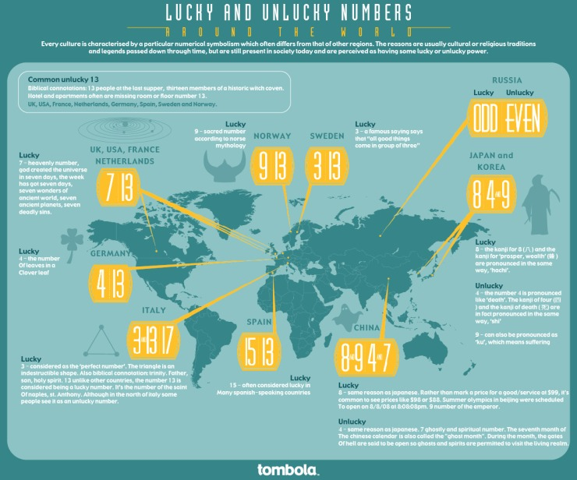
Group # 13

Slide 3
Agenda
Problem Statement
Data Files
Data Extraction
Plots
Linear Regression Model
Step AIC
Lasso / Ridge / Elastic Net
Logistic / Naïve Bayes Algorithm
Regression – Error Metric
Classifications
Classification – AUC
Challenges
Future Enhancements

Slide 4
Problem Statement
“Retain and Acquire more customers and increase profits”
Generate Insights from customer data
Minimize operation costs
Target right set of customers

Slide 5
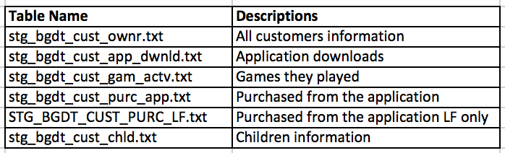
Data Files

Slide 6
Data Extraction
Extracted 121 variables from the data
Easy: 4
Medium: 79 (Used functions)
Difficult: 38 (Derived from data given in files)
RFM variables
Favorite variables
* File to see all variables: Group13-Cute2-ExtractedVariables.txt

Slide 7
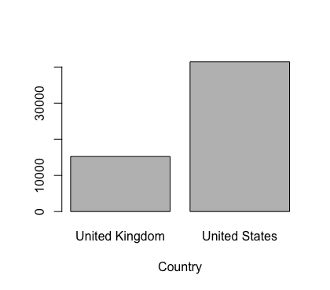
Plots

Slide 8
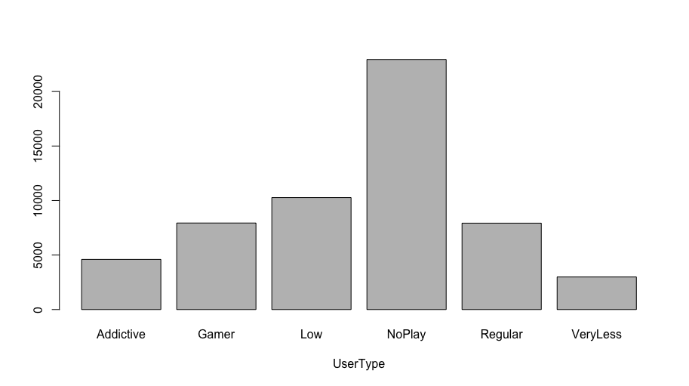
Plots

Slide 9
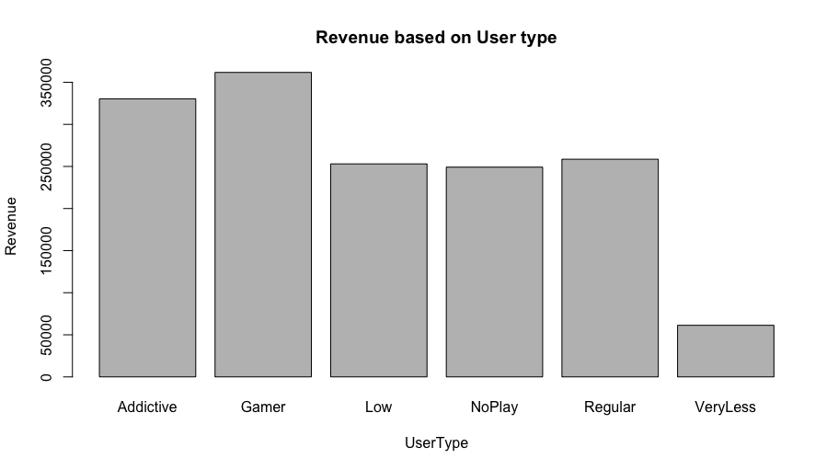
Plots

Slide 10
Linear Regression Model
Predicting Total Revenue per customer based on extracted variables
Ran on all extracted variables
Reduced variables based on significant attributes and data knowledge
Final model is on 34 attributes
* File to see Model summary: Group13-Cute2-Lin_Reg_Summary.txt

Slide 11
Step AIC
Ran Step AIC
Step AIC also gave us same 34 attributes
Ran Step AIC on 34 attributes came from Linear Regression as well
No further reduction in variables suggested
* File to see Step AIC Model summary: Group13-Cute2-StepAIC_Summary.txt

Slide 12
Lasso / Ridge / Elastic Net
Ran all 3 models on 34 attributes
Ran Lasso with alpha = 1
Minimum Lambda: 0.01425907
Ran Ridge with alpha = 1
Minimum Lambda: 4.669203
Ran Elastic Net with alpha = 1
Minimum Lambda: 0.02367626

Slide 13
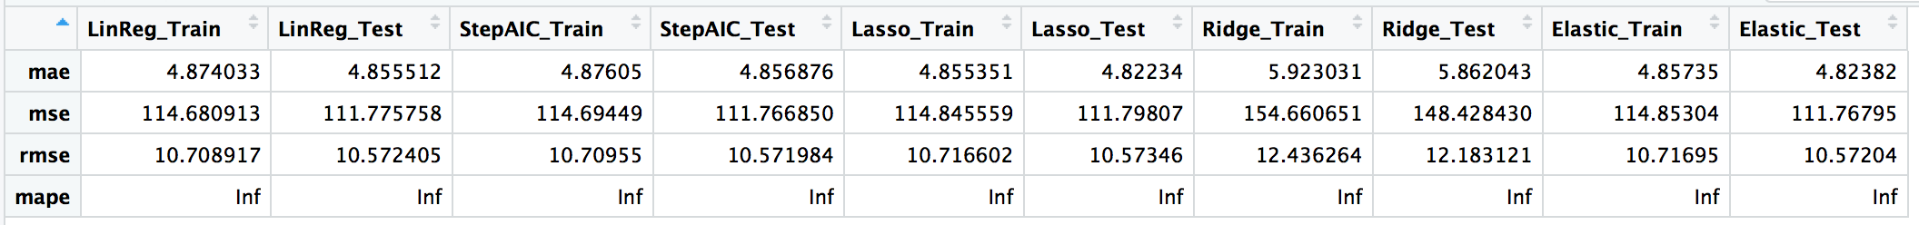
Regression - Error Metric

Slide 14
Classifications
Classifying high / low value customers accurately
Help in running marketing campaigns for new games
Algorithms
Logistic
Naïve Bayes
Classified customers based on median values

Slide 15
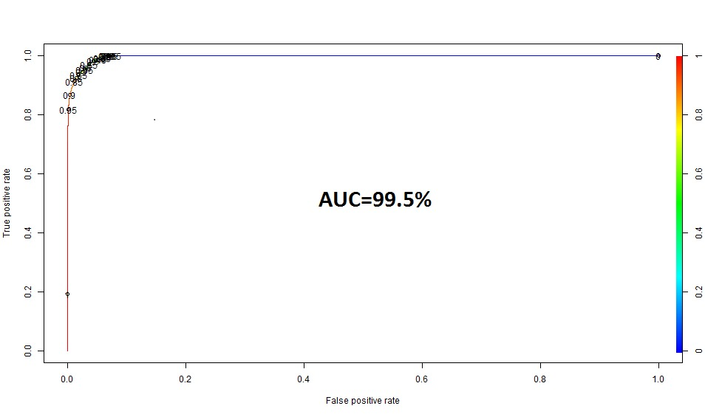
Classification - AUC

Slide 16
Challenges
Too many missing values
Revenue is 0 for many customers
Paid one time in previous years and using for couple of years
Paid for the games but didn’t play
User variations on total time of playing game

Slide 17
Future Enhancements
More Feature Engineering
RFM analysis
Better threshold for Logistic classification
More categories for Naïve Bayes classification

Slide 18
Thank You

