Slide 1

CSC-336 Web Technologies Lecture 2:
Topics:
Lists, Links, Images & Multi-Page Websites
Muhammad Naveed Shaikh
Department of Computer Engineering naveedshaikh@cuiatd.edu.pk
COMSATS University Islamabad | Abbottabad Campus

Slide 2
Topics from Previous Week
HTML Structure
Headings,
Paragraphs
Formatting ,<br> and <hr> tags
Lists, Anchor, Image element

Slide 3
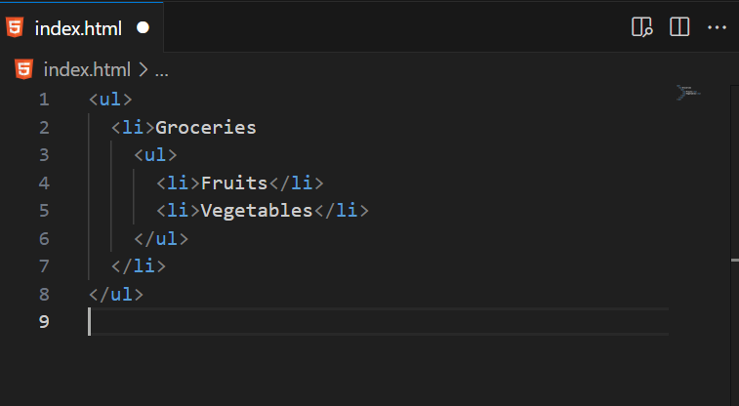
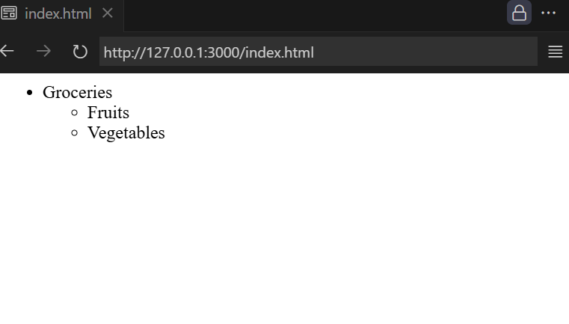
Lists in HTML
Types of Lists
Unordered Lists (<ul>) → Bulleted points
Ordered Lists (<ol>) → Numbered points
Nested Lists → A list inside another list

Slide 4
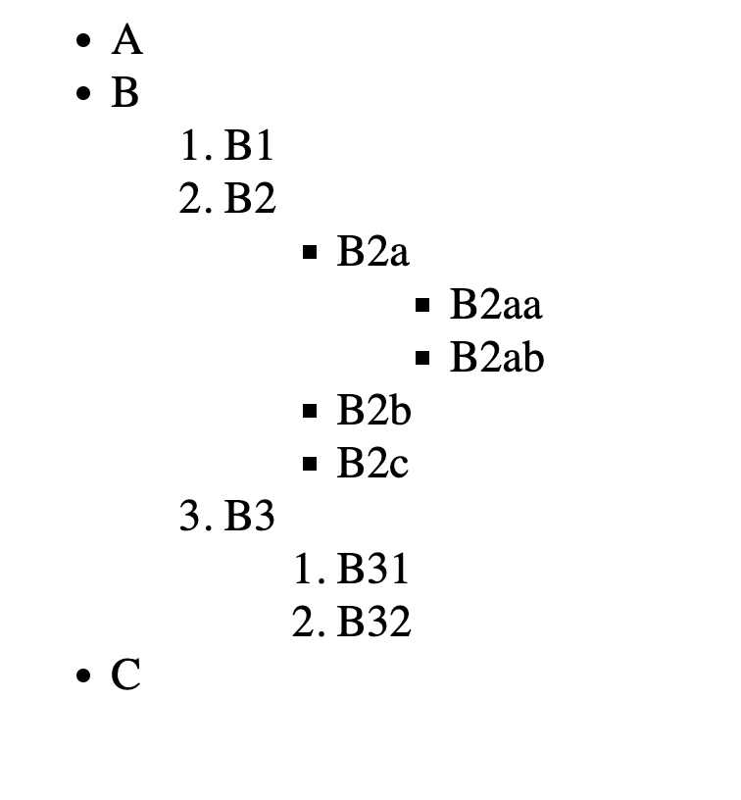
Practice Problem for Nested List

Slide 5
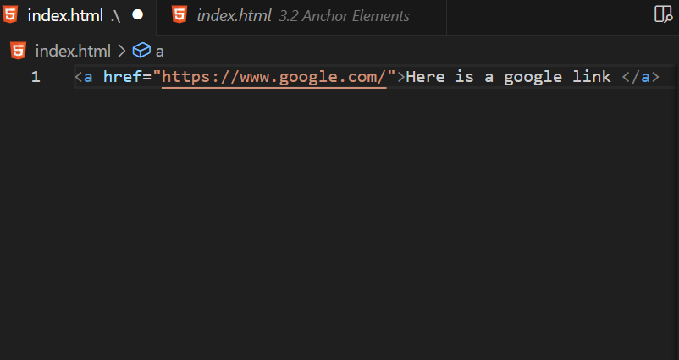
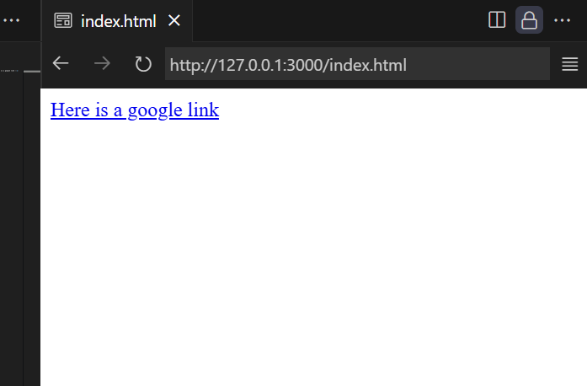
Anchor Element
<tag attribute=“value”> Content</tag>

Slide 6
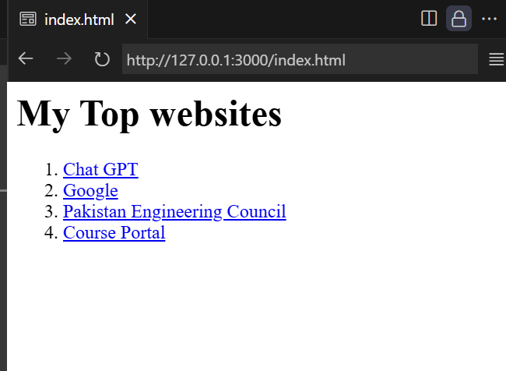
Practice Problem

Slide 7
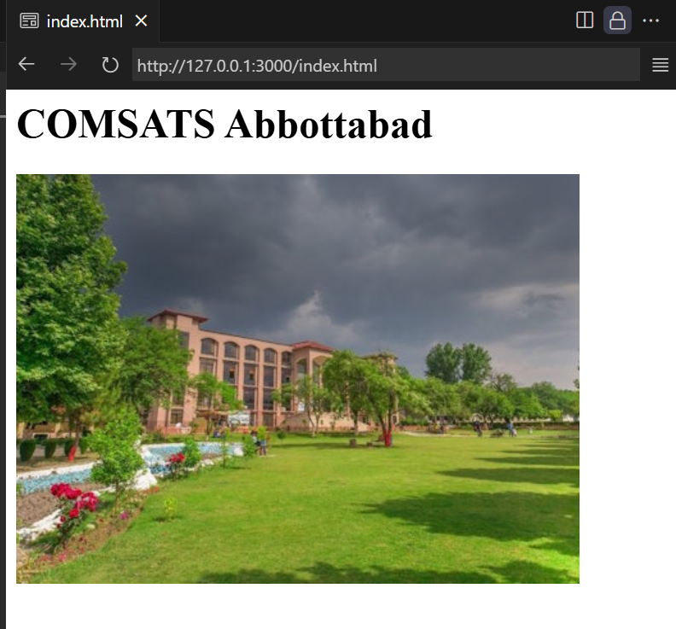
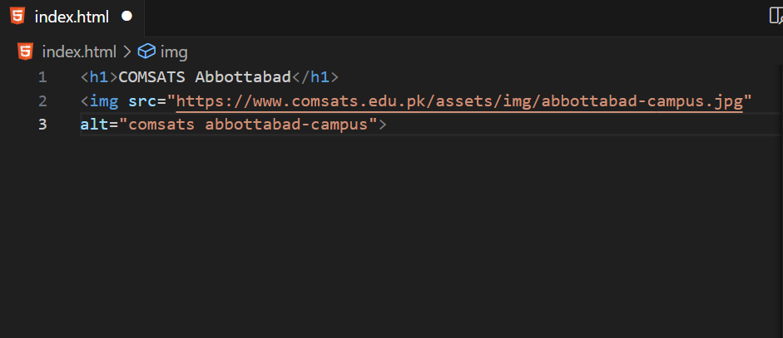
Image Element
Img < src =“ ” alt=“ ”>
Relative Address (Drive)
Absolute Address (Internet)

Slide 8
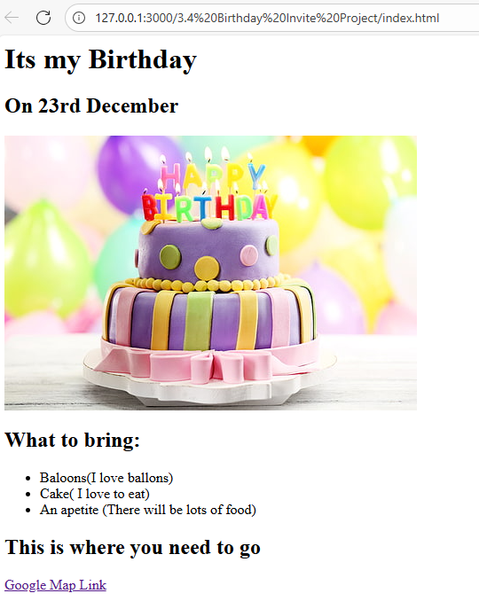
Birthday Invite page (Practice Problem)
Birthday Page

Slide 9


File Paths
Absolute Paths → Relative to Root
📂 Root
├── 📄 Document.docx
└── 📁 Project
├── 🌐 Index.html
└── 📁 Images
└── 🖼️ Image1.png

Slide 10

File Paths
Relative Path
📂 Root
├── 📄 Document.docx
└── 📁 Project
├── 🌐 Index.html
└── 📁 Image
└── 🖼️ Image1.png

Slide 11



File Paths
Special Characters
📂 Root
├── 📄 Document.docx
└── 📁 Project
├── 🖼️ Image1.png
├── 🌐 Index.html
└── 📁 Images
└── 🖼️ Image2.png
Upper Level (../)
Current Directory (./)

Slide 12
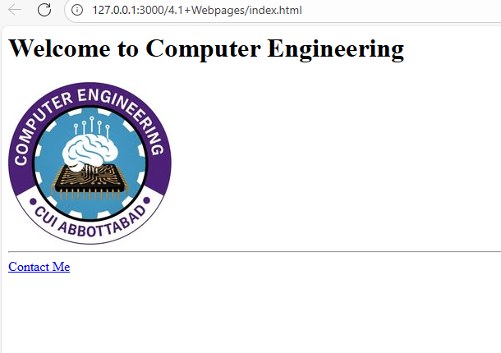
Multi-Page Website
It is good practice to build multi page website

Slide 13
HTML Boilerplate
<!DOCTYPE html>
<html lang=“en”>
<head>
<meta charset=“UTF-8”>
<title>Website Name</title>
</head>
<body>
<h1> Hello World!</h1>
</body>
</html>

Slide 14
HTML Boilerplate
<!DOCTYPE html> It defines the html version.

Slide 15
HTML Boilerplate
<!DOCTYPE html>
<html lang=“en”> it defines the language of the web
</html>

Slide 16
HTML Boilerplate
<!DOCTYPE html>
<html lang=“en”>
<head> it defines the all important settings of the webpage
</head>
</html>

Slide 17
HTML Boilerplate
<!DOCTYPE html>
<html lang=“en”>
<head>
<meta charset=“UTF-8”>
</head>
</html>
Metadata = data about data, information about the document that browsers, search engines, and social media use. UTF-8 : Ensures text displays correctly, supports emojis & multiple languages

Slide 18
HTML Boilerplate
<!DOCTYPE html>
<html lang=“en”>
<head>
<meta charset=“UTF-8”>
<title>Website Name</title> it is the name of webpage.
</head>
</html>

Slide 19
HTML Boilerplate
<!DOCTYPE html>
<html lang=“en”>
<head>
<meta charset=“UTF-8”>
<title>Website Name</title>
</head>
<body>
</body>
</html>
It contains actual web content to be displayed on webpage

Slide 20
HTML Boilerplate
<!DOCTYPE html>
<html lang=“en”>
<head>
<meta charset=“UTF-8”>
<title>Website Name</title>
</head>
<body>
<h1> Hello World!</h1>
</body>
</html>

Slide 21
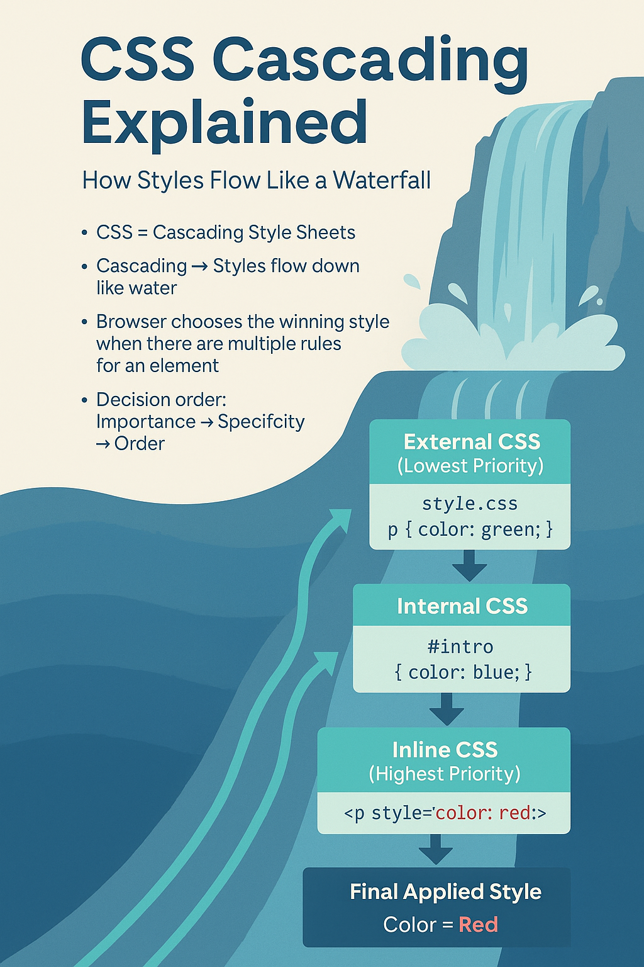
Introduction to CSS
What is CSS?
CSS = Cascading Style Sheets
Cascading →Styles flow down like water
Browser chooses the winning style
when there are multiple rules for the same element.
Decision order:
Importance → Specificity → Order

Slide 22
How to ADD CSS
Three ways:
Inline
<tag style=“css ”/>
Internal
<style> css</style>
External
<link href=“style.css”/>

Slide 23
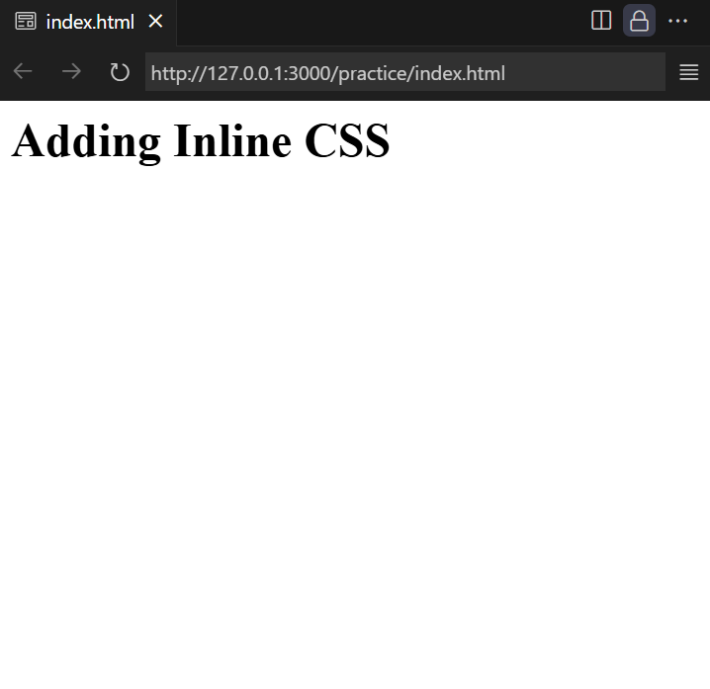
Inline CSS
<h1>Adding Inline CSS</h1>

Slide 24
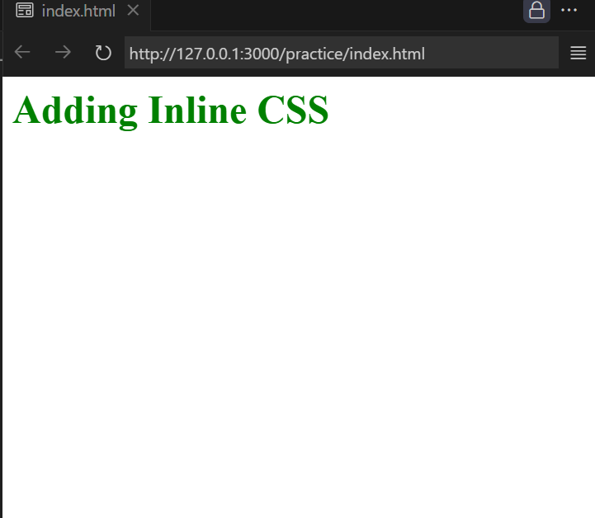
Inline CSS
<h1 style="color: green;">Adding Inline CSS</h1>

Slide 25
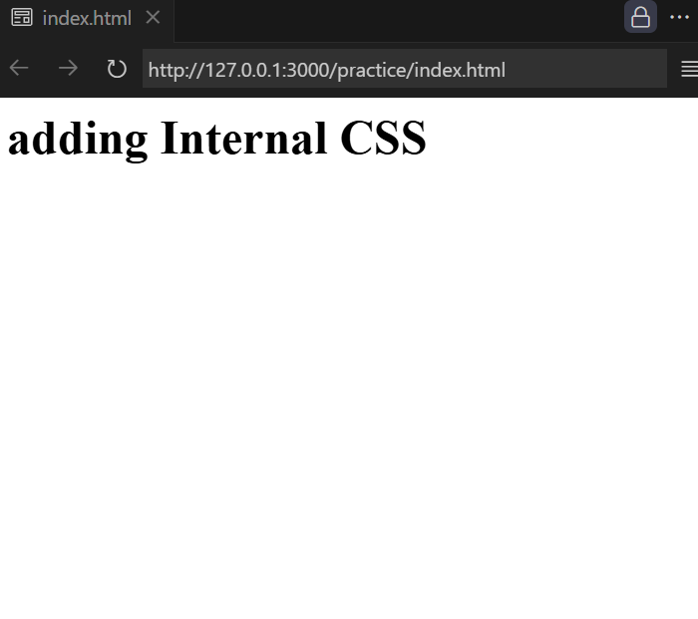
Internal
<html>
<head>
</head>
<body>
<h1>adding Internal CSS</h1>
</body>
</html>

Slide 26
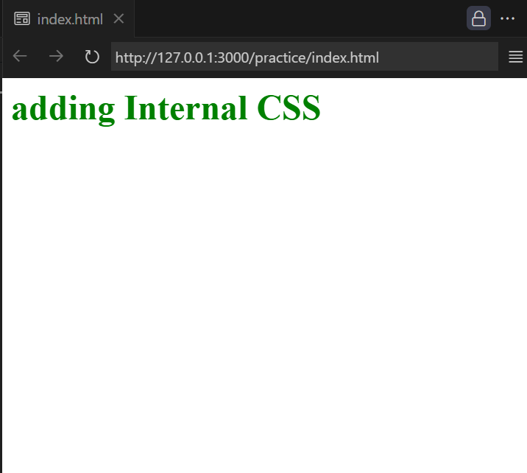
Internal
<html>
<head>
<style>
h1{ color:green }
</style>
</head>
<body>
<h1>adding Internal CSS</h1>
</body>
</html>

Slide 27
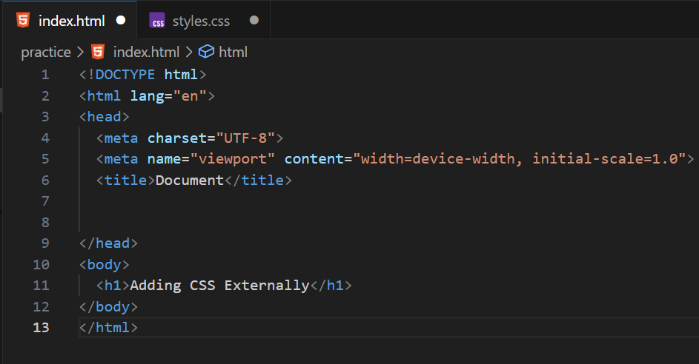
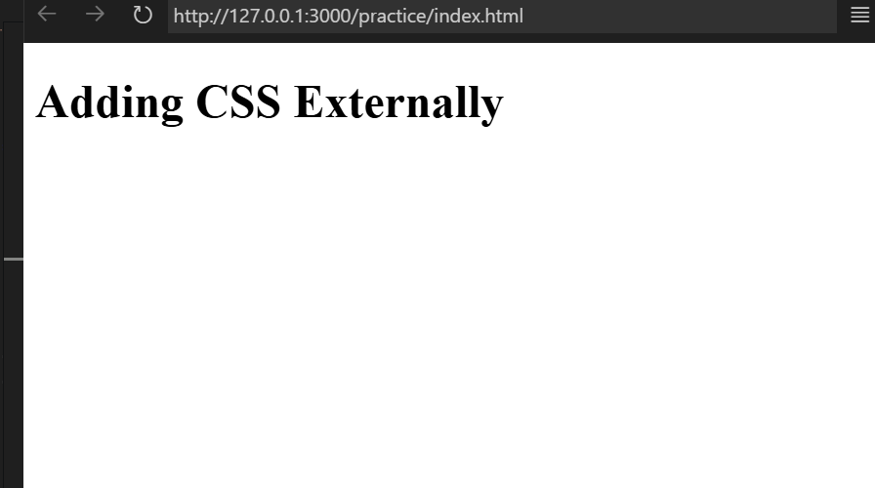
External

Slide 28
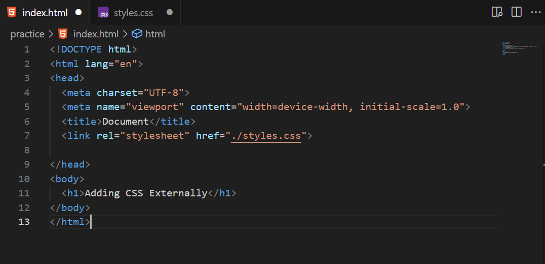
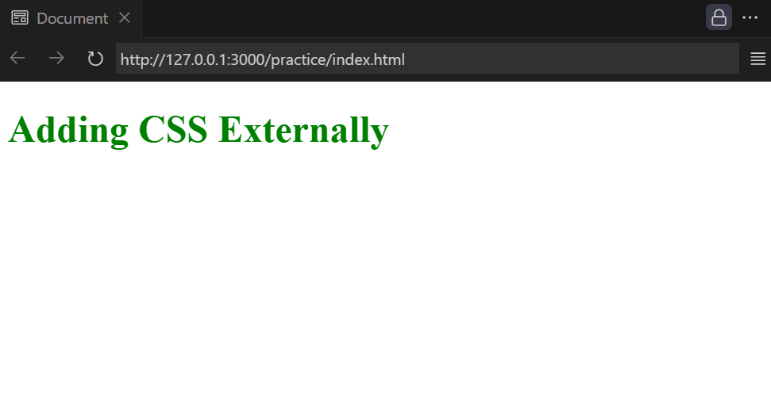
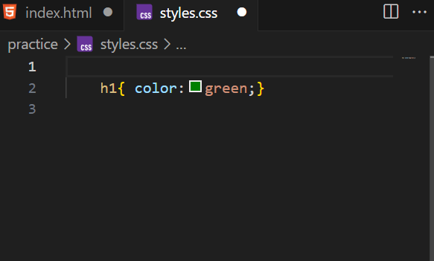
External
Two files

Slide 29
CSS Selectors
Definition:
CSS selectors are patterns used to select HTML elements to apply styles.
They connect HTML and CSS by telling the browser which elements to style.
Without selectors, CSS wouldn't know where to apply rules.

Slide 30
ELEMENT SELECTORS
h1 { color: blue;}
Syntax:
element {CSS Rule;}
Examples:
p{text-align:center;}
h2{background-color: orange;}

Slide 31
ELEMENT SELECTORS
h1 { color: blue;}
Syntax:
element {CSS Rule;}
Examples:
p{text-align:center;}
h2{background-color: orange;}

Slide 32
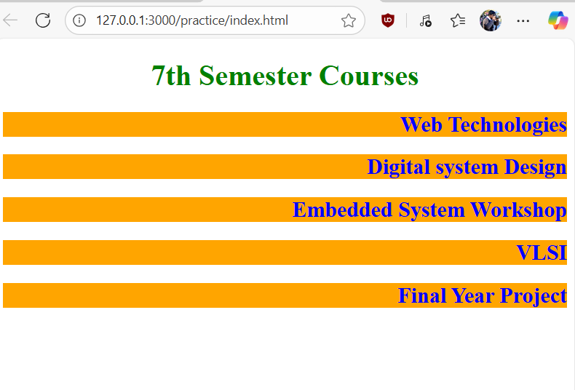
Practice Case Study#1
Design this web page using only Element Selector

Slide 33
Class SELECTOR
.Green_Heading { color: green;}
Syntax:
.classname{CSS Rule;}
classname is attribute defined using the class keyword in any html element

Slide 34
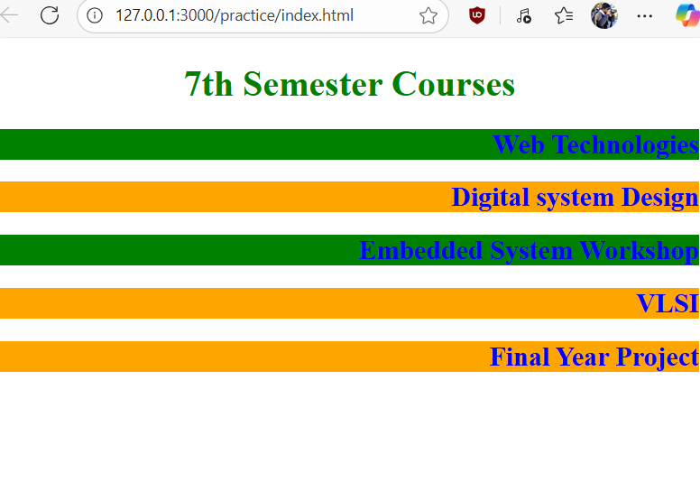
Practice Case Study#2
Modify the case study#1 using class selector

Slide 35
Class Selector
Multiple element can have same class
One tag/element can be declared in multiple classes
<h1 class=“red-color” > Heading1 </h1>
<p class=“red-color”> paragraph </p>
<h1 class=“blue”> heading1 </h1>
<h2 class=“blue col”> column1</h2>
<h3 clas=“col”> heading3</h3>

Slide 36
ID SELECTOR
#Green { color: green;}
Syntax:
#id_name{CSS Rule;}
Id_name is attribute with keyword ID defined in any html element.

Slide 37
ID SELECTOR
Some of the examples of class definitions.
Key difference between class and ID selector:
ID is unique to each element
While many element can be assigned to same class.
<h1 id=“one” class=“red-color” > Heading1 </h1>
<p id=“Two” class=“red-color”> paragraph </p>
<h1 id=“card” class=“blue”> heading1 </h1>
<h2 id=“item” class=“blue col”> column1</h2>
<h3 clas=“col”> heading3</h3>

Slide 38
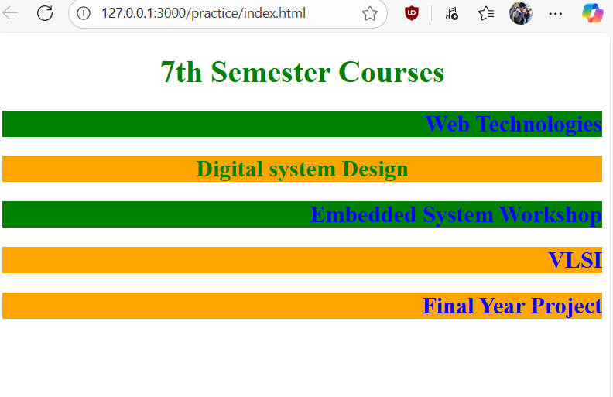
Practice Case Study#3
Modify the case study#2 using ID selector

Slide 39
Attribute Selector
p[href=“https://www.google.com”] { color: green;}
Syntax:
element[attr]{CSS Rule}
attr➔ attribute
element[attr=value]{CSS Rule}
attr➔ attribute, value➔ attribute value
The CSS attribute selector matches elements based on the element having a given attribute explicitly set, with options for defining an attribute value or substring value match.

Slide 40
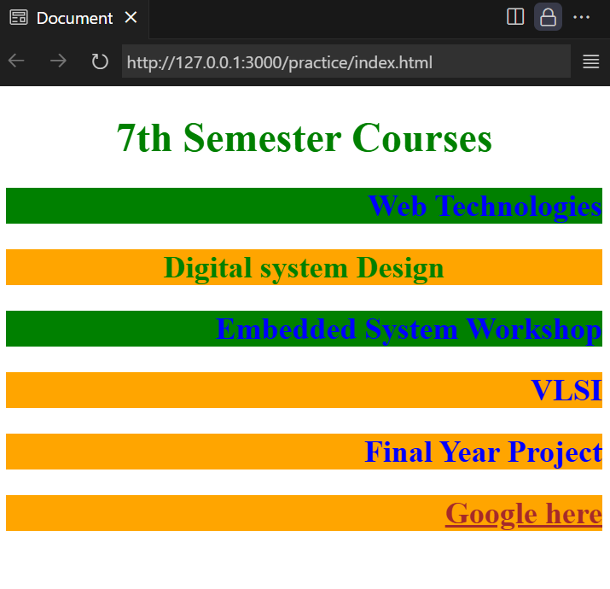
Practice Case Study#4
Modify the case study#3 using attribute selector

Slide 41
Universal Selector
*{ color: green;}
Syntax:
*{CSS Rule}
The CSS universal selector (*) matches elements of any type.

Slide 42
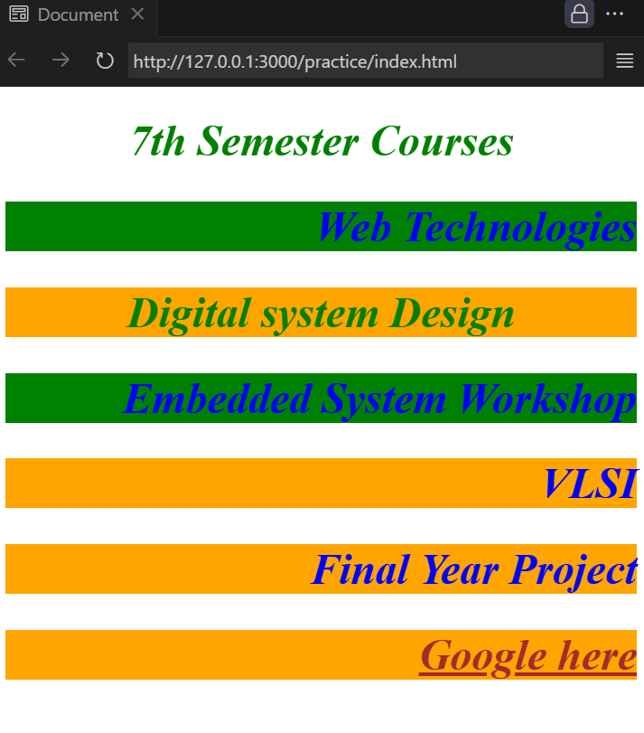
Practice Case Study#5
Modify the case study#4 using universal selector
Hint: italic and font size

Slide 43
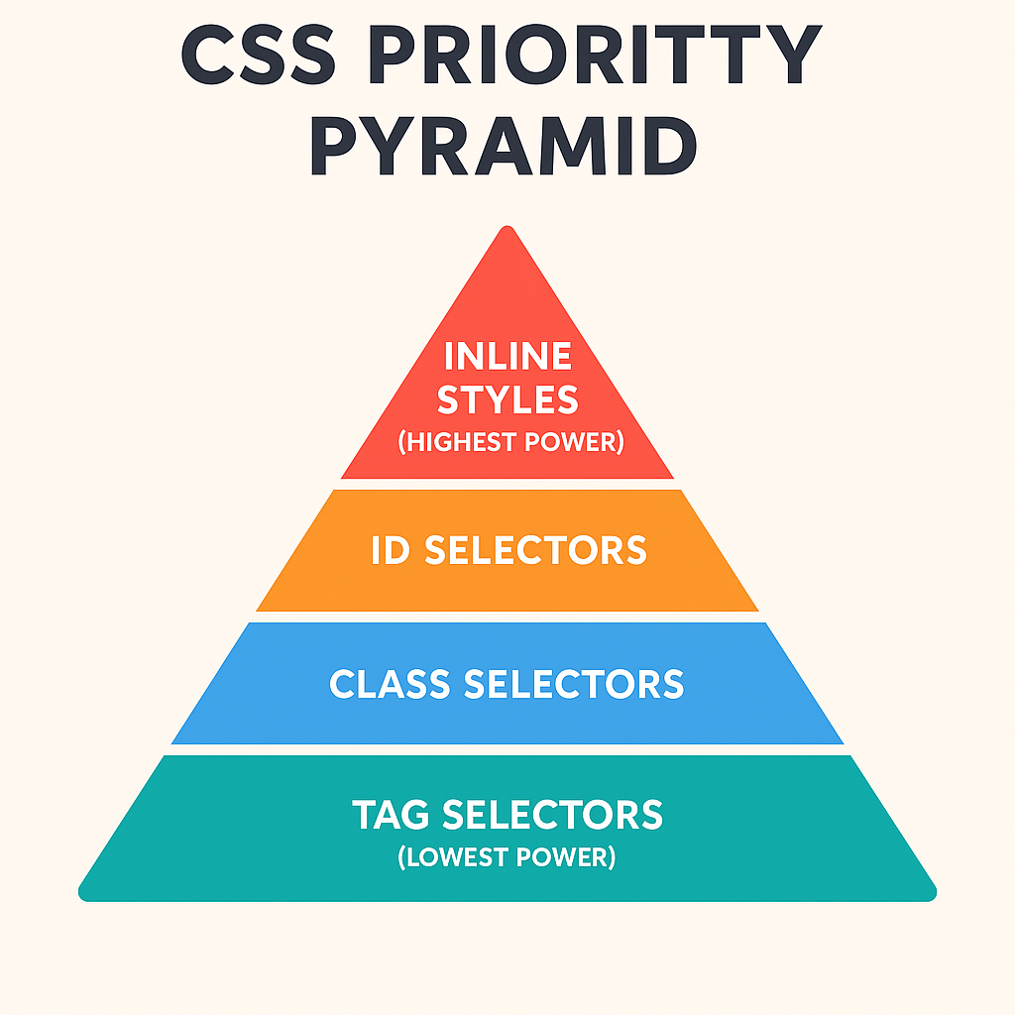
CSS Priority Pyramid

Slide 44
How Specificity Works?
Each selector gets points based on its type.
The higher the total, the stronger the rule.
If two rules have equal specificity, the last one in the CSS file wins.
Selector Type | Example | Specificity Score | Priority
Inline Styles | <h1 style="color:red;"> | 1000 | 🔺 Highest
ID Selector | #title {} | 100 | Very High
Class / Pseudo-Class | .heading {} or :hover | 10 | Medium
Element / Tag | p {} or h1 {} | 1 | Low
Universal Selector | * {} | 0 | Lowest

