Slide 1

Used Car Price Prediction Analysis by SHEIKH FAIZAL ALI
This Photo by Unknown Author is licensed under CC BY-NC

Slide 2
Introduction
Objective: Predicting used car prices based on features like age, brand, city, kilometers driven and fuel type.
Data: Collected from multiple cities and car brands to analyze trends and provide actionable insights.

Slide 3
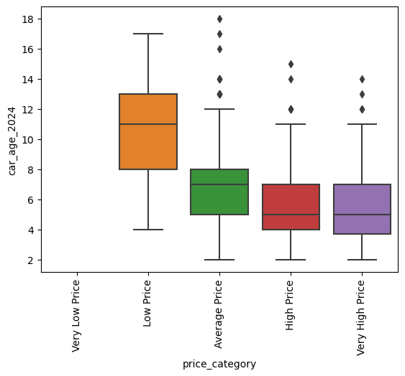
Exploratory Data Analysis (EDA)
Key Factors Influencing Car Prices:
1. Age of Vehicle: Significant depreciation with age.

Slide 4
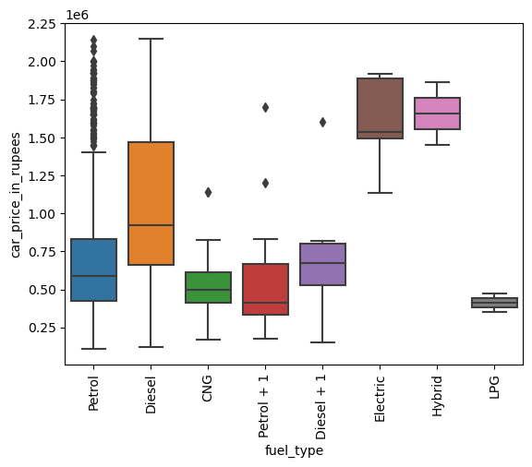
Exploratory Data Analysis (EDA)
Key Factors Influencing Car Prices:
2. Fuel Type: Premium pricing for electric vehicles.

Slide 5
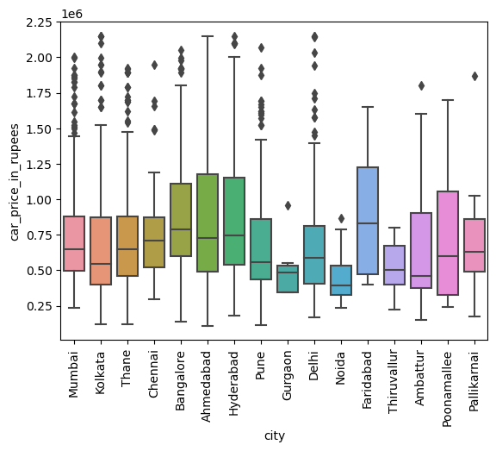
Exploratory Data Analysis (EDA)
Key Factors Influencing Car Prices:
3. City: Price variations based on regional demand.

Slide 6
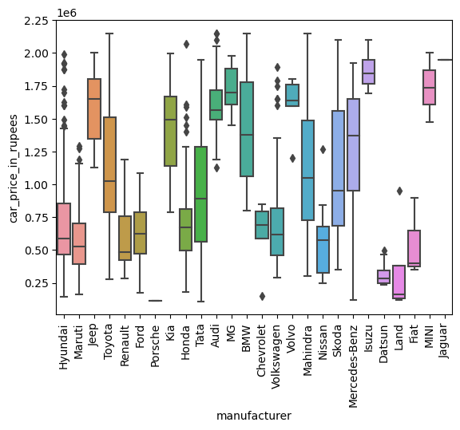
Exploratory Data Analysis (EDA)
Key Factors Influencing Car Prices:
4. Brand: Luxury brands depreciate faster; mainstream brands retain value better.

Slide 7
INFERENCES FROM THE EDA
1. We can see that the price varies with the kilometres the cars has been driven. Cars which have high number of kilometres tend to have lower price and vice versa.
2. Cars age matter a lot with the price range. Older cars tend to be very cheaper than the fresher cars.
3. From fuel type and car price comparison we can see that the electric and hybrid cars tend to fetch higher value as compared any other fuel type. After these two variants Diesel cars fetch the third highest value in used cars
4. During our city wise comparison, Bangalore and Faridabad have high priced cars as compared to Gurgaon and Noida where the used car value is among the lowest
5. Hyundai, Maruti, Fiat, Renault tend to have lower value as compared to Mini, Isuzu, MG, Volvo, Jeep.

Slide 8
Modeling Approach
Regression Model:
This predictive model is a reliable tool for understanding car price variations based on critical factors like age, fuel type, city, and brand. The insights can guide strategic decisions for both buyers and sellers in the pre-owned car market.
Key Findings:
- Adjusted R-squared ~70%, indicating strong predictive power.
- Significant features: Vehicle age, fuel type, city, and manufacturer.

Slide 9
RECOMMENDATIONS FOR THE CLIENT
1. For Buyers:
Invest in electric vehicles to benefit from market demand and potential incentives.
Consider buying in cities with lower price premiums (e.g., Kolkata).
2. For Sellers:
Sell cars earlier to minimize depreciation losses.
Highlight fuel type (Diesel/Electric) and city-specific demand to maximize sale value.
3. Brand-Specific Insights:
If selling luxury vehicles (Land Rover, Porsche), focus on niche markets to reduce the impact of steep depreciation.
Mainstream brands (Hyundai, Honda) offer better retention value.

