Slide 1
What Shapes Student CGPA?
An Engineering Student Academic Performance Dataset and Machine Learning Analysis
ACADEMIC PERFORMANCE / ENGINEERING STUDENTS
1,108 usable responses across four universities
Behaviour patterns, SGPA prediction, and CGPA prediction
STUDENT
FORM
DATA
RULES
CGPA
Notes:
Assalamu alaikum. Amader project er naam 'What Shapes Student CGPA?'. Amra 1,108 jon engineering student er survey data niye kaj korsi. Amra bujhte chaisi student ra nijer academic life niye ki bole, kon pattern gula valo ba kharap result er sathe ashe, ar ei answer gula diye notun student er CGPA group predict kora jay kina. Flow ta simple: Student → Form → Data → Rules → CGPA.

Slide 2
OPENING
PURPOSE + SOURCE
What Are We Trying to Understand?
1
2
3
What do students report?
Which patterns appear with better or worse results?
Can those answers predict a new student's result?
Attendance, study time, stress, sleep, support, environment…
Compare answer groups with CGPA groups
Train on some students, test on unseen ones
Data
Student behaviour
Understandable rules
Train / Test
Unseen-student result
First we understand the data; then we test prediction.
CSE 4112 · Machine Learning Lab · What Shapes Student CGPA?
2
Notes:
Amader tinta simple question. Ek, student ra ki report kore. Dui, kon answer pattern gula valo ba kharap result er sathe beshi dekha jay. Tin, ei answer diye notun student er result predict kora jay kina. Amader goal shudhu accuracy na — result ta jeno bujha jay.

Slide 3
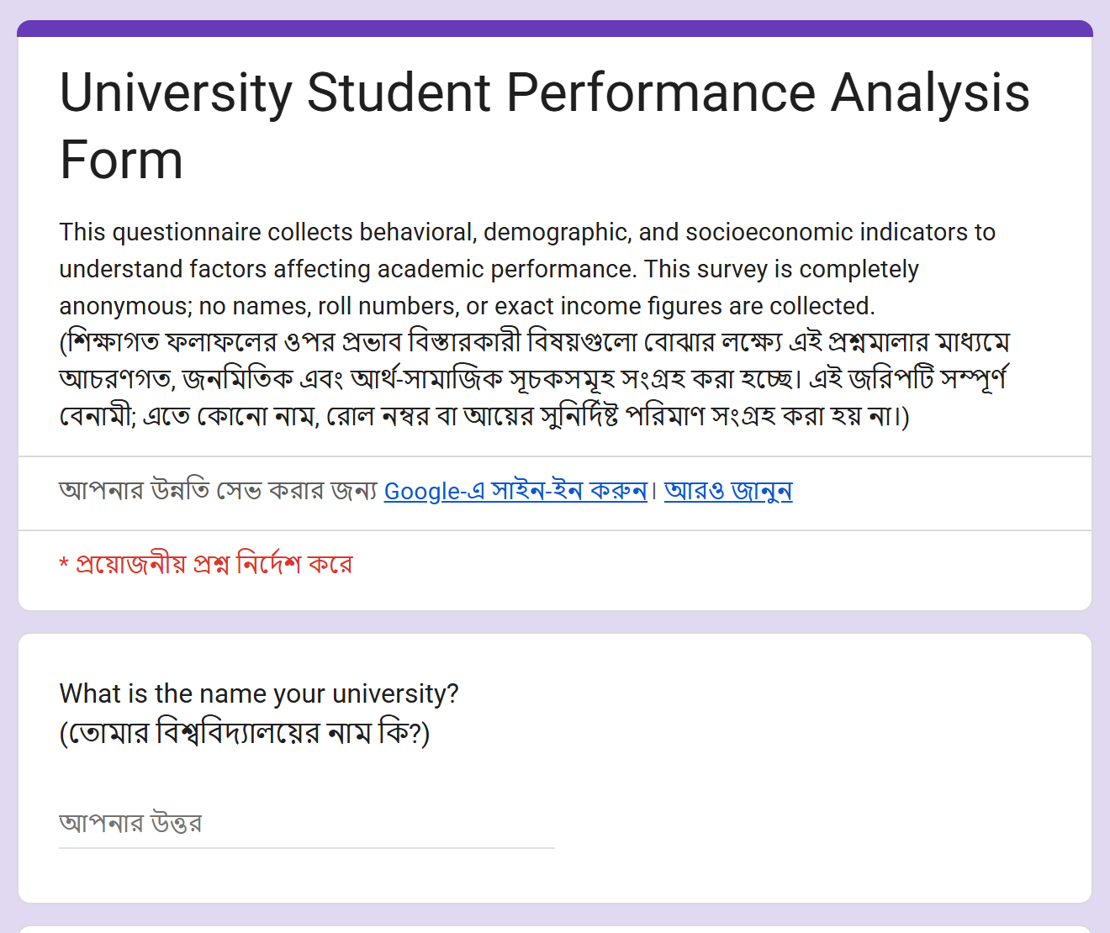
DATA COLLECTION
PURPOSE + SOURCE
Data Came From Student Surveys
2
1,126
similar Google Forms
raw responses
1,108
4
usable records
universities
Same questions, slightly different wording
Analysis snapshot: responses up to 03 Sep 2026. The two forms were merged carefully.
CSE 4112 · Machine Learning Lab · What Shapes Student CGPA?
5
Notes:
Data duita Google Form theke eseche. Multi-university form e 230 ta, ar KUET form e 896 ta response — mot 1,126. Clean korar por 1,108 ta usable record. Duita form e question same, shudhu wording ektu alada, tai careful vabe merge korsi.

Slide 4
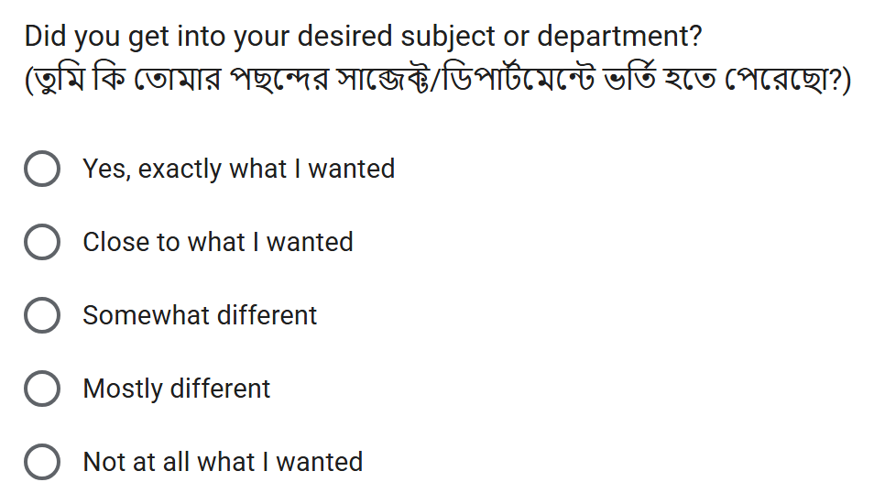
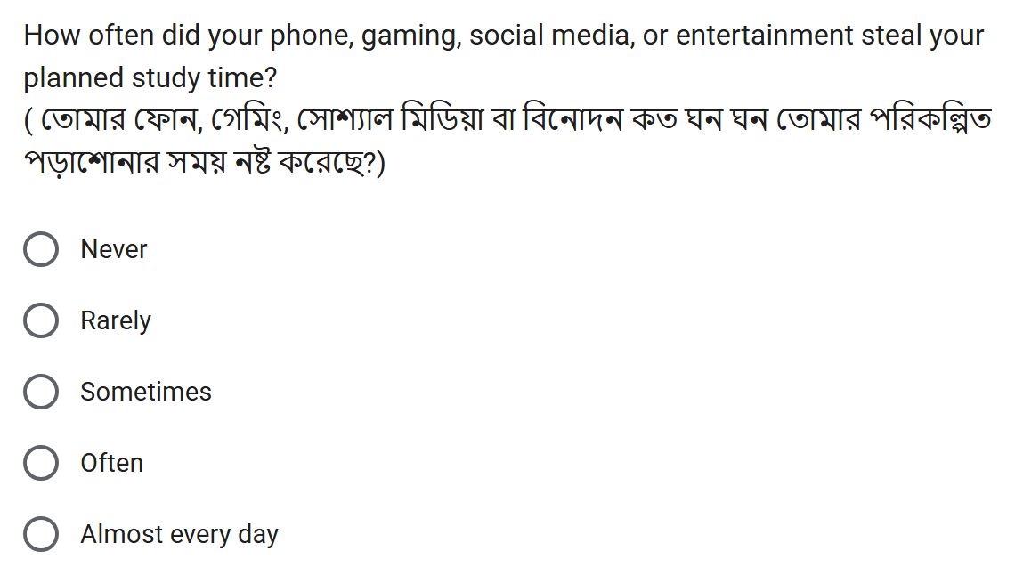
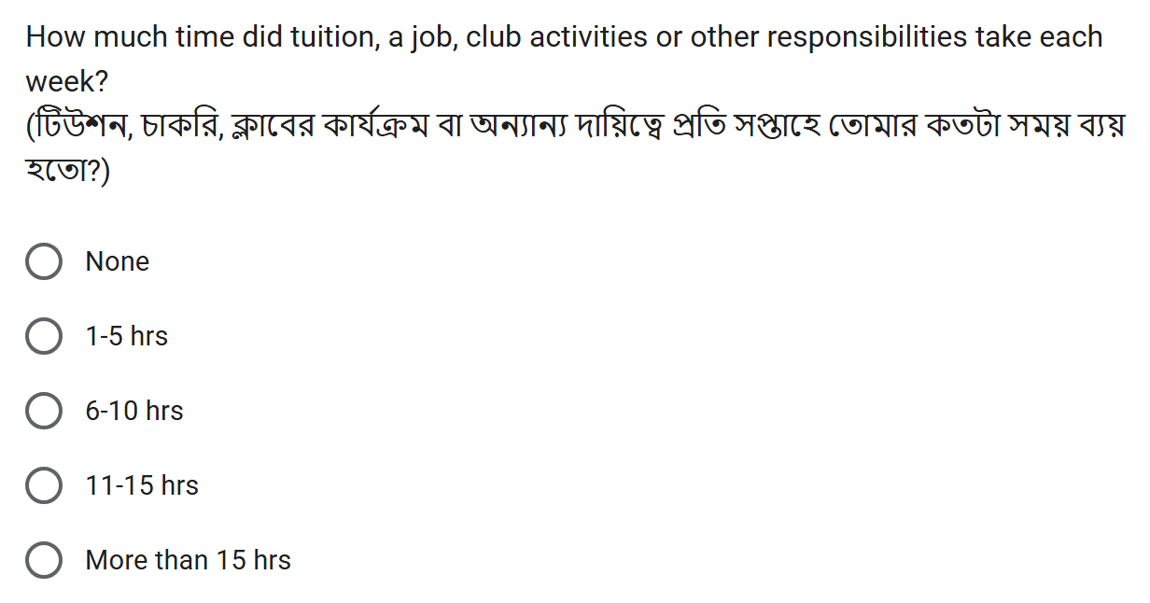
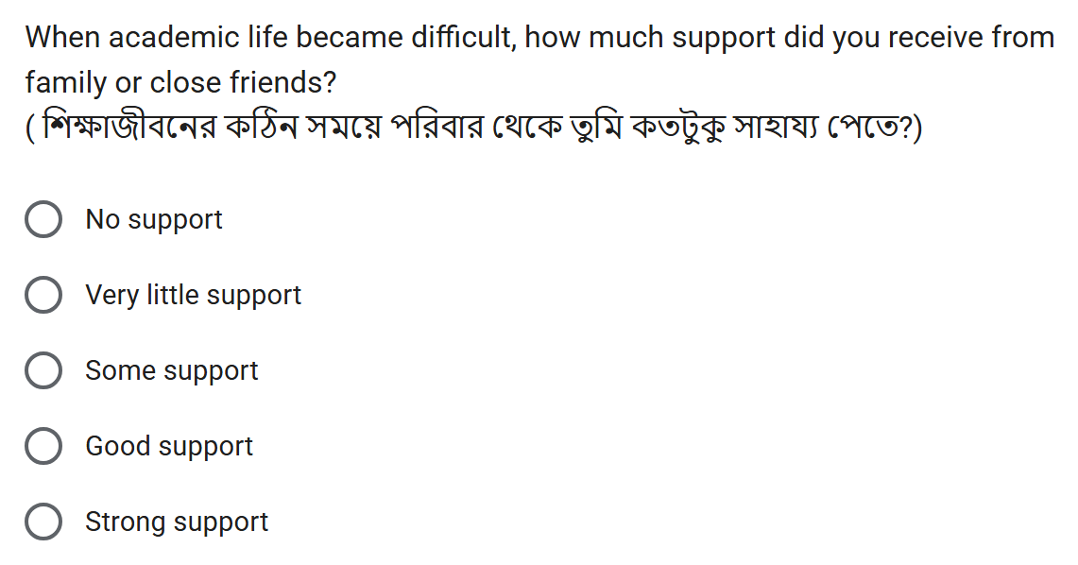
DATA COLLECTION
PURPOSE + SOURCE
What Did the Form Look Like?
Real screenshots of the University Student Performance Analysis Form — English + Bangla, anonymous.
The KUET form (896 responses) asked the same core questions with slightly different wording; both were merged.
CSE 4112 · Machine Learning Lab · What Shapes Student CGPA?
6
Notes:
Eta amader actual Google Form er screenshot — header ar charta question. KUET form e same core question chilo, shudhu wording ektu alada, tai duita merge kore ek dataset banaisi. Protiti question English ar Bangla duitai ache, ar form ta anonymous — name ba roll number nai. Answer gula option theke select korte hoy, tai sob student er answer compare kora easy. Model niye kotha bolar age amra dekhate chai data ta ashole kotha theke esheche.

Slide 5
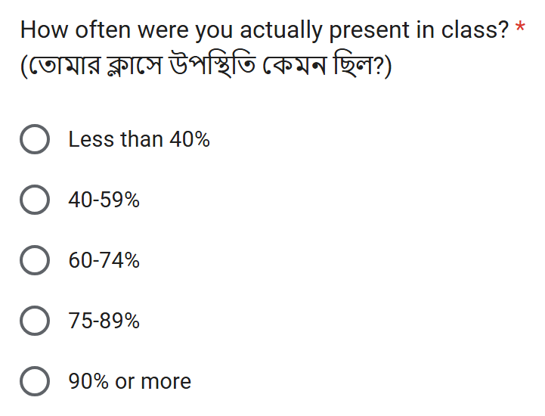
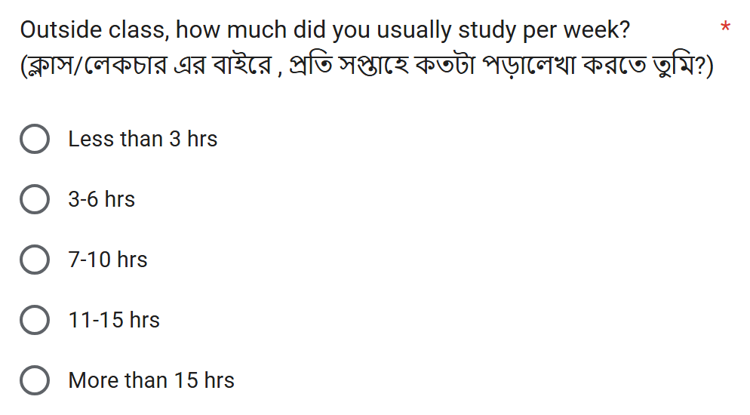
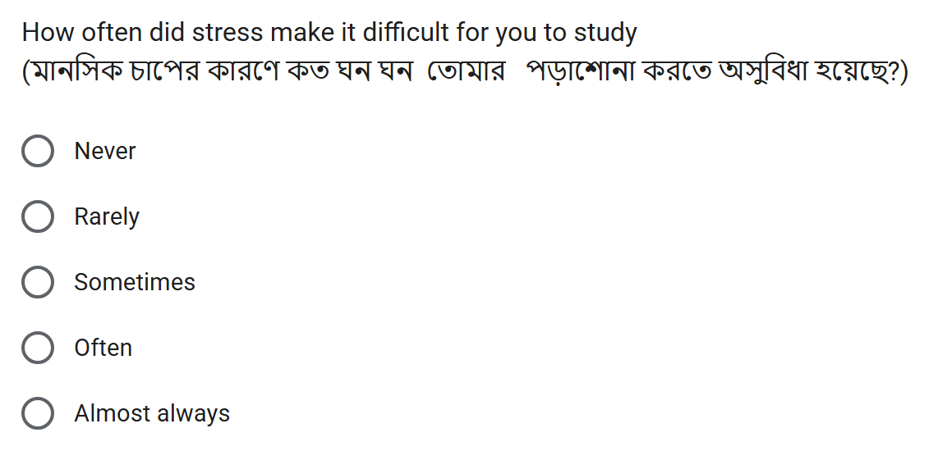
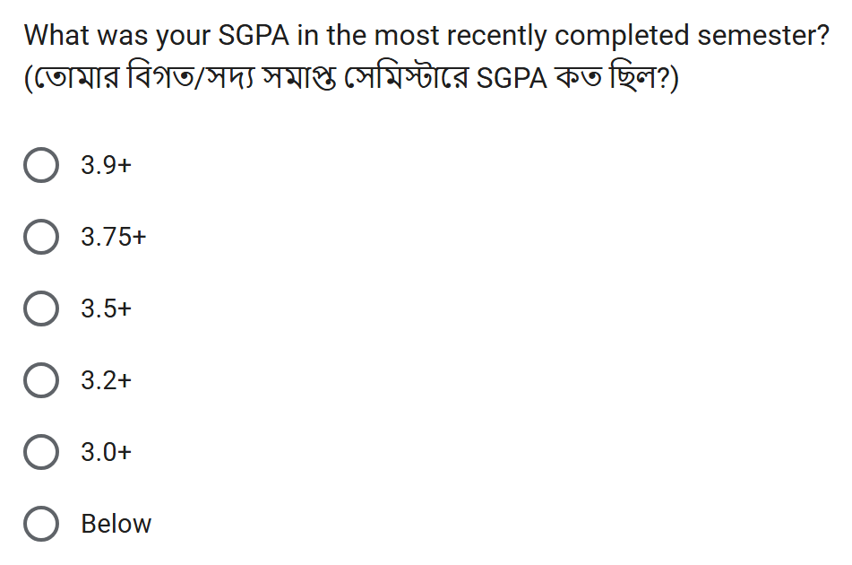
DATA COLLECTION
PURPOSE + SOURCE
Example Questions We Asked
CSE 4112 · Machine Learning Lab · What Shapes Student CGPA?
7
Notes:
Ekhane charta real question dekhano holo — attendance, weekly study time, stress, ar recent SGPA. Beshirvag answer category hishebe, jemon '75-89%' ba 'Often'. Ei category gula thakar karone different student der answer shohoje compare kora jay.

Slide 6
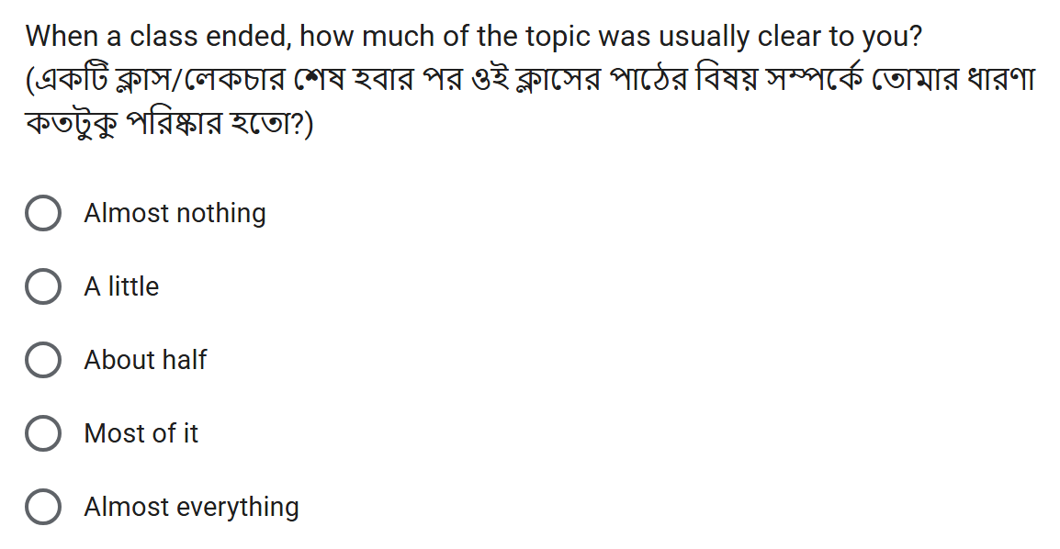
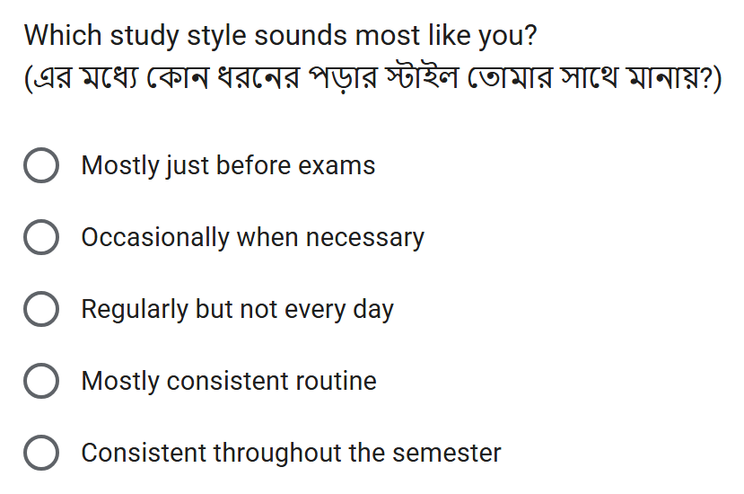
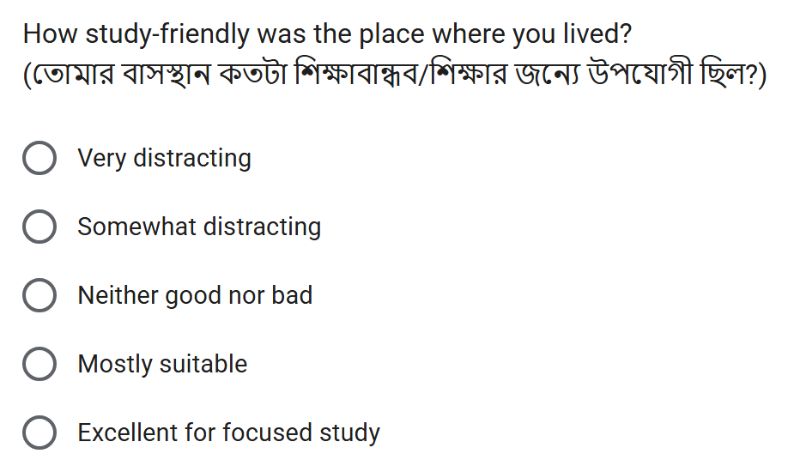
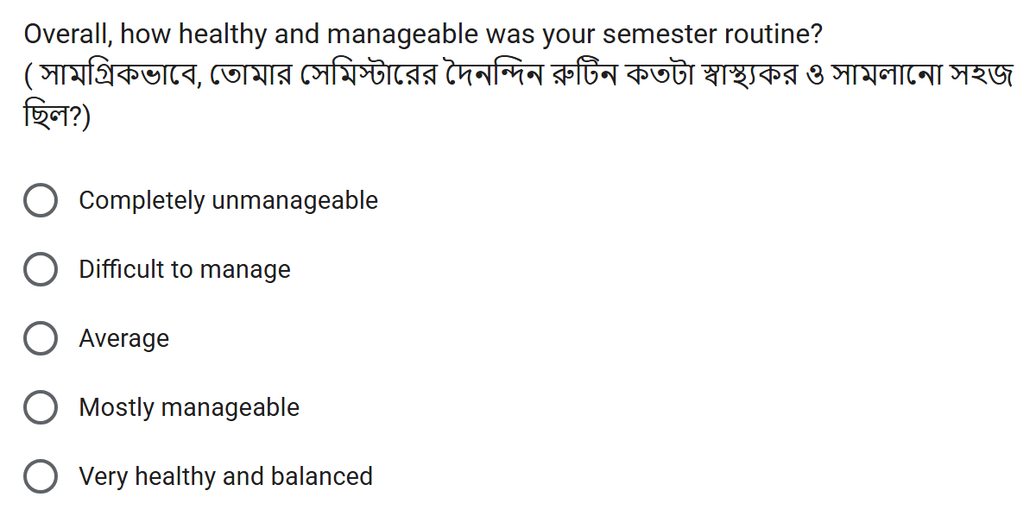
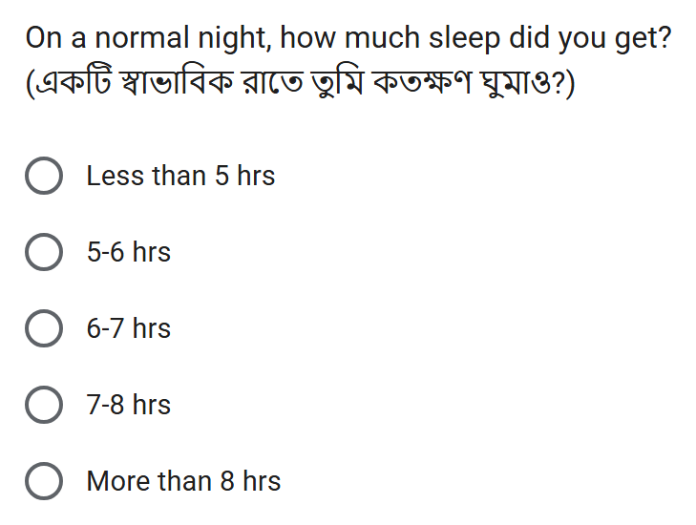
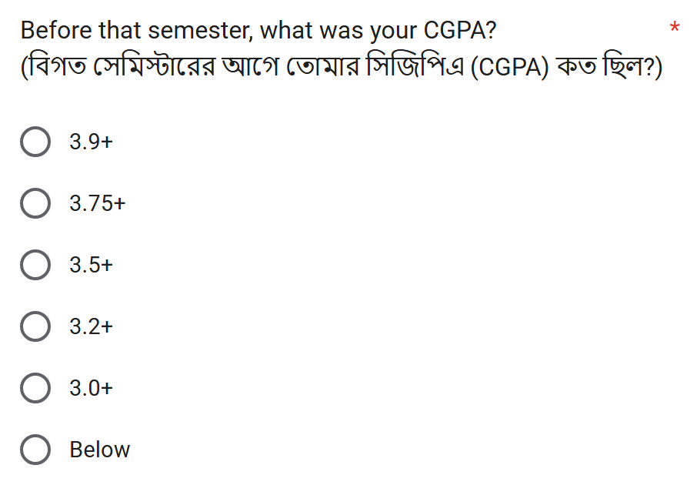
DATA COLLECTION
PURPOSE + SOURCE
Form Questions Behind the Decision Tree Rules
Topic clear after class · trees: SGPA, CGPA (+SGPA)
Study style · trees: SGPA
Study-friendly living place · trees: CGPA (behaviour)
Semester routine manageable · trees: CGPA (+SGPA)
Sleep per night · trees: CGPA (+SGPA)
CGPA question · what the CGPA trees predict
CSE 4112 · Machine Learning Lab · What Shapes Student CGPA?
8
Notes:
Ei chhoy ta real form question Decision Tree er rule e ashe — topic clarity, study style, study environment, semester routine, sleep, ar CGPA question ta nije target. Protiti screenshot er upore lekha ache kon tree seta use korse. Tree jokhon IF-AND rule dey, rule er protiti condition ei question gular answer theke ashe.

Slide 7
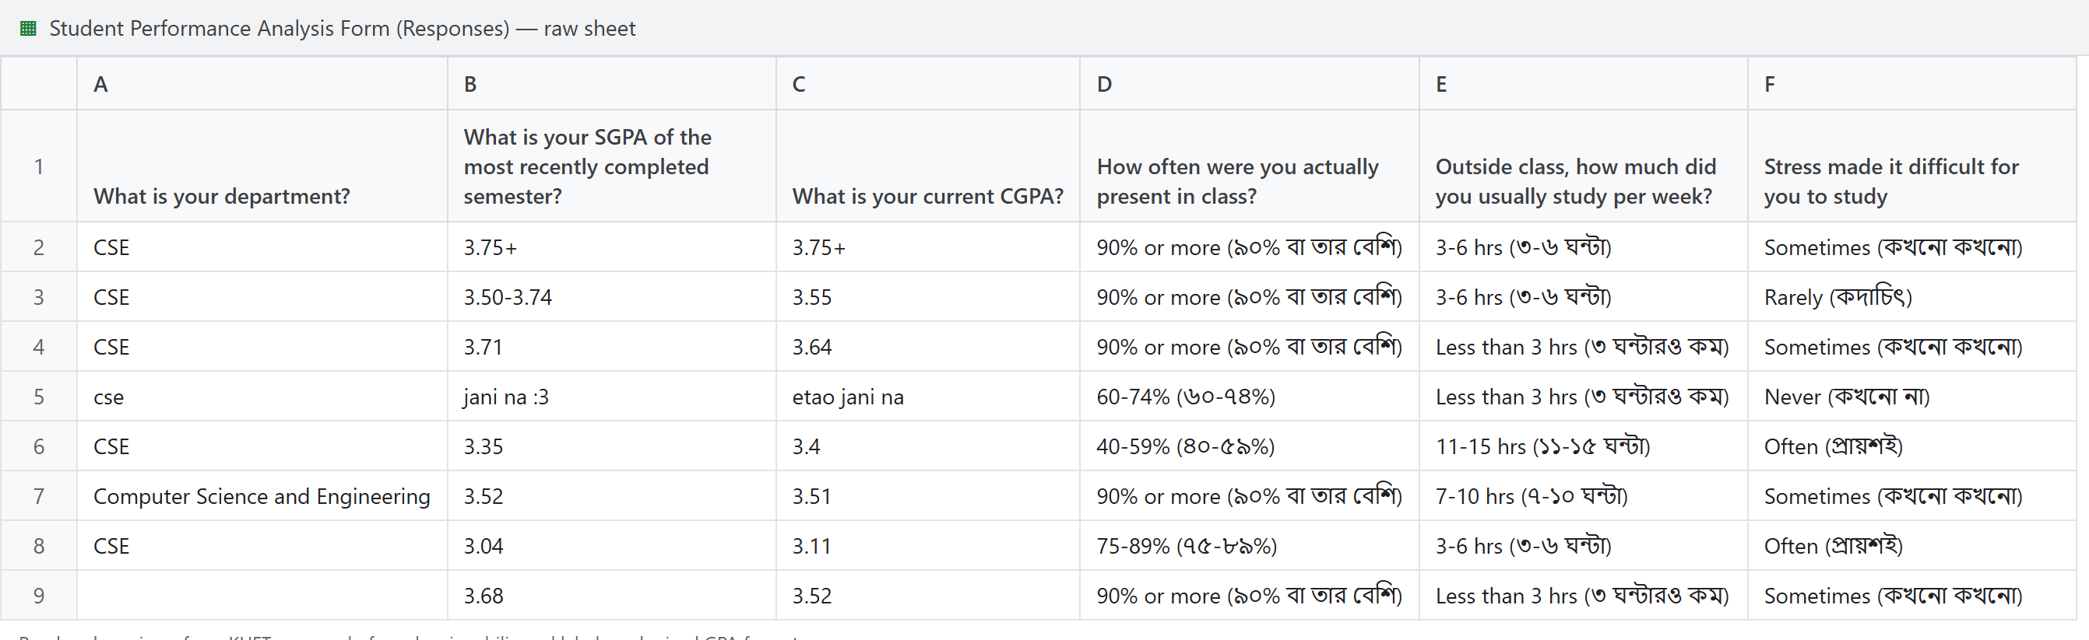
DATA COLLECTION
Form responses glimpse

Slide 8
DATA COLLECTION
DATASET
Student Information in Our Dataset
🎓
Academic
📚
Study habits
🌙
Lifestyle
University · Department · Semester · Recent SGPA
Attendance · Self-study time · Study style · Topic clear after class
Sleep · Phone / social media · Semester routine
😣
Pressure
💪
Motivation & support
🏠
Environment
Stress · Tuition / job / club hours
Got desired department · Family / friend support · Career expectation
Study-friendly living place
Target: CGPA group
C0 <3.20
C1 3.20–3.49
C2 3.50–3.74
C3 3.75+
CSE 4112 · Machine Learning Lab · What Shapes Student CGPA?
9
Notes:
Form e shudhu academic info na, non-academic diko ache: study habit, lifestyle, pressure, motivation-support, environment. Ar amader target holo CGPA group — C0 theke C3. Mane project ta academic ar behaviour duita dik eksathe dekhe.

Slide 9
DATA COLLECTION
DATASET
From Raw Responses to Usable Data
1,126 raw responses
Fix spellings & labels
Merge the two forms
1,108 clean rows
BRAC / Brac / BRAc
BRAC
90% or more (৯০% বা তার বেশি)
90% or more
110 department spellings
24 departments
Two GPA formats + typed numbers
C0 – C3 groups
18 rows with no CGPA
removed
CSE 4112 · Machine Learning Lab · What Shapes Student CGPA?
11
Notes:
Raw data te 1,126 ta response chilo. Same answer different vabe lekha — jemon BRAC, Brac, BRAc — egula ek kora hoyeche. Bangla bracket shoriye ek label kora hoyeche, duita GPA format ke C0-C3 group e ana hoyeche, ar 18 ta row jekhane CGPA chilo na seta bad deya hoyeche. Final 1,108 ta clean row. Cleaning na korle computer same answer ke alada vabto.

Slide 10
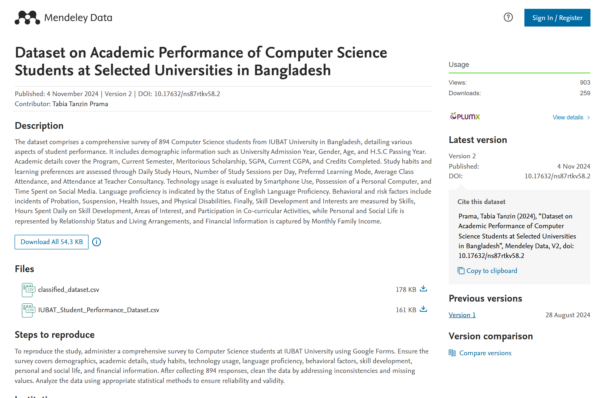
REFERENCE DATASET
DATASET
What Do Existing Student Datasets Look Like?
CSE 4112 · Machine Learning Lab · What Shapes Student CGPA?
12
Notes:
Teacher er suggestion onujayi reference dataset er screenshot rakhsi. Eta IUBAT er 894 jon Computer Science student er dataset, Mendeley Data te public. Ekhane attendance, daily study hour, social media hour, previous SGPA, current CGPA ache. Classified copy te performance category ache. Amra dekhte chaisi existing dataset e kon feature gula common.

Slide 11
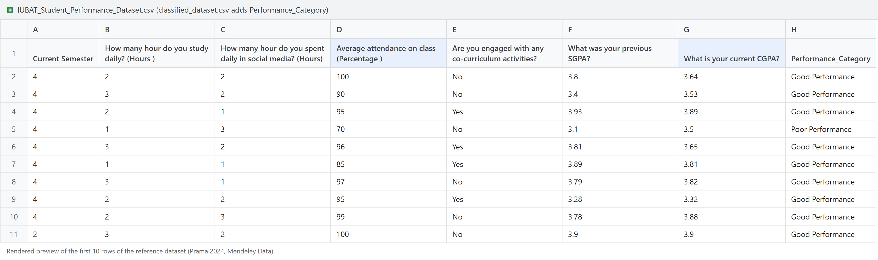
REFERENCE DATASET
DATASET
What Do Existing Student Datasets Look Like?
894
31
Numbers
4 levels
IUBAT Computer Science students
questions / columns
CGPA and SGPA typed as numbers
performance category in classified copy
CSE 4112 · Machine Learning Lab · What Shapes Student CGPA?
12
Notes:
Teacher er suggestion onujayi reference dataset er screenshot rakhsi. Eta IUBAT er 894 jon Computer Science student er dataset, Mendeley Data te public. Ekhane attendance, daily study hour, social media hour, previous SGPA, current CGPA ache. Classified copy te performance category ache. Amra dekhte chaisi existing dataset e kon feature gula common.

Slide 12
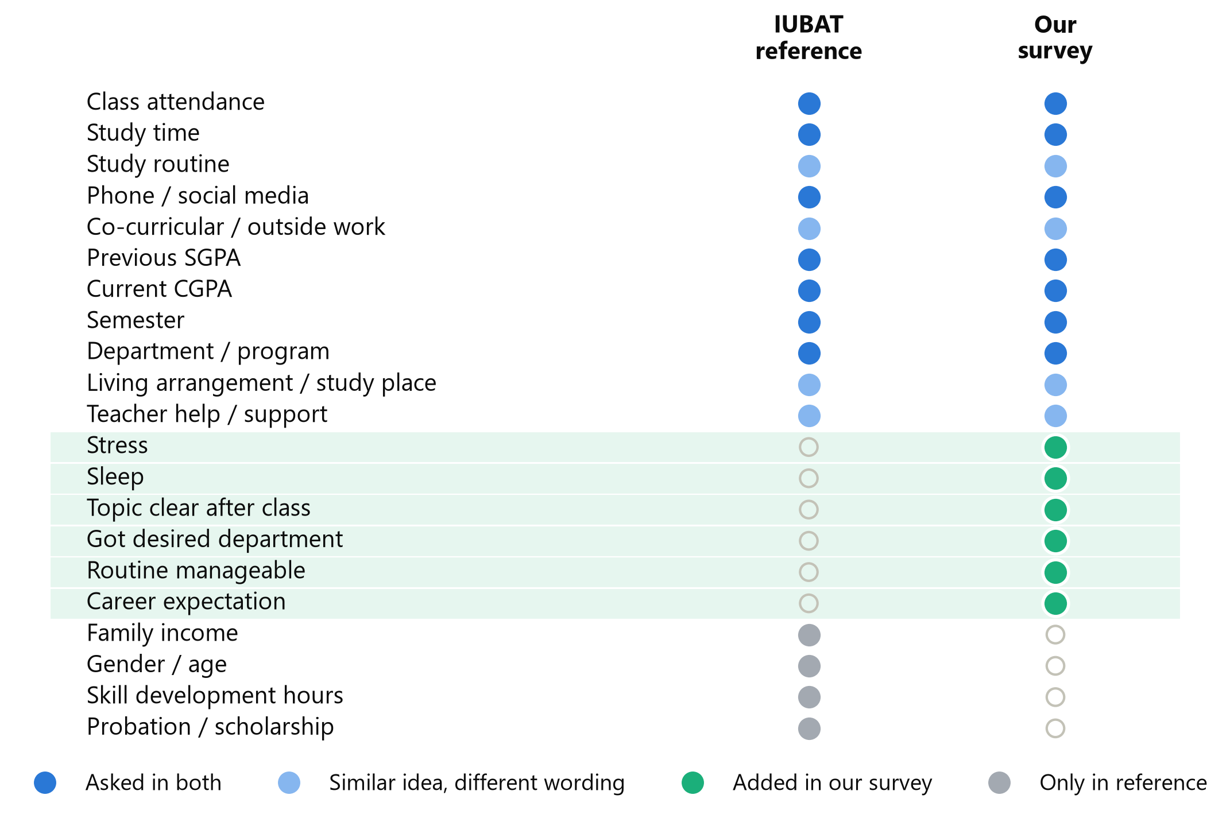
REFERENCE DATASET
DATASET
What Is Similar and What Did We Add?
7
4
asked in both
similar idea
6 added in our survey
• Stress
• Sleep
• Topic clear after class
• Got desired department
• Routine manageable
• Career expectation
Reference stores exact numeric CGPA / SGPA; our form uses bands (C0–C3)
CSE 4112 · Machine Learning Lab · What Shapes Student CGPA?
13
Notes:
Reference er sathe amader form compare korle 7 ta topic duitatei ache — attendance, study time, social media, previous SGPA, CGPA. Ar amra notun add korsi stress, sleep, topic clarity, desired department, routine, career expectation. Mane amader dataset familiar idea follow kore, kintu motivation ar environment related question beshi.

Slide 13
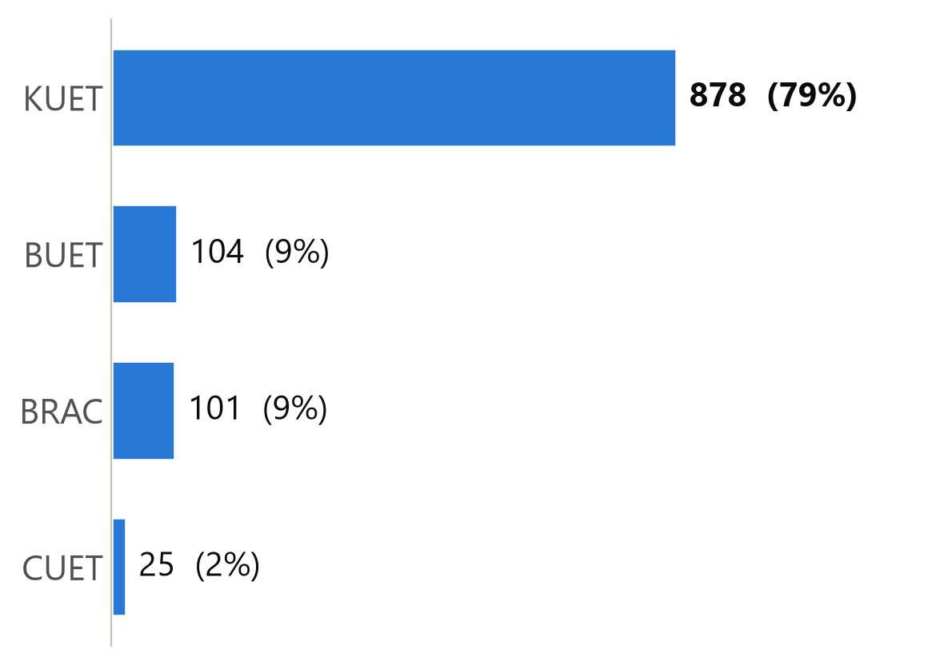
DATASET STATISTICS
DATASET
Which universities are in the Dataset?
1,108
usable students
CSE 4112 · Machine Learning Lab · What Shapes Student CGPA?
16
Notes:
Mot 1,108 jon student. Kintu university gula soman na — KUET theke 878 jon, mane 79.2%. BUET 104, BRAC 101, CUET 25. Tai conclusion shob university te soman vabe apply hobe emon bola jabe na.

Slide 14
DATASET STATISTICS
DATASET
We Predicted Four CGPA Groups
C0
C1
C2
C3
CGPA below 3.20
CGPA 3.20 to 3.49
CGPA 3.50 to 3.74
CGPA 3.75 and above
236
321
303
248
students · 21.3%
students · 29.0%
students · 27.3%
students · 22.4%
The form collected CGPA ranges, not exact numbers → a four-group classification problem.
CSE 4112 · Machine Learning Lab · What Shapes Student CGPA?
17
Notes:
Form e exact CGPA na, range neya hoyechilo. Tai amra char ta group banaisi: C0 mane 3.20 er niche (236 jon), C1 3.20 theke 3.49 (321), C2 3.50 theke 3.74 (303), C3 3.75 ba beshi (248). Eta four-class classification problem. Ei C0-C3 label shob slide e same thakbe.

Slide 15
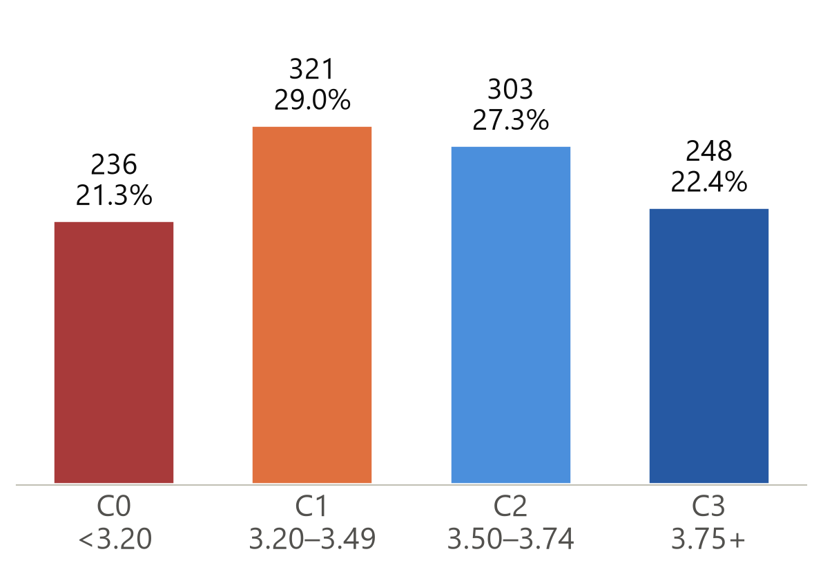
DATASET STATISTICS
DATASET
How Are Students Distributed Across CGPA Groups?
29.0%
21.3%
largest (C1) = guessing baseline
smallest group (C0)
Class shares are close enough for direct evaluation
CSE 4112 · Machine Learning Lab · What Shapes Student CGPA?
18
Notes:
Model banano age check korsi kono ekta group ki pura data dominate kore kina. Sobcheye boro group C1 (29.0%), sobcheye choto C0 (21.3%). Char ta group mota-muti balanced, tai direct evaluation use korsi. Recent SGPA group o prai same vabe chora.

Slide 16
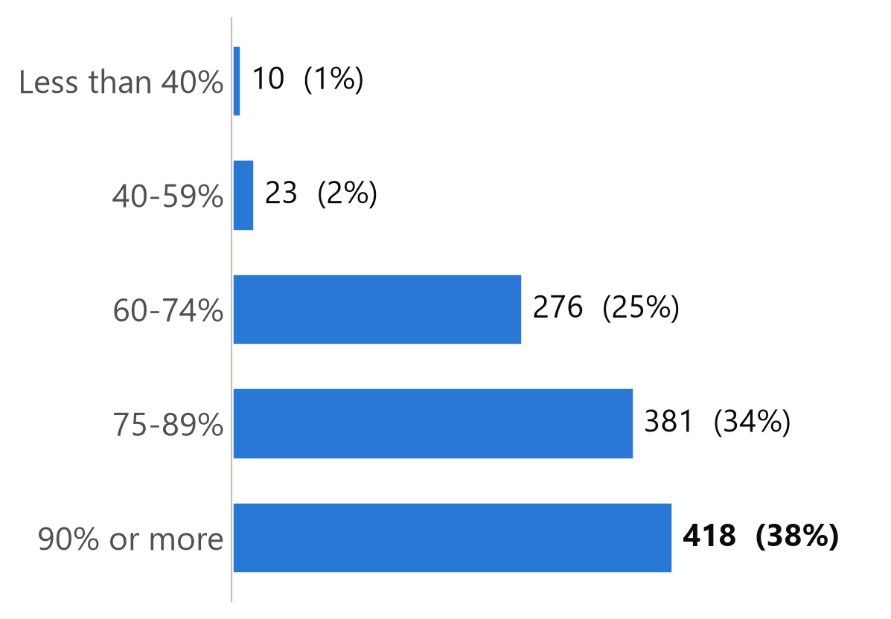
WHAT STUDENTS ANSWERED
OBSERVED PATTERNS
How Often Do Students Attend Classes?
418 · 37.7%
most common: 90% or more
799 · 72.1%
attend 75% or more
33 · 3.0%
attend below 60%
CSE 4112 · Machine Learning Lab · What Shapes Student CGPA?
19
Notes:
Ei slide e shudhu actual answer, kono prediction na. Sobcheye common answer '90% or more' — 418 jon. 72.1% student 75% er beshi class kore, ar matro 33 jon 60% er kom.

Slide 17
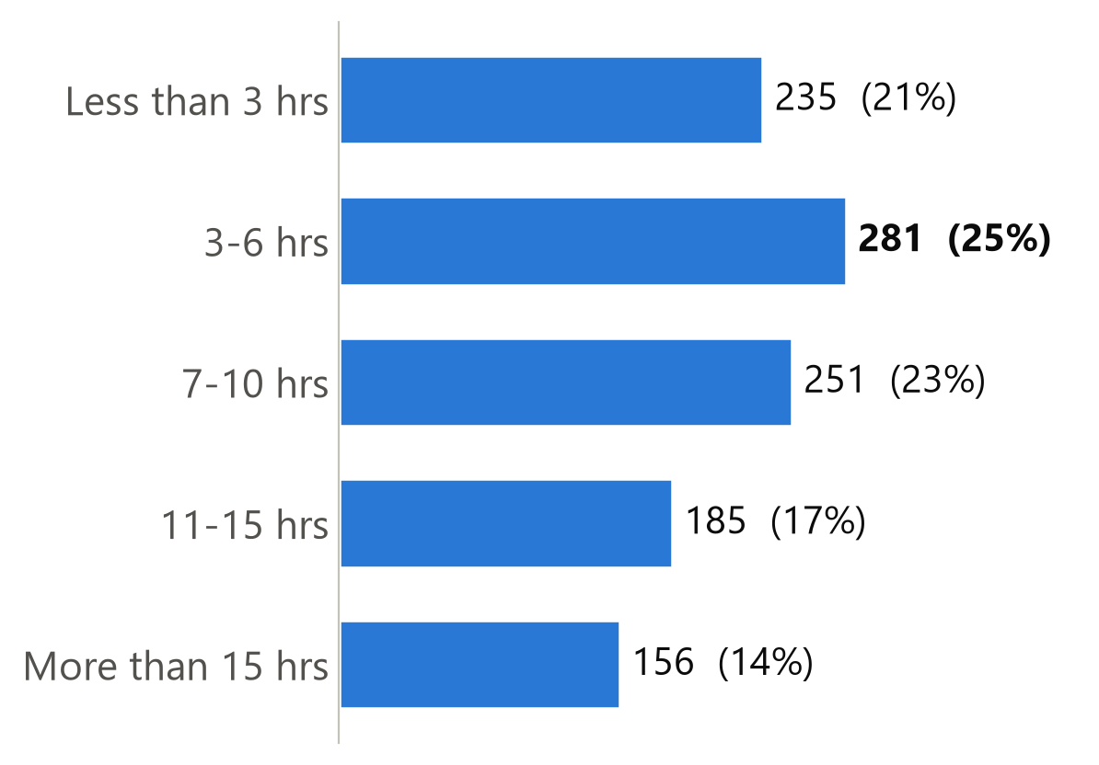
WHAT STUDENTS ANSWERED
OBSERVED PATTERNS
How Much Time Do Students Study?
281 · 25.4%
most common: 3–6 hrs a week
235 · 21.2%
study less than 3 hrs a week
341 · 30.8%
study more than 10 hrs a week
CSE 4112 · Machine Learning Lab · What Shapes Student CGPA?
20
Notes:
Class er baire weekly study time. Sobcheye beshi student 3-6 ghonta pore (281 jon). 235 jon 3 ghontar kom, ar 341 jon 10 ghontar beshi pore.

Slide 18
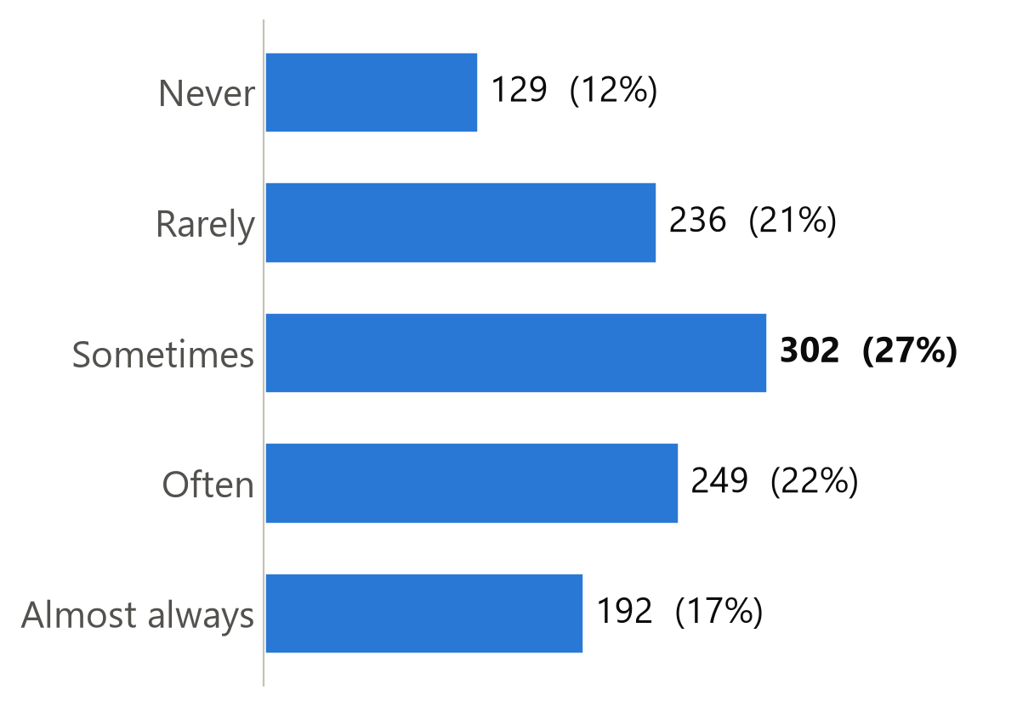
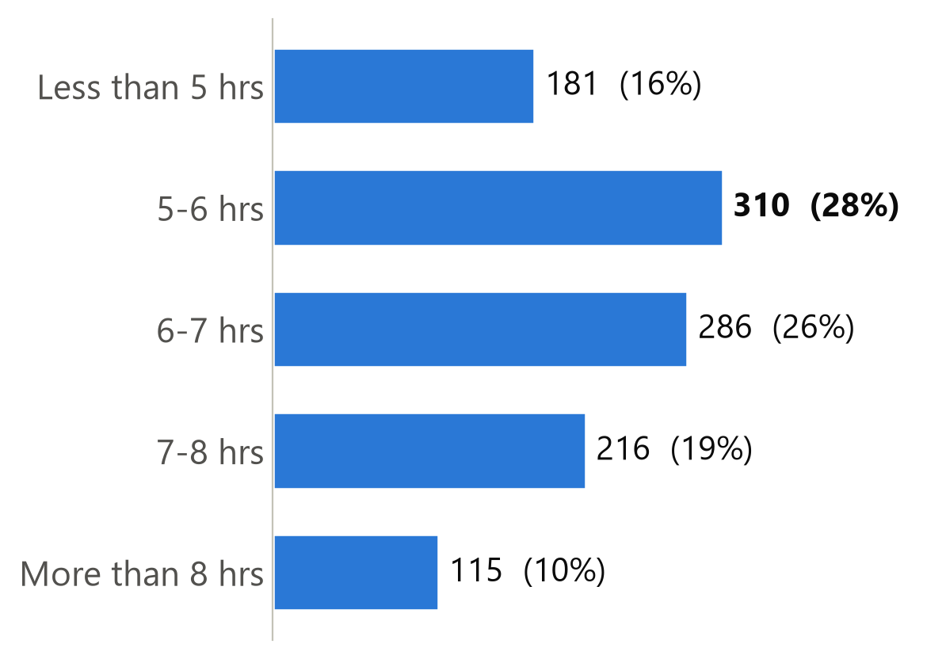
WHAT STUDENTS ANSWERED
OBSERVED PATTERNS
What Do Students Report About Stress and Sleep?
Stress made studying difficult
Sleep on a normal night
Often + almost always: 441 students (39.8%)
Under 6 hours: 491 students (44.3%)
CSE 4112 · Machine Learning Lab · What Shapes Student CGPA?
21
Notes:
Lifestyle ar pressure dekhi. 39.8% student bole stress often ba almost always porashona te problem kore. Ar 44.3% student rate 6 ghontar kom ghumay. Age response pattern dekhe nicchi, result er sathe link pore dekhbo.

Slide 19
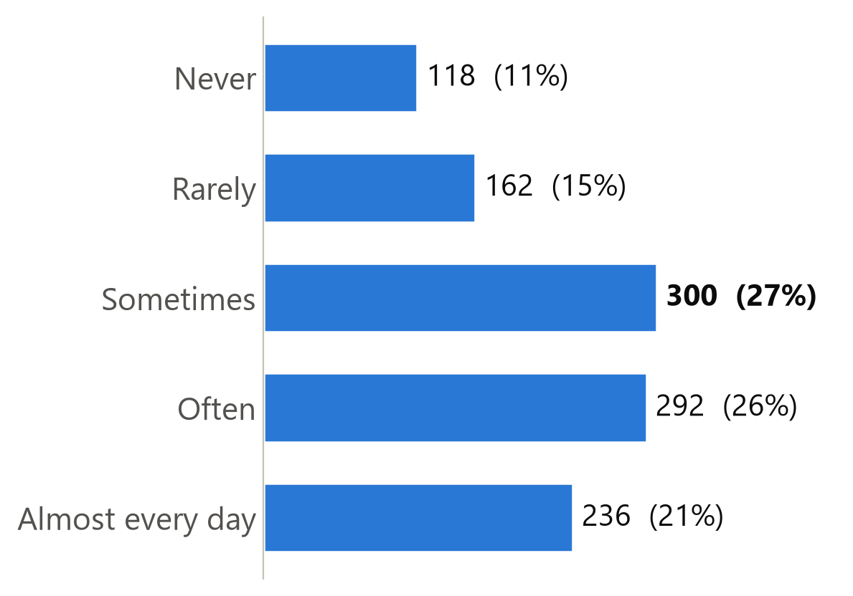
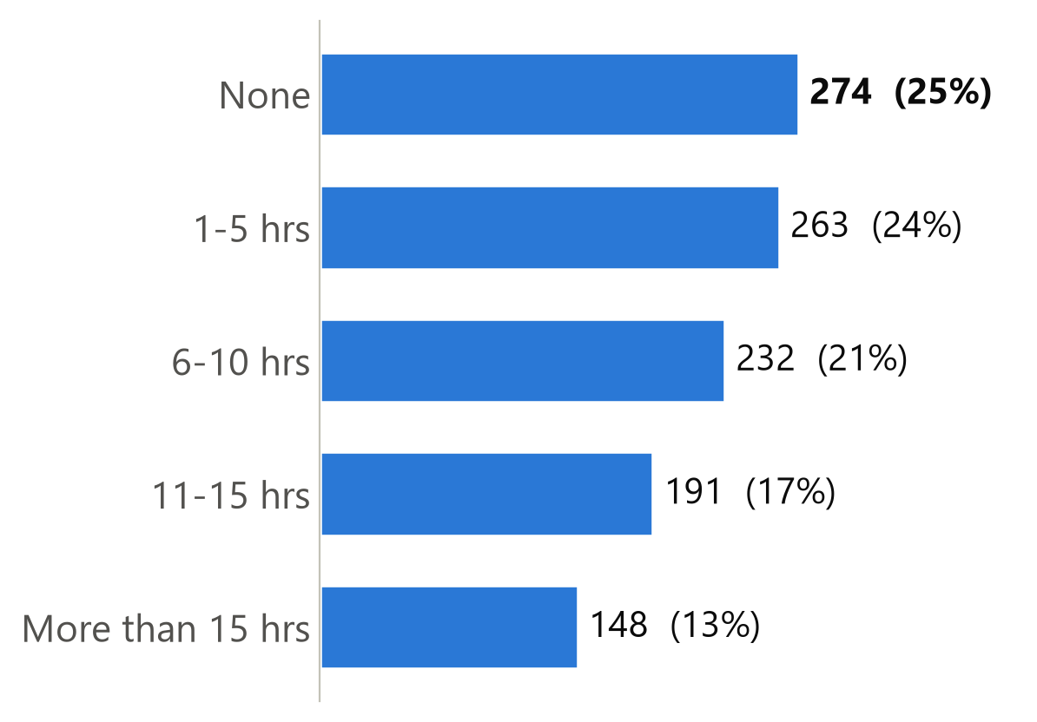
WHAT STUDENTS ANSWERED
OBSERVED PATTERNS
Distraction and Outside Commitments
Phone / gaming / social media took study time
Outside commitments: tuition, job, club hours
Often + almost every day: 528 (47.7%)
6 hours or more: 571 (51.5%)
CSE 4112 · Machine Learning Lab · What Shapes Student CGPA?
22
Notes:
Ei duita feature bole porashonar time koto ta onno dike jay. 47.7% student bole phone ba social media often ba prai protidin study time niye ney. Ar 51.5% student saptahe 6 ghontar beshi tuition, job ba club e dey.

Slide 20
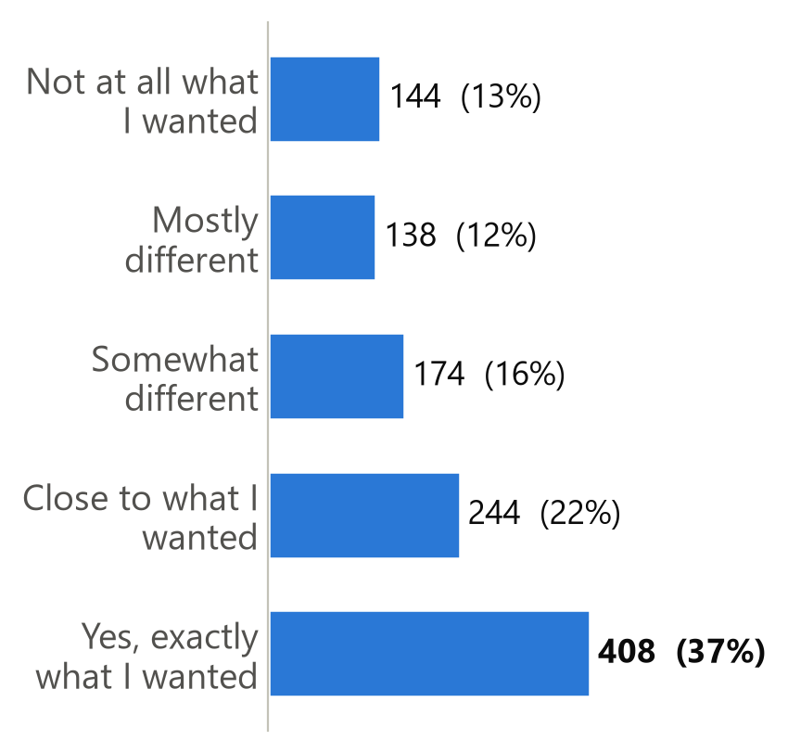
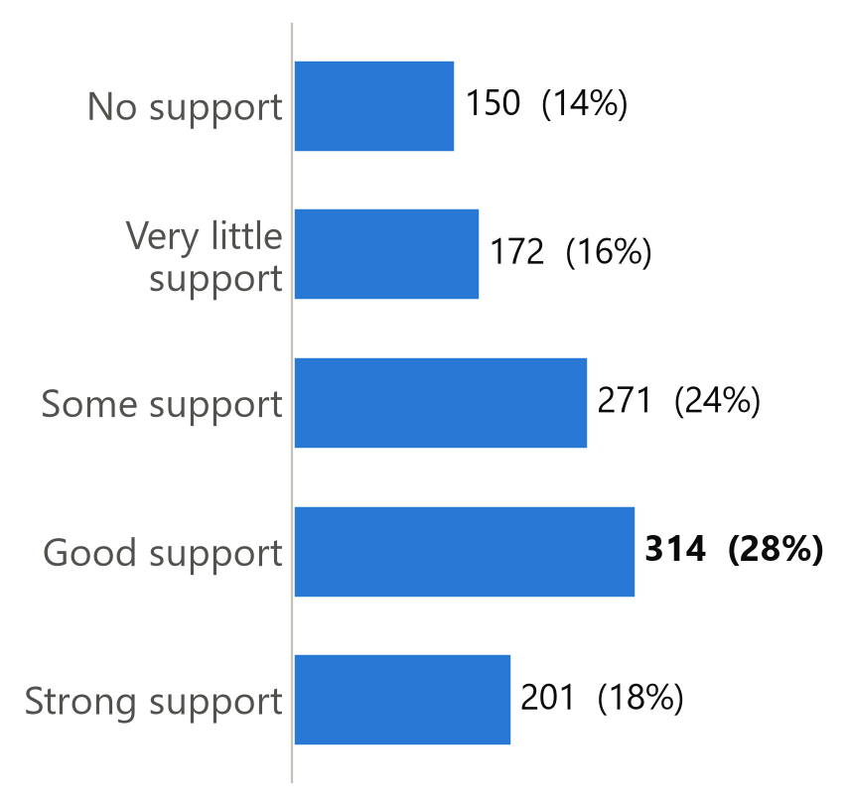
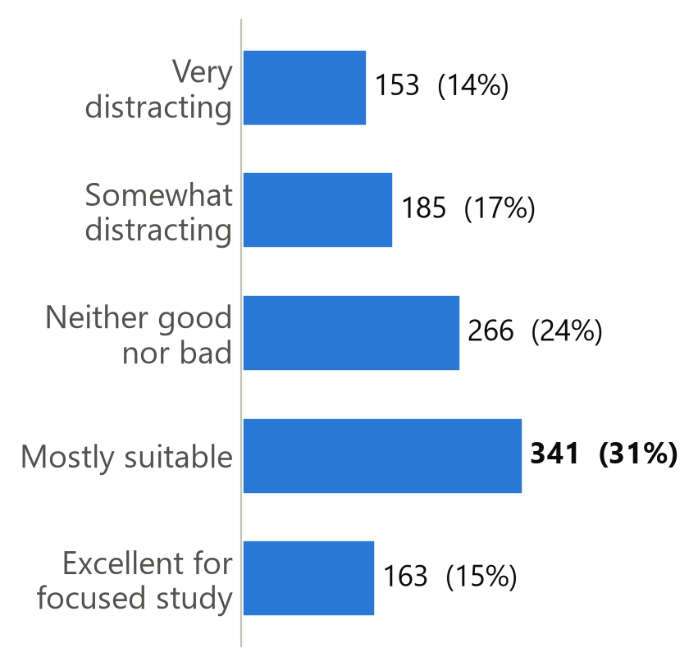
WHAT STUDENTS ANSWERED
OBSERVED PATTERNS
Motivation, Support and Study Environment
Got desired department
Family / friend support
Study-friendly living place
Exactly what I wanted: 408 (36.8%)
Good + strong: 515 (46.5%)
Mostly suitable + excellent: 504 (45.5%)
CSE 4112 · Machine Learning Lab · What Shapes Student CGPA?
23
Notes:
Motivation, support ar environment. 36.8% student thik jei department chaisilo seta peyeche. Prai 46.5% family ba friend theke valo support pay, ar 45.5% er thakar jayga porashonar jonno upojukto.

Slide 21
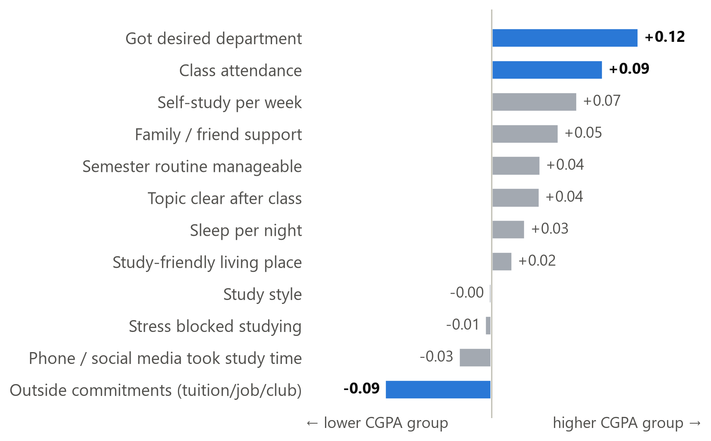
OBSERVED PATTERNS
OBSERVED PATTERNS
Which Student Features Move With CGPA?
⬆
Got desired department
small positive pattern (+0.12)
⬆
Class attendance
small positive pattern (+0.09)
⬇
Outside commitments
small negative pattern (-0.09)
Larger number = stronger pattern, and all are small. Associations, not causes. Blue = reliable after checking.
CSE 4112 · Machine Learning Lab · What Shapes Student CGPA?
24
Notes:
Official analysis e 12 ta behaviour question er moddhe tinta pattern reliable chilo: desired department peleo, attendance beshi hole higher CGPA group er dike, ar tuition-job-club hour beshi hole lower group er dike. Kintu link gula choto — shob number 0.12 er niche. Tai amra bolbo associated, cause na.

Slide 22
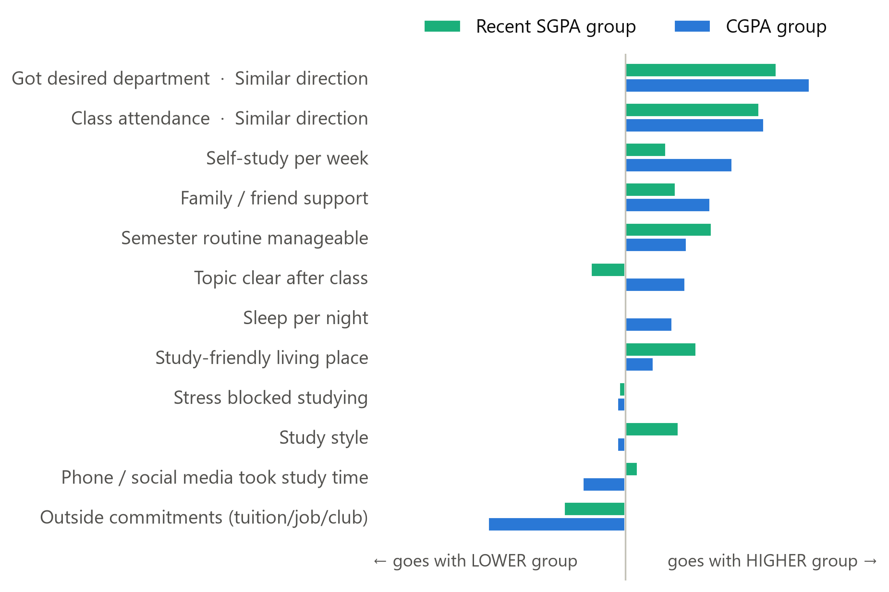
SGPA + CGPA PATTERNS
SGPA + CGPA PATTERNS
Do SGPA and CGPA Show the Same Patterns?
✔ Class attendance
same direction: SGPA +0.09, CGPA +0.09
✔ Got desired department
same direction: SGPA +0.10, CGPA +0.12
10 other questions
too weak to claim a matching pattern
CSE 4112 · Machine Learning Lab · What Shapes Student CGPA?
38
Notes:
Teacher dekhte chaisilen SGPA ar CGPA te pattern ek rokom ashe kina. Duita tree alada question e split kore, tai direct data check korlam: protiti answer SGPA ar CGPA er sathe kon dike jay. Attendance ar desired department duitatei same direction e — beshi hole higher group. Baki gula eto choto je bola jay na.

Slide 23
Attendance and CGPA
C0 < 3.20
C1 3.20–3.49
C2 3.50–3.74
C3 ≥ 3.75
Less than 40%
30%
20%
20%
30%
n=10
Attendance
40-59%
26%
30%
26%
17%
n=23
60-74%
25%
29%
29%
17%
n=276
75-89%
21%
31%
25%
22%
n=381
90% or more
19%
27%
28%
26%
n=418
CGPA
Notes:
Source: evidence/data.json. Derived from verified raw survey records.

Slide 24
Weekly study time and CGPA
C0 < 3.20
C1 3.20–3.49
C2 3.50–3.74
C3 ≥ 3.75
Less than 3 hrs
24%
28%
29%
19%
n=235
Study Time
3-6 hrs
26%
29%
27%
19%
n=281
7-10 hrs
16%
30%
30%
24%
n=251
11-15 hrs
18%
31%
24%
26%
n=185
More than 15 hrs
21%
26%
26%
27%
n=156
CGPA
Notes:
Source: evidence/data.json. Derived from verified raw survey records.

Slide 25
Study style and CGPA
C0 < 3.20
C1 3.20–3.49
C2 3.50–3.74
C3 ≥ 3.75
Occasionally when necessary
20%
24%
30%
26%
n=267
Study Style
Mostly just before exams
24%
32%
26%
18%
n=296
Regularly but not every day
18%
35%
28%
19%
n=257
Mostly consistent routine
24%
27%
25%
24%
n=157
Consistent throughout the semester
20%
24%
27%
28%
n=131
CGPA
Notes:
Source: evidence/data.json. Derived from verified raw survey records.

Slide 26
Topic clarity and CGPA
C0 < 3.20
C1 3.20–3.49
C2 3.50–3.74
C3 ≥ 3.75
Almost nothing
24%
31%
25%
20%
n=181
Topic Clarity
A little
23%
26%
26%
24%
n=265
About half
19%
32%
29%
20%
n=312
Most of it
18%
29%
32%
22%
n=217
Almost everything
25%
26%
21%
29%
n=133
CGPA
Notes:
Source: evidence/data.json. Derived from verified raw survey records.

Slide 27
Sleep and CGPA
C0 < 3.20
C1 3.20–3.49
C2 3.50–3.74
C3 ≥ 3.75
Less than 5 hrs
22%
35%
24%
19%
n=181
Sleep
5-6 hrs
21%
26%
31%
22%
n=310
6-7 hrs
20%
32%
26%
22%
n=286
7-8 hrs
20%
29%
25%
26%
n=216
More than 8 hrs
28%
19%
30%
23%
n=115
CGPA
Notes:
Source: evidence/data.json. Derived from verified raw survey records.

Slide 28
Stress and CGPA
C0 < 3.20
C1 3.20–3.49
C2 3.50–3.74
C3 ≥ 3.75
Never
24%
29%
25%
22%
n=129
Stress
Rarely
23%
24%
34%
19%
n=236
Sometimes
17%
33%
25%
26%
n=302
Often
20%
35%
23%
22%
n=249
Almost always
26%
22%
31%
21%
n=192
CGPA
Notes:
Source: evidence/data.json. Derived from verified raw survey records.

Slide 29
Phone distraction and CGPA
C0 < 3.20
C1 3.20–3.49
C2 3.50–3.74
C3 ≥ 3.75
Never
23%
19%
31%
27%
n=118
Attendance
Rarely
22%
27%
31%
19%
n=162
Sometimes
18%
33%
28%
21%
n=300
Often
20%
31%
26%
23%
n=292
Almost every day
25%
28%
24%
24%
n=236
CGPA
Each bar = 100% of students choosing that answer. Descriptive association, N = 1,108.
Notes:
Source: evidence/data.json. Derived from verified raw survey records.

Slide 30
Outside commitments and CGPA
C0 < 3.20
C1 3.20–3.49
C2 3.50–3.74
C3 ≥ 3.75
None
20%
24%
28%
28%
n=274
Outside commitments
1-5 hrs
20%
27%
27%
25%
n=263
6-10 hrs
20%
34%
28%
18%
n=232
11-15 hrs
25%
29%
27%
19%
n=191
More than 15 hrs
23%
32%
25%
20%
n=148
CGPA
Notes:
Source: evidence/data.json. Derived from verified raw survey records.

Slide 31
Desired department and CGPA
C0 < 3.20
C1 3.20–3.49
C2 3.50–3.74
C3 ≥ 3.75
Not at all what I wanted
28%
31%
23%
18%
n=144
Desired Department
Mostly different
33%
24%
22%
20%
n=138
Somewhat different
21%
33%
28%
18%
n=174
Close to what I wanted
18%
28%
27%
27%
n=244
Yes, exactly what I wanted
17%
29%
31%
24%
n=408
CGPA
Notes:
Source: evidence/data.json. Derived from verified raw survey records.

Slide 32
Support and CGPA
C0 < 3.20
C1 3.20–3.49
C2 3.50–3.74
C3 ≥ 3.75
No support
25%
26%
26%
23%
n=150
Family Support
Very little support
28%
25%
24%
22%
n=172
Some support
19%
37%
25%
18%
n=271
Good support
18%
27%
31%
25%
n=314
Strong support
22%
26%
28%
24%
n=201
CGPA
Notes:
Source: evidence/data.json. Derived from verified raw survey records.

Slide 33
Study environment and CGPA
C0 < 3.20
C1 3.20–3.49
C2 3.50–3.74
C3 ≥ 3.75
Very distracting
30%
24%
23%
24%
n=153
Study Environment
Somewhat distracting
21%
31%
24%
24%
n=185
Neither good nor bad
18%
33%
29%
21%
n=266
Mostly suitable
17%
29%
33%
22%
n=341
Excellent for focused study
28%
26%
22%
23%
n=163
CGPA
Notes:
Source: evidence/data.json. Derived from verified raw survey records.

Slide 34
Routine manageability and CGPA
C0 < 3.20
C1 3.20–3.49
C2 3.50–3.74
C3 ≥ 3.75
Completely unmanageable
27%
27%
32%
14%
n=165
Routine manageability
Difficult to manage
21%
30%
19%
29%
n=263
Average
18%
32%
30%
20%
n=332
Mostly manageable
20%
27%
30%
23%
n=233
Very healthy and balanced
25%
24%
26%
24%
n=115
CGPA
Notes:
Source: evidence/data.json. Derived from verified raw survey records.

Slide 35
FRAMEWORK
SGPA PREDICTION
How the Model Learns
📝
🏋️
🌳
🆕
🎯
Student answers
Training students
Decision Tree learns rules
New test student
Predicted group
12 questions
881 (80%)
IF … AND … → group
221 (20%)
C0 · C1 · C2 · C3
Training data teaches the rules. Test data checks whether the rules work on students the model has never seen.
CSE 4112 · Machine Learning Lab · What Shapes Student CGPA?
28
Notes:
Framework ta simple. Student er answer niye 80% student diye Decision Tree ke train kori — tree IF-AND rule shikhe. Tarpor baki 20% student, jader tree kokhono dekhe nai, tader answer diye group predict kori ar actual result er sathe milai. Training rule shekhay, test check kore rule gula notun student e kaj kore kina.

Slide 36
WEKA target-specific model results
Stratified 10-fold cross-validation, seed 1
WEKA model | QNA -> SGPA prediction | QNA -> CGPA Prediction | QNA + SGPA -> CGPA Prediction
J48 | 30.13% | 26.68% | 38.29%
Random Forest | 29.76% | 29.40% | 43.92%
SMO | 25.95% | 27.86% | 37.11%
Logistic | 24.95% | 29.58% | 36.84%
Naive Bayes | 26.68% | 30.04% | 38.11%
ZeroR | 26.86% | 29.04% | 29.04%
Same 1,102 records. Questionnaire: 12 inputs. Main CGPA: same inputs + recent SGPA.
Notes:
Sources: sgpa_J48_cv.txt, sgpa_RandomForest_cv.txt, sgpa_SMO_cv.txt, sgpa_Logistic_cv.txt, sgpa_NaiveBayes_cv.txt, sgpa_ZeroR_cv.txt; questionnaire_J48_cv.txt, questionnaire_RandomForest_cv.txt, questionnaire_SMO_cv.txt, questionnaire_Logistic_cv.txt, questionnaire_NaiveBayes_cv.txt, questionnaire_ZeroR_cv.txt; main_J48_cv.txt, main_RandomForest_cv.txt, main_SMO_cv.txt, main_Logistic_cv.txt, main_NaiveBayes_cv.txt, main_ZeroR_cv.txt

Slide 37
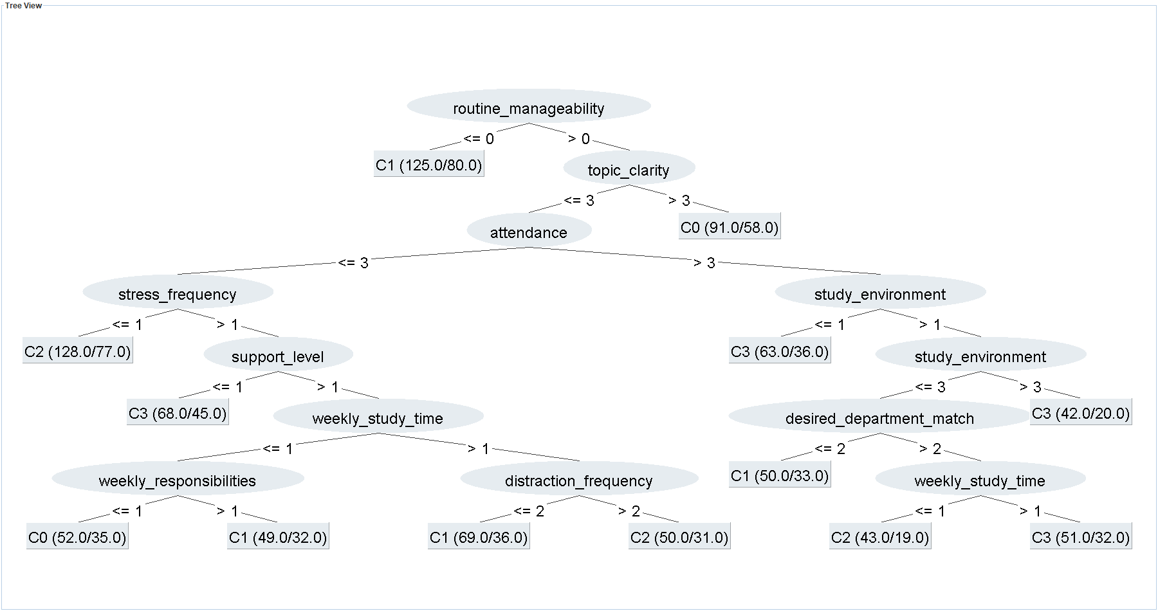
WEKA J48: Recent SGPA
WEKA J48 -C 0.25 -M 40. Recent SGPA. Test: 29.86%. ZeroR test: 27.15%.
Notes:
Sources: sgpa_J48_holdout.txt, sgpa_tree.dot, sgpa_weka_viewer.png. Exact WEKA TreeVisualizer export. Numeric option codes are listed in backup. Leaf (N/errors) denotes training support and training errors.

Slide 38
WEKA J48: SGPA rules
IF routine is completely unmanageable
C1
IF routine is above completely unmanageable
AND almost everything is clear after class
C0
Selected branches from the preceding WEKA J48 tree. Full text and option codes in backup.
Notes:
Exact rules: sgpa_tree.txt and results.json. These are predictions from tree branches, not causal statements.

Slide 39
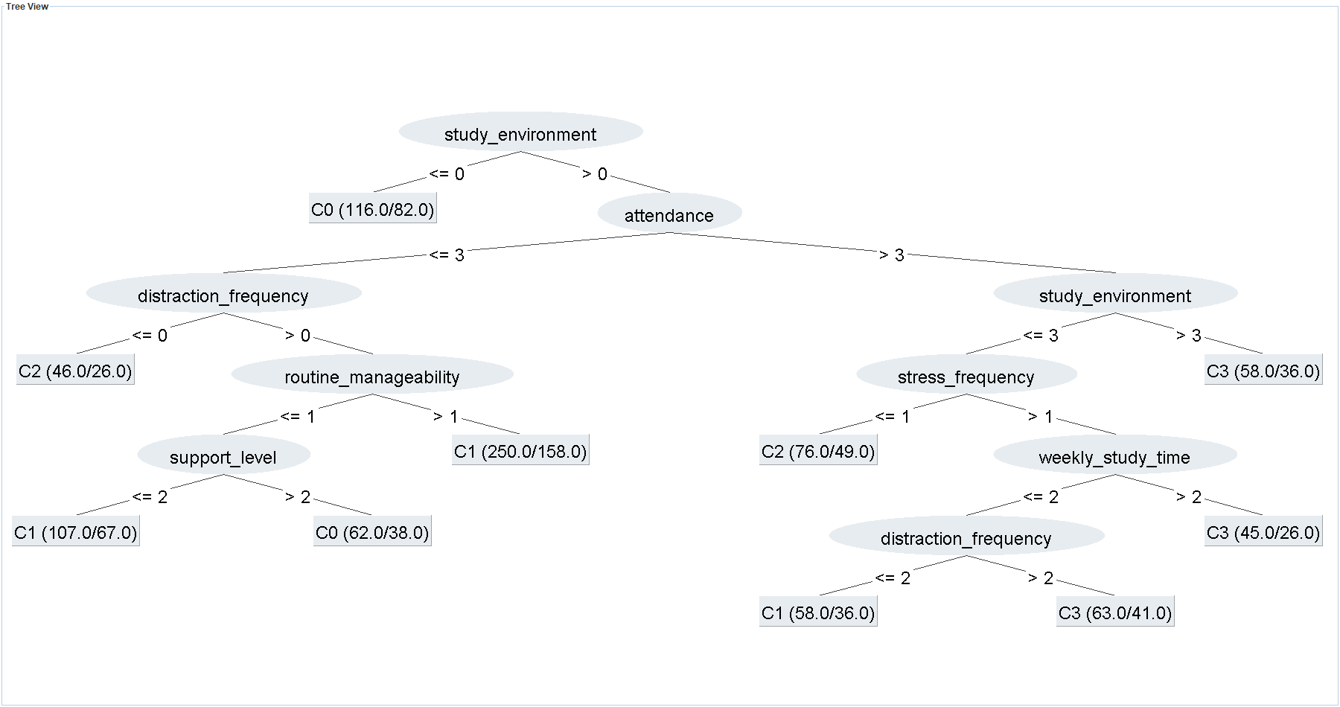
WEKA J48: CGPA from questionnaire variables
WEKA J48 -C 0.25 -M 40. CGPA from questionnaire variables. Test: 32.13%. ZeroR test: 28.96%.
Notes:
Sources: questionnaire_J48_holdout.txt, questionnaire_tree.dot, questionnaire_weka_viewer.png. Exact WEKA TreeVisualizer export. Numeric option codes are listed in backup. Leaf (N/errors) denotes training support and training errors.

Slide 40
Questionnaire J48 rules
IF study environment is very distracting
C0
IF environment is excellent for focused study
AND attendance is 90% or more
C3
Selected branches from the preceding WEKA J48 tree. Full text and option codes in backup.
Notes:
Exact rules: questionnaire_tree.txt and results.json. These are predictions from tree branches, not causal statements.

Slide 41
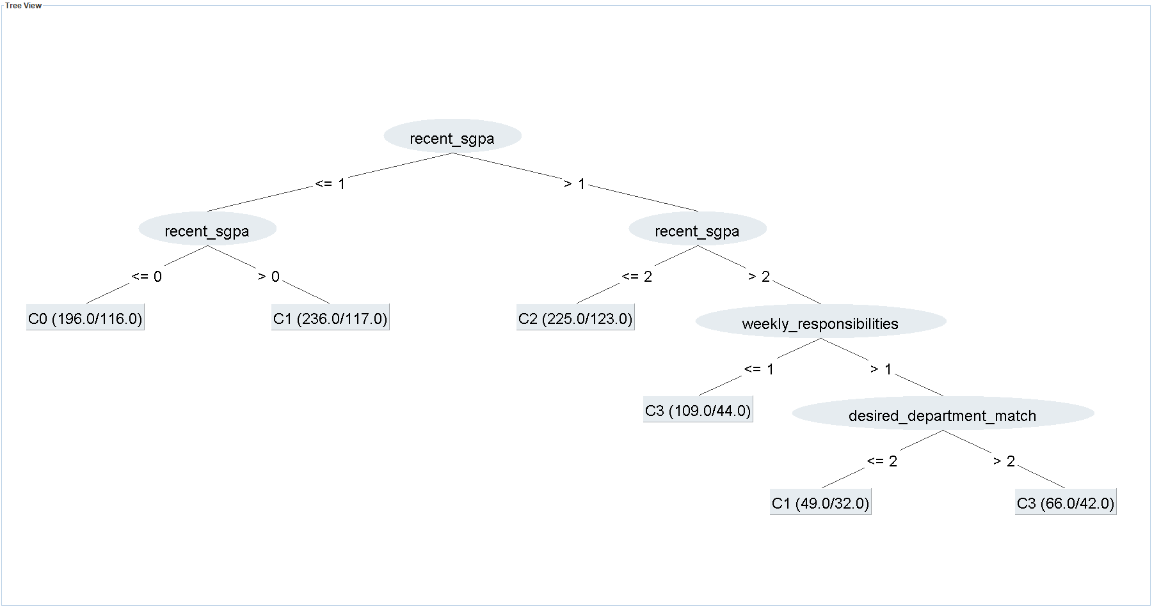
WEKA J48: Main CGPA prediction
WEKA J48 -C 0.25 -M 40. Main CGPA prediction. Test: 49.77%. ZeroR test: 28.96%.
Notes:
Sources: main_J48_holdout.txt, main_tree.dot, main_weka_viewer.png. Exact WEKA TreeVisualizer export. Numeric option codes are listed in backup. Leaf (N/errors) denotes training support and training errors.

Slide 42
Main CGPA J48 rules
IF recent SGPA is below 3.20
C0
IF recent SGPA is 3.20–3.49
C1
IF recent SGPA is 3.50–3.74
C2
IF recent SGPA is 3.75 or higher
AND outside commitments are 0–5 hours per week
C3
Selected branches from the preceding WEKA J48 tree. Full text and option codes in backup.
Notes:
Exact rules: main_tree.txt and results.json. These are predictions from tree branches, not causal statements.

Slide 43
WEKA J48 training and test accuracy
Target | Training (881) | Test (221) | ZeroR test
Recent SGPA | 39.39% | 29.86% | 27.15%
CGPA questionnaire | 36.55% | 32.13% | 28.96%
Main CGPA | 46.20% | 49.77% | 28.96%
Each row evaluates the same fitted WEKA J48 on its training and test records.
Notes:
Sources: sgpa_J48_holdout.txt, questionnaire_J48_holdout.txt, main_J48_holdout.txt. All J48 models C=.25 M=40.

Slide 44
WEKA J48: main CGPA test confusion matrix
Fixed test set
Predicted
C0
C1
C2
C3
C0 < 3.20
C1 3.20–3.49
C2 3.50–3.74
C3 ≥ 3.75
C0
22
15
6
4
C1
8
31
15
10
C2
7
15
29
9
C3
3
11
8
28
Rows = actual class. Columns = predicted class. Blue cells are correct predictions.
Notes:
Source: main_J48_holdout.txt, TEST section, 221 held-out records.

Slide 45
WEKA Random Forest and SMO matrices
Random Forest
SMO
Predicted
Predicted
C0
C1
C2
C3
C0
C1
C2
C3
C0
95
81
26
34
C0
61
113
34
28
C1
57
159
71
33
C1
51
154
75
40
C2
47
79
126
48
C2
42
93
109
56
C3
43
50
49
104
C3
35
56
70
85
Main CGPA, stratified 10-fold cross-validation, N = 1,102. Rows actual, columns predicted.
Notes:
Sources: main_RandomForest_cv.txt, main_SMO_cv.txt.

Slide 46
WEKA Logistic and Naive Bayes matrices
Logistic
Naive Bayes
Predicted
Predicted
C0
C1
C2
C3
C0
C1
C2
C3
C0
61
107
38
30
C0
69
101
34
32
C1
49
145
83
43
C1
51
169
70
30
C2
42
92
101
65
C2
54
104
96
46
C3
31
55
61
99
C3
39
49
72
86
Main CGPA, stratified 10-fold cross-validation, N = 1,102. Rows actual, columns predicted.
Notes:
Sources: main_Logistic_cv.txt, main_NaiveBayes_cv.txt.

Slide 47
WEKA ZeroR baseline matrix
Main CGPA, 10-fold CV
Predicted
Always predicts C1
C0
C1
C2
C3
C0
0
236
0
0
C1
0
320
0
0
Every prediction falls
in one column.
C2
0
300
0
0
C3
0
246
0
0
WEKA ZeroR, main CGPA, 10-fold CV, N = 1,102. Accuracy = 29.04%.
Notes:
Source: main_ZeroR_cv.txt.

Slide 48
WEKA main CGPA accuracy: 10-fold CV
WEKA 3.8.7, stratified 10-fold CV, seed 1. Same 1,102 records and main CGPA inputs.
Notes:
Sources: main_J48_cv.txt, main_RandomForest_cv.txt, main_SMO_cv.txt, main_Logistic_cv.txt, main_NaiveBayes_cv.txt, main_ZeroR_cv.txt

Slide 49
Previous studies and models
Study | Target / population | Models | Reported result
Ahmed (2024) | Student performance classification | SVM, tree, NB, KNN with K-means | SVM accuracy 96.0%
Maruf et al. (ICCIT 2024) | Bangladesh SSC / HSC | Tuned classifiers and stacking | 82.23% SSC 86.89% HSC
Albonny & Duru (2026) | Bangladesh school average course grade | Linear regression, tree, RF, DNN | RF R² = 0.933 Regression metric
Different populations, targets and evaluation designs. Source links in speaker notes.
Notes:
Ahmed (2024): https://doi.org/10.1155/2024/4067721
Maruf et al. ICCIT 2024: https://doi.org/10.1109/ICCIT64611.2024.11021990
Albonny & Duru (2026): https://dergipark.org.tr/tr/pub/ijonfest/article/1879280

Slide 50
Previous work and our WEKA models
Previous work
This project
School results and student performance
SVM, trees and ensembles
Classification and regression targets
Engineering students, four CGPA bands
J48, Random Forest, SMO, Logistic,
Naive Bayes and ZeroR
WEKA 10-fold comparison
Different datasets and targets; reported scores are not directly comparable.
Notes:
Ahmed (2024): https://doi.org/10.1155/2024/4067721
Maruf et al. ICCIT 2024: https://doi.org/10.1109/ICCIT64611.2024.11021990
Albonny & Duru (2026): https://dergipark.org.tr/tr/pub/ijonfest/article/1879280
Project results: main_J48_cv.txt, main_RandomForest_cv.txt, main_SMO_cv.txt, main_Logistic_cv.txt, main_NaiveBayes_cv.txt, main_ZeroR_cv.txt

Slide 51
What did we learn?
•
Student answers vary across academic and lifestyle questions.
•
Desired department, attendance and outside commitments show the clearest CGPA associations.
•
Questionnaire-only classification stays close to the baseline.
•
Recent SGPA is the first split in the main J48 tree.
•
Random Forest leads the CV comparison; J48 provides readable rules.
Notes:
Source: evidence/data.json. Derived from verified raw survey records.

Slide 52
Limitations
•
Self-reported answers without verified registrar records
•
KUET-heavy sample and a one-time survey
•
Banded SGPA / CGPA with different time wording between forms
•
Questionnaire imputation occurred before splitting / CV
•
Small associations and exploratory prediction estimates
Notes:
Sources: raw questionnaire, cleaning_verification.log, data_provenance.json. Questionnaire source-mode imputation used full dataset before CV.

Slide 53
Conclusion
Data
Relationship
WEKA
1,108 usable engineering-student responses
Question-by-question CGPA patterns
J48 rules and comparison with five standard classifiers
Associations and predictions, not causal proof.
Notes:
Source: evidence/data.json. Derived from verified raw survey records.

Slide 54
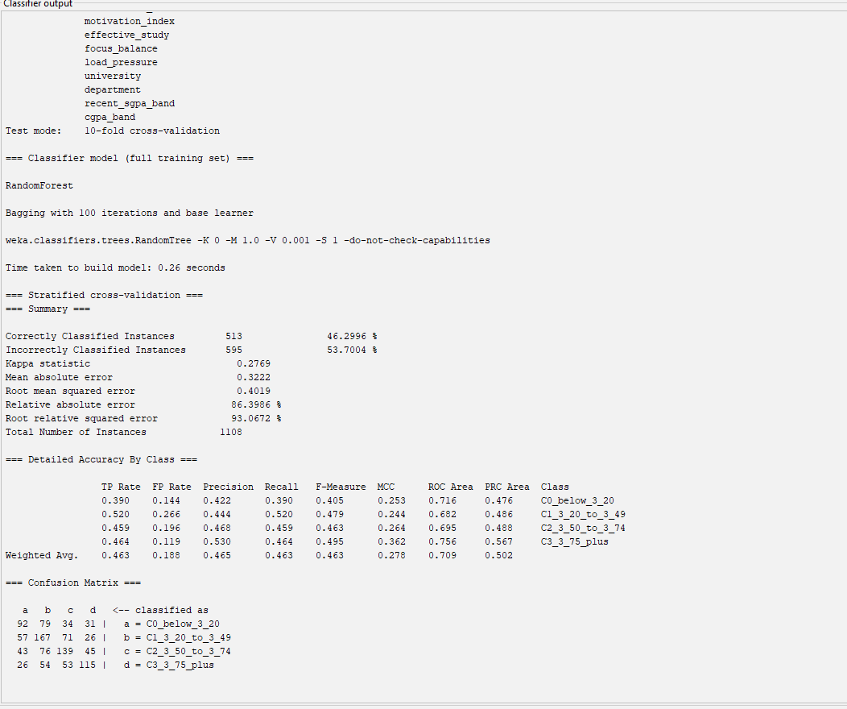
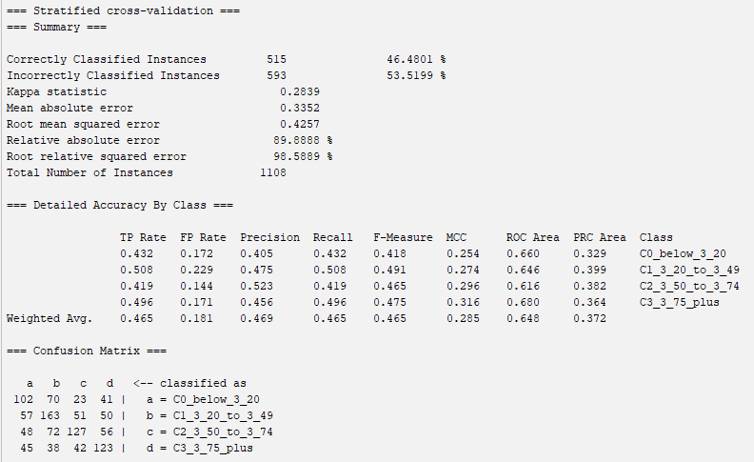
CONCLUSION
MAIN CGPA PREDICTION
We Also Ran the Models in WEKA (Real Screenshots)
Main CGPA Random Forest output — 1,108 instances, class = cgpa_band
SMO on the main CGPA task, 10-fold cross-validation: 46.5% correct · confusion matrix rows = actual
46.5%
46.3%
29.0%
main CGPA SMO
main CGPA Random Forest
ZeroR = always guessing the most common group
CSE 4112 · Machine Learning Lab · What Shapes Student CGPA?
45
Notes:
Course er requirement onujayi amra WEKA teo model chalaisi — egula real screenshot. Bam dike main CGPA Random Forest output. Dan dike SMO, mane WEKA er SVM, main CGPA task e 10-fold cross-validation e 46.5% thik — confusion matrix er row actual, column predicted. Main CGPA Random Forest 46.3%, ar ZeroR guessing 29.0%. Python ar WEKA same golpo bole.

Slide 55
CONCLUSION
MAIN CGPA PREDICTION
Models Used in Previous Work and in Our Project
Study | Students / target | Models used | Key result
[1] Ahmed (2024) | Student performance (classification) | K-means + SVM, Decision Tree, Naive Bayes, KNN | SVM best after parameter tuning (96% accuracy); Naive Bayes lowest
[2] Maruf et al. (2024) | Bangladeshi SSC and HSC students: SSC and HSC exam results | Tuned individual ML models + stacking ensemble; SHAP explanations | Stacking ensemble best: 82.23% (SSC) and 86.89% (HSC); feature scaling mattered
[3] Albonny & Duru (2026) | Bangladeshi secondary-school students: Average grade of five common courses (regression) | Multiple Linear Regression, Decision Tree, Random Forest, Deep Neural Network | Random Forest best (R² 93.3 vs DNN 93.0); student group most important; study time and attendance also important
This project | 1,108 engineering students, 4 universities: CGPA group C0–C3 | Decision Tree for rules · Random Forest, SVM, Logistic, Naive Bayes, k-NN, Gradient Boosting · WEKA J48, SMO | Main CGPA tree: 45.7% on unseen students · WEKA SMO 46.5% (cross-validation)
Only models and results stated in the papers' published abstracts are shown. The numbers come from different students and targets, so they are not directly comparable.
CSE 4112 · Machine Learning Lab · What Shapes Student CGPA?
46
Notes:
Teacher er direct question — reference ra kon model use korse ar amra konta. Ahmed SVM, Decision Tree, Naive Bayes, KNN; Maruf et al. ensemble ar explainable AI; Albonny and Duru regression, tree, random forest, deep neural network. Amra Decision Tree diye rule explain korsi, ar comparison er jonno Random Forest, SVM, Logistic, Naive Bayes, k-NN, Gradient Boosting — Python ar WEKA duitatei.

Slide 56
CONCLUSION
FINDINGS + CONCLUSION
What Data Would Make Prediction Better?
🧾
Verified semester grades from official records
📘
Course-level grades, not only one summary
🔁
Repeated measurements of the same students
⌚
Objective study / activity indicators
⚖️
Balanced sampling across universities
More rows of the same questionnaire may help less than better-quality features.
CSE 4112 · Machine Learning Lab · What Shapes Student CGPA?
50
Notes:
Prediction valo korte ki lagbe: official grade, course-level result, same student ke bar bar measure kora, objective study data, ar balanced university sample. Same form e aro row add korar cheye better quality feature beshi help korbe.

Slide 57
CONCLUSION
FINDINGS + CONCLUSION
Our Complete Story
1
Form
2
Student answers
3
Data statistics
4
Behaviour graphs
5
Decision Tree rules
6
Rule validation
7
Train / Test
8
Confusion matrix
9
Conclusion
CSE 4112 · Machine Learning Lab · What Shapes Student CGPA?
51
Notes:
Pura project ek chobite: form, student answer, data statistics, behaviour graph, Decision Tree rule, rule validation, train-test, confusion matrix, ar conclusion.

Slide 58
FINDINGS + CONCLUSION
Thank You
Questions?
2107020 · Sheikh Md. Galib Mahim
2107030 · Md. Eftakar Jaman Arfan
2107007 · Asif Jawad
2107008 · Rakibul Islam
2107012 · Md Enam E Elahi
2107014 · Al Mubtasim Preom
CSE 4112 · Machine Learning Laboratory · KUET
Notes:
Dhonnobad. Kono question thakle bolun.

Slide 59
BACKUP
TECHNICAL BACKUP
Full Question List of the Survey Form
# | Question | Options | In tree
1 | What is the name your university? | CUET | BRAC | Brac | BRAC University | BRAc | BUET | Buet | Cuet | … | —
2 | How satisfied are you with getting admitted into your university? | Very dissatisfied | Dissatisfied | Neutral | Satisfied | Very satis… | —
3 | What is your department? | Electrical and Electronic Engineering | Computer Science and Engine… | —
4 | Did you get into your desired subject or department? | Not at all what I wanted | Mostly different | Somewhat different | … | Yes
5 | Which semester are you currently in? | 1 | 2 | 3 | 4 | 5 | 6 | 7 | 8 | 9 | 10 | 11 | 12 | —
6 | What was your SGPA in the most recently completed semester? | 3.0+ | 3.2+ | 3.5+ | 3.75+ | 3.9+ | Below | Yes
7 | Before that semester, what was your CGPA? | 3.0+ | 3.2+ | 3.5+ | 3.75+ | 3.9+ | Below | —
8 | How satisfied were you with your latest semester result? | Very dissatisfied | Dissatisfied | Neutral | Satisfied | Very satis… | —
9 | How often were you actually present in class? | 60-74% | 75-89% | 90% or more | Yes
10 | Outside class, how much did you usually study per week? | Less than 3 hrs | 3-6 hrs | 7-10 hrs | 11-15 hrs | More than 15 hrs | Yes
11 | Which study style sounds most like you? | Occasionally when necessary | Mostly just before exams | Regularly … | Yes
12 | When a class ended, how much of the topic was usually clear to you? | Almost nothing | A little | About half | Most of it | Almost everyt… | Yes
13 | On a normal night, how much sleep did you get? | Less than 5 hrs | 5-6 hrs | 6-7 hrs | 7-8 hrs | More than 8 hrs | Yes
14 | How often did stress make it difficult for you to study | Never | Rarely | Sometimes | Often | Almost always | Yes
15 | How much time did tuition, a job, club activities or other responsibilities take each week | None | 1-5 hrs | 6-10 hrs | 11-15 hrs | More than 15 hrs | Yes
16 | How often did your phone, gaming, social media, or entertainment steal your planned study | Never | Rarely | Sometimes | Often | Almost every day | Yes
17 | How study-friendly was the place where you lived? | Very distracting | Somewhat distracting | Neither good nor bad | Mo… | Yes
18 | When academic life became difficult, how much support did you receive from family or close | No support | Very little support | Some support | Good support | St… | Yes
19 | Overall, how healthy and manageable was your semester routine? | Completely unmanageable | Difficult to manage | Average | Mostly ma… | Yes
20 | Do you think this course of study will take you to your dream career? | Not at all | Slightly | Somewhat | Mostly | Completely | —
CSE 4112 · Machine Learning Lab · What Shapes Student CGPA?
54
Notes:
Viva er jonno form er shob question ar option. Last column e dekhano kon question tree te use hoyeche.

Slide 60
BACKUP
TECHNICAL BACKUP
Data Dictionary: Feature → Type → Used Where
Feature | Slide label | Group | Type | Questionnaire trees | Main CGPA tree | Blank handling
university | University | Academic | nominal | No | No | KUET rows set to KUET (single-university form); 9 spelling
department_other | Department other | Academic | free text | No | No | Merged into department
timestamp | Timestamp | Admin | datetime | No | No | Dropped
department | Department | Academic | nominal (free text) | No | No | 110 spellings -> 24 departments -> 18 groups (<15 students
semester | Semester | Academic | ordinal number | No | No | 2 blanks -> median semester of the same university
recent_sgpa | Recent semester SGPA | Academic | ordinal band | No | Yes | Blanks filled from CGPA class in notebook 02; those rows a
cgpa | Cgpa | Target | ordinal band | No | No | 18 rows with no usable CGPA dropped
attendance | Class attendance | Study habits | ordinal band | Yes | Yes | <1.3% blanks -> most common answer in the same form
weekly_study_time | Self-study per week | Study habits | ordinal band | Yes | Yes | <1.3% blanks -> most common answer in the same form
study_style | Study style | Study habits | ordinal | Yes | Yes | <1.3% blanks -> most common answer in the same form
topic_clarity | Topic clear after class | Study habits | Likert | Yes | Yes | <1.3% blanks -> most common answer in the same form
sleep_duration | Sleep per night | Lifestyle | ordinal band | Yes | Yes | <1.3% blanks -> most common answer in the same form
stress_frequency | Stress blocked studying | Stress/pressure | Likert | Yes | Yes | <1.3% blanks -> most common answer in the same form
weekly_responsibilities | Outside commitments (tuition/job/club) | Responsibility | ordinal band | Yes | Yes | Blank -> 'None'
desired_department_match | Got desired department | Motivation | Likert | Yes | Yes | <1.3% blanks -> most common answer in the same form
distraction_frequency | Phone / social media took study time | Lifestyle | Likert | Yes | Yes | <1.3% blanks -> most common answer in the same form
study_environment | Study-friendly living place | Environment | Likert | Yes | Yes | <1.3% blanks -> most common answer in the same form
support_level | Family / friend support | Support | Likert | Yes | Yes | <1.3% blanks -> most common answer in the same form
admission_satisfaction | Satisfied with admission | Motivation | Likert | No | No | <1.3% blanks -> most common answer in the same form
career_expectation | Course leads to dream career | Motivation | Likert | No | No | <1.3% blanks -> most common answer in the same form
result_satisfaction | Satisfied with last result | Motivation | Likert | No | No | Kept for description only
routine_manageability | Semester routine manageable | Lifestyle | Likert | Yes | Yes | <1.3% blanks -> most common answer in the same form
email | Email | Admin | text | No | No | Dropped
CSE 4112 · Machine Learning Lab · What Shapes Student CGPA?
55
Notes:
Protiti feature er type, kon tree te use hoyeche, ar blank answer kivabe handle kora hoyeche.

Slide 61
BACKUP
TECHNICAL BACKUP
Exact Train / Test Counts and Tree Settings
Split | C0 | C1 | C2 | C3 | Total
CGPA split: train | 189 | 256 | 240 | 196 | 881
CGPA split: test | 47 | 64 | 60 | 50 | 221
SGPA split: train | 189 | 237 | 226 | 229 | 881
SGPA split: test | 47 | 59 | 57 | 58 | 221
Experiment | Depth | Min students per box | Final boxes | CV accuracy (train only) | Test accuracy
SGPA prediction | 3 | 40 | 6 | 28.6% | 29.4%
CGPA questionnaire diagnostic | 3 | 40 | 6 | 28.0% | 27.1%
Main CGPA prediction | 3 | 20 | 8 | 42.1% | 45.7%
Tree size chosen by 5-fold CV inside the training set: depth 3 vs 4 × at least 20/30/40 students per box; depth 4 only if ≥ 1 point better. Seed 42. Test set used once.
CSE 4112 · Machine Learning Lab · What Shapes Student CGPA?
56
Notes:
Exact split count ar tree setting. Tree size training set er vitore 5-fold CV diye select kora, test set shudhu ekbar use hoyeche.

Slide 62
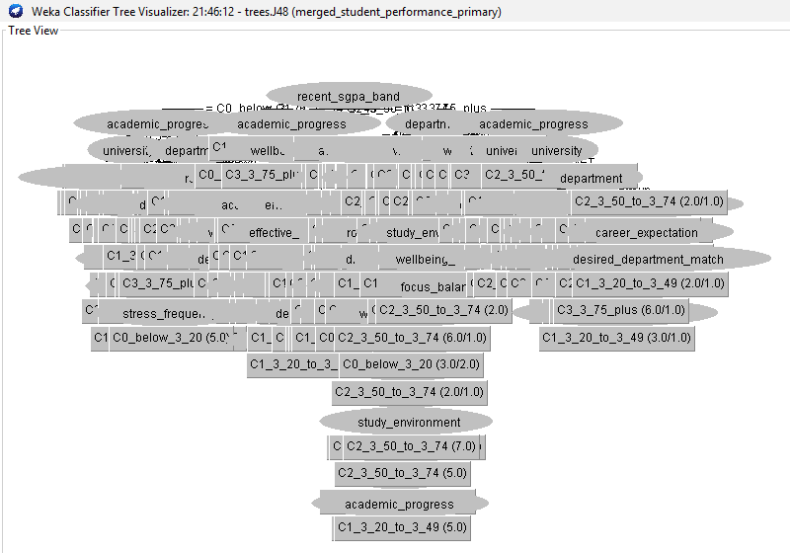
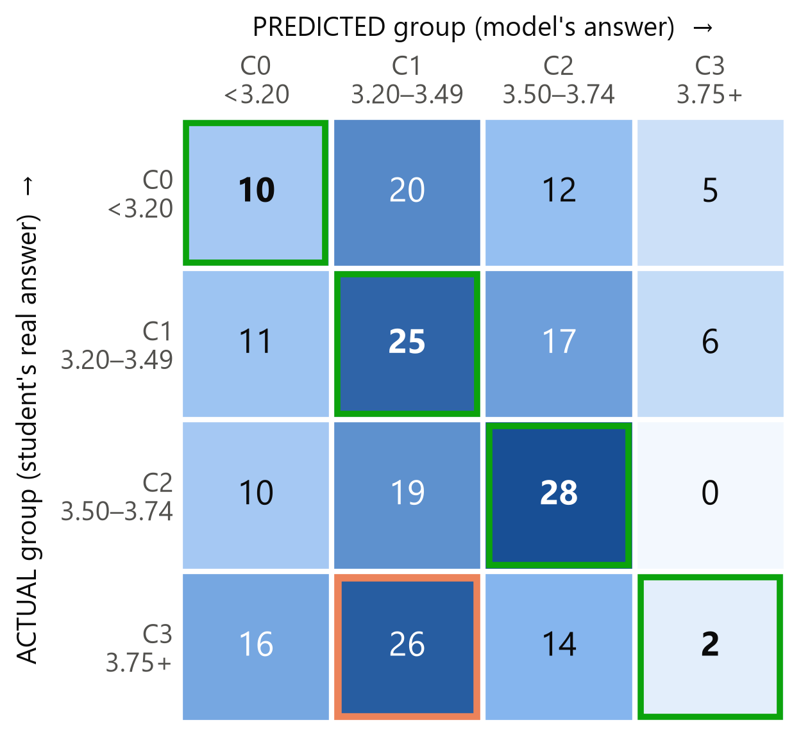
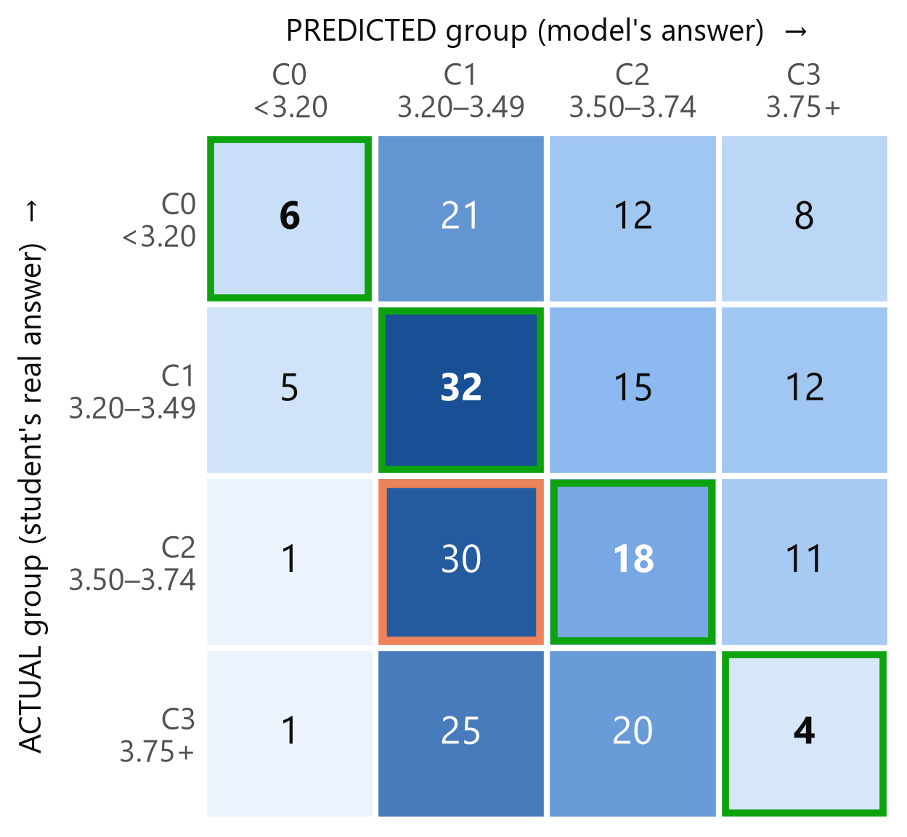
BACKUP
TECHNICAL BACKUP
Why the Full WEKA J48 Tree Is Not Shown
315
268
6–8
leaves: WEKA J48, CGPA diagnostic
leaves: WEKA J48, main CGPA task
final boxes in our shallow trees
Real WEKA J48 tree viewer (main CGPA task)
Exp A: behaviour → SGPA (test)
Exp B: behaviour → CGPA (test)
CSE 4112 · Machine Learning Lab · What Shapes Student CGPA?
57
Notes:
WEKA J48 er full tree te 315 ar 268 ta leaf — slide e explain kora possible na, ar behaviour J48 prai guessing er soman. Tai alada shallow tree banaisi. Niche SGPA prediction ar CGPA questionnaire diagnostic er test confusion matrix.

Slide 63
BACKUP
TECHNICAL BACKUP
Full WEKA Results (10-fold cross-validation)
Model | Main CGPA acc. | W-F1 | Kappa | CGPA diagnostic acc. | W-F1 | Kappa
ZeroR | 29.0% | — | 0.000 | 29.0% | — | 0.000
Logistic | 45.1% | 0.451 | 0.263 | 29.8% | 0.293 | 0.050
J48 | 39.8% | 0.399 | 0.195 | 29.3% | 0.294 | 0.053
RandomForest | 46.3% | 0.463 | 0.277 | 33.6% | 0.327 | 0.100
SMO | 46.5% | 0.465 | 0.284 | 31.6% | 0.304 | 0.069
NaiveBayes | 39.7% | 0.397 | 0.192 | 31.3% | 0.312 | 0.077
Source: raw WEKA output logs (Weka Result.zip). W-F1 = weighted F1. Kappa = agreement beyond chance.
CSE 4112 · Machine Learning Lab · What Shapes Student CGPA?
58
Notes:
WEKA er full result: accuracy, weighted F1, kappa. main CGPA task e SMO ar Random Forest sobcheye valo.

Slide 64
BACKUP
TECHNICAL BACKUP
Full Python Results (repeated stratified 10-fold CV)
Model | Main CGPA acc. | Macro-F1 | Kappa | CGPA diagnostic acc. | Macro-F1 | Kappa
ZeroR (baseline) | 29.0% | 0.112 | 0.000 | 29.0% | 0.112 | 0.000
OneR-like (depth-1 tree) | 34.5% | 0.263 | 0.083 | 28.2% | 0.180 | 0.027
Naive Bayes | 24.5% | 0.215 | 0.049 | 23.8% | 0.201 | 0.033
Logistic Regression | 35.8% | 0.349 | 0.128 | 29.1% | 0.272 | 0.025
k-NN (k=25) | 35.8% | 0.302 | 0.109 | 29.9% | 0.242 | 0.035
Decision Tree (J48-like) | 43.3% | 0.427 | 0.234 | 26.6% | 0.264 | 0.026
Random Forest | 43.6% | 0.426 | 0.230 | 31.0% | 0.279 | 0.050
Gradient Boosting | 43.4% | 0.432 | 0.237 | 28.0% | 0.258 | 0.012
SVM (RBF) | 41.2% | 0.392 | 0.192 | 31.2% | 0.284 | 0.054
CSE 4112 · Machine Learning Lab · What Shapes Student CGPA?
59
Notes:
Python er full result, 30 ta fit er average. main CGPA task e Gradient Boosting er macro-F1 sobcheye beshi.

Slide 65
BACKUP
TECHNICAL BACKUP
Cross-Validation vs Hold-Out
Hold-out (teacher-facing)
Cross-validation (robustness)
• One fixed 80/20 split
• 881 train · 221 test students
• Main CGPA shallow tree: 45.7% on test
• Easy to explain: rules → unseen students
• Every student is tested once per round
• 10 folds × 3 repeats = 30 fits
• Main CGPA depth-6 tree: 43.3% average
• Stable ranking, less luck from one split
Both checks show that recent academic performance carries the strongest CGPA signal.
CSE 4112 · Machine Learning Lab · What Shapes Student CGPA?
60
Notes:
Hold-out holo ekta fixed split — teacher ke train ar test dekhanor jonno. Cross-validation onek bar split kore average ney — robustness check. Duitai same kotha bole: recent SGPA behaviour er cheye beshi information dey.

Slide 66
BACKUP
TECHNICAL BACKUP
Team Contribution
Roll | Team member | Contribution
2107020 | Sheikh Md. Galib Mahim | Merge and cleaning pipeline, EDA, modelling notebook, documentation
2107030 | Md. Eftakar Jaman Arfan | WEKA experiments and result tables
2107007 | Asif Jawad | Form design and data collection
2107008 | Rakibul Islam | Report writing and related work
2107012 | Md Enam E Elahi | Report writing and related work
2107014 | Al Mubtasim Preom | KUET scheme cleaning
Draft copied from the previous deck — confirm names and roles with the team before presenting.
CSE 4112 · Machine Learning Lab · What Shapes Student CGPA?
61
Notes:
Team er kaj er distribution. Present korar age team er sathe confirm korte hobe.

Slide 67
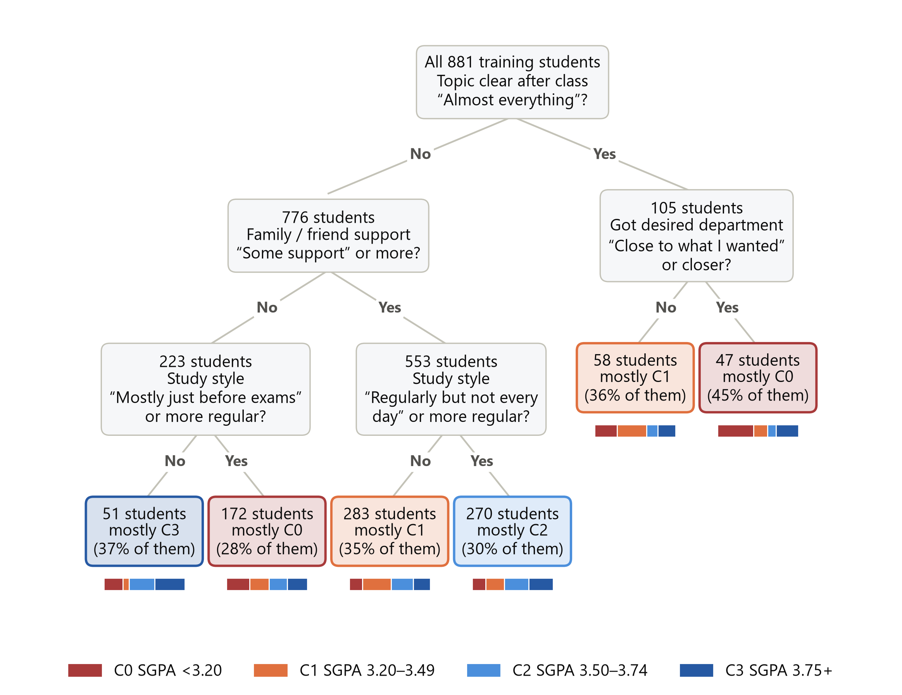
BACKUP
TECHNICAL BACKUP
SGPA Decision Tree (Full View)
CSE 4112 · Machine Learning Lab · What Shapes Student CGPA?
63
Notes:
Behaviour theke recent SGPA predict korar full shallow tree. Main slide e shudhu rule card dekhano hoyeche.

Slide 68

BACKUP
TECHNICAL BACKUP
WEKA Screenshots: Random Forest Runs
Main CGPA task: Random Forest 46.3% (10-fold CV)
CGPA questionnaire diagnostic: Random Forest 33.6% (10-fold CV)
CSE 4112 · Machine Learning Lab · What Shapes Student CGPA?
64
Notes:
WEKA te Random Forest er duita target-specific run er real screenshot — main CGPA task ar questionnaire diagnostic. Taskbar crop kore bad deya hoyeche.

