Slide 1
What Shapes Student CGPA?
An Engineering Student Academic Performance Dataset and Machine Learning Analysis
ACADEMIC PERFORMANCE / ENGINEERING STUDENTS
920 checked responses from four universities
Behaviour patterns, SGPA prediction, and CGPA prediction
STUDENT
FORM
DATA
RULES
CGPA
Notes:
Assalamu alaikum. Amader project er naam 'What Shapes Student CGPA?'. Amra 920 jon engineering student er survey data niye kaj korsi. Amra bujhte chaisi student ra nijer academic life niye ki bole, kon pattern gula valo ba kharap result er sathe ashe, ar ei answer gula diye notun student er CGPA group predict kora jay kina. Flow ta simple: Student → Form → Data → Rules → CGPA.

Slide 2
OPENING
PURPOSE + SOURCE
What Are We Trying to Understand?
1
2
3
What do students report?
Which patterns appear with better or worse results?
Can those answers predict a new student's result?
Attendance, study time, stress, sleep, support, environment…
Compare answer groups with CGPA groups
Train on some students, test on unseen ones
Data
Student behaviour
Understandable rules
Train / Test
Unseen-student result
First we understand the data; then we test prediction.
CSE 4112 · Machine Learning Lab · What Shapes Student CGPA?
2
Notes:
Amader tinta simple question. Ek, student ra ki report kore. Dui, kon answer pattern gula valo ba kharap result er sathe beshi dekha jay. Tin, ei answer diye notun student er result predict kora jay kina. Amader goal shudhu accuracy na — result ta jeno bujha jay.

Slide 3
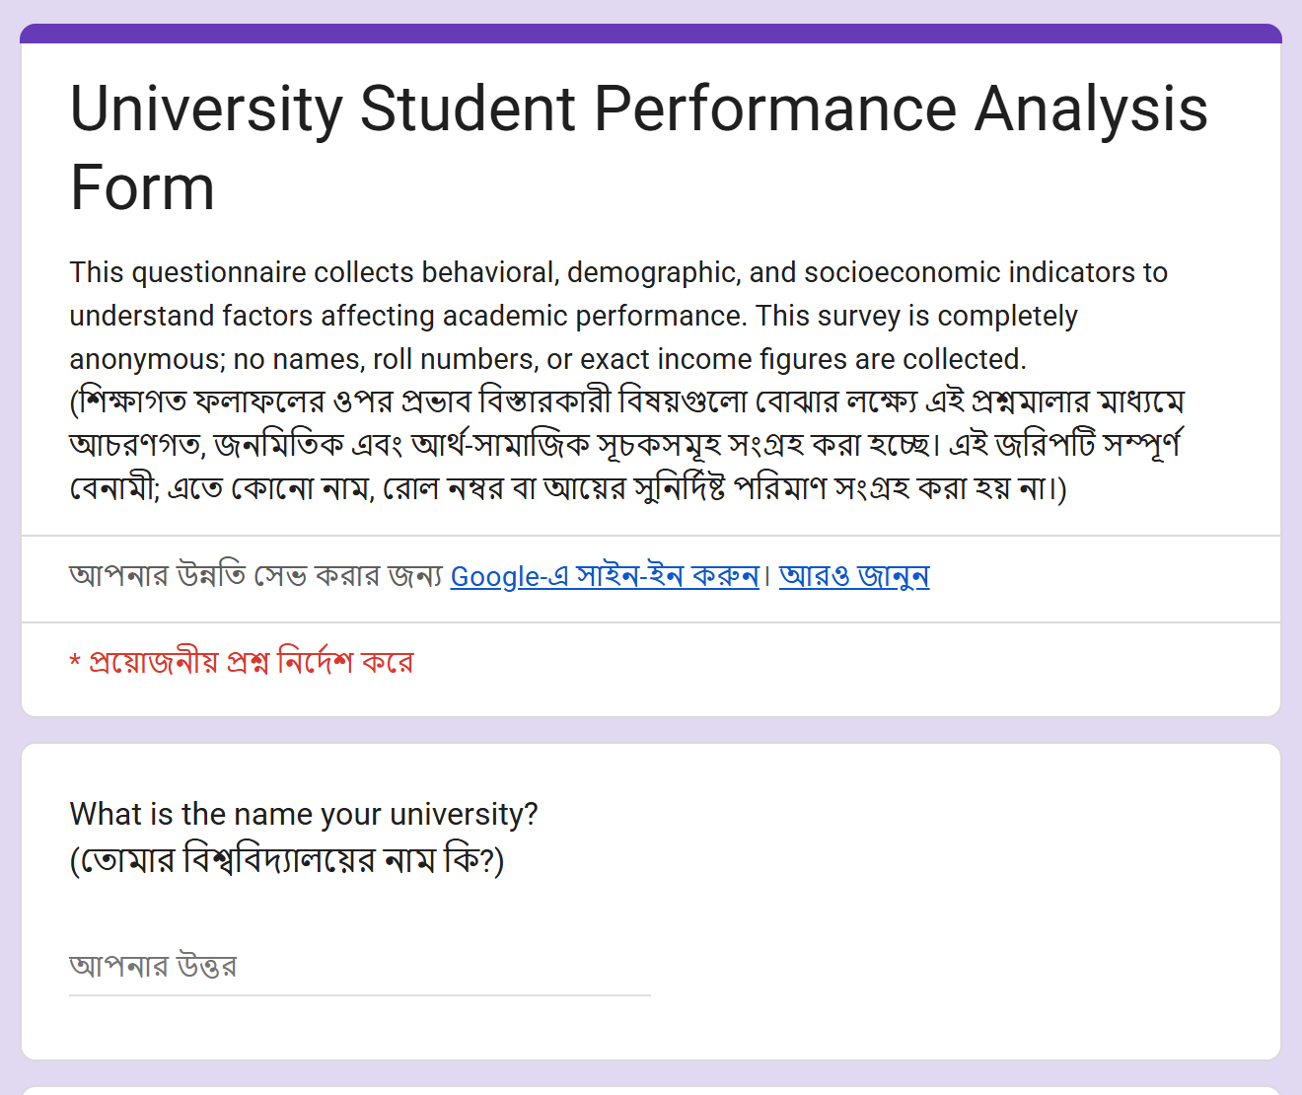
DATA COLLECTION
PURPOSE + SOURCE
Data Came From Student Surveys
2
1,126
similar Google Forms
raw responses
920
4
final records
universities
Same questions, slightly different wording
Analysis snapshot: responses up to 03 Sep 2026. The two forms were merged carefully.
CSE 4112 · Machine Learning Lab · What Shapes Student CGPA?
5
Notes:
Data duita Google Form theke eseche. Multi-university form e 230 ta, ar KUET form e 896 ta response — mot 1,126. Clean ar SGPA-CGPA check er por 920 ta final record. Duita form e question same, shudhu wording ektu alada, tai careful vabe merge korsi.

Slide 4
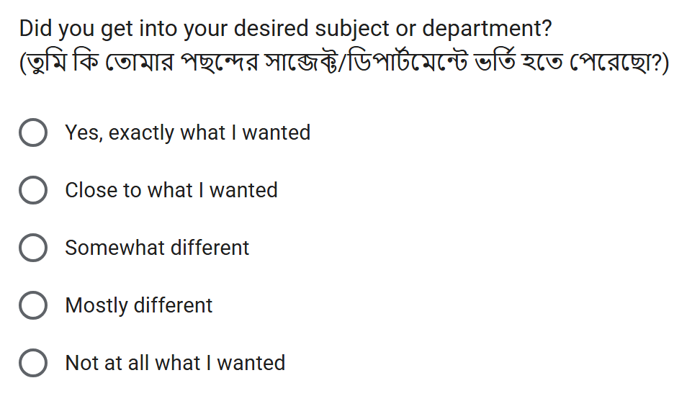
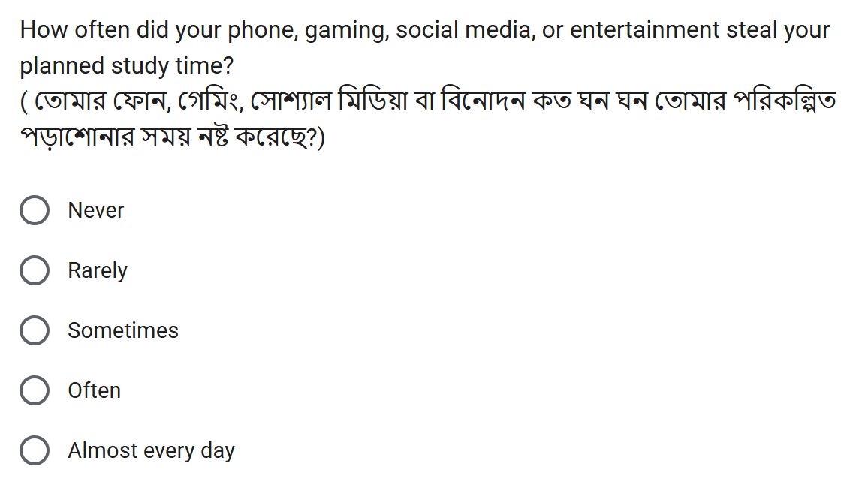
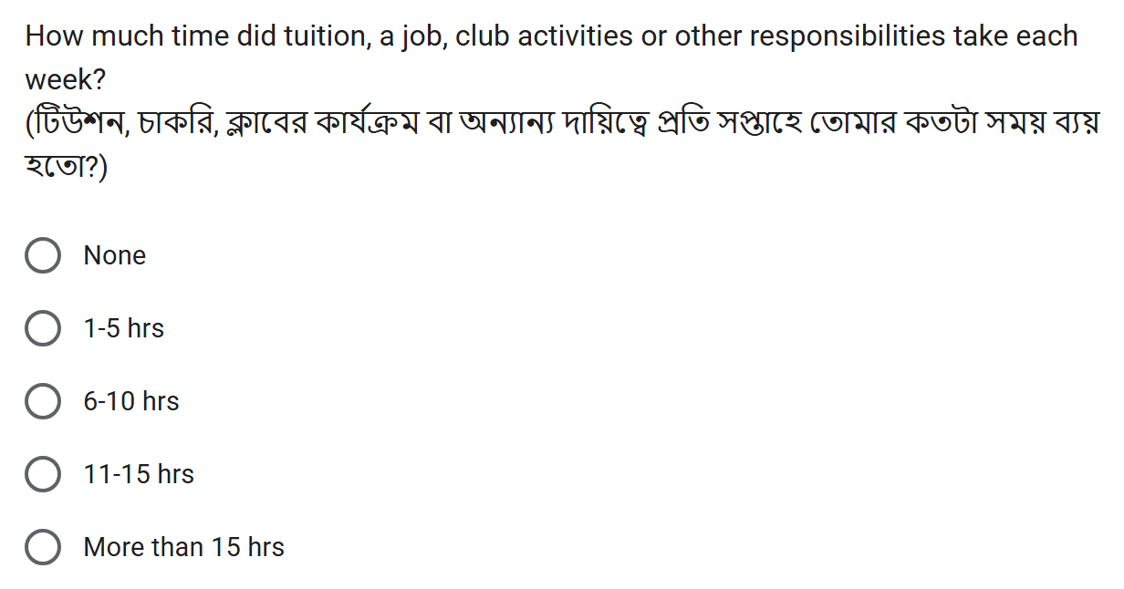
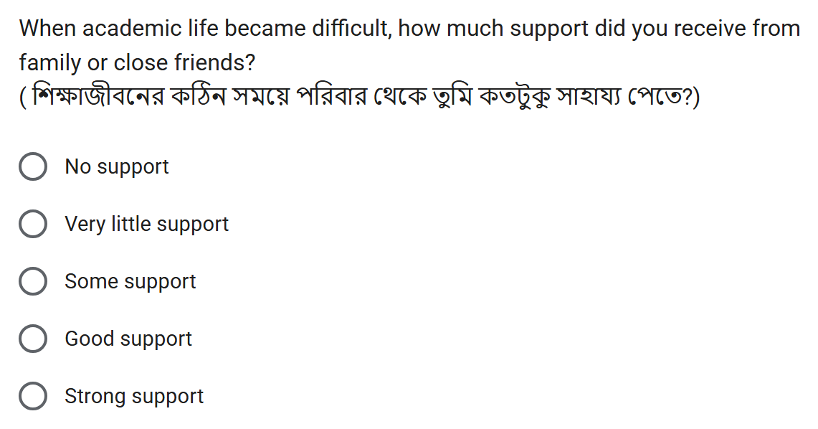
DATA COLLECTION
PURPOSE + SOURCE
What Did the Form Look Like?
Real screenshots of the University Student Performance Analysis Form — English + Bangla, anonymous.
The KUET form (896 responses) asked the same core questions with slightly different wording; both were merged.
CSE 4112 · Machine Learning Lab · What Shapes Student CGPA?
6
Notes:
Eta amader actual Google Form er screenshot — header ar charta question. KUET form e same core question chilo, shudhu wording ektu alada, tai duita merge kore ek dataset banaisi. Protiti question English ar Bangla duitai ache, ar form ta anonymous — name ba roll number nai. Answer gula option theke select korte hoy, tai sob student er answer compare kora easy. Model niye kotha bolar age amra dekhate chai data ta ashole kotha theke esheche.

Slide 5
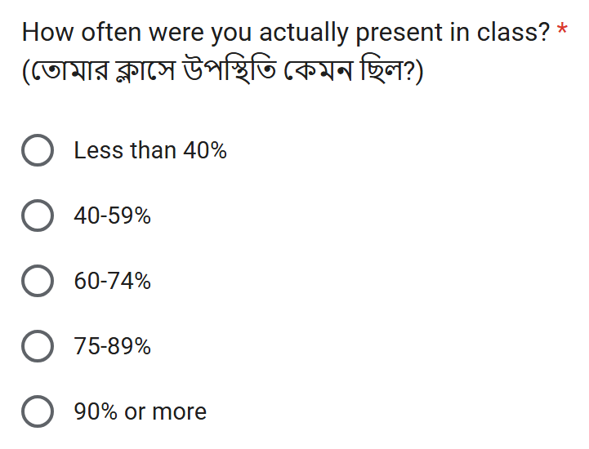
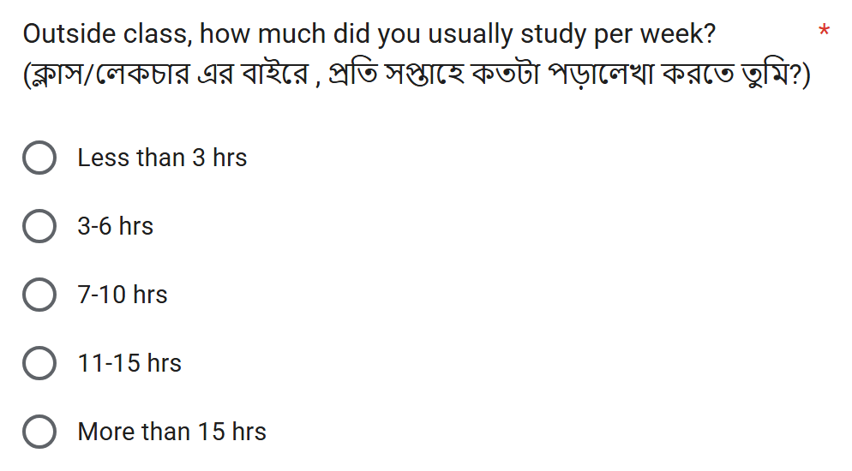
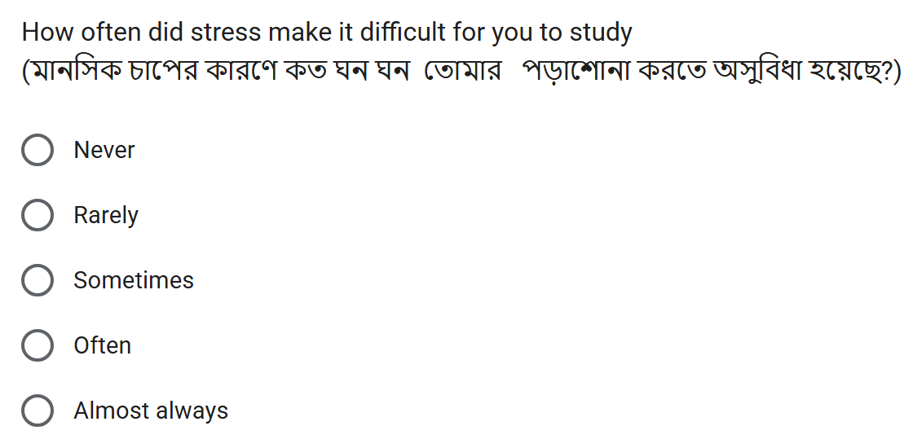
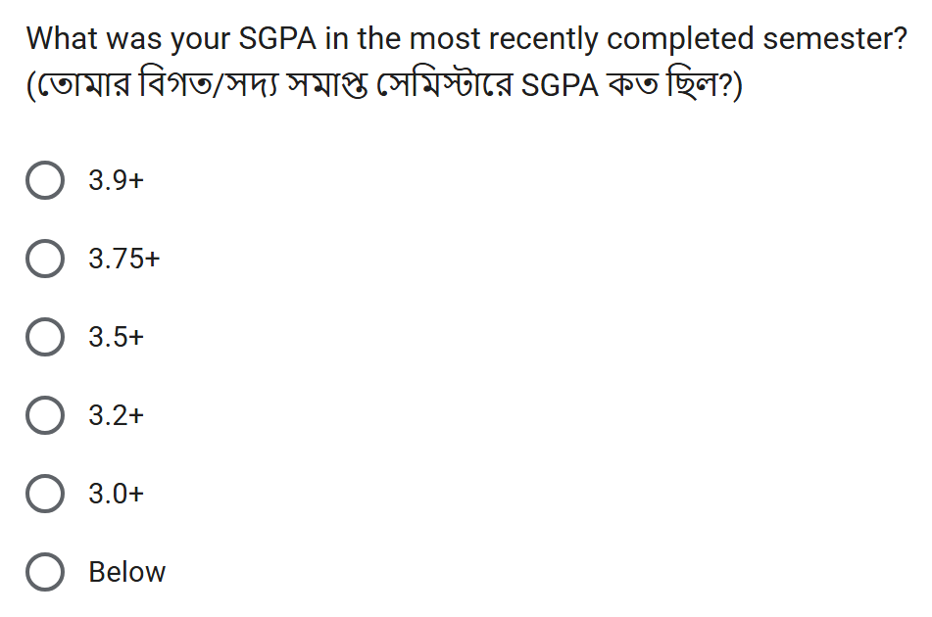
DATA COLLECTION
PURPOSE + SOURCE
Example Questions We Asked
CSE 4112 · Machine Learning Lab · What Shapes Student CGPA?
7
Notes:
Ekhane charta real question dekhano holo — attendance, weekly study time, stress, ar recent SGPA. Beshirvag answer category hishebe, jemon '75-89%' ba 'Often'. Ei category gula thakar karone different student der answer shohoje compare kora jay.

Slide 6
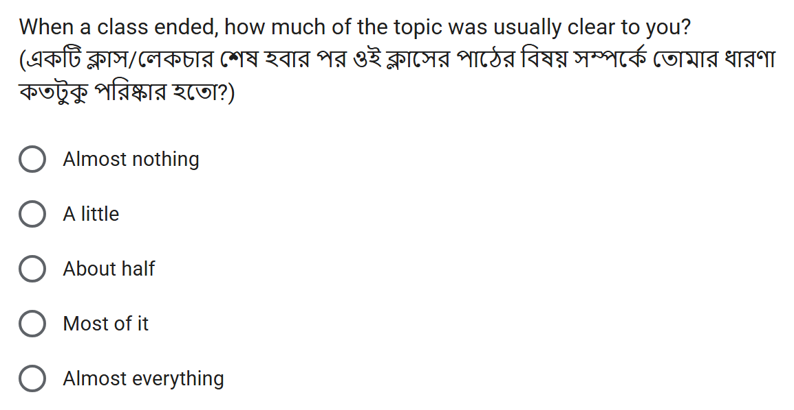
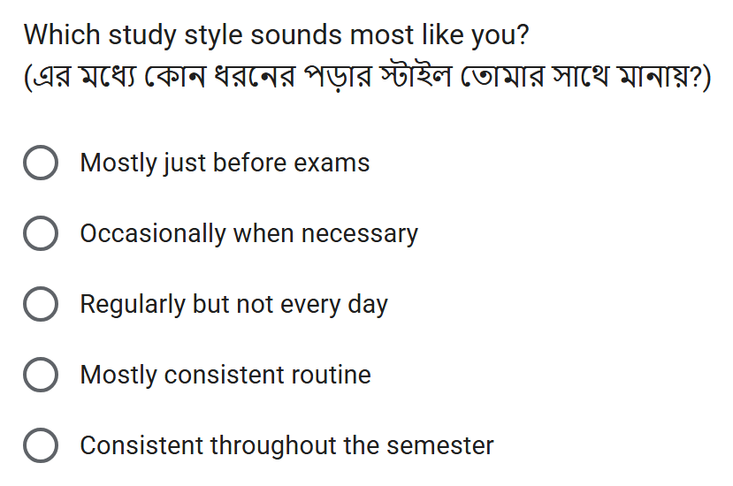
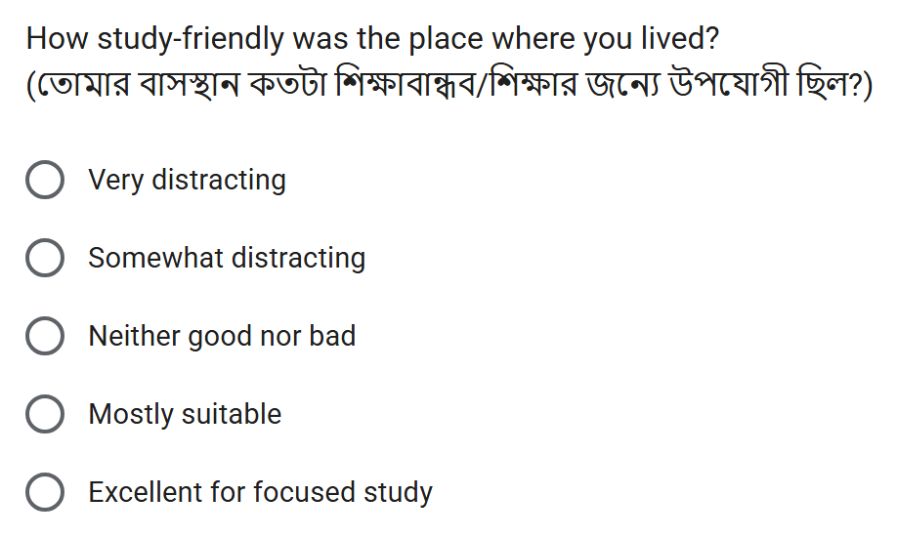
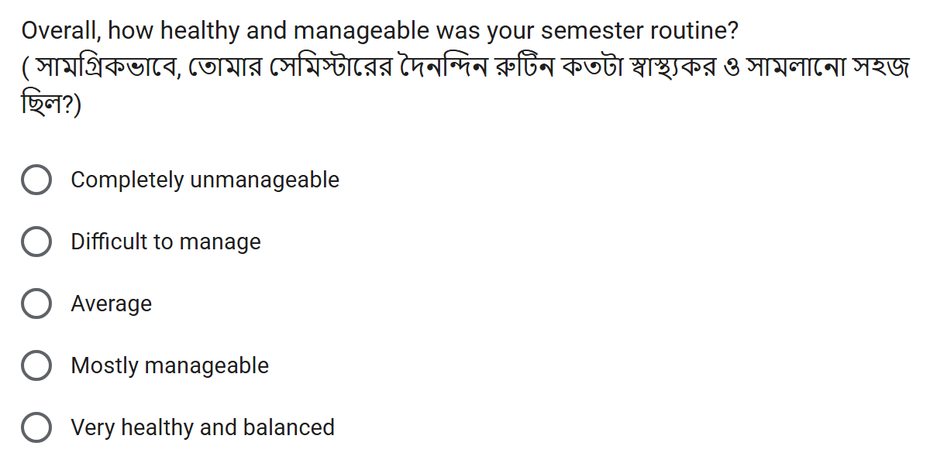
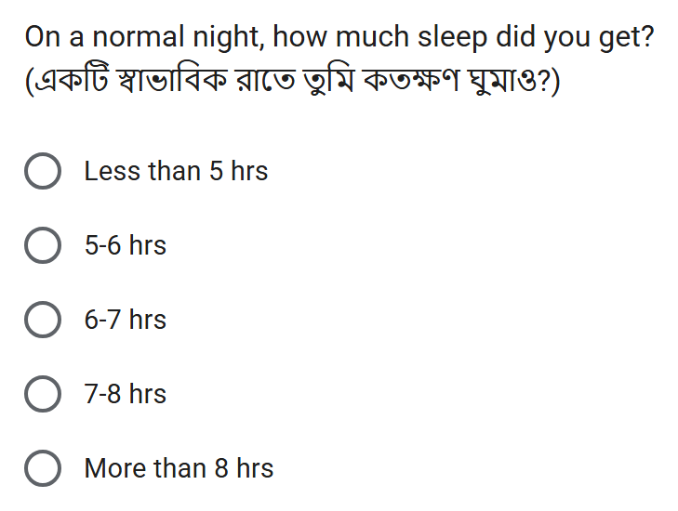
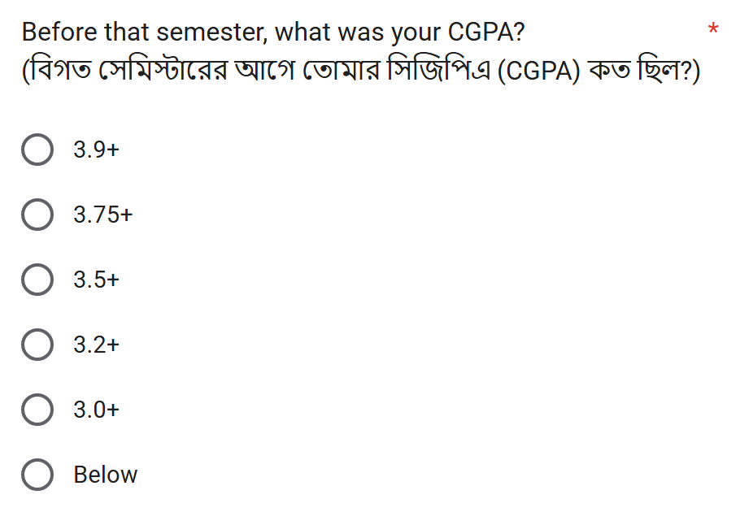
DATA COLLECTION
PURPOSE + SOURCE
Form Questions Behind the Decision Tree Rules
Topic clear after class · trees: SGPA, CGPA (+SGPA)
Study style · trees: SGPA
Study-friendly living place · trees: CGPA (behaviour)
Semester routine manageable · trees: CGPA (+SGPA)
Sleep per night · trees: CGPA (+SGPA)
CGPA question · what the CGPA trees predict
CSE 4112 · Machine Learning Lab · What Shapes Student CGPA?
8
Notes:
Ei chhoy ta real form question Decision Tree er rule e ashe — topic clarity, study style, study environment, semester routine, sleep, ar CGPA question ta nije target. Protiti screenshot er upore lekha ache kon tree seta use korse. Tree jokhon IF-AND rule dey, rule er protiti condition ei question gular answer theke ashe.

Slide 7
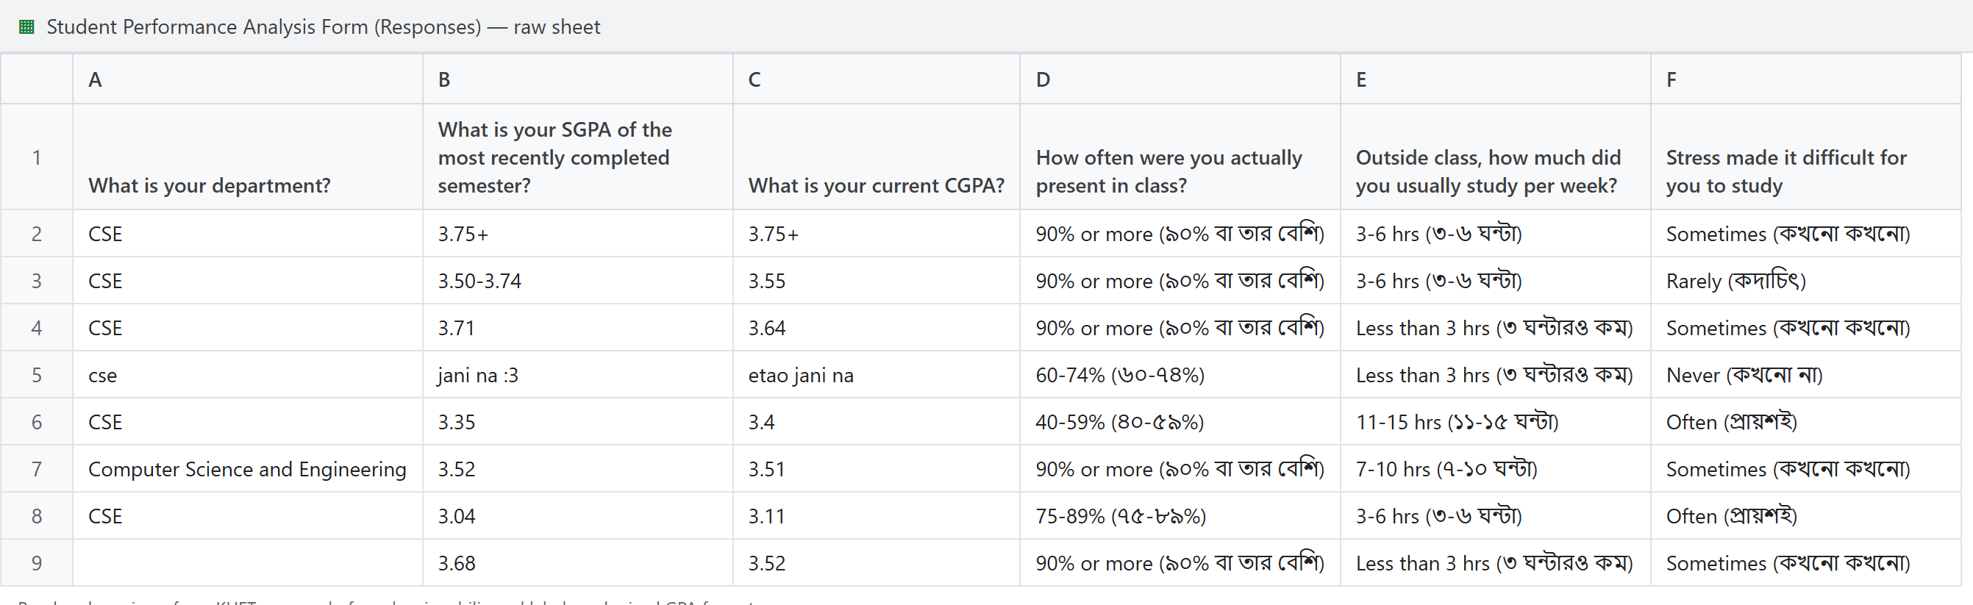
DATA COLLECTION
Form responses glimpse

Slide 8
DATA COLLECTION
DATASET
Student Information in Our Dataset
1
Academic
2
Study habits
3
Lifestyle
University · Department · Semester · Recent SGPA
Attendance · Self-study time · Study style · Topic clear after class
Sleep · Phone / social media · Semester routine
4
Pressure
5
Motivation & support
6
Environment
Stress · Tuition / job / club hours
Got desired department · Family / friend support · Career expectation
Study-friendly living place
Target: CGPA group
C0 <3.20
C1 3.20–3.49
C2 3.50–3.74
C3 3.75+
CSE 4112 · Machine Learning Lab · What Shapes Student CGPA?
9
Notes:
Form e shudhu academic info na, non-academic diko ache: study habit, lifestyle, pressure, motivation-support, environment. Ar amader target holo CGPA group — C0 theke C3. Mane project ta academic ar behaviour duita dik eksathe dekhe.

Slide 9
DATA COLLECTION
DATASET
From Raw Responses to Usable Data
1,126 raw responses
Fix spellings & labels
Merge the two forms
1,108 clean rows
BRAC / Brac / BRAc
BRAC
90% or more (৯০% বা তার বেশি)
90% or more
110 department spellings
24 departments
Two GPA formats + typed numbers
C0 – C3 groups
18 rows with no CGPA
removed
CSE 4112 · Machine Learning Lab · What Shapes Student CGPA?
11
Notes:
Raw data te 1,126 ta response chilo. Same answer different vabe lekha — jemon BRAC, Brac, BRAc — egula ek kora hoyeche. Bangla bracket shoriye ek label kora hoyeche, duita GPA format ke C0-C3 group e ana hoyeche, ar 18 ta row jekhane CGPA chilo na seta bad deya hoyeche. Final 1,108 ta clean row. Cleaning na korle computer same answer ke alada vabto.

Slide 10
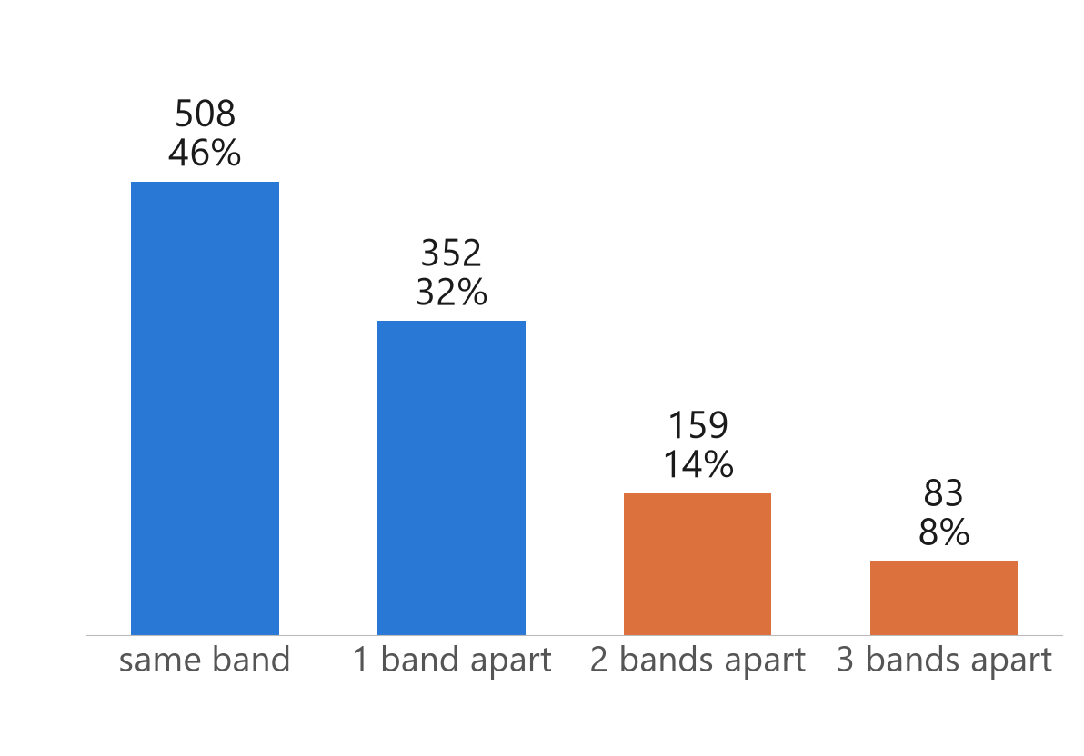
DATA QUALITY CHECK
DATA CHECK
Do a Student's SGPA and CGPA Agree?
78%
22%
860 within 1 band
242 are 2–3 apart
CGPA averages many semesters, so it moves slowly
CSE 4112 · Machine Learning Lab · What Shapes Student CGPA?
Notes:
For each of the 1102 students with a real SGPA, we compared the recent SGPA group with the CGPA group. 860 students (78%) are in the same group or one group apart. 242 students are 2 or 3 groups apart. Because CGPA is an average of all semesters, a gap that big should be rare.

Slide 11
DATA QUALITY CHECK
DATA CHECK
One Semester Moves CGPA Only a Little
Example: a bad semester
Example: a great semester
• CGPA 3.80 after 5 semesters
• 6th semester SGPA: 2.80
• New CGPA: 3.63
• Group moves only C3 → C2
• CGPA 3.00 after 5 semesters
• 6th semester SGPA: 4.00
• New CGPA: 3.17
• Group stays C0
Big gaps can happen for a few students. When many answers in one group show them, we check that group.
CSE 4112 · Machine Learning Lab · What Shapes Student CGPA?
Notes:
Simple arithmetic: new CGPA = (5 × old CGPA + new SGPA) / 6. A very bad semester (3.80 then 2.80) gives 3.63, a very good semester (3.00 then 4.00) gives 3.17. So a big SGPA/CGPA gap is possible for a few students, but it should not be common.

Slide 12
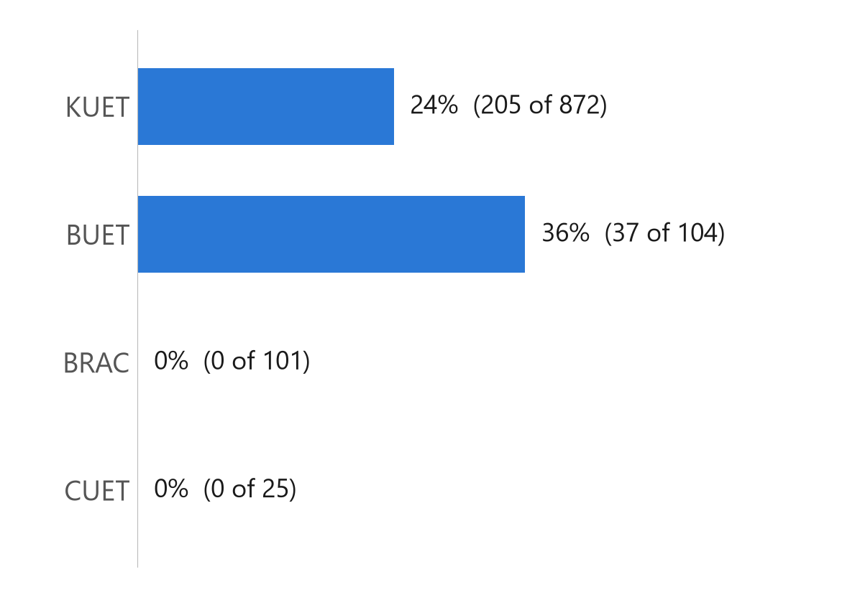
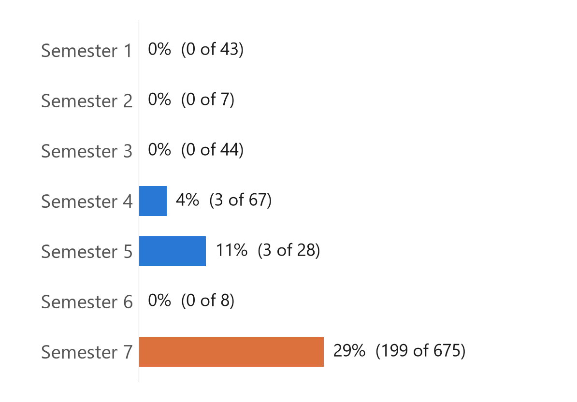
DATA QUALITY CHECK
DATA CHECK
Where Were the Big Gaps?
By university (2–3 bands apart)
KUET, by semester
KUET has 205 of the 242 big gaps
KUET semester 7: 199 of 675 (29%)
CSE 4112 · Machine Learning Lab · What Shapes Student CGPA?
Notes:
BRAC and CUET have no big gaps. BUET has 37 of 104, KUET has 205 of 872. Inside KUET almost all big gaps are in semester 7 (199 of 675). Other KUET semesters have 0 to 3 each. BUET was not removed: the numbers are smaller and there is no single time pattern.

Slide 13
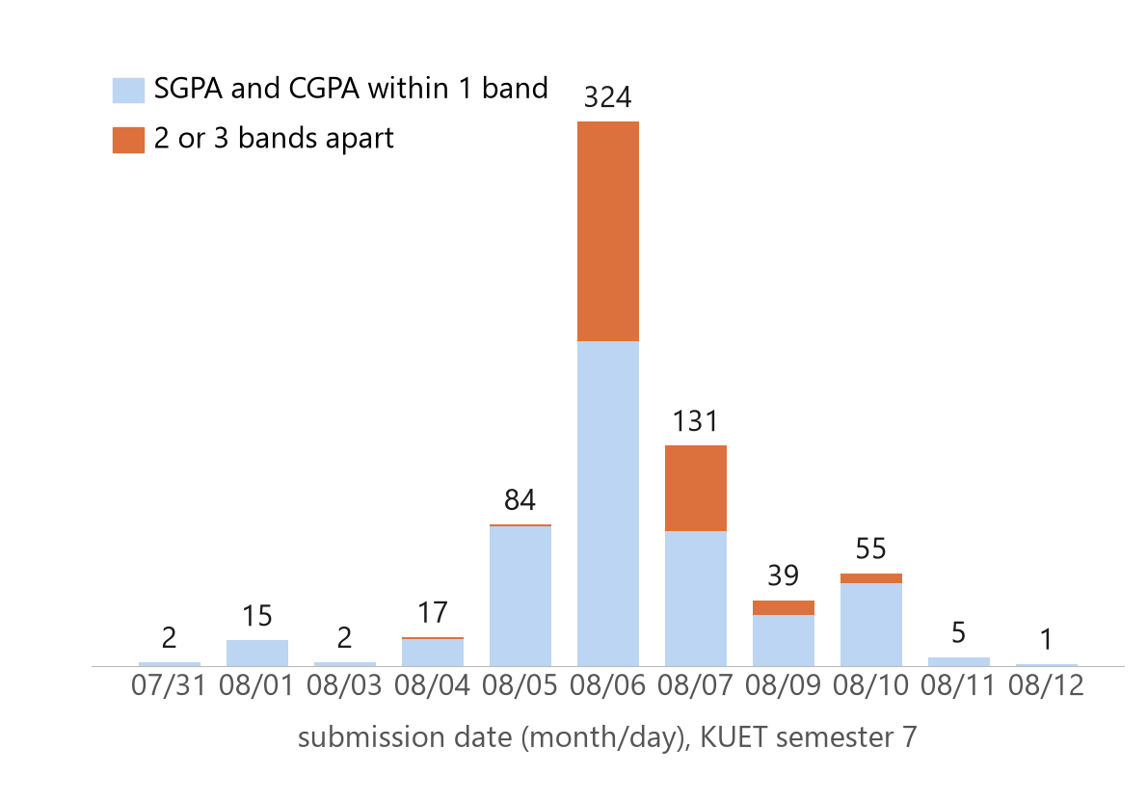
DATA QUALITY CHECK
DATA CHECK
When Were These Answers Submitted?
40%
of the 6–7 Aug answers had a big gap (182 of 455)
CSE 4112 · Machine Learning Lab · What Shapes Student CGPA?
Notes:
KUET semester-7 answers came in over two weeks. On 6 and 7 August we got 455 answers in two days, and 182 of them (40%) had a big SGPA/CGPA gap. Before 6 August only 2 of 120 did. The form is anonymous, so we do not know who filled these answers, only that this group looks different.

Slide 14
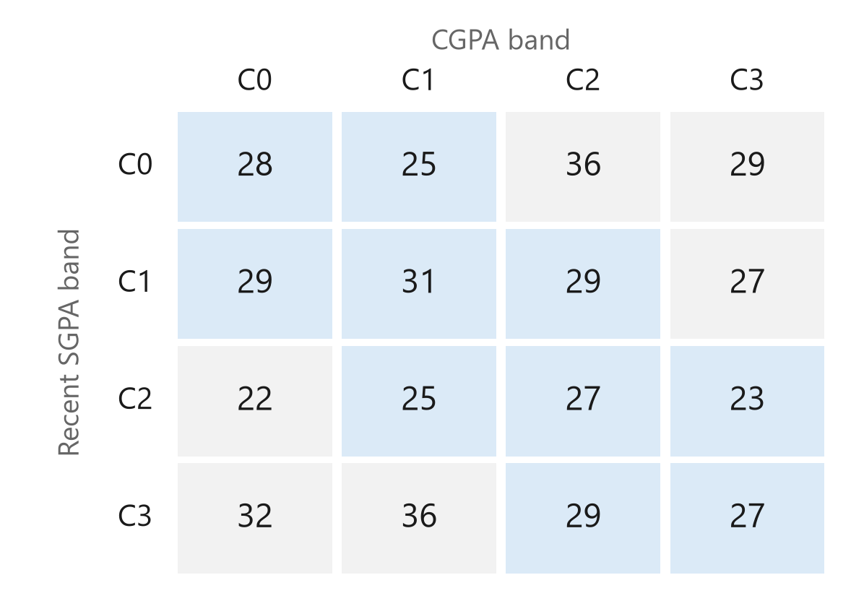
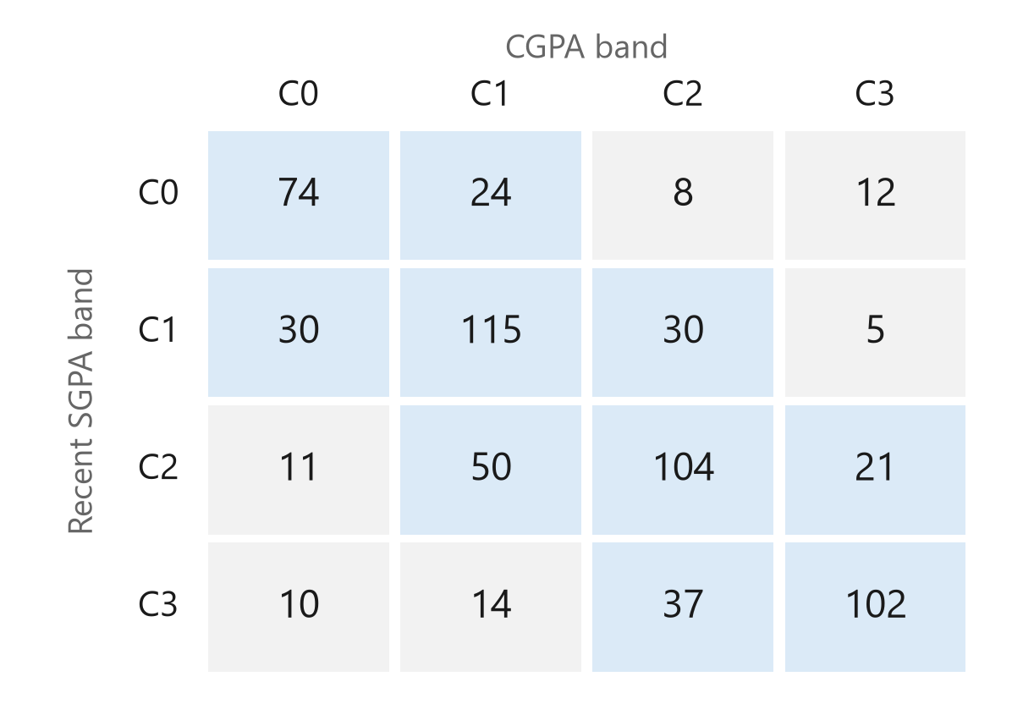
DATA QUALITY CHECK
DATA CHECK
The 6–7 August Answers Look Random
6–7 Aug, KUET semester 7 (455)
All other students (647)
Answers spread over every cell
Most answers sit near the diagonal
CSE 4112 · Machine Learning Lab · What Shapes Student CGPA?
Notes:
Each table counts students by recent SGPA group (rows) and CGPA group (columns). Blue cells = same group or one group apart. For most students the numbers sit near the diagonal (SGPA-CGPA correlation 0.62). In the 6-7 August group the numbers are spread almost evenly (correlation -0.04), which is what random picking looks like.

Slide 15
DATA QUALITY CHECK
DATA CHECK
What We Kept and What We Removed
1,108 clean rows
Keep rows with a real SGPA
Check SGPA vs CGPA
920 final rows
6 rows with no real SGPA
removed
455 answers from 6–7 Aug
checked
273 with a gap of 0–1 band
kept
182 with a gap of 2–3 bands
removed
Result satisfaction question
not used (subjective)
CSE 4112 · Machine Learning Lab · What Shapes Student CGPA?
Notes:
From 1,108 clean rows we kept the 1102 with a real recent SGPA. From the 455 answers sent on 6-7 August we kept 273 whose SGPA and CGPA are at most one group apart, and removed 182 with a gap of 2 or 3 groups. That leaves 920 rows, about 83% of the data. We also do not use the result satisfaction question, because it depends on each student's own goals.

Slide 16
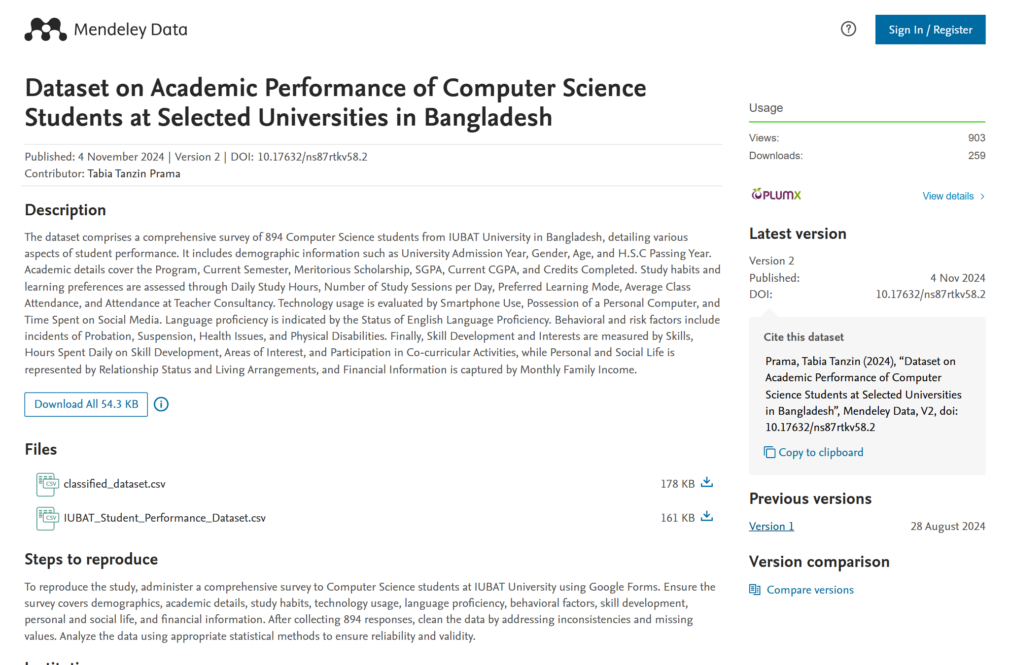
REFERENCE DATASET
DATASET
What Do Existing Student Datasets Look Like?
CSE 4112 · Machine Learning Lab · What Shapes Student CGPA?
12
Notes:
Teacher er suggestion onujayi reference dataset er screenshot rakhsi. Eta IUBAT er 894 jon Computer Science student er dataset, Mendeley Data te public. Ekhane attendance, daily study hour, social media hour, previous SGPA, current CGPA ache. Classified copy te performance category ache. Amra dekhte chaisi existing dataset e kon feature gula common.

Slide 17
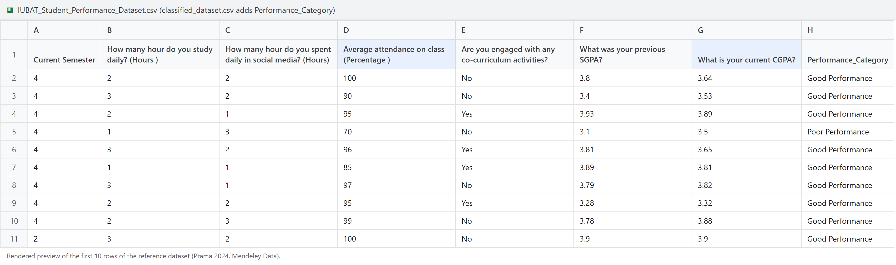
REFERENCE DATASET
DATASET
What Do Existing Student Datasets Look Like?
894
31
Numbers
4 levels
IUBAT Computer Science students
questions / columns
CGPA and SGPA typed as numbers
performance category in classified copy
CSE 4112 · Machine Learning Lab · What Shapes Student CGPA?
12
Notes:
Teacher er suggestion onujayi reference dataset er screenshot rakhsi. Eta IUBAT er 894 jon Computer Science student er dataset, Mendeley Data te public. Ekhane attendance, daily study hour, social media hour, previous SGPA, current CGPA ache. Classified copy te performance category ache. Amra dekhte chaisi existing dataset e kon feature gula common.

Slide 18
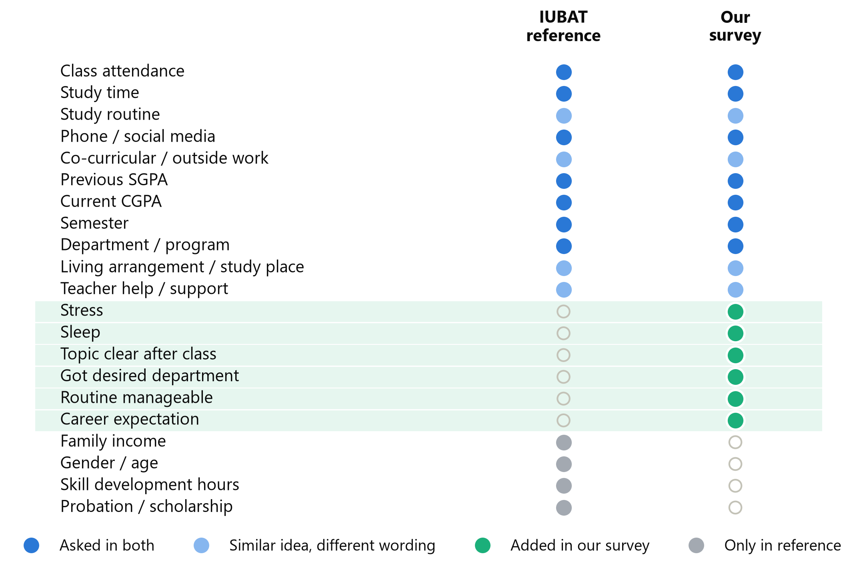
REFERENCE DATASET
DATASET
What Is Similar and What Did We Add?
7
4
asked in both
similar idea
6 added in our survey
• Stress
• Sleep
• Topic clear after class
• Got desired department
• Routine manageable
• Career expectation
Reference stores exact numeric CGPA / SGPA; our form uses bands (C0–C3)
CSE 4112 · Machine Learning Lab · What Shapes Student CGPA?
13
Notes:
Reference er sathe amader form compare korle 7 ta topic duitatei ache — attendance, study time, social media, previous SGPA, CGPA. Ar amra notun add korsi stress, sleep, topic clarity, desired department, routine, career expectation. Mane amader dataset familiar idea follow kore, kintu motivation ar environment related question beshi.

Slide 19
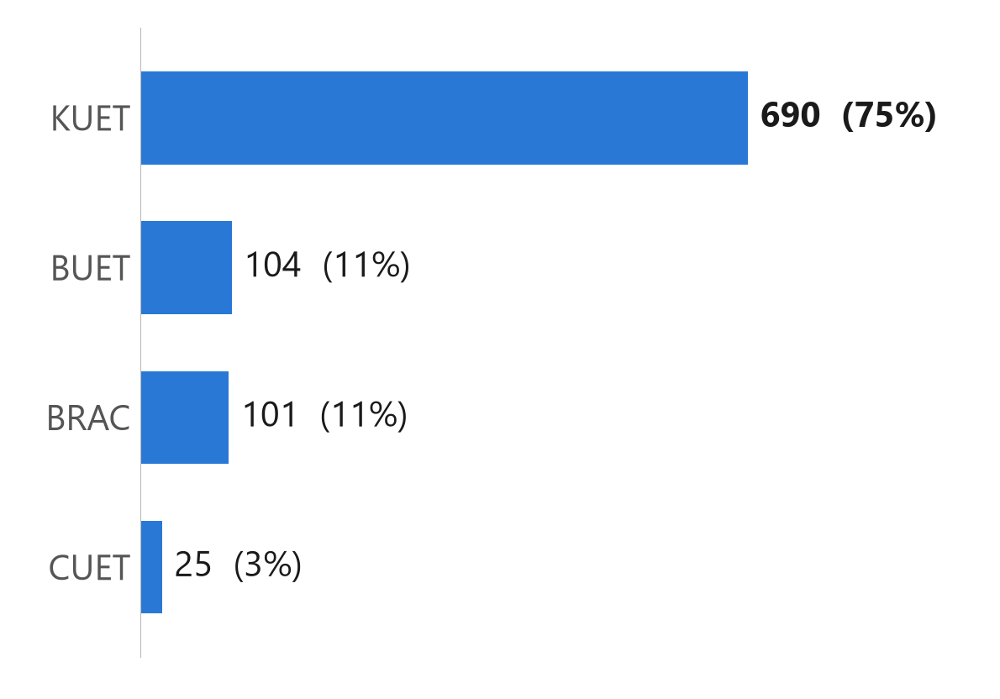
DATASET STATISTICS
DATASET
Which universities are in the Dataset?
920
students in the final dataset
CSE 4112 · Machine Learning Lab · What Shapes Student CGPA?
16
Notes:
After the data check we have 920 students. The universities are not equal: KUET 690 (75.0%), BUET 104, BRAC 101, CUET 25. So we cannot say the results apply equally to every university.

Slide 20
DATASET STATISTICS
DATASET
We Predicted Four CGPA Groups
C0
C1
C2
C3
CGPA below 3.20
CGPA 3.20 to 3.49
CGPA 3.50 to 3.74
CGPA 3.75 and above
182
284
264
190
students · 19.8%
students · 30.9%
students · 28.7%
students · 20.7%
The form collected CGPA ranges, not exact numbers → a four-group classification problem.
CSE 4112 · Machine Learning Lab · What Shapes Student CGPA?
17
Notes:
The form collected CGPA ranges, not exact numbers, so we made four groups: C0 below 3.20 (182 students), C1 3.20 to 3.49 (284), C2 3.50 to 3.74 (264), C3 3.75 or above (190). This is a four-class classification problem. These C0-C3 labels stay the same on every slide.

Slide 21
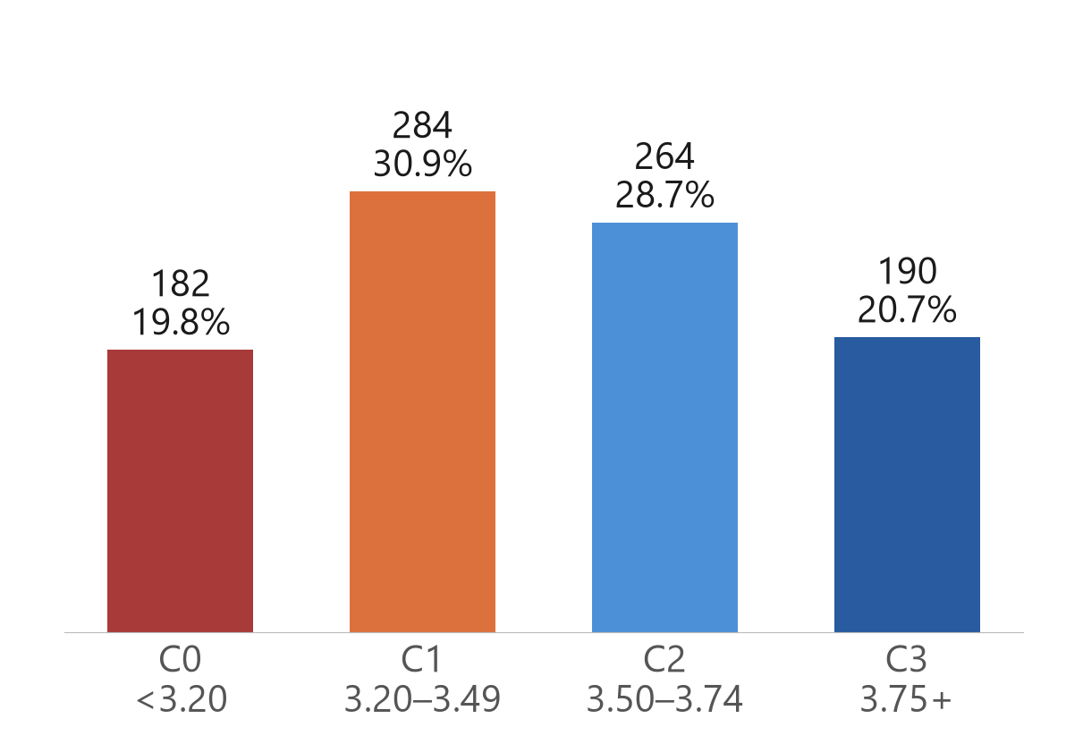
DATASET STATISTICS
DATASET
How Are Students Distributed Across CGPA Groups?
Class shares are close enough for direct evaluation
CSE 4112 · Machine Learning Lab · What Shapes Student CGPA?
18
Notes:
Before building models we checked that no group dominates. The largest group is C1 (30.9%), the smallest is C0 (19.8%). The four groups are roughly balanced, so accuracy is a fair measure.

Slide 22
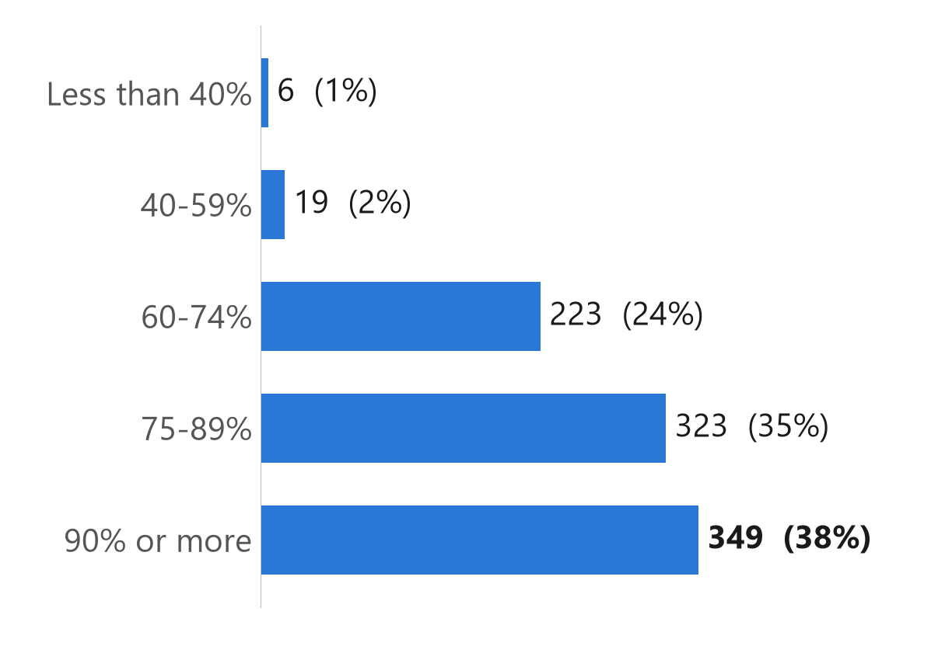
WHAT STUDENTS ANSWERED
OBSERVED PATTERNS
How Often Do Students Attend Classes?
349 · 37.9%
most common: 90% or more
672 · 73.0%
attend 75% or more
25 · 2.7%
attend below 60%
CSE 4112 · Machine Learning Lab · What Shapes Student CGPA?
19
Notes:
This slide only shows answers, no prediction. The most common answer is '90% or more' (349 students). 73.0% attend 75% or more, and only 25 attend below 60%.

Slide 23
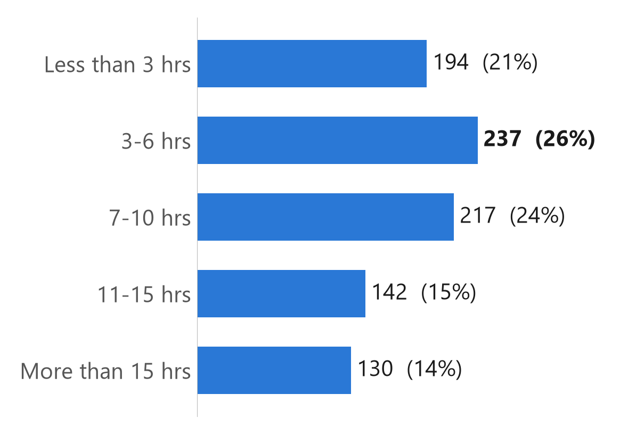
WHAT STUDENTS ANSWERED
OBSERVED PATTERNS
How Much Time Do Students Study?
237 · 25.8%
most common: 3–6 hrs a week
194 · 21.1%
study less than 3 hrs a week
272 · 29.6%
study more than 10 hrs a week
CSE 4112 · Machine Learning Lab · What Shapes Student CGPA?
20
Notes:
Study time outside class. Most students study 3-6 hrs a week (237 students). 194 study less than 3 hours, and 272 study more than 10 hours.

Slide 24
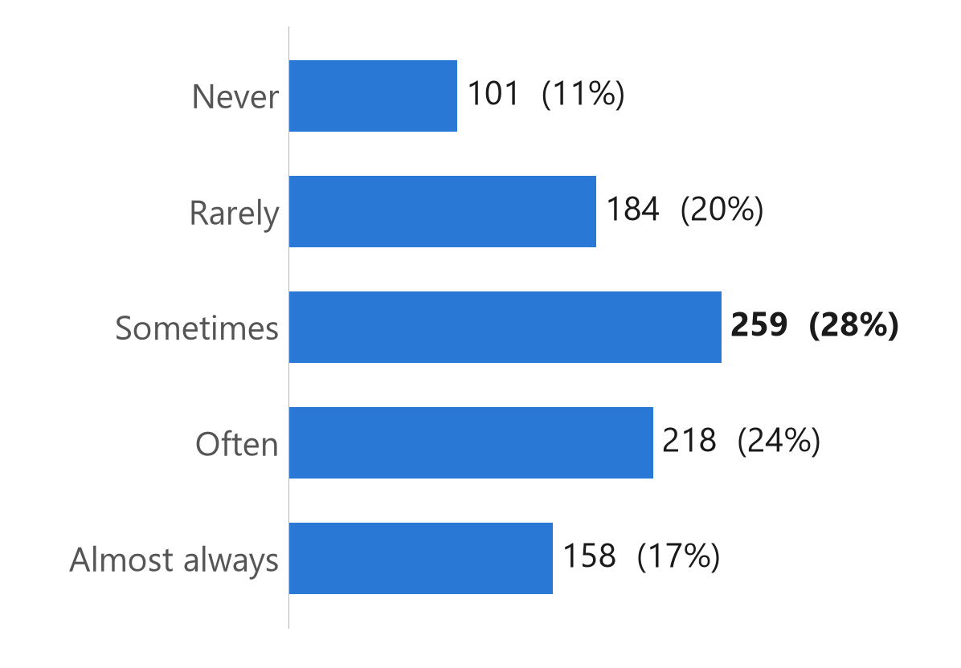
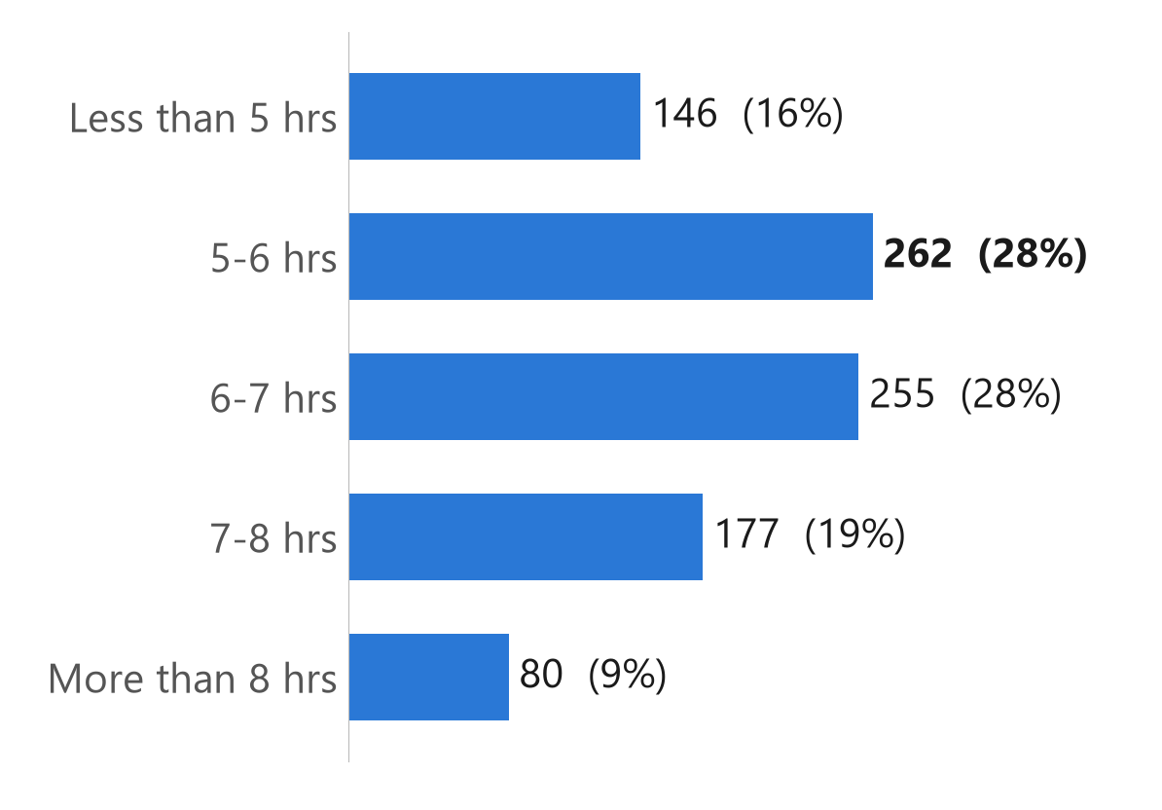
WHAT STUDENTS ANSWERED
OBSERVED PATTERNS
What Do Students Report About Stress and Sleep?
Stress made studying difficult
Sleep on a normal night
Often + almost always: 376 students (40.9%)
Under 6 hours: 408 students (44.3%)
CSE 4112 · Machine Learning Lab · What Shapes Student CGPA?
21
Notes:
40.9% of students say stress often or almost always made studying difficult. 44.3% sleep less than 6 hours. Here we only describe answers; links with results come later.

Slide 25
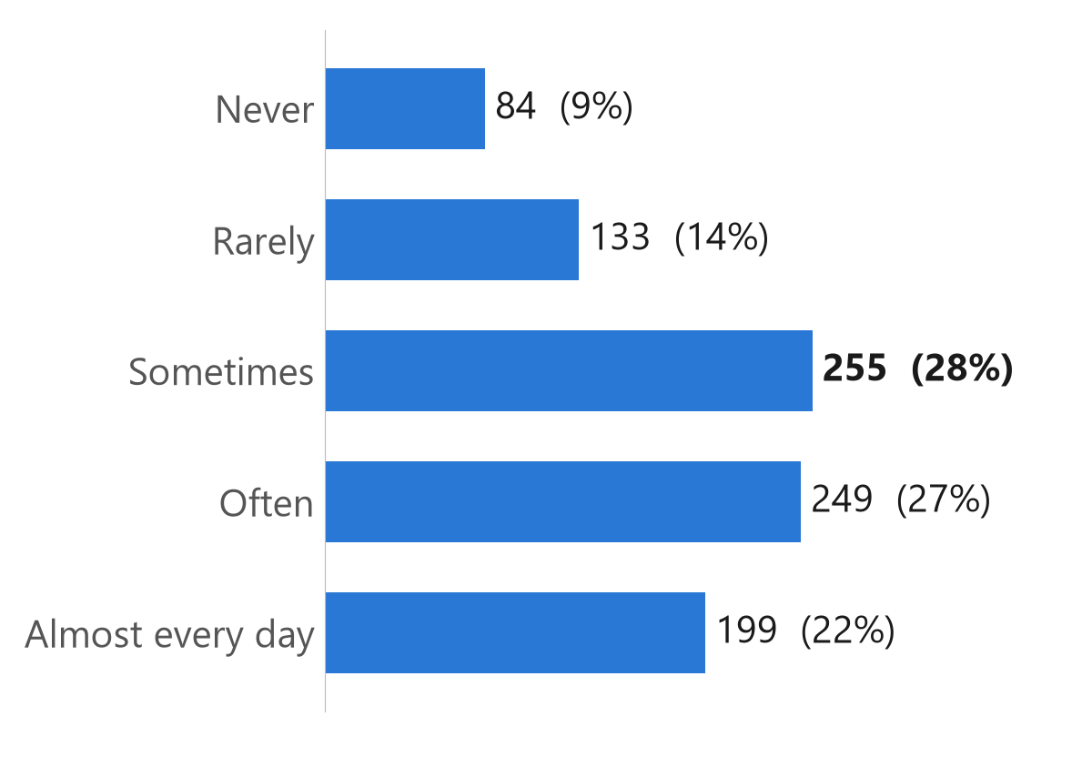
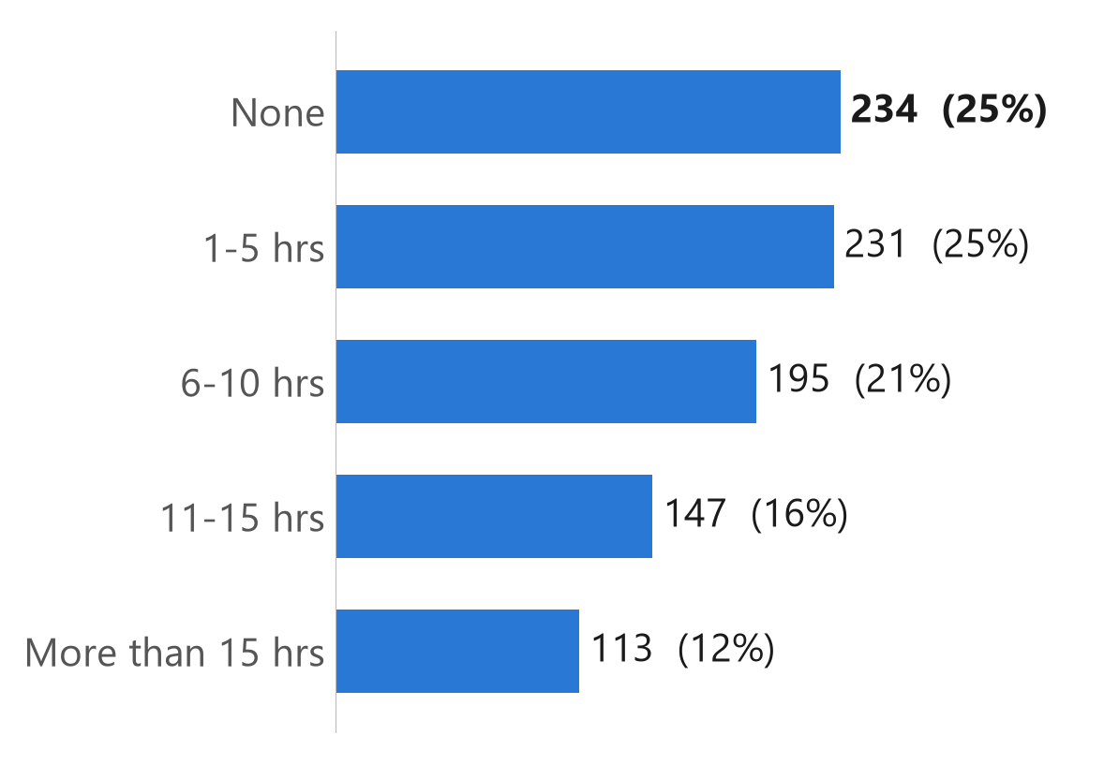
WHAT STUDENTS ANSWERED
OBSERVED PATTERNS
Distraction and Outside Commitments
Phone / gaming / social media took study time
Outside commitments: tuition, job, club hours
Often + almost every day: 448 (48.7%)
6 hours or more: 455 (49.5%)
CSE 4112 · Machine Learning Lab · What Shapes Student CGPA?
22
Notes:
48.7% say phone or social media often or almost every day took their study time. 49.5% spend 6 or more hours a week on tuition, job or club work.

Slide 26
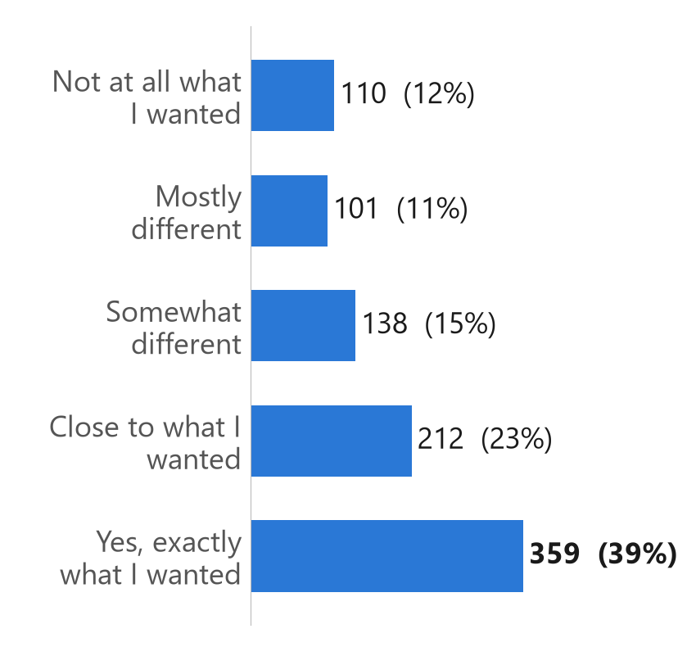
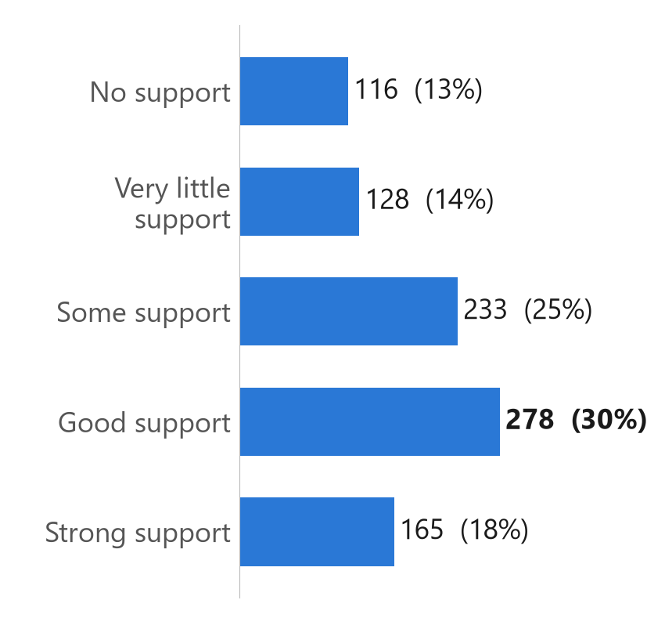
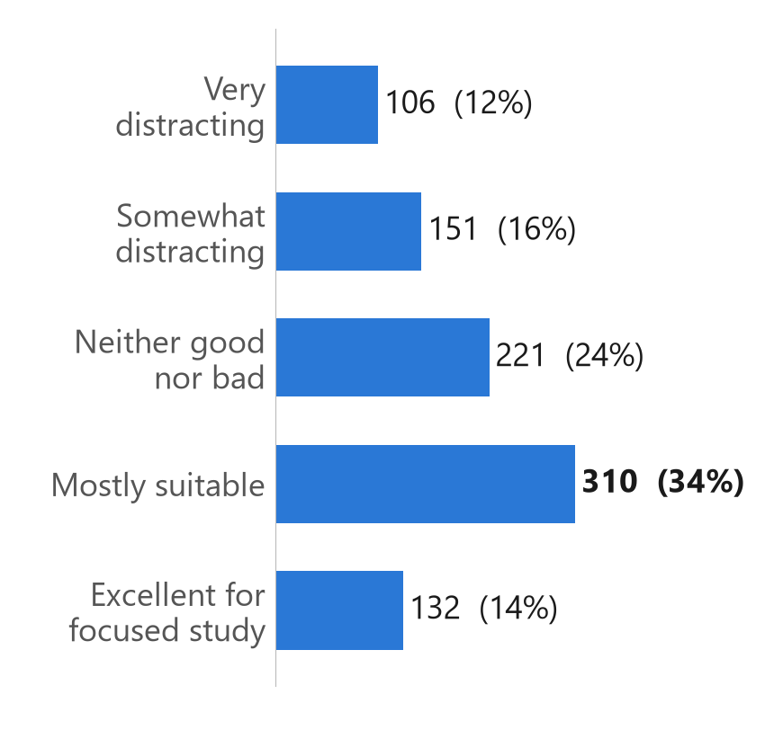
WHAT STUDENTS ANSWERED
OBSERVED PATTERNS
Motivation, Support and Study Environment
Got desired department
Family / friend support
Study-friendly living place
Exactly what I wanted: 359 (39.0%)
Good + strong: 443 (48.2%)
Mostly suitable + excellent: 442 (48.0%)
CSE 4112 · Machine Learning Lab · What Shapes Student CGPA?
23
Notes:
39.0% got exactly the department they wanted. 48.2% get good or strong support from family or friends, and 48.0% say their living place is mostly suitable or excellent for study.

Slide 27
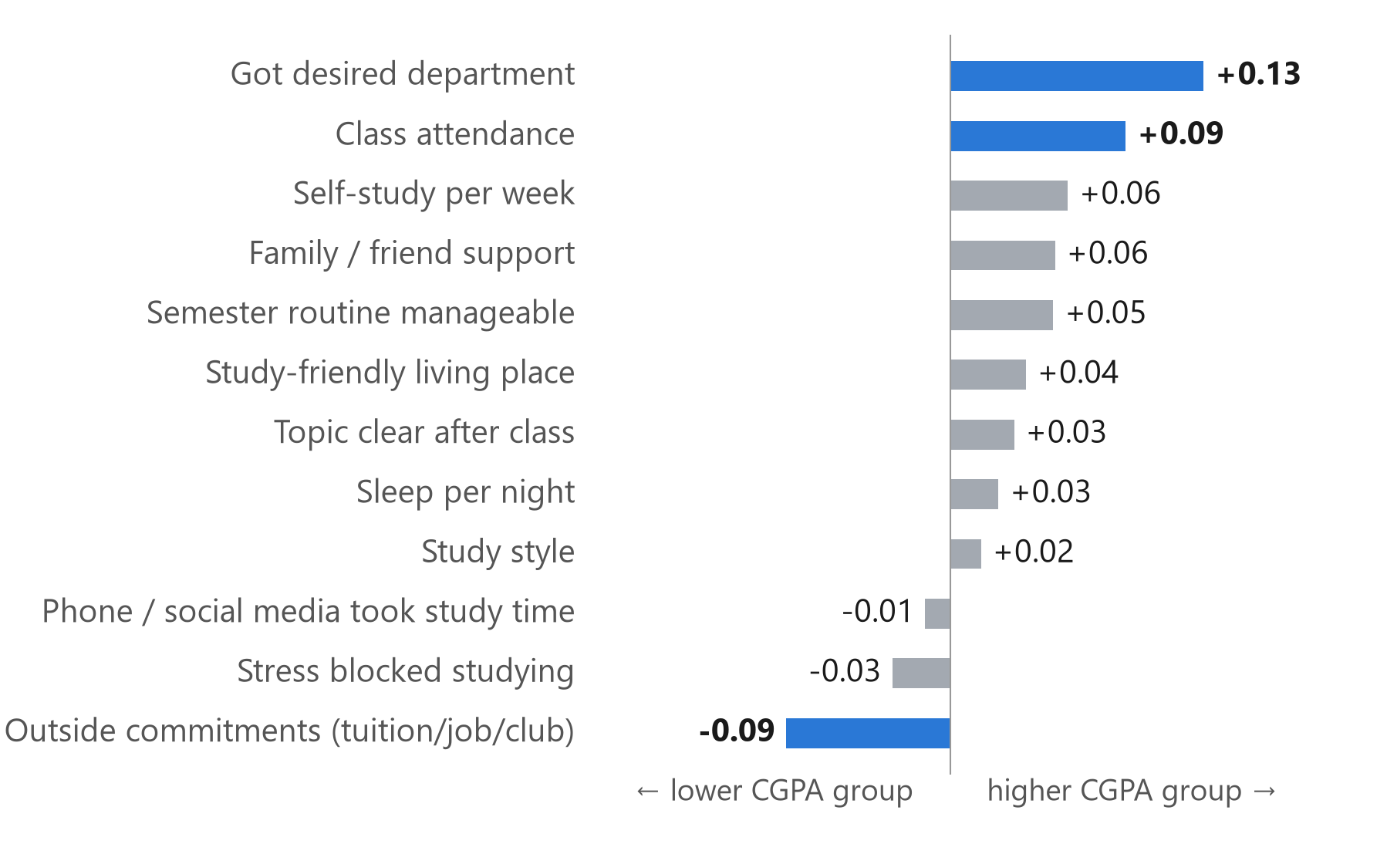
OBSERVED PATTERNS
OBSERVED PATTERNS
Which Student Features Move With CGPA?
⬆
Got desired department
small positive pattern (+0.13)
⬆
Class attendance
small positive pattern (+0.09)
⬇
Outside commitments
small negative pattern (-0.09)
Larger number = stronger pattern, and all are small. Associations, not causes. Blue = reliable after checking.
CSE 4112 · Machine Learning Lab · What Shapes Student CGPA?
24
Notes:
Out of 12 behaviour questions, 3 patterns were reliable after checking: getting the desired department and higher attendance go with a higher CGPA group, and more tuition/job/club hours go with a lower group. All links are small (the largest is 0.13), so we say 'associated', not 'causes'.

Slide 28
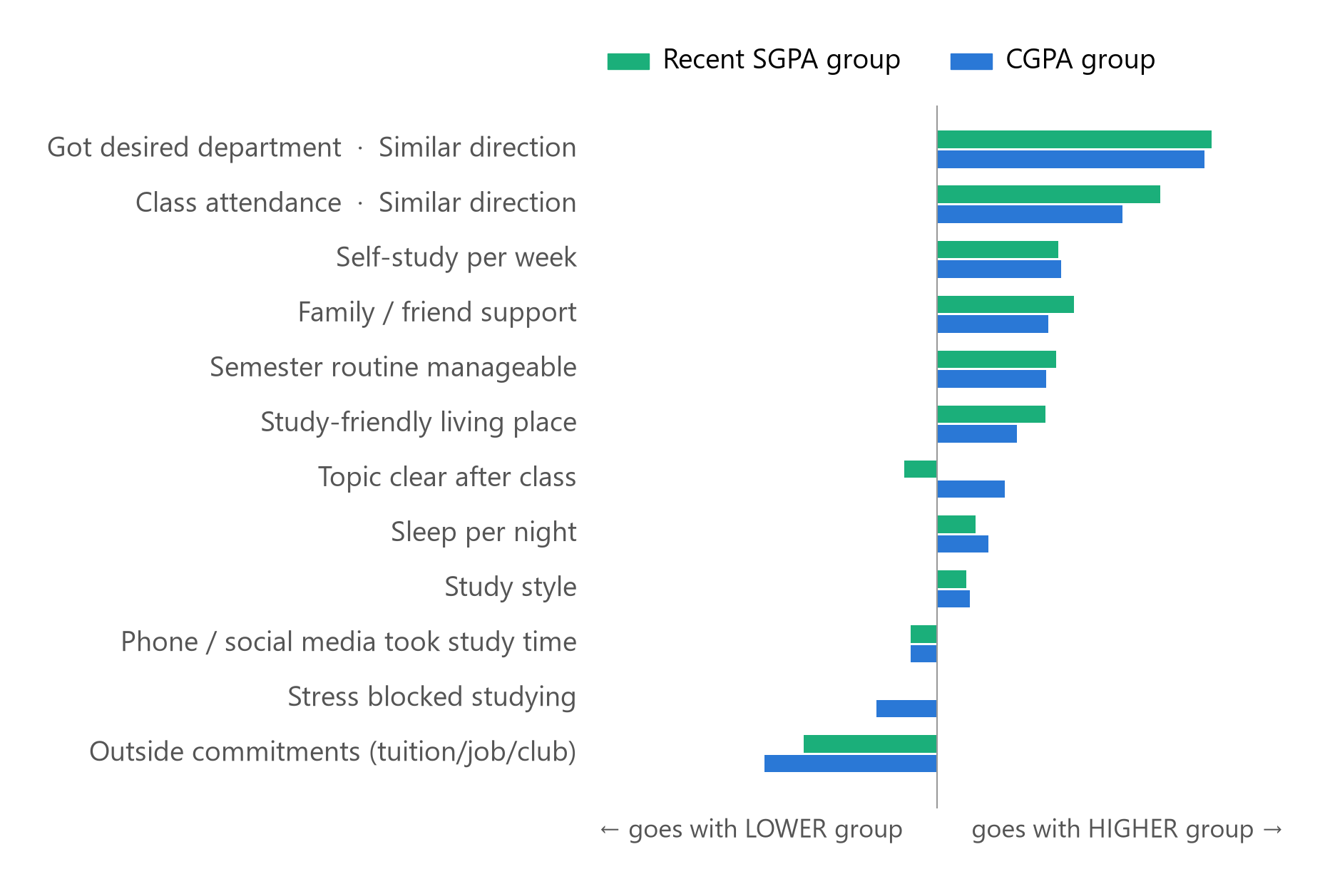
SGPA + CGPA PATTERNS
SGPA + CGPA PATTERNS
Do SGPA and CGPA Show the Same Patterns?
Class attendance
same direction: SGPA +0.11, CGPA +0.09
Got desired department
same direction: SGPA +0.14, CGPA +0.13
10 other questions
too weak to claim a matching pattern
CSE 4112 · Machine Learning Lab · What Shapes Student CGPA?
38
Notes:
We checked whether each answer moves in the same direction for SGPA and CGPA. Attendance and getting the desired department go the same way for both. The other 10 questions are too weak to claim a matching pattern.

Slide 29
Attendance and CGPA
C0 < 3.20
C1 3.20–3.49
C2 3.50–3.74
C3 ≥ 3.75
Less than 40%
33%
17%
33%
17%
n=6
Attendance
40-59%
21%
37%
26%
16%
n=19
60-74%
22%
31%
30%
17%
n=223
75-89%
20%
34%
28%
19%
n=323
90% or more
17%
28%
29%
26%
n=349
CGPA
Notes:
Source: docs/final_results.json (920 students after the data check). Each bar = 100% of the students who chose that answer.

Slide 30
Weekly study time and CGPA
C0 < 3.20
C1 3.20–3.49
C2 3.50–3.74
C3 ≥ 3.75
Less than 3 hrs
23%
29%
31%
17%
n=194
Study Time
3-6 hrs
24%
30%
29%
17%
n=237
7-10 hrs
14%
32%
30%
24%
n=217
11-15 hrs
18%
35%
25%
22%
n=142
More than 15 hrs
19%
28%
26%
26%
n=130
CGPA
Notes:
Source: docs/final_results.json (920 students after the data check). Each bar = 100% of the students who chose that answer.

Slide 31
Study style and CGPA
C0 < 3.20
C1 3.20–3.49
C2 3.50–3.74
C3 ≥ 3.75
Occasionally when necessary
20%
24%
31%
25%
n=240
Study Style
Mostly just before exams
25%
34%
26%
16%
n=257
Regularly but not every day
16%
38%
28%
18%
n=218
Mostly consistent routine
19%
29%
30%
22%
n=110
Consistent throughout the semester
16%
25%
32%
27%
n=95
CGPA
Notes:
Source: docs/final_results.json (920 students after the data check). Each bar = 100% of the students who chose that answer.

Slide 32
Topic clarity and CGPA
C0 < 3.20
C1 3.20–3.49
C2 3.50–3.74
C3 ≥ 3.75
Almost nothing
21%
34%
27%
18%
n=149
Topic Clarity
A little
21%
29%
26%
24%
n=220
About half
18%
33%
31%
17%
n=267
Most of it
18%
29%
32%
21%
n=191
Almost everything
23%
28%
23%
27%
n=93
CGPA
Notes:
Source: docs/final_results.json (920 students after the data check). Each bar = 100% of the students who chose that answer.

Slide 33
Sleep and CGPA
C0 < 3.20
C1 3.20–3.49
C2 3.50–3.74
C3 ≥ 3.75
Less than 5 hrs
18%
38%
25%
18%
n=146
Sleep
5-6 hrs
20%
27%
32%
20%
n=262
6-7 hrs
19%
34%
27%
19%
n=255
7-8 hrs
18%
28%
28%
26%
n=177
More than 8 hrs
26%
25%
29%
20%
n=80
CGPA
Notes:
Source: docs/final_results.json (920 students after the data check). Each bar = 100% of the students who chose that answer.

Slide 34
Stress and CGPA
C0 < 3.20
C1 3.20–3.49
C2 3.50–3.74
C3 ≥ 3.75
Never
21%
33%
25%
22%
n=101
Stress
Rarely
18%
28%
38%
17%
n=184
Sometimes
16%
34%
27%
23%
n=259
Often
20%
35%
22%
22%
n=218
Almost always
27%
22%
33%
18%
n=158
CGPA
Notes:
Source: docs/final_results.json (920 students after the data check). Each bar = 100% of the students who chose that answer.

Slide 35
Phone distraction and CGPA
C0 < 3.20
C1 3.20–3.49
C2 3.50–3.74
C3 ≥ 3.75
Never
21%
20%
33%
25%
n=84
Phone Distraction
Rarely
21%
27%
35%
17%
n=133
Sometimes
17%
36%
29%
18%
n=255
Often
19%
33%
26%
22%
n=249
Almost every day
23%
29%
26%
23%
n=199
CGPA
Each bar = 100% of students choosing that answer. Descriptive association, N = 920.
Notes:
Source: docs/final_results.json (920 students after the data check). Each bar = 100% of the students who chose that answer.

Slide 36
Outside commitments and CGPA
C0 < 3.20
C1 3.20–3.49
C2 3.50–3.74
C3 ≥ 3.75
None
20%
26%
29%
26%
n=234
Outside commitments
1-5 hrs
20%
29%
28%
24%
n=231
6-10 hrs
16%
37%
30%
16%
n=195
11-15 hrs
22%
31%
30%
16%
n=147
More than 15 hrs
22%
35%
27%
16%
n=113
CGPA
Notes:
Source: docs/final_results.json (920 students after the data check). Each bar = 100% of the students who chose that answer.

Slide 37
Desired department and CGPA
C0 < 3.20
C1 3.20–3.49
C2 3.50–3.74
C3 ≥ 3.75
Not at all what I wanted
26%
33%
26%
15%
n=110
Desired Department
Mostly different
34%
23%
24%
20%
n=101
Somewhat different
21%
38%
26%
14%
n=138
Close to what I wanted
18%
29%
29%
25%
n=212
Yes, exactly what I wanted
14%
31%
32%
23%
n=359
CGPA
Notes:
Source: docs/final_results.json (920 students after the data check). Each bar = 100% of the students who chose that answer.

Slide 38
Support and CGPA
C0 < 3.20
C1 3.20–3.49
C2 3.50–3.74
C3 ≥ 3.75
No support
23%
26%
31%
20%
n=116
Family Support
Very little support
27%
27%
27%
20%
n=128
Some support
18%
40%
24%
17%
n=233
Good support
15%
29%
32%
24%
n=278
Strong support
22%
28%
30%
21%
n=165
CGPA
Notes:
Source: docs/final_results.json (920 students after the data check). Each bar = 100% of the students who chose that answer.

Slide 39
Study environment and CGPA
C0 < 3.20
C1 3.20–3.49
C2 3.50–3.74
C3 ≥ 3.75
Very distracting
33%
24%
23%
21%
n=106
Study Environment
Somewhat distracting
21%
32%
25%
22%
n=151
Neither good nor bad
15%
35%
31%
19%
n=221
Mostly suitable
15%
31%
34%
21%
n=310
Excellent for focused study
27%
28%
22%
23%
n=132
CGPA
Notes:
Source: docs/final_results.json (920 students after the data check). Each bar = 100% of the students who chose that answer.

Slide 40
Routine manageability and CGPA
C0 < 3.20
C1 3.20–3.49
C2 3.50–3.74
C3 ≥ 3.75
Completely unmanageable
27%
32%
31%
10%
n=127
Routine manageability
Difficult to manage
21%
30%
21%
28%
n=226
Average
16%
33%
32%
19%
n=290
Mostly manageable
17%
30%
32%
22%
n=195
Very healthy and balanced
24%
27%
28%
21%
n=82
CGPA
Notes:
Source: docs/final_results.json (920 students after the data check). Each bar = 100% of the students who chose that answer.

Slide 41
FRAMEWORK
SGPA PREDICTION
How the Model Learns
1
2
3
4
5
Student answers
Training students
Decision Tree learns rules
New test student
Predicted group
12 questions
736 (80%)
IF … AND … → group
184 (20%)
C0 · C1 · C2 · C3
Training data teaches the rules. Test data checks whether the rules work on students the model has never seen.
CSE 4112 · Machine Learning Lab · What Shapes Student CGPA?
28
Notes:
Framework ta simple. Student er answer niye 80% student diye Decision Tree ke train kori — tree IF-AND rule shikhe. Tarpor baki 20% student, jader tree kokhono dekhe nai, tader answer diye group predict kori ar actual result er sathe milai. Training rule shekhay, test check kore rule gula notun student e kaj kore kina.

Slide 42
WEKA target-specific model results
Stratified 5-fold cross-validation, seed 1
WEKA model | QNA -> SGPA prediction | QNA -> CGPA Prediction | QNA + SGPA -> CGPA Prediction
J48 | 26.30% | 27.83% | 54.35%
Random Forest | 32.39% | 30.54% | 54.24%
SMO | 27.93% | 28.15% | 55.22%
Logistic | 29.02% | 30.11% | 54.67%
Naive Bayes | 30.00% | 31.20% | 54.46%
ZeroR | 29.24% | 30.87% | 30.87%
Same 920 students. Questionnaire: 12 inputs. Main CGPA: same inputs + recent SGPA.
Notes:
Source: WEKA 3.8.7 logs in docs/weka_runs/final/ (files ending _cv5.txt). Result satisfaction is not used as an input.

Slide 43
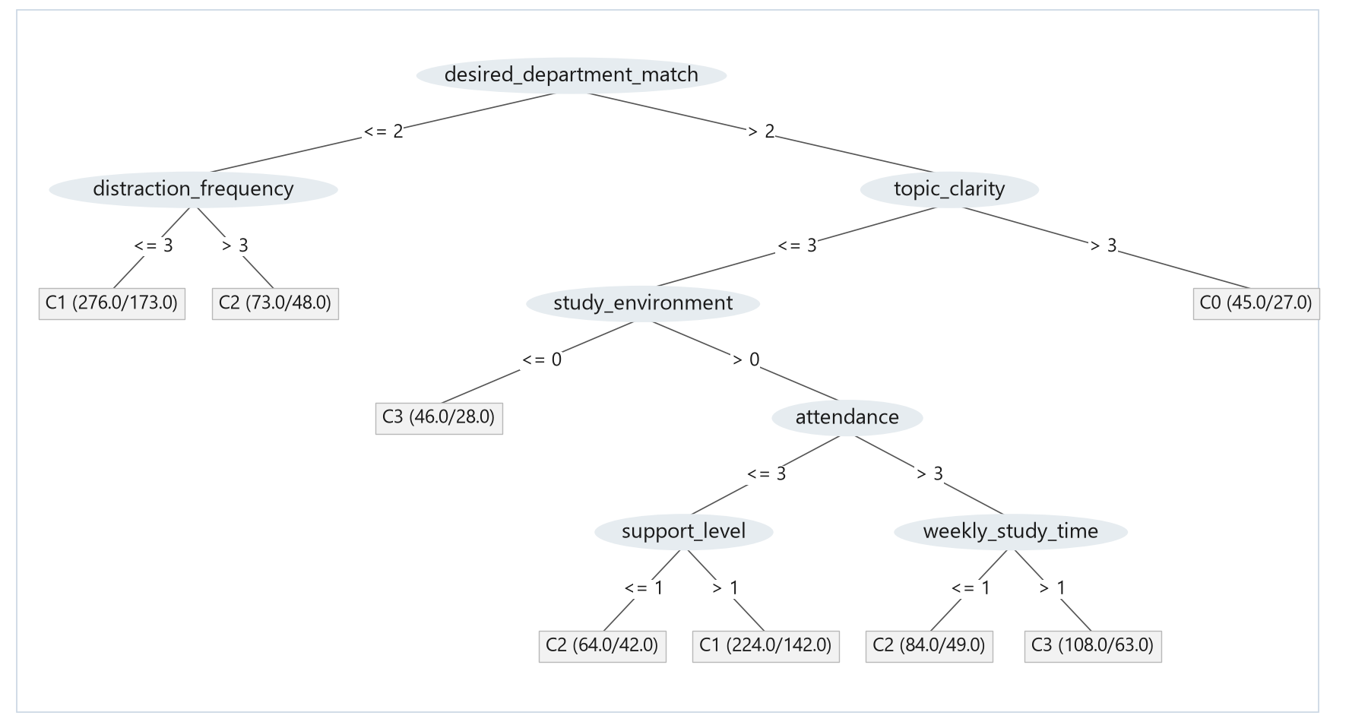
WEKA J48: Recent SGPA
WEKA J48 -C 0.25 -M 40, built on all 920 students. Recent SGPA. 5-fold CV: 26.30%. ZeroR: 29.24%.
Notes:
Tree drawn from the WEKA J48 output (docs/weka_runs/final/sgpa_J48_tree_full.txt). Leaf (N/errors) = students in that leaf / students it places in the wrong group.

Slide 44
WEKA J48: SGPA rules
IF the student did not get the desired department
AND phone does not take study time almost every day
C1
IF got the desired department AND attendance 90% or more
AND self-study is 7 or more hours a week
C3
Selected branches from the preceding WEKA J48 tree. Full text and option codes in backup.
Notes:
Rules come from the WEKA J48 tree in docs/weka_runs/final/sgpa_J48_tree_full.txt. They are predictions, not causes.

Slide 45
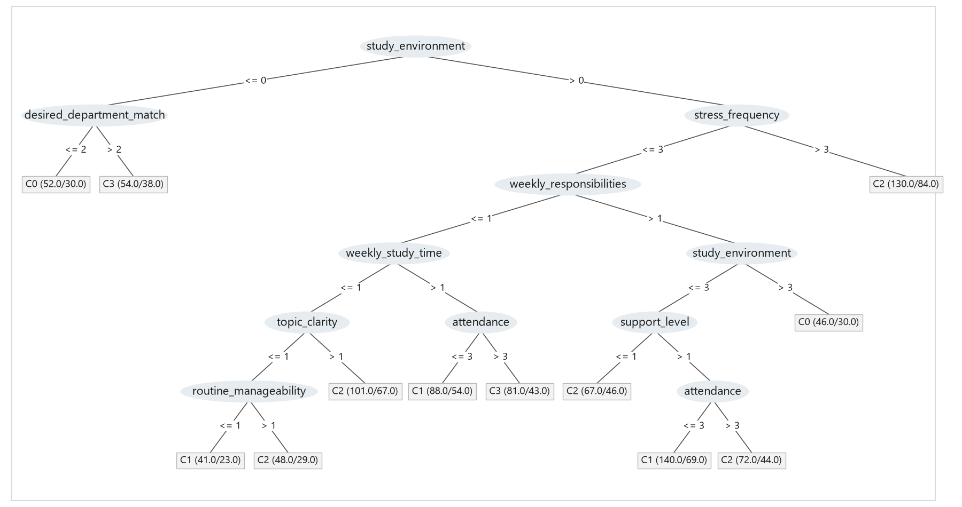
WEKA J48: CGPA from questionnaire variables
WEKA J48 -C 0.25 -M 40, built on all 920 students. CGPA from questionnaire variables. 5-fold CV: 27.83%. ZeroR: 30.87%.
Notes:
Tree drawn from the WEKA J48 output (docs/weka_runs/final/questionnaire_cgpa_J48_tree_full.txt). Leaf (N/errors) = students in that leaf / students it places in the wrong group.

Slide 46
Questionnaire J48 rules
IF the living place is very distracting
AND the student did not get the desired department
C0
IF the living place is not very distracting
AND stress almost always made studying difficult
C2
Selected branches from the preceding WEKA J48 tree. Full text and option codes in backup.
Notes:
Rules come from the WEKA J48 tree in docs/weka_runs/final/questionnaire_cgpa_J48_tree_full.txt. They are predictions, not causes.

Slide 47
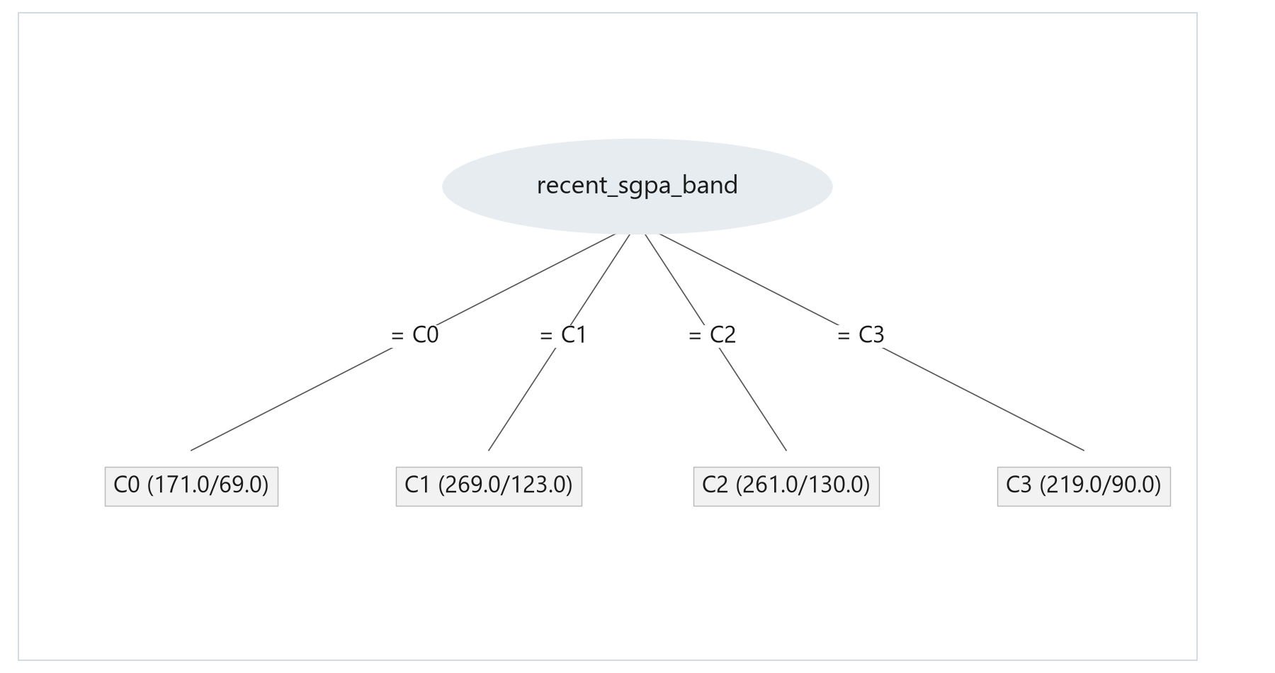
WEKA J48: Main CGPA prediction
WEKA J48 -C 0.25 -M 40, built on all 920 students. Main CGPA prediction. 5-fold CV: 54.35%. ZeroR: 30.87%.
Notes:
Tree drawn from the WEKA J48 output (docs/weka_runs/final/main_cgpa_J48_tree_full.txt). Leaf (N/errors) = students in that leaf / students it places in the wrong group.

Slide 48
Main CGPA J48 rules
IF recent SGPA is below 3.20
C0
IF recent SGPA is 3.20–3.49
C1
IF recent SGPA is 3.50–3.74
C2
IF recent SGPA is 3.75 or higher
C3
The whole WEKA J48 tree: four rules, one for each recent SGPA group.
Notes:
Source: docs/weka_runs/final/main_cgpa_J48_tree_full.txt. With at least 40 students per leaf, J48 keeps only recent SGPA.

Slide 49
WEKA J48: cross-validation and 80/20 test accuracy
Target | 5-fold CV (920) | 80/20 test (184) | ZeroR test
Recent SGPA | 26.30% | 27.17% | 30.43%
CGPA questionnaire | 27.83% | 33.15% | 35.87%
Main CGPA | 54.35% | 51.09% | 35.87%
J48 with minNumObj 40. 5-fold CV on all 920 students; 80/20 = WEKA percentage split, seed 1 (736 train, 184 test).
Notes:
Sources: sgpa_J48_holdout.txt, questionnaire_J48_holdout.txt, main_J48_holdout.txt. All J48 models C=.25 M=40.

Slide 50
WEKA J48: main CGPA test confusion matrix
80/20 split, 184 test students
Predicted
C0
C1
C2
C3
C0 < 3.20
C1 3.20–3.49
C2 3.50–3.74
C3 ≥ 3.75
C0
15
11
4
5
C1
10
35
20
1
C2
1
10
18
17
C3
2
0
9
26
Rows = actual class. Columns = predicted class. Blue cells are correct predictions.
Notes:
Source: docs/weka_runs/final/main_cgpa_J48_split80.txt (WEKA percentage split 80%, seed 1).

Slide 51
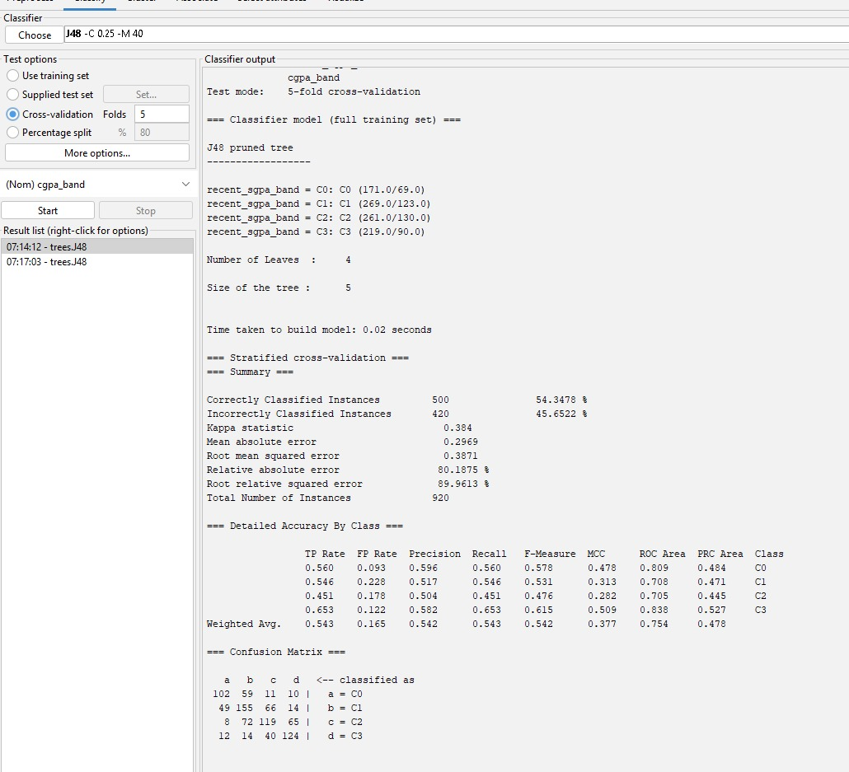
WEKA j48 matrix
J48 5-fold
Predicted
C0
C1
C2
C3
C0
102
59
11
10
C1
49
155
66
14
C2
8
72
119
65
C3
12
14
40
124
Main CGPA, stratified 5-fold cross-validation, N = 920.
Rows actual, columns predicted.
Notes:
Sources: docs/weka_runs/final/main_cgpa_RandomForest_cv5.txt and main_cgpa_SMO_cv5.txt.

Slide 52
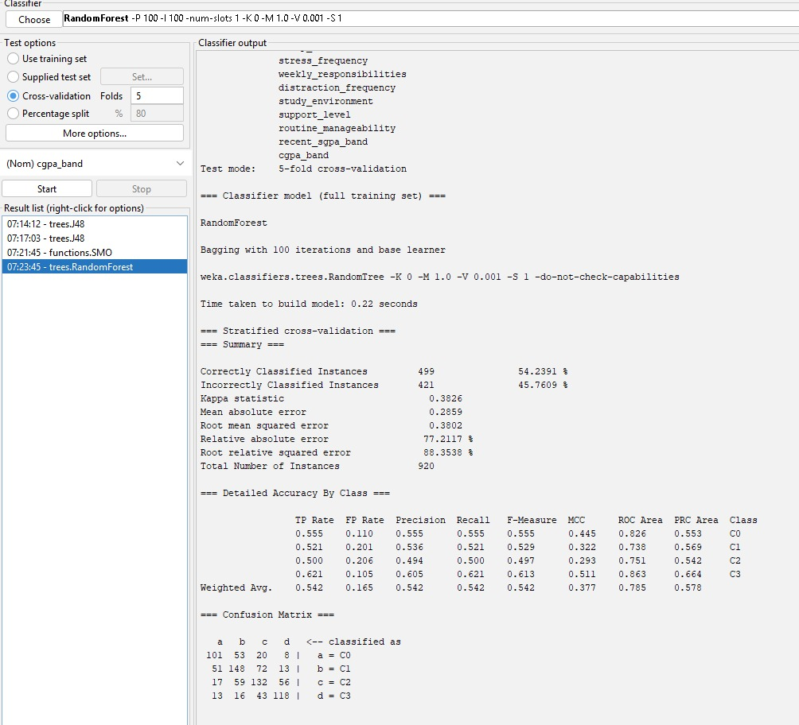
WEKA Random Forest matrix
Random Forest 5-fold
Predicted
C0
C1
C2
C3
C0
101
53
20
8
C1
51
148
72
13
C2
17
59
132
56
C3
13
16
43
118
Main CGPA, stratified 5-fold cross-validation, N = 920.
Rows actual, columns predicted.
Notes:
Sources: docs/weka_runs/final/main_cgpa_RandomForest_cv5.txt and main_cgpa_SMO_cv5.txt.

Slide 53
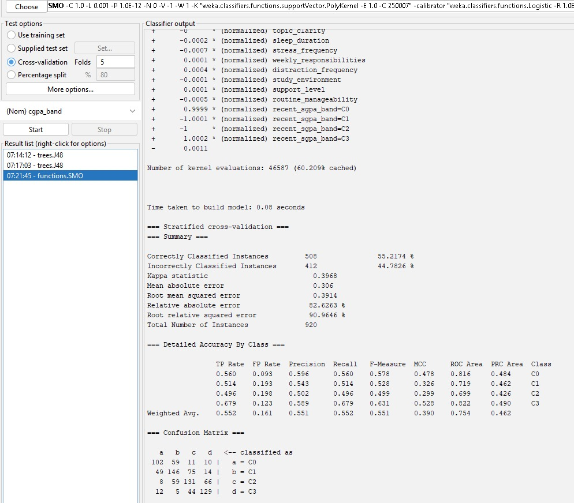
WEKA SMO matrix
SMO 5-fold
Predicted
C0
C1
C2
C3
C0
102
59
11
10
C1
49
146
75
14
C2
8
59
131
66
C3
12
5
44
129
Main CGPA, stratified 5-fold cross-validation, N = 920.
Rows actual, columns predicted.
Notes:
Sources: docs/weka_runs/final/main_cgpa_RandomForest_cv5.txt and main_cgpa_SMO_cv5.txt.

Slide 54
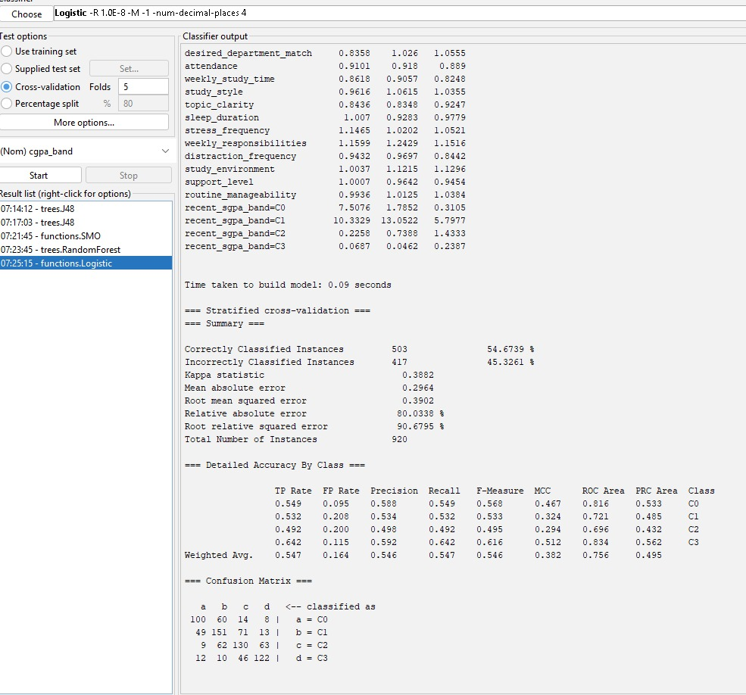
WEKA Logistic matrix
Logistic 5-fold
Predicted
C0
C1
C2
C3
C0
100
60
14
8
C1
49
151
71
13
C2
9
62
130
63
C3
12
10
46
122
Main CGPA, stratified 5-fold cross-validation, N = 920. Rows actual, columns predicted.
Notes:
Sources: docs/weka_runs/final/main_cgpa_Logistic_cv5.txt and main_cgpa_NaiveBayes_cv5.txt.

Slide 55
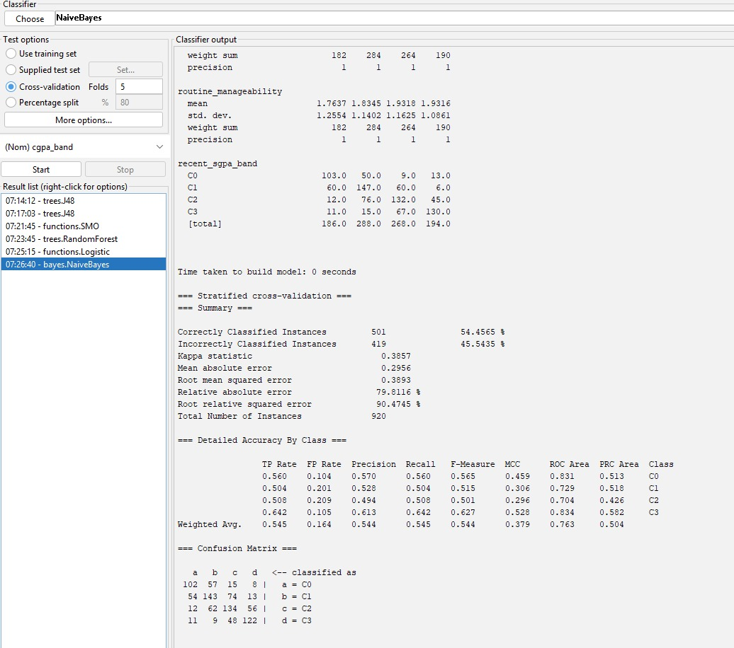
WEKA Naive Bayes matrix
Naive Bayes 5-fold
Predicted
C0
C1
C2
C3
C0
102
57
15
8
C1
54
143
74
13
C2
12
62
134
56
C3
11
9
48
122
Main CGPA, stratified 5-fold cross-validation, N = 920.
Rows actual, columns predicted.
42
Notes:
Sources: docs/weka_runs/final/main_cgpa_Logistic_cv5.txt and main_cgpa_NaiveBayes_cv5.txt.

Slide 56
WEKA ZeroR baseline matrix
Main CGPA, 5-fold CV
Predicted
Always predicts C1
C0
C1
C2
C3
C0
0
182
0
0
C1
0
284
0
0
Every prediction falls
in one column.
C2
0
264
0
0
C3
0
190
0
0
WEKA ZeroR, main CGPA, 5-fold CV, N = 920. Accuracy = 30.87%.
Notes:
Source: docs/weka_runs/final/main_cgpa_ZeroR_cv5.txt.

Slide 57
WEKA main CGPA accuracy: 5-fold CV
WEKA 3.8.7, stratified 5-fold CV, seed 1. Same 920 students and main CGPA inputs.
Notes:
Sources: docs/weka_runs/final/main_cgpa_*_cv5.txt

Slide 58
Accuracy before and after the data check
Main CGPA (12 questions + recent SGPA), 5-fold cross-validation, seed 1
WEKA model | All 1,102 students | After data check (920) | Change
J48 | 43.56% | 54.35% | +10.8 points
Random Forest | 45.01% | 54.24% | +9.2 points
SMO | 46.10% | 55.22% | +9.1 points
Logistic | 46.37% | 54.67% | +8.3 points
Naive Bayes | 44.83% | 54.46% | +9.6 points
ZeroR | 29.04% | 30.87% | +1.8 points
Before: 1,102 students with a real SGPA. After: 182 answers with a 2–3 band SGPA/CGPA gap removed.
Notes:
Same models, same settings, same 5-fold cross-validation. The only change is removing the 182 unreliable answers. SMO goes from 46.10% to 55.22%. Logs: docs/weka_runs/final/before1102_main_*_cv5.txt and main_cgpa_*_cv5.txt.

Slide 59
Previous studies and models
Study | Target / population | Models | Reported result
Ahmed (2024) | Student performance classification | SVM, tree, NB, KNN with K-means | SVM accuracy 96.0%
Maruf et al. (ICCIT 2024) | Bangladesh SSC / HSC | Tuned classifiers and stacking | 82.23% SSC 86.89% HSC
Albonny & Duru (2026) | Bangladesh school average course grade | Linear regression, tree, RF, DNN | RF R² = 0.933 Regression metric
Different populations, targets and evaluation designs. Source links in speaker notes.
Notes:
Ahmed (2024): https://doi.org/10.1155/2024/4067721
Maruf et al. ICCIT 2024: https://doi.org/10.1109/ICCIT64611.2024.11021990
Albonny & Duru (2026): https://dergipark.org.tr/tr/pub/ijonfest/article/1879280

Slide 60
Previous work and our WEKA models
Previous work
This project
School results and student performance
SVM, trees and ensembles
Classification and regression targets
Engineering students, four CGPA bands
J48, Random Forest, SMO, Logistic,
Naive Bayes and ZeroR
WEKA 5-fold comparison
Different datasets and targets; reported scores are not directly comparable.
Notes:
Ahmed (2024): https://doi.org/10.1155/2024/4067721
Maruf et al. ICCIT 2024: https://doi.org/10.1109/ICCIT64611.2024.11021990
Albonny & Duru (2026): https://dergipark.org.tr/tr/pub/ijonfest/article/1879280
Project results: main_J48_cv.txt, main_RandomForest_cv.txt, main_SMO_cv.txt, main_Logistic_cv.txt, main_NaiveBayes_cv.txt, main_ZeroR_cv.txt

Slide 61
What did we learn?
•
Checking SGPA against CGPA removed 182 unreliable answers.
•
Desired department, attendance and outside commitments show the clearest CGPA associations.
•
Questionnaire-only classification stays close to the baseline.
•
Recent SGPA is the first split in the main J48 tree.
•
Accuracy rose from about 46% to 55% (SMO); J48 gives readable rules.
Notes:
Sources: docs/final_results.json and docs/weka_runs/final/.

Slide 62
Limitations
•
Self-reported answers without verified registrar records
•
KUET-heavy sample (75%) and a one-time survey
•
Banded SGPA / CGPA with different time wording between forms
•
Data check removed 182 answers; some kept answers may still be careless
•
Small associations; prediction relies mostly on recent SGPA
Notes:
The data check only looked at the 6-7 August KUET semester-7 group. Other students with a big SGPA/CGPA gap (for example 37 at BUET) were kept.

Slide 63
Conclusion
Data
Relationship
WEKA
920 checked engineering-student responses (from 1,126 collected)
Question-by-question CGPA patterns
J48 rules and comparison with five standard classifiers
Associations and predictions, not causal proof.
Notes:
Source: evidence/data.json. Derived from verified raw survey records.

Slide 64
FINDINGS + CONCLUSION
Thank You
Questions?
2107020 · Sheikh Md. Galib Mahim
2107030 · Md. Eftakar Jaman Arfan
2107007 · Asif Jawad
2107008 · Rakibul Islam
2107012 · Md Enam E Elahi
2107014 · Al Mubtasim Preom
CSE 4112 · Machine Learning Laboratory · KUET
Notes:
Dhonnobad. Kono question thakle bolun.

Slide 65
BACKUP
TECHNICAL BACKUP
Full Question List of the Survey Form
# | Question | Options | In tree
1 | What is the name your university? | CUET | BRAC | Brac | BRAC University | BRAc | BUET | Buet | Cuet | … | —
2 | How satisfied are you with getting admitted into your university? | Very dissatisfied | Dissatisfied | Neutral | Satisfied | Very satis… | —
3 | What is your department? | Electrical and Electronic Engineering | Computer Science and Engine… | —
4 | Did you get into your desired subject or department? | Not at all what I wanted | Mostly different | Somewhat different | … | Yes
5 | Which semester are you currently in? | 1 | 2 | 3 | 4 | 5 | 6 | 7 | 8 | 9 | 10 | 11 | 12 | —
6 | What was your SGPA in the most recently completed semester? | 3.0+ | 3.2+ | 3.5+ | 3.75+ | 3.9+ | Below | Yes
7 | Before that semester, what was your CGPA? | 3.0+ | 3.2+ | 3.5+ | 3.75+ | 3.9+ | Below | —
8 | How satisfied were you with your latest semester result? | Very dissatisfied | Dissatisfied | Neutral | Satisfied | Very satis… | —
9 | How often were you actually present in class? | 60-74% | 75-89% | 90% or more | Yes
10 | Outside class, how much did you usually study per week? | Less than 3 hrs | 3-6 hrs | 7-10 hrs | 11-15 hrs | More than 15 hrs | Yes
11 | Which study style sounds most like you? | Occasionally when necessary | Mostly just before exams | Regularly … | Yes
12 | When a class ended, how much of the topic was usually clear to you? | Almost nothing | A little | About half | Most of it | Almost everyt… | Yes
13 | On a normal night, how much sleep did you get? | Less than 5 hrs | 5-6 hrs | 6-7 hrs | 7-8 hrs | More than 8 hrs | Yes
14 | How often did stress make it difficult for you to study | Never | Rarely | Sometimes | Often | Almost always | Yes
15 | How much time did tuition, a job, club activities or other responsibilities take each week | None | 1-5 hrs | 6-10 hrs | 11-15 hrs | More than 15 hrs | Yes
16 | How often did your phone, gaming, social media, or entertainment steal your planned study | Never | Rarely | Sometimes | Often | Almost every day | Yes
17 | How study-friendly was the place where you lived? | Very distracting | Somewhat distracting | Neither good nor bad | Mo… | Yes
18 | When academic life became difficult, how much support did you receive from family or close | No support | Very little support | Some support | Good support | St… | Yes
19 | Overall, how healthy and manageable was your semester routine? | Completely unmanageable | Difficult to manage | Average | Mostly ma… | Yes
20 | Do you think this course of study will take you to your dream career? | Not at all | Slightly | Somewhat | Mostly | Completely | —
CSE 4112 · Machine Learning Lab · What Shapes Student CGPA?
54
Notes:
Viva er jonno form er shob question ar option. Last column e dekhano kon question tree te use hoyeche.

Slide 66
BACKUP
TECHNICAL BACKUP
Data Dictionary: Feature → Type → Used Where
Feature | Slide label | Group | Type | Questionnaire trees | Main CGPA tree | Blank handling
university | University | Academic | nominal | No | No | KUET rows set to KUET (single-university form); 9 spelling
department_other | Department other | Academic | free text | No | No | Merged into department
timestamp | Timestamp | Admin | datetime | No | No | Dropped
department | Department | Academic | nominal (free text) | No | No | 110 spellings -> 24 departments -> 18 groups (<15 students
semester | Semester | Academic | ordinal number | No | No | 2 blanks -> median semester of the same university
recent_sgpa | Recent semester SGPA | Academic | ordinal band | No | Yes | 6 rows without a real SGPA removed
cgpa | Cgpa | Target | ordinal band | No | No | 18 no-CGPA + 182 big-gap rows removed
attendance | Class attendance | Study habits | ordinal band | Yes | Yes | <1.3% blanks -> most common answer in the same form
weekly_study_time | Self-study per week | Study habits | ordinal band | Yes | Yes | <1.3% blanks -> most common answer in the same form
study_style | Study style | Study habits | ordinal | Yes | Yes | <1.3% blanks -> most common answer in the same form
topic_clarity | Topic clear after class | Study habits | Likert | Yes | Yes | <1.3% blanks -> most common answer in the same form
sleep_duration | Sleep per night | Lifestyle | ordinal band | Yes | Yes | <1.3% blanks -> most common answer in the same form
stress_frequency | Stress blocked studying | Stress/pressure | Likert | Yes | Yes | <1.3% blanks -> most common answer in the same form
weekly_responsibilities | Outside commitments (tuition/job/club) | Responsibility | ordinal band | Yes | Yes | Blank -> 'None'
desired_department_match | Got desired department | Motivation | Likert | Yes | Yes | <1.3% blanks -> most common answer in the same form
distraction_frequency | Phone / social media took study time | Lifestyle | Likert | Yes | Yes | <1.3% blanks -> most common answer in the same form
study_environment | Study-friendly living place | Environment | Likert | Yes | Yes | <1.3% blanks -> most common answer in the same form
support_level | Family / friend support | Support | Likert | Yes | Yes | <1.3% blanks -> most common answer in the same form
admission_satisfaction | Satisfied with admission | Motivation | Likert | No | No | <1.3% blanks -> most common answer in the same form
career_expectation | Course leads to dream career | Motivation | Likert | No | No | <1.3% blanks -> most common answer in the same form
result_satisfaction | Satisfied with last result | Motivation | Likert | No | No | Not used: depends on personal goals (subjective)
routine_manageability | Semester routine manageable | Lifestyle | Likert | Yes | Yes | <1.3% blanks -> most common answer in the same form
email | Email | Admin | text | No | No | Dropped
CSE 4112 · Machine Learning Lab · What Shapes Student CGPA?
55
Notes:
Protiti feature er type, kon tree te use hoyeche, ar blank answer kivabe handle kora hoyeche.

Slide 67
BACKUP
TECHNICAL BACKUP
Exact Train / Test Counts and Tree Settings
Split | C0 | C1 | C2 | C3 | Total
CGPA split: train | 147 | 218 | 218 | 153 | 736
CGPA split: test | 35 | 66 | 46 | 37 | 184
SGPA split: train | 143 | 213 | 210 | 170 | 736
SGPA split: test | 28 | 56 | 51 | 49 | 184
Experiment | Depth | Min students per box | Final boxes | 5-fold CV accuracy | Test accuracy
SGPA prediction | 5 | 40 | 8 | 26.3% | 27.2%
CGPA questionnaire diagnostic | 6 | 40 | 12 | 27.8% | 33.1%
Main CGPA prediction | 1 | 40 | 4 | 54.4% | 51.1%
WEKA J48 with at least 40 students per leaf (minNumObj 40). 5-fold CV on all 920 students; test = WEKA 80/20 percentage split, seed 1.
CSE 4112 · Machine Learning Lab · What Shapes Student CGPA?
56
Notes:
Exact split count ar tree setting. Tree size training set er vitore 5-fold CV diye select kora, test set shudhu ekbar use hoyeche.

Slide 68
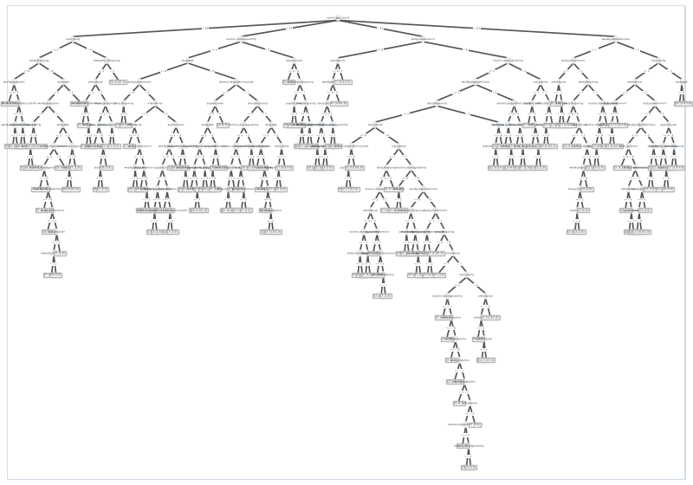
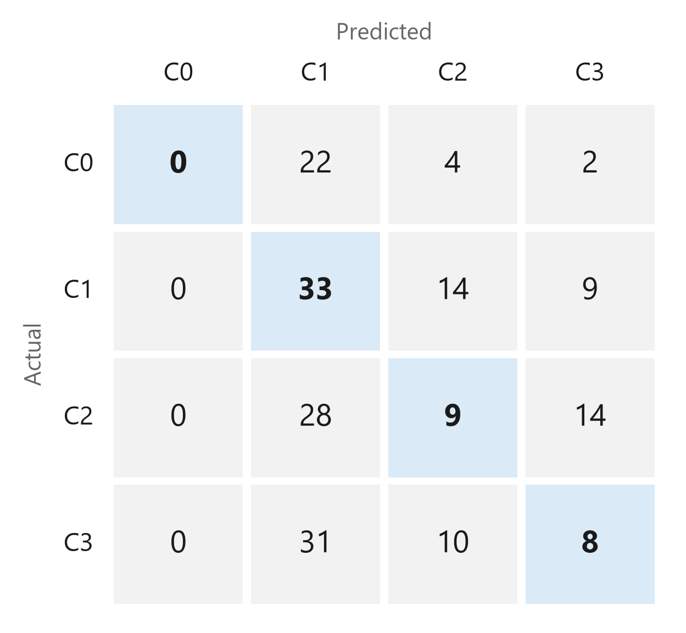
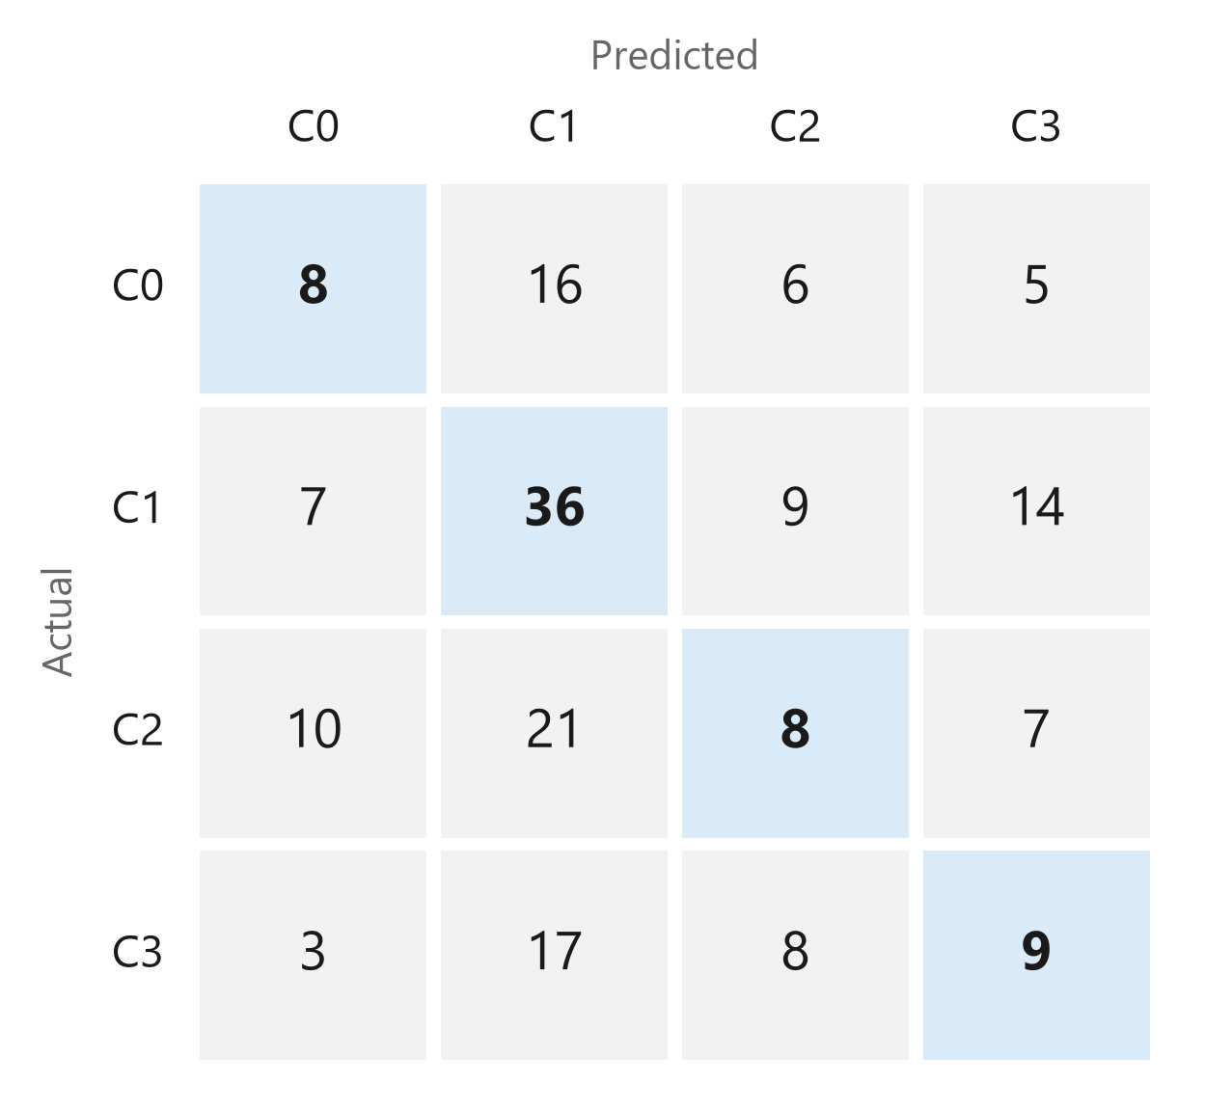
BACKUP
TECHNICAL BACKUP
Why the Full WEKA J48 Tree Is Not Shown
216
175
4–12
leaves: default WEKA J48, CGPA from questions
leaves: default WEKA J48, main CGPA
leaves with at least 40 students per leaf
Default J48 tree (main CGPA): too big to read
Exp A: behaviour → SGPA (test)
Exp B: behaviour → CGPA (test)
CSE 4112 · Machine Learning Lab · What Shapes Student CGPA?
57
Notes:
Default WEKA J48 grows 175 leaves for main CGPA and 216 for the questionnaire tree, which cannot be explained on a slide. With at least 40 students per leaf the trees stay small. The two matrices are J48 on the 80/20 test split.

Slide 69
BACKUP
TECHNICAL BACKUP
Full WEKA Results (5-fold cross-validation)
Model | Main CGPA acc. | W-F1 | Kappa | CGPA diagnostic acc. | W-F1 | Kappa
ZeroR | 30.9% | — | 0.000 | 30.9% | — | 0.000
Logistic | 54.7% | 0.546 | 0.388 | 30.1% | 0.285 | 0.032
J48 | 54.4% | 0.542 | 0.384 | 27.8% | 0.266 | 0.004
RandomForest | 54.2% | 0.542 | 0.383 | 30.5% | 0.295 | 0.046
SMO | 55.2% | 0.551 | 0.397 | 28.1% | 0.212 | -0.024
NaiveBayes | 54.5% | 0.544 | 0.386 | 31.2% | 0.299 | 0.052
Source: WEKA logs in docs/weka_runs/final/. W-F1 = weighted F1. Kappa = agreement beyond chance.
CSE 4112 · Machine Learning Lab · What Shapes Student CGPA?
58
Notes:
WEKA er full result: accuracy, weighted F1, kappa. main CGPA task e SMO ar Random Forest sobcheye valo.

Slide 70
BACKUP
TECHNICAL BACKUP
WEKA Results on the 80/20 Test Split
Model | Main CGPA acc. | W-F1 | Kappa | CGPA diagnostic acc. | W-F1 | Kappa
ZeroR | 35.9% | — | 0.000 | 35.9% | — | 0.000
OneR | 51.1% | 0.511 | 0.338 | 25.5% | 0.226 | -0.039
J48 | 51.1% | 0.511 | 0.338 | 33.1% | 0.316 | 0.065
NaiveBayes | 52.2% | 0.523 | 0.352 | 28.8% | 0.277 | 0.007
Logistic | 50.0% | 0.499 | 0.324 | 27.7% | 0.269 | -0.002
SMO | 51.1% | 0.511 | 0.338 | 29.3% | 0.224 | -0.028
RandomForest | 45.6% | 0.462 | 0.258 | 26.6% | 0.254 | -0.020
CSE 4112 · Machine Learning Lab · What Shapes Student CGPA?
59
Notes:
WEKA percentage split 80% (seed 1): 736 students for training, 184 for testing. Logs: docs/weka_runs/final/*_split80.txt. Show this only if the teacher asks; the main result is 5-fold CV.

Slide 71
BACKUP
TECHNICAL BACKUP
Cross-Validation vs Hold-Out
Hold-out (teacher-facing)
Cross-validation (robustness)
• One fixed 80/20 split
• 736 train · 184 test students
• Main CGPA J48 tree: 51.1% on test
• Easy to explain: rules → unseen students
• Every student is tested once
• 5 folds, seed 1
• Main CGPA SMO: 55.2% (J48 54.4%)
• Less luck from one split
Both checks show that recent academic performance carries the strongest CGPA signal.
CSE 4112 · Machine Learning Lab · What Shapes Student CGPA?
60
Notes:
Hold-out uses one fixed split, which is easy to explain. Cross-validation tests every student once, so it depends less on luck. We report 5-fold CV as the main result.

Slide 72
BACKUP
TECHNICAL BACKUP
Team Contribution
Roll | Team member | Contribution
2107020 | Sheikh Md. Galib Mahim | Merge and cleaning pipeline, EDA, modelling notebook, documentation
2107030 | Md. Eftakar Jaman Arfan | WEKA experiments and result tables
2107007 | Asif Jawad | Form design and data collection
2107008 | Rakibul Islam | Report writing and related work
2107012 | Md Enam E Elahi | Report writing and related work
2107014 | Al Mubtasim Preom | KUET scheme cleaning
Draft copied from the previous deck — confirm names and roles with the team before presenting.
CSE 4112 · Machine Learning Lab · What Shapes Student CGPA?
61
Notes:
Team er kaj er distribution. Present korar age team er sathe confirm korte hobe.

Slide 73
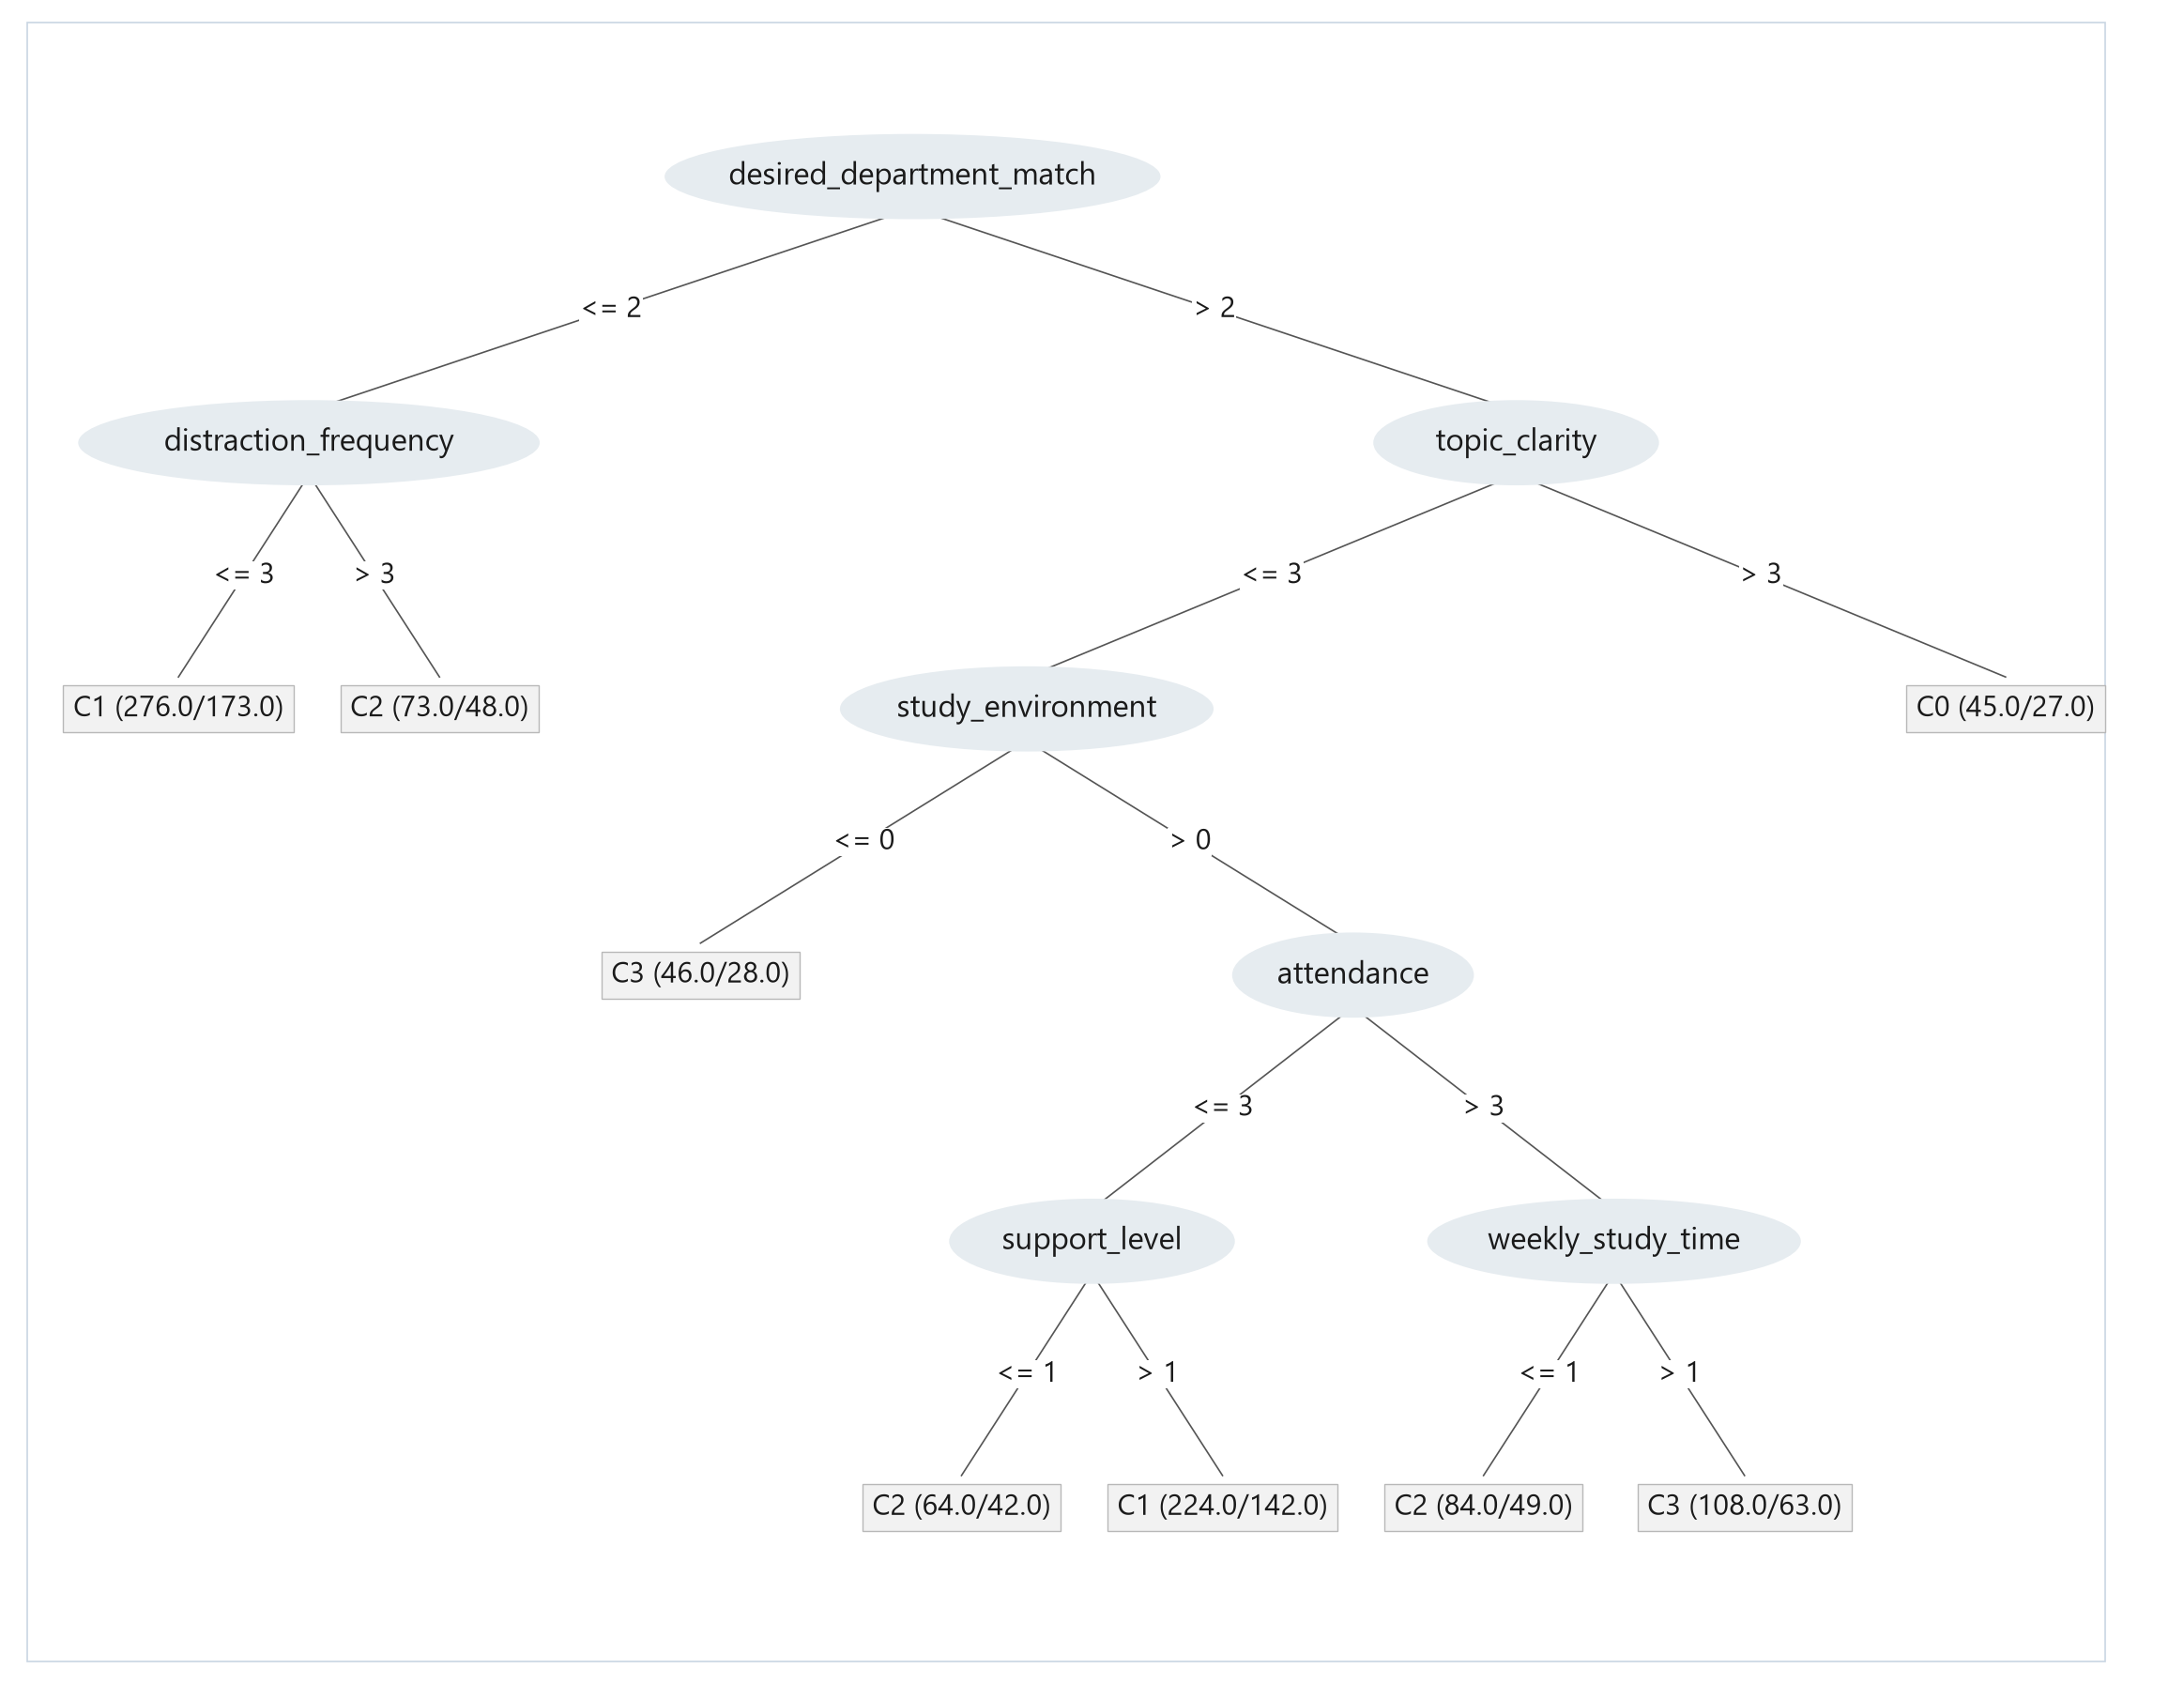
BACKUP
TECHNICAL BACKUP
SGPA Decision Tree (Full View)
CSE 4112 · Machine Learning Lab · What Shapes Student CGPA?
63
Notes:
Behaviour theke recent SGPA predict korar full shallow tree. Main slide e shudhu rule card dekhano hoyeche.

Slide 74


BACKUP
TECHNICAL BACKUP
WEKA Output: Random Forest Runs
Main CGPA task: Random Forest 54.2% (5-fold CV)
CGPA questionnaire: Random Forest 30.5% (5-fold CV)
CSE 4112 · Machine Learning Lab · What Shapes Student CGPA?
64
Notes:
Real WEKA 3.8.7 output text. Replace with WEKA Explorer screenshots if you take them.

