Slide 1
What Shapes Student CGPA?
An Engineering Student Academic Performance Dataset
and Machine Learning Analysis
Student
Form
Data
Relation
WEKA
CGPA
1,108 usable responses BUET · BRAC · CUET · KUET
Notes:
Project title supplied in CGPA_Final_Clean_Slide_Plan_WEKA_Only.md

Slide 2
What are we trying to understand?
01
What did students answer?
02
How does each answer relate to CGPA?
03
Can WEKA predict SGPA / CGPA?
Notes:
Source: evidence/data.json. Derived from verified raw survey records.

Slide 3
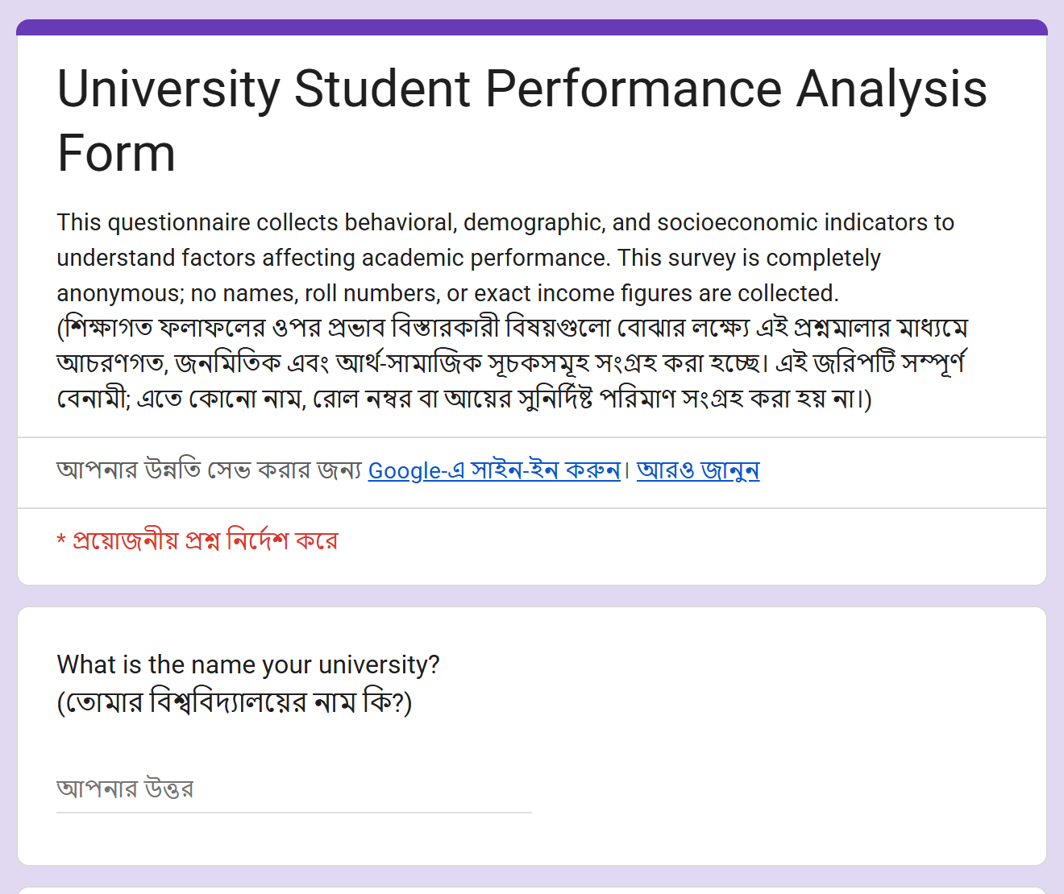
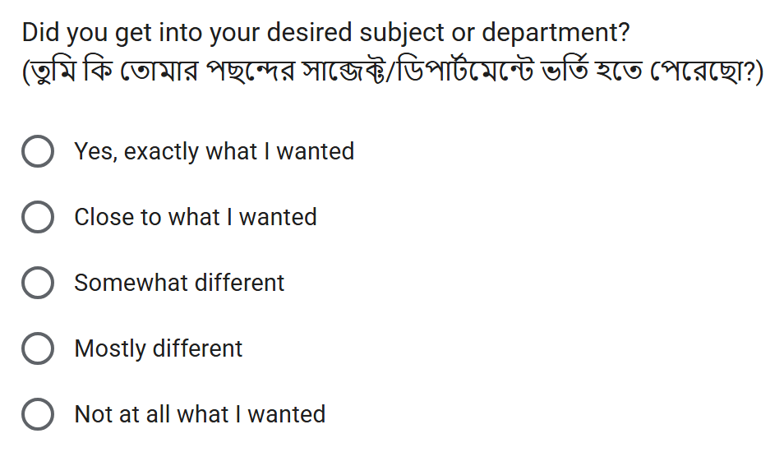
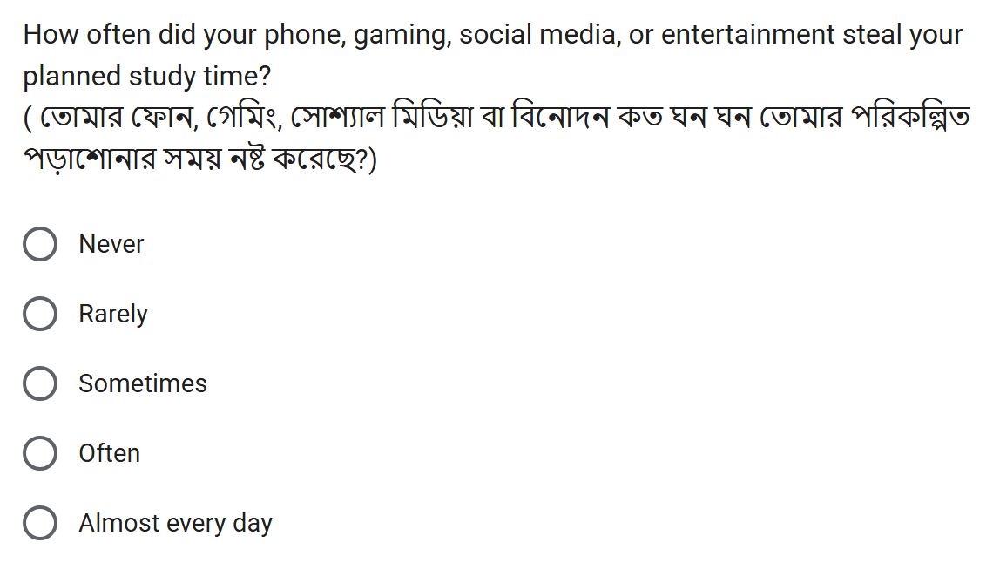
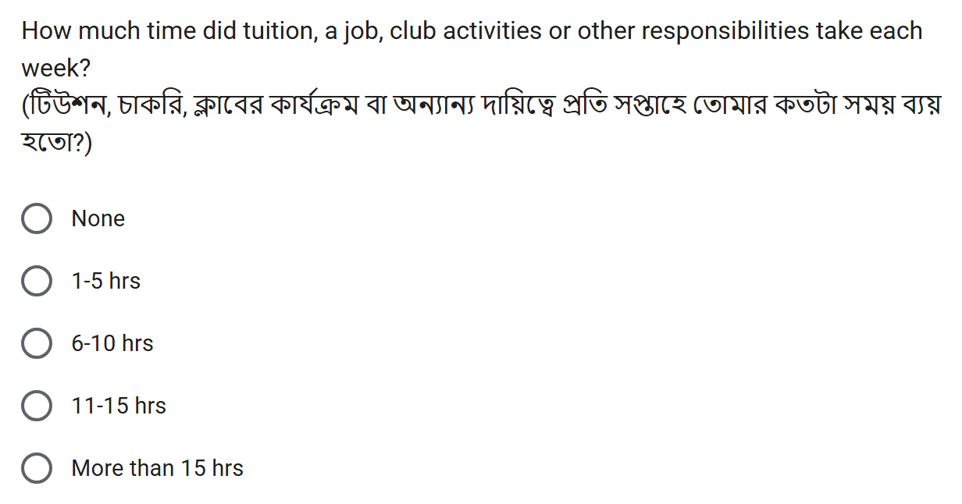
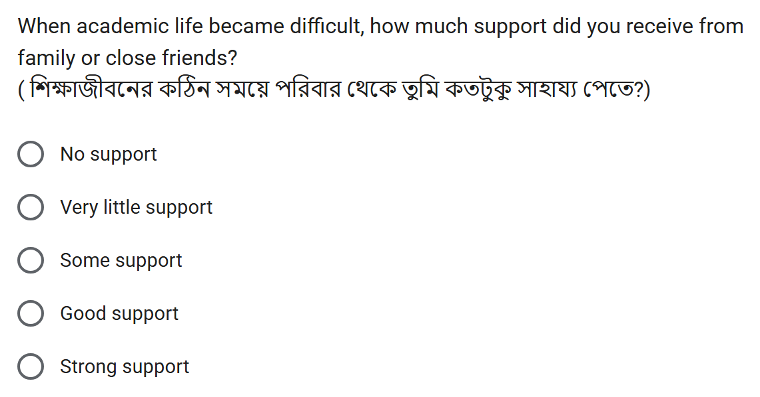
What did the form look like?
English + Bangla survey screenshots. Both forms asked the same core questions.
Notes:
Reference: user-supplied What_Shapes_Student_CGPA_Final_64_Slides_Ready.pptx, slide 6. Exact embedded screenshot assets reused.

Slide 4
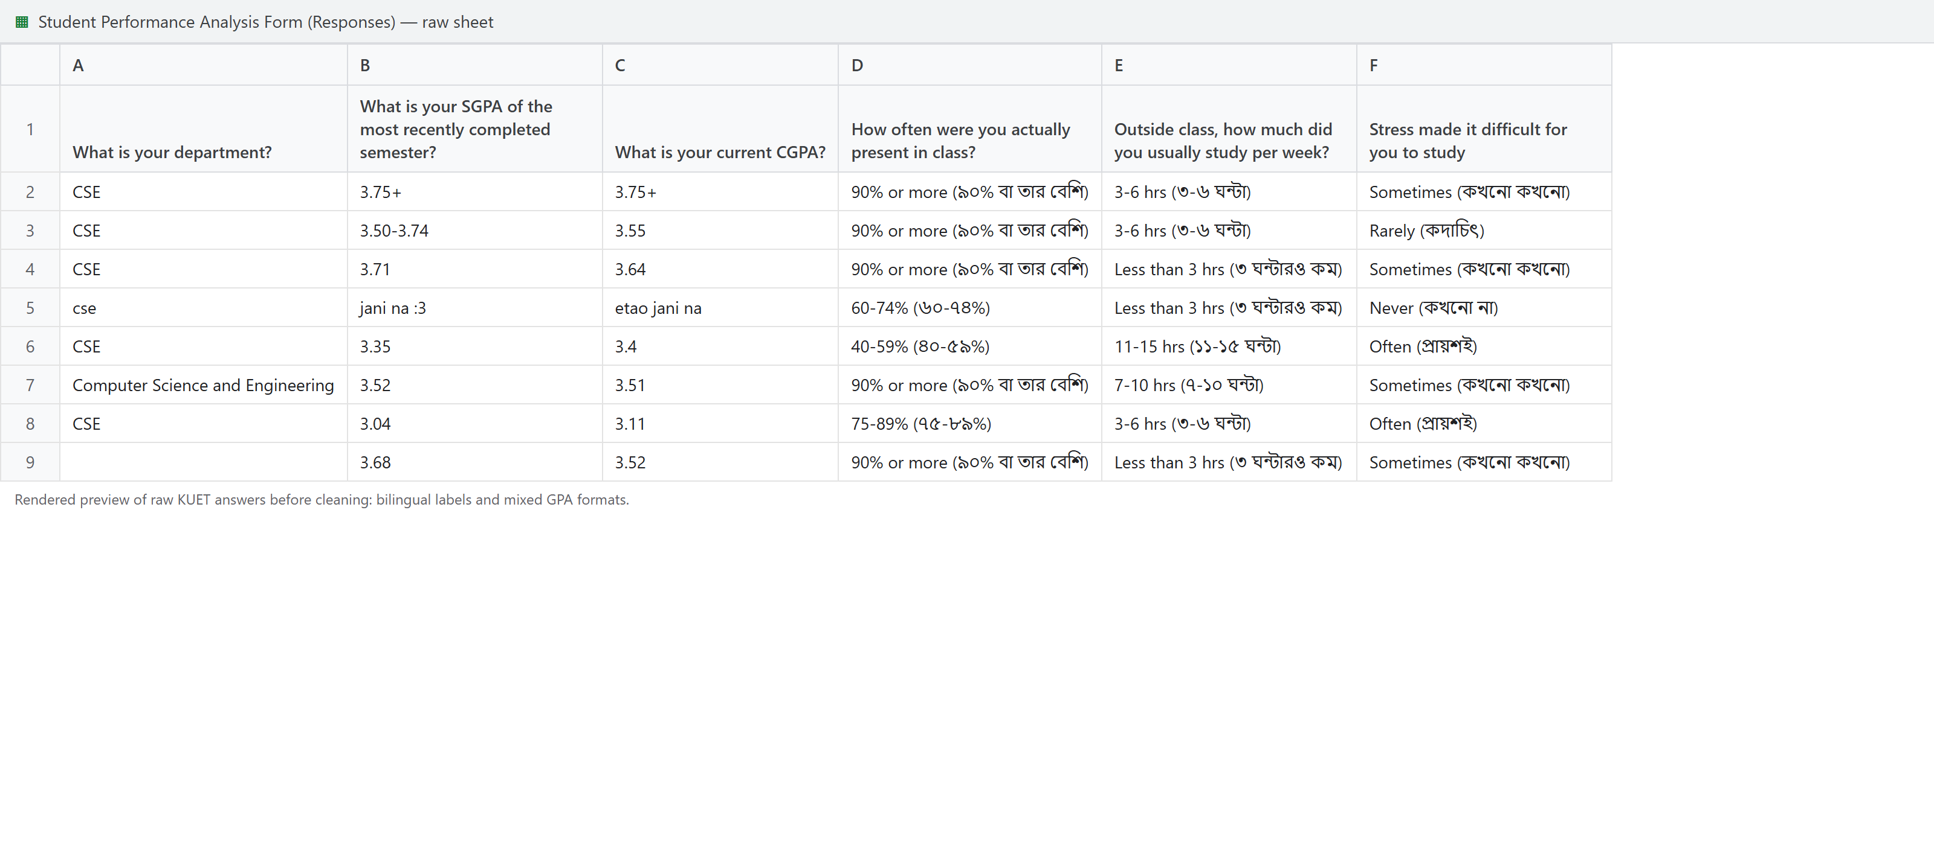
KUET form responses
896 responses
KUET response export preview
Notes:
Source: teacher_focused_final/assets/dataset_screenshots/raw_responses_preview.png, rendered raw KUET CSV preview.

Slide 5
Total responses
230
+
896
=
1,126
BUET · BRAC · CUET
KUET
Raw responses
1,108 usable records
18 responses without usable CGPA removed
Notes:
Source: evidence/data.json. Derived from verified raw survey records.

Slide 6
Response categories
Academic
Study habit
Lifestyle
Stress / responsibility
Motivation / support
Environment
Academic result
Notes:
Source: evidence/data.json. Derived from verified raw survey records.

Slide 7
Form responses: academic questions
Class attendance
Self-study per week
Study style
Less than 40%
10 (0.9%)
Less than 3 hrs
235 (21.2%)
Occasionally when necessary
267 (24.1%)
40-59%
23 (2.1%)
3-6 hrs
281 (25.4%)
Mostly just before exams
296 (26.7%)
60-74%
276 (24.9%)
7-10 hrs
251 (22.7%)
Regularly but not every day
257 (23.2%)
75-89%
381 (34.4%)
11-15 hrs
185 (16.7%)
Mostly consistent routine
157 (14.2%)
90% or more
418 (37.7%)
More than 15 hrs
156 (14.1%)
Consistent throughout the semester
131 (11.8%)
Counts and percentages from the cleaned dataset, N = 1,108
Notes:
Source: evidence/data.json. Derived from verified raw survey records.

Slide 8
Form responses: understanding and SGPA
Topic clear after class
Recent semester SGPA
Almost nothing
181 (16.3%)
below 3.20
236 (21.3%)
A little
265 (23.9%)
3.20-3.49
297 (26.8%)
About half
312 (28.2%)
3.50-3.74
286 (25.8%)
Most of it
217 (19.6%)
3.75+
289 (26.1%)
Almost everything
133 (12.0%)
N = 1,108. SGPA distribution includes six historically imputed answers.
Notes:
Source: evidence/data.json. Derived from verified raw survey records.

Slide 9
Form responses: lifestyle
Sleep per night
Phone / social media took study time
Less than 5 hrs
181 (16.3%)
Never
118 (10.6%)
5-6 hrs
310 (28.0%)
Rarely
162 (14.6%)
6-7 hrs
286 (25.8%)
Sometimes
300 (27.1%)
7-8 hrs
216 (19.5%)
Often
292 (26.4%)
More than 8 hrs
115 (10.4%)
Almost every day
236 (21.3%)
Counts and percentages from the cleaned dataset, N = 1,108
Notes:
Source: evidence/data.json. Derived from verified raw survey records.

Slide 10
Form responses: stress and responsibilities
Stress blocked studying
Outside commitments (tuition/job/club)
Never
129 (11.6%)
None
274 (24.7%)
Rarely
236 (21.3%)
1-5 hrs
263 (23.7%)
Sometimes
302 (27.3%)
6-10 hrs
232 (20.9%)
Often
249 (22.5%)
11-15 hrs
191 (17.2%)
Almost always
192 (17.3%)
More than 15 hrs
148 (13.4%)
Counts and percentages from the cleaned dataset, N = 1,108
Notes:
Source: evidence/data.json. Derived from verified raw survey records.

Slide 11
Form responses: motivation and environment
Got desired department
Family / friend support
Not at all what I wanted
144 (13.0%)
No support
150 (13.5%)
Mostly different
138 (12.5%)
Very little support
172 (15.5%)
Somewhat different
174 (15.7%)
Some support
271 (24.5%)
Close to what I wanted
244 (22.0%)
Good support
314 (28.3%)
Yes, exactly what I wanted
408 (36.8%)
Strong support
201 (18.1%)
Study-friendly living place
Semester routine manageable
Very distracting
153 (13.8%)
Completely unmanageable
165 (14.9%)
Somewhat distracting
185 (16.7%)
Difficult to manage
263 (23.7%)
Neither good nor bad
266 (24.0%)
Average
332 (30.0%)
Mostly suitable
341 (30.8%)
Mostly manageable
233 (21.0%)
Excellent for focused study
163 (14.7%)
Very healthy and balanced
115 (10.4%)
Counts and percentages from the cleaned dataset, N = 1,108
Notes:
Source: evidence/data.json. Derived from verified raw survey records.

Slide 12
Universities in the dataset
878
79.2%
104
9.4%
101
9.1%
25
2.3%
KUET
BUET
BRAC
CUET
Notes:
Source: evidence/data.json. Derived from verified raw survey records.

Slide 13
Predicted CGPA classes
C0
C1
C2
C3
< 3.20
3.20–3.49
3.50–3.74
≥ 3.75
236 students
21.3%
321 students
29.0%
303 students
27.3%
248 students
22.4%
Notes:
Source: evidence/data.json. Derived from verified raw survey records.

Slide 14
CGPA distribution
321
29.0%
303
27.3%
236
21.3%
248
22.4%
C0
C1
C2
C3
ZeroR majority class = C1. The N = 1,108 descriptive baseline is 28.97%.
Notes:
Source: evidence/data.json. Derived from verified raw survey records.

Slide 15
Recent SGPA distribution
297
26.8%
286
25.8%
289
26.1%
236
21.3%
C0
C1
C2
C3
Same class ranges as CGPA. Descriptive N = 1,108 includes six historical imputations.
Notes:
Source: evidence/data.json. Derived from verified raw survey records.

Slide 16
Attendance and CGPA
C0 < 3.20
C1 3.20–3.49
C2 3.50–3.74
C3 ≥ 3.75
Less than 40%
30%
20%
20%
30%
n=10
40-59%
26%
30%
26%
17%
n=23
60-74%
25%
29%
29%
17%
n=276
75-89%
21%
31%
25%
22%
n=381
90% or more
19%
27%
28%
26%
n=418
Each bar = 100% of students choosing that answer. Descriptive association, N = 1,108.
Notes:
Source: evidence/data.json. Derived from verified raw survey records.

Slide 17
Weekly study time and CGPA
C0 < 3.20
C1 3.20–3.49
C2 3.50–3.74
C3 ≥ 3.75
Less than 3 hrs
24%
28%
29%
19%
n=235
3-6 hrs
26%
29%
27%
19%
n=281
7-10 hrs
16%
30%
30%
24%
n=251
11-15 hrs
18%
31%
24%
26%
n=185
More than 15 hrs
21%
26%
26%
27%
n=156
Each bar = 100% of students choosing that answer. Descriptive association, N = 1,108.
Notes:
Source: evidence/data.json. Derived from verified raw survey records.

Slide 18
Study style and CGPA
C0 < 3.20
C1 3.20–3.49
C2 3.50–3.74
C3 ≥ 3.75
Occasionally when necessary
20%
24%
30%
26%
n=267
Mostly just before exams
24%
32%
26%
18%
n=296
Regularly but not every day
18%
35%
28%
19%
n=257
Mostly consistent routine
24%
27%
25%
24%
n=157
Consistent throughout the semester
20%
24%
27%
28%
n=131
Each bar = 100% of students choosing that answer. Descriptive association, N = 1,108.
Notes:
Source: evidence/data.json. Derived from verified raw survey records.

Slide 19
Topic clarity and CGPA
C0 < 3.20
C1 3.20–3.49
C2 3.50–3.74
C3 ≥ 3.75
Almost nothing
24%
31%
25%
20%
n=181
A little
23%
26%
26%
24%
n=265
About half
19%
32%
29%
20%
n=312
Most of it
18%
29%
32%
22%
n=217
Almost everything
25%
26%
21%
29%
n=133
Each bar = 100% of students choosing that answer. Descriptive association, N = 1,108.
Notes:
Source: evidence/data.json. Derived from verified raw survey records.

Slide 20
Sleep and CGPA
C0 < 3.20
C1 3.20–3.49
C2 3.50–3.74
C3 ≥ 3.75
Less than 5 hrs
22%
35%
24%
19%
n=181
5-6 hrs
21%
26%
31%
22%
n=310
6-7 hrs
20%
32%
26%
22%
n=286
7-8 hrs
20%
29%
25%
26%
n=216
More than 8 hrs
28%
19%
30%
23%
n=115
Each bar = 100% of students choosing that answer. Descriptive association, N = 1,108.
Notes:
Source: evidence/data.json. Derived from verified raw survey records.

Slide 21
Stress and CGPA
C0 < 3.20
C1 3.20–3.49
C2 3.50–3.74
C3 ≥ 3.75
Never
24%
29%
25%
22%
n=129
Rarely
23%
24%
34%
19%
n=236
Sometimes
17%
33%
25%
26%
n=302
Often
20%
35%
23%
22%
n=249
Almost always
26%
22%
31%
21%
n=192
Each bar = 100% of students choosing that answer. Descriptive association, N = 1,108.
Notes:
Source: evidence/data.json. Derived from verified raw survey records.

Slide 22
Phone distraction and CGPA
C0 < 3.20
C1 3.20–3.49
C2 3.50–3.74
C3 ≥ 3.75
Never
23%
19%
31%
27%
n=118
Rarely
22%
27%
31%
19%
n=162
Sometimes
18%
33%
28%
21%
n=300
Often
20%
31%
26%
23%
n=292
Almost every day
25%
28%
24%
24%
n=236
Each bar = 100% of students choosing that answer. Descriptive association, N = 1,108.
Notes:
Source: evidence/data.json. Derived from verified raw survey records.

Slide 23
Outside commitments and CGPA
C0 < 3.20
C1 3.20–3.49
C2 3.50–3.74
C3 ≥ 3.75
None
20%
24%
28%
28%
n=274
1-5 hrs
20%
27%
27%
25%
n=263
6-10 hrs
20%
34%
28%
18%
n=232
11-15 hrs
25%
29%
27%
19%
n=191
More than 15 hrs
23%
32%
25%
20%
n=148
Each bar = 100% of students choosing that answer. Descriptive association, N = 1,108.
Notes:
Source: evidence/data.json. Derived from verified raw survey records.

Slide 24
Desired department and CGPA
C0 < 3.20
C1 3.20–3.49
C2 3.50–3.74
C3 ≥ 3.75
Not at all what I wanted
28%
31%
23%
18%
n=144
Mostly different
33%
24%
22%
20%
n=138
Somewhat different
21%
33%
28%
18%
n=174
Close to what I wanted
18%
28%
27%
27%
n=244
Yes, exactly what I wanted
17%
29%
31%
24%
n=408
Each bar = 100% of students choosing that answer. Descriptive association, N = 1,108.
Notes:
Source: evidence/data.json. Derived from verified raw survey records.

Slide 25
Support and CGPA
C0 < 3.20
C1 3.20–3.49
C2 3.50–3.74
C3 ≥ 3.75
No support
25%
26%
26%
23%
n=150
Very little support
28%
25%
24%
22%
n=172
Some support
19%
37%
25%
18%
n=271
Good support
18%
27%
31%
25%
n=314
Strong support
22%
26%
28%
24%
n=201
Each bar = 100% of students choosing that answer. Descriptive association, N = 1,108.
Notes:
Source: evidence/data.json. Derived from verified raw survey records.

Slide 26
Study environment and CGPA
C0 < 3.20
C1 3.20–3.49
C2 3.50–3.74
C3 ≥ 3.75
Very distracting
30%
24%
23%
24%
n=153
Somewhat distracting
21%
31%
24%
24%
n=185
Neither good nor bad
18%
33%
29%
21%
n=266
Mostly suitable
17%
29%
33%
22%
n=341
Excellent for focused study
28%
26%
22%
23%
n=163
Each bar = 100% of students choosing that answer. Descriptive association, N = 1,108.
Notes:
Source: evidence/data.json. Derived from verified raw survey records.

Slide 27
Routine manageability and CGPA
C0 < 3.20
C1 3.20–3.49
C2 3.50–3.74
C3 ≥ 3.75
Completely unmanageable
27%
27%
32%
14%
n=165
Difficult to manage
21%
30%
19%
29%
n=263
Average
18%
32%
30%
20%
n=332
Mostly manageable
20%
27%
30%
23%
n=233
Very healthy and balanced
25%
24%
26%
24%
n=115
Each bar = 100% of students choosing that answer. Descriptive association, N = 1,108.
Notes:
Source: evidence/data.json. Derived from verified raw survey records.

Slide 28
Questionnaire–CGPA relationships
Desired department
+0.117
Attendance
+0.088
Outside commitments
-0.087
Weekly study time
+0.068
Support
+0.054
Routine manageability
+0.039
Topic clarity
+0.038
Sleep
+0.030
Phone distraction
-0.027
Study environment
+0.018
Stress
-0.005
Study style
-0.005
Spearman ρ: direction and strength of ordinal association. All magnitudes are small.
Notes:
Source: evidence/data.json, Spearman rank correlations on 1,102 rows with observed SGPA. Signs follow the response order in backup.

Slide 29
Do SGPA and CGPA show the same pattern?
Attendance
Weekly study time
Study style
Topic clarity
Stress
Sleep
Phone distraction
Outside commitments
Desired department
Support
Study environment
Routine manageability
-0.15
0.00
0.15
CGPA
Recent SGPA
Spearman ρ. Desired department / attendance: positive in both. Commitments: negative in both.
Notes:
Source: evidence/data.json, paired Spearman correlations on identical N=1,102.

Slide 30
WEKA target-specific model results
Stratified 10-fold cross-validation, seed 1
WEKA model | Recent SGPA | CGPA questionnaire | Main CGPA
J48 | 30.13% | 26.68% | 38.29%
Random Forest | 29.76% | 29.40% | 43.92%
SMO | 25.95% | 27.86% | 37.11%
Logistic | 24.95% | 29.58% | 36.84%
Naive Bayes | 26.68% | 30.04% | 38.11%
ZeroR | 26.86% | 29.04% | 29.04%
Same 1,102 records. Questionnaire: 12 inputs. Main CGPA: same inputs + recent SGPA.
Notes:
Sources: sgpa_J48_cv.txt, sgpa_RandomForest_cv.txt, sgpa_SMO_cv.txt, sgpa_Logistic_cv.txt, sgpa_NaiveBayes_cv.txt, sgpa_ZeroR_cv.txt; questionnaire_J48_cv.txt, questionnaire_RandomForest_cv.txt, questionnaire_SMO_cv.txt, questionnaire_Logistic_cv.txt, questionnaire_NaiveBayes_cv.txt, questionnaire_ZeroR_cv.txt; main_J48_cv.txt, main_RandomForest_cv.txt, main_SMO_cv.txt, main_Logistic_cv.txt, main_NaiveBayes_cv.txt, main_ZeroR_cv.txt

Slide 31
Train / test split
1,102 records
881 training
WEKA J48
80%
221 testing
Test predictions
20%, held aside
Six SGPA-imputed rows excluded. Fixed split seed 42, reused for all three tree experiments.
Notes:
Source: evidence/split_indices.csv and data_provenance.json. CGPA-stratified existing split, seed 42, shared across all targets.

Slide 32
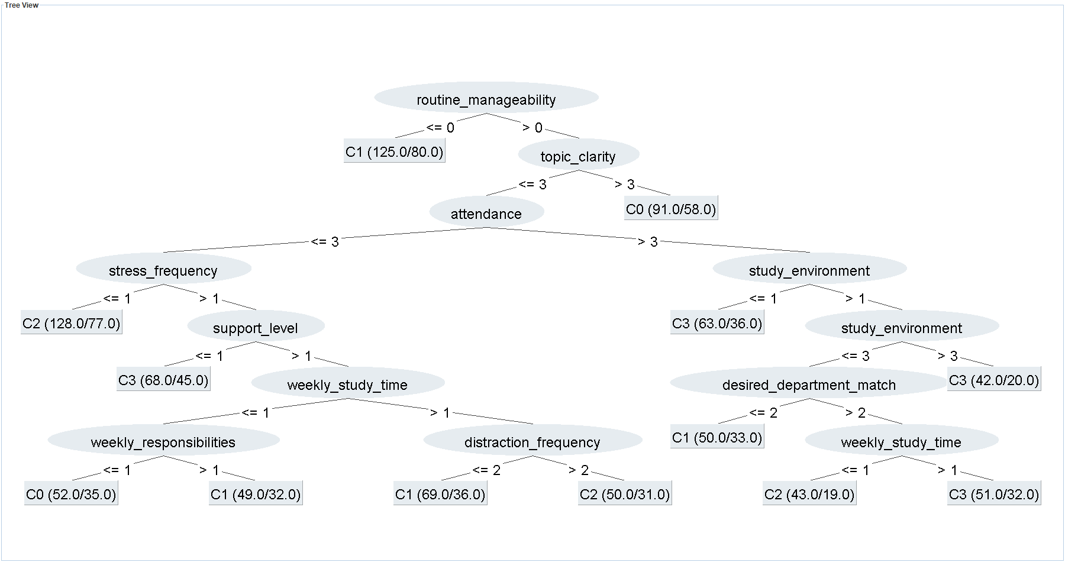
WEKA J48: Recent SGPA
WEKA J48 -C 0.25 -M 40. Recent SGPA. Test: 29.86%. ZeroR test: 27.15%.
Notes:
Sources: sgpa_J48_holdout.txt, sgpa_tree.dot, sgpa_weka_viewer.png. Exact WEKA TreeVisualizer export. Numeric option codes are listed in backup. Leaf (N/errors) denotes training support and training errors.

Slide 33
WEKA J48: SGPA rules
IF routine is completely unmanageable
C1
IF routine is above completely unmanageable
AND almost everything is clear after class
C0
Selected branches from the preceding WEKA J48 tree. Full text and option codes in backup.
Notes:
Exact rules: sgpa_tree.txt and results.json. These are predictions from tree branches, not causal statements.

Slide 34
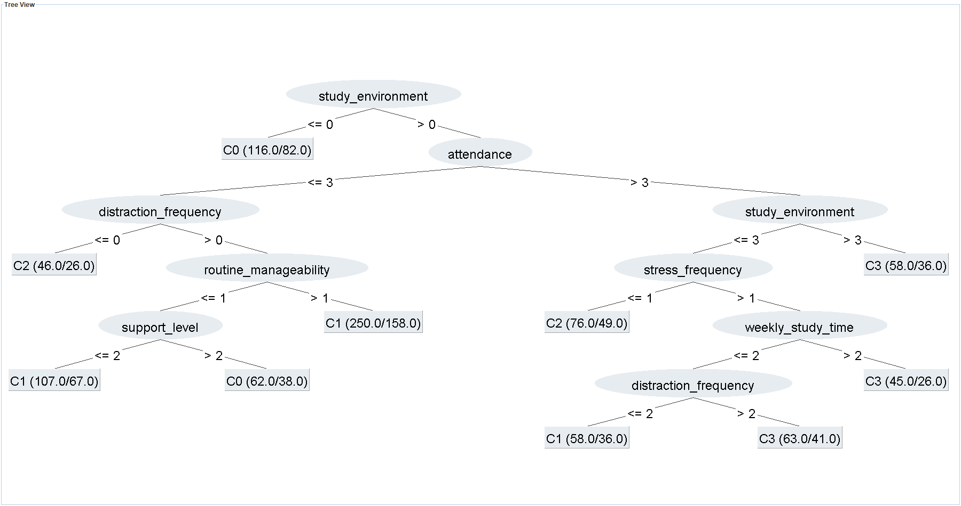
WEKA J48: CGPA from questionnaire variables
WEKA J48 -C 0.25 -M 40. CGPA from questionnaire variables. Test: 32.13%. ZeroR test: 28.96%.
Notes:
Sources: questionnaire_J48_holdout.txt, questionnaire_tree.dot, questionnaire_weka_viewer.png. Exact WEKA TreeVisualizer export. Numeric option codes are listed in backup. Leaf (N/errors) denotes training support and training errors.

Slide 35
Questionnaire J48 rules
IF study environment is very distracting
C0
IF environment is excellent for focused study
AND attendance is 90% or more
C3
Selected branches from the preceding WEKA J48 tree. Full text and option codes in backup.
Notes:
Exact rules: questionnaire_tree.txt and results.json. These are predictions from tree branches, not causal statements.

Slide 36
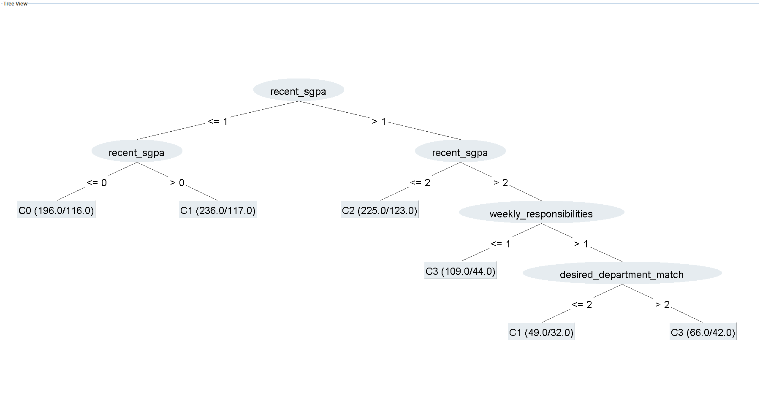
WEKA J48: Main CGPA prediction
WEKA J48 -C 0.25 -M 40. Main CGPA prediction. Test: 49.77%. ZeroR test: 28.96%.
Notes:
Sources: main_J48_holdout.txt, main_tree.dot, main_weka_viewer.png. Exact WEKA TreeVisualizer export. Numeric option codes are listed in backup. Leaf (N/errors) denotes training support and training errors.

Slide 37
Main CGPA J48 rules
IF recent SGPA is below 3.20
C0
IF recent SGPA is 3.20–3.49
C1
IF recent SGPA is 3.50–3.74
C2
IF recent SGPA is 3.75 or higher
AND outside commitments are 0–5 hours per week
C3
Selected branches from the preceding WEKA J48 tree. Full text and option codes in backup.
Notes:
Exact rules: main_tree.txt and results.json. These are predictions from tree branches, not causal statements.

Slide 38
WEKA J48 training and test accuracy
Target | Training (881) | Test (221) | ZeroR test
Recent SGPA | 39.39% | 29.86% | 27.15%
CGPA questionnaire | 36.55% | 32.13% | 28.96%
Main CGPA | 46.20% | 49.77% | 28.96%
Each row evaluates the same fitted WEKA J48 on its training and test records.
Notes:
Sources: sgpa_J48_holdout.txt, questionnaire_J48_holdout.txt, main_J48_holdout.txt. All J48 models C=.25 M=40.

Slide 39
WEKA J48: main CGPA test confusion matrix
Fixed test set
Predicted
C0
C1
C2
C3
C0 < 3.20
C1 3.20–3.49
C2 3.50–3.74
C3 ≥ 3.75
C0
22
15
6
4
C1
8
31
15
10
C2
7
15
29
9
C3
3
11
8
28
Rows = actual class. Columns = predicted class. Blue cells are correct predictions.
Notes:
Source: main_J48_holdout.txt, TEST section, 221 held-out records.

Slide 40
WEKA Random Forest and SMO matrices
Random Forest
SMO
Predicted
Predicted
C0
C1
C2
C3
C0
C1
C2
C3
C0
95
81
26
34
C0
61
113
34
28
C1
57
159
71
33
C1
51
154
75
40
C2
47
79
126
48
C2
42
93
109
56
C3
43
50
49
104
C3
35
56
70
85
Main CGPA, stratified 10-fold cross-validation, N = 1,102. Rows actual, columns predicted.
Notes:
Sources: main_RandomForest_cv.txt, main_SMO_cv.txt.

Slide 41
WEKA Logistic and Naive Bayes matrices
Logistic
Naive Bayes
Predicted
Predicted
C0
C1
C2
C3
C0
C1
C2
C3
C0
61
107
38
30
C0
69
101
34
32
C1
49
145
83
43
C1
51
169
70
30
C2
42
92
101
65
C2
54
104
96
46
C3
31
55
61
99
C3
39
49
72
86
Main CGPA, stratified 10-fold cross-validation, N = 1,102. Rows actual, columns predicted.
Notes:
Sources: main_Logistic_cv.txt, main_NaiveBayes_cv.txt.

Slide 42
WEKA ZeroR baseline matrix
Main CGPA, 10-fold CV
Predicted
Always predicts C1
C0
C1
C2
C3
C0
0
236
0
0
C1
0
320
0
0
Every prediction falls
in one column.
C2
0
300
0
0
C3
0
246
0
0
WEKA ZeroR, main CGPA, 10-fold CV, N = 1,102. Accuracy = 29.04%.
Notes:
Source: main_ZeroR_cv.txt.

Slide 43
WEKA main CGPA accuracy: 10-fold CV
WEKA 3.8.7, stratified 10-fold CV, seed 1. Same 1,102 records and main CGPA inputs.
Notes:
Sources: main_J48_cv.txt, main_RandomForest_cv.txt, main_SMO_cv.txt, main_Logistic_cv.txt, main_NaiveBayes_cv.txt, main_ZeroR_cv.txt

Slide 44
Why keep a decision tree?
WEKA J48
Random Forest / SMO
A single tree
Visible split conditions
Rules tied to exact branches
Prediction benchmarks
No single short tree
Random Forest leads this comparison
Interpretability and predictive performance answer different presentation questions.
Notes:
Source: evidence/data.json. Derived from verified raw survey records.

Slide 45
Previous studies and models
Study | Target / population | Models | Reported result
Ahmed (2024) | Student performance classification | SVM, tree, NB, KNN with K-means | SVM accuracy 96.0%
Maruf et al. (ICCIT 2024) | Bangladesh SSC / HSC | Tuned classifiers and stacking | 82.23% SSC 86.89% HSC
Albonny & Duru (2026) | Bangladesh school average course grade | Linear regression, tree, RF, DNN | RF R² = 0.933 Regression metric
Different populations, targets and evaluation designs. Source links in speaker notes.
Notes:
Ahmed (2024): https://doi.org/10.1155/2024/4067721
Maruf et al. ICCIT 2024: https://doi.org/10.1109/ICCIT64611.2024.11021990
Albonny & Duru (2026): https://dergipark.org.tr/tr/pub/ijonfest/article/1879280

Slide 46
Previous work and our WEKA models
Previous work
This project
School results and student performance
SVM, trees and ensembles
Classification and regression targets
Engineering students, four CGPA bands
J48, Random Forest, SMO, Logistic,
Naive Bayes and ZeroR
WEKA 10-fold comparison
Different datasets and targets; reported scores are not directly comparable.
Notes:
Ahmed (2024): https://doi.org/10.1155/2024/4067721
Maruf et al. ICCIT 2024: https://doi.org/10.1109/ICCIT64611.2024.11021990
Albonny & Duru (2026): https://dergipark.org.tr/tr/pub/ijonfest/article/1879280
Project results: main_J48_cv.txt, main_RandomForest_cv.txt, main_SMO_cv.txt, main_Logistic_cv.txt, main_NaiveBayes_cv.txt, main_ZeroR_cv.txt

Slide 47
What did we learn?
•
Student answers vary across academic and lifestyle questions.
•
Desired department, attendance and outside commitments show the clearest CGPA associations.
•
Questionnaire-only classification stays close to the baseline.
•
Recent SGPA is the first split in the main J48 tree.
•
Random Forest leads the CV comparison; J48 provides readable rules.
Notes:
Source: evidence/data.json. Derived from verified raw survey records.

Slide 48
Limitations
•
Self-reported answers without verified registrar records
•
KUET-heavy sample and a one-time survey
•
Banded SGPA / CGPA with different time wording between forms
•
Questionnaire imputation occurred before splitting / CV
•
Small associations and exploratory prediction estimates
Notes:
Sources: raw questionnaire, cleaning_verification.log, data_provenance.json. Questionnaire source-mode imputation used full dataset before CV.

Slide 49
Conclusion
Data
Relationship
WEKA
1,108 usable engineering-student responses
Question-by-question CGPA patterns
J48 rules and comparison with five standard classifiers
Associations and predictions, not causal proof.
Notes:
Source: evidence/data.json. Derived from verified raw survey records.

Slide 50
Thank you
2107020 Sheikh Md. Galib Mahim
2107030 Md. Eftakar Jaman Arfan
2107007 Asif Jawad
2107008 Rakibul Islam
2107012 Md Enam E Elahi
2107014 Al Mubtasim Preom
Notes:
Team names and rolls retained from existing deck source.

Slide 51
Backup A: questionnaire options 1
Attendance
Weekly study time
0: Less than 40%
1: 40-59%
2: 60-74%
3: 75-89%
4: 90% or more
0: Less than 3 hrs
1: 3-6 hrs
2: 7-10 hrs
3: 11-15 hrs
4: More than 15 hrs
Study style
Topic clarity
0: Occasionally when necessary
1: Mostly just before exams
2: Regularly but not every day
3: Mostly consistent routine
4: Consistent throughout the semester
0: Almost nothing
1: A little
2: About half
3: Most of it
4: Almost everything
Notes:
Source: evidence/data.json. Derived from verified raw survey records.

Slide 52
Backup A: questionnaire options 2
Stress
Sleep
0: Never
1: Rarely
2: Sometimes
3: Often
4: Almost always
0: Less than 5 hrs
1: 5-6 hrs
2: 6-7 hrs
3: 7-8 hrs
4: More than 8 hrs
Phone distraction
Outside commitments
0: Never
1: Rarely
2: Sometimes
3: Often
4: Almost every day
0: None
1: 1-5 hrs
2: 6-10 hrs
3: 11-15 hrs
4: More than 15 hrs
Notes:
Source: evidence/data.json. Derived from verified raw survey records.

Slide 53
Backup A: questionnaire options 3
Desired department
Support
0: Not at all what I wanted
1: Mostly different
2: Somewhat different
3: Close to what I wanted
4: Yes, exactly what I wanted
0: No support
1: Very little support
2: Some support
3: Good support
4: Strong support
Study environment
Routine manageability
0: Very distracting
1: Somewhat distracting
2: Neither good nor bad
3: Mostly suitable
4: Excellent for focused study
0: Completely unmanageable
1: Difficult to manage
2: Average
3: Mostly manageable
4: Very healthy and balanced
Notes:
Source: evidence/data.json. Derived from verified raw survey records.

Slide 54
Backup A: remaining form fields
Field | Role
University / department / semester | Academic background
Admission satisfaction | Context
Career expectation | Motivation context
Result satisfaction | Excluded outcome-related item
Recent SGPA | SGPA target or extra main CGPA input
CGPA | Four-band CGPA target
Timestamp | Administration only
Notes:
Source: raw CSV question headers and data_dictionary.csv. Fields below are excluded from the 12-input questionnaire models.

Slide 55
Backup B: cleaning and exclusions
•
Merged 230 + 896 raw rows. Removed 18 unusable CGPA targets.
•
Standardised bilingual options, institution labels and GPA bands.
•
Mapped ordered answers to numeric option codes.
•
Filled questionnaire blanks using within-source modes.
•
Excluded six target-conditioned SGPA imputations from all models.
Notes:
Source: cleaning_verification.log and data_provenance.json.

Slide 56
Backup C: exact WEKA settings
Run | Settings
CV comparison | WEKA 3.8.7; 10 folds; seed 1; N=1,102
J48 comparison | -C 0.25 -M 2
J48 explanatory trees | -C 0.25 -M 40; train 881 / test 221
Random Forest | 100 iterations; seed 1; default feature subset
SMO | Default C=1; polynomial kernel exponent 1
Logistic / Naive Bayes / ZeroR | WEKA 3.8.7 defaults; exact options in notes
Full option strings and saved ARFF files accompany the deck.
Notes:
J48: -C 0.25 -M 2
Random Forest: -P 100 -I 100 -num-slots 1 -K 0 -M 1.0 -V 0.001 -S 1
SMO: -C 1.0 -L 0.001 -P 1.0E-12 -N 0 -V -1 -W 1 -K "weka.classifiers.functions.supportVector.PolyKernel -E 1.0 -C 250007" -calibrator "weka.classifiers.functions.Logistic -R 1.0E-8 -M -1 -num-decimal-places 4"
Logistic: -R 1.0E-8 -M -1 -num-decimal-places 4
Naive Bayes:
ZeroR:

Slide 57
Backup D: SGPA full J48 tree
J48 pruned tree
------------------
routine_manageability <= 0: C1 (125.0/80.0)
routine_manageability > 0
| topic_clarity <= 3
| | attendance <= 3
| | | stress_frequency <= 1: C2 (128.0/77.0)
| | | stress_frequency > 1
| | | | support_level <= 1: C3 (68.0/45.0)
| | | | support_level > 1
| | | | | weekly_study_time <= 1
| | | | | | weekly_responsibilities <= 1: C0 (52.0/35.0)
| | | | | | weekly_responsibilities > 1: C1 (49.0/32.0)
| | | | | weekly_study_time > 1
| | | | | | distraction_frequency <= 2: C1 (69.0/36.0)
| | | | | | distraction_frequency > 2: C2 (50.0/31.0)
| | attendance > 3
| | | study_environment <= 1: C3 (63.0/36.0)
| | | study_environment > 1
| | | | study_environment <= 3
| | | | | desired_department_match <= 2: C1 (50.0/33.0)
| | | | | desired_department_match > 2
| | | | | | weekly_study_time <= 1: C2 (43.0/19.0)
| | | | | | weekly_study_time > 1: C3 (51.0/32.0)
| | | | study_environment > 3: C3 (42.0/20.0)
| topic_clarity > 3: C0 (91.0/58.0)
Number of Leaves : 13
Size of the tree : 25
Notes:
sgpa_tree.txt. Exact text from WEKA.

Slide 58
Backup E: questionnaire CGPA full J48 tree
J48 pruned tree
------------------
study_environment <= 0: C0 (116.0/82.0)
study_environment > 0
| attendance <= 3
| | distraction_frequency <= 0: C2 (46.0/26.0)
| | distraction_frequency > 0
| | | routine_manageability <= 1
| | | | support_level <= 2: C1 (107.0/67.0)
| | | | support_level > 2: C0 (62.0/38.0)
| | | routine_manageability > 1: C1 (250.0/158.0)
| attendance > 3
| | study_environment <= 3
| | | stress_frequency <= 1: C2 (76.0/49.0)
| | | stress_frequency > 1
| | | | weekly_study_time <= 2
| | | | | distraction_frequency <= 2: C1 (58.0/36.0)
| | | | | distraction_frequency > 2: C3 (63.0/41.0)
| | | | weekly_study_time > 2: C3 (45.0/26.0)
| | study_environment > 3: C3 (58.0/36.0)
Number of Leaves : 10
Size of the tree : 19
Notes:
questionnaire_tree.txt. Exact text from WEKA.

Slide 59
Backup F: main CGPA full J48 tree
J48 pruned tree
------------------
recent_sgpa <= 1
| recent_sgpa <= 0: C0 (196.0/116.0)
| recent_sgpa > 0: C1 (236.0/117.0)
recent_sgpa > 1
| recent_sgpa <= 2: C2 (225.0/123.0)
| recent_sgpa > 2
| | weekly_responsibilities <= 1: C3 (109.0/44.0)
| | weekly_responsibilities > 1
| | | desired_department_match <= 2: C1 (49.0/32.0)
| | | desired_department_match > 2: C3 (66.0/42.0)
Number of Leaves : 6
Size of the tree : 11
Notes:
main_tree.txt. Exact text from WEKA.

Slide 60
Backup G: sgpa WEKA CV metrics
Model | Accuracy | Macro F1 | Kappa
J48 | 30.13% | 0.299 | 0.066
Random Forest | 29.76% | 0.293 | 0.059
SMO | 25.95% | 0.233 | -0.001
Logistic | 24.95% | 0.240 | -0.009
Naive Bayes | 26.68% | 0.261 | 0.017
ZeroR | 26.86% | 0.106 | 0.000
Notes:
Sources: sgpa_J48_cv.txt, sgpa_RandomForest_cv.txt, sgpa_SMO_cv.txt, sgpa_Logistic_cv.txt, sgpa_NaiveBayes_cv.txt, sgpa_ZeroR_cv.txt. Macro F1 from WEKA confusion matrices.

Slide 61
Backup G: questionnaire WEKA CV metrics
Model | Accuracy | Macro F1 | Kappa
J48 | 26.68% | 0.263 | 0.017
Random Forest | 29.40% | 0.284 | 0.045
SMO | 27.86% | 0.212 | 0.002
Logistic | 29.58% | 0.272 | 0.039
Naive Bayes | 30.04% | 0.277 | 0.049
ZeroR | 29.04% | 0.113 | 0.000
Notes:
Sources: questionnaire_J48_cv.txt, questionnaire_RandomForest_cv.txt, questionnaire_SMO_cv.txt, questionnaire_Logistic_cv.txt, questionnaire_NaiveBayes_cv.txt, questionnaire_ZeroR_cv.txt. Macro F1 from WEKA confusion matrices.

Slide 62
Backup G: main WEKA CV metrics
Model | Accuracy | Macro F1 | Kappa
J48 | 38.29% | 0.383 | 0.174
Random Forest | 43.92% | 0.437 | 0.246
SMO | 37.11% | 0.362 | 0.150
Logistic | 36.84% | 0.363 | 0.148
Naive Bayes | 38.11% | 0.372 | 0.164
ZeroR | 29.04% | 0.113 | 0.000
Notes:
Sources: main_J48_cv.txt, main_RandomForest_cv.txt, main_SMO_cv.txt, main_Logistic_cv.txt, main_NaiveBayes_cv.txt, main_ZeroR_cv.txt. Macro F1 from WEKA confusion matrices.

Slide 63
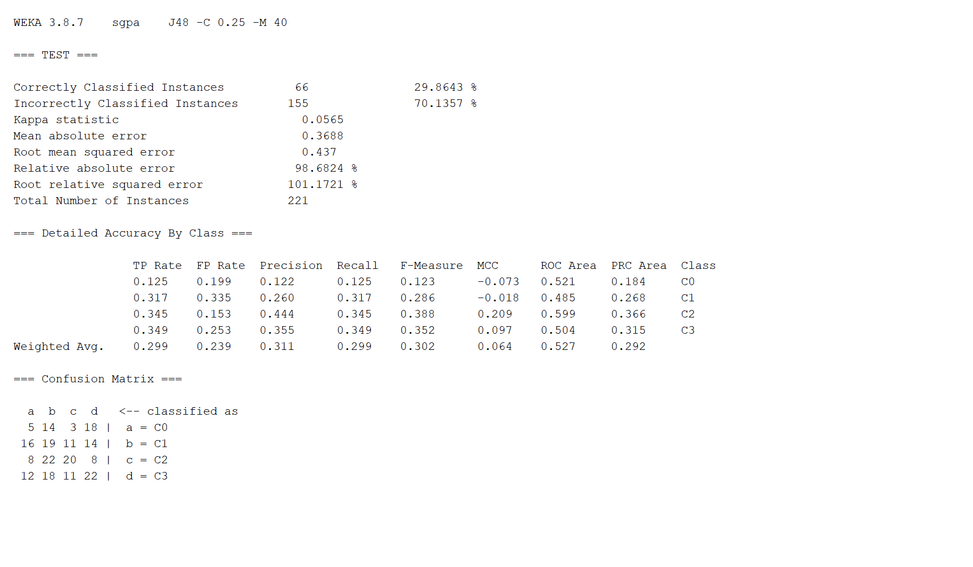
Backup H: WEKA sgpa output
Verbatim WEKA J48 test output capture. Original complete text log accompanies the deck.
Notes:
sgpa_weka_output.png renders the verbatim WEKA test log in a Swing text component. It is not a screenshot of the Explorer window.

Slide 64
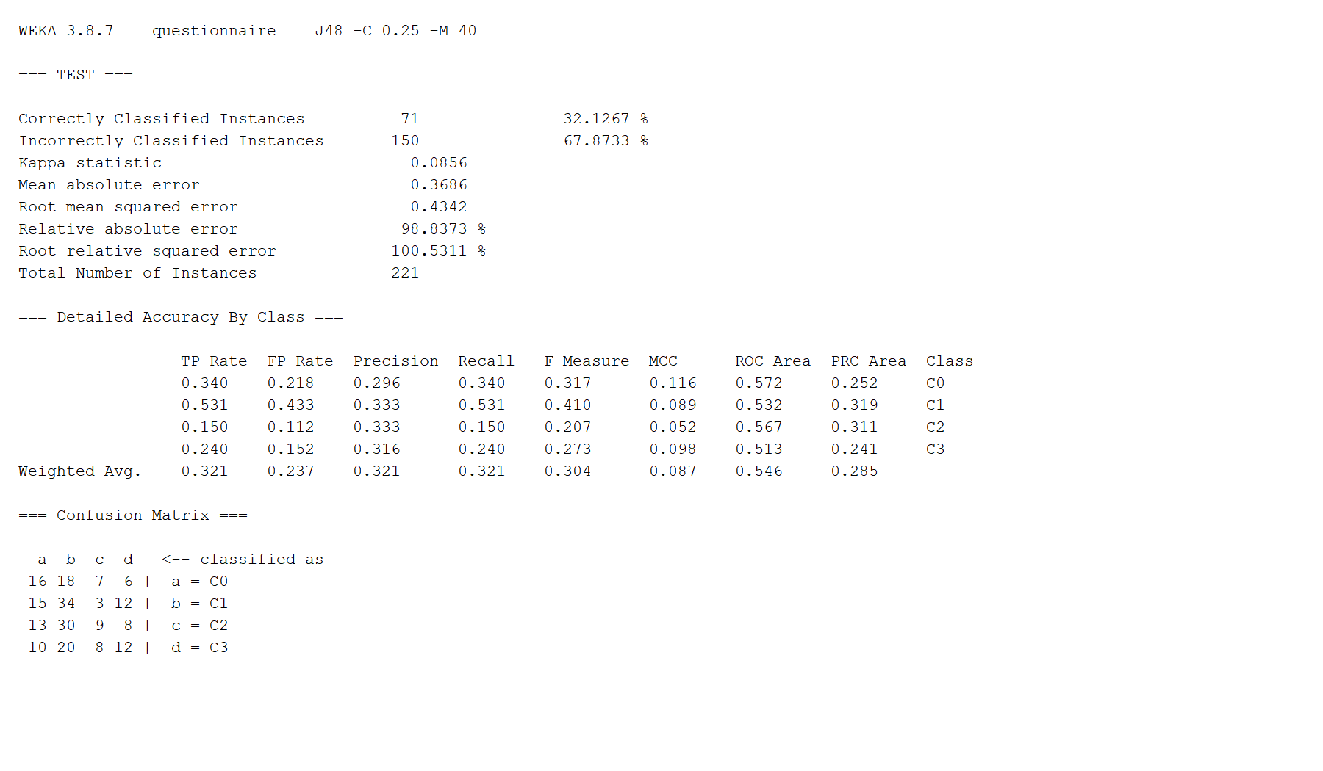
Backup H: WEKA questionnaire output
Verbatim WEKA J48 test output capture. Original complete text log accompanies the deck.
Notes:
questionnaire_weka_output.png renders the verbatim WEKA test log in a Swing text component. It is not a screenshot of the Explorer window.

Slide 65

Backup H: WEKA main output
Verbatim WEKA J48 test output capture. Original complete text log accompanies the deck.
Notes:
main_weka_output.png renders the verbatim WEKA test log in a Swing text component. It is not a screenshot of the Explorer window.

Slide 66
Backup I: team contribution
Member | Recorded role (confirm with team)
Sheikh Md. Galib Mahim | Cleaning, EDA, modelling notebook and documentation
Md. Eftakar Jaman Arfan | WEKA experiments and result tables
Asif Jawad | Form design and data collection
Rakibul Islam | Report writing and related work
Md Enam E Elahi | Report writing and related work
Al Mubtasim Preom | KUET schema cleaning
Notes:
Source: existing teacher_focused_final/scripts/build_deck.py. Roles were marked draft in the existing source.

